Slide 1

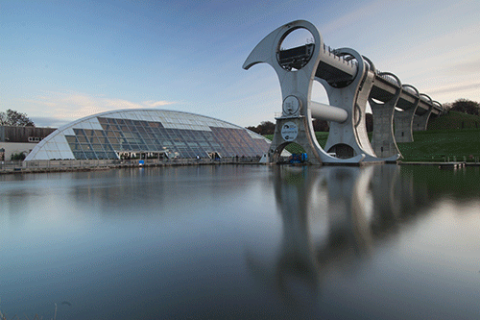
Dynamics
N5 Physics

Slide 2
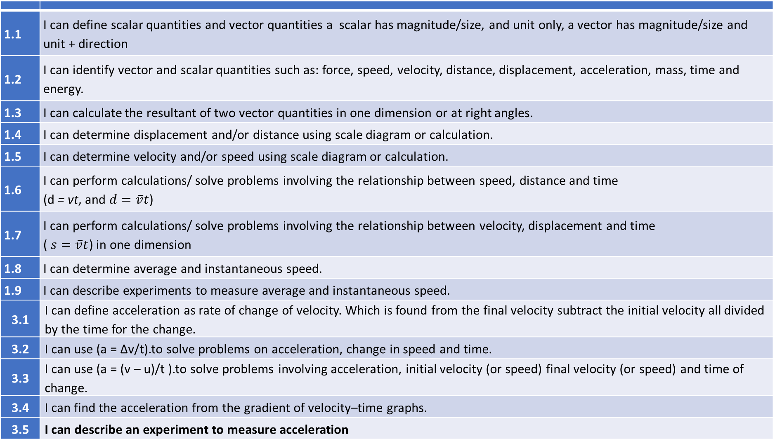
Revision
1.1 | I can define scalar quantities and vector quantities a scalar has magnitude/size, and unit only, a vector has magnitude/size and unit + direction
1.2 | I can identify vector and scalar quantities such as: force, speed, velocity, distance, displacement, acceleration, mass, time and energy.
1.3 | I can calculate the resultant of two vector quantities in one dimension or at right angles.
1.4 | I can determine displacement and/or distance using scale diagram or calculation.
1.5 | I can determine velocity and/or speed using scale diagram or calculation.
1.6 | I can perform calculations/ solve problems involving the relationship between speed, distance and time (d = vt, and $d=\overline{v}t$)
1.7 | I can perform calculations/ solve problems involving the relationship between velocity, displacement and time ( $s=\overline{v}t$) in one dimension
1.8 | I can determine average and instantaneous speed.
1.9 | I can describe experiments to measure average and instantaneous speed.
3.1 | I can define acceleration as rate of change of velocity. Which is found from the final velocity subtract the initial velocity all divided by the time for the change.
3.2 | I can use (a = ∆v/t).to solve problems on acceleration, change in speed and time.
3.3 | I can use (a = (v – u)/t ).to solve problems involving acceleration, initial velocity (or speed) final velocity (or speed) and time of change.
3.4 | I can find the acceleration from the gradient of velocity–time graphs.
3.5 | I can describe an experiment to measure acceleration
Revision
Revision
Revision
Revision
S3?

Slide 3
State the headings on the table
Scalars | Vectors
Energy | Velocity
Temperature | Acceleration
Pressure | Displacement
Time | (Momentum)- not required
Mass | Force
Current | (Weight/ friction etc)
Speed | Gravitational field strength
Volume
Voltage
Distance
Area
Resistance
Frequency

Slide 4
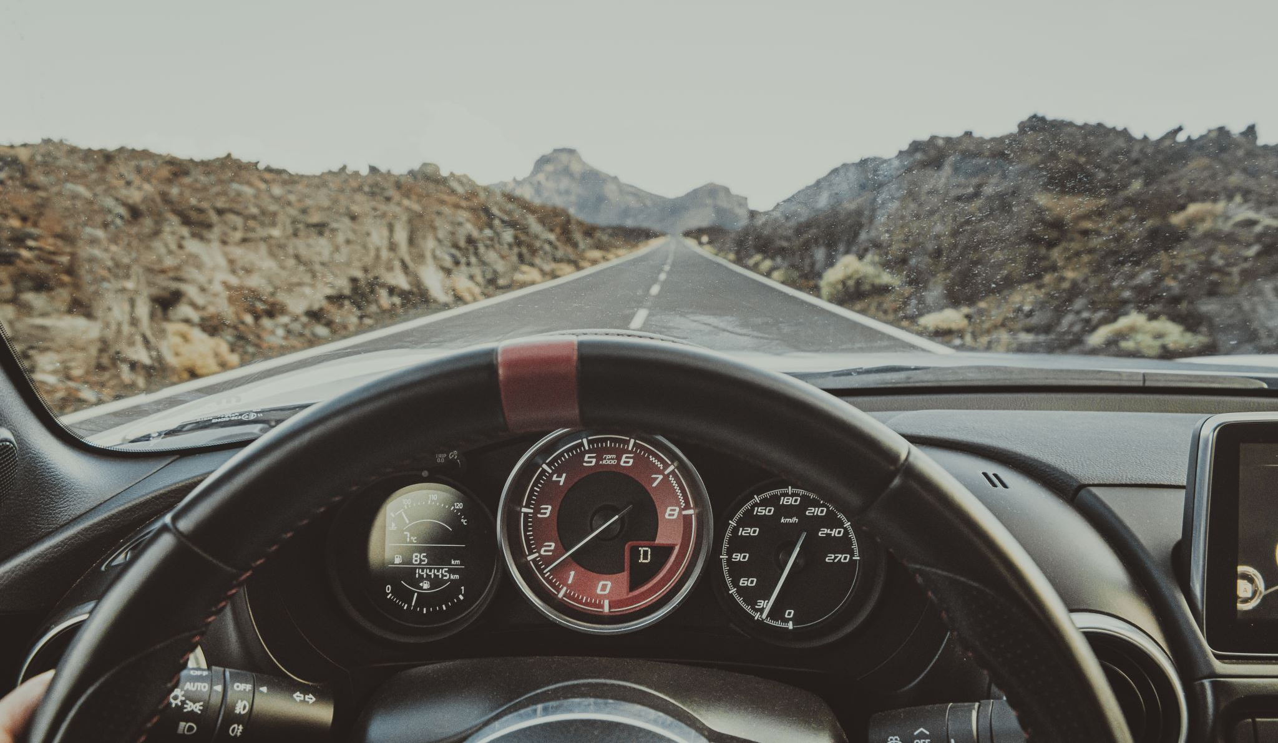

Speed is described by the equation.
Speed =distance ÷ time
$speed=\frac{distance}{time}$
$v=\frac{d}{t}$
Speed is the distance travelled in unit time (distance travelled per second)

Slide 5


Symbols and Units
Symbol | Definition | Unit | Unit Symbol
v | speed | metres per second | ms⁻¹
d | distance | metre | m
t | time | second | s
d
$$\overline{v}$$
$$t$$
But don’t use the triangle unless you absolutely have to.

Slide 6

Average Speed
The average speed of an object is defined as the total distance travelled divided by the time for the journey, or the rate of covering a distance.
$$\overline{v}=\frac{d}{t}$$
The bar over any quantity in Physics denotes that it is an average value

Slide 7
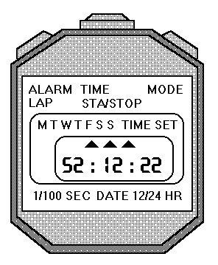
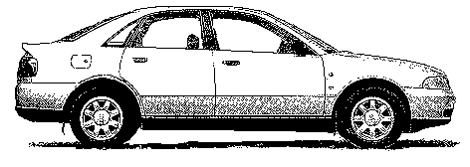

Measuring Average Speed
Measure the distance travelled by the car using a trundle wheel/tape measure etc.
Measure the time for the journey with a stopwatch.
Use speed=distance/time
To measure the average speed you need to measure the distance for the whole journey and measure the time taken for the whole journey. The distance can be measured with a trundle wheel, tape measure etc., and the time can be measured with a stop watch. Use the formula:
$\overline{v}=\frac{d}{t}$
…to calculate the average speed for the journey.
distance

Slide 8

Instantaneous Speed
The instantaneous speed of an object is defined as the length of the vehicle divide by the time to pass a point.
$$v=\frac{d}{t}$$

Slide 9
Measuring the Average Speed of a Vehicle
Aim: Measurement of average speed of a trolley
Apparatus: Runway, trolley with single mask, light gate, computer timer, metre rule
Instructions Measure distance, d, between the two light gates. Set the computer to measure the time between the trolley passing through the light gates. Release the trolley and record the time, t. Calculate average speed ṽ = d / t Repeat several times and calculate an average.
Evaluation Look over your results and comment on the accuracy and precision

Slide 10
Measuring the Instantaneous Speed of a Vehicle
Aim: Measuring the instantaneous speed of a vehicle
Apparatus Runway, trolley with single mask, light gate, computer timer, ruler.
Instructions Measure distance, d, between the two light gates. Set the computer to measure the time between the trolley passing through the light gates. Release the trolley and record the time, t. Calculate average speed ṽ = d / t Repeat several times and calculate an average.
Evaluation Look over your results and comment on the accuracy and precision
Use a small width of card (this is too big)

Slide 11
Speed velocity, distance and Displacement
B
A

Slide 12
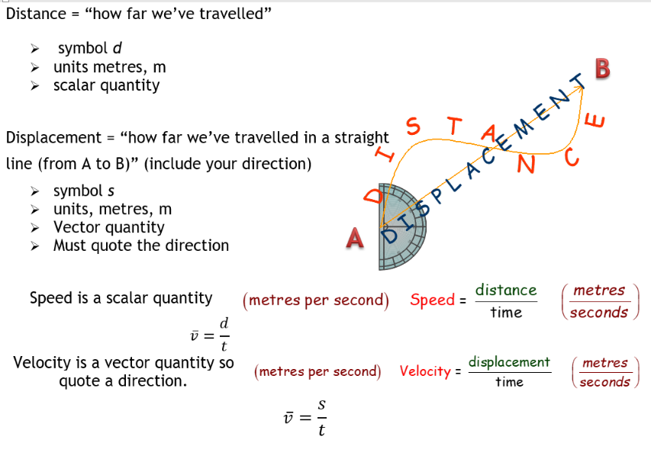

Slide 13


Velocity $s=vt$
Velocity is the rate of change of displacement and is described by the equation below.
$$velocity=\frac{displacement}{time} v= \frac{s}{t}$$
Velocity is a vector quantity.
The direction of the velocity will be the same as the direction of the displacement.
If the velocity is measured over the whole journey then it is known as average velocity, with the symbol $\overline{v}$.

Slide 14
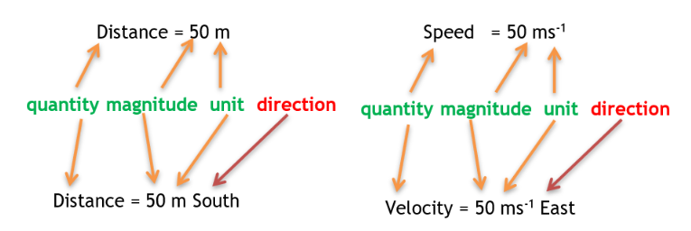
Scalars and Vectors, Distance and Displacement, Speed and Velocity

Slide 15



Acceleration
  What is acceleration?
  How to measure acceleration
  Using the equations to calculate acceleration

Slide 16


Acceleration
TASK
Write down what you think is the meaning of acceleration

Slide 17

My money is on……
I bet you nearly all said
“speeding up”

Slide 18

Warning!
For all of our examples we will assume you are travelling in a straight line so the value (magnitude) of your speed is the same as the magnitude of the velocity so I might be a little careless in my language.
You should always try to use velocity with acceleration

Slide 19
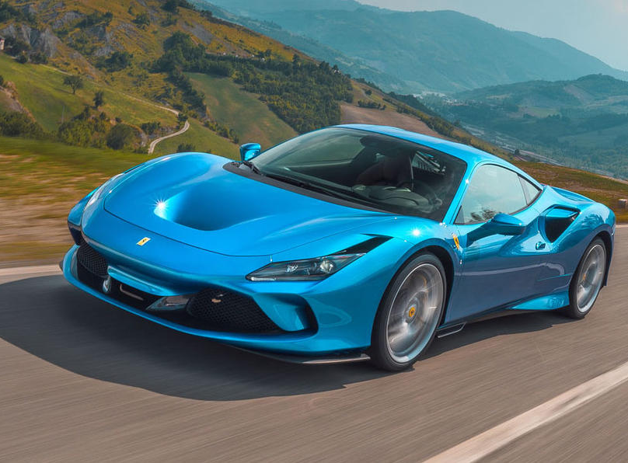
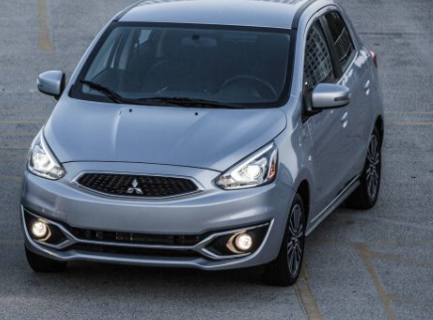
Buying a “fast” car
Have you ever looked closely at advertisements for cars? Most of them will say something like this:
0 – 60 mph in 8 seconds
What does this tell you?
It’s not how fast the car can go – cars can manage more than 60 miles per hour.
It’s how quickly the car gains speed – the car’s. The less time a car takes to gain speed, the greater its acceleration.

Slide 20
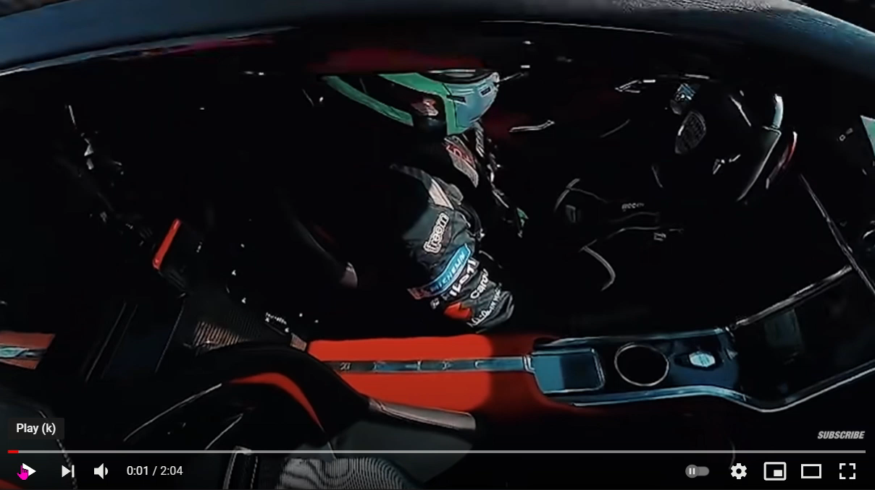
Time how long it takes this car to get from 3 mph to 63 mph, it isn’t long
I think this car was going for top speed rather than maximum acceleration. You could later work out the acceleration for different changes of velocity. Do you see how the road is long and straight so the
magnitude of speed = size of velocity along the road.

Slide 21


Vauxhall Nippy:
Top speed: 115 mph
Engine size: 1.2 litres
0 – 60 mph: 10 seconds
Ferrari Flyer:
Top speed: 130 mph
Engine size: 2.4 litres
0 – 60 mph: 5 seconds
Mazda Vroom:
Top speed: 135 mph
Engine size: 2.0 litres
0 – 60 mph: 6 seconds
Ford Speeda:
Top speed: 125 mph
Engine size: 1.6 litres
0 – 60 mph: 7.5 seconds
1. Which car has the highest top speed?
2. Which car has the greatest acceleration?
3. Which car would you prefer to drive? Why?

Slide 22
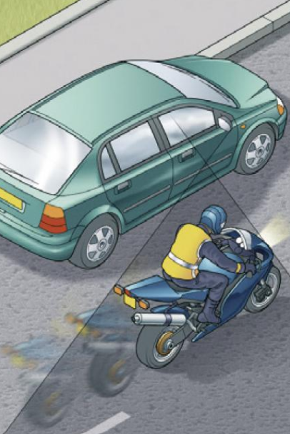
ACCELERATION
Imagine two drivers side by side at a set of traffic lights, the lights are on red. Angus is in a boring saloon car, and Caitlin is sitting on her motorbike. The lights turn green and both vehicles set off. Both vehicles accelerate, the speed of both vehicles increases.
After a while both vehicles reach the same speed; but we can tell that the motorbike will have a greater acceleration than the car.
Acceleration is not just about the increase in your velocity it takes account of the time it takes to change your velocity.
The time it takes your speed velocity to change must be in the equation.

Slide 23
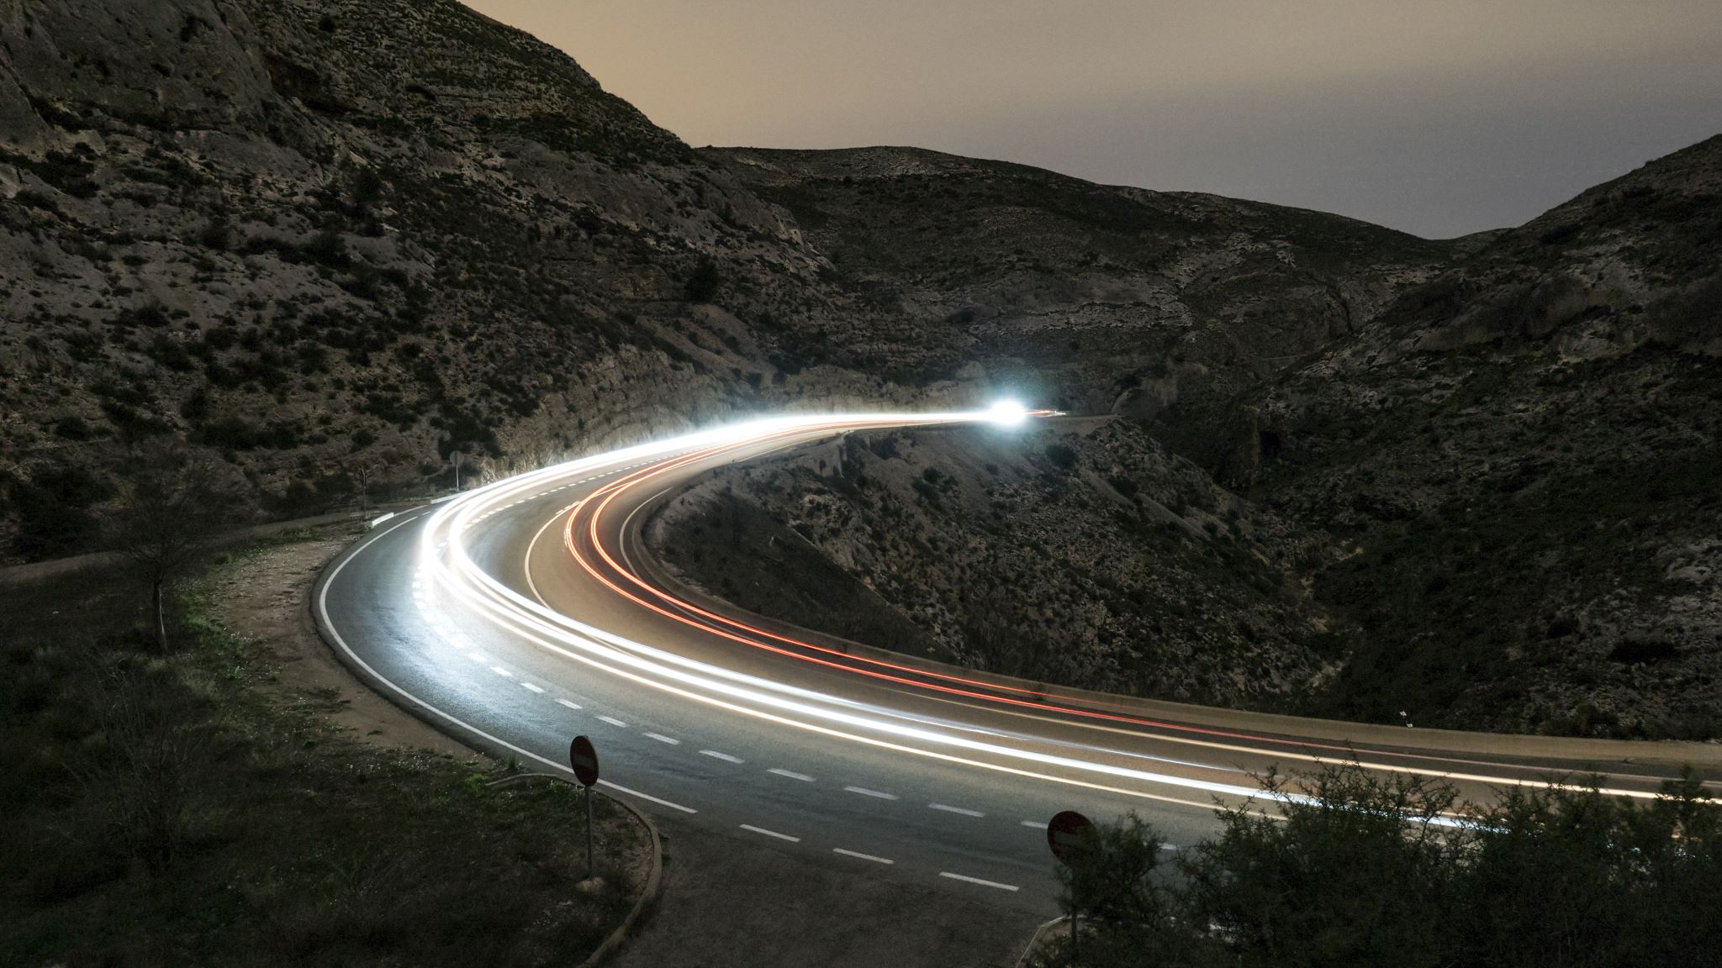
Acceleration
Acceleration is the rate of change of velocity.
(how quickly you change your velocity).
Or
change of velocity per second
If you change your velocity quickly you have a high acceleration.

Slide 24
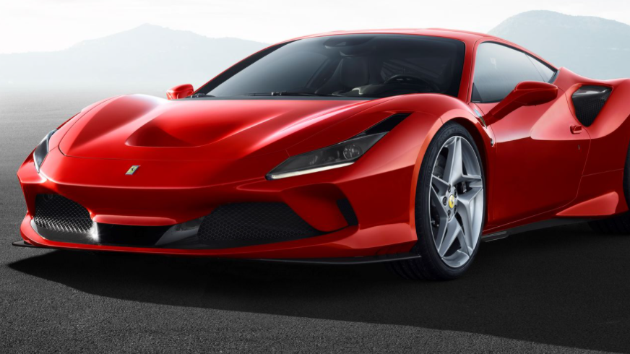
a | acceleration
Δ | change in
v | velocity
v | final velocity
u | initial velocity
t | time
a= Δv
t
a= v-u
t

Slide 25
Units of Acceleration
If the change in velocity is measured in metres per second (m/s) and the time is measured in seconds, then the acceleration is measured in metres per second per second (m/s²).
For example, if a car accelerates at 2 m/s²,then its speed increases by 2 metres per second every second.
If it was stationary when the clock is started, then after the first second it will be going at 2 m/s, after the second second it will be travelling at 4 m/s, and after ten seconds the car will be travelling at 20 m/s. what will be the speed of the car after sixty seconds?

Slide 26

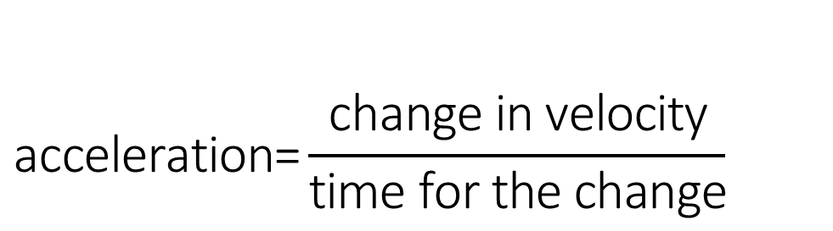
$$\text{acceleration}\text{=}\frac{\text{change} \text{in} \text{velocity}}{\text{time} \text{for} \text{the} \text{change}}$$
The proper unit for acceleration is
metres per second per second,
metres per second squared.
(miles per hour per second).
m/s ² or ms⁻²
mph/s
Notes:
If the change in speed is measured in metres per second (m/s) and the time is measured in seconds, then the acceleration is measured in metres per second per second (m/s²).
For example, if a car accelerates at 2 m/s²,then its speed increases by 2 metres per second every second. If it was stationary when the clock is started, then after the first second it will be going at 2 m/s, after the second second it will be travelling at 4m/s, and after ten seconds the car will be travelling at 20m/s. what will be the speed of the car after sixty seconds?
When you buy a new car, figures are given to indicate the acceleration car companies often only quote the time it takes for vehicles to speed up from 0 mph to 60 mph. From this information the customer can work out whether it is a sporty or slow car. As a customer, wanting to purchase a new sporty car, would you want a long time or a short time for the change in speed to occur?
lf a car is slowing down then it is said to be decelerating or has a negative acceleration.

Slide 27

…..and lastly
Do you think you are accelerating when you are slowing down?

Slide 28
Slowing down is accelerating
If we look at the formula
If you are slowing down your velocity is changing
So you are accelerating.
We will find out that you will have a negative acceleration if you are slowing down which is also called a deceleration
a= Δv
t
a= v-u
t

Slide 29
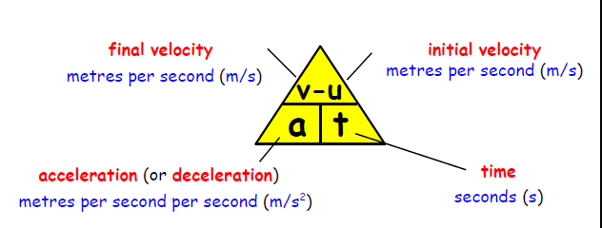
Calculating Acceleration

Slide 30
Acceleration
A Jaguar can reach 27 m/s from rest in 9.0 s, calculate its acceleration.
The space shuttle reaches 1000 m/s, 45 s after launch. Calculate the acceleration.
A car reach 30 m/s from a speed of 18 m/s in 6 s. calculate its acceleration.
A train moving at 10 m/s increases its speed to 45 m/s in 10 s. calculate its acceleration.
A bullet travelling at 240 m/s hits a wall and stops in 0.2 s. Calculate its acceleration.
A car travelling at 20 m/s brakes and slows to a halt in 8 s. Calculate its acceleration, it ought to be a negative value!

Slide 31
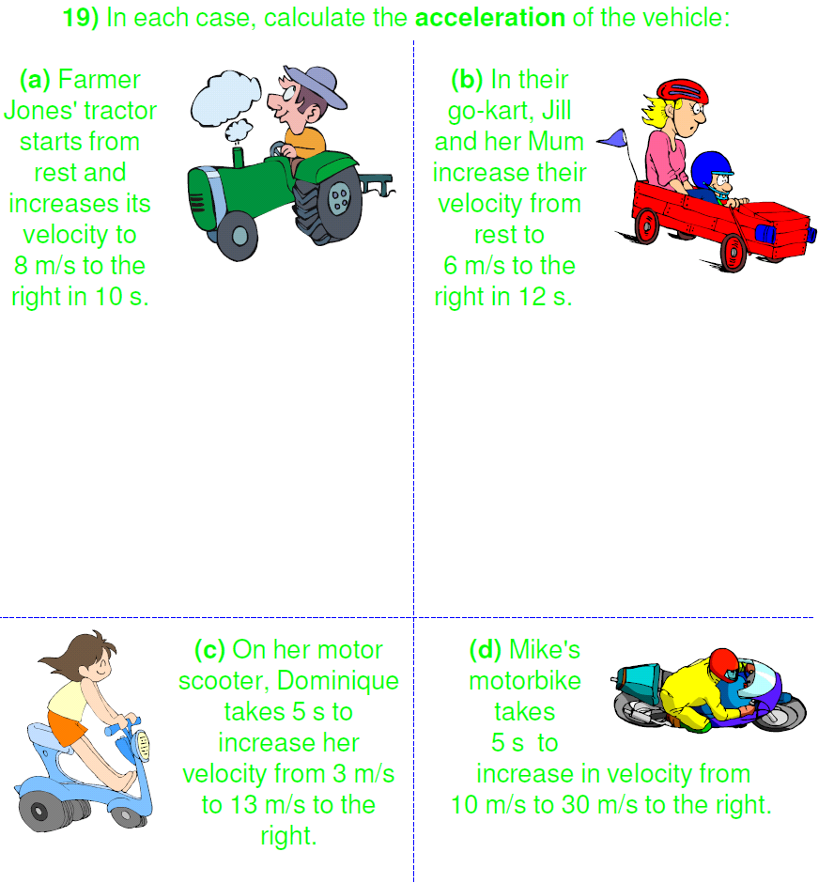
In each case, calculate the acceleration of the vehicle:
(a) Farmer Jones' tractor starts from rest and increases its velocity to 8 m/s to the right in 10 s.
(b) In their go-kart, Jill and her Mum increase their velocity from rest to 6 m/s to the right in 12 s.
(c) On her motor scooter, Dominique takes 5 s to increase her velocity from 3 m/s to 13 m/s to the right.
(d) Mike's motorbike takes 5 s to increase in velocity from 10 m/s to 30 m/s to the right.

Slide 36
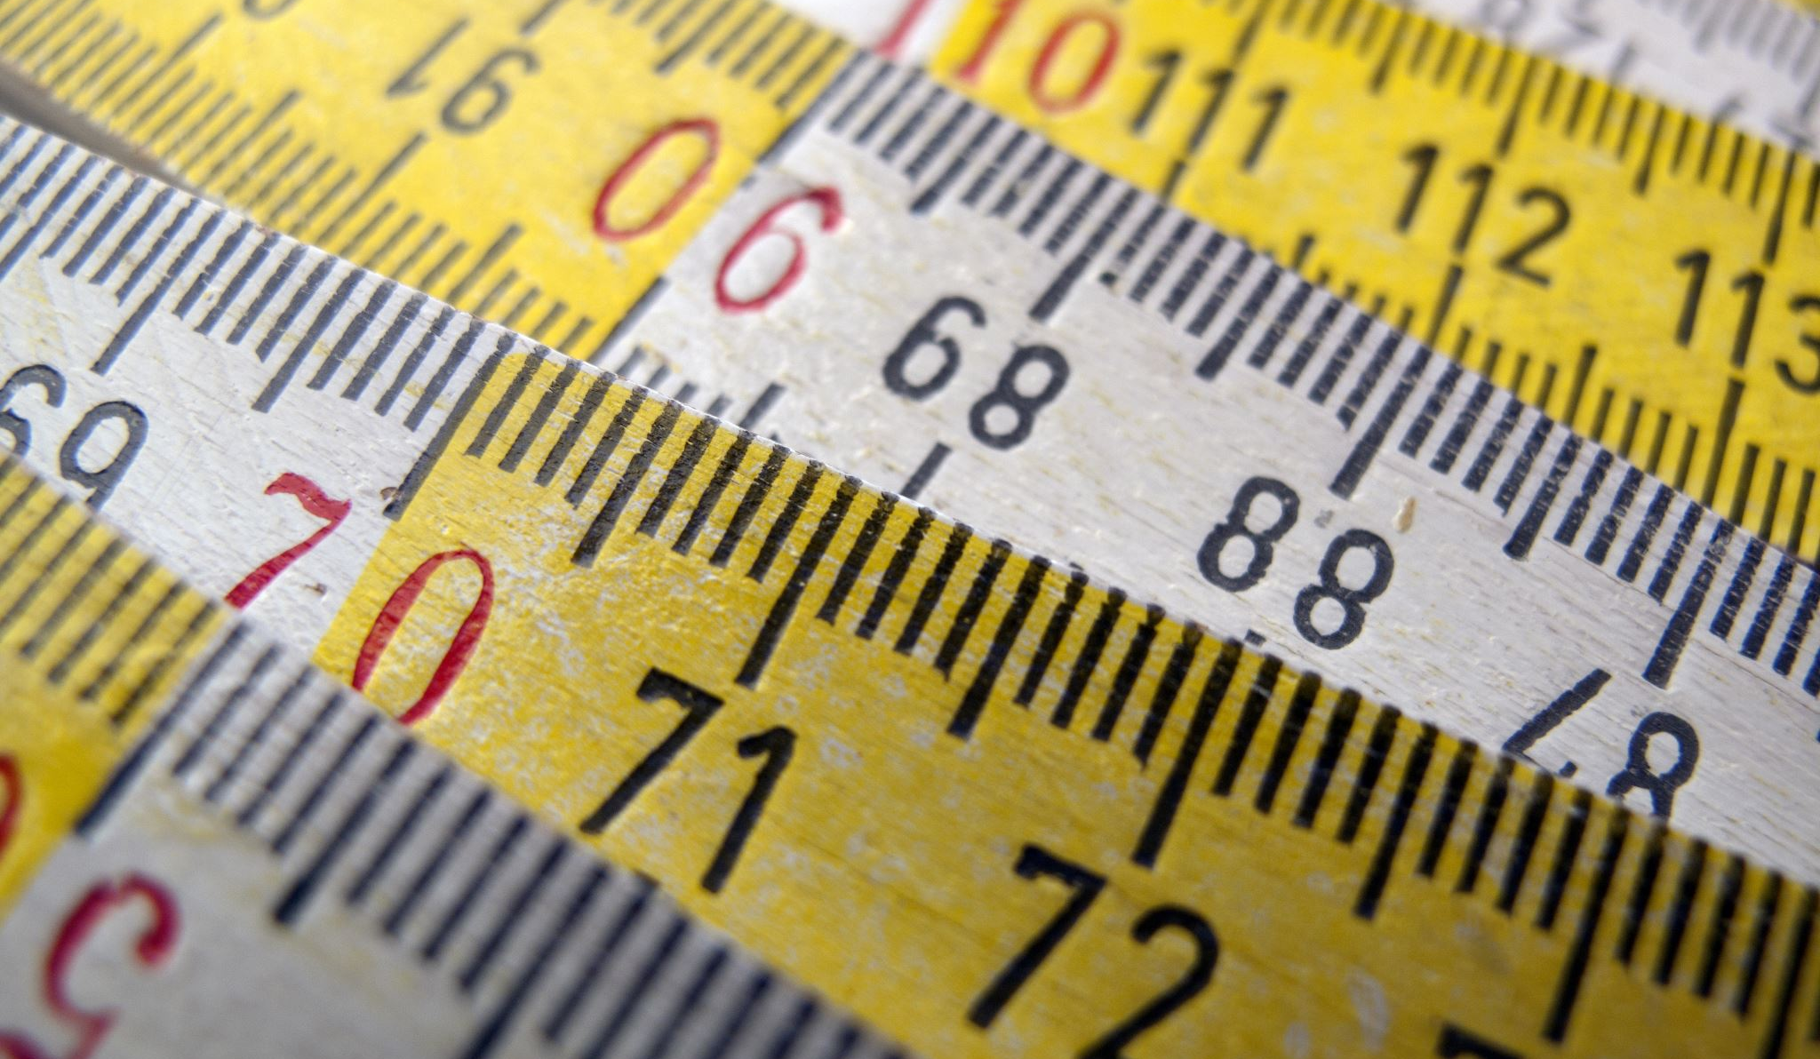
Measuring Acceleration
Describe how you could measure the acceleration of a small vehicle as it runs down a slope in the laboratory.

Slide 37

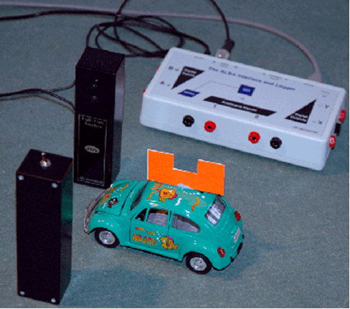
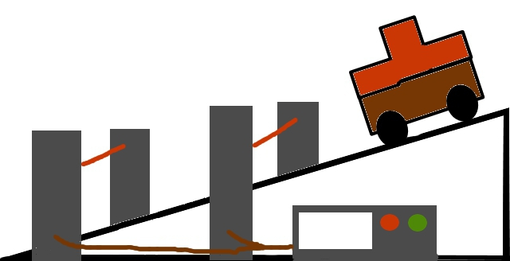
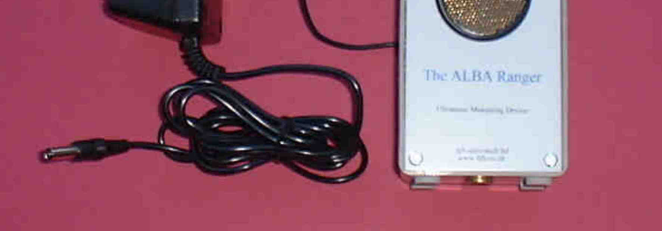
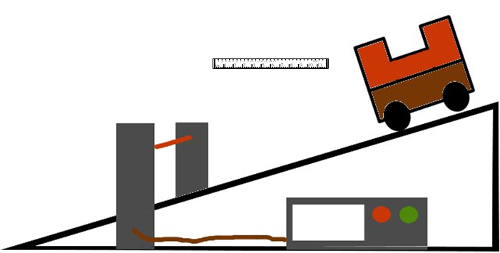
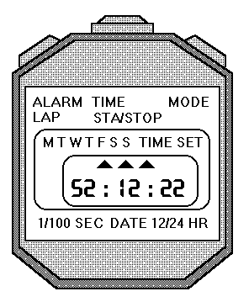
Many different ways

Slide 38
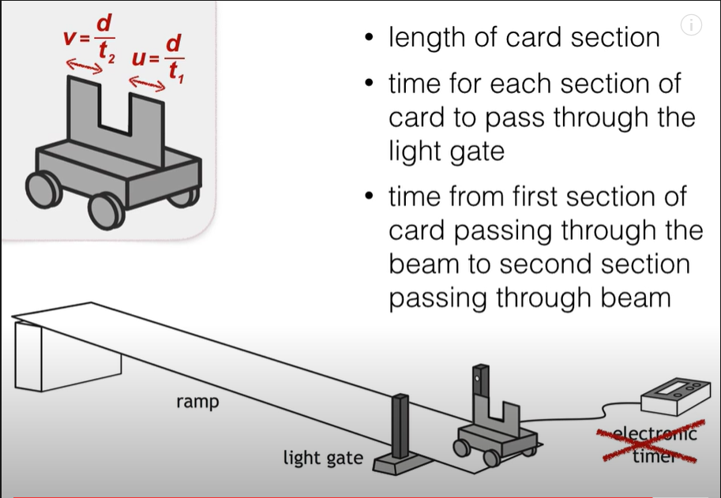
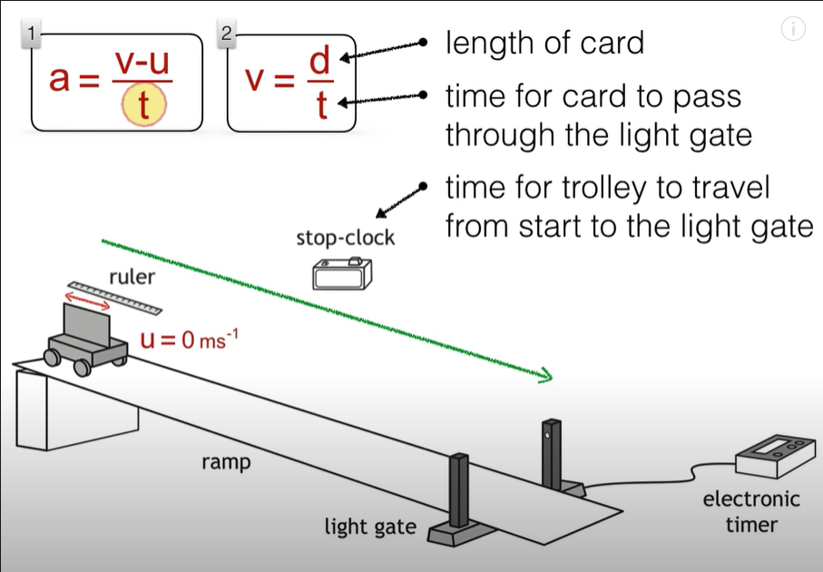
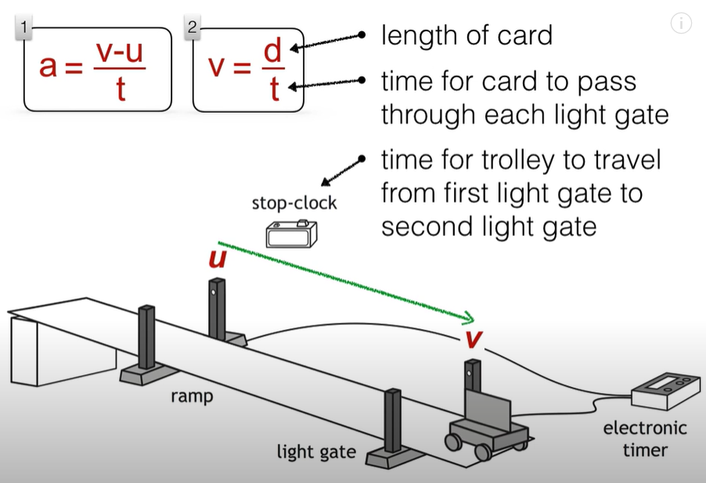
https://www.youtube.com/watch?v=YUqwdD73610
There are different ways to measure acceleration here are a few.

Slide 39
Don’t measure acceleration we calculate it!
We don’t measure v and u we calculate them from
u=s/t
  Where
    s = length of the card
    t= time for the vehicle to pass through the top light gates.
    v=s/t
  Where
    s = length of the card
    t= time for the vehicle to pass through the bottom light gates.
    We also need to know the time it took the car to go between the light gates.
    Or v=s/t where s= length of second piece of card, and t is the time for the vehicle to pass through the light gate.

Slide 40


Measuring acceleration with the ALBA RANGER
Here the Ranger sends out pulses of sound / ultrasound. The sound waves reflect off the object and the reflected waves return to the ranger.
If the pulses are returning after a longer time what does this tell you about the vehicle?
What about the pulses reflecting in a shorter time?

Slide 41

Measuring acceleration with two light gates and a single mask

Slide 42
Does it matter how far apart the light gates are?
Surely the further apart the light gates the greater the value of v.
No it doesn’t matter how far apart the light gates are if the acceleration down the slope is constant
Yes the further apart the light gates the greater
the value of v but the longer it takes to go between the light gates. If a=v-u/t then v is greater but also t so these two cancel and a remains constant.

Slide 43
Measuring acceleration with only one light gate
Notice we now have a double mask!

Slide 44
How can we only use 1 light gate to find acceleration?
Yes the vehicle has a double MASK. u and v are still taken from the time it takes the mask to pass through the light gate and we need to measure the length of the mask.

Slide 45
Measuring Acceleration
You can measure acceleration in the lab with EITHER one single mask and two light gates or a double mask and one light gate.
Whichever way the experiment is conducted the measurements that need to be made are:
  Width of the mask or masks.
  Time for first light beam to be broken.
  Time for second light beam to be broken.
  Time between the breaks in the light beam to be measured.

Slide 46
Measuring acceleration from rest
If the vehicle is starting from rest then u does not need to be physically measured.
A stopwatch can be used to time the vehicle from the time of release until the mask cuts the light gate
The time for the mask to break the light beam allows the final velocity to be calculate from v=s/t where s is the length of the mask and t the time to pass through the light gate.

Slide 47
How can we only use 1 light gate and a single mask to find acceleration?
TASK
Using equipment of your choice investigate the effect of the angle of a slope on acceleration.
Here we take u, the starting velocity as zero, so we don’t need to measure that.
We time how long the vehicle takes to travel to the light gate. v is found from the time it takes the mask to pass through the light gate and we need to measure the length of the mask.

Slide 48
Measurements | Calculations
t₁ time to pass first light gate
t₂ time to pass second light gate
t₃ time between light gate
Length of mask

Slide 49

Now we need to try it and see what works and what doesn’t
Set up each method and find the value of the acceleration down the slope three times by each method.
Record all of your measurements
Evaluate each method, discussing what is easy or hard to set up, which measurements are easy or hard to take and which measurements do you think are reliable. How confident do you feel that your answer tells you the exact value for the acceleration of your vehicle down the slope?

