Slide 1
Properties of Matter Revision
N5 Physics

Slide 2
Get the notes here

Slide 3
What is temperature
The temperature of a substance is ……

Slide 4
Specific heat capacity (use your compendium for the Data Sheet)
Calculate the energy required to heat 5.0kg of water from 20 °C to 65 °C (use your compendium for the Data Sheet)
Calculate the final temperature of glass if 2.0 kg of glass are heated from 15 °C using 30 kJ of energy.

Slide 5
Specific latent heat (use your compendium for the Data Sheet)
Determine the material I am vaporising if I use 2.18×10⁶ J of energy to vaporise 2.63 kg of a material.
Calculate the energy required to melt 6.5 kg of ice

Slide 6
Pressure
Calculate the pressure exerted on a block when a nail is hit with a force of 20N on an area of 1×10⁻⁶ m²
Determine my mass if I exert a pressure of 21.0kPa by standing on one foot, with a length of 0.30 m and a width of 0.10 m

Slide 7
Convert between degrees Celsius and Kelvin
Convert the following Celsius temperatures to Kelvin.
a) -273 °C
b) -150 °C
c) 10 °C
d) 27 °C
e) 150 °C
Convert the following Kelvin temperatures to Celsius.
a) 10 K
b) 23 K
c) 100 K
d) 350 K
e) 373 K

Slide 8
Boyle’s Law Questions
100 cm³ of air is contained in a syringe at atmospheric pressure (10⁵ Pa). If the volume is reduced to
a) 50 cm³ or
b) 20 cm³
without a change in temperature, Calculate the new pressures.
If the piston in a cylinder containing 300 cm³ of gas at a pressure of 10⁵ Pa is moved outwards so that the pressure of the gas falls to 8 × 10⁴ Pa, find the new volume of the gas.

Slide 9
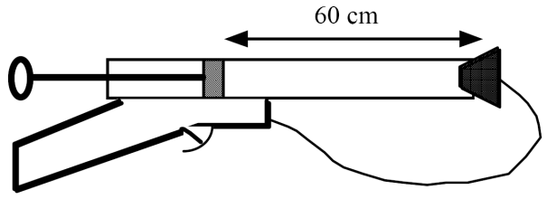
More Boyle’s Law Questions
A weather balloon contains 80 m³ of helium at normal atmospheric pressure of 1 x 10⁵ Pa. Calculate the volume of the balloon at an altitude where air pressure is 8 × 10⁴ Pa.
The cork in a pop-gun is fired when the pressure reaches 3 atmospheres. If the plunger is 60 cm from the cork when the air in the barrel is at atmospheric pressure, Calculate the distance the plunger moves before the cork pops out.

Slide 10
Gay-Lussac Law Questions
A fixed mass of gas at a constant volume has its temperature increased from 350 K to 525 K. If its original pressure is 0.8 x 10⁵ Pa, calculate the final pressure reached
An electric light bulb is designed so that the pressure of the inert gas inside it is 100 kPa (normal air pressure) when the temperature of the bulb is 350 °C. Calculate the pressure inside the bulb if this is done at 15 °C .

Slide 11
More pressure v temperature questions
The pressure in a car tyre is 2.5 × 10⁵ Pa at 27 °C. After a long journey the pressure has risen to 3.0 × 10⁵ Pa. Assuming the volume has not changed, calculate the new temperature of the tyre.
A compressed air tank which at room temperature of 27 °C normally contains air at 4 atmospheres, is fitted with a safety valve which operates at 10 atmospheres. During a fire the safety valve was released. Estimate the average temperature of the air in the tank when this happened.

Slide 12
Charles’ Law Questions
At what temperature will a litre of trapped gas have its volume doubled if it was at-20ºC?
A fixed mass of air occupies a volume of 0.2 m³ at a temperature of 0 ºC. If the pressure remains unchanged, determine the temperature when its volume is 0.4 m³

Slide 13
More Charles’ Law Questions
A weather balloon contains 100m³ of helium when atmospheric pressure is 90kPa. If atmospheric pressure changes to 100 kPa, calculate the new volume of helium at the same temperature.
Air is trapped in a glass capillary tube by a bead of mercury. The volume of air is found to be 0.10 cm³ at a temperature of 27 °C. Calculate the volume of air at a temperature of 87 °C.

