Slide 1
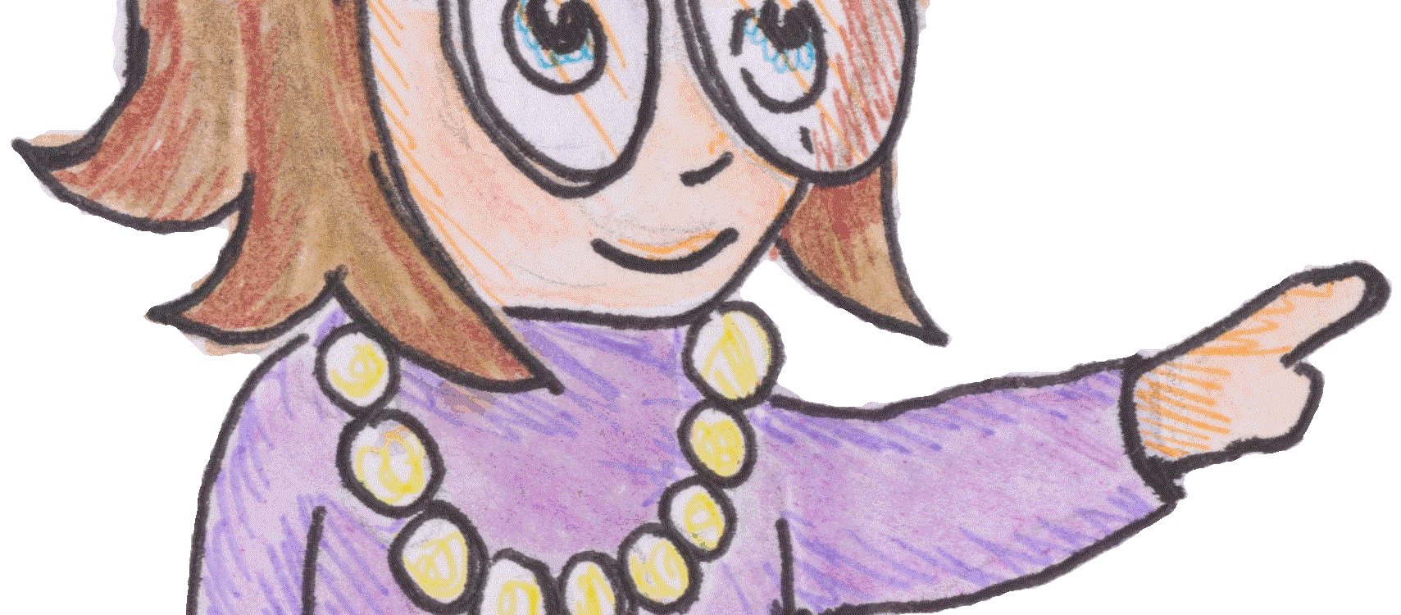
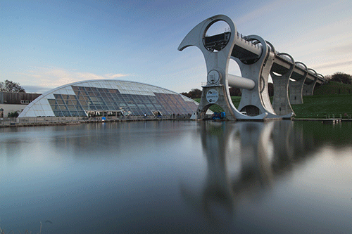
Energy
N5 Physics

Slide 2
Revision
5.1 | I can state that energy is never created or destroyed, it is conserved.
5.2 | I can identify and explain energy conversions and transfer.
5.3 | I can apply the principle of ‘conservation of energy’ to examples where energy is transferred between stores.
5.4 | I can use Ew=Fd to solve problems involving work done, unbalanced force, and distance or displacement.
5.5 | I can identify and explain ‘loss’ of energy where energy is transferred.
5.6 | I can define gravitational potential energy. Ep is the energy an object has because of its position above the Earth’s surface and its mass
5.7 | I can use Ep=mgh to solve problems on involving gravitational potential energy, mass, gravitational field strength and height
5.8 | I can define kinetic energy as the energy an object has because of its speed.
5.9 | I can use Ek= ½ mv² to solve problems involving kinetic energy, mass and speed
5.10 | I can use Ew=Fd, Ep=mgh, Ek= ½ mv² to solve problems involving conservation of energy

Slide 3
State the law!
The Principle of the Conservation of Energy
(states that) energy cannot be created or destroyed – it can only transformed from one store of energy to another. Energy is conserved – the total amount of energy present stays the same before and after any changes.

Slide 4
Stores and Pathways
Store a part of a system which can be measured to tell us about the energy available.
Pathway a physical process which transfers energy from one store to another.
Notes:
It is worth emphasizing that the store involves at least one measurable quantity. In some cases the measurements may be less practical in the school lab, which will influence the examples we choose to share with students.
Pathway = process = mechanism = method = POWER. It happens over a period of time, which means we can consider this as a rate. Accumulated change.

Slide 5
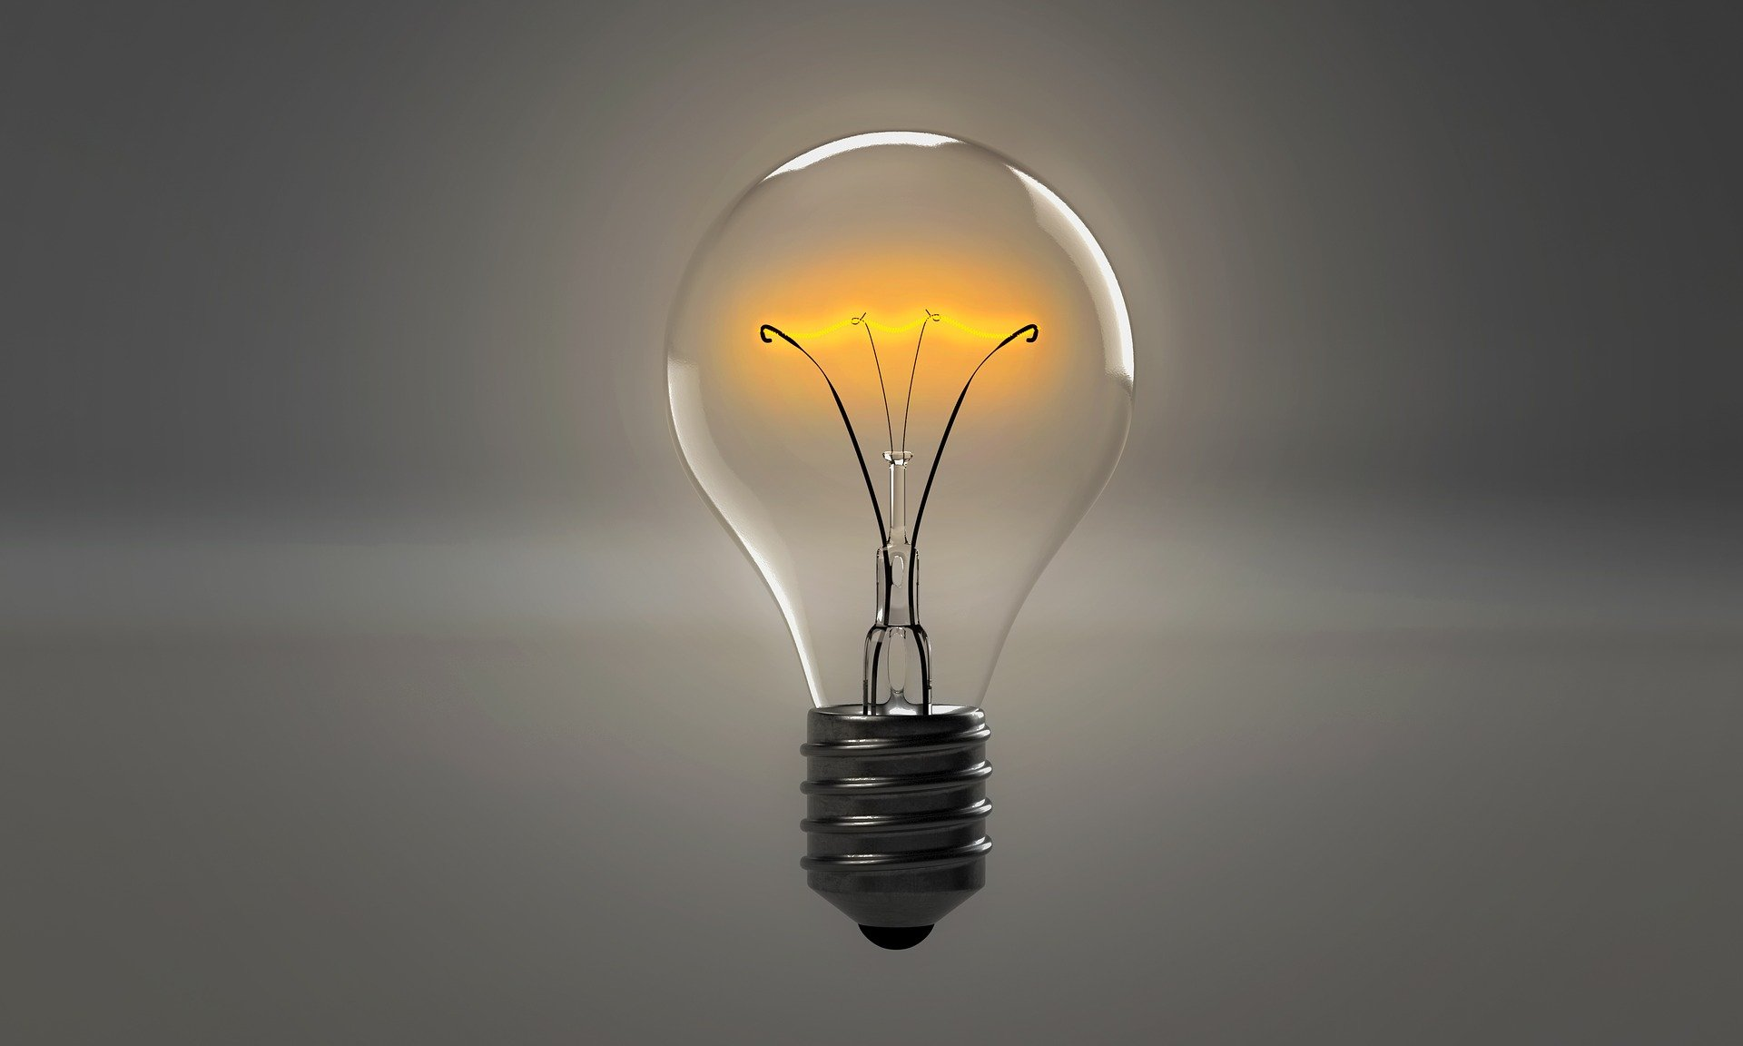
Energy ‘loss’
We often talk about energy loss. But, energy cannot be destroyed it can be changed.
The problem is that it doesn’t always change the way we want. We often say that the type of energy we are after is the ‘useful’ energy and that any other forms of energy that our energy store is transferred into are ‘wasted’ energy. For example, electrical energy in a light bulb is transferred into light (useful energy) and heat (wasted energy).

Slide 6
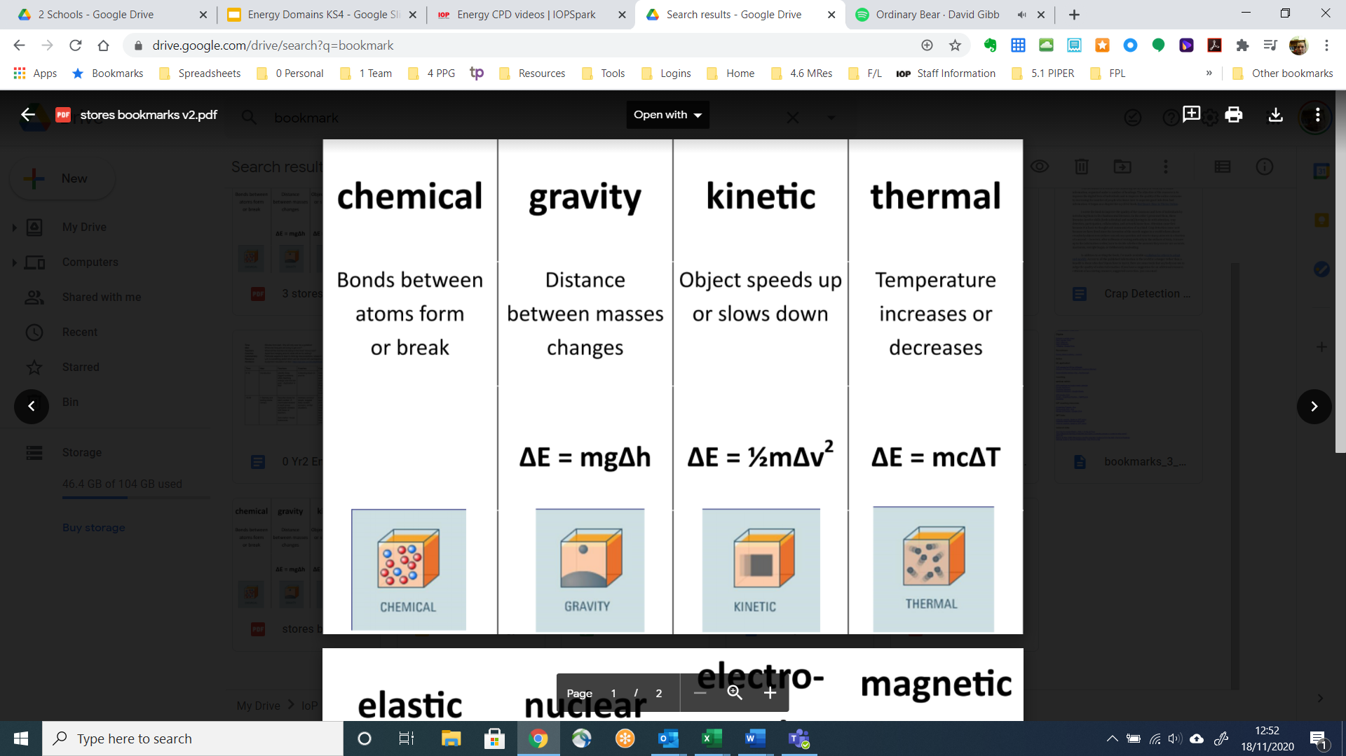
Stores and equations
Notes:
https://drive.google.com/file/d/1iw4_GJTJVJSZFT08POKYX9WHs4xbyDEO/view?usp=sharing

Slide 7
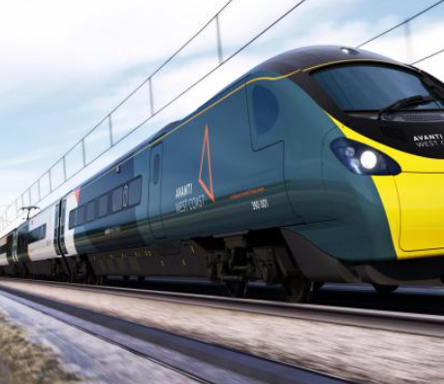
Work
At the moment you probably feel that you are doing lots of work. But in Physics work has a special meaning
When you push something to make it move you are doing work. Work is also done when a locomotive pulls a train or when a crane lifts a load.

Slide 8
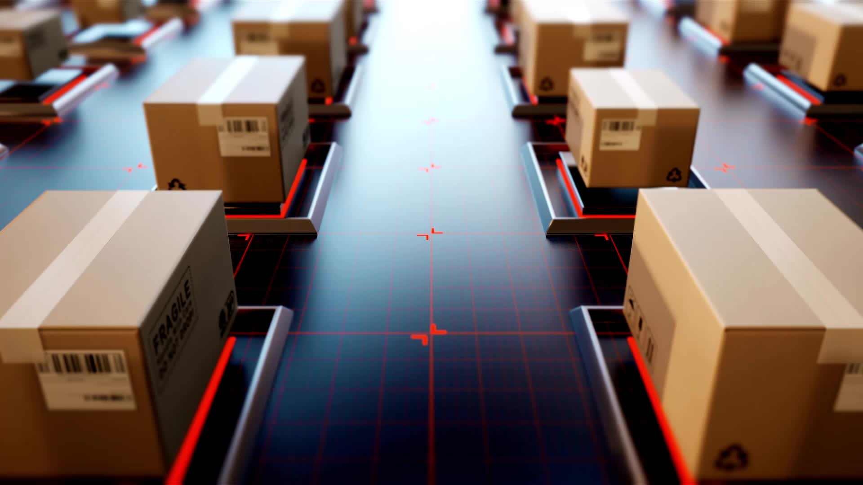
Work done
Work is the energy transferred to or from an object via the application of force along a displacement.
The work done, or the energy transferred, depends on the force exerted and the distance moved in the direction of the force.
work done = force × distance
Ew = Fd
Where
force is measured in Newtons
distance is measured in metres,
work done is measured in joules.

Slide 9
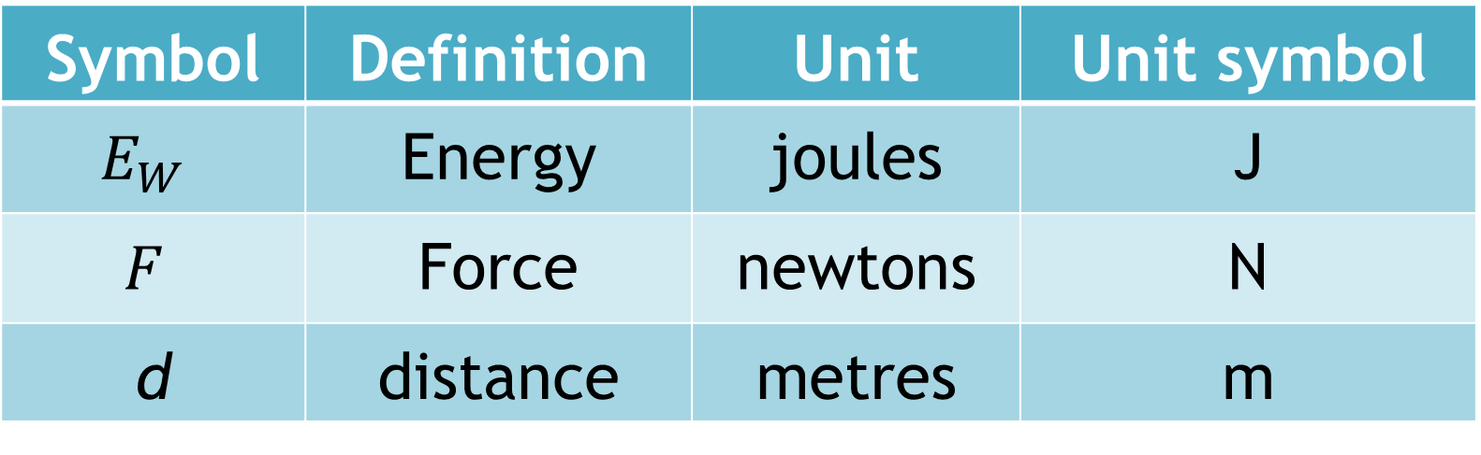
Quantities & Symbols
Symbol | Definition | Unit | Unit symbol
$$E_{W}$$ | Energy | joules | J
$$F$$ | Force | newtons | N
d | distance | metres | m

Slide 10


Acceleration
TASK
Write down what you think is the meaning of acceleration

Slide 11
Examples
A shopper pushes a supermarket trolley a distance of 600m with a force of 70 N. Calculate work done.
A locomotive pulls a carriage a distance of 1.6 km with a force of 28000 N. Calculate the work done
The brakes of a car exert a force of 500 N to stop the car. If the braking distance is 67m calculate the work done by the brakes to stop the car.

Slide 12
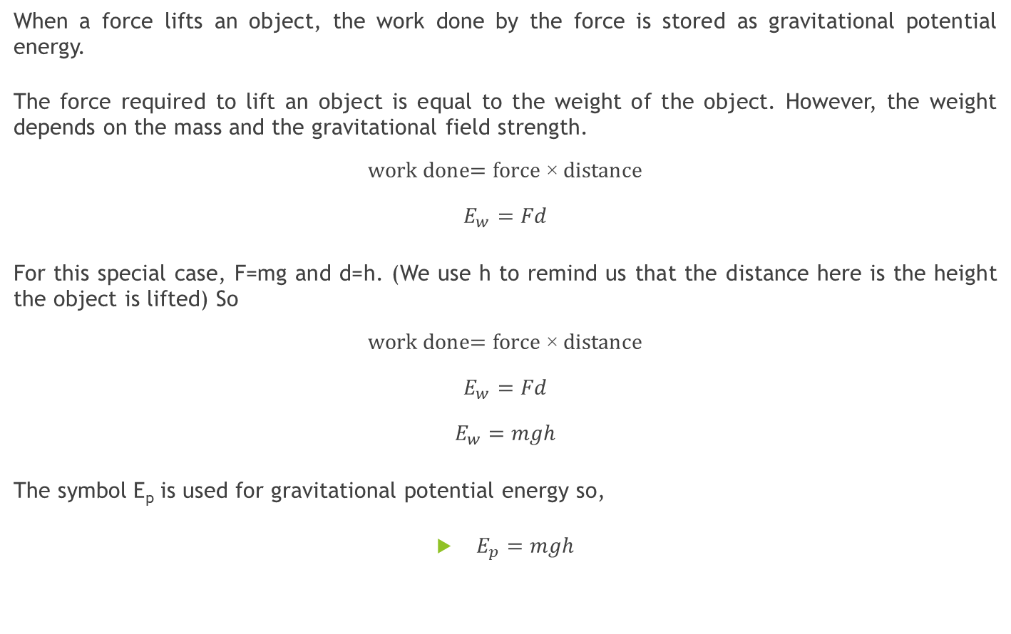
A special case- Gravitational Potential energy
When a force lifts an object, the work done by the force is stored as gravitational potential energy.
The force required to lift an object is equal to the weight of the object. However, the weight depends on the mass and the gravitational field strength.
$$\text{work} \text{done}\text{= }\text{force}\text{ × }\text{distance}$$
$$E_{w}=Fd$$
For this special case, F=mg and d=h. (We use h to remind us that the distance here is the height the object is lifted) So
$$\text{work} \text{done}\text{= }\text{force}\text{ × }\text{distance}$$
$$E_{w}=Fd$$
$$E_{w}=mgh$$
The symbol E_{p} is used for gravitational potential energy so,
$E_{p}=mgh$
Force, F
m
height, h
m

Slide 13
Gravitational Potential Energy Examples
A lift moves a 45kg girls up 9 m from the ground floor to the top floor. Calculate the girl’s gain in gravitational potential energy
A boy lifts a 3.8 kg school bag up to 0.92m from the floor to the bench. Calculate the gain in the gravitational potential energy of the bag.

Slide 14
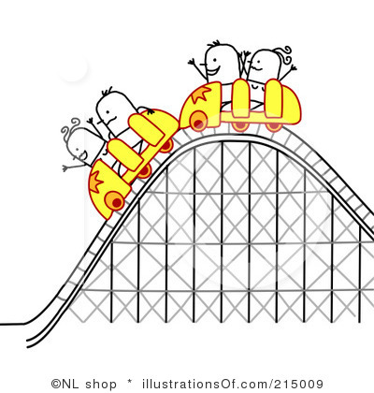
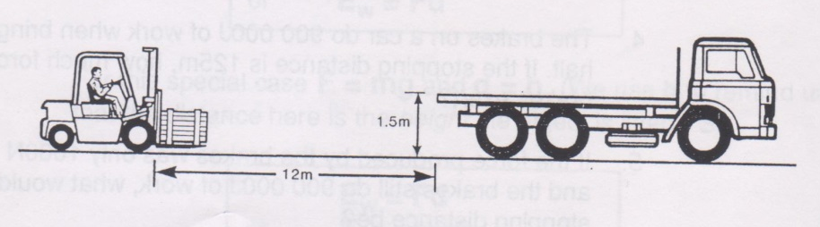
1. A locomotive exerts a pull of 10 000 N to pull a train of loaded wagons a distance of 300 m. Calculate the work done.
2. A gardener pushes a lawnmower with a force of 150N for a distance of 220m. Calculate the work done.
3. If a girl uses 1200 J of energy pushing a trolley a distance of 60m, how big is the force she exerts?
4. The brakes on a car do 900 000 J of work when bringing it to a halt. If the stopping distance is 125 m, Calculate the force do the brakes exert.
5. If the force produced by the brakes was only 1000N in question 4, and the brakes still do 900 000 J of work, what would be the new stopping distance?
6. The force of friction between a pencil and paper is 0.12N. Calculate the distance you’d push a pencil to do 5 J of work.
7. A mountain rescue helicopter winches up an injured climber of mass 65 kg a distance of 30m from a rock edge. Calculate the gain in gravitational potential energy.
8. Calculate the gain in gravitational potential energy when a 50 kg sack of potatoes is lifted 0.85m up onto a lorry.
9. Estimate the gravitational potential energy you would gain if you were winched up 30m to the top of a funfair ride.
10. A fork lift truck is to be used to load a crate of mass 200kg onto a lorry.
It has to drive 12m to the lorry and then lift the crate up 1.5m onto the lorry. The driving force is 500N and the energy available to complete the operation is 8000 J. Will the fork-lift truck be able to load the crate onto the lorry? Justify your answer by calculations.
30m

Slide 15
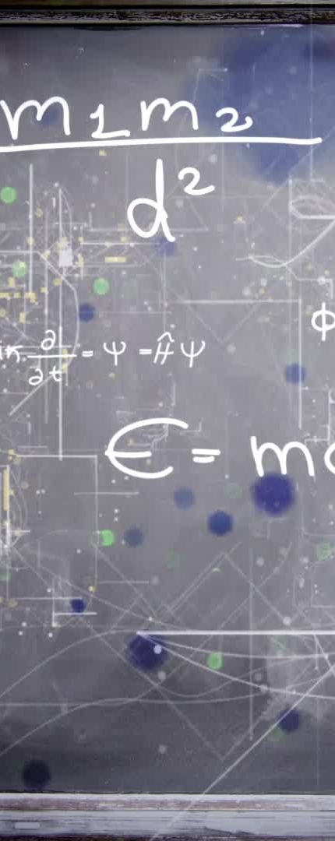
Summary of Ep
We can calculate gravitational potential energy by using the following formula:
Ep = m × g × h
Where
E_{p} is the gravitational potential energy in Joules
m is the mass of the object in kg
g is the gravitational field strength = 9.8 ms⁻²
h is the height of the object in metres

Slide 16
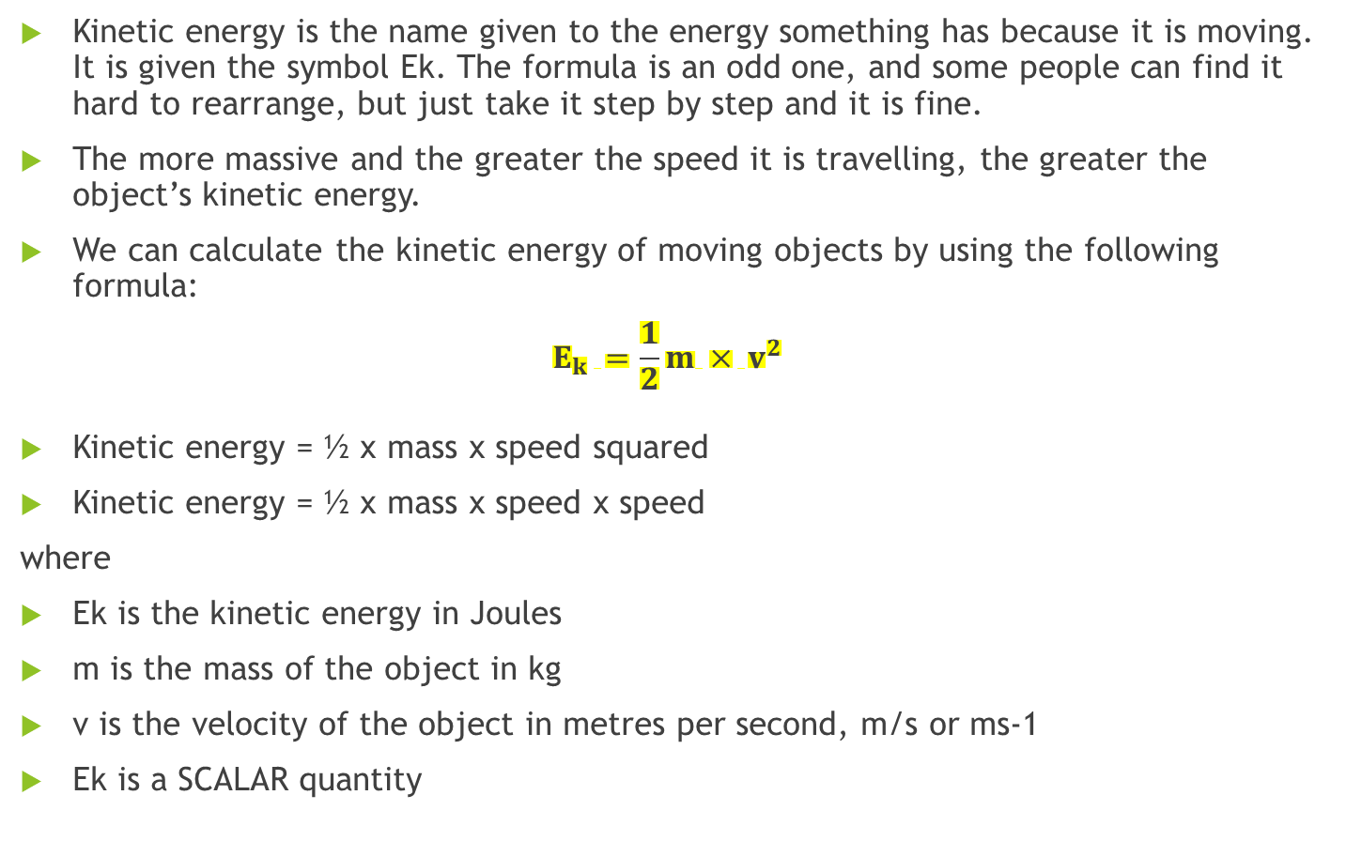
Kinetic Energy
Kinetic energy is the name given to the energy something has because it is moving. It is given the symbol Ek. The formula is an odd one, and some people can find it hard to rearrange, but just take it step by step and it is fine.
The more massive and the greater the speed it is travelling, the greater the object’s kinetic energy.
We can calculate the kinetic energy of moving objects by using the following formula:
$$E_{k} =\frac{1}{2}m × v^{2}$$
Kinetic energy = ½ x mass x speed squared
Kinetic energy = ½ x mass x speed x speed
where
Ek is the kinetic energy in Joules
m is the mass of the object in kg
v is the velocity of the object in metres per second, m/s or ms-1
Ek is a SCALAR quantity

Slide 17
Example
A wimpy kid on an office chair, with a combined mass of 65kg is travelling at 12m/s. Calculate E_{k}.

Slide 18
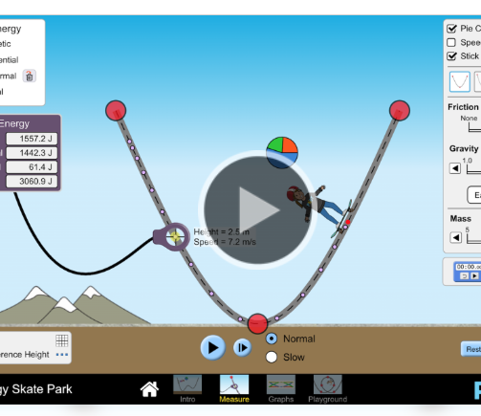
simulator
https://phet.colorado.edu/sims/html/energy-skate-park/latest/energy-skate-park_en.html

Slide 19
Summary
Quantity | Symbol | Unit | Unit Symbol
Kinetic Energy | E_{k} | Joules | J
Work done | E_{w} or W | Joules | J
Gravitational potential energy | E_{p} | Joules | J
Height | h | metres | m
Speed | v | metres per second | ms⁻¹

Slide 20
Worked example:
A crane lifts a crate of mass of 60kg to a height of 60m.
(a) calculate the gravitational potential energy gained by the crate
(b) if the cable of the crane snaps once it has completed lifting the crate , calculate the maximum velocity of the crate just as it reaches the ground (ignoring air resistance)
a) Using the equation Ep = m × g × h
Ep = 60 x 9.8 x 25
Ep = 15,000 J Mass, m = 60 kg Height, h = 25 m Gravitational field strength, g = 9.8 Nkg-1
b) If the crate falls, all of its potential energy will be transformed into kinetic energy. We are told to neglect air resistance – this means we can ignore any loss of energy to heat.
We can say that the gravitational potential energy, Ep is equal to the kinetic energy, Ek, therefore:
Ep = Ek = 15,000 J as worked out previously
Using the equation
Ek = ½ × m × v² = 15,000 J
15,000 = ½ x 60 x v²
v² = (15,000 × 2)/60 = 500
v = 22.7 m/s

Slide 21
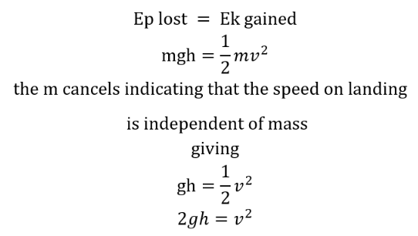
Energy cannot be created or destroyed we can only transfer it from one place to another. When we drop an object the GRAVITATIONAL POTENTIAL ENERGY is converted to KINETIC ENERGY, provided there are no losses due to friction.
Notice the mass of the object does not affect the speed that the object will reach as it falls. Amazing!

Slide 22
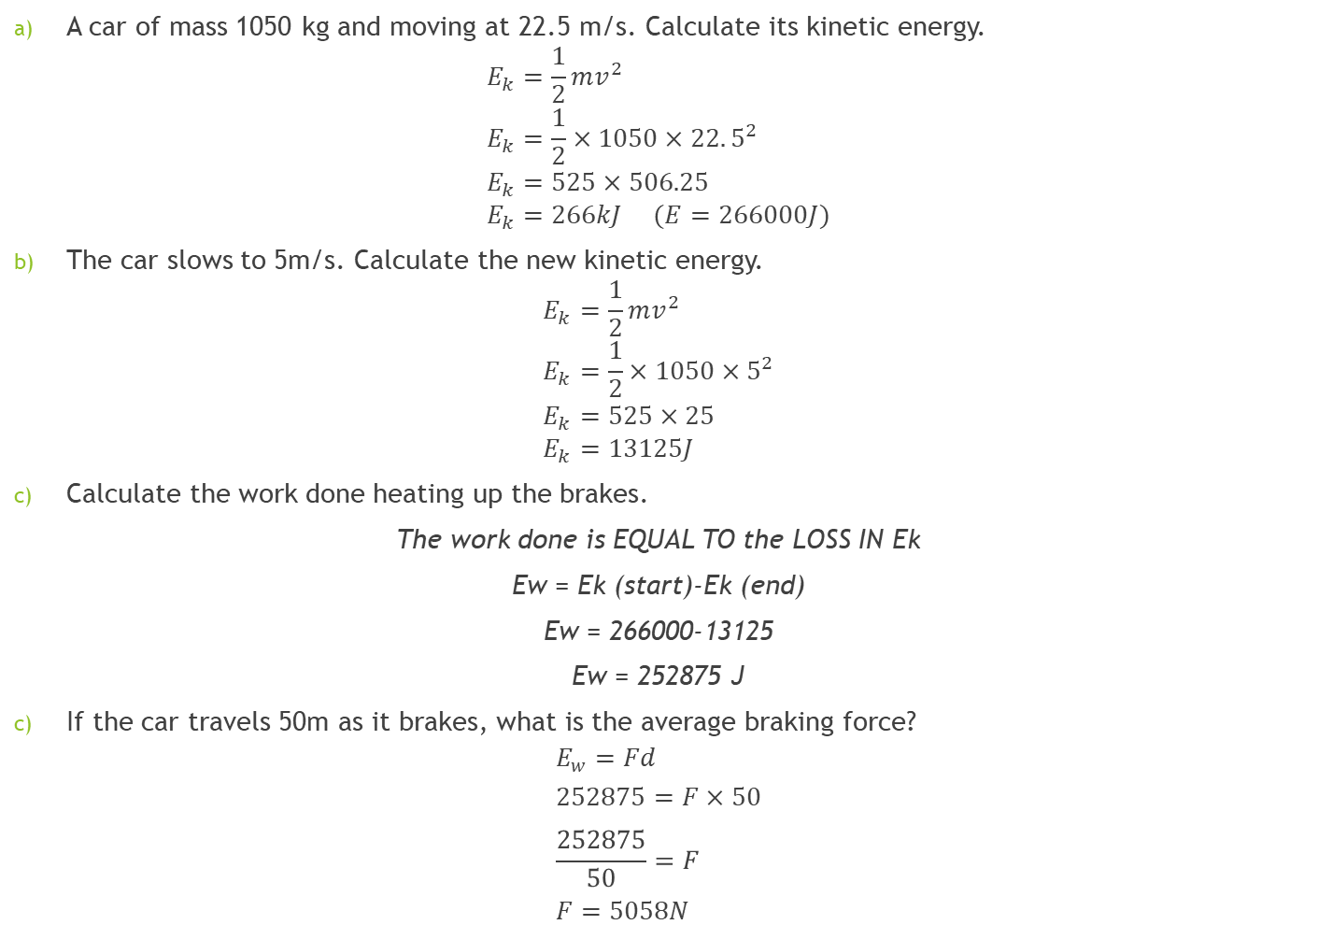
A car of mass 1050 kg and moving at 22.5 m/s. Calculate its kinetic energy.
$$E_{k}=\frac{1}{2}mv^{2} \\ E_{k}=\frac{1}{2}×1050×22.5^{2} \\ E_{k}=525×506.25 \\ E_{k}=266kJ (E=266000J)$$
The car slows to 5m/s. Calculate the new kinetic energy.
$$E_{k}=\frac{1}{2}mv^{2} \\ E_{k}=\frac{1}{2}×1050×5^{2} \\ E_{k}=525×25 \\ E_{k}=13125J$$
Calculate the work done heating up the brakes.
The work done is EQUAL TO the LOSS IN Ek
Ew = Ek (start)-Ek (end)
Ew = 266000-13125
Ew = 252875 J
If the car travels 50m as it brakes, what is the average braking force?
$$E_{w}=Fd \\ 252875=F×50 \\ \frac{252875}{50}=F \\ F=5058N$$

Slide 23
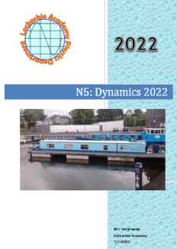
Try the questions in the Dynamics Book from p85

