Slide 1
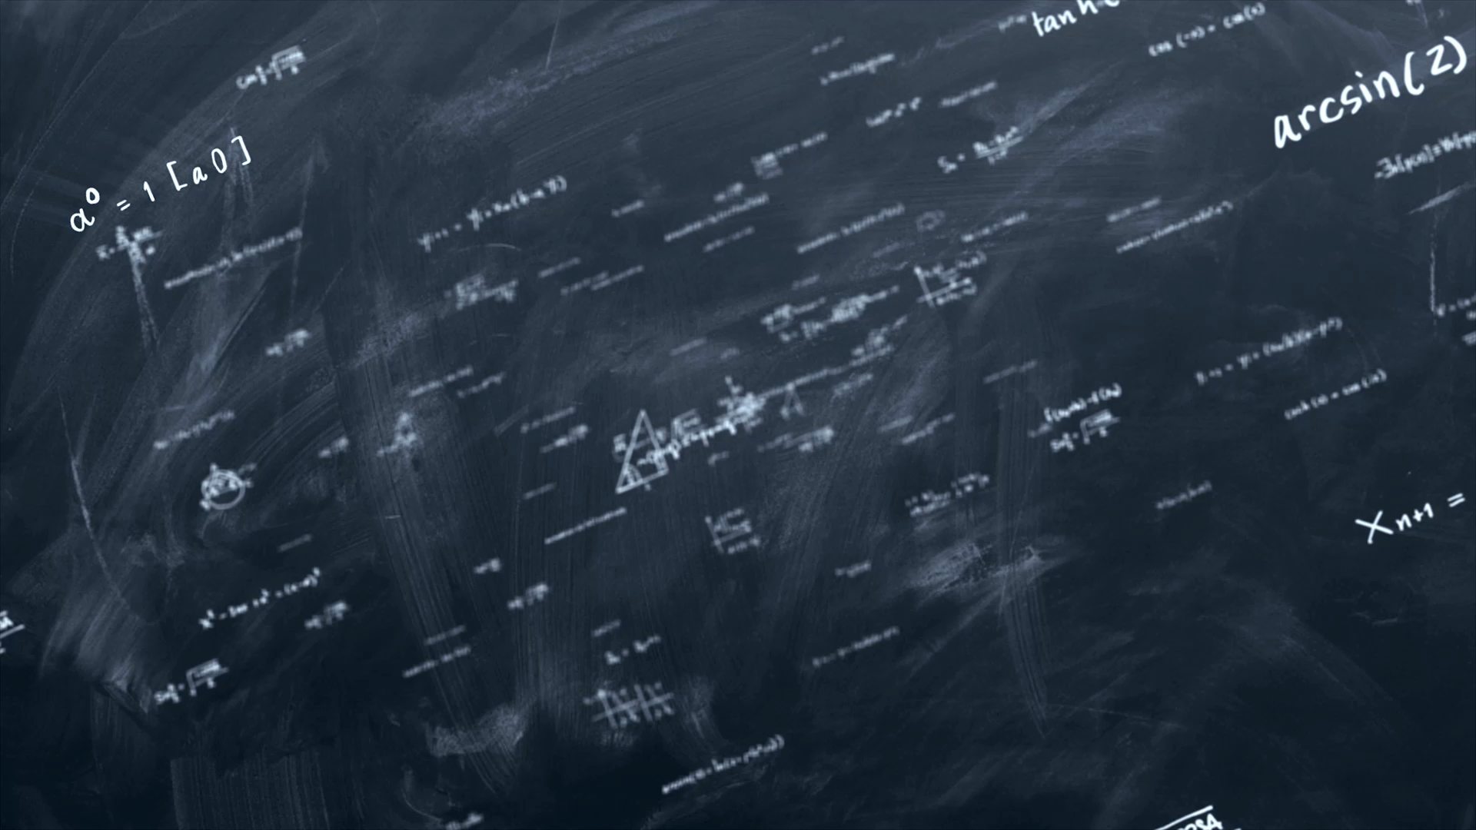
N5 Physics
Quantity, Symbol, Unit, Unit Symbol
For each equation note the quantity highlighted, state its unit and unit symbol and whether it is a scalar or vector quantity. Up to 4 marks per question, keep your score. How many cards can you complete before making a mistake or forgetting one?

Slide 2

‘d’ as in v$=\frac{d}{t}$
distance
metre
m
scalar
/4

Slide 3

‘s’ as in v$=\frac{s}{t}$
displacement
metre
m
vector
/4

Slide 4

‘t’ as in $a=\frac{v−u}{t}$
Time for the change
second
s
scalar
/4

Slide 5

‘a’ as in $a=\frac{v−u}{t}$
Acceleration
metres per second squared
ms⁻² or m/s²
vector
/4

Slide 6

‘v’ as in $a=\frac{v−u}{t}$
Final velocity
metres per second
ms⁻¹ or m/s
vector
/4

Slide 7

‘u’ as in $a=\frac{v−u}{t}$
Initial/starting velocity
metres per second
ms⁻¹ or m/s
vector
/4

Slide 8

‘Δv’ as in $a=\frac{Δv}{t}$
Change in velocity
metres per second
ms⁻¹ or m/s
vector
/4

Slide 9

‘$\overline{v}$’ as in $s=\overline{v}t$
Average velocity
metres per second
ms⁻¹ or m/s
vector
/4

Slide 10

‘$\overline{v}$’ as in $d=\overline{v}t$
Average speed
metres per second
ms⁻¹ or m/s
scalar
/4

Slide 11
‘Δv’ as in $a=\frac{Δv}{t}$
Change in velocity
metres per second
ms⁻¹ or m/s
vector
/4

Slide 12

‘F’ as in $F=ma$
force
Newton
N
vector
/4

Slide 13

‘m’ as in $F=ma$
mass
kilogram
kg
scalar
/4

Slide 14

‘g’ as in $W=mg$
Acceleration due to gravity/ gravitational field strength
metres per second squared/ newtons per kilogram
ms⁻² or m/s² or N kg⁻¹
vector
/4

Slide 15

‘W’ as in $W=mg$
Weight or (Force of gravity)
Newton
N
Vector
Never use gravity alone in an exam
/4

Slide 16

‘E_{p}’ as in $E_{p}=mgh$
(gravitational) potential Energy
Joule
J (must look like a capital)
scalar
/4

Slide 17

‘h’ as in $E_{p}=mgh$
height
metre
m
scalar
/4

Slide 18

‘E_{k}’ as in $E_{k}=\frac{1}{2}mv^{2}$
Kinetic Energy
Joule
J (must look like a capital)
scalar
/4

Slide 19

‘v’ as in $E_{k}=\frac{1}{2}mv^{2}$
speed
metres per second
ms⁻¹ or m/s
scalar
/4

Slide 20

‘E_{w}’ or W as in $E_{w}=Fd$
Work done
Joule
J (must look like a capital)
scalar
/4

Slide 21

‘F’ as in $E_{w}=Fd$
force
Newton
N
vector
/4

Slide 22

‘Q’ as in $Q=It$
charge
coloumb
C
scalar
/4

Slide 23

‘V’ as in $V=IR$
voltage
volt
V
scalar
/4

Slide 24

‘I’ as in $V=IR$
current
ampere
A
scalar
/4

Slide 25

‘R’ as in $V=IR$
resistance
ohm
Ω
scalar
/4

Slide 26
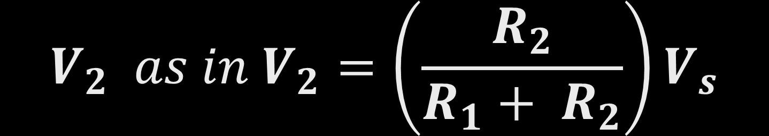
$$V_{2} as in V_{2}=\left(\frac{R_{2}}{R_{1}+ R_{2}}\right)V_{s}$$
Voltage across resistor 2
Volt
V
scalar
/4

Slide 27

$$R_{2} as in V_{2}=\left(\frac{R_{2}}{R_{1}+ R_{2}}\right)V_{s}$$
Resistance of resistor 2
ohm
Ω
scalar
/4

Slide 28

$$V_{s} as in V_{2}=\left(\frac{R_{2}}{R_{1}+ R_{2}}\right)V_{s}$$
Supply Voltage
Volt
V
scalar
/4

Slide 29

$R_{T} as in$ $\frac{1}{R_{T}}= \frac{1}{R_{1}}+ \frac{1}{R_{2}}$
Total Resistance in parallel
ohm
Ω
scalar
/4

Slide 30

‘V₁’ as in $\frac{V_{1}}{R_{1}}=\frac{V_{2}}{R_{2}}$
Voltage across resistor 1
Volt
V
scalar
/4

Slide 31

‘R_{T}’ as in $\frac{1}{R_{T}}=\frac{1}{R_{1}}+\frac{1}{R_{2}}+…$
Total resistance of resistors in parallel
ohm
Ω
scalar
/4

Slide 32

‘R_{T}’ as in $R_{T}=R_{1}+R_{2}+…$
Total resistance of resistors in series
ohm
Ω
scalar
/4

Slide 33

‘E’ as in $E=QV$
Energy
Joule
J (must look like a capital)
scalar
/4

Slide 34

‘Q’ as in $E=QV$
charge
coloumb
C
scalar
/4

Slide 35

‘P’ as in $P= \frac{E}{t}$
Power
Watt (yes Watt is the unit of power)
W
scalar
/4

Slide 36

‘P’ as in $P=IV$
power
Watt (yes Watt is the unit of power!)
W
scalar
/4

Slide 37

‘I’ as in $P=I^{2}R$
current
ampere
A
scalar
/4

Slide 38

‘V’ as in $P=\frac{V^{2}}{R}$
voltage
Volt
V
scalar
/4

Slide 39

‘E_{H}’ as in $E_{H}=cmT$
Heat Energy
Joule
J (must look like a capital)
scalar
/4

Slide 40

‘c’ as in${ E}_{H}=cmT$
Specific heat capacity
Joules per kilogram per degree Celsius or
Joules per kilogram per kelvin
J kg⁻¹ °C⁻¹ or J kg⁻¹ K⁻¹
scalar
/4

Slide 41

‘ ΔT’ as in${ E}_{H}=cmT$
Change in temperature
degree Celsius or Kelvin
°C or K
Scalar
NB It is a change of temperature a change of 1 K is the same as a change of 1 °C
/4

Slide 42

‘E_{H}’ as in $E_{H}=ml$
Heat energy required to change the state of a substance
Joule
J (must look like a capital)
scalar
/4

Slide 43

‘l’ as in $E_{H}=ml$
Specific latent heat
Joules per kilogram
Jkg⁻¹ or J/kg
scalar
/4

Slide 44

‘A’ as in p = $\frac{F}{A}$
area
square metre
m²
Scalar
It is incorrect to say metres square or metres squared!
/4

Slide 45

‘A’ as in p=$\frac{F}{A}$
area
Square metre
m²
scalar
/4

Slide 46

‘p’ as in p=$\frac{F}{A}$
pressure
Pascal or Newton per square metre
Pa
scalar
/4

Slide 47

‘p’ as in$p=\frac{F}{A}$
Pressure
Pascals
Pa or (Nm⁻²)
scalar
/4

Slide 48

p₁’ as in $p_{1}V_{1}=p_{2}V_{2}$
Original Pressure
Pascals
Pa or (Nm⁻²)
scalar
/4

Slide 49
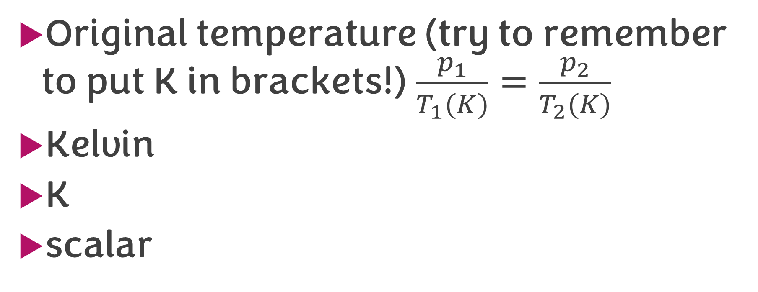

‘T₁’ as in $\frac{p_{1}}{T_{1}}=\frac{p_{2}}{T_{2}}$
Original temperature (try to remember to put K in brackets!) $\frac{p_{1}}{T_{1}(K)}=\frac{p_{2}}{T_{2}(K)}$
Kelvin
K
scalar
/4

Slide 50

‘T’ as in $\frac{pV}{T}=constant$
temperature
Kelvin
K
scalar
/4

Slide 51
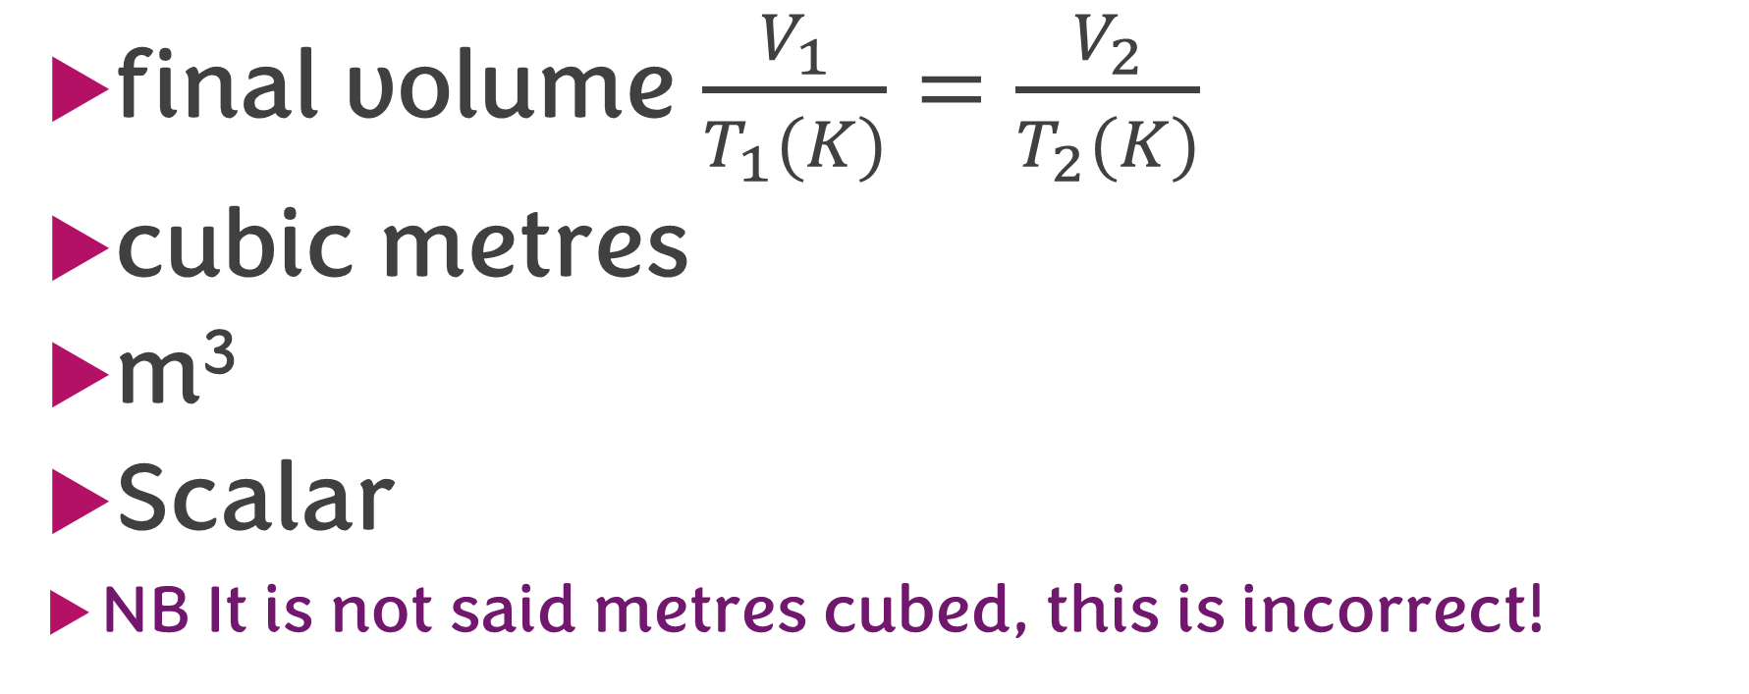
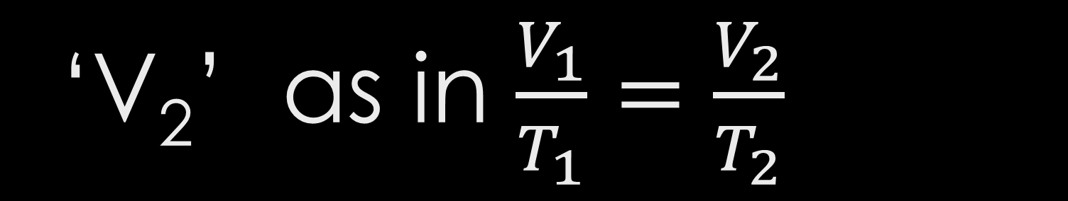
‘V₂’ as in $\frac{V_{1}}{T_{1}}=\frac{V_{2}}{T_{2}}$
final volume $\frac{V_{1}}{T_{1}(K)}=\frac{V_{2}}{T_{2}(K)}$
cubic metres
m³
Scalar
NB It is not said metres cubed, this is incorrect!
/4

Slide 52

‘f’ as in $f=\frac{N}{t}$
frequency
Hertz
Hz
scalar
/4

Slide 53

‘N’ as in $f=\frac{N}{t}$
Number of waves
No units
scalar
/3

Slide 54
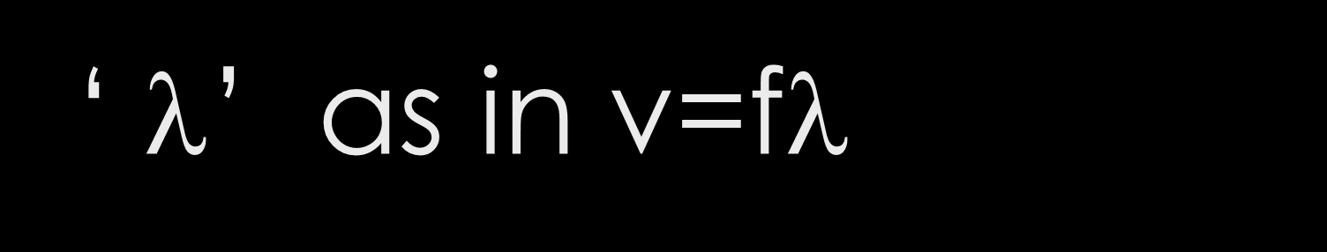
‘ $$’ as in v=f$$
Wavelength of the wave
metre
m
scalar
/4

Slide 55
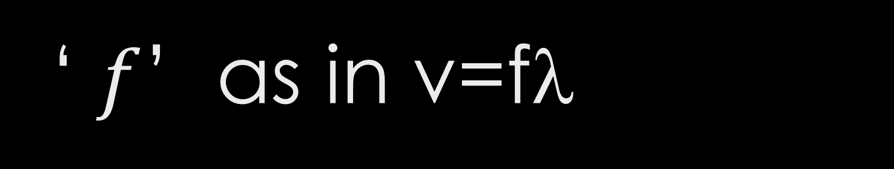
‘ $f$’ as in v=f$$
Frequency of the wave
Hertz
Hz
scalar
/4

Slide 56

‘ $v$’ as in v=f$$
Speed of the wave
metres per second
ms⁻¹ or m/s
scalar
/4

Slide 57

‘f’ as in $T=\frac{1}{f}$
frequency
Hertz
Hz
scalar
/4

Slide 58

‘T’ as in $T=\frac{1}{f}$
period
second
s
scalar
/4

Slide 59

‘N’ as in $A=\frac{N}{t}$
Number of disintegrations
No unit
/2

Slide 60

‘A’ as in $A=\frac{N}{t}$
Activity
Becquerels
Bq
scalar
/4

Slide 61

‘D’ as in $D=\frac{E}{m}$
Absorbed Dose
Gray
Gy (often mGy, μGy , usually no need to covert)
scalar
/4

Slide 62

‘E’ as in $D=\frac{E}{m}$
Energy
Joule
J (must look like a capital)
scalar
/4

Slide 63

‘m’ as in $D=\frac{E}{m}$
mass
kilogram
kg
scalar
/4

Slide 64

‘H’ as in $H=Dw_{r}$
Equivalent Dose
Sievert
Sv (often mSv, μSv , usually no need to covert)
scalar
/4

Slide 65

‘$\dot{H}$’ as in $\dot{H}=\frac{H}{t}$
Equivalent Dose rate
Sievert per hour or year or day etc
Svh⁻¹, Svy⁻¹ (often mSv, μSv , usually no need to covert)
scalar
/4

