Slide 1
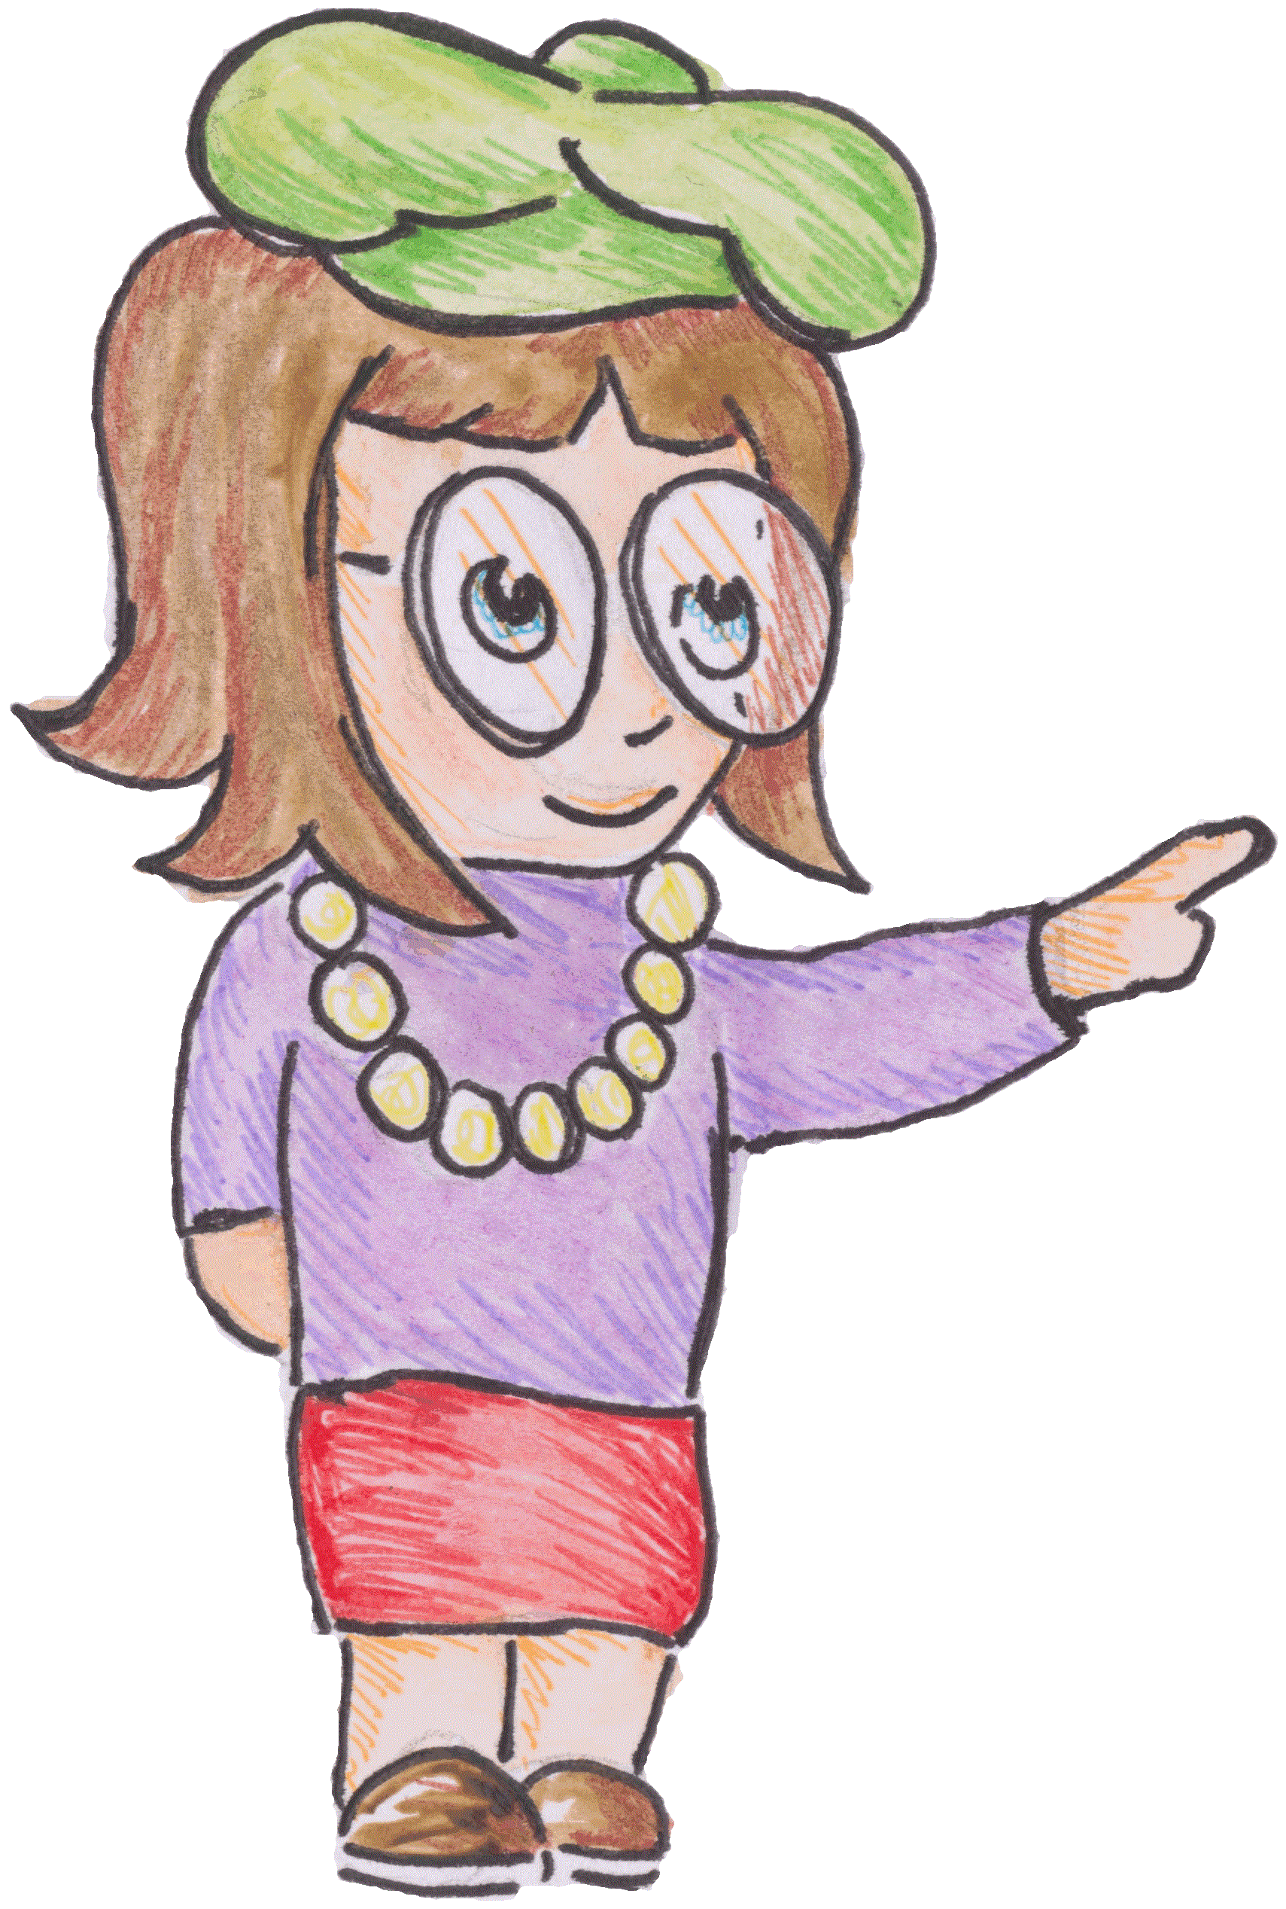
IOP Scotland Teacher Network
49th Stirling Physics Teachers’ Meeting
ESCAPE
the
CLASSROOM
Thurs 23rd May 2024
Notes:
Hi, if you’ve come here to think this is about retirement I think you’d better leave for another workshop quickly and I wont tell anyone, just please give good feedback.
This workshop is about using ERs as a interactive class activity. I first heard about those at the amazing European Science Teachers’ Science on Stage.

Slide 2
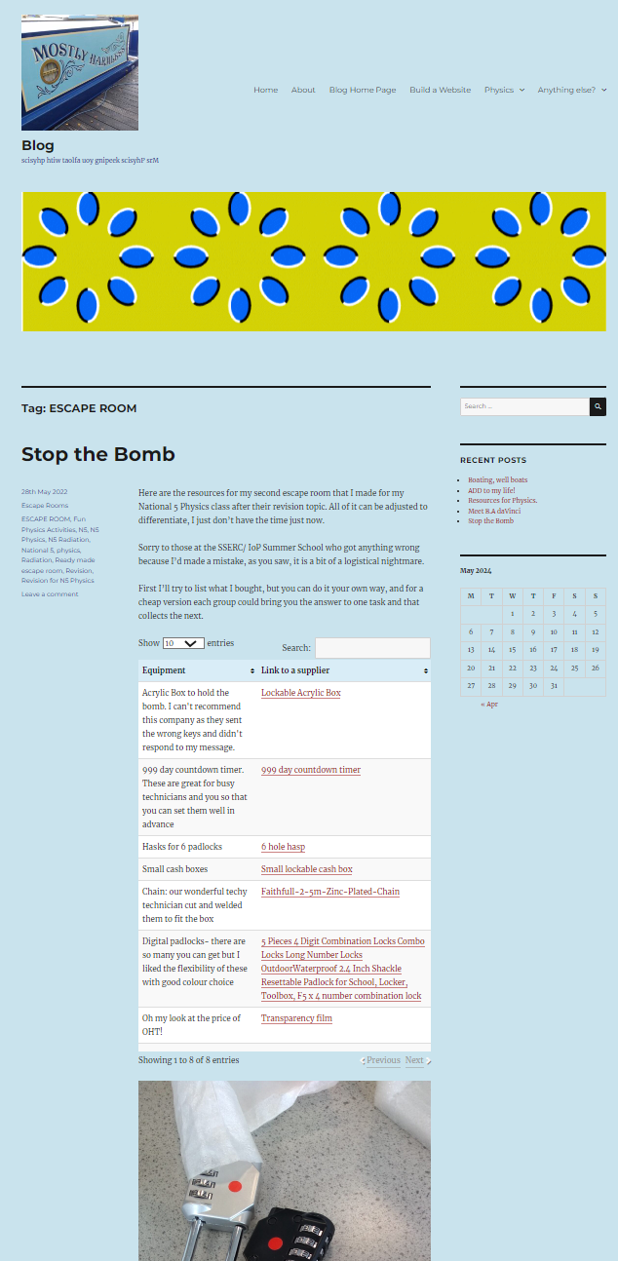
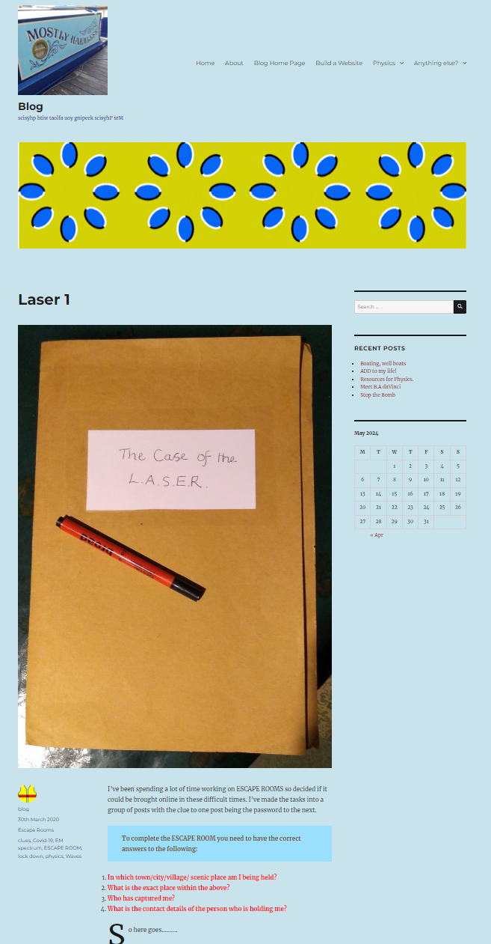
IOP Scotland Teacher Network
https://www.mrsphysics.co.uk/blog/laser-1/
https://www.mrsphysics.co.uk/blog/stop-the-bomb/
Notes:
This was my first one, too long and complicated but lots of good stuff in it, I’d love to adapt for simplicity. Part of my reasoning is to get students to read the small print and do those things they love to miss! I’ve made it online, but I can’t do it! You can get a certificate if you manage it

Slide 3
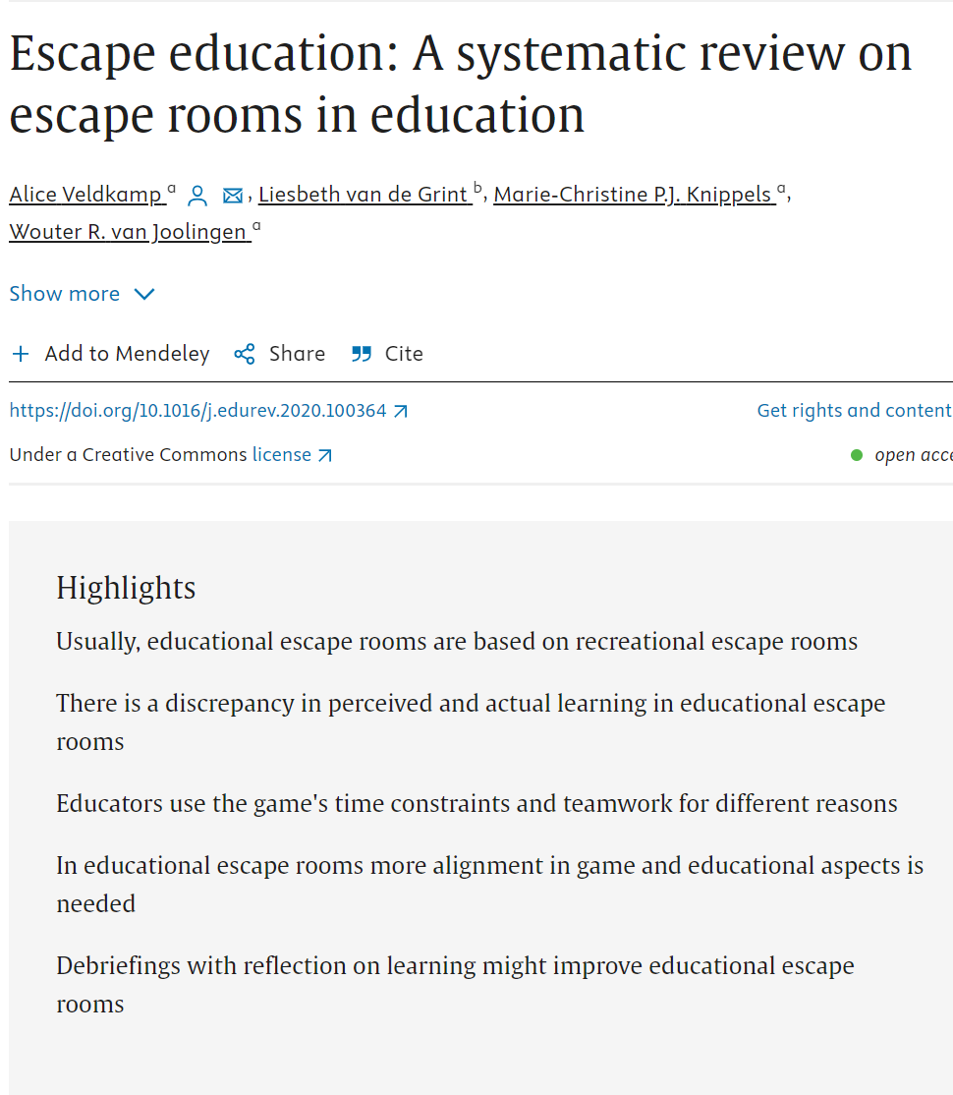
IOP Scotland Teacher Network
The research is coming
Mixed reviews… but my kids loved them. Stress relief?
Escape education: A systematic review on escape rooms in education - ScienceDirect
Notes:
I think these are pseudoscience and lots of looking at other peoples work without having done any of their own. I can see problems, but also plenty of engagement. David suggested it would make an excellent start to your N5 course- I agree.

Slide 4
IOP Scotland Teacher Network
Reasons
Teamwork, communication, PS, critical, analytical thinking, reasoning, performing under pressure
When
Standalone, intro, consolidation
Teachers
When to intervene, monitor, guide, hints, debrief- but don’t guide too early
What
At SoS suggested a story works best but not too busy like mine 1st attempt!
Notes:
It says what’s on the slide

Slide 5
IOP Scotland Teacher Network
Ideas
Sudukoa, rebuses, crosswords jigsaws- but we’ve got Science so:
Weighing
Vectors
Refraction
pH tests (ooh chemistry)
Circuits
problems,
Cryptograms
Radioactive decay (theory!)
Mirrors, UV beads,
Projectiles, odd one out,
Practice problems, perfect answers

Slide 6
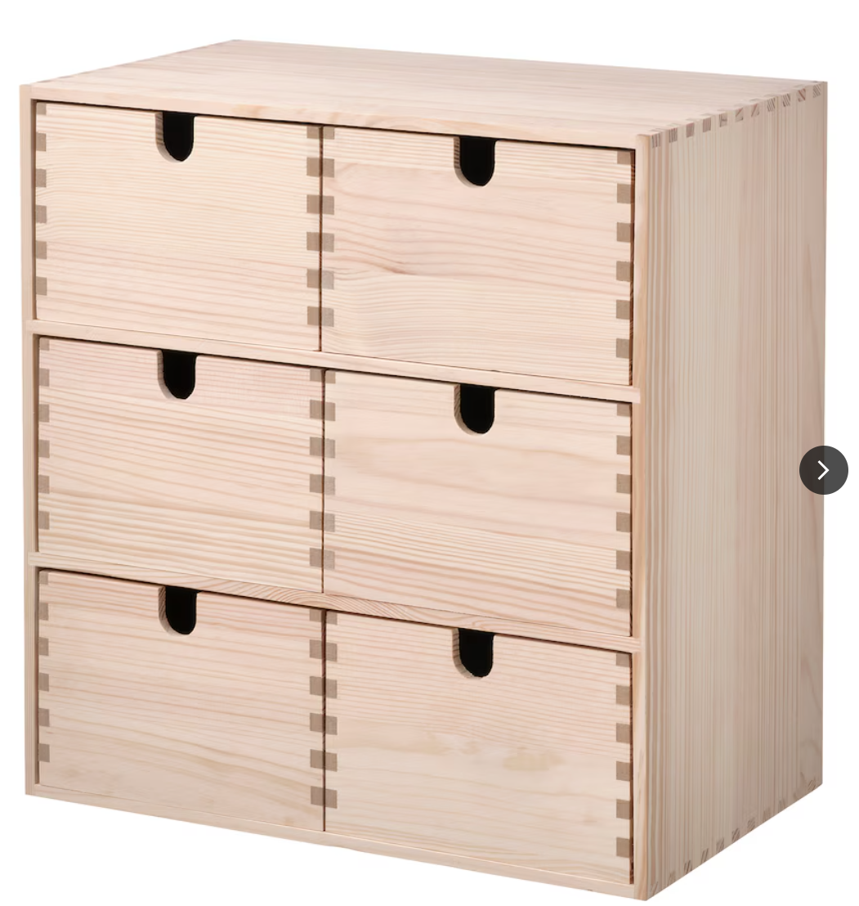
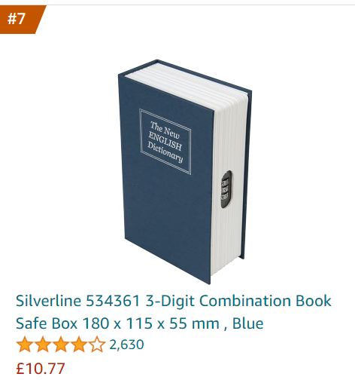
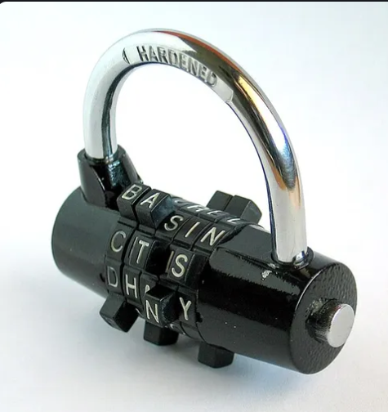
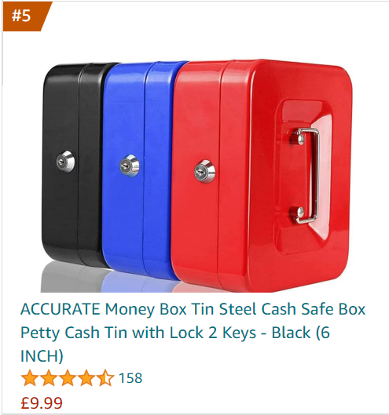
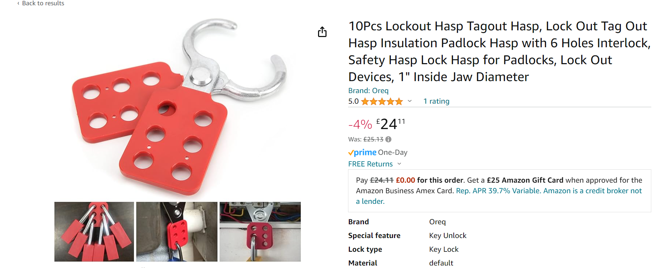
IOP Scotland Teacher Network
Notes:
Expensive but worth it. It might be something a local company of family run Parent Teachers association might sponsor, but I’d get it for Physics or at least Science!!

Slide 7
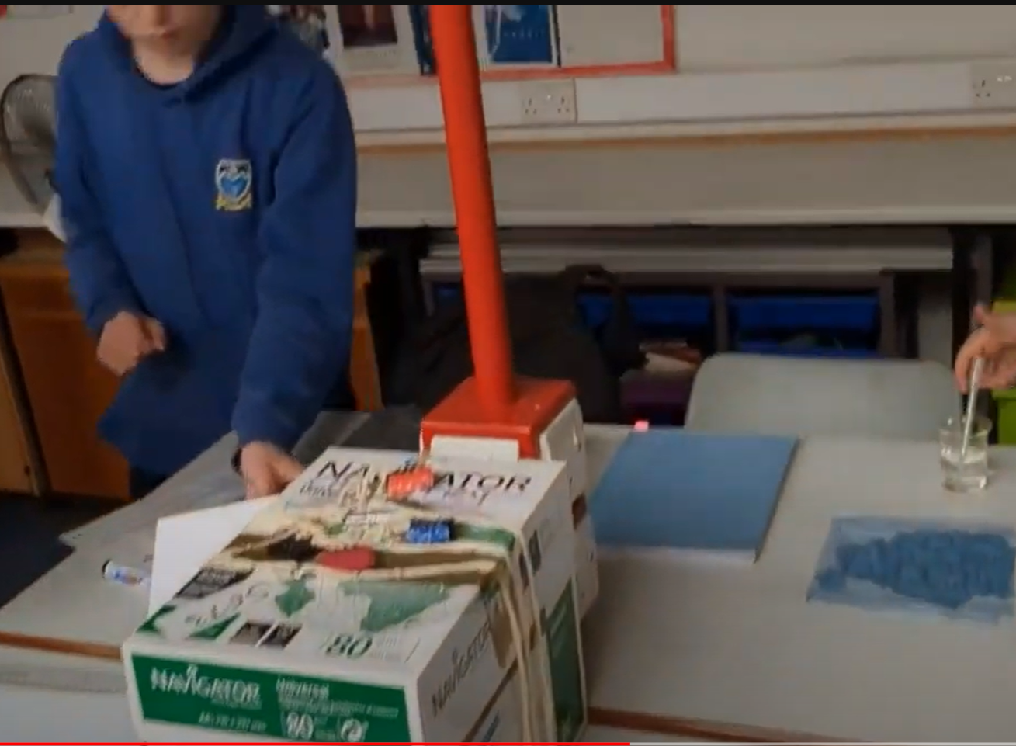
IOP Scotland Teacher Network
Monifieth High School
https://www.youtube.com/watch?v=Vr4Ftrrq8oA
(you can do a great job on a budget too)
Notes:
Mr Rajcoumer did his own after attending a workshop. I think you’ll agree it is brill and much cheaper than mine version.

Slide 8
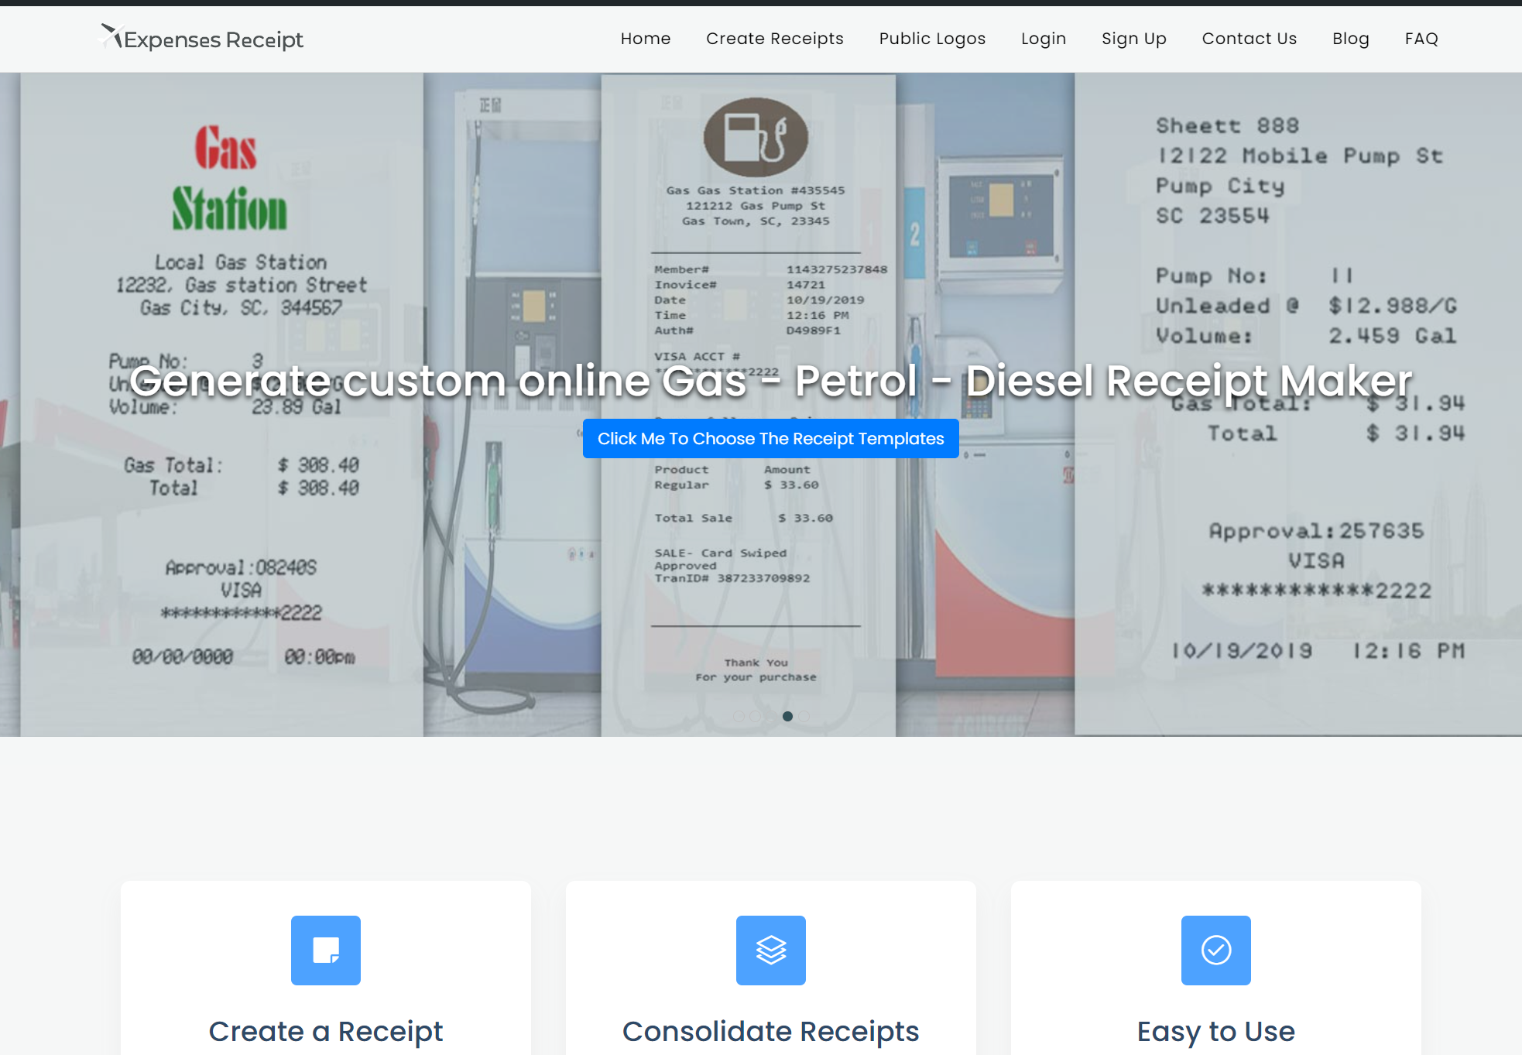
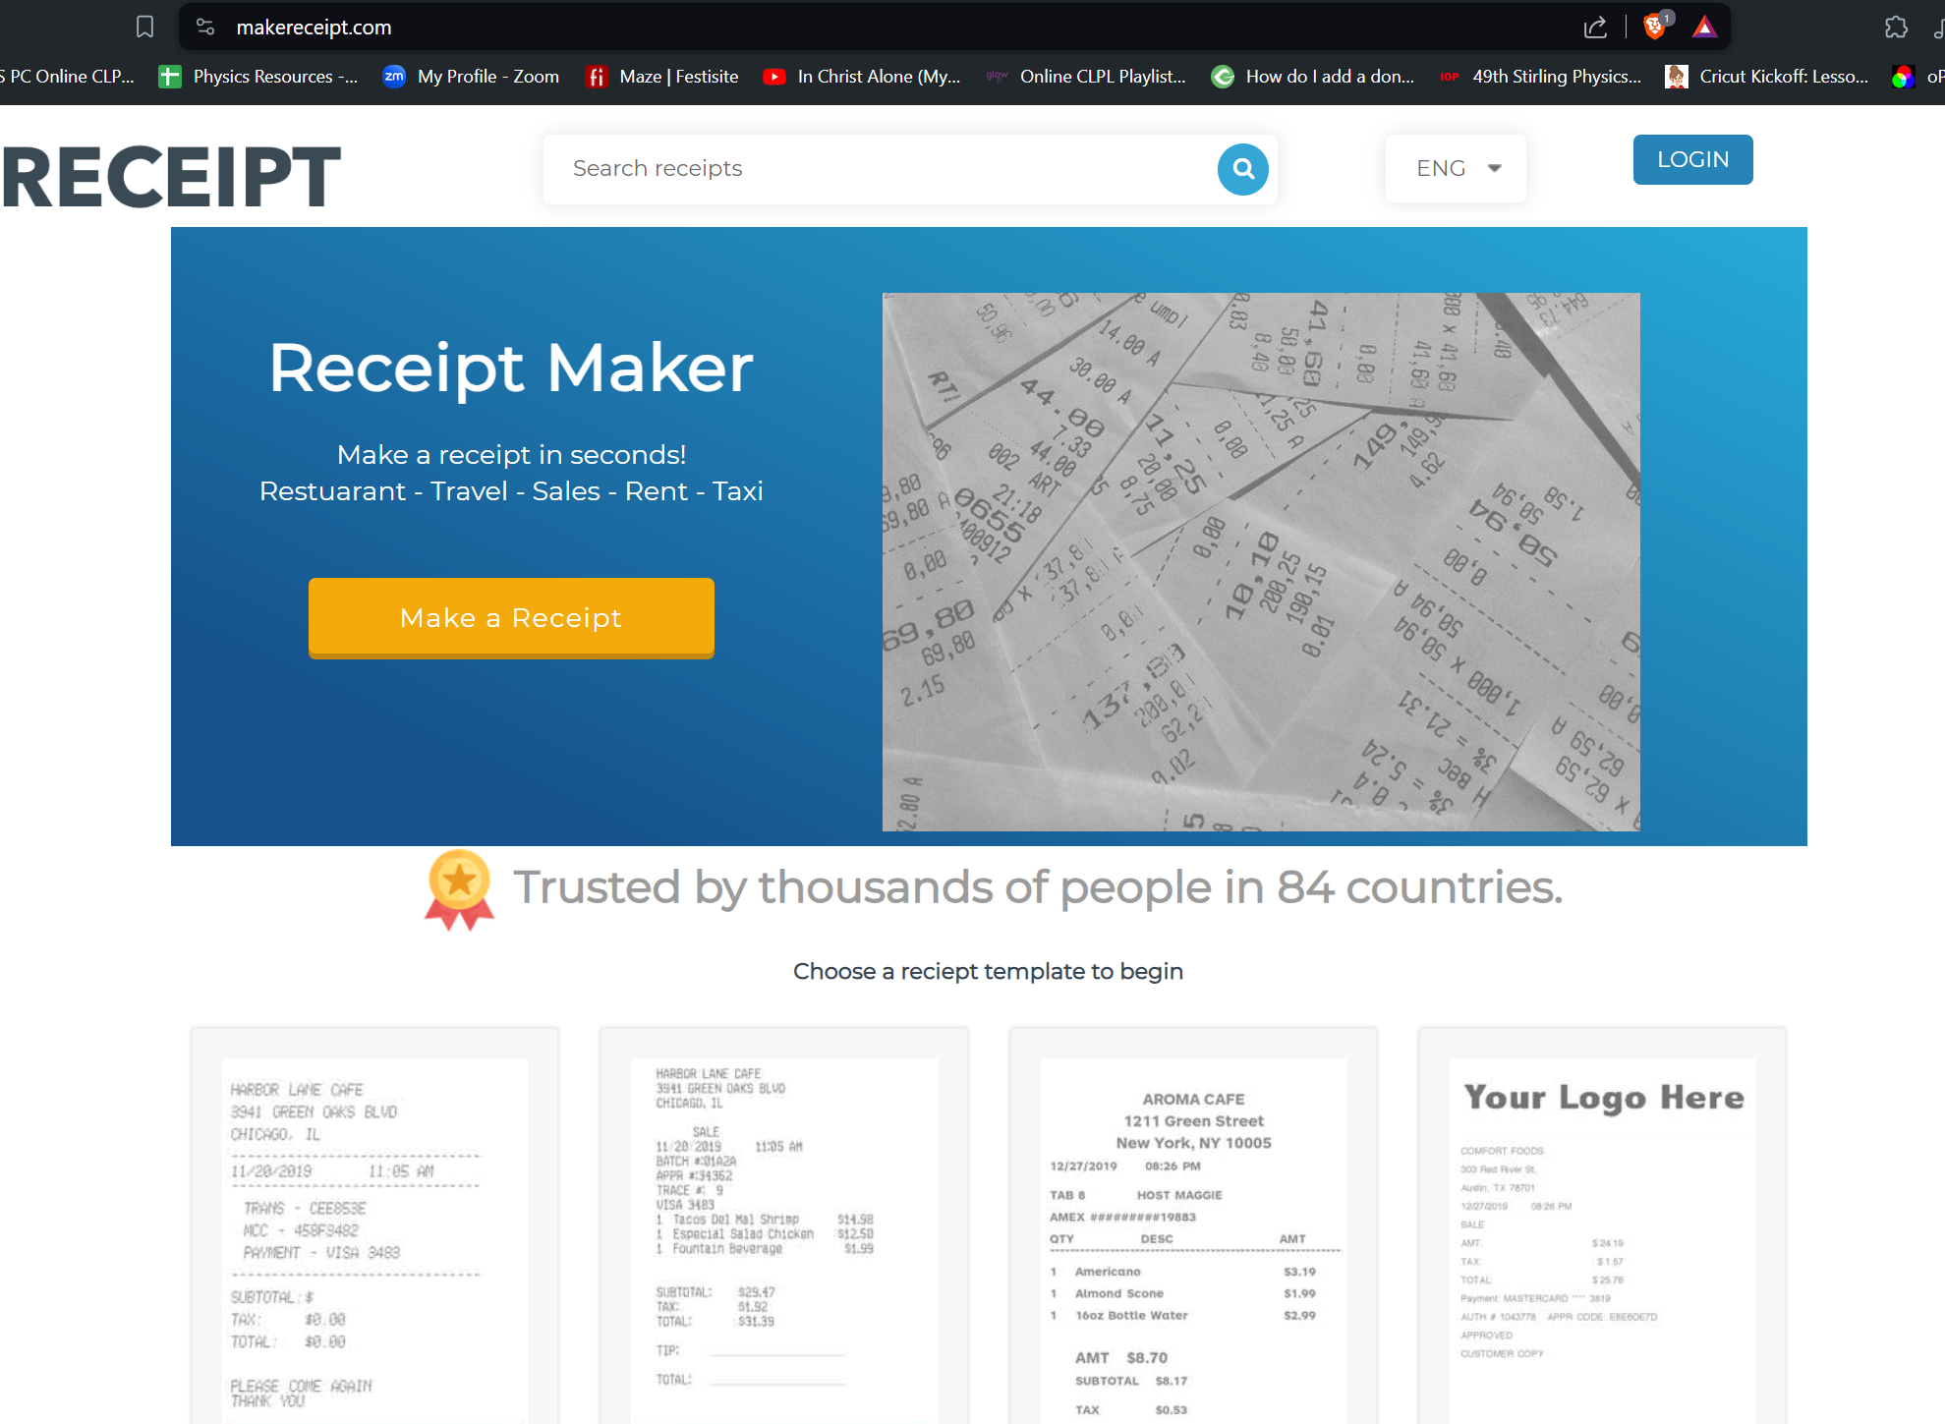
IOP Scotland Teacher Network
https://www.makereceipt.com/
https://expensesreceipt.com/index.html
Notes:
Go show your creativity

Slide 9
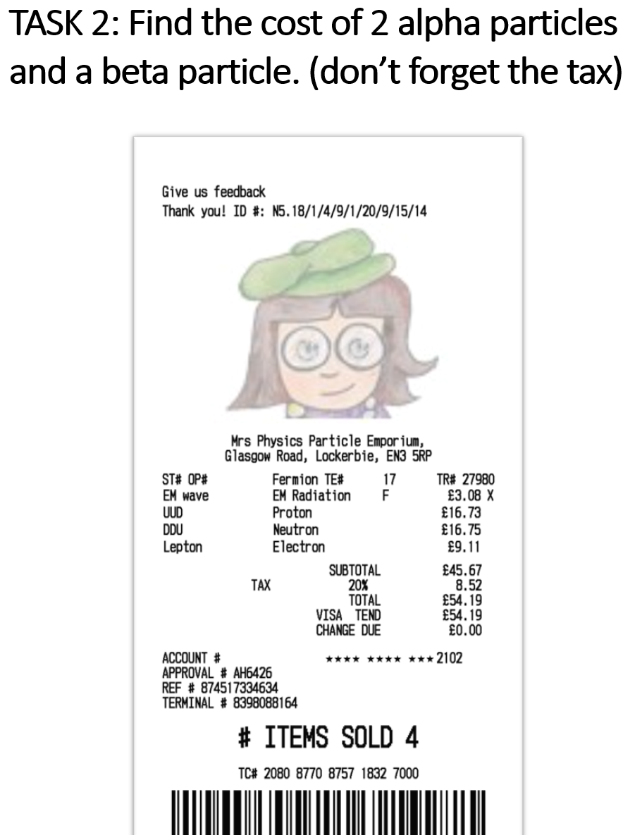
Differentiation or Pockal it!
Find the cost of 2 alpha particles and a beta particle
(ignore the tax)
Find the cost of 2 alpha particles and a beta particle
(don’t tell them about the tax)

Slide 10
copycoder
https://www.copycoder.com/
A great idea for checking on perfect answers to definitions.
Selecting the correct ones and doing a sum results in the answer to a lock

Slide 11
Decoder / Cipher
Easiest way is to change font!

Slide 12
Check your bearrings
Can students find bearrings
A great way to give practice to N5 students about bearrings!
Where do you end up.
Add numbers underneath for a clue answer

Slide 13
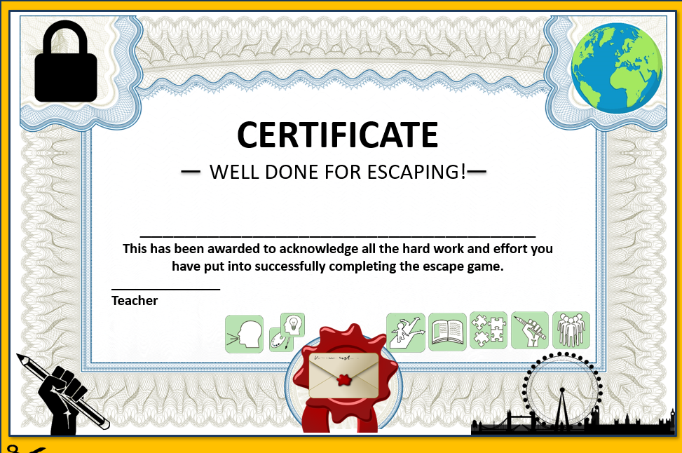
GO & SHOW YOUR CREATIVITY-EITHER
Try and make some puzzles
Try the puzzles I’ve made
Or do the Radiation ER

