Slide 1
TRANSPORT UNIT
FORCES/dyanmics
LOCKERBIE ACADEMY
S1-S3 Road Safety & PHYSICS

Slide 2
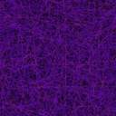
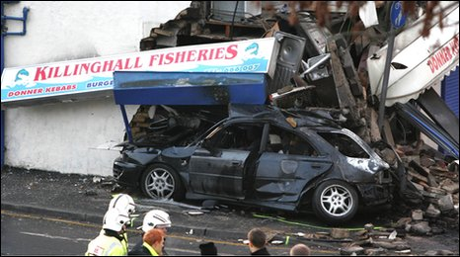
BACKGROUND
bbc news background
For an everyday activity, travelling by road is probably the riskiest thing many of us do on a regular basis.
On average, some seven people are killed every day on the roads in Great Britain. Hundreds more are injured, many of them seriously, often with life changing consequences.
In the past 10 years, the death toll has amounted to 32,298. As such road crashes are the largest single cause of accidental death for people aged between 5 and 35 years.

Slide 3
MINDMAP OF ROAD TRANSPORT- FORCES
Unbalanced
Force
cause acc^{n}
Hookes Law
Balanced versus
unbalanced
The Physics
of
Car Crashes
Changing
Friction
measuring
FORCES?
Friction
FORCES
Types of
FORCES
Contact v
Non-contact
What are
FORCES?
WEIGHT
Thrust
Mass v
Weight
The Effects

Slide 4
WHAT WE WILL BE COVERING
WHAT IS A FORCE?
Forces around us
EFFECTS OF A FORCE?
Contact versus non contact forces
MEASURING FORCES
Balanced or Unbalanced
The Effect of Forces investigation
Frictions investigation
Frictions investigation part 2

Slide 5
Unit plan- Continued
Forces and speed
forces, including
  weight, friction, upthrust,
acceleration
Newton’s Laws of Motion
& momentum if you can handle it!
The Effect of Forces investigation
Frictions investigation
Frictions investigation part 2
Recap

Slide 6
WORDBANK
S1 Physics Transport
Copy the following words into your jotter and literacy logs
Back to mind map

Slide 7



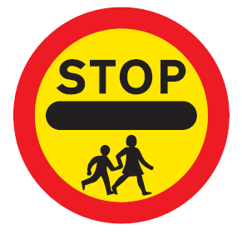


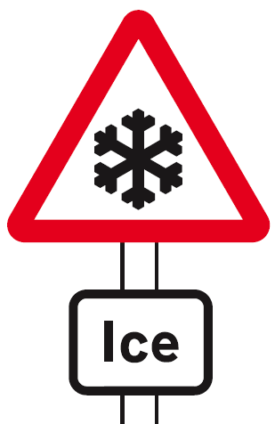
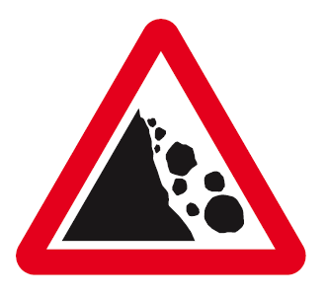

LOCKERBIE ACADEMY TRANSPORT UNIT
Which of these signs are about Forces?
Notes:
7
All of these road signs relate to Physics in some way, whether mention of speed, force, acceleration or other physics terms. We are going to use the topic of road safety to teach you about MECHANICS. DYNAMICS and KINEMATICS (there are some big words for you to find out about)
We will use the upside down car, which we made up as our logo for this topic. It is meant to represent no road accidents here as we know about the Physics behind driving and we should know how to be safe.

Slide 8
WHAT IS A FORCE?

Slide 9
ASK A STUDENT!
WHAT IS A FORCE?
Think
Pair
Share
Timer- Dr WHO

Slide 10
WHAT YOU THOUGHT

Slide 11
Forces
A FORCE is a PUSH or a PULL.
Forces can’t be seen, but the effect of a force can be seen.
They are measured in newton – N
They always act in a certain direction
A newtonbalance , spring balance or forcemeter is used to measure forces.

Slide 12
ASK A STUDENT!
NAME SOME FORCE WORDS?
Think
Pair
Share
Timer- Countdown

Slide 13
WHAT YOU THOUGHT

Slide 14
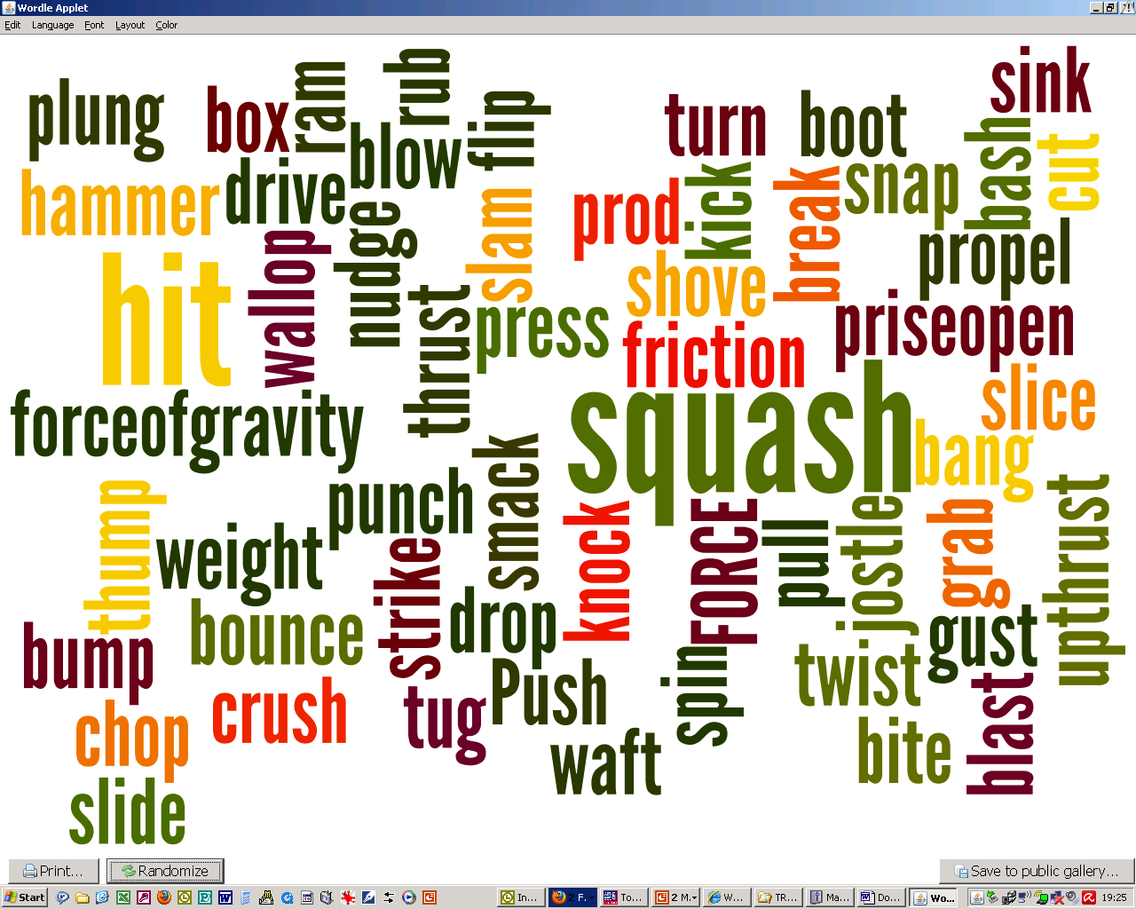
e

Slide 15
EFFECTS OF A FORCE?

Slide 16
TASK
CAREFULLY, DO NOT DESTROY THE OBJECTS
Take one of the objects from the tray and apply different FORCES to it.
List the force word that you would use to explain the force.
Record the effect on the object.
Object | Force | Effect
timer- the avengers

Slide 17
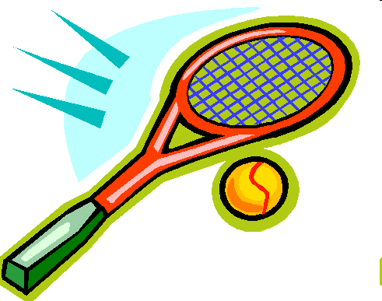
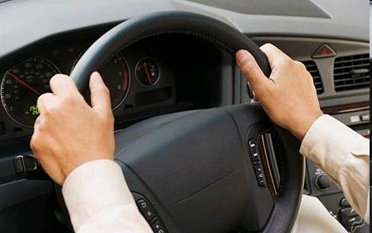
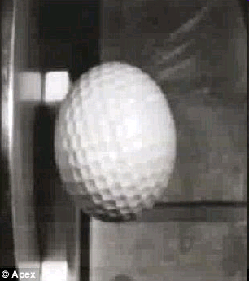
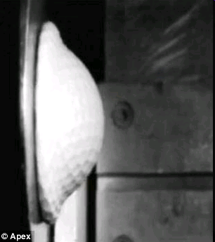
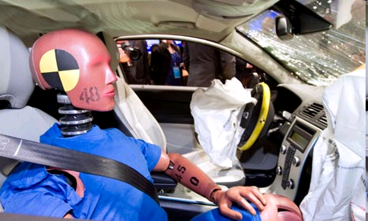
BEWARE
It seems amazing but you cannot see Forces. You can only see their effects.
Notes:
17
http://www.dailymail.co.uk/sciencetech/article-1284051/Incredible-slow-motion-picture-golf-ball-flattens-hits-steel-plate-150mph.html
t looks like a rubber ball that has been squashed after being flung at a wall.
But these images actually show what happens during a high speed impact - to a golf ball. The slow motion close-up of the smash reveals the incredible forces at play when a golf ball is fired at a piece of steel at 150mph. Internet picture of a golf ball hitting a piece of steel at 150mph in slow motion The video stills show what happens when a golf ball slams into a steel plate at high speed The clip reveals the unbelievable distortion it undergoes and its flexibility - even under the extreme stress of going from 150mph to zero in a split second.
The whole ball is flattened like a pancake against the steel before bouncing off and instantly reforming into its original shape as the energy from the impact is transferred across the ball to the opposite end in a wave.

Slide 18
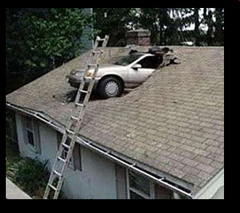
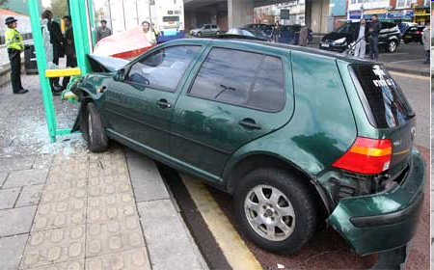
Forces
Forces change an object’s
  speed,
  shape,
  direction of movement.
Squash that golf ball

Slide 19
Write down some FORCES that act on a car when driving or in a car crash.

Slide 20
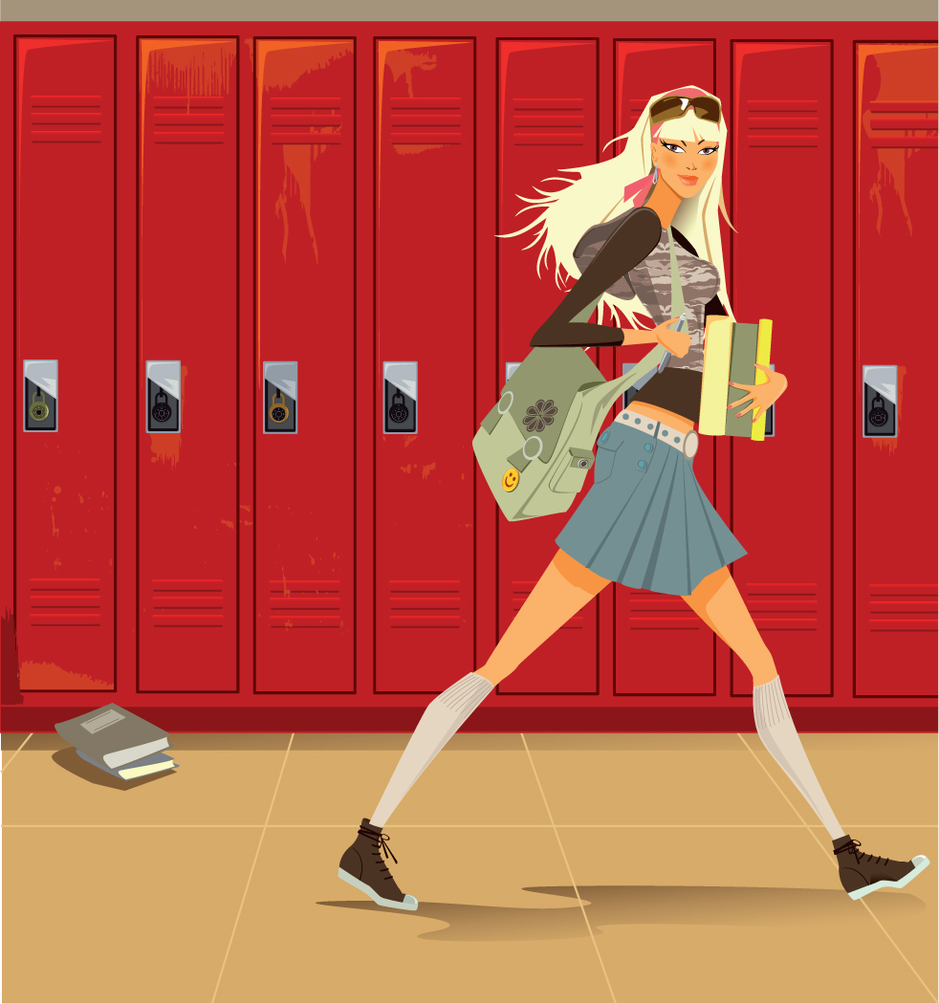
GO ON A FORCE WALK WITH YOUR TEACHER
TAKE YOUR TEACHER ON A FORCE WALK!

Slide 21
Forces
Forces change an object’s
  speed,
  shape,
  direction of movement.
All of these are seen during a car crash

Slide 22
ASK A STUDENT!
LIST SOME FORCES and NAME THE EFFECT?
Think
Pair
Share
Timer- Hawaii-5-0

Slide 23
Examples of forces
Weight, friction, upthrust

Slide 24
We can divide forces into 2 groups
Think
Pair
Share
CONTACT FORCES
NON CONTACT FORCES

Slide 25
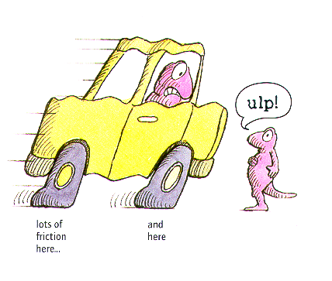
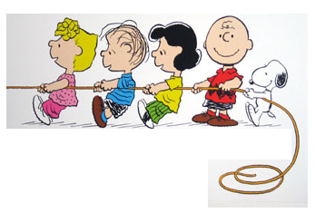
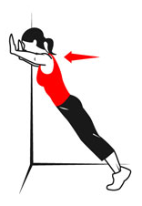
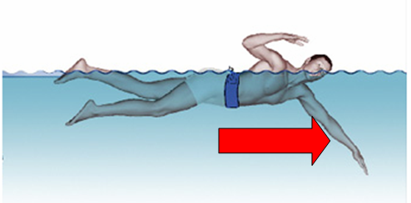
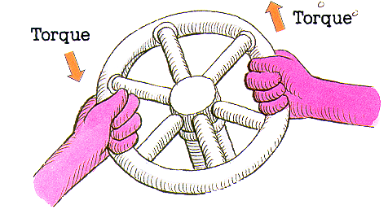
Contact Forces
Friction
Tension (Pull)
Air Resistance
Applied Force (Push)
Spring Force (Twist)
Water resistance

Slide 26
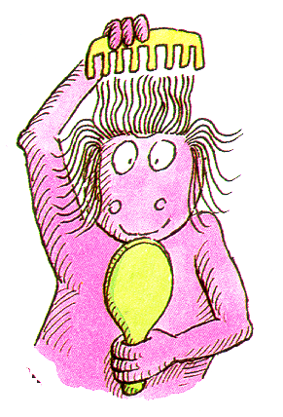

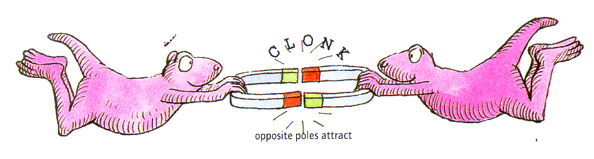
Non Contact Forces
Weight
Static Electricity
Magnetic force

Slide 27
What type of force can you think of?
Non- Contact Forces
Contact Forces
Force of Gravity (WEIGHT)
Magnetic Force
Electrical Force
Friction
Tension (Pull)
Air Resistance
Applied Force (Push)
Spring Force (Twist)
http://www.physicsclassroom.com/class/newtlaws/u2l2b.cfm

Slide 28
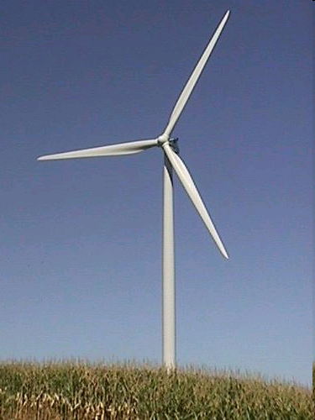
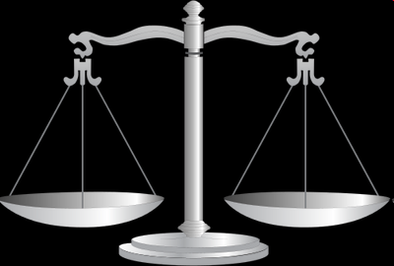
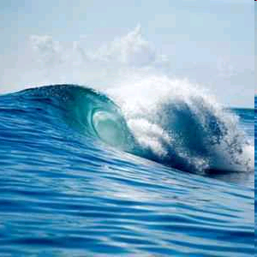
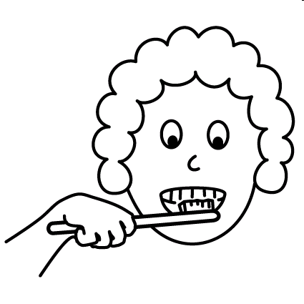
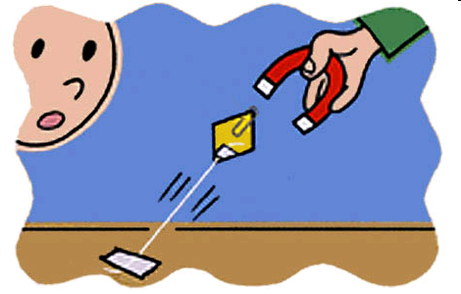
WHAT CAUSES THESE FORCES?

Slide 29
Activity: Write out which force fits with each picture
Use the white board and write the force that acts on the picture and state whether they are CONTACT or NON CONTACT
Weight Air resistance Pull
Upthrust Friction
Water resistance Push

Slide 30
Weight

Slide 31
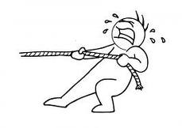
PULL

Slide 32
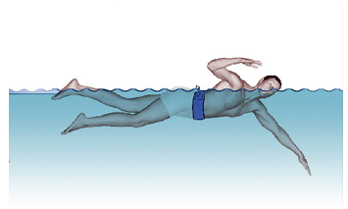
PULL
Water Resistance

Slide 33
Air
Resistance

Slide 34
FRICTION

Slide 35
Upthrust

Slide 36
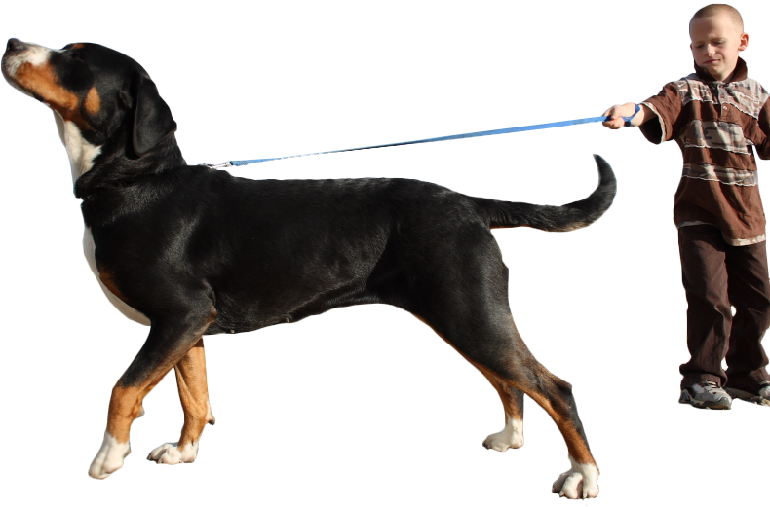

Slide 37
FORCE
Specs!

Slide 38
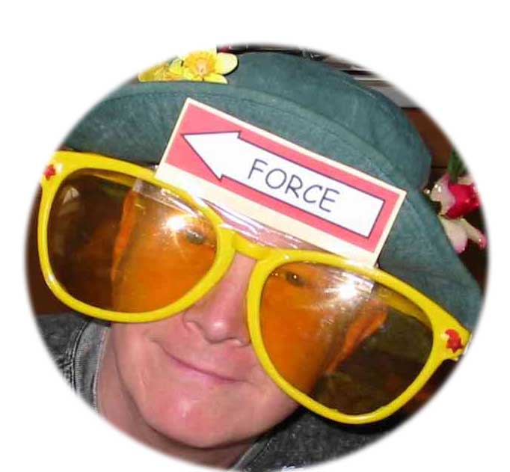
FORCES SPECS
View forces through the special Forces Specs!

Slide 39
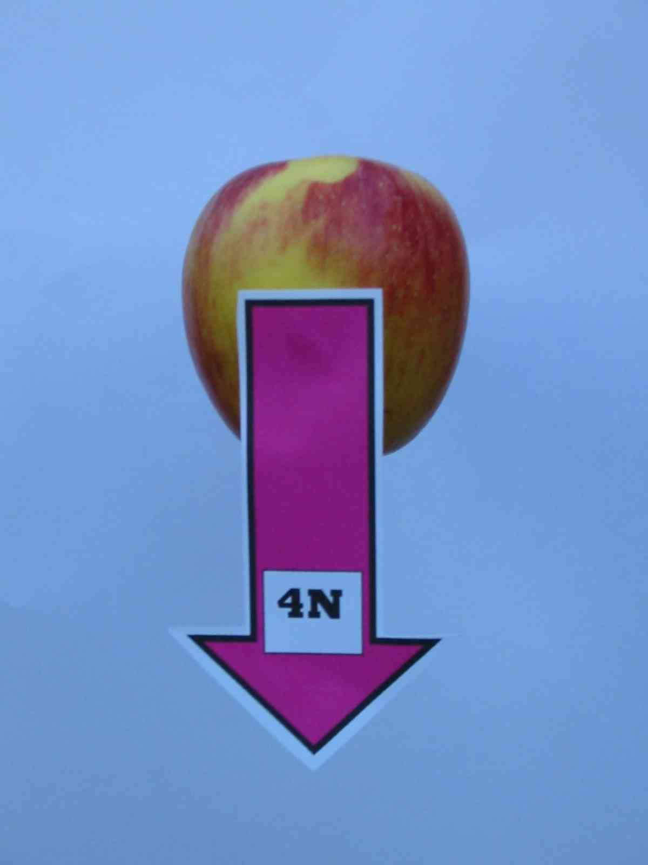
If forces came ready-labelled science might be easier.
1.1

Slide 40
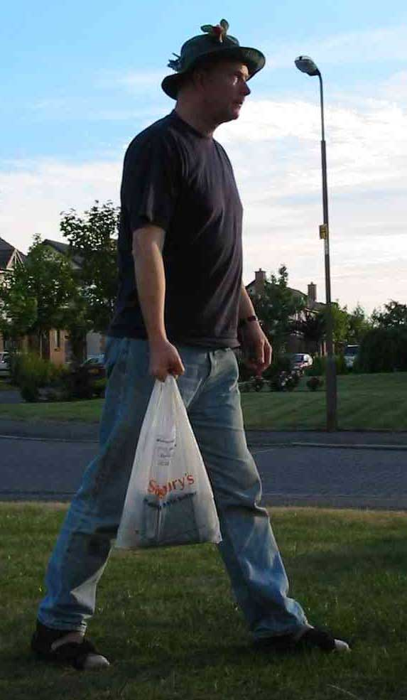
A shopper carries his shopping home.
How does this situation appear through forces spectacles?
1.2

Slide 41
There are forces acting everywhere. Here are just a few of them.
1.3

Slide 42
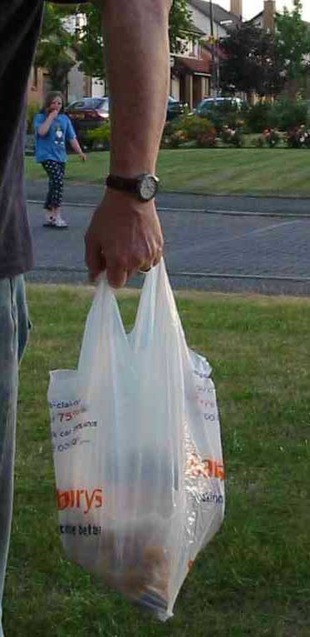
Let’s consider the forces acting on the hand.
Can you identify the forces which act on the hand?
1.4

Slide 43
A support force from the arm muscles acts on the hand
A force (the weight of the bag) acts on the hand
1.5

Slide 44
Now consider the forces acting on the shopping.
1.6

Slide 45
The simplest model shows the shopping as a single mass.
1.7
The stretched plastic bag supports the shopping with an upward force.
The Force of Gravity acts on the shopping with a downward force.

Slide 46
Measuring FORCES?

Slide 47
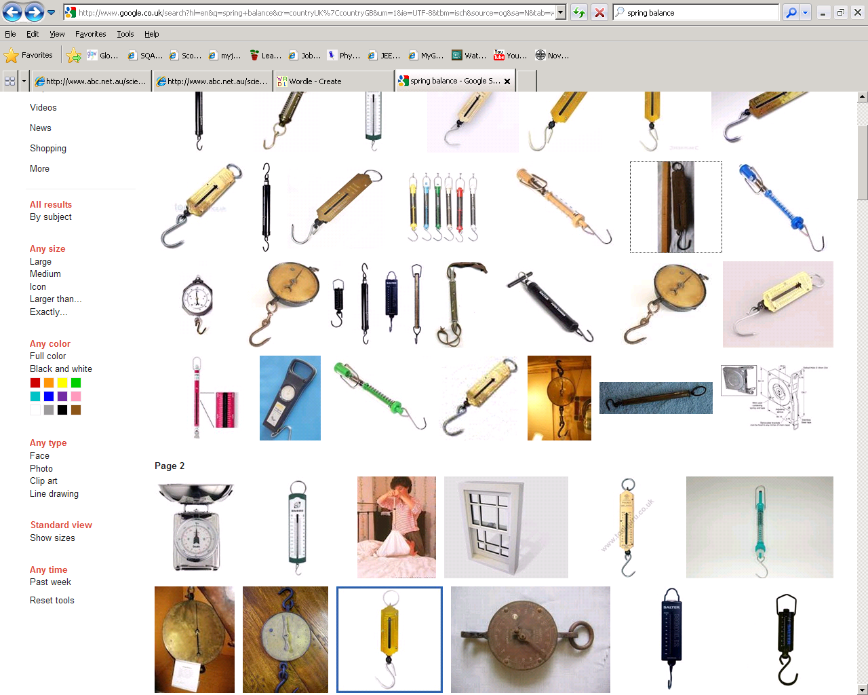
Measuring forces
We can use one of the effects of a force to measure forces.
This is called HOOKES LAW

Slide 48
Hookes law

Slide 49
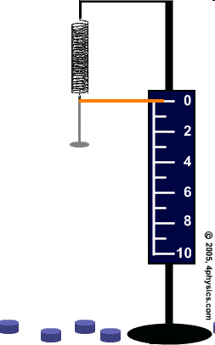
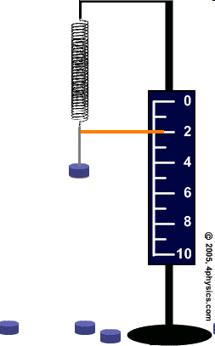
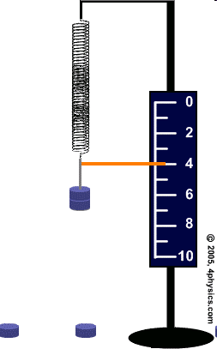

Slide 50
Procedure
Hang a spring from a clamp stand make sure it cannot fly off.
Clamp the metre stick vertically in the clamp, alongside the spring.
Record the metre rule reading level with the bottom of the spring. The number of masses hanging from the spring is 0 and the extension of the spring is 0 cm.
Hang a mass hanger from the bottom of the spring. Record the new metrestick reading, the number of masses (1) and the extension of the spring.

Slide 51
Procedure
Repeat this for 5 masses
Plot the number of masses on the horizontal axis, since it is the input (or independent) variable. The extension of the spring is the output (or dependent) variable and you should plot it on the vertical axis.

Slide 52
extension
Repeat the experiment with sweet laces and see if the experiment gives the same results.
DO NOT EAT THE LACES!
AVOID SUGAR COATED LACES

Slide 53
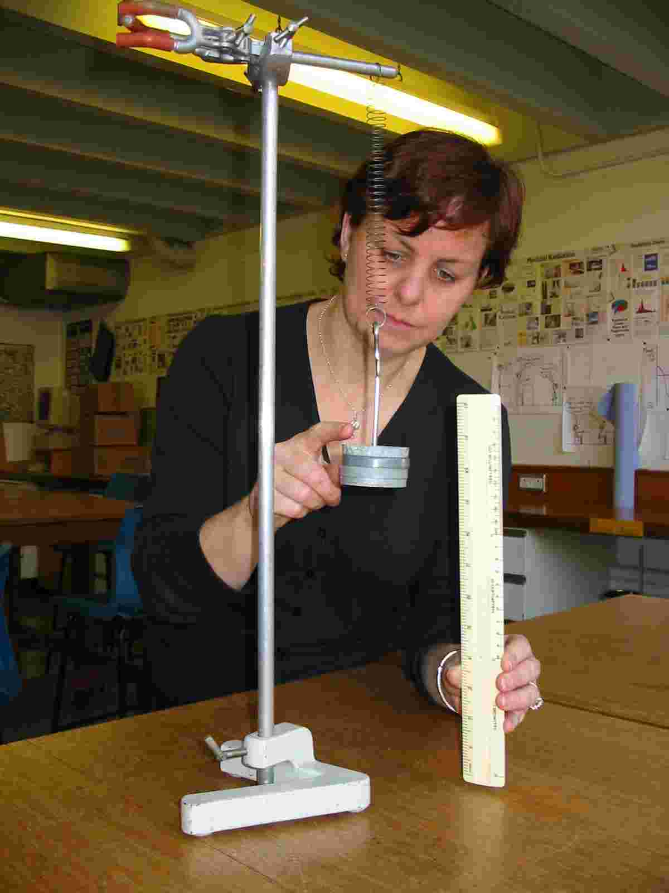

The spring exerts a force upwards on the mass.
The Force of gravity exerts a force downwards on the mass.
1.9

Slide 54
Homework: Spring experiment
Weight | Extension (cm)
(N) | Spring 1 | Spring 2
0 | 0.0 | 0.0
1 | 2.4 | 1.7
2 | 4.8 | 3.4
3 | 7.2 | 5.1
4 | 9.6 | 6.8
5 | 12.0 | 8.5
6 | 14.4 | 10.2
7 | 16.8 | 11.9
8 | 19.2 | 13.6
9 | 21.6 | 15.3
10 | 24.0 | 17.0
This data is in the homework sheets. Draw a graph using the data in this table so you will be able to compare the two springs.

Slide 56
HOOKE’S LAW CONCLUSION
Double the force and you double the stretch.
Hmm- we can use this!

Slide 58
Chart wizard
Title
Key:
object 1
object 2
object 3

Slide 59
OK, let’s consider the forces acting on the mass. Look through forces spectacles and simplify this situation.

Slide 60
model
The two forces act on the mass. They have a cancelling effect and the result is a mass ‘in equilibrium’.
This is as simple as the modelling process can get.
reality
1.10

Slide 61
Spring balance / newton meter

Slide 62
The instrument for measuring forces is the Newton Balance, spring balance or Forcemeter.
Forces are measured in units of NEWTONS (N)

Slide 63
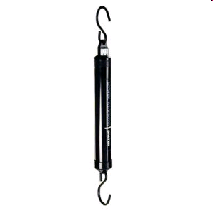
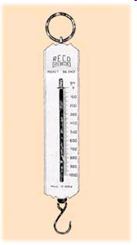
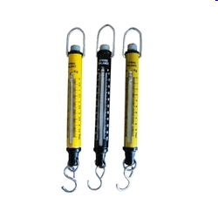
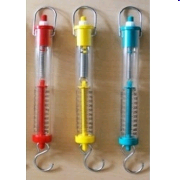
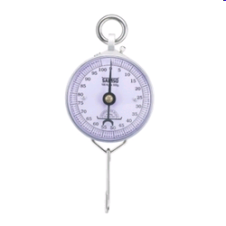
Newton Balance, spring balance or Forcemeter

Slide 64
Measuring WEIGHT/ FORCE

Slide 65
WEIGHING really is FINDING YOUR WEIGHT!
When we “weigh” something, either hanging an object from the scales or placing the object on a scale, we are actually measuring the force of gravity on that object. The object is pulled down by the Earth and we measure that force. HOWEVER we record the answer in units of MASS.
The following experiment shows you how!

Slide 66
Weight and mass – what’s the link?
In this experiment, you’ll find out the link between weight and mass
Copy the table below to record your readings.
Hang different masses from newton balances.
Record the weight from the newton balance.
Mass hung on newton balance (kg) | Weight on newton balance (N)
0.1
0.2
0.3
0.4
0.5
0.6

Slide 67
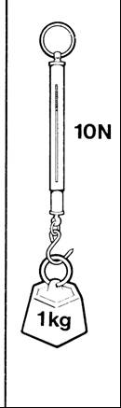
Weight is a force which is caused by the pull of gravity.
You have found that on Earth the pull of gravity on a kilogram is about 10 newtons.
The weight of 1kg is approx. 10 N or 9.8 N
The ratio of weight to mass is given the symbol g
  g = 10 N/kg or 9.8 Nkg⁻¹
  g is called “gravitational field strength” it is your weight per unit mass.

Slide 68
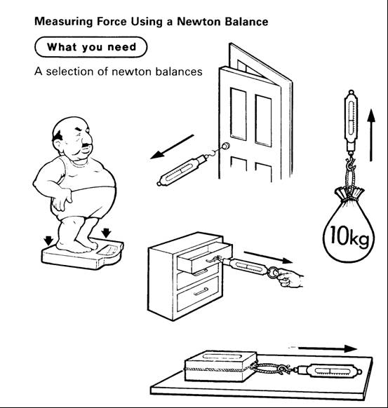
Measuring forces-- Using a NEWTON BALANCE to measure Forces.
Find the force to lift your bag
Find the force to open a door /drawer / zip /
Find the force to pull the toy cars.
Record your results in a table

Slide 69
MEASURING FORCES –use these or find some of your own
TASK | Predicted force | Measured force
 | (N) | (N)
Lifting a school bag
Opening a door
Pulling up a zip
Opening a cupboard
starting a planned moving
pulling an empty shoe

Slide 70
Estimating the size of FORCES?

Slide 71
Estimating forces
0.1 N
2 N
20 N
650 N
1800 N
10,000 N
1,500,000 N
200,000,000 N
Match these different situations to the most likely force.
Write these nos. in your jotter
Choose from:
e.g PULLING A TRAIN

Slide 72
0.1 N , 2 N , 20 N, 650 N, 1800 N , 10,000 N, 1,500,000 N, 200,000,000 N
How much can an ant lift?
Force =
Engine force in a sports car
Force =
Weightlifter
Force =
Lifting your own weight
Force =
Space Shuttle engines
Force =
Force to keep a small bird in the air
Force =
Weight of a chicken
Force =

Slide 73
Measuring MASS and WEIGHT
Use scales to measure the MASS of some SMALL objects
Now use a spring balance to find the weight of the same objects.
What conclusion can you make about an object’s weight compared to it’s mass?

Slide 74
Write your results into a table like this:
Object | Mass (kg) | Weight (N)
Eg Pencil case

Slide 75
Mass & weight

Slide 76
Mass and Weight- LEVEL 3
The mass of an object is the amount of matter that is in the object
the weight of an object is the force of gravity that acts on that object
➔Mass is related to how much stuff in an object and weight is related to the pull of the Earth

Slide 77
Mass and Weight- LEVEL 4
Mass is a measure of the amount of matter in an object.
Mass is caused by the number of particles in an object. Particles are too small to be seen so we deal with larger bundles called kilograms.
To be honest mass isn’t really understood by scientists. Maybe it could be something you could win a NOBEL PRIZE for!
ADD PICTURE
02/10/2011
JAH

Slide 78
Level 3
Mass is measured in kilograms (kg).
Wherever you go your mass remains the same.

Slide 79
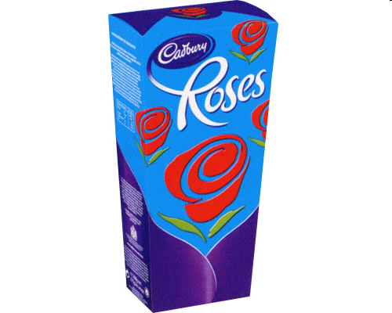
Mass and Weight- LEVEL 3
E.g if you had a big (1 kg) box of Roses chocolates on the Earth the amount and number of chocolates would be the same wherever you took those chocolates.
There would still be a 1 kg box of chocolates with the same number of mini dairy milks etc., providing that you don't eat the chocolates!

Slide 80
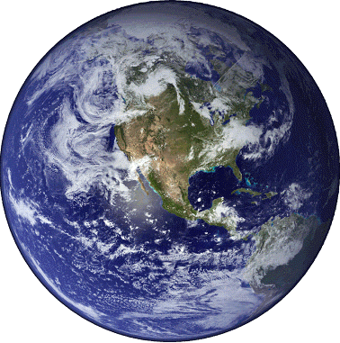
Mass and Weight- LEVEL 3
In the same way if a girl has a mass of 40 kg (about 6 stone 4 pounds) on the Earth, her mass is still 40 kg up in a plane, on the moon or out in space. Her mass stays the same.

Slide 81
Weight not gravity
Mass and Weight- LEVEL 3/4

Slide 82
What’s the difference? Mass and Weight- LEVEL 3/4
What’s the difference?
We often say things like:
“My weight is 55 kilograms”
“This bag weighs 2 kilograms”
The problem is, we’re using the wrong word – at least as far as Physics is concerned.

Slide 83
CONFUSING NOTES- Level 3/4
WEIGHT & MASS causes problems in the lab.
What you call your weight, measured in kilograms should really be called mass. This can be confusing.
All we ask is that when you are being scientific try to remember that it is mass that is measured in kilograms.
This is like the confusion that happens when you use the word battery to mean cell.

Slide 84
Weight is a force which is caused by the pull of gravity.
You have found that on Earth the pull of gravity on a kilogram is about 10 newtons.
The weight of 1kg is 10 N
The ratio of weight to mass is given the symbol g
  g = 10 N/kg

Slide 85
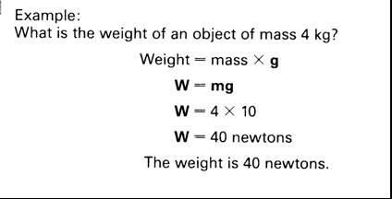
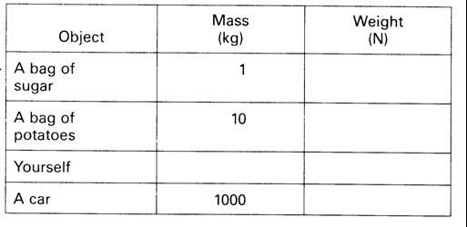

Slide 86
Practice Questions
A bag of sugar has a mass of 1kg, what is the weight?
A bag of potatoes has a mass of 5kg, what is the weight of the potatoes?
A loaf of bread has a mass of 0.5kg, what is its weight?
An apple has a weight of 1N, what is the mass of the apple?

Slide 87
Practice Questions
A small car has a weight of 8000N what is the mass of the car?
What is the mass of a small S1 pupil who has a weight of 450N?
What is the weight of Ruaridh’s pen if it has a mass of 200g

Slide 88
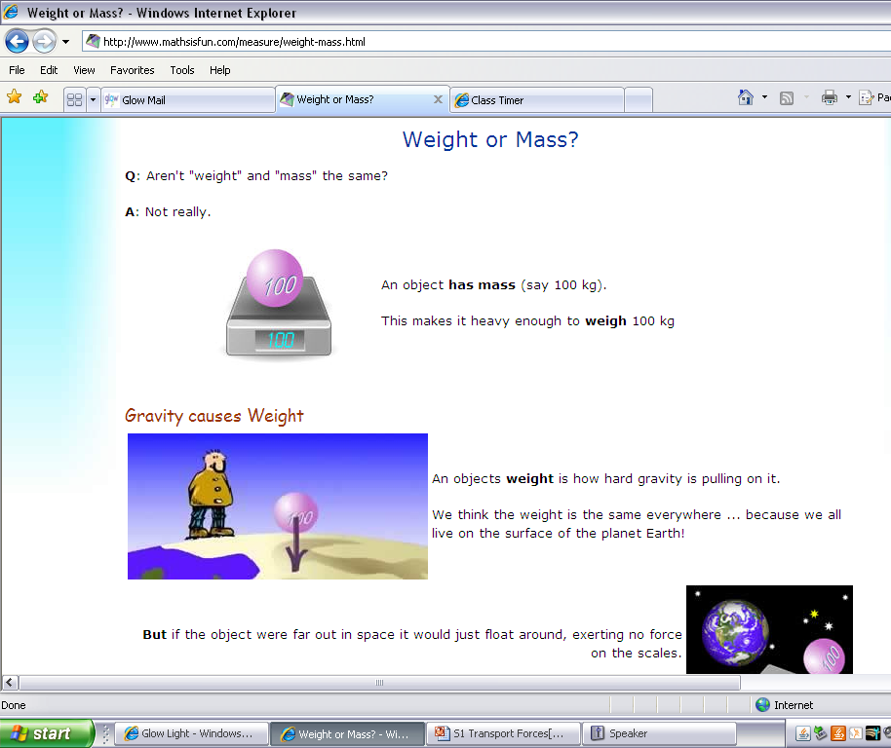
Losing – and gaining – weight
://www.mathsisfun.com/measure/weight-mass.html

Slide 89
Weight and Mass –
This is still the pull of the Earth
Making the 1kg mass stay on the scales.
The scales are calibrated to take this force and display a value 10 times LESS than this Force
The Earth is pulling the mass downwards giving it weight. The spring balance displays units of Force
1 Kg
a WEIGHT of 10N

Slide 90
Measuring force & Weight
What causes weight?
What is the relationship between weight and mass?
Would this be different on other planets?
Write a formula relating weight to mass.

Slide 91
HOMEWORK/ RESEARCH
a) Find out about some aspect of space travel. For example training astronauts, eating in space etc.
OR
b) Find out more about gravity. For example, what causes it, does it change on other planets, what are black holes.
OR
c) Try to describe a room or an activity without gravity. (ignore the lack of air)

Slide 92
SUMMARY
Weight is the force due to gravity on an object.
An object with a very large mass, eg the Earth, the moon, pulls other objects eg humans, towards it. This pull is called the force of gravity or WEIGHT.

Slide 93
TRY THESE EXAMPLES- What to do –Level 3
In these sentences, the underlined words are wrong. Rewrite the sentences and correct the mistakes.
My weight is 50 kilograms.
Mass is caused by the pull of the Earth.
Because mass is a force, it is measured in kilograms.
This box has a mass of 70 newtons.

Slide 94
What’s the difference? Level 3/4
Mass is the amount of stuff that makes up an object. It’s measured in kilograms.
Weight is the force of gravity acting on an object. It’s caused by the Earth pulling down on the object. Because weight is a force, we measure it in newtons.
Mass is measured in kilograms.
Weight is force caused by the pull of the Earth. It is measured in newtons.

Slide 95
Losing – and gaining – weight
People often say they want to lose weight. What they really mean is that they want to lose some of their mass.
One of the best ways of losing weight is to travel to the Moon. This is because the Moon’s gravity is weaker, and doesn’t pull you down with such a big force. This is why astronauts on the Moon can jump quite high, even though they are wearing big spacesuits.
What other things would be easier on the moon and are there any other forces that would be different?

Slide 96

GOING FURTHER LEVEL 4/5

Slide 97


GOING FURTHER LEVEL 4/5
Other planets also have gravitational fields which exert forces.
The gravitational field strength at the surface of some objects in our solar system are shown in the table.

Slide 98
Losing – and gaining – weight
But when you’re on the Moon, your mass doesn’t change. Remember, mass is the amount of stuff there is in you – travelling to the Moon doesn’t change that.
://www.mathsisfun.com/measure/weight-mass.html

Slide 99
WHAT YOU THOUGHT

Slide 100
Revisions quiz
1. What three things can forces do?
2. What unit are forces measured in?
3. Who is the unit named after? Give his full name.
4. What do you measure forces with?
5 What force is needed to lift an apple – 1 N, 20 N or 100 N?
6. Is mass or weight measured in kilograms?
7. Weight is a force. This means it is measured in:
8. What causes weight?
9. If you travel to the Moon, does your mass change?
10 If you travel to the Moon, does your weight change?

Slide 101
Revisions quiz - My score out of 18: _____
On which planet is your weight greatest?
On Earth, how many newtons are there for each kilogram of mass?
A dog has a mass of 7 kg. What is its weight?
A girl has a mass of 42.5 kg. What is her weight?
A train has a mass of 12,500 kg. What is its weight?
A bag has a mass of 500 grammes. What is its weight?
What’s wrong with these sentences?
  “The bag of apples “weighs 3 kg.”
  And this sentence? “In deep space, astronauts
have no mass.”

Slide 102
friction

Slide 103
Friction
Friction is a very specific type of force which opposes motion. There are many types of friction, but all are caused by a moving object rubbing against something else. Frictional forces will always act in the opposite direction to the direction of motion.

Slide 104

Air friction/ resistance is the force of air being pushed out of the way of a moving object.
e.g. When you put your hand out the window of a moving car you feel a force pushing your hand. Be careful! DANGER

Slide 105
Air resistance
It is the force that slows things down when they are moving through air.
It pushes against a moving car or against the body of a person falling from the sky.
Go through the powerpoint on PARACHUTES (Physics)

Slide 106

Friction Surface friction
When an object is dragged across a surface, there is a strong frictional force. This is affected by the surfaces. Generally, smoother or wetter surfaces will have less friction.
E.g. Pushing a box along a carpet or along ice.

Slide 107
Friction- ANSWER THESE IN A TABLE IN YOUR JOTTER
With the person next to you
Think of two examples where we try to minimise friction.
Think of one example where we try to increase friction.
With the other people at your table…
Discuss how we reduce or increase friction in the examples you used
Can you think of any situations where an object can be moving, but not be affected by any friction?

Slide 108
LABEL THE places where there is FRICTION

Slide 109
Friction
-good or bad
02/10/2011
JAH

Slide 110

Useful or Not so useful?
Walking or running
110

Slide 111

Useful or Not so useful?
Brake pads rubbing against a wheel
111

Slide 112

Useful or Not so useful?
Using a parachute when Sky diving
112

Slide 113

Useful or Not so useful?
Gloves for goalkeeping
113

Slide 114

Useful or Not so useful?
Spacecraft re-entering the Earth's atmosphere making heat.
114

Slide 115

Useful or Not so useful?
Friction between a boat and the water
115

Slide 116

Useful or Not so useful?
Friction causing car tyres to become bald
116

Slide 117


Useful or Not so useful?
In all moving parts in machinery making heat
117

Slide 118
Friction good
braking
walking
space craft re-entry
running
writing
sky-diving (drag)
opening bottles
cutting things
putting spin on an object
rock climbing
steering wheel
striking matches
cats using to drink
slugs
conveyor belts
sports
sharpening knives
holding things
grip for tyres/shoes
Friction bad
sledging
skiing
ice skating????
shooting (drag slows the bullet)
snowboarding
putting on clothes (chaffing)
swimming
wears down tyres
engines wear away
slide
F1 racing !!!!
ceramic brakes!!!
in space things don’t stop easily
boats
rotating machinery slowed down and wears away

Slide 119
REDUCING FRICTION
Look at different ways to reduce Friction
  Lubricants
  Rollers
  Small ballbearings
  Cushions of Air
Investigate

Slide 120

Try some experiments to change friction
02/10/2011
JAH

Slide 121

Try some experiments to change friction

Slide 122
Decreasing Friction
lubrication eg oil, wax, grease, soap
streamlining
more aerodynamic
reduce mass
rollers
layer of air
polystyrene beads
smooth surface
ice
water on road
LORRY BOARD
Increasing Friction
less aerodynamic
greater surface area
spoilers
increase mass
surface rough eg sand
gritting roads
stickier surface
rougher tyres

Slide 123
The Force of Friction
When we move one surface over another, the rough, uneven parts rub together.
This creates a force which tries to slow down or stop the movement. This force is called friction.
The smoother the surfaces rubbing together, the l _ _ _ _ the friction – Movement is
e _ _ _ _ _. The rougher the surfaces rubbing together, the h _ _ _ _ _ the friction - Movement is more d _ _ _ _ _ _ _ _.

Slide 124
Measuring Frictional Forces
Aim
To measure the force required to overcome friction on two different surfaces.
Method
A Newton balance is used to measure the horizontal force required to pull a schoolbag along a surface. The force applied is steadily increased until the bag moves.
Conclusion
Results
Which surface caused the least friction?
How else do you think you could reduce friction in this case?
How could you increase it?
Surface | Force (N)
Carpet
Desk

Slide 125
Measuring friction
02/10/2011
JAH

Slide 126



Investigation on friction

Slide 127


Slide 128

Friction is the force that helps you to walk along without sliding about as if you were on ice. It is the force that resists things rubbing against each other. There is less friction between smooth surfaces so things slide easily across a polished table or on surfaces such as ice.
Rough surfaces like sandpaper will not slide together unless they are pushed hard as there is more friction. Friction is useful because it makes feet and car tyres grip the road. However, it can be a nuisance in machines where the moving parts rub against each other and wear away the machine, such as in a bike. Oil reduces the friction and allows the touching part to move more easily
Literacy Extension- Summarise this passage

Slide 130
FRICTION and CAR CRASH TESTS
After any accident the police test the road surface to find out the COEFFICIENT of FRICTION.

Slide 131
Friction
What is friction?
Give 3 examples where it is annoying:
Give 3 examples where it is useful:
What effect does friction have on the surfaces?

Slide 132
STREAMLINING
02/10/2011
JAH

Slide 133

STREAMLINING- Does the shape matter?
Think about a sports car.
What about a speedboat?
How about a javelin
Or even a shark?
All these things are specially shaped to reduce friction. This is called streamlining.

Slide 134
STREAMLINING- Does the shape matter?
All these things are specially shaped to reduce friction. This is called streamlining.
Streamlining reduces the effect of air friction on an object.
Streamlining reduces the effect of drag (water friction) on an object.

Slide 135
STREAMLINING- Does the shape matter?
Collect Shape in water sheet.
This has all the details you need to carry out the experiment.
Copy the table to record your results.
Shape | Time to fall through water (s)
Ball
Disc
Cigar

Slide 136
STREAMLINING
How does shape affect speed?
Collect Shape in water sheet. This has all the details you need to carry out the experiment.
Copy the table to record your results.
Shape | Time to fall through water (s)
Ball
Disc
Cigar
02/10/2011
JAH

Slide 137
STREAMLINING
Draw and label a diagram of the equipment you used.
Now describe what you did in your experiment.
Explain how you kept the experiment fair.
Draw a bar graph showing your results.
Conclusion
The shape that travelled fastest through the water was the _________ shape.
This means it has good s______________.

Slide 138
Now design a shape that you think will take the shortest time to fall between A and B.
Make your shape from the piece of plasticene that your teacher will give you.
Each group will have their shape timed in the ‘Streamline Challenge’.

Slide 139

STREAMLINING
These illustrations show how the shape of cars has changed over the last 100 years. Cars have become closer to the ground and much more streamlined. A lot of this is because of aerodynamic testing

Slide 140


Cars and streamlining
Back in the 1900s, cars looked like this.
Now cars look more like this.
Why bother?
This is streamlining – shaping a car to reduce air friction.

Slide 141
Streamlining and Cars
There are three main reasons for streamlining.
Streamlining means cars can go _______________.
Streamlining means cars use less ________.
Streamlining means cars look ___________ .

Slide 142
How is it done?
To streamline a car, designers try to give it a smooth shape. They try not to have too many bits sticking out, like mirrors and aerials.
Look through the features listed here. Copy the ones that help to improve the streamlining of a car.
* Recessed means that they don’t stick out.

Slide 143
How is it done?
Low-profile tyres
Rear spoiler
Smooth shape
seatbelts
Electric windows
Recessed* door handles
Central locking
Air-bags
Recessed* mirrors

Slide 144


How is it done?
Draw your own, streamlined, car of the future here. Make sure you include those important streamlining features

Slide 145
Road crashes & Friction
Tyres, run off zones, icy conditions, surfaces, sporty shapes

Slide 146
In your groups plan an investigation to find out more about one of the variables below.
Tyres, run off zones, icy conditions, road surfaces, or if possible sporty shapes

Slide 147
Plan-- Write out your
Aim - (We aim to find out…..)
Method
(Step by step guide to your investigation)
What are you changing? What are you keeping the same?
Diagram- (draw your set up)
Results- (record your answers)
Conclusion-(what you found out)
Evaluation- (do you think your results are realistic?)

Slide 148
FORCES as a VECTOR
02/10/2011
JAH

Slide 149
Forces
Two things make up a force
1. its size, how strong a push or pull is, and
2. its direction, which way it pushes or pulls.
We draw forces as arrows.
1. The length of the arrow shows how strong the force is and
2. The way it points shows the direction of the force.

Slide 150
What do forces do?
Here is my object
The size of the arrow represents the size of the force.
We apply a force
This object has a bigger force acting on it.
HOW WILL WE CHANGE WHAT WE SEE?
If we want the object to slow down again, we need to apply a braking force in the opposite direction.

Slide 151
BALANCED & Unbalanced FORCES?

Slide 152
For the effects of a force to be seen the forces must be unbalanced.

Slide 153
Balanced Forces
Forces are balanced if they are the same size but in opposing directions:
40N
40N

Slide 154
Unbalanced Forces
When forces working in opposite directions are unequal they are unbalanced:
Which direction will the box move?
100N
20N

Slide 155
Resultant Force
If two forces are unbalanced there is a resultant force.
It could replace all the others to give the same effect.
The difference between two forces is the resultant force.

Slide 156
What is the resultant force?
Hint: work out the difference between the two forces.
The resultant force is 100N – 20N = 80N
100N
20N

Slide 157


Slide 158
upthrust
Don't Even Sink About It!
02/10/2011
JAH

Slide 159


Does a can of coke float?
Does salt water really make that much difference?
Buoyancy can be a difficult concept for students. It’s all about density
Notes:
Floating image http://www.google.com/imgres?um=1&hl=en&cr=countryUK|countryGB&biw=1280&bih=869&tbs=ctr:countryUK|countryGB&tbm=isch&tbnid=kmPZZJMfNFLtSM:&imgrefurl=http://www.onthegotours.com/Jordan/Unique-Adventures/Yoga-in-Jordan&docid=ZQpqGq2AGEG70M&imgurl=http://www.onthegotours.com/repository/TheDeadSeaJordan-74621251107757_800_600.jpg&w=800&h=600&ei=T_KHT6asNOfW0QXc55XkCQ&zoom=1&iact=hc&vpx=331&vpy=456&dur=368&hovh=166&hovw=221&tx=163&ty=124&sig=109036749043200092835&page=1&tbnh=166&tbnw=221&start=0&ndsp=15&ved=1t:429,r:6,s:0,i:87
Cola image
http://i00.i.aliimg.com/photo/v0/109650682/Coca_Cola_Classic_330ml_products_drinks_in.jpg

Slide 160
WORDBANK
160
S1 Physics Transport
Copy the following words into your jotter and literacy logs
02/10/2011
JAH
Back to mind map

Slide 161
WORDBANK
UPTHRUST is the upward force exerted on an object by the surrounding fluid (liquid or gas) in which the object is immersed.
Buoyancy Force is another name for UPTHRUST
fluid - a substance that has no fixed shape
And can easily flow (liquid or gas)

Slide 162
EXPERIMENTS Using the experiment sheets try one or more of the following experiments
Floating raisins
Floating and sinking cans of coke
Shapes and floating
Salty seas
ADVANCED (SCQF level 6)-
The Fisherman’s Anchor Problem
6. Making Lava Lamps
Remember as part of your Introduction to Science you found the density of a pebble.

Slide 163
Why do we wear PFDs (personal flotation devices, also known as life jackets) when we ride on a boat? How is the Knock Nevis, the largest ship in the world and weighing 647,995 tons when fully loaded with petroleum, able to float with no problem? It all has to do with buoyancy force.

Slide 164
Buoyancy acts against weight. If the density of the object is greater than that of the surrounding fluid, the object sinks. If the densities are equal, the object is neutrally buoyant and hovers in the fluid. If the density of the object is less than that of the surrounding fluid, the object floats.

Slide 165
So although the human body can typically float in water because of the air in the lungs, a person wearing a properly-fitting, well-maintained PFD, the density of which is extremely low, is practically guaranteed to float.

Slide 166
Density is defined as the mass per unit volume of an object (ρ = m / V). Remember that mass is not the same as weight. A small but heavy object, such as a lead fishing sinker, is denser than a lighter object of the same size, such as a cork. The same holds for a bowling ball vs. a soccer ball. Both are relatively the same size, however, the bowling ball has much more matter. Mass is how much matter is there is in an object, and is measured in kilograms (kg). Weight is the size of the gravitational pull on an object, and is measured in units of force, such as (kgm/s²), Weight is calculated by multiplying mass and acceleration due to gravity.

Slide 167
So how exactly does a huge cargo ship stay positively buoyant, even when fully loaded?
The key is to ensure that the volume of the ship is large enough to displace the mass of the ship. In the 3rd century BC, the Greek mathematician Archimedes realized that when he got into his bathtub, his body displaced the water making it rise and spill out of the tub. His discovery led to two laws of buoyancy that are still the basis of today’s shipbuilding. His first law states that any floating object displaces a volume of water whose mass is equal to the mass of the object. The second law describes the effect a boat’s shape has on how well it floats.

Slide 168
Upthrust
It is the force that pushes things up in water.
It helps boats and swimmers and keep them on top of the water so they don’t sink
02/10/2011
JAH

Slide 169
Newton’s 3 laws of motion

Slide 170
FORCE
Physics Transport
Back to mind map

Slide 171
Newton’s Laws of motion
Isaac Newton wrote 3 laws about the motion of objects.
Unless you apply an unbalanced force to an object, it will keep doing whatever it was doing before.
Force = mass (kg) x acceleration (m/s²)
If you push something it pushes back on you

Slide 172
Forces and Isaac Newton
Newton’s first law of motion: An object’s speed will only change if a force is applied.
Newton’s second law of motion: Speed or acceleration is proportional to the force.
Newton’s third law of motion: Every action has an equal and opposite reaction.

Slide 173
NEWTONS THREE LAWS OF MOTION
Newton’s First Law states:
A body will remain at rest or travel at a constant speed in a straight line, unless acted upon by an unbalanced force.
A body will remain at rest or travel at constant velocity, unless acted upon by an unbalanced force.

Slide 174



All Complicated Forces Explained
1. Balanced forces cause objects to stay at rest or travel at a constant speed.
A bullet travelling through space just keeps
on going.
2. Unbalanced Forces cause objects to speed up or slow down.
I’d rather push a Mini than a 4X4!
3. To every Action Force there is an equal and opposite Reaction Force.
If you shove me I’ll shove you back
(at the same time)!

Slide 175
Newton’s 1st law of motion

Slide 176
The BEST IDEA EVER
http://www.youtube.com/watch?v=jwPc0kK9VHU&feature=endscreen&NR=1

Slide 177

Common Pupil Myth
An object which does not move has no forces acting on it.

Slide 178

Why is Newton’s first law difficult to understand?
Friction?

Slide 179
Starting point:
Forces can produce changes in
Speed
Direction
Shape

Slide 180
Starting point:
Forces can produce changes in
Speed
Direction
Shape
start, stop, speed up, slow down

Slide 181
Forces “starting and stopping” is OK with most people.
Change in speed is bit a little trickier….

Slide 182

Some wrong ideas:
Nothing moves unless you push it. [it is moved by a mover]
Speed is proportional to motive force.
Men have more teeth than women.

Slide 183


Newton’s First Law
An object will remain at rest or continue at a steady speed in a straight line unless an (unbalanced) force acts on it.

Slide 184

play

Slide 185

play

Slide 186
Newton’s First Law
An object will remain stationary or move at a constant speed in one direction unless an unbalanced force acts upon it.
Balanced forces
When there are two or more forces acting on an object and they add up to a total force of zero, we say the forces are balanced.
Unbalanced forces
When an object is acted on by a force which will cause it to accelerate or change direction.

Slide 187
Newton’s First Law
In each of the following calculate the unbalanced force and its direction.
(a)
(d)
60N
30N
50N
10N
50N
(b)
(e)
20N
10N
60N
10N
50N
(c)
(f)
10N
90N
50N
45N
60N
110N

Slide 188
Newton’s First Law
In each of the following calculate the unbalanced force and its direction.
(a)
(d)
60N
20N
30N
50N
10N
50N
20N
(b)
(e)
20N
10N
50N
10N
60N
50N
20N
(c)
(f)
10N
90N
50N
30N
110N
5N
45N
60N

Slide 189
What do forces do?
Lets assume we have an object to which we are going to apply forces.
With no forces acting on it, our object is stationary.
If we apply a force to the right for a short time, it will accelerate
But even when we stop applying the force, it will keep going at a constant speed
If we want the object to slow down again, we need to apply a braking force in the opposite direction.

Slide 190
What do forces do?
Lets assume we have an object to which we are going to apply forces.
With no forces acting on it, our object is stationary.
If we apply a force to the right for a short time, it will accelerate
But even when we stop applying the force, it will keep going at a constant speed
If we want the object to slow down again, we need to apply a braking force in the opposite direction.

Slide 191
An example of newtons first law
Egg seat belts
Seat belts

Slide 192






Starter: Which car is the safest?

Slide 193
Newton’s second law
Speeding up/ slowing down

Slide 194
Newton’s Second Law
Newton’s 2nd law allows us to analyse the motion of objects. Any unbalanced force causes an object to change velocity, or to change direction. This cannot happen without an unbalanced force.
F_{un}= Unbalanced Force (N)
m = Mass (kg)
a = Acceleration (m/s²)
F_{un}
m
a

Slide 195
2nd Law Questions
Calculate the force required to accelerate a 10kg cannonball at a rate of 180m/s².
A 100 kg person jumps out of an aircraft,
  Calculate his weight.
  What is his acceleration?
  What will his downward speed be after 15s?
A car starts from rest and accelerates to 20m/s in 18 seconds. If the car has a mass of 1350kg calculate:
  Its acceleration.
  The forward force being produced by the engine.

Slide 196
Check Your Answers
F=ma = 10 x 180 = 1800 N
  W=mg = 100 x 10 = 1000 N
  a=F/m = 1000/100 = 10 m/s
  v=u+at = 0 + 10 x 15 = 150m/s
  a=(v-u)/t = (20-0)/18 = 1.11 m/s
  F=ma = 1350 x 1.11 = 1498.5 N

Slide 197
Initial FORCES RESEARCH PROJECT
What have you learned?
02/10/2011
JAH

Slide 198
INVESTIGATIONS
02/10/2011
JAH
Choose one of the investigations to choose from or design your own
• Friction and the driving surface
• Car tyre design
• Brakes how to make them better
• Being a crash test dummy
• Seatbelts are they worth it?
• Run offs what should they be made of?
• How and why lorry brakes smell at the bottom of a slope (height and speed_

Slide 199
LOCKERBIE ACADEMY TRANSPORT UNIT
Look at Road safety Campaigns, stopping distance, reaction timers, car accidents
Discuss how cars can be designed to be safe. Where can improvements be made?
02/10/2011
JAH

Slide 200
DISCUSSION- Choose one of the topics to discuss
• Should the speed limit on motorways be increased?
• What should be the punishment for drink drivers?
• The age for people to learn to drive should be increased/ decreased.
• The cost for Fuel in rural areas should be reduced
• We should learn to drive at school
• Driving lessons should be free and compulsory
• The insurance for young drivers is too expensive
• All cars in Scotland should have snow tyres in winter
02/10/2011
JAH

Slide 201
YOUR TASK.
Working in teams you need to:
6. Record this value on your worksheet
7. time how long note down
8. record as tally marks on your worksheet every time each person in the group leaves the track
9. Find the average speed of the car for each person
10.Find the average velocity of the car for each person.
11.Using the ALBA package record the instantaneous speed of the vehicle at the specific place in the track (see the additional worksheet)
02/10/2011
JAH

Slide 202
TASK
We need to know the
1. distance your vehicle will travel
2. the average speed over the whole journey
3. the instantaneous speed of the vehicle as it goes round the roundabout (or alternative)
02/10/2011
JAH

Slide 203
02/10/2011
JAH

Slide 204
Activity: On your worksheet side 1
What are the forces that act on it?
Are they Balanced or Unbalanced?
Tasks
Now draw the arrows to show the forces and tell if the object moves because of the forces (unbalanced) or stays where it is (balanced)

Slide 205
Activity Timer
http://classtools.net/education-games-php/timer/

Slide 206
Activity: On your worksheet side 2
Are they Balanced or Unbalanced?
What will happen?
Tasks
Now fill in the gaps next to each picture and then draw your own balanced or unbalanced situation and tell what happens

Slide 207
Stopping a car…
Tiredness
Too much alcohol
Thinking distance
Too many drugs
Poor visibility
Wet roads
Icy roads
Braking distance
Tyres/brakes worn out
Driving too fast

Slide 208






Speed Worksheet: Label the graph

Slide 209
Plenary
Fill in the gaps with the words given:
Forces can change the shape, the ____________ or direction of something which is moving.
Contact forces are friction, air resistance, _________ , _________ and upthrust.
Non-contact forces are magnetism, _______________ and __________________ electricity.

Slide 210
Plenary
We use a __________________ to measure forces. The units for measuring forces are __________________, or N for short.
Weight is a __________________ that attracts objects towards each other.
__________________ is the force of gravity pulling things __________________ the Earth.
Weight is measured in __________________, because it is a force.

Slide 211
Videos
Explanation of mass and inertia
Inertia ep1
http://www.youtube.com/watch?v=by-7kkAu2Pg&feature=related
Mass ep2
http://www.youtube.com/watch?v=uvy4nWh0KwE&feature=related
animations
http://www.misterteacher.com/whiteboard/forces.html#free
Experiment Newton’s law of motion
http://www.youtube.com/watch?v=uOSBC0SXVR4&feature=fvw
http://www.youtube.com/watch?v=7Ix-eywqUOg&NR=1
http://www.youtube.com/watch?v=e9eoFl1nbkc&feature=related
http://www.youtube.com/watch?v=rBi1WwLjBA8&feature=related

Slide 212
Complete the sheet to find the resultant forces.
Decide whether the forces are balanced or unbalanced.

Slide 213
Balanced forces have no resultant force.
A resultant force means a change in motion:
      There is a change in speed or direction

Slide 214
Log IT
Make a note of each graph in your books.
How does speed relate to the shape of the graph?
      The steeper the slope, the faster the speed

Slide 215
Safety cage
Anti-lock Brakes
Traction control
Safety Features in Cars
Crumple zones
Electric windows
Seatbelts
Air bags
Paddle shift controls
Notes:
215
215

Slide 216
Safety Features
These may be active or passive.
Active safety features directly improve the safety of a car. They have an immediate effect in saving lives in an accident. They include
Notes:
216
216

Slide 217
Safety Features
Passive safety features indirectly increase the safety of a car. They contribute to safe driving but do not affect the safety of travellers in a car in the event of an accident. They include
Notes:
217
217

Slide 218

How do active safety features work?
Seatbelts, air bags and crumple zones are useful in crash because they all…
Change shape
Absorb energy, and so
Reduce injuries
Notes:
218
218

Slide 219


Question: How do seatbelts save lives?
Answer: They reduce the force on the passenger.
Explain how they do this in terms of
F = m x a
Notes:
219
219

Slide 220


Question: How do escape lanes save lives?
Answer: They increase the stopping (collision) distance.
Explain how they do this in terms of
F = m x a
© Steve McCulloch
Notes:
220
220

Slide 221

Most safety devices work by
Increasing the time to stop
Increasing the distance needed to stop
Decreasing the acceleration
Notes:
221
221

Slide 222
Activity Timer
02/10/2011
JAH
http://classtools.net/education-games-php/timer/
With sound
http://www.vickiblackwell.com/timer.html
Other
http://www.teachitworld.com/index.asp?CurrMenu=357

Slide 223
Activity Timer
http://classtools.net/education-games-php/timer/
http://classtools.net/education-games-php/timer/
02/10/2011
JAH

