Slide 1
LOCKERBIE ACADEMY
TRANSPORT UNIT
GRAPHS
S1-S3 Road Safety & PHYSICS

Slide 2
Velocity-Time
GRAPHS advanced 2
Complete after the acceleration section
S1-S3 Physics Transport
Back to mind map

Slide 3
Velocity-Time
GRAPHS
Describing graphs
S1-S3 Physics Transport
Back to mind map

Slide 4
The motion of any object can be represented by a line drawn on a speed-time or velocity-time graph. This give a visual indication of how objects are moving.
Examples
Speeding up  Uniform/  Slowing down
⬧ increasing Steady speed  negative
velocity  constant velocity acceleration
(accelerating)  (constant speed)  (decelerating)
Velocity (ms⁻¹)
Velocity (ms⁻¹)
Velocity (ms⁻¹)
Time (s)
Time (s)
Time (s)

Slide 5
Describe the motion represented by the line on each speed-time graph:
0 - 8 seconds: ___________ ____ from ____ metres per second
to ____ metres per second. (Constant/uniform _____________ ).
8 - 11 seconds: __________ _________ of ____ metres per second.
11 - 18 seconds: ___________ _______ from ____ metres per second to ____ metres per second. (Constant/uniform ____________ ).

Slide 6
Speed time graph challenge
Draw a set of axes for a speed-time graph in your jotter.
In your neighbour’s jotter, neatly and using a ruler, draw in a simple journey involving at least two changes in acceleration.
In your own jotter write a short story which could be described by the graph your neighbour drew. Now calculate the total distance travelled on the journey.

Slide 7
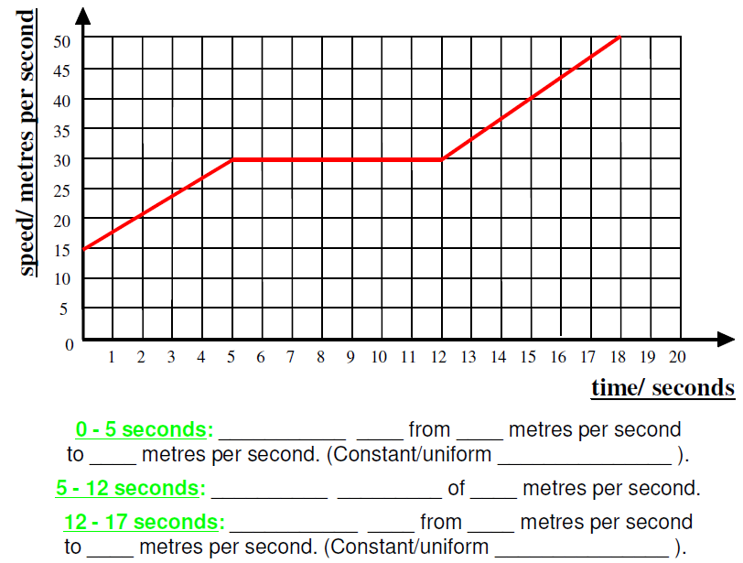

Slide 10
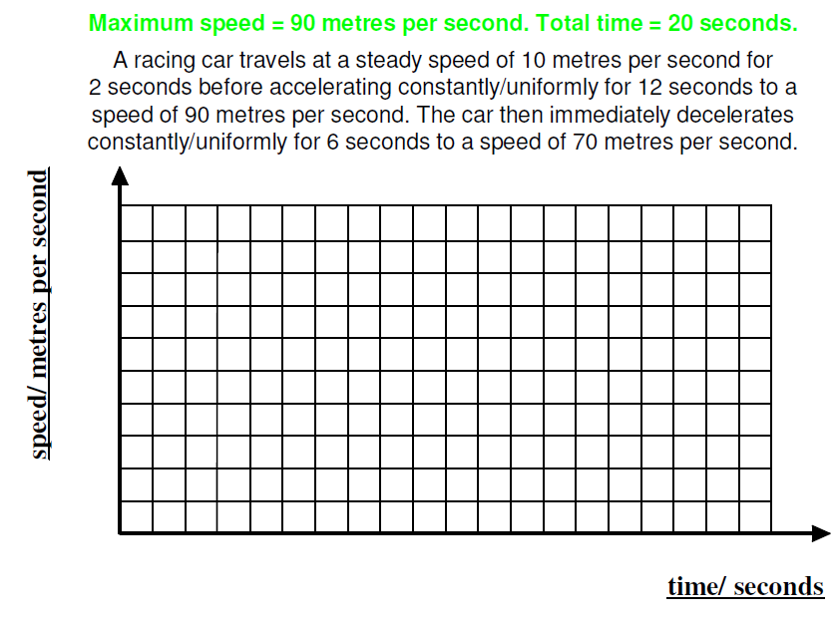

Slide 11
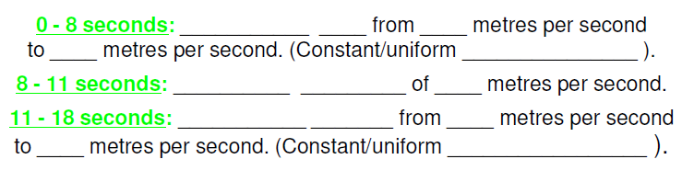

Slide 12
Velocity-Time
GRAPHS
Finding the acceleration from velocity-time graphs
S1-S3 Physics Transport
Back to mind map

Slide 13
The gradient of a velocity time graph (steepness) tells us the acceleration of the object. The steeper the graph (bigger the gradient) the greater the acceleration.
Velocity (ms⁻¹)
Time (s)

Slide 14
Finding the gradient of a velocity-time graph
Gradient= rise/run
Or v/h
In our case that is
vertical= (v-u)
Horizontal=t
Gradient=(v-u)/t
Gradient = acceleration
v
Velocity (ms⁻¹)
u
Time (s)
t

Slide 15
Drawing Speed-Time Graphs
Draw a speed-time graph for the following journey
A train leaves the station and take 30s to accelerate to 15m/s.
It remains at this speed for a further 15 seconds.
As it approaches the next station it slows to 5m/s. It takes 20 seconds to decelerate to this speed
As it finally pulls into the next station it slows to a stop in 15 seconds.

Slide 16
What It Should Look Like
Let’s find out the
accelerations

Slide 17
What It Should Look Like
a=0ms⁻²
a=-0.5ms⁻²
a=0.5ms⁻²
a=-0.3ms⁻²

Slide 18
Describe the motion represented by the line on each speed-time graph:
0 - 10 seconds: ___________ ____ from ____ metres per second
to ____ metres per second. (Constant/uniform _______________ ).
10 - 15 seconds: __________ _________ of ____ metres per second.
15 - 20 seconds: ___________ _______ from ____ metres per second
to ____ metres per second. (Constant/uniform _________________ ).

Slide 19
Finding the Acceleration from velocity-time graph:
Gradient = rise/run
a=(v-u)/t
a=(10-0)/10
a=1m/s²
Gradient = rise/run
a=(v-u)/t
a=(10-10)/5
a=0m/s²
Gradient = rise/run
a=(v-u)/t
a=(0-10)/5
a=-2m/s²

Slide 20
Problems
1. Calculate the average velocity over OA AB and BC
2. Calculate (a)the acceleration over OA, AB and BC
(b) the total distance traveled in the 12 s
5m/s², 0, 3.75m/s²,
127.5m

Slide 21
Velocity-Time
GRAPHS
Finding the distance and displacement from velocity-time graphs
S1-S3 Physics Transport
Back to mind map

Slide 22
The AREA under a speed time graph tells us HOW FAR we have travelled (DISTANCE)
The area under a velocity time graph tells us the DISPLACEMENT of the object.

Slide 23
Speed – Time Graphs 2
Speed time graphs, when drawn accurately can be used to find the total distance travelled during a journey. No matter what the shape of the graph….
Total distance covered=Area under a speed time graph
Often, to find the area, the graph will need to be split into standard geometrical shapes like triangles and rectangles
Speed (m/s)
Make a sketch of this graph and divide it up into appropriate shapes
Time (s)

Slide 24
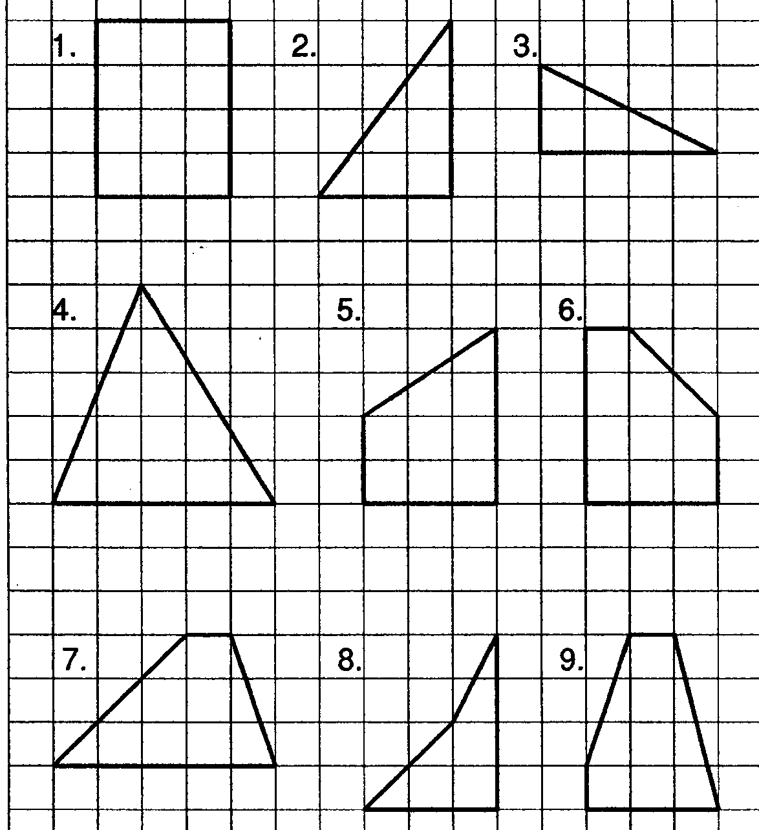
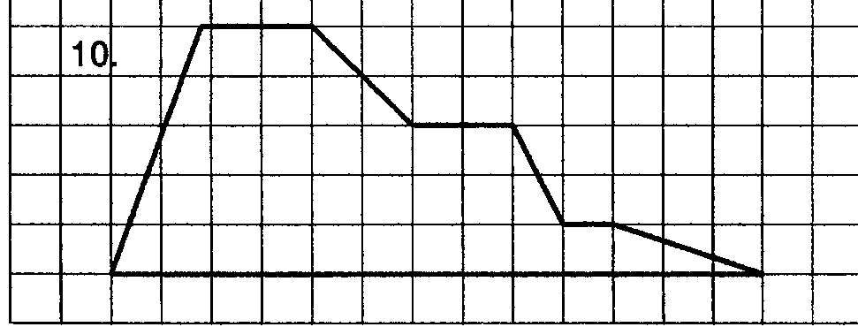
Copy out the shapes and find the area of each shape.
Include your working
02/10/2011
JAH

Slide 25
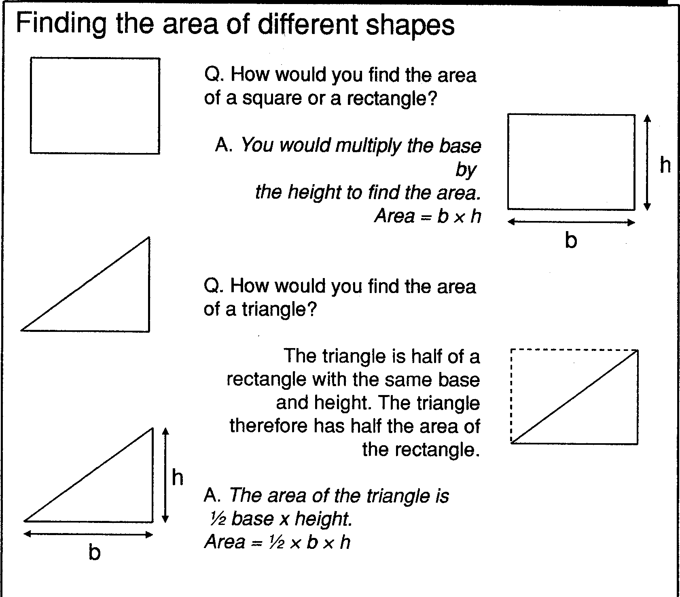
02/10/2011
JAH

Slide 26
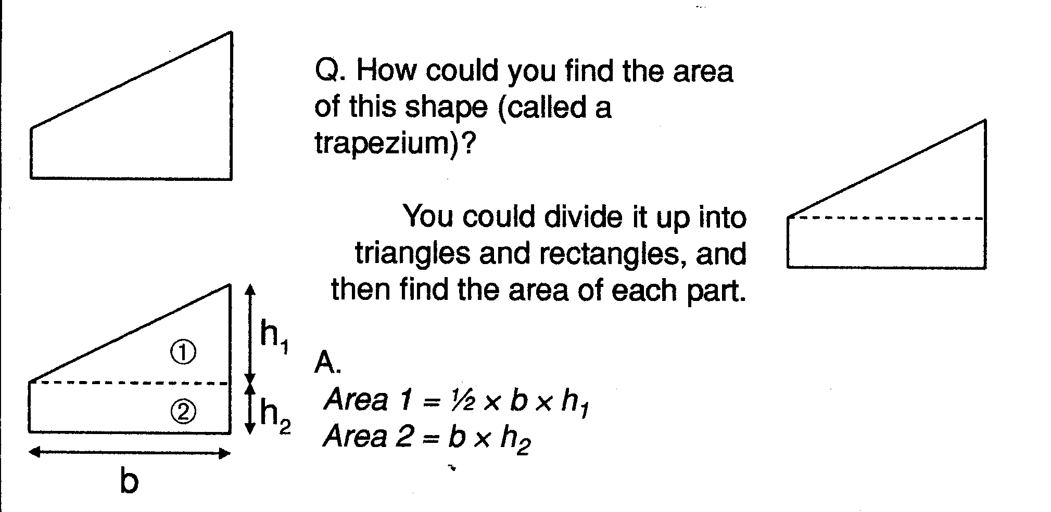
02/10/2011
JAH

Slide 27
The AREA under a speed time graph tells us HOW FAR we have travelled (DISTANCE)
The AREA under a speed time graph tells us HOW FAR we have travelled (DISTANCE)
v(m/s)
100
0
t(s)
300

Slide 28
My object is travelling very fast. It is travelling at constant speed, its instantaneous speed is constant. It’s acceleration is zero.
To find the distance travelled, d, we’d use the formula;
d= 100x 300=30 000m

Slide 29
Find the average speed for this journey.
Velocity (ms⁻¹)
10
The area of the triangle is exactly the same as the area of the rectangle with a speed exactly half way between the two values, u & v
30
t(s)

Slide 30
v(m/s)
10
This yellow area is the same as the pink area
Average speed
30
t(s)
the area of the pink shape is the same as the area of the yellow triangle. Both give you the distance travelled

Slide 31
How far did it go?
C
A
B
D
E

Slide 32
How far did it go?
B
C
A
D
E
Displacement = area under v-t graph
= Triangle A + Rectangle B + Triangle C + Rectangle D + Triangle E
= (½x30x15) + (15x15) + (½x10x20) + (20x5) + (½x15x5)
= 225 + 225 + 100 + 100 + 37.5
= 687.5 m

Slide 33
Problem
2. Calculate the total distance traveled in the 12 s
127.5m

Slide 34
Velocity time graphs; Summary
The gradient of a velocity time graph gives the acceleration of an object
the area under a velocity time graph gives the total distance travelled
Increasing or decreasing gradient gives the rate at which the acceleration is increasing or decreasing
Zero gradient means the object is travelling at constant speed

Slide 35
Distance-Time
GRAPHS
S1-S3 Physics Transport
Back to mind map

Slide 36
Distance-time graphs
2) Horizontal line =
40
30
20
10
0
4) Diagonal line downwards =
Distance
(metres)
Time/s
20 40 60 80 100
Diagonal line =
3) Steeper diagonal line =

Slide 37
Distance time graphs ; Summary
The gradient of a distance time graph gives the velocity
increasing gradient means object is accelerating
decreasing gradient means object is decelerating
zero gradient means object is stationary

Slide 38
Problems
Describe the motion of the vehicle during the 12s journey
Calculate the average speed over OA AB and BC
5m/s, 0m/s, 3.75m/s

