Slide 1
White Board Revision of Electricity 2
Keep track of your score and no cheating!
Using the SSERCmeet video by Chris Hooley
https://www.youtube.com/watch?v=uxUZvJ4F7_U

Slide 2
All solids can be classified into 3 groups- name them?
On the video see 2min 04s -2min 36s
Conductors, insulators and semi-conductors (a subset of insulators)

Slide 3
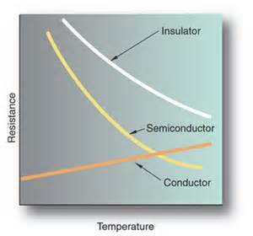
What happens to conductivity with temperature (in C,I & S)?
2:36-3:37 on the video

Slide 4
What is an intrinsic semi conductor?
An intrinsic semiconductor, also called an undoped semiconductor, is a pure semiconductor without any significant dopant species present.
The number of charge carriers is therefore determined by the properties of the material itself instead of the amount of impurities.
In intrinsic semiconductors the number of excited electrons and the number of holes are equal:
n = p

Slide 5
Can you define a conductor, insulator and semiconductor?
3:57-5:25 on the video
Conductor- a material for which an applied voltage causes a current. Usually the current is proportional to the voltage.
Insulator- a material for which an applied voltage causes very little current. I very small until V very very large.
Semiconductor- an insulator where the voltage required to drive a current is smaller than in an insulator.

Slide 6
What is the photoelectric effect?
Intro: 8:50-10:02 this bit is for watching at home
Experimental evidence for band gaps: 10:02-10:34
The production of a free electron from the surface of a metal, when sufficiently high frequency radiation is incident upon it.
What is the work function?
The minimum energy required to free an electron from the surface of the metal, i.e. the minimum energy to cause photoemission.

Slide 7
What is the Fermi Level?
13:28-13:57
The highest energy level occupied by an electron at a given time. (NB at zero Temperature)

Slide 8
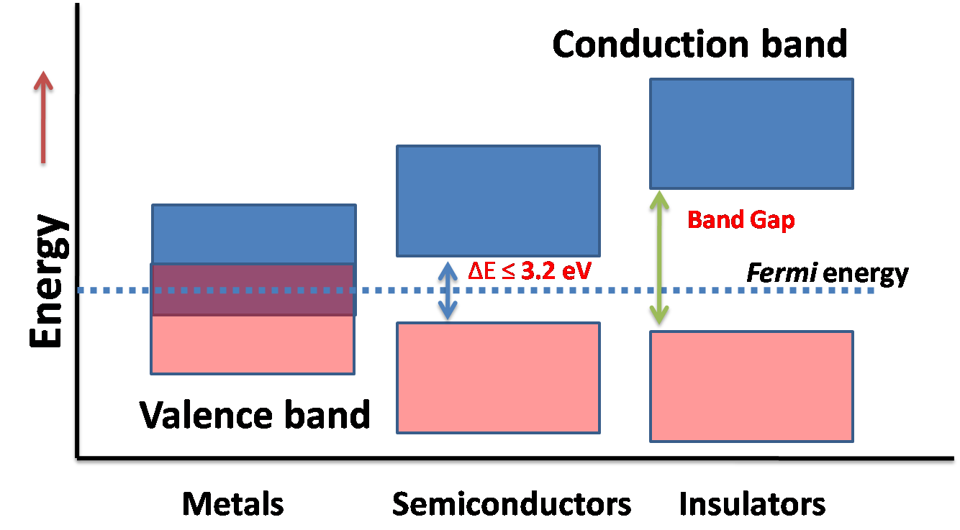
Draw diagrams to show the energy bands in a conductor, insulator and semi-conductor
https://nirajchawake.files.wordpress.com/2014/10/picture1.png

Slide 9
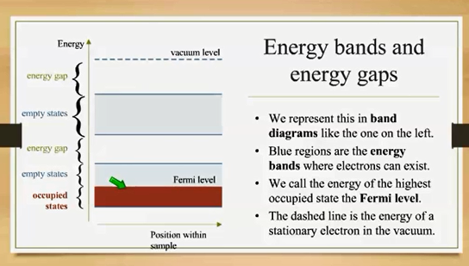

Slide 10
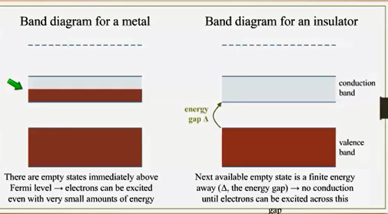
Watch 10:36-12:27

Slide 11
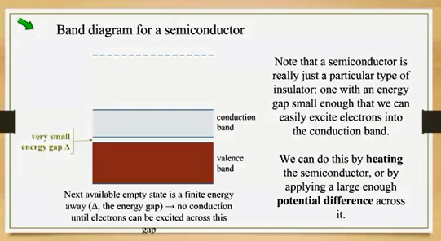
18:40-19:50

Slide 12
How can we increase the conductivity of a semi-conductors? (other than temp)
28:35 – 29:00
Heat them (increase T so the electrons have more Energy)
Apply a large voltage across them
    Or more usefully
Dope an intrinsic semiconductor to make extrinsic semiconductors, either p-type with positive holes or n-type with additional electrons.

Slide 13
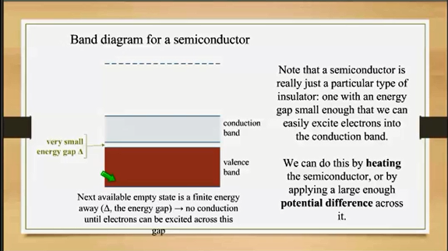

Slide 14
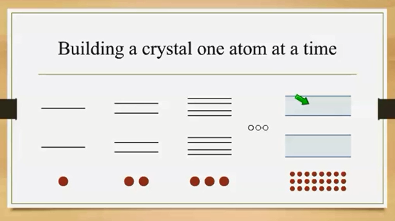
How do these bands arise?
No this isn’t a question it is an chance to go a little deeper (not required but can make it clearer to understand- maybe)
21:30- 27:40

Slide 15
How is an n-type semiconductor made? (Physics not engineering!)
Group 5 material
“doping” adding a small (approximately 1ppm) of group 5 material to add additional electrons as charge carriers.
ELECTRON

Slide 16
What is the overall charge on a p-type semiconductor?
Zero as every electron has a corresponding proton of the opposite charge in the nucleus.
A “hole” is an absence of an electron but the nucleus has the exact numbers of protons to balance the negative charge.

Slide 17
What is the overall charge carriers on a p-type semiconductor?
The overall charge carriers in a p-type semiconductor are “positive holes”
Doping: 29:02-32:20

Slide 18
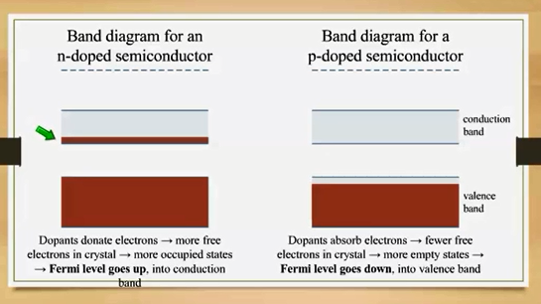
Try to draw a band diagram for an n-type and p- type semiconductors
32:20-34:00

Slide 19
What do we call a doped semiconductor
An extrinsic semiconductor

Slide 20
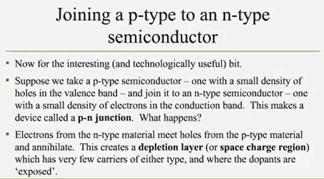
How do we increase the usefulness of a p-type semiconductor?
Grow a p-type semiconductor next to an n-type semiconductor to make a diode
34:26- 36:20
36:20-39:00

Slide 21
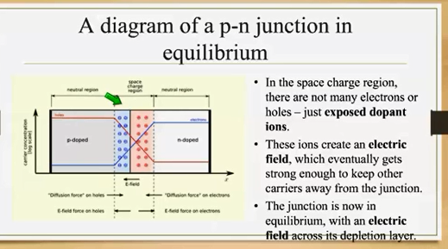
36:20- 39:00

Slide 22
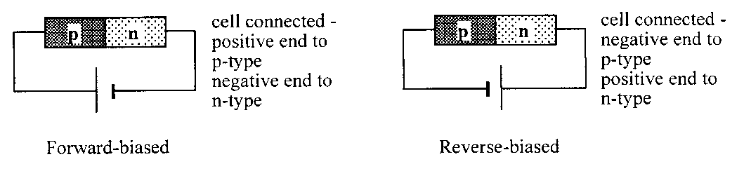
Diodes can be connected in two ways, name them, and show how they are connected each way.
39:40 -40:55 for the introduction
41:17 for forward bias
44:10-44:47 for reverse bias
Summary 44:47-45:25

Slide 23
Is an LED forward or reverse biased?
Forward
45:30- 47:31
What determines the colour of the light emitted from an LED?
The proportions of the materials that they are made from.

