Slide 1


Cutting Edge Science
Tall Oaks from Little Acorns Grow
Notes:
Lockerbie Academy Science Dept has been in the forefront of cutting edge research, giving you opportunities people in other schools can only dream of. Are you going to take those opportunities?

Slide 2
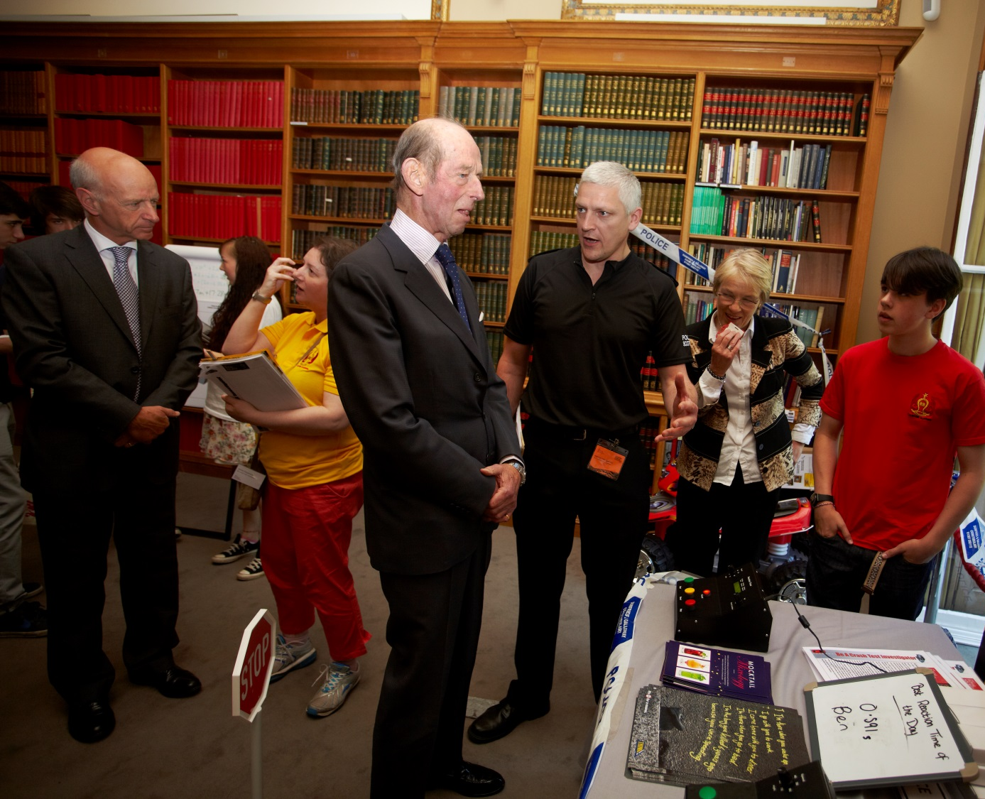
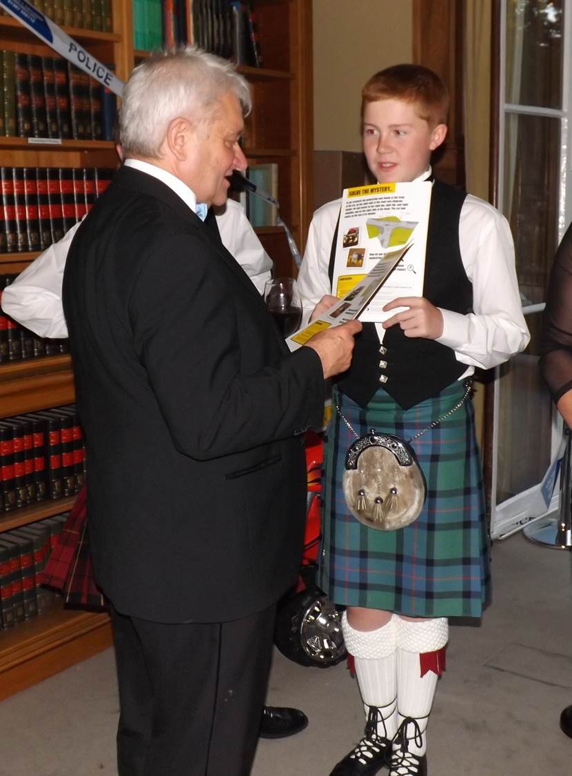
Lockerbie Academy- Wow Opportunities
Notes:
From a little project that Mrs H had seeded, we got grants of over £8k for the school and part of this was to take 17 of our young people to London for 10 days and they met, the Queen’s cousin, FRS, Nobel Prize Winners and all manner of amazing people. All they did was grasp the opportunity!
Mrs H goes on a course and gets given a reaction timer
Problem = too many LA student have been killed on the roads
Funding supplied by CX, Royal Society Partnership Grant
Works with Police Scotland
Eat lots of cake and share ideas
Put together a programme for YOU
Write up, enter competitions
Go to London, the only Student Exhibit
Win competitions to London, Brussels, Hungary, more London
Write up in EU journals, Student journals

Slide 3
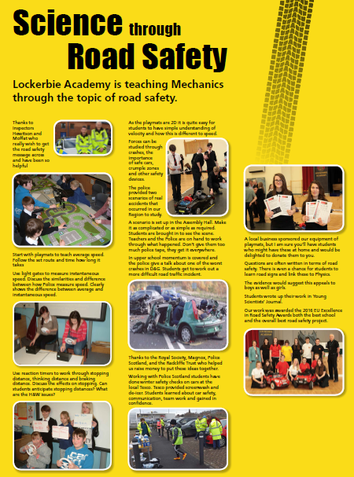
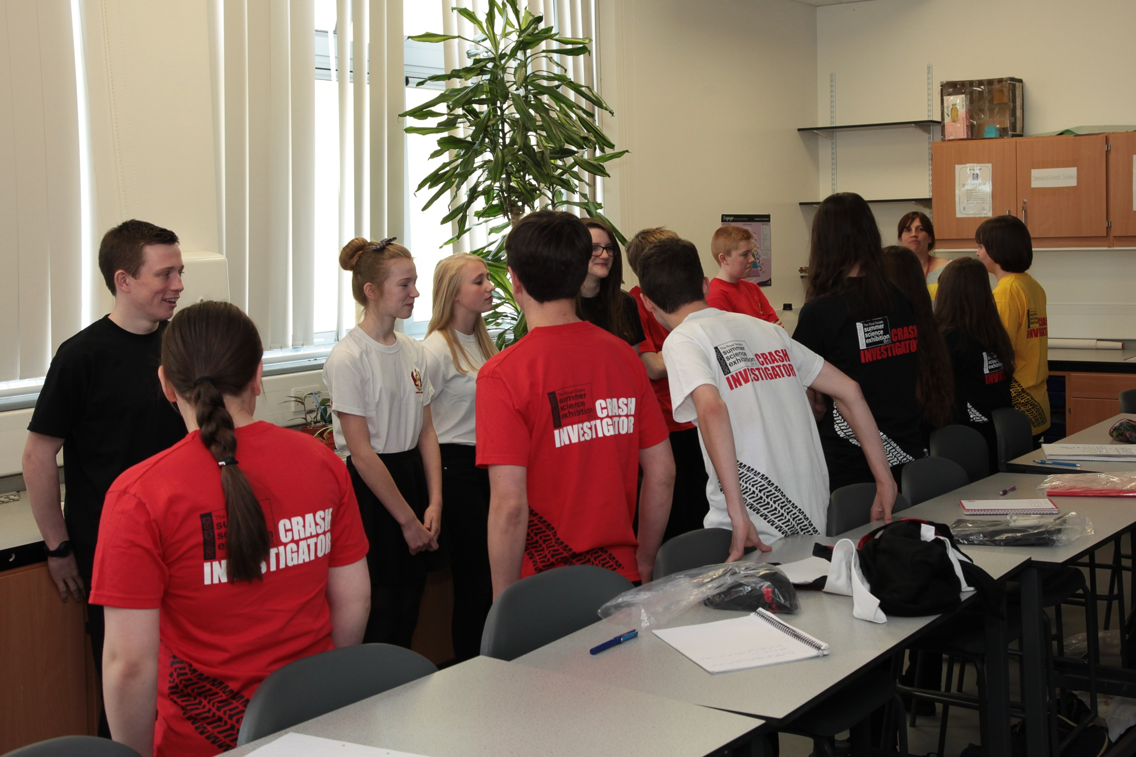
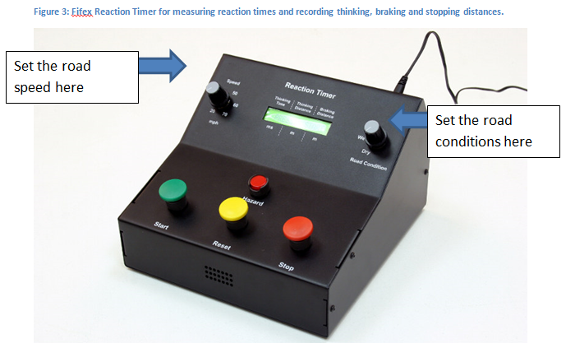
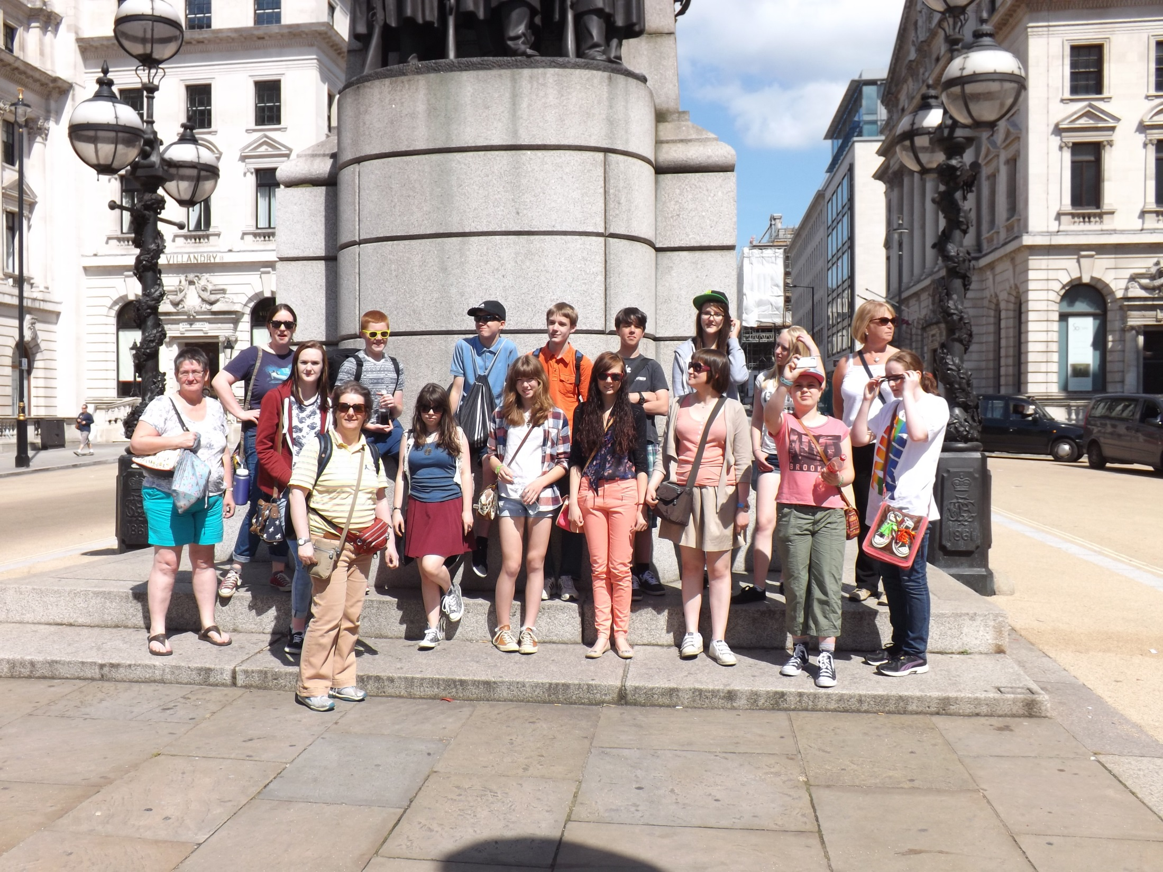
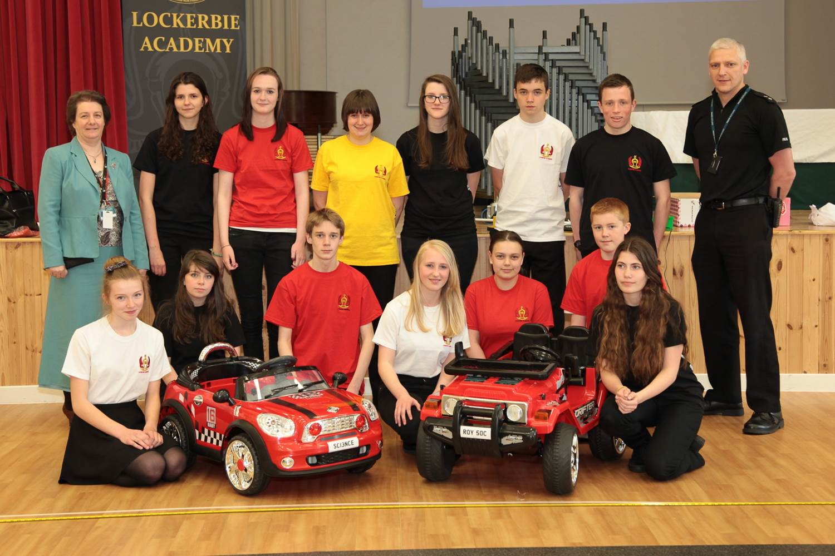

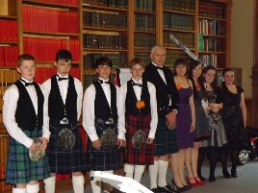
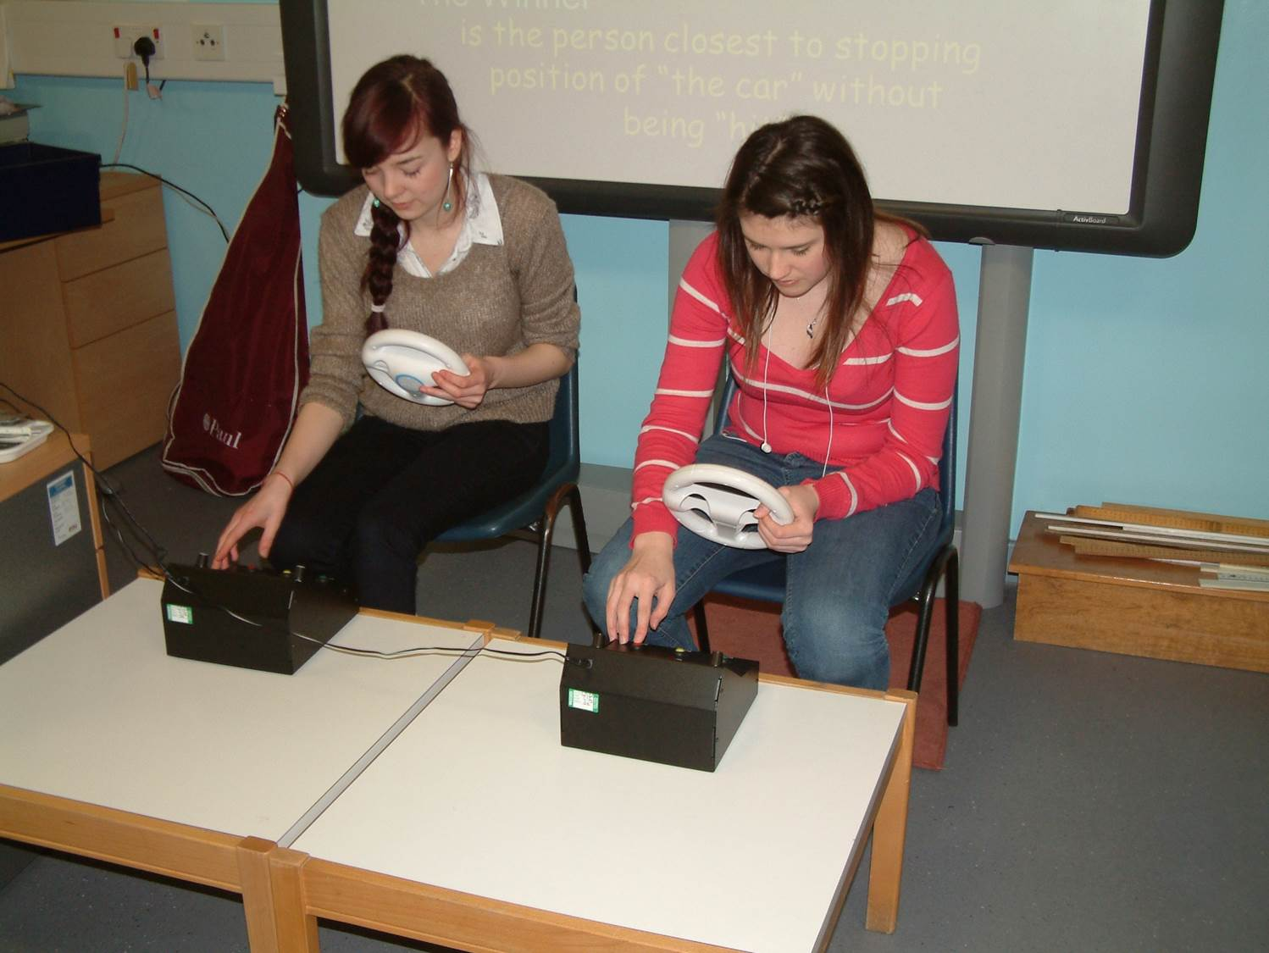
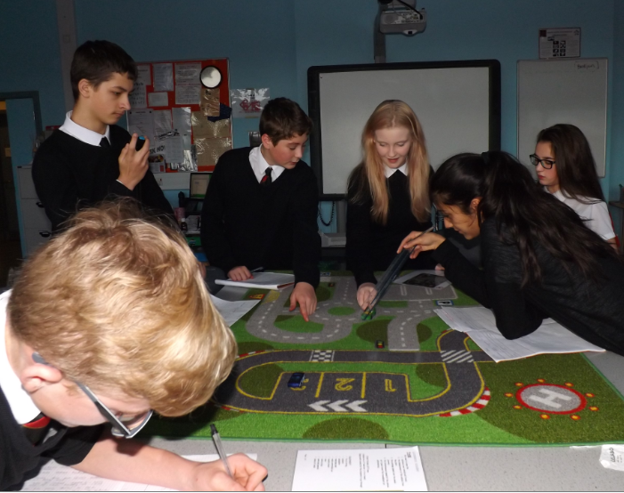
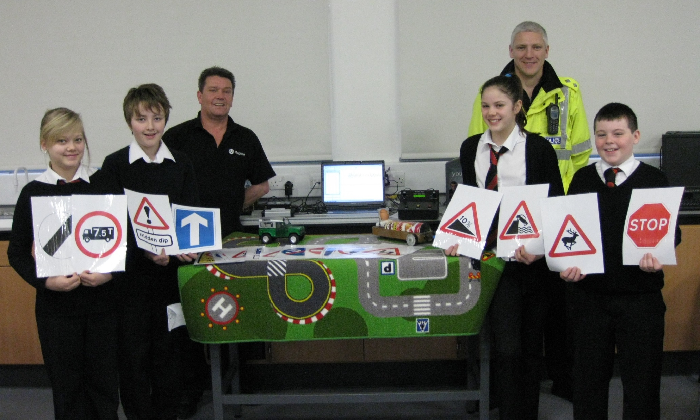

Slide 4
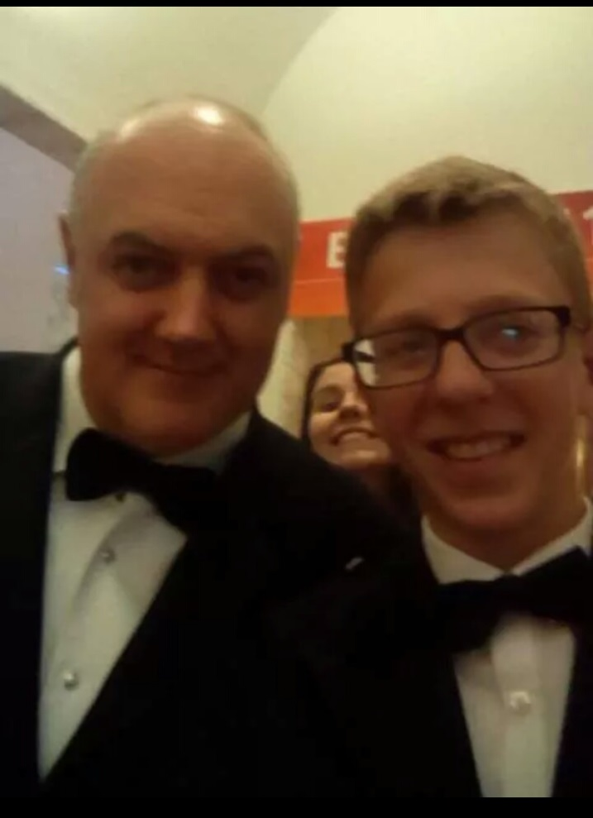
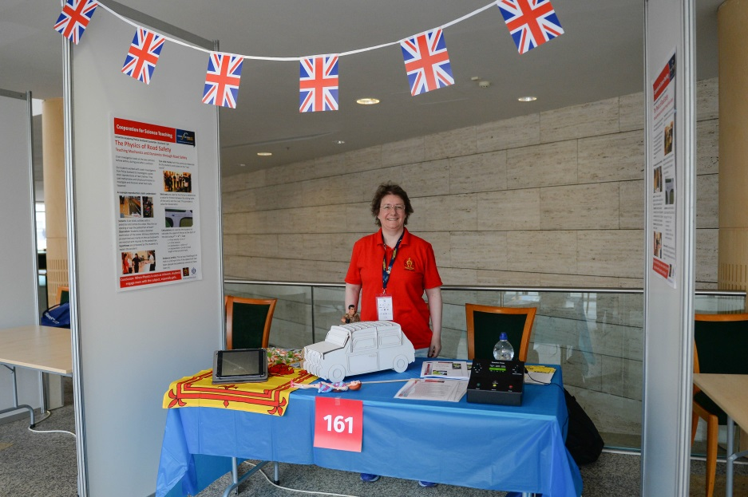
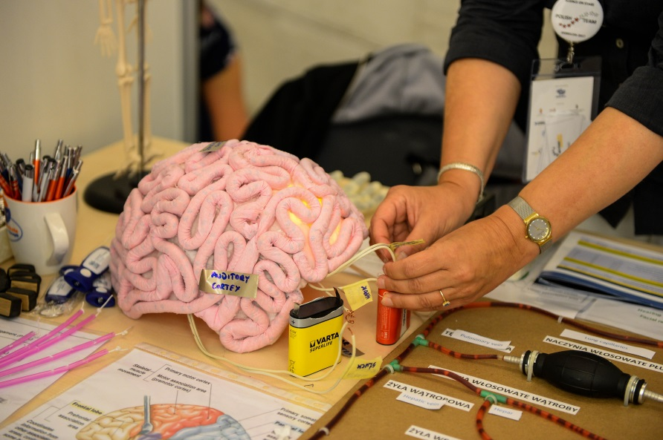
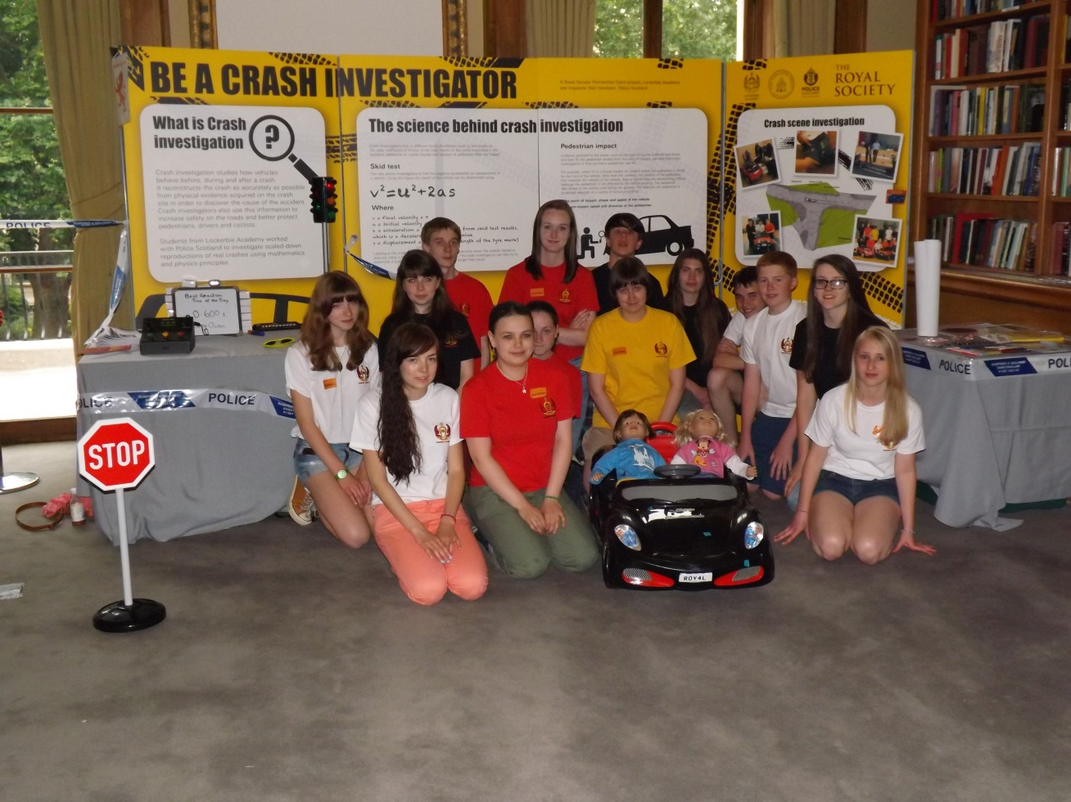
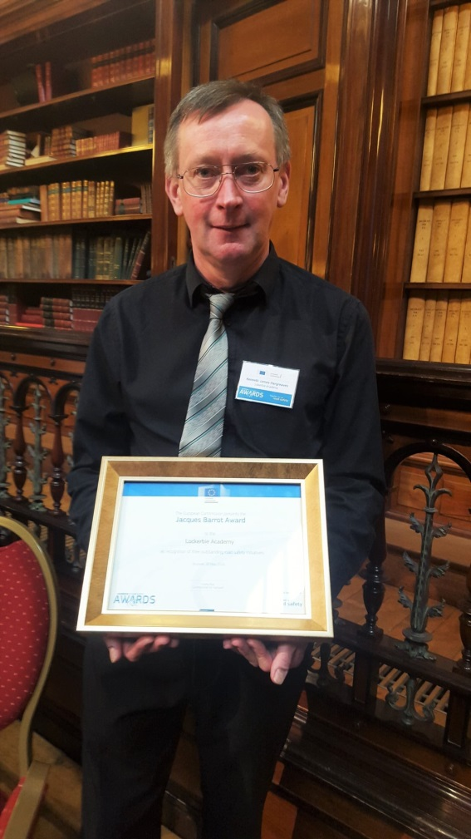
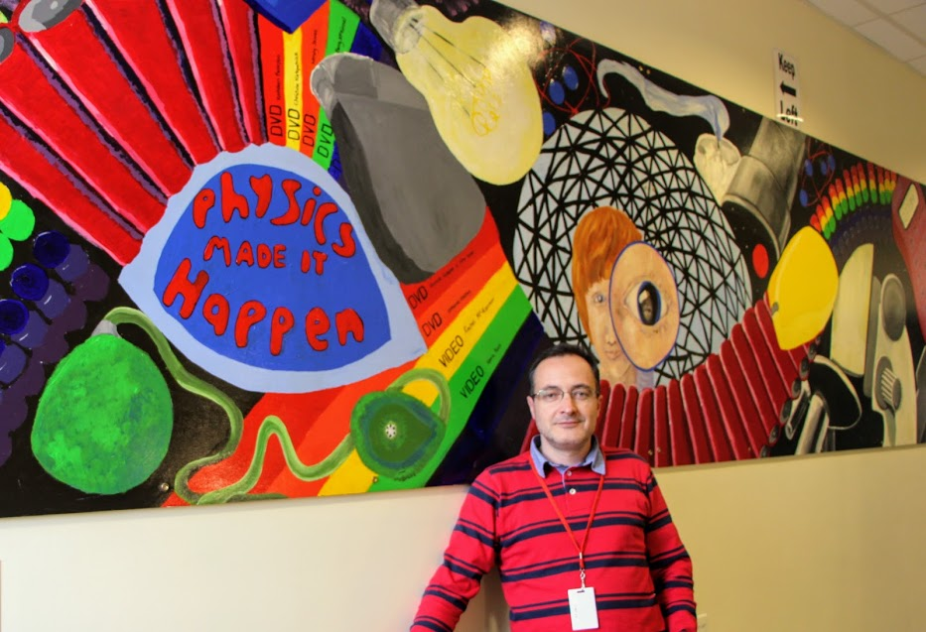
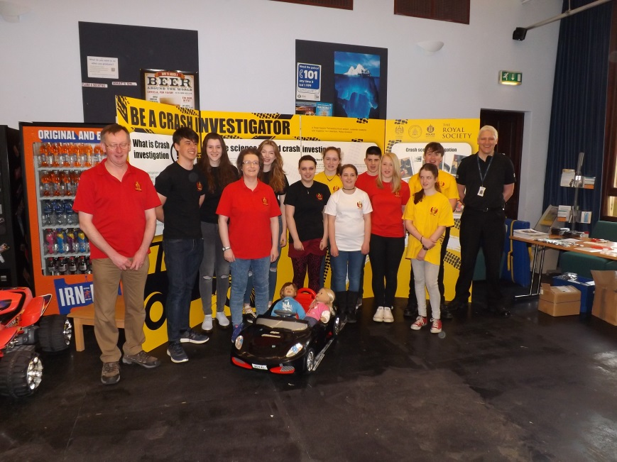
Notes:
Whilst in London the group visited the sites and spoke to a range of people including FRS. We took a group of YP to the D&G Science Fayre to discuss the work. Mr H got to go to Brussels and meet the EU Transport Minister and Mrs H went to a Hungarian Science teachers conference, bringing information home to share with you OUR STUDENTS. Whilst there she met Nelson who came across to share in our next project, but he also brought his love of Dark Skies and from his visit some of our students took the opportunity to enter an international competition and Ross and Oliver came second and Rachel, Emma, Emily and James came third. So what is our new project?

Slide 5
New Idea
Hypothesis
Young people today have worse hearing than students from 15 years ago because of the music they listen to through headphones?
?

Slide 6
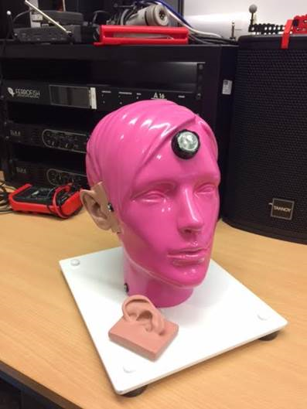
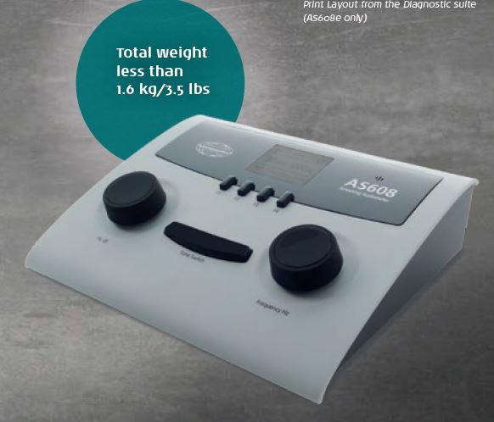
Rosie the pink Head & The AuDIOMETERS

Slide 7
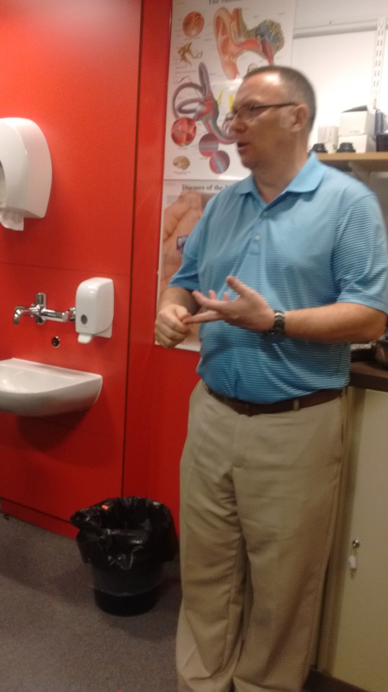
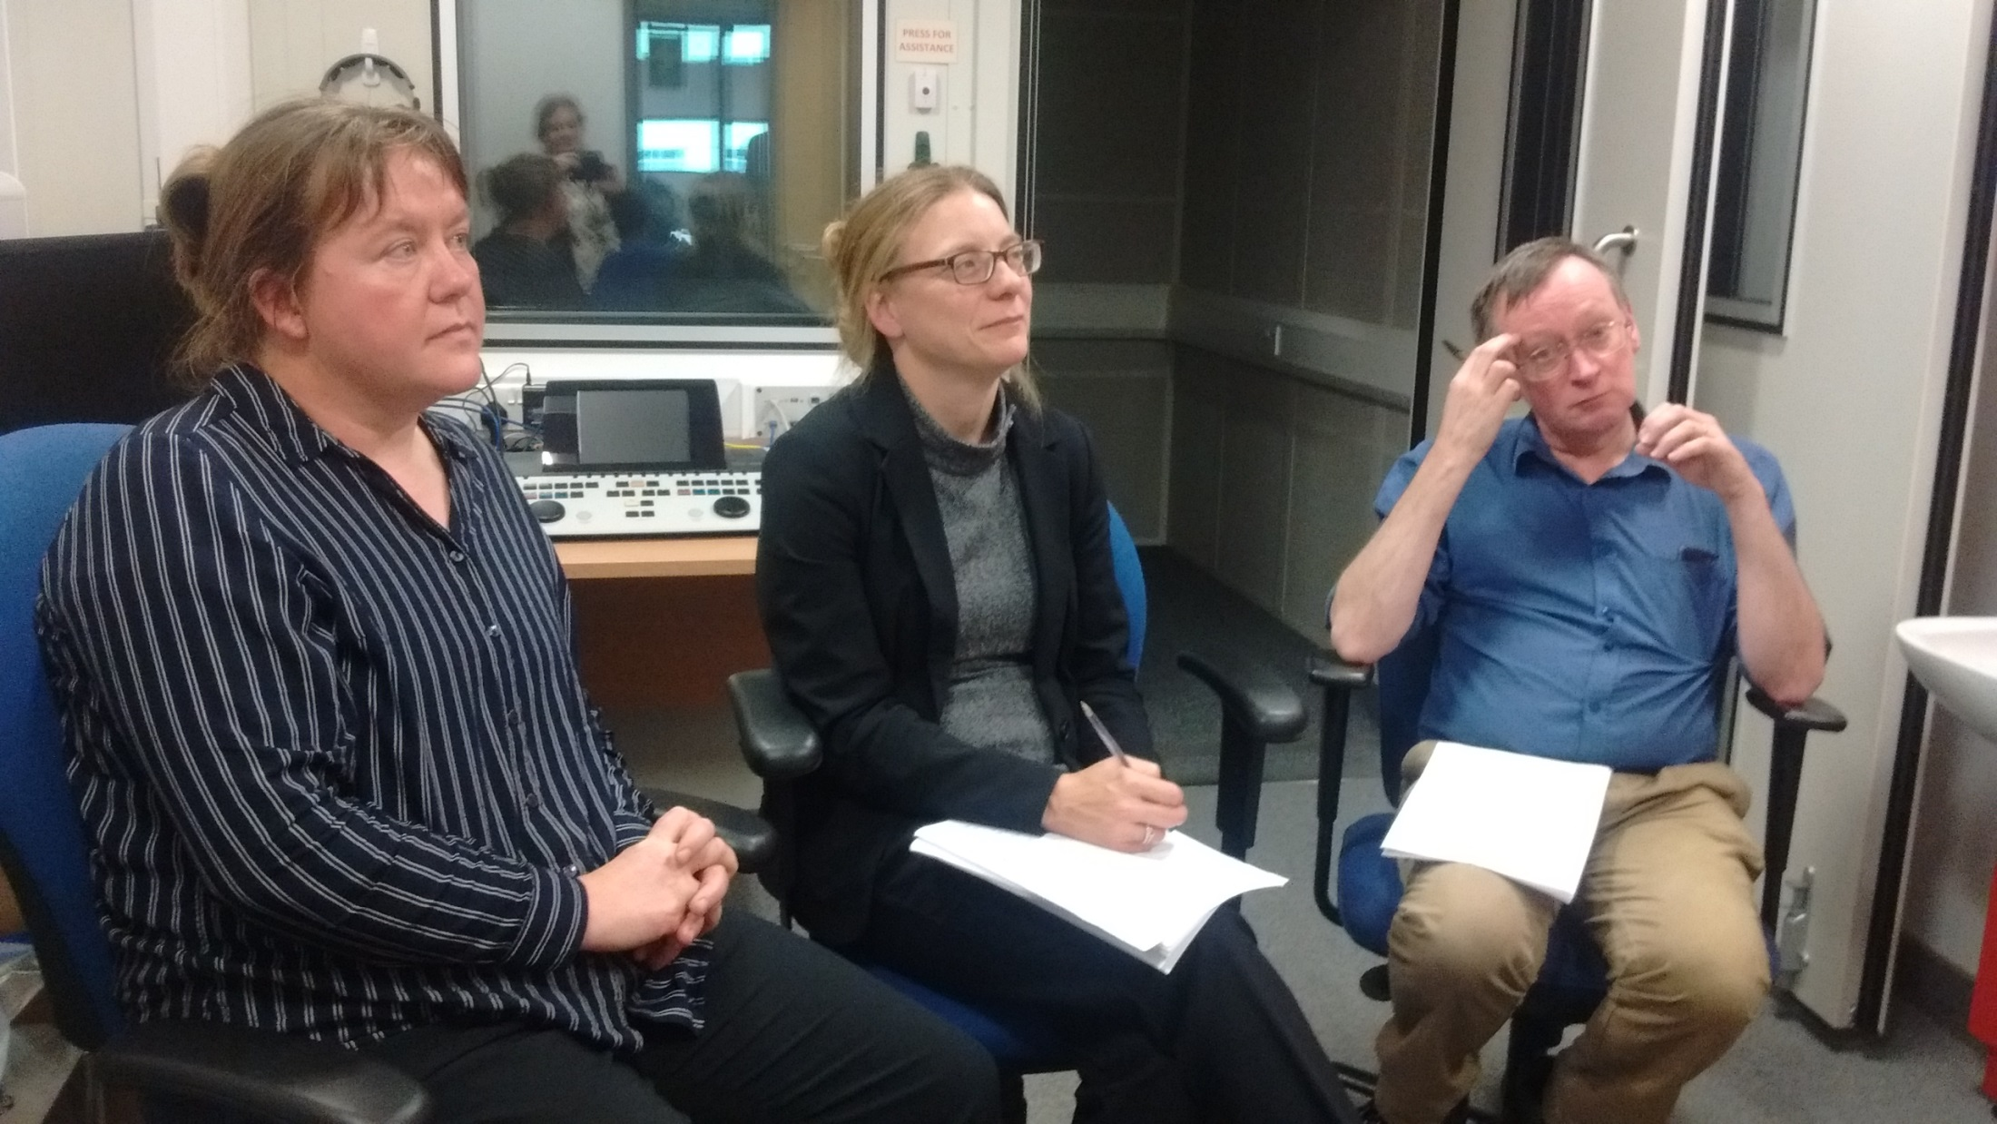
INSERT PHOTOS
Expert input from
researchers
at MRC

Slide 8
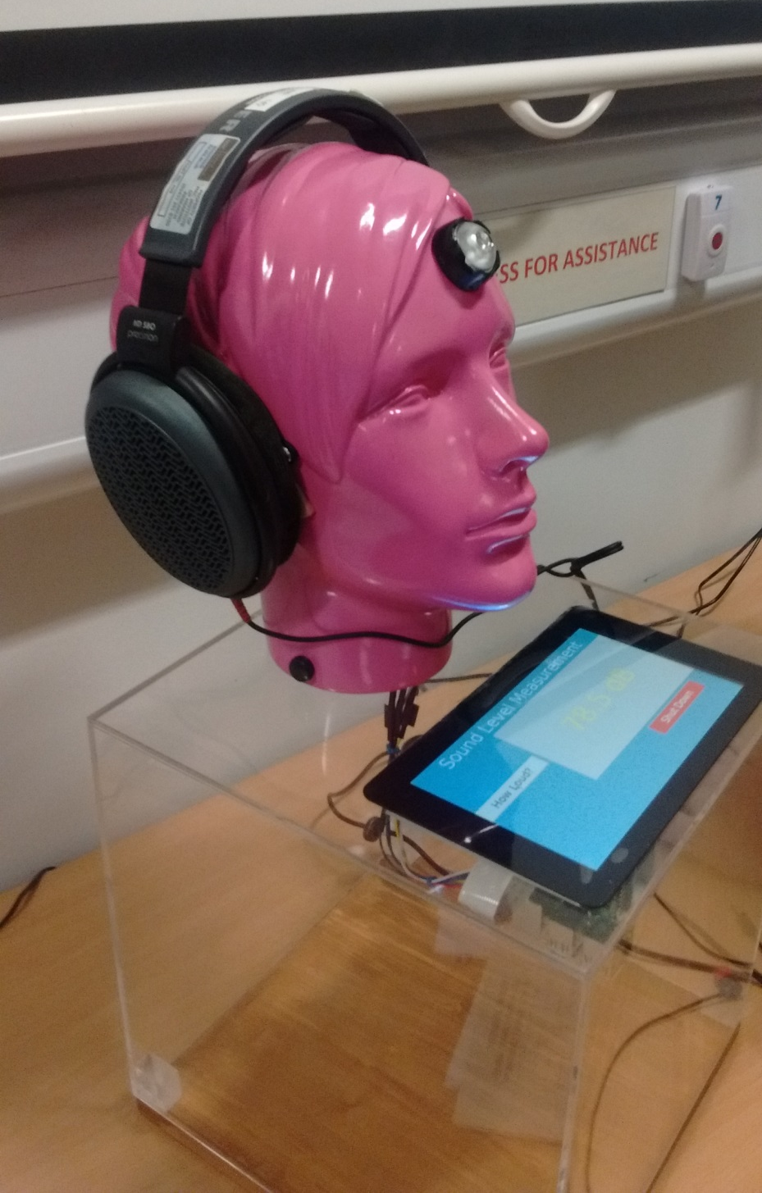
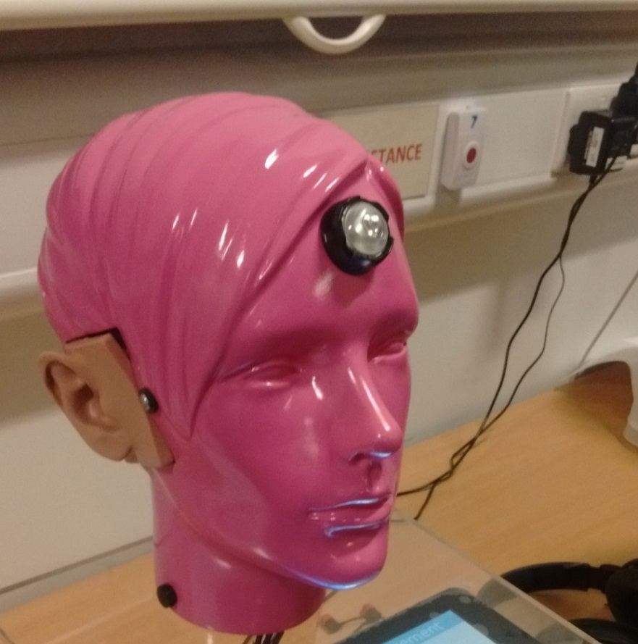
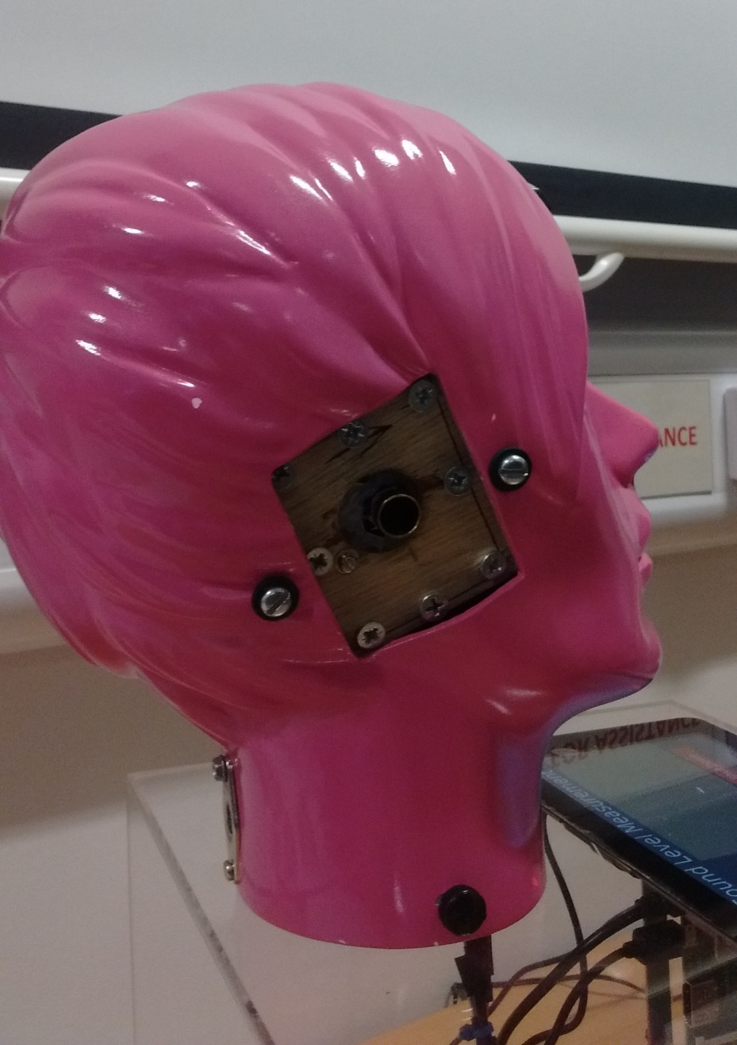
ROSIE

Slide 9
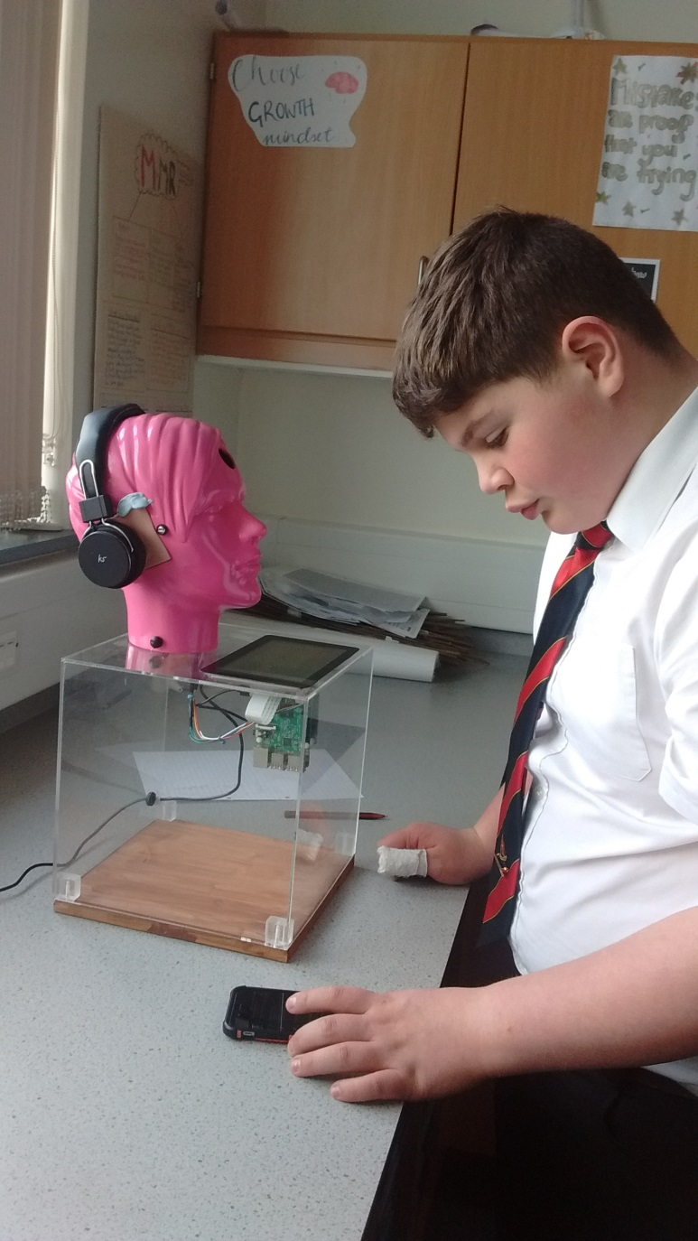
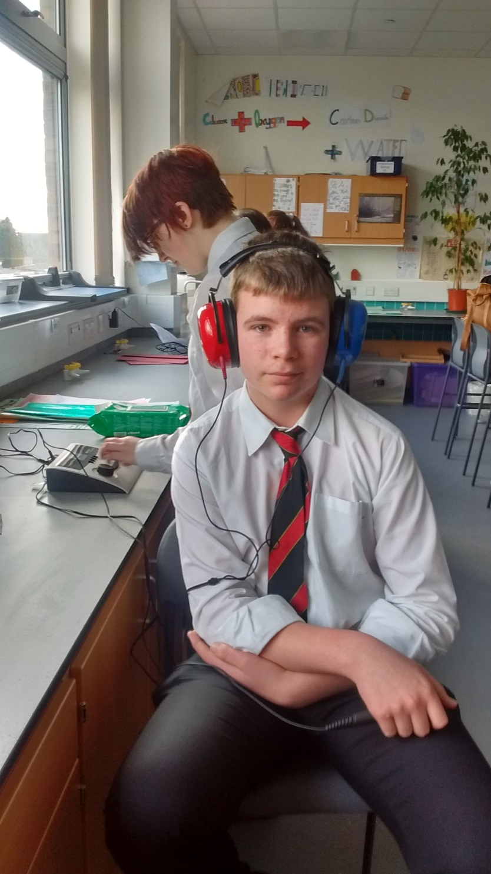
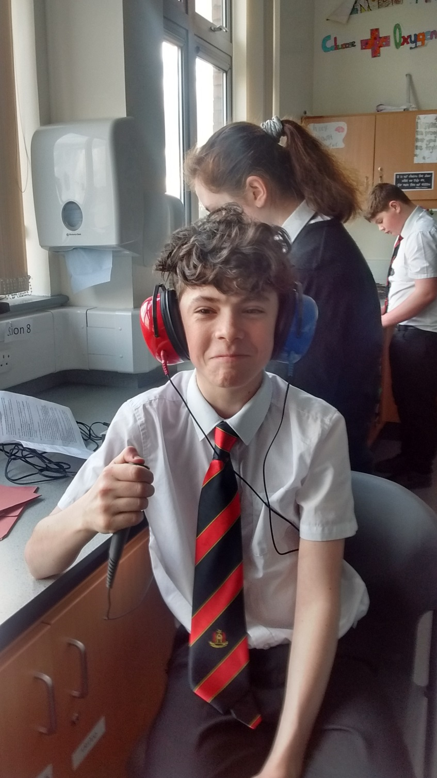
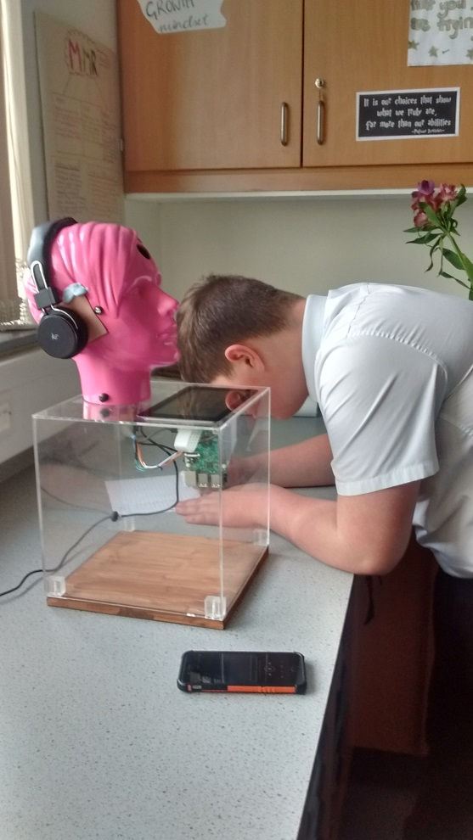
Notes:
Who we need? People to have their hearing tested, People to train to be audiometrist, people with music or not, committment

Slide 10
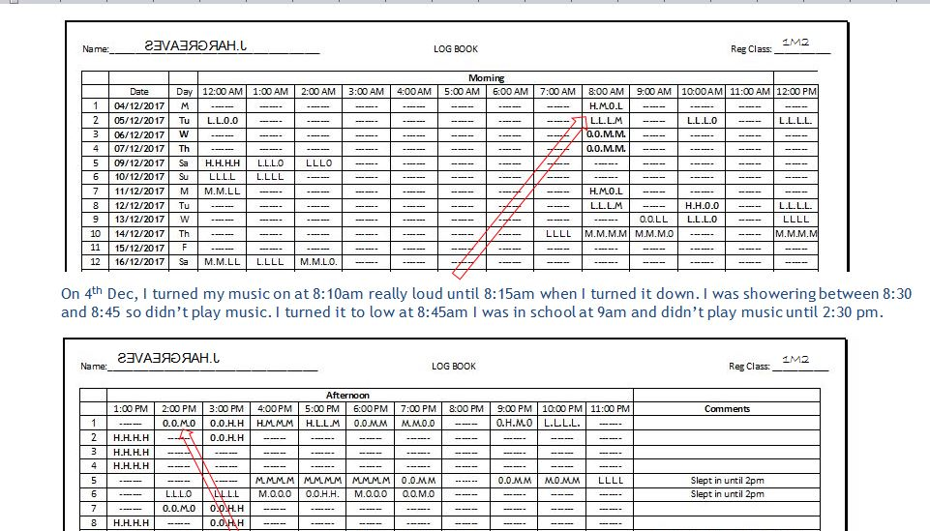

Slide 11
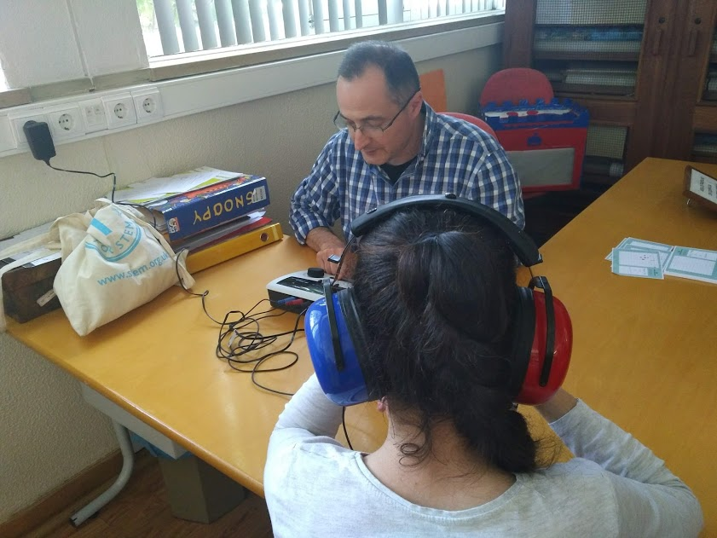
Portugal

Slide 12

Who KNOWS WHERE IT WILL LEAD?

