Slide 1
Physics Support Materials
Higher Mechanics and Properties of Matter
Solutions to Problems - Equations of Motion
Click on a question number
27, 28, 33, 34, 35, 36, 37, 38, 39, 40, 41, 42, 43, 44, 45, 46, 47, 48, 49

Slide 2
Physics Support Materials
Higher Mechanics and Properties of Matter
Equations of Motion
27
The graph below shows how the acceleration of an object varies with time. The object starts from rest.
30
a / m s⁻²
20
4
v / m s⁻¹
10
2
0
5
10
t / s
Draw a velocity - time graph for the first 10 s of the motion.
Click the mouse to continue

Slide 3
Physics Support Materials
Higher Mechanics and Properties of Matter
Equations of Motion
28
The velocity time graph for an object is shown below.
Draw the corresponding acceleration - time graph.
v / m s⁻¹
a / m s⁻²
10
10
5
5
0
t / s
0
2
3
4
10
0.5
2
3
4
10
3
t / s
10
Click the mouse to continue

Slide 4
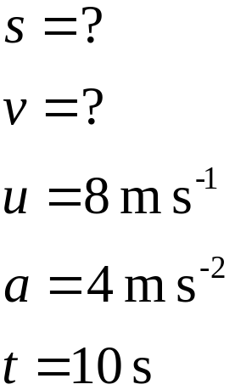
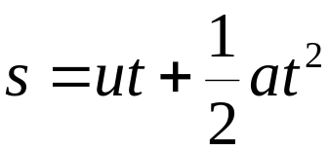
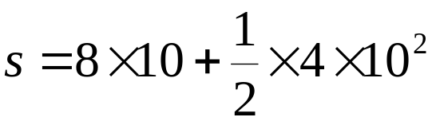
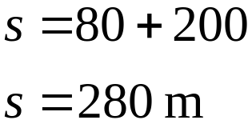
Physics Support Materials
Higher Mechanics and Properties of Matter
Equations of Motion
33
An object accelerates uniformly at 4 m s⁻² from an initial speed of 8 m s⁻¹. How far does it travel in 10 s?
Click the mouse to continue

Slide 5
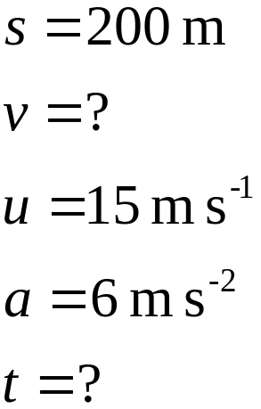


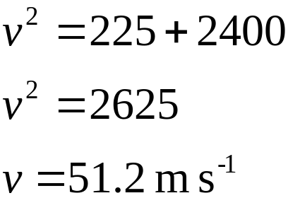
Physics Support Materials
Higher Mechanics and Properties of Matter
Equations of Motion
34
A car accelerates uniformly at 6 m s⁻². Its initial speed is 15 m s⁻¹ and it covers a distance of 200 m. Calculate its final velocity.
Click the mouse to continue

Slide 6
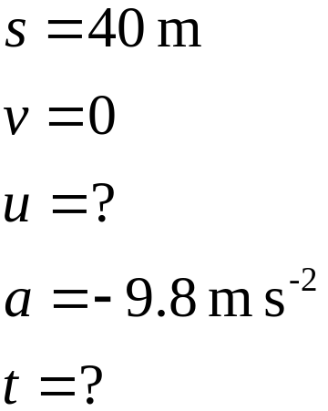

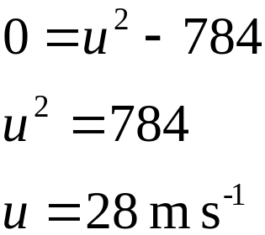
Physics Support Materials
Higher Mechanics and Properties of Matter
Equations of Motion
35
A ball is thrown to a height of 40 m above its starting point. With what velocity was it thrown?
Choose the initial direction as being positive. i.e. up is +ve.
Click the mouse to continue

Slide 7
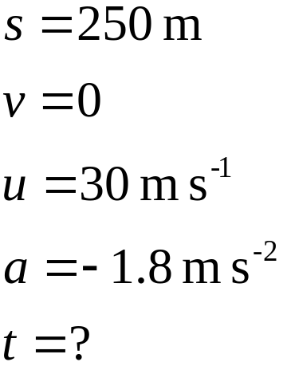


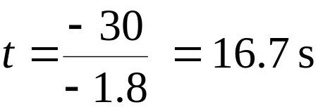
Physics Support Materials
Higher Mechanics and Properties of Matter
Equations of Motion
36
A car travelling at 30 m s⁻¹ slows down at 1.8 m s⁻² over a distance of 250 m. How long does it take to stop?
Click the mouse to continue

Slide 8
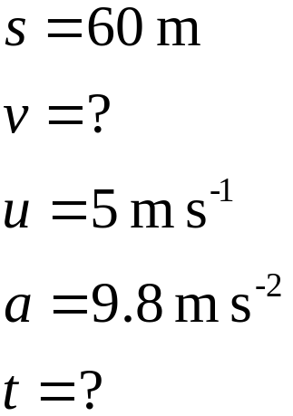


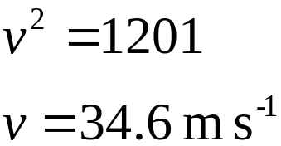
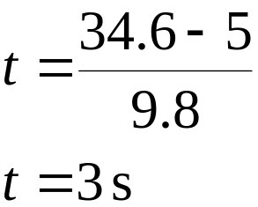
Physics Support Materials
Higher Mechanics and Properties of Matter
Equations of Motion
37
If a stone is thrown vertically down a well at 5 m s⁻¹, calculate the time taken for the stone to reach the water surface 60 m below.
Choose the initial direction as being positive. i.e. down is +ve.
Click the mouse to continue

Slide 9
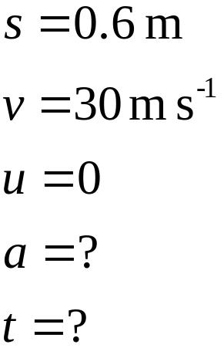


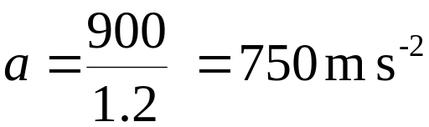
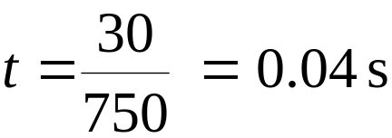

Physics Support Materials
Higher Mechanics and Properties of Matter
Equations of Motion
38
A tennis ball launcher is 0.6 m long and the velocity of a tennis ball leaving the launcher is 30 m s⁻¹. Calculate:
a) the average acceleration of a tennis ball .
b) the time of transit in the launcher .
Click the mouse to continue

Slide 10
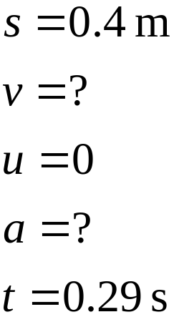
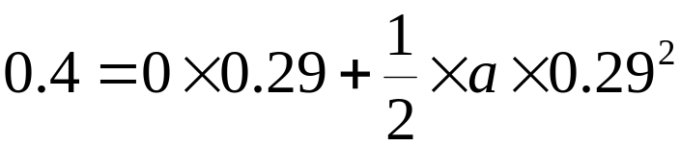

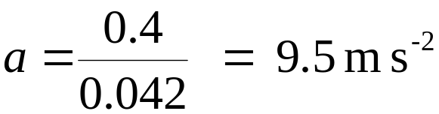

Physics Support Materials
Higher Mechanics and Properties of Matter
Equations of Motion
39
In an experiment to find ‘g’, a steel ball falls from rest through 40 cm. The time taken is 0.29 s. What is the value calculated for ‘g’?
Click the mouse to continue

Slide 11
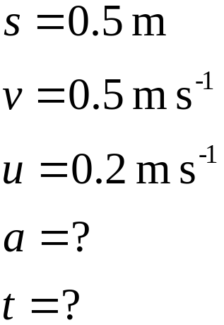



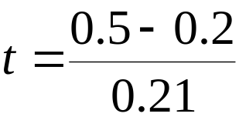


Physics Support Materials
Higher Mechanics and Properties of Matter
Equations of Motion
40
A trolley accelerates down a slope. Two photocells spaced 0.5 m apart measure the velocities to be 20 cm s⁻¹ and 50 cm s⁻¹. Calculate:
a) the acceleration of the trolley
b) the time taken to cover the 0.5 m
Click the mouse to continue

Slide 12
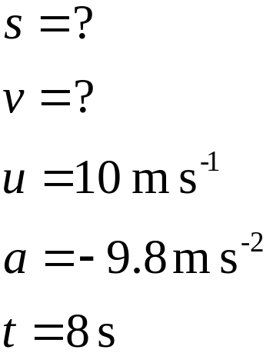
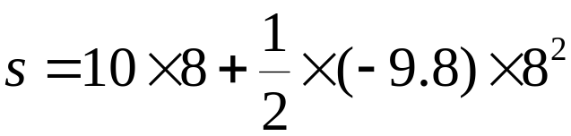


Physics Support Materials
Higher Mechanics and Properties of Matter
Equations of Motion
41
A helicopter is rising vertically at 10 m s⁻¹ when a wheel falls off. The wheel hits the ground 8 s later. Calculate at what height the helicopter was flying when the wheel came off.
Choose the initial direction as being positive. i.e. up is +ve.
Click the mouse to continue

Slide 13
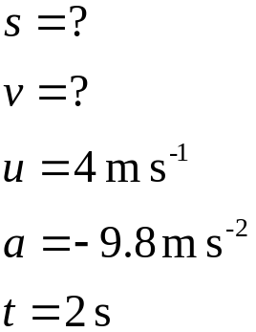
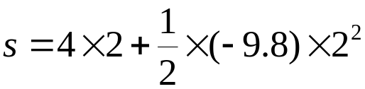
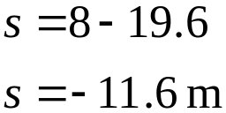
Physics Support Materials
Higher Mechanics and Properties of Matter
Equations of Motion
42
A ball is thrown upwards from the side of a cliff as shown below.
4 m s⁻¹
Choose the initial direction as being positive. i.e. up is +ve.
33 m
a) Calculate:
Sea
i) the height of the ball above sea level after 2 s.
The displacement of the ball is 11.6 m down. This means the ball is 33 - 11.6 = 21.4 m above sea level
Click the mouse to continue

Slide 14


Physics Support Materials
Higher Mechanics and Properties of Matter
Equations of Motion
42 continued
A ball is thrown upwards from the side of a cliff as shown below.
4 m s⁻¹
Choose the initial direction as being positive. i.e. up is +ve.
33 m
a) Calculate:
Sea
ii) the ball’s velocity after 2 s.
Click the mouse to continue

Slide 15
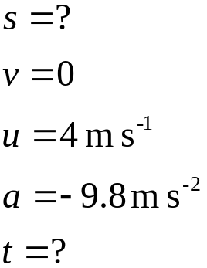


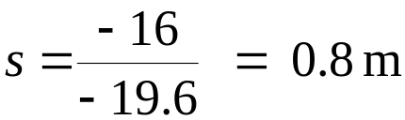
Physics Support Materials
Higher Mechanics and Properties of Matter
Equations of Motion
42 continued
A ball is thrown upwards from the side of a cliff as shown below.
4 m s⁻¹
Choose the initial direction as being positive. i.e. up is +ve.
33 m
Sea
b) What is the total distance travelled by the ball from launch to landing in the sea?
Consider the motion of the ball from release to the top of its flight
The ball travels 0.8 m up, 0.8 m back to its starting point, then 33 m to the sea. i.e. 34.6 m in total
Click the mouse to continue

Slide 16
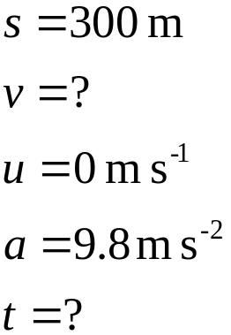
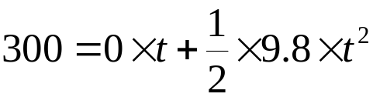

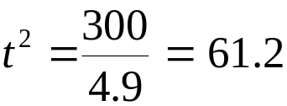

Physics Support Materials
Higher Mechanics and Properties of Matter
Equations of Motion
43
A box is released from a plane travelling with a horizontal velocity of 300 m s⁻¹ and at a height of 300 m. Find:
a) how long it takes the box to hit the ground
Consider the vertical motion of the box
Down is the positive direction
Click the mouse to continue

Slide 17
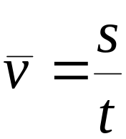

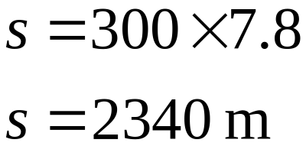
Physics Support Materials
Higher Mechanics and Properties of Matter
Equations of Motion
43 continued
A box is released from a plane travelling with a horizontal velocity of 300 m s⁻¹ and at a height of 300 m. Find:
b) the horizontal distance between the point of impact and the release point
Consider the horizontal motion of the box
c) the position of the plane relative to the box at the time of impact
The box and the plane have the same horizontal motion (constant speed), so they travel the distance horizontally as the box falls. At impact, the plane is vertically above the box.
Click the mouse to continue

Slide 18
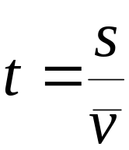
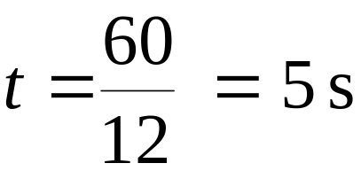
Physics Support Materials
Higher Mechanics and Properties of Matter
Equations of Motion
44
A projectile is fired horizontally from the edge of a cliff at 12 m s⁻¹ and hits the sea 60 m away. Find:
a) the time of flight
12 m s⁻¹
Sea
60 m
Consider the horizontal motion of the projectile
Click the mouse to continue

Slide 19
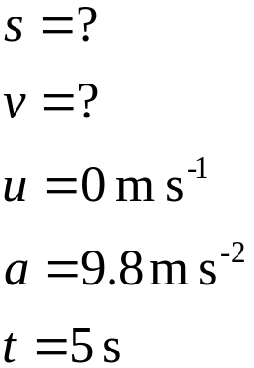
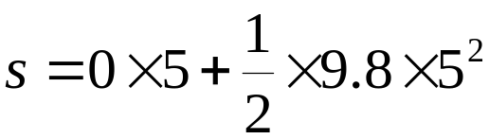

Physics Support Materials
Higher Mechanics and Properties of Matter
Equations of Motion
44 continued
A projectile is fired horizontally from the edge of a cliff at 12 m s⁻¹ and hits the sea 60 m away. Find:
b) the height of the starting point above the sea level
12 m s⁻¹
Consider the vertical motion of the projectile
Down is the positive direction
Sea
60 m
Click the mouse to continue

Slide 20
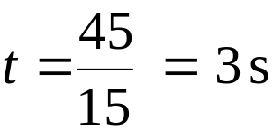
Physics Support Materials
Higher Mechanics and Properties of Matter
Equations of Motion
45
A ball is projected horizontally at 15 m s⁻¹ from the top of a vertical cliff. It reaches the horizontal ground 45 m from the foot of the cliff.
a) Draw graphs, giving appropriate numerical values of the ball’s
i) horizontal speed against time
Calculating the time of flight:
Consider the horizontal motion of the projectile
v / m s⁻¹
15
10
5
0
1
2
3
t / s
Click the mouse to continue

Slide 21
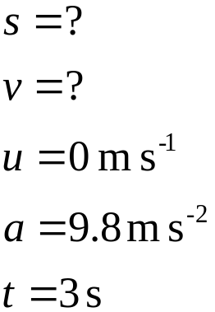
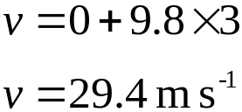
Physics Support Materials
Higher Mechanics and Properties of Matter
Equations of Motion
45 continued
A ball is projected horizontally at 15 m s⁻¹ from the top of a vertical cliff. It reaches the horizontal ground 45 m from the foot of the cliff.
a) Draw graphs, giving appropriate numerical values of the ball’s
ii) vertical speed against time
Consider the vertical motion of the projectile
Calculating the final vertical velocity:
v / m s⁻¹
30
20
10
0
1
2
3
t / s
Click the mouse to continue

Slide 22

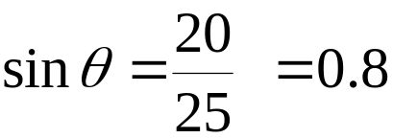

Physics Support Materials
Higher Mechanics and Properties of Matter
Equations of Motion
45 continued
A ball is projected horizontally at 15 m s⁻¹ from the top of a vertical cliff. It reaches the horizontal ground 45 m from the foot of the cliff.
b) Use a vector diagram to find the velocity of the ball 2 s after its projection.
After 2 s the horizontal velocity is 15 m s⁻¹
After 2 s the vertical velocity is 20 m s⁻¹
15 m s⁻¹
v² = 15² + 20²
v² = 625
v
20 m s⁻¹
v = 25 m s⁻¹
Click the mouse to continue

Slide 23
Physics Support Materials
Higher Mechanics and Properties of Matter
Equations of Motion
46
A projectile is fired across level ground taking 6 s to travel from A to B. The highest point reached is C. Air resistance is negligible.
C
Velocity - time graphs for the flight are shown below
A
B
v_{H} / m s⁻¹
v_{v} / m s⁻¹
40
30
0
t / s
0
t / s
3
6
3
6
-30
a) Describe the horizontal and vertical motions of the projectile
The horizontal motion is a constant speed ( 40 m s⁻¹)
The vertical motion is a constant acceleration ( 10 m s⁻²)
Click the mouse to continue

Slide 24
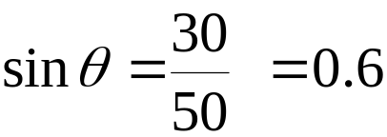

Physics Support Materials
Higher Mechanics and Properties of Matter
Equations of Motion
46 continued
A projectile is fired across level ground taking 6 s to travel from A to B. The highest point reached is C. Air resistance is negligible.
C
v_{H} / m s⁻¹
v_{v} / m s⁻¹
40
30
A
B
3
3
0
6
0
t / s
6
t / s
-30
b) Use a vector diagram to find the speed and angle at which the projectile was fired from point A.
v
30 m s⁻¹
v² = 30² + 40²
v² = 2500
40 m s⁻¹
v = 50 m s⁻¹
Click the mouse to continue

Slide 25
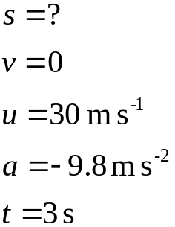
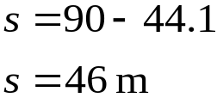
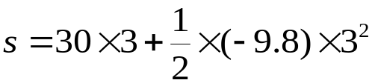
Physics Support Materials
Higher Mechanics and Properties of Matter
Equations of Motion
46 continued
A projectile is fired across level ground taking 6 s to travel from A to B. The highest point reached is C. Air resistance is negligible.
C
v_{H} / m s⁻¹
v_{v} / m s⁻¹
40
30
A
B
3
3
0
6
0
t / s
6
t / s
-30
c) Find the speed at position C. Explain why this is the smallest speed of the projectile.
The speed at C is 40 m s⁻¹ ( The vertical speed is zero)
d) Calculate the height above the ground of point C.
Consider the vertical motion of the projectile
Click the mouse to continue

Slide 26
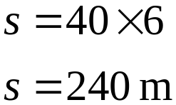
Physics Support Materials
Higher Mechanics and Properties of Matter
Equations of Motion
46 continued
A projectile is fired across level ground taking 6 s to travel from A to B. The highest point reached is C. Air resistance is negligible.
C
v_{H} / m s⁻¹
v_{v} / m s⁻¹
40
30
A
B
3
3
0
6
0
t / s
6
t / s
-30
e) Find the range AB.
Consider the horizontal motion of the projectile
Click the mouse to continue

Slide 27


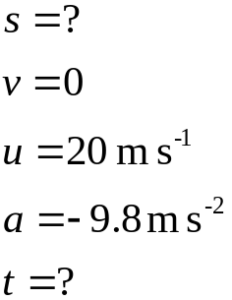
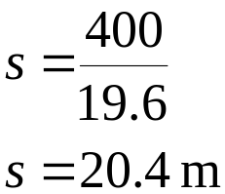


Physics Support Materials
Higher Mechanics and Properties of Matter
Equations of Motion
47
An object of mass 5 kg is propelled with a speed of 40 m s⁻¹ at an angle of 30º to the horizontal.
40 m s⁻¹
30º
Range
Find:
a) the vertical component of its initial velocity
b) the maximum vertical height reached
Consider the vertical motion of the projectile
Click the mouse to continue

Slide 28

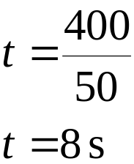
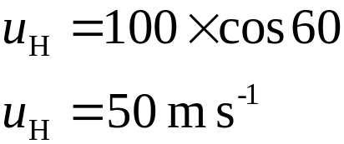
Physics Support Materials
Higher Mechanics and Properties of Matter
Equations of Motion
48
A missile is launched at 60º to the ground and strikes a target on a hill as shown below.
100 m s⁻¹
60º
400 m
If the initial speed of the missile was 100 ms⁻¹ find:
a) the time taken to reach the target
Consider the horizontal motion of the projectile
Click the mouse to continue

Slide 29




Physics Support Materials
Higher Mechanics and Properties of Matter
Equations of Motion
48 continued
A missile is launched at 60º to the ground and strikes a target on a hill as shown below.
100 m s⁻¹
60º
400 m
If the initial speed of the missile was 100 ms⁻¹ find:
b) the height of the target above the launcher.
Consider the vertical motion of the projectile
Click the mouse to continue

Slide 30







Physics Support Materials
Higher Mechanics and Properties of Matter
Equations of Motion
49
A stunt driver hopes to jump across a canal of width 10 m. The drop to the other side is 2 m as shown. a) Calculate the horizontal speed required to make it to the other side.
v
Consider the vertical motion of the car
2 m
10 m
Let the required speed of the car be v
Consider the horizontal motion of the car
b) State any assumptions you have made.
The calculations do not take into account the size of the car. In practice, the front of the car starts accelerating down before the back.
Click the mouse to continue

