Slide 1
Physics Support Materials
Higher Mechanics and Properties of Matter
Solutions to Problems - Vectors
Click on a question number
14, 15, 16, 17, 18, 19, 21, 22, 23, 24, 25, 26

Slide 2
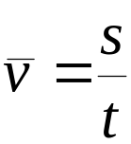
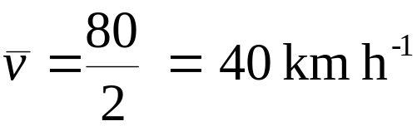
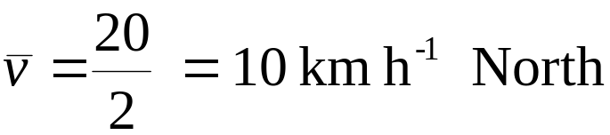
Physics Support Materials
Higher Mechanics and Properties of Matter
Vectors
14
A car travels 50 km N and then returns 30 km S. The whole journey takes 2 hours. Calculate:
a) the distance travelled
Distance travelled is 80 km
b) the average speed
c) the displacement
Displacement is 20 km N
d) the average velocity
Click the mouse to continue

Slide 3


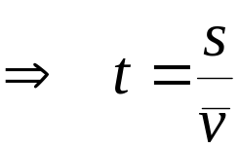
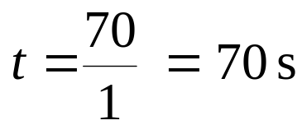
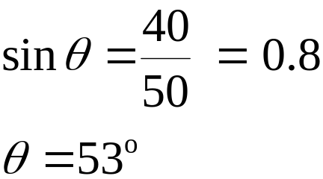
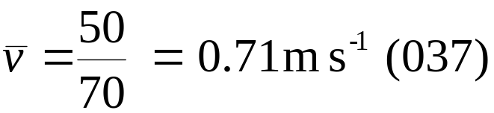
Physics Support Materials
Higher Mechanics and Properties of Matter
Vectors
15
A girl delivers newspapers to three houses, X, Y and Z, as shown in the diagram. Starting at X, the girl walks directly from one house to the next.
a) Calculate the total distance the girl walks.
Z
Distance travelled is 70 km
b) Calculate the girl’s final displacement from X.
50 m
40 m
Displacement is 50 km (037)
c) If the girl walks at a steady speed of 1 m s⁻¹ , calculate the time she takes to get from X to Z.
X
30 m
Y
d) Calculate her resultant velocity.
Click the mouse to continue

Slide 4
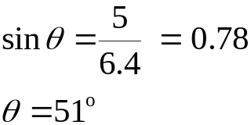
Physics Support Materials
Higher Mechanics and Properties of Matter
Vectors
16
Find the resultant force in the following cases:
a)
3 N
3 N
30º
4 N
Resultant is 6.8 N (077)
30º
6.8 N
4 N
8 N
b)
R² = 8² +8²
R² = 128
R = 11.3
8 N
8 N
11.3 N
Resultant is 11.3 N (045)
8 N
c)
2 N
R² = 5² +4²
R² = 41
R = 6.4
5 N
4 N
6.4 N
3 N
8 N
4 N
5 N
6 N
Resultant is 6.4 N (129)
Click the mouse to continue

Slide 5
Physics Support Materials
Higher Mechanics and Properties of Matter
Vectors
17
An aircraft has a maximum speed of 1000 km h ⁻¹. If it is flying north into a headwind, speed 100 km h ⁻¹, what is the maximum velocity of the aircraft?
Maximum velocity is 900 km h⁻¹ North
Click the mouse to continue

Slide 6
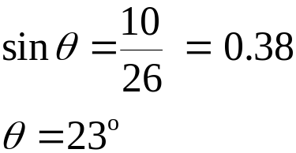
Physics Support Materials
Higher Mechanics and Properties of Matter
Vectors
18
A model aircraft is flying north with a velocity of 24 m s⁻¹. A wind is blowing from the west at 10 m s^{-1.} What is the resultant velocity of the plane?
10 m s⁻¹
10 m s⁻¹
R² = 10² +24²
R² = 676
R = 26
24 m s⁻¹
24 m s⁻¹
26 m s⁻¹
Resultant velocity is 26 ms⁻¹(023)
Click the mouse to continue

Slide 7
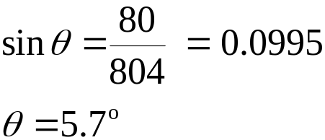
Physics Support Materials
Higher Mechanics and Properties of Matter
Vectors
19
An aircraft pilot wishes to fly north at 800 km h⁻¹. A wind is blowing at 80 km h⁻¹ from the west. What speed and course must he select to fly the desired course?
R² = 800² +80²
R² = 64640
R = 804
80 km h⁻¹
Course to steer
800 km h⁻¹
(Resultant course)
804 km h⁻¹
Course to select is 804 km h⁻¹(354)
Click the mouse to continue

Slide 8
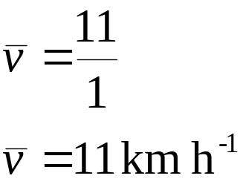
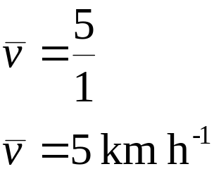
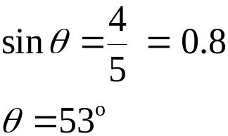
Physics Support Materials
Higher Mechanics and Properties of Matter
Vectors
21
Find the average speed and average velocity of the following: An orienteer who runs 5 km due south, 4 km due west and then 2 km north in 1 hour.
5 km
5 km
2 km
4 km
Average velocity is 5 km h⁻¹(223)
Click the mouse to continue

Slide 9
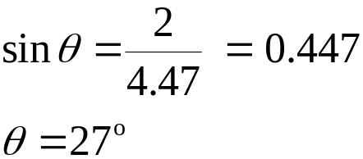
Physics Support Materials
Higher Mechanics and Properties of Matter
Vectors
22
A ship is sailing east at 4 m s⁻¹. A passenger walks due north at 2 m s⁻¹. What is the resultant velocity of the passenger relative to the sea?
4.5 m s⁻¹
R² = 4² +2²
R² = 20
R = 4.47
2 m s⁻¹
4 m s⁻¹
Resultant velocity is 4.5 m s⁻¹(063)
Click the mouse to continue

Slide 10

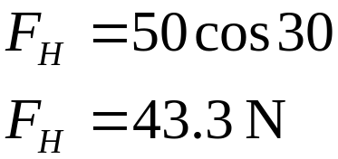
Physics Support Materials
Higher Mechanics and Properties of Matter
Vectors
23
A man pulls a garden roller with a maximum force of 50 N.
50 N
30º
F_{H}
Find his effective horizontal force.
Without changing the force applied, explain how he could increase this effective force.
Reduce the angle at which the force is applied.
Click the mouse to continue

Slide 11
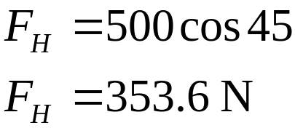
Physics Support Materials
Higher Mechanics and Properties of Matter
Vectors
24
A barge is dragged along a canal as shown below.
500 N
45º
What is the component of the force parallel to the canal?
Click the mouse to continue

Slide 12
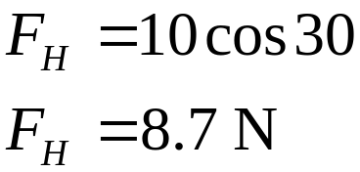
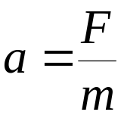
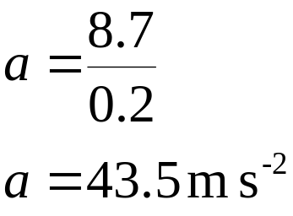
Physics Support Materials
Higher Mechanics and Properties of Matter
Vectors
25
A toy train of mass 0.2 kg, is given a push of 10 N at an angle of 30º to the rails. Calculate:
a) the component of the force along the rails
b) the acceleration of the train
Click the mouse to continue

Slide 13

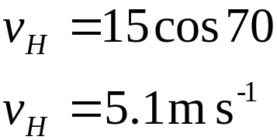

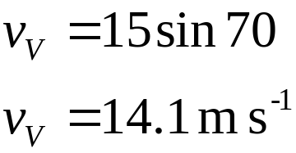
Physics Support Materials
Higher Mechanics and Properties of Matter
Vectors
26
A football is kicked up at an angle of 70º at 15 m s⁻¹. Calculate:
a) the horizontal component of the velocity .
b) the vertical component of the velocity .
Click the mouse to continue

