Slide 1

Polar to Rectangular Coordinates
Adding Vectors

Slide 2
How do you know where you are?

Slide 3
You need a reference point………
Now you are going places!

Slide 4
We can quote the position from the reference point using x and y values
Y
y
x
X

Slide 5
Or we can use polar coordinates
Y
y
R
θ
x
X

Slide 6
Y
y
R
θ
x
X

Slide 7
Y
y
R
θ
x
X

Slide 8
Y
y
R
θ
x
X

Slide 9
Y
y
R
θ
x
X

Slide 10
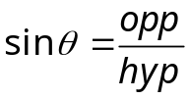



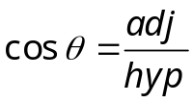

Y
y
R
θ
x
X

Slide 11
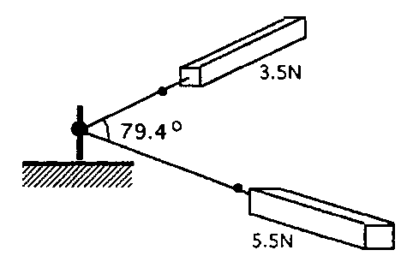
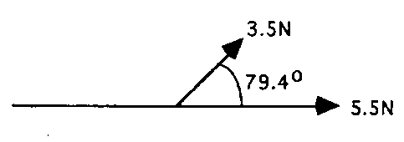
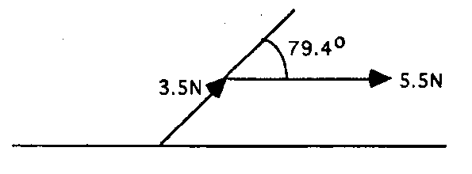
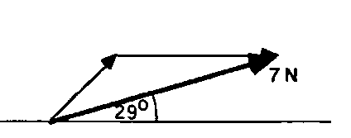
A force of 3.5 N pulls at an angle of 79.4º to a force of 5.5 N as shown.
What single force are these equal to?
VECTOR DIAGRAM:
This is the same as and is equivalent to
which is 7 N at an angle of 29º to the direction of the 5.5 N force.

Slide 12
Resolving Vectors by Scale Diagrams
Always draw a small plan to show all vectors. Include the direction.
Choose an adequate scale (as large as possible but which fits on the page). Use an easy conversion.
Use a sharp pencil and draw the first vector (any one to start).
Put an arrow on the end and ensure you have clearly indicated the start.
On the head of the first vector draw the next vector. Ensure the angles are measured correctly and accurately.
Keep adding vectors until all are drawn.

Slide 13
Resolving Vectors by Scale Diagrams
CHECK!
Draw a line from the START of the FIRST to the HEAD of the FINAL vector. This is the RESULTANT.
Find the angle and measure or calculate it. DON’T MISS THIS OFF!

Slide 14
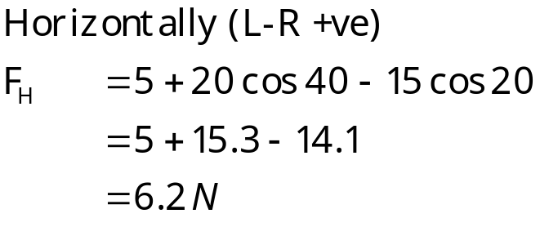
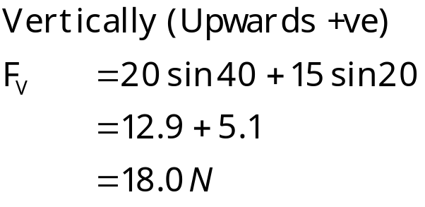
Resolving by components
20 N
120º
40º
15 N
5 N

Slide 15

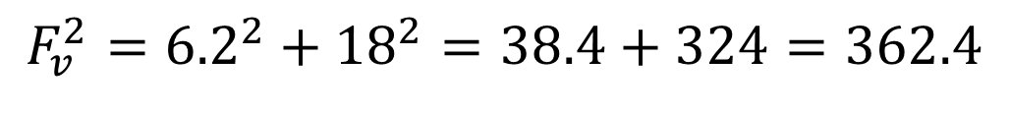

6.2 N
$$F_{v}^{2}={6.2}^{2}+{18}^{2}=38.4+324=362.4$$
18.0 N
R
θ
$$F_{v}^{2}=\sqrt{362.4}=19.0N$$
$$tanθ=\frac{6.2}{18}=0.344$$
θ=19°

Slide 16
25 N
Resolve vectors horizontally:
Choose a direction to be positive.
Find components to each vector.
5 N
45º
60º
+
20 N
10 N
10 N
Horizonal vector Fh=10+25cos60-5cos45-20+0=-1N
Resolve vectors vertically:
Choose a direction to be positive.
Find components to each vector.
Find the resultant vector by Pythagoras:
+
Vertical vector Fv=0+25sin60+5sin45-10+0=15.2N

Slide 17
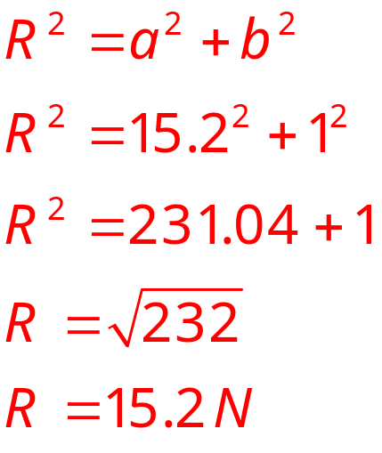
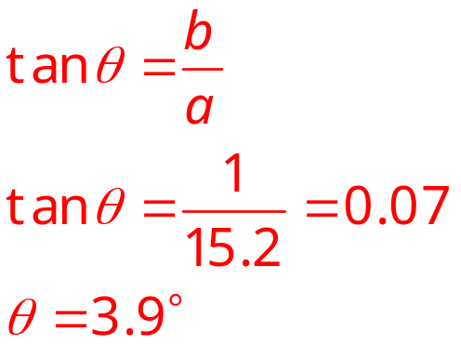
1 N
Pythagoras states that the square of the long side of a right-angled triangle is the sum of the squares of the other two sides
R
15.2 N
θ
1 N
Find θ:

Slide 18
Vector Addition by Components
+
+
40 N
5 N
60 °
30 °
10 N

