Slide 1



Momentum (formula)
And impulse

Slide 2
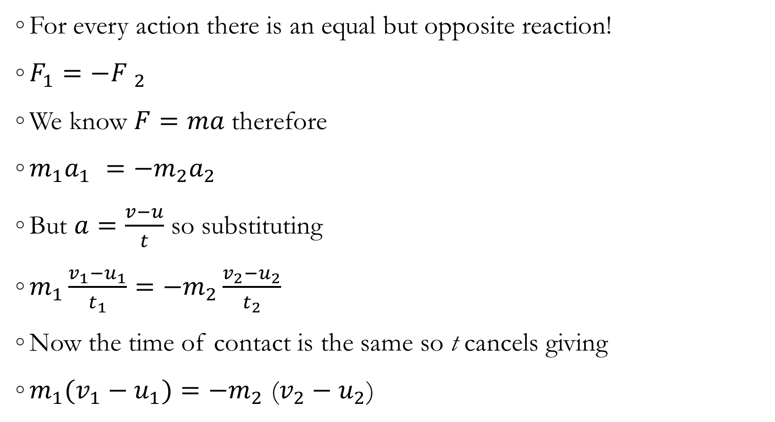
Newton’s Third Law
For every action there is an equal but opposite reaction!
$F_{1}=−{F }_{2}$
We know $F=ma$therefore
$m_{1}a_{1 }=−m_{2}a_{2 }$
But $a=\frac{v−u}{t}$ so substituting
$m_{1}\frac{v_{1}−u_{1}}{t_{1}}=−m_{2}\frac{v_{2}−u_{2}}{t_{2}}$
Now the time of contact is the same so t cancels giving
$m_{1}(v_{1}−u_{1})=−m_{2}$ ($v_{2}−u_{2}$)

Slide 3
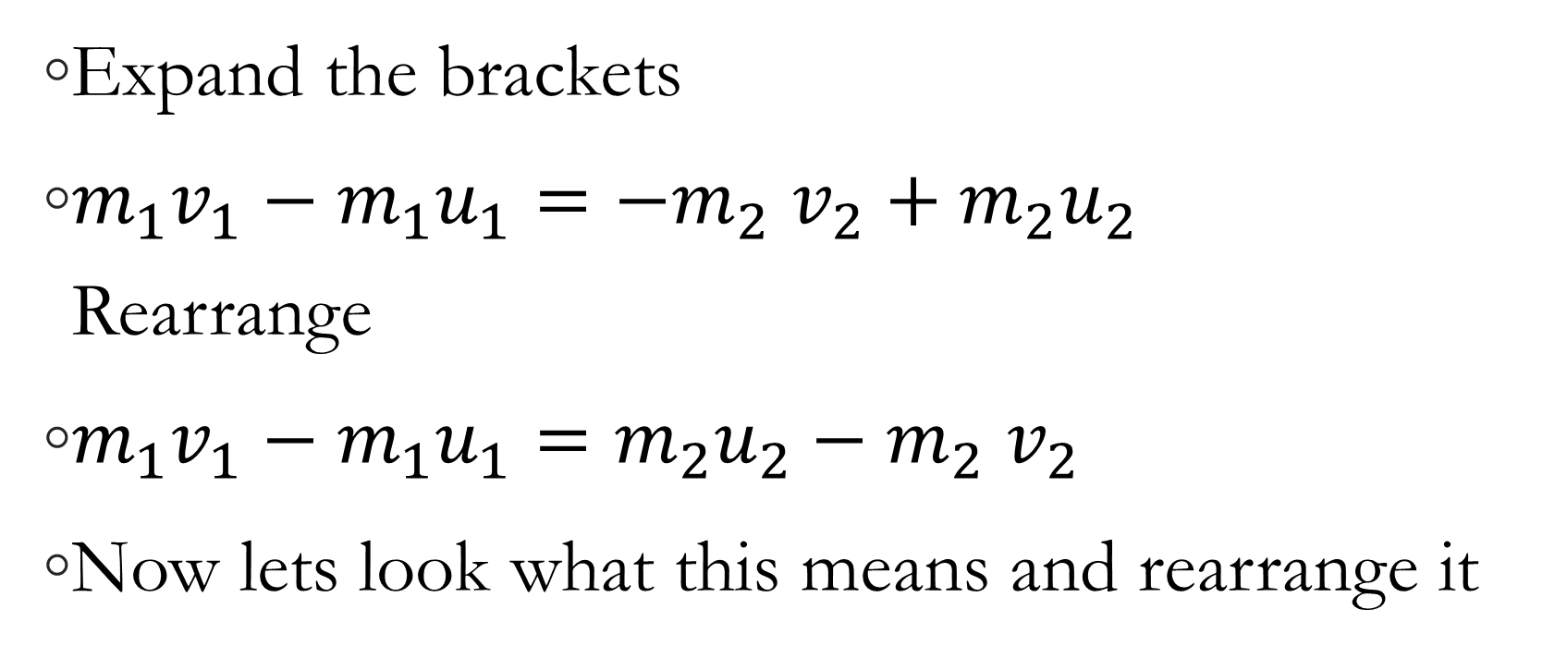
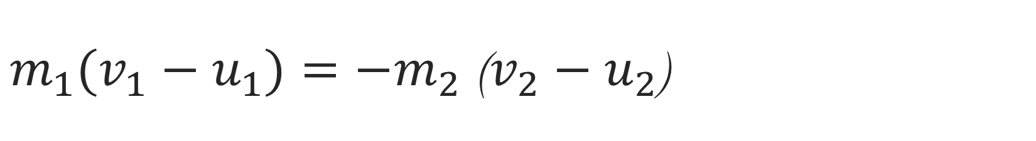
$m_{1}(v_{1}−u_{1})=−m_{2}$ ($v_{2}−u_{2}$)
Expand the brackets
$m_{1}v_{1}−m_{1}u_{1}=−m_{2}$ $v_{2}+{m_{2}u}_{2}$
Rearrange
$m_{1}v_{1}−m_{1}u_{1}={m_{2}u}_{2}−m_{2}$ $v_{2}$
Now lets look what this means and rearrange it

Slide 4
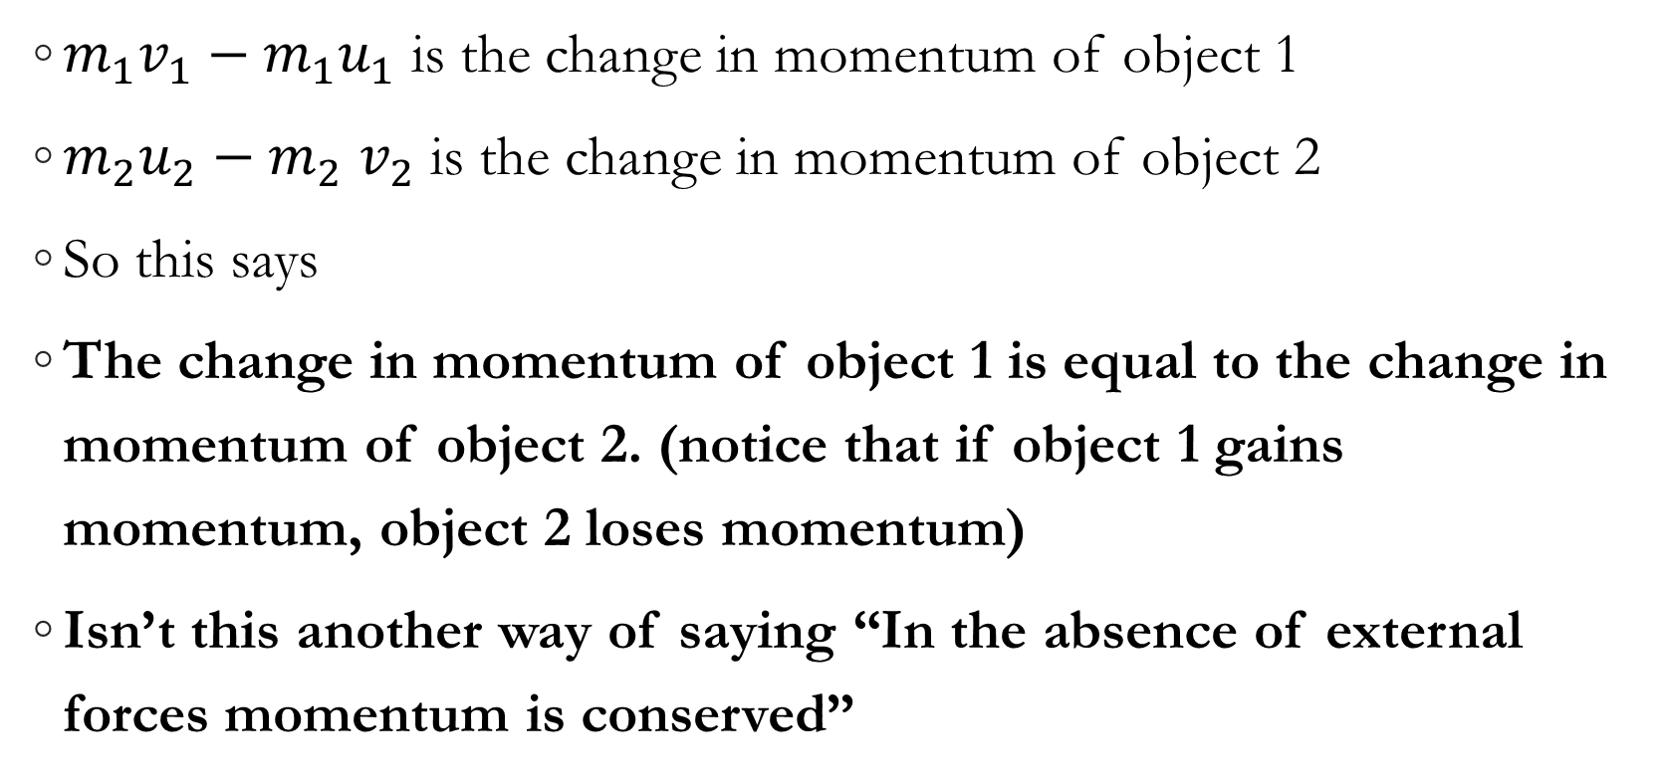
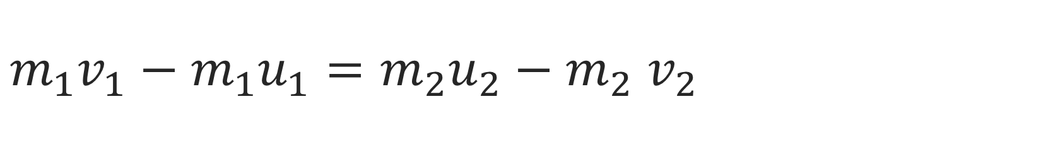
$m_{1}v_{1}−m_{1}u_{1}={m_{2}u}_{2}−m_{2}$ $v_{2}$
$m_{1}v_{1}−m_{1}u_{1}$ is the change in momentum of object 1
${m_{2}u}_{2}−m_{2}$ $v_{2}$ is the change in momentum of object 2
So this says
The change in momentum of object 1 is equal to the change in momentum of object 2. (notice that if object 1 gains momentum, object 2 loses momentum)
Isn’t this another way of saying “In the absence of external forces momentum is conserved”

Slide 5
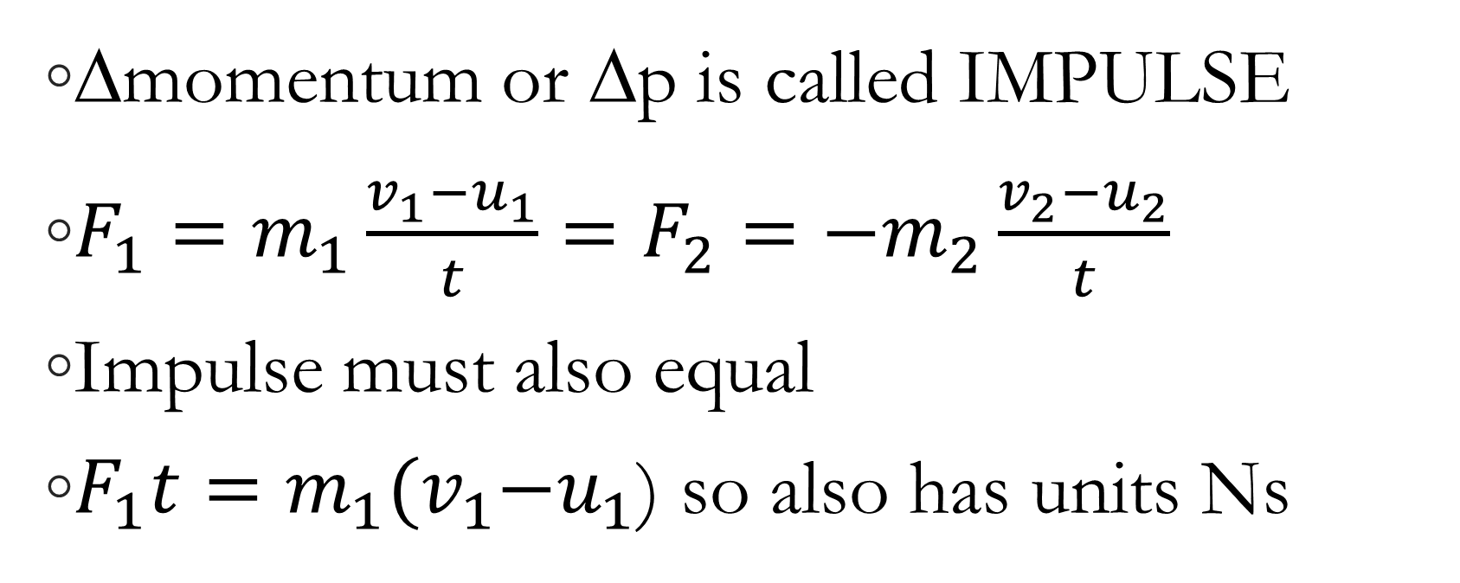
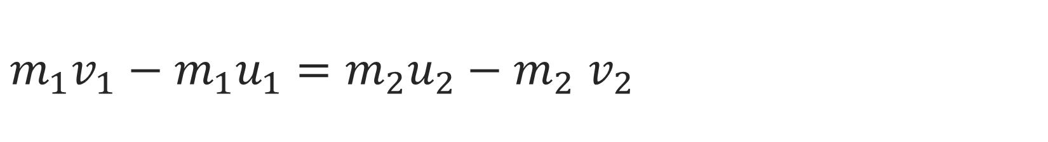
$m_{1}v_{1}−m_{1}u_{1}={m_{2}u}_{2}−m_{2}$ $v_{2}$
Δmomentum or Δp is called IMPULSE
$F_{1}=m_{1}\frac{v_{1}−u_{1}}{t}=F_{2}=−m_{2}\frac{v_{2}−u_{2}}{t}$
Impulse must also equal
$F_{1}t=m_{1}{(v}_{1}−u_{1}$) so also has units Ns

Slide 6
Force time graphs
F
Impulse or change in momentum must also be equal to the AREA under an F-t graph
12
t
0
5

Slide 7
Force time graphs
F
For force-time graphs:
area under graph
= Ft
= Δp (change in momentum)
= impulse
Impulse = area under the graph
= ½ x 12 x 5 = 30 N s.
12
t
0
5

Slide 8
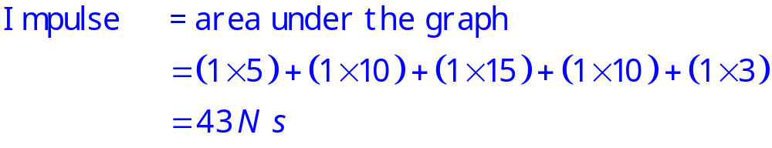
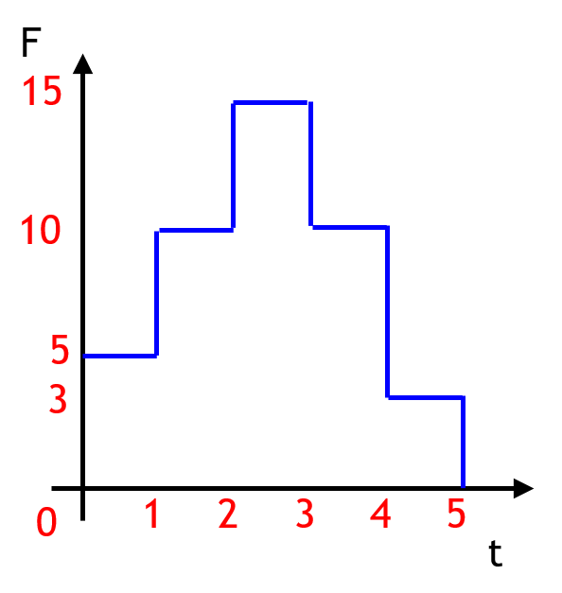

Slide 9
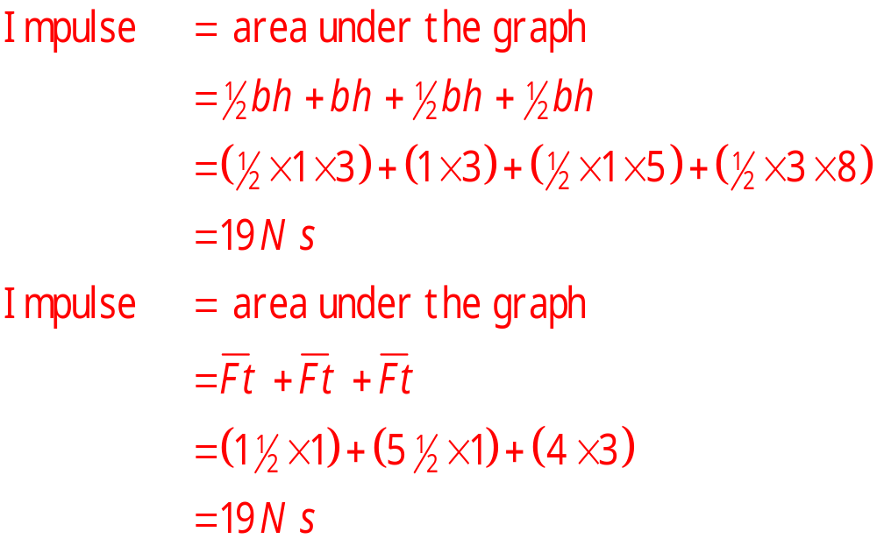
F
8
3
t
0
1
2
5

