Slide 1

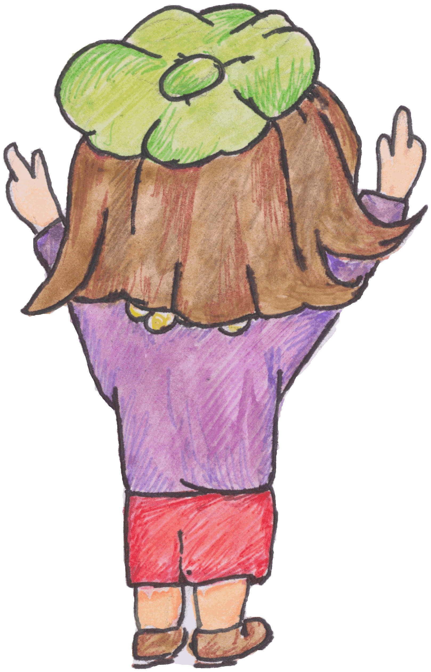
Electricity
N5 Electricity
Section 9&10 of the compendium

Slide 2
Outcomes
Potential Difference (Voltage)
10.1 | I know that a charged particle experiences a force in an electric field
10.2 | I can describe the effect of electric fields on a charged particle
10.3 | I know the path a charged particle takes between two oppositely charged parallel plate
10.4 | I know the path a charged particle takes near a single point charge
10.5 | I know the path a charged particle takes between two oppositely charged points
10.6 | I know the path a charged particle takes between two like charged points
10.7 | I can define the potential difference (voltage) of the supply as a measure of the energy given to the charge carriers in a circuit.

Slide 3
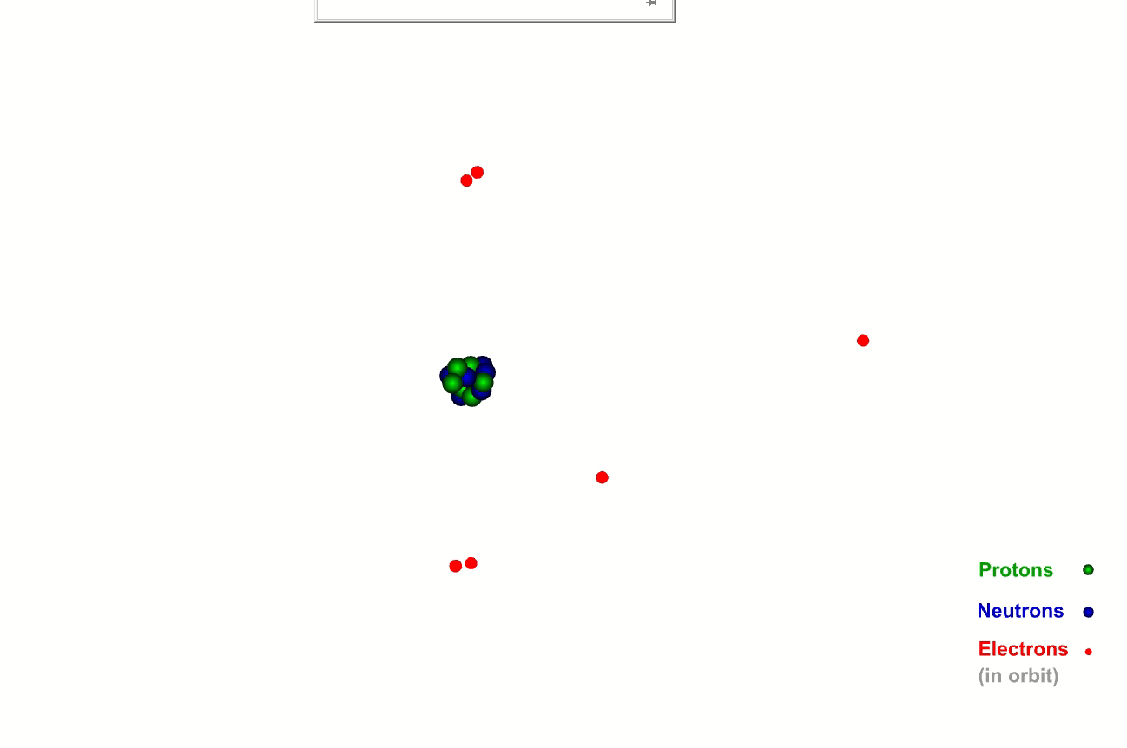
The ATOM & IONISATION

Slide 4
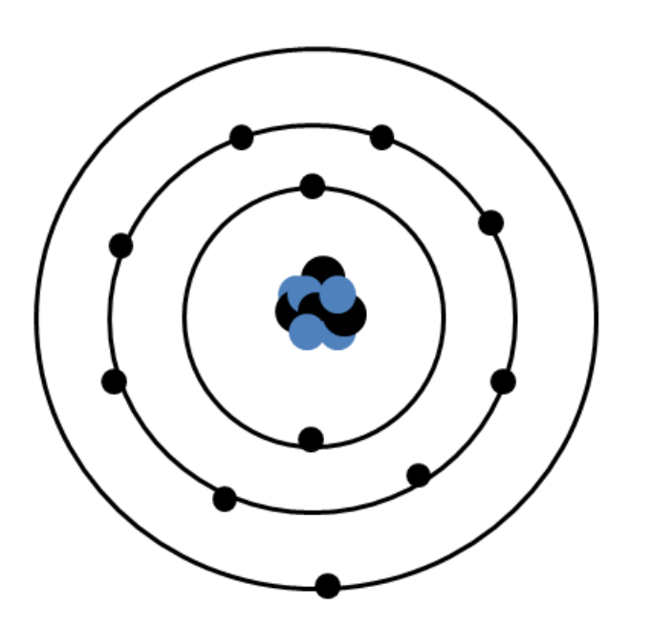
The Atom
Neutron (0)
Nucleus (+)
Proton (+)
Electron (-)
Electron shell (n/a)

Slide 5
The Atom
The atom has an overall charge of 0 (zero) as the number of protons = number of electrons
Neutron has no charge (0)
Proton has positive charge (+)
Electron has negative charge (-)
Nucleus is positively charged due to the protons (+)
CHARGE THE PHYSICS PROPERTY OF MATTER THAT CAUSES
IT TO EXPERIENCE A FORCE IN AN ELECTRIC OR MAGNETIC FIELD
Charge Q, measured in COULOMBS symbol C

Slide 6
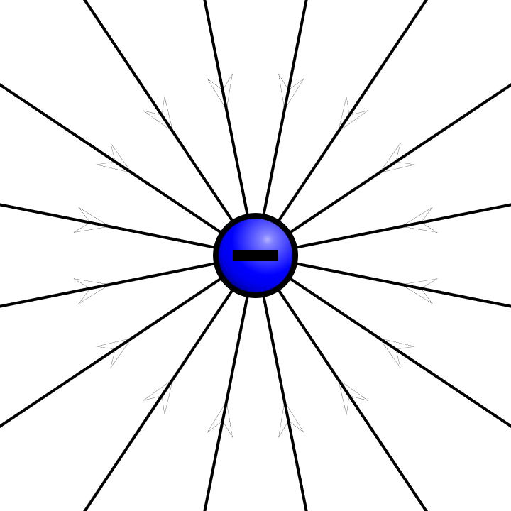
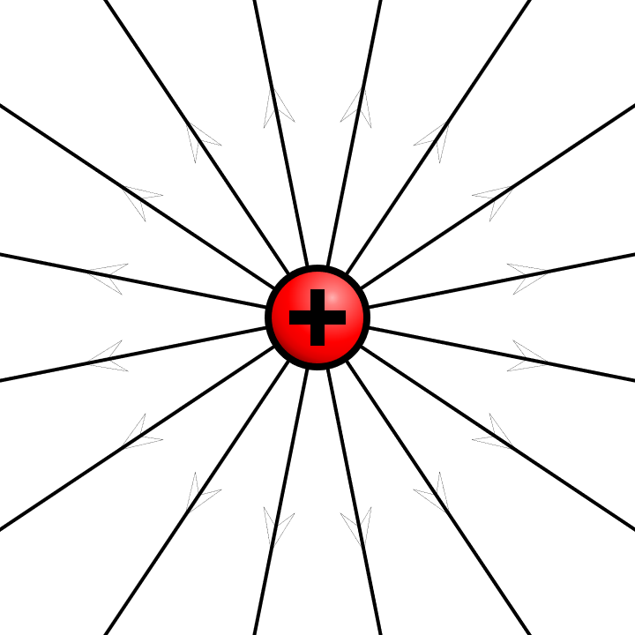
Electric fields caused by charges

Slide 7
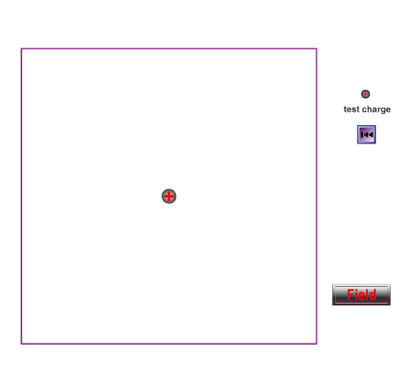
Electric fields
Charged particles apply forces to other charged particles.
The area around a charge where forces are experienced is called an electric field.
The field lines are drawn to show the acceleration and direction on a positive unit test charge placed in the field

Slide 8
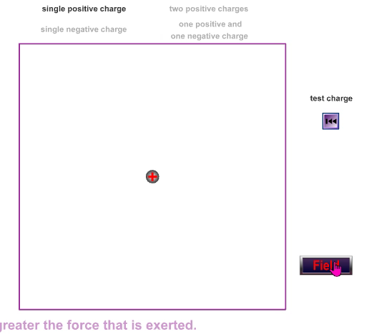
Direction of the electric field and field lines

Slide 9
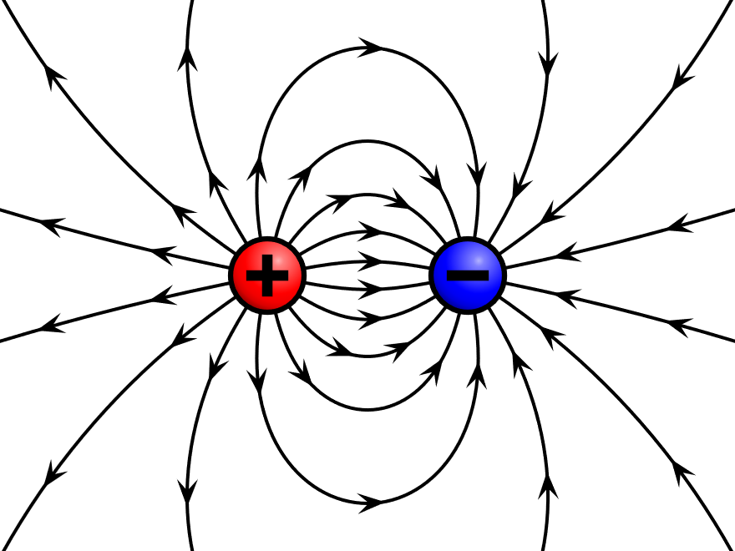
Electric fields caused by charges

Slide 10
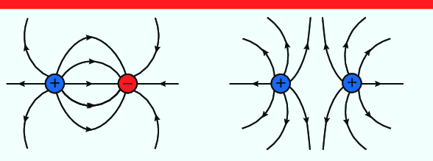
Electric fields caused by charges

Slide 11
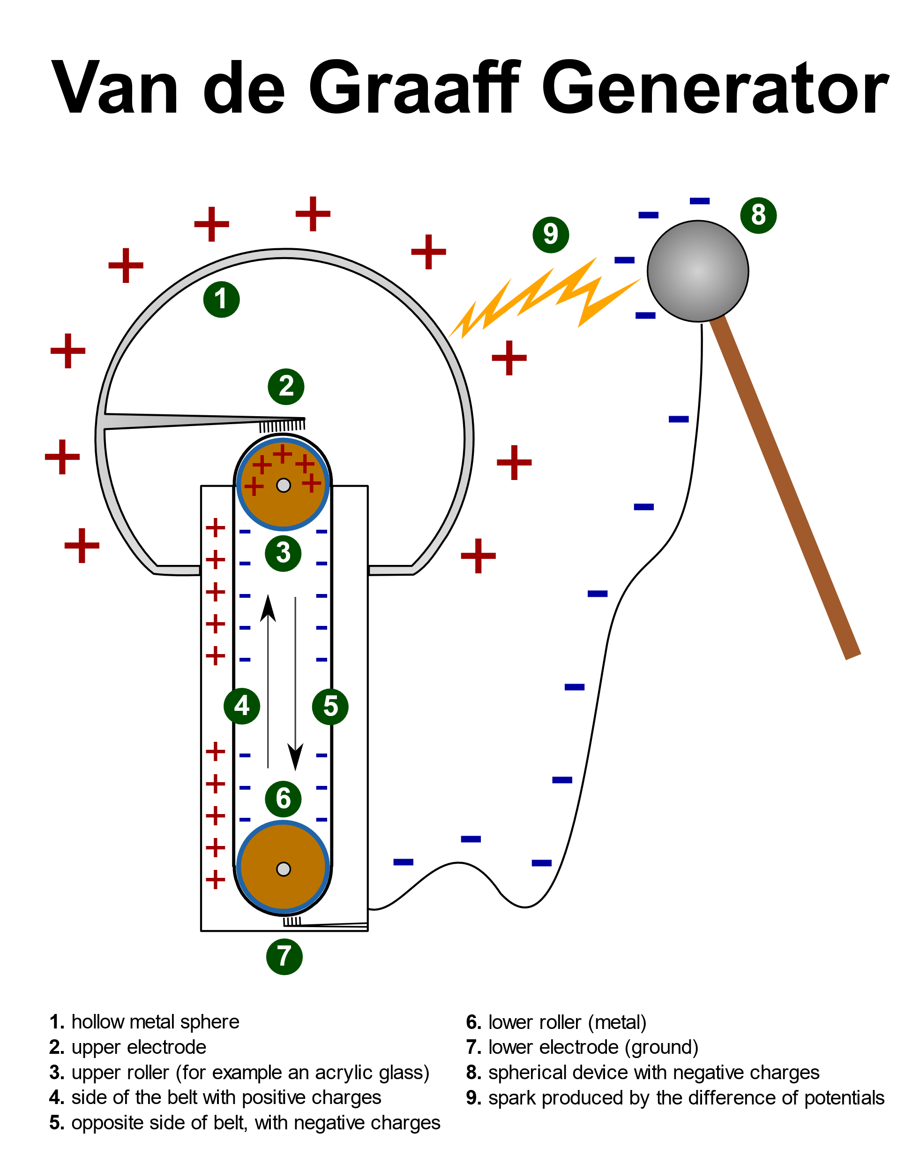
The Van De GraafF
By Omphalosskeptic - Own work, CC BY-SA 3.0, https://commons.wikimedia.org/w/index.php?curid=33070240
An example of
Fields
Forces
Charge
Current
…and Physics is fun!

Slide 12
outcomes
Electrical Charge Carriers
9.1 | I can define electrical current as the electrical charge transferred per unit time.
9.2 | I can carry out calculations using Q=It where t is measured in seconds.
9.3 | I can explain the difference between A.C. and D.C.
9.4 | I can compare the traces of a.c with d.c when viewed on an oscilloscope or data logging software.

Slide 13

When electric charge moves we have a current

Slide 14
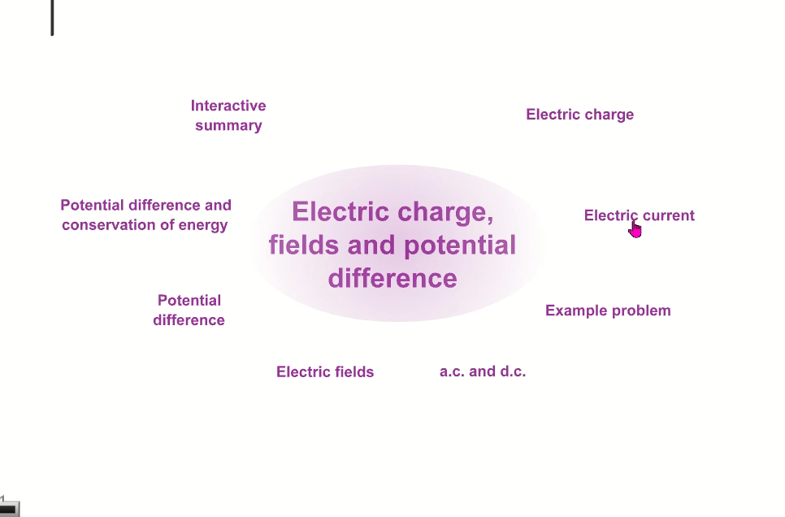
Electric Current

Slide 15

Questions on$Q=It$
 | CHARGE | TIME | CURRENT
a) | 200C | 40s
b) |  | 15s | 4A
c) | 900C |  | 5A
d) |  | 3min | 7.5 mA
e) | l60 mC | 0.04s
f) | 900 mC |  | 4.5 :A
g) | 648kC | 24h
State the number of types of charge.
State what happens when:
two positive charges are brought close together,
two negative charges are brought close together,
a positive and negative charge are brought close together

Slide 16
4. A lightning strike lasts for 2.8 ms and delivers 50.4 C of charge. Calculate the current during the lightning strike.
5. Calculate the charge which flows along a wire when 25 μA passes for 2 h?
6. If a capacitor stores 20 mC of charge and the average discharge current is 0.4 μ A, calculate the time it take to fully discharge
7. If 72 kC of charge flows through a resistor in 4 h, calculate the current.
8. Calculate the charge transported if a current of 3 mA passes for 6 min.
9. In a television set there is a current of 2.8 A drawn from the plug and a current of 75 mA passing along the tube to the screen.
Calculate the charge is delivered to the set in 5 min.
Calculate the charge delivered to the screen in 5 min.
If each electron has a charge of 1.6 x 10 ⁻¹⁹ C, determine the number of electrons delivered to the screen in 5 min.

Slide 17
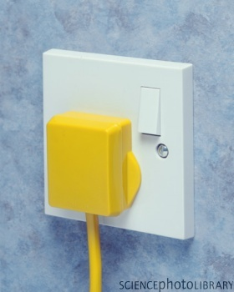
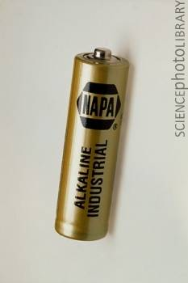
Electrical Energy Sources
What’s the difference?

Slide 18
Direct Current (DC)
+ve
+ve
-ve
-ve
Cells are typically 1.5V DC

Slide 19
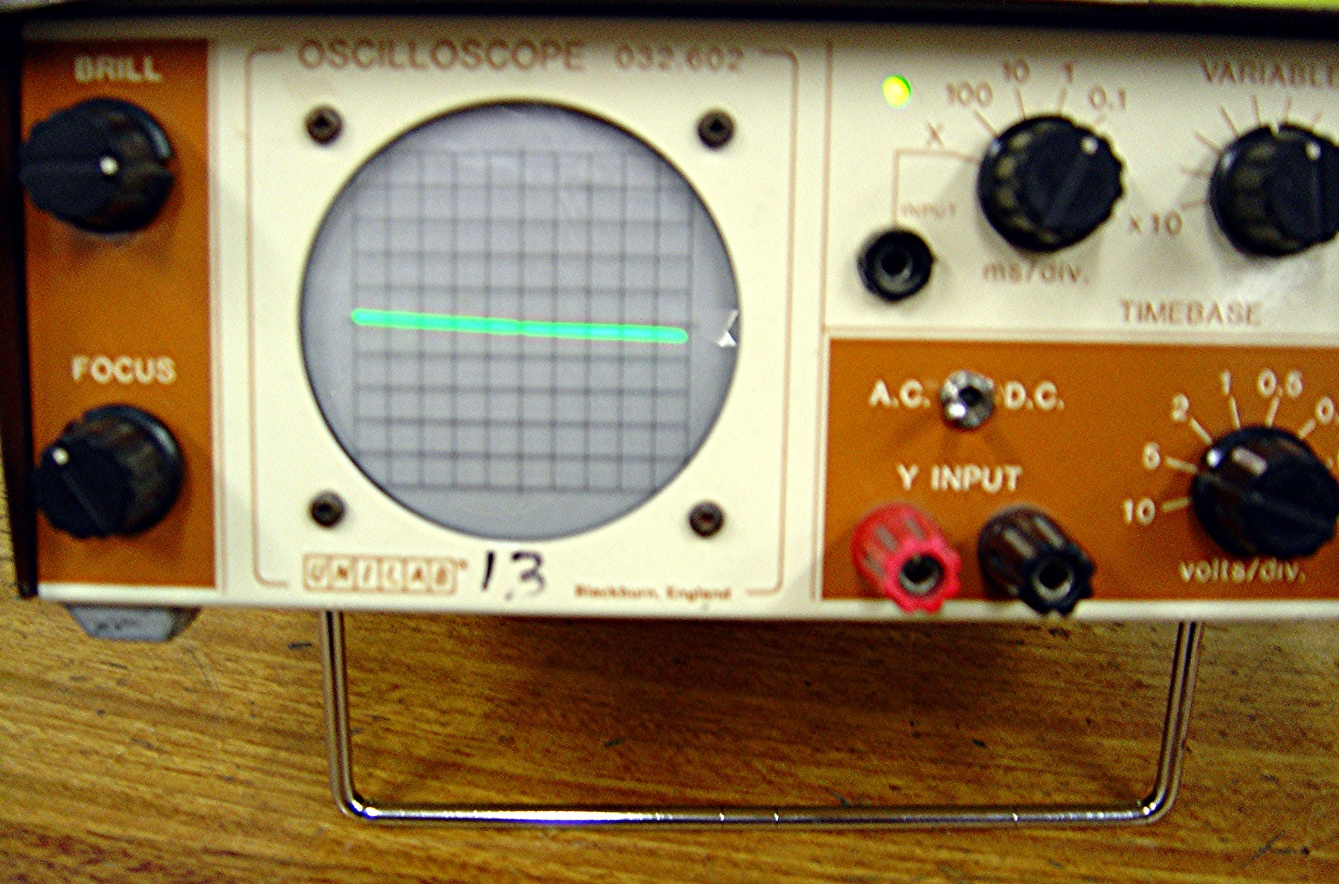
Time base ms/division
AC/DC switch
0V
Y axis
V/div

Slide 20
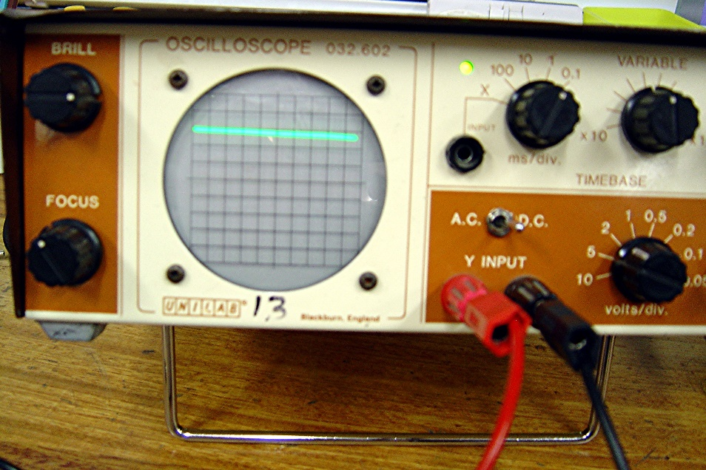
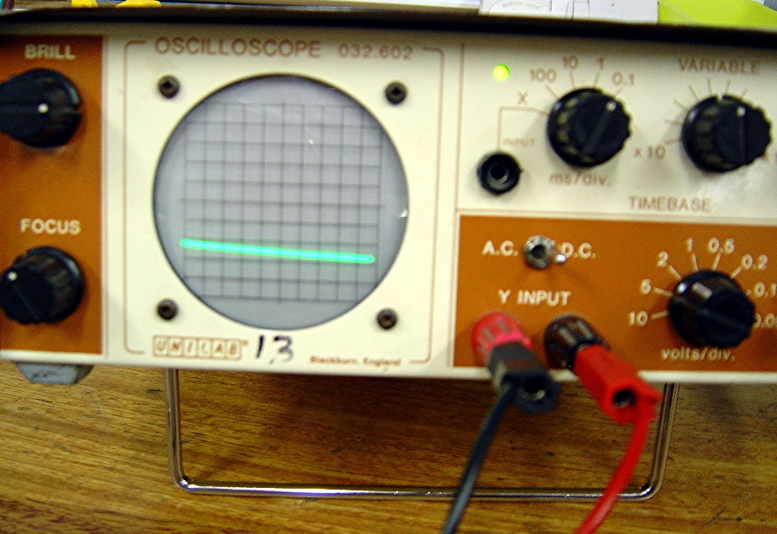
Direct Current
+ 6V
- 6V
Y input positive
Connections reversed

Slide 21
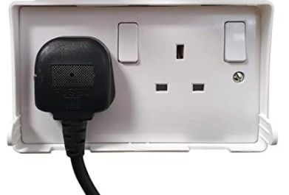
Alternating Current
The mains supplies 230V AC (Alternating Current) 50Hz

Slide 22
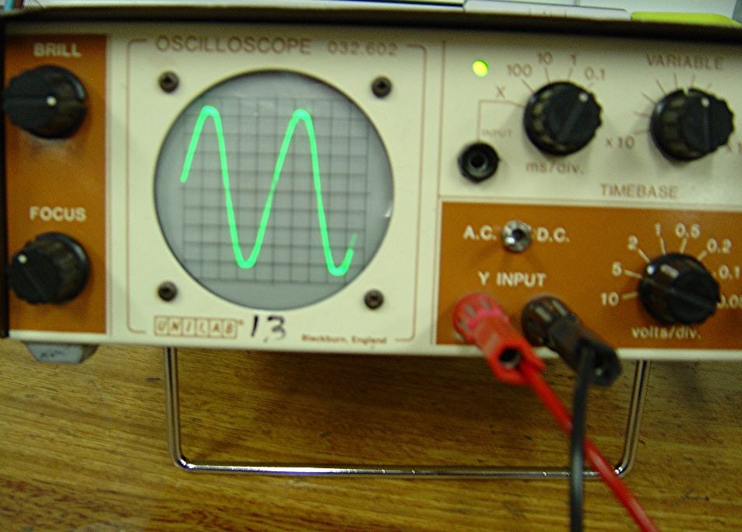
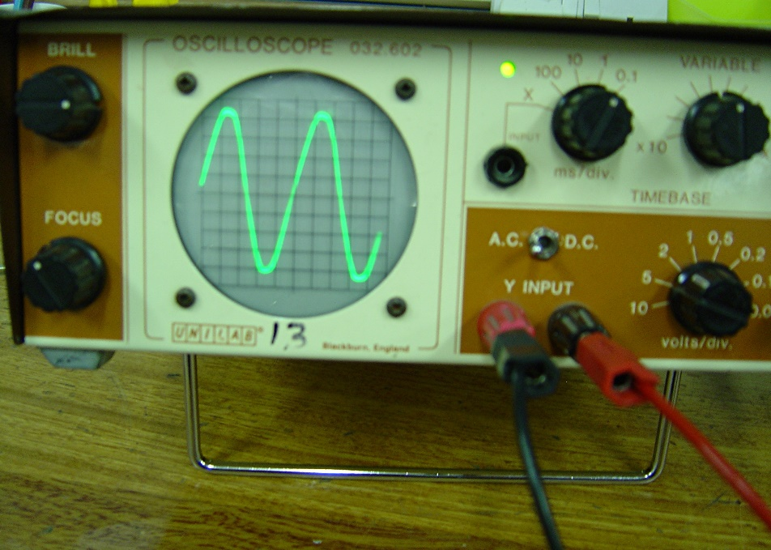
Alternating Current
Mains current cycles from positive to negative many times per second (50Hz)
Signal pattern is the same independent of how the leads are connected

Slide 23
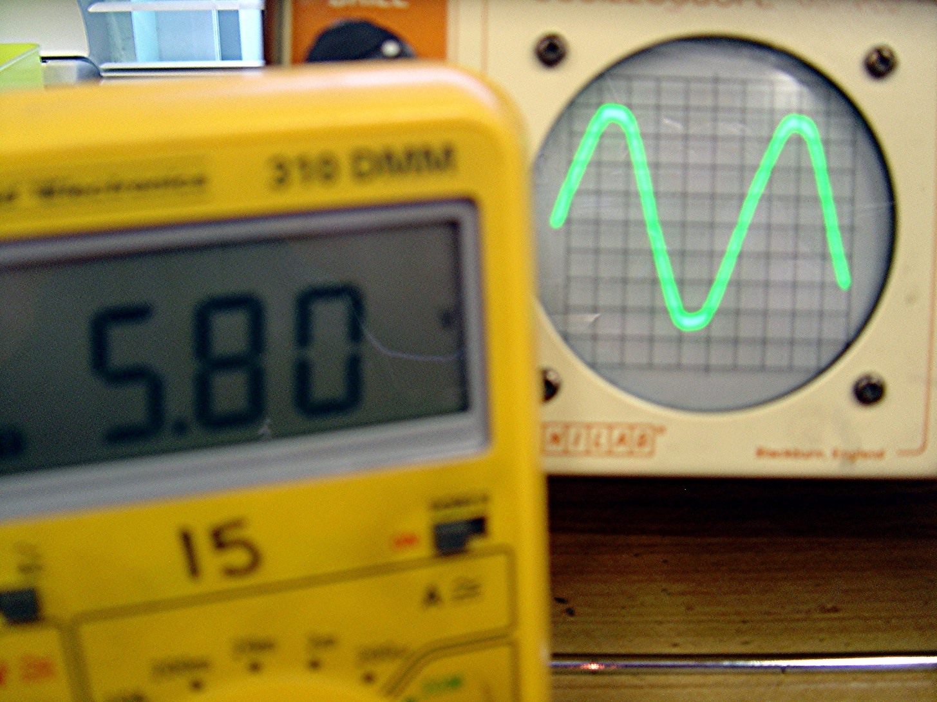
Alternating Current
8V peak
Multimeter 5.8V
V_{peak} = √2 V_{measured}

Slide 24
AC and DC, notes not definitions
A cell provides direct current (D.C.). The current flows always in the same direction (negative to positive). A typical cell has a voltage of 1.5 V.
If the electricity supply is A.C. (alternating current) the current constantly changes direction. Mains electricity is 230V A.C. at 50 Hz. This means that the current cycles from positive to negative 50 times per second (well 100 changes actually).
The measured AC voltage is less than the peak voltage (by a factor of √2). This is called the RMS (root mean square) value.

Slide 25
a.C /d.c definitions
D.C In direct current the electrons flow in one direction only.
A.C. In alternating current the electrons change direction (many times per second)
(Higher definition for A.C………..
a current which changes direction and instantaneous value with time)

Slide 26
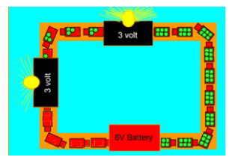
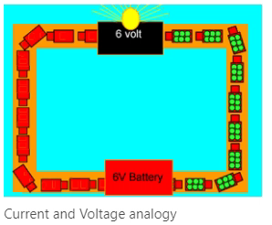
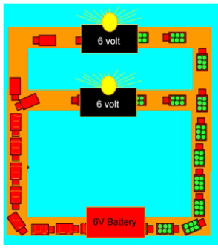

Voltage
$$E=QV$$
$$V=\frac{E}{Q}$$
The animation shows trucks carrying bags of energy from the battery to the lamp. The lamp takes the energy and transfers it to light

