Slide 1
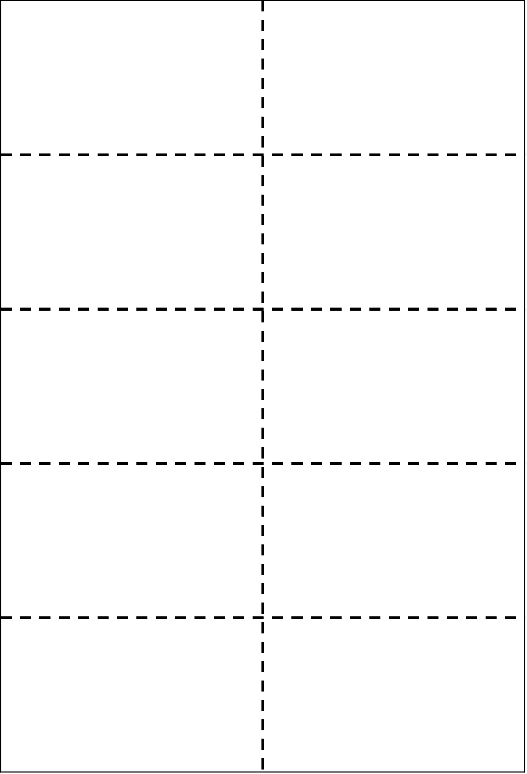
Peak Voltage & Peak current
Describe a.c and d.c.
1
2
V_{rms}
I_{rms}
Formulae for V_{rms} & I_{rms}
3
4
Find frequency of an a.c. supply from an oscilloscope
Find the peak voltage from an oscilloscope
5
6
Use appropriate relationships to solve problems involving potential difference, current, power and resistance
Use appropriate relationships to solve problems involving potential divider circuits.
7
8
Define electromotive force (EMF)
Internal resistance
9
10

Slide 2
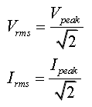
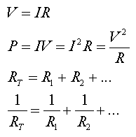
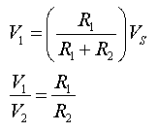

The maximum voltage / current produced by an a.c. supply. These can be measured using an oscilloscope.
a.c. is a current which changes direction and instantaneous value with time.
d.c. is a current which travels in one direction.
The values given to an a.c supply that would have the same heating effect as an equivalent d.c supply
Count the number of divisions for the amplitude of the wave. Multiply this by the number of volts per division.
Find the period (time for one wave (T)).
frequency = $\frac{1}{T}$
The total amount of energy given to each coulomb of charge by a power supply.
The resistance of a power supply.

Slide 3
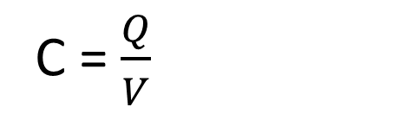
Terminal potential difference
Lost volts
11
12
Short circuit current
E = V_{tpd} + Ir
13
14
Be able to find the EMF, internal resistance and short circuit current from a graph of V_{tpd} vs current
Describe an experiment to find the EMF and internal resistance of a supply.
15
16
Define Capacitance
C = $\frac{Q}{V}$
17
18
Q = It
Find the total energy stored in a capacitor from a charge vs potential difference graph.
19
20

Slide 4
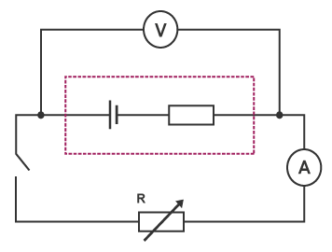
V_{tpd} = E – V_{lost}
The voltage across the terminals of a supply when a load resistance is connected.
V_{lost} = Ir
The voltage across the internal resistance when a load resistance is connected.
E = V_{tpd} + V_{lost}
E = IR + Ir
E = I (R + r)
The current drawn from a supply when the terminals are connected together with no load resistance. This can produce a large current and can be dangerous.
I = E/r
V = -rI + E
(Y = mx + c)
EMF = Y-intercept
Internal resistance = negative the gradient.
Short circuit current = current when V_{tpd} = 0
.
C = Capacitance – measured in farads (F)
Q = Charge – measured in coulombs (C)
V = potential difference – measured in volts (V)
A capacitor of 1 farad capacitance will store 1 coulomb of charge when the potential difference across it is 1 volt.
The energy stored by a capacitor is equal to the area under a charge vs potential difference graph.
Q = Charge – measured in coulombs (C)
I = Current – measured in amperes (A)
t = time – measured in seconds (s)

Slide 5
Equations to find the energy stored by a capacitor
Sketch a graph of voltage vs time for a charging capacitor
21
22
Sketch a graph of current vs time for a charging capacitor
Sketch a graph of voltage vs time for a discharging capacitor
23
24
Describe the effect of changing resistance on the charging and discharging curves for a capacitor?
Sketch a graph of current vs time for a discharging capacitor
25
26
Describe the effect of changing capacitance on the charging and discharging curves for capacitors?
Describe experiments to measure the current and voltage for charging and discharging capacitors
27
28
Conduction band
Valence band
29
30

Slide 6
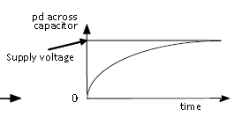

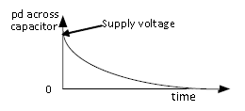
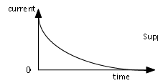
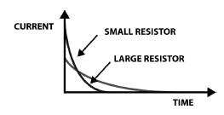
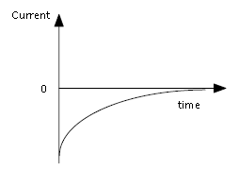
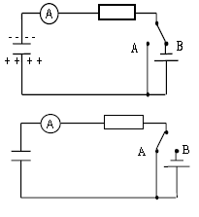
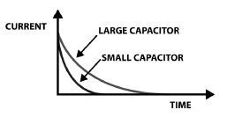
.
The range of possible energies an electron can have and still be part of an atom.
The range of possible energy levels for free electrons. These are electrons that have gained enough energy to escape the valence band.

Slide 7
Describe the band structure of insulators, semiconductors and conductors
Describe how an n-type semiconductor is formed
31
32
Describe how a p-type semiconductor is formed
P-n junction
33
34
Forward bias
Reverse bias
35
36
Describe how an LED emits light
Photovoltaic mode (solar cells)
37
38
Photoconductive mode
(LDR)
39
40

Slide 8
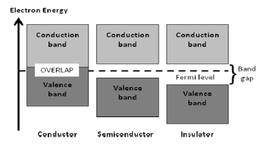
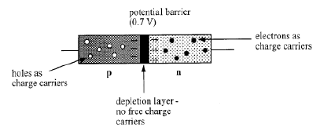
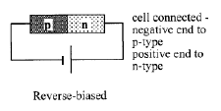
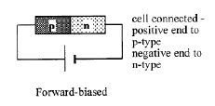
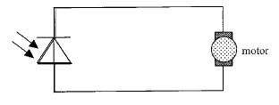
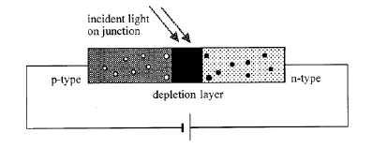
A material such as silicon has impurities added with an extra outer electron e.g. Arsenic
A material such as silicon has impurities added with one fewer extra outer electron e.g. Indium
An LED is a forward biased p-n junction. When an electron and a hole recombine. The electron moves from the conduction band into the valence band and emits a photon of light.
No bias applied
Reverse bias

