Slide 1
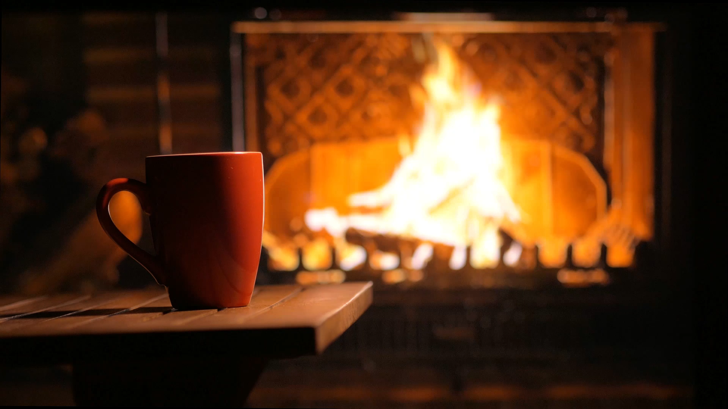

HEAT TRANSFER
HEAT LOSS FROM HOUSES
S2 Physics

Slide 2

Radiation is affected by
BLACK and SHINY surfaces.
_______ ________
absorb radiation better than _______ ________.
_______ ________
give out (emit) radiation better than _______ ________.
_______ ________.
reflect radiation better than _______ ________..
Black surfaces
shiny ones
Black surfaces
shiny ones
shiny surfaces
Black ones

Slide 3
Revision
fluids
___________ are liquids and gases
Convection occurs in ________________
To start a convection current
The substance is __________________
This causes the particles to _____________
There are fewer in the space so become ______ _______
The less dense fluid ___________
The fluid cools and the spacing _________________
The cooler fluid becomes ____ ______ and ______
fluids
heated
spread out (don’t say expand)
less
dense
rises
decreases
more
dense
falls

Slide 4
ReVIEW
Heat can be transferred in _ ways
_______________
_______________
________________
Usually heat is transferred in all 3 ways at once.
Heat ALWAYS travels from ______ places to ______ places
3
CONDUCTION
CONVECTION
RADIATION
Hot cold

Slide 5
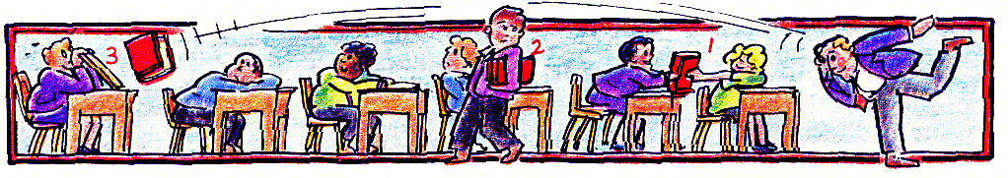
A model of heat transfer processes
book is like heat energy
3. RADIATION – book thrown to the back of the room. The energy does not need particles to transfer the energy.

Slide 6
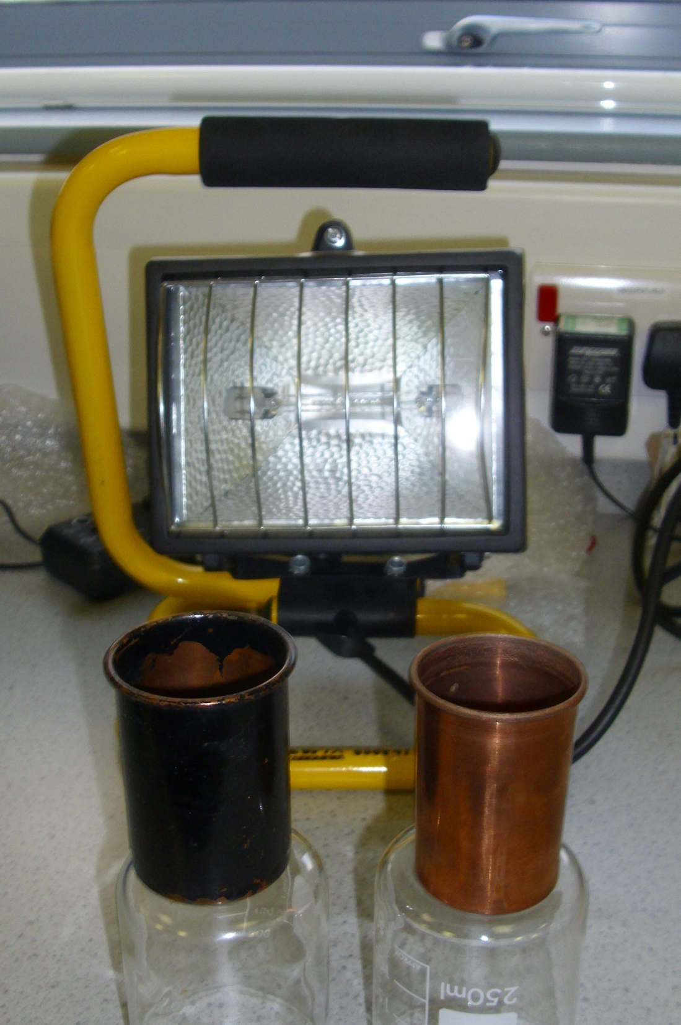
Reflectors of radiation
Could you design an experiment with a radiant heater, a black and shiny surface to determine which surface REFLECTS more radiation?
Where would you place the detector?
What might you use as a detector?

Slide 7
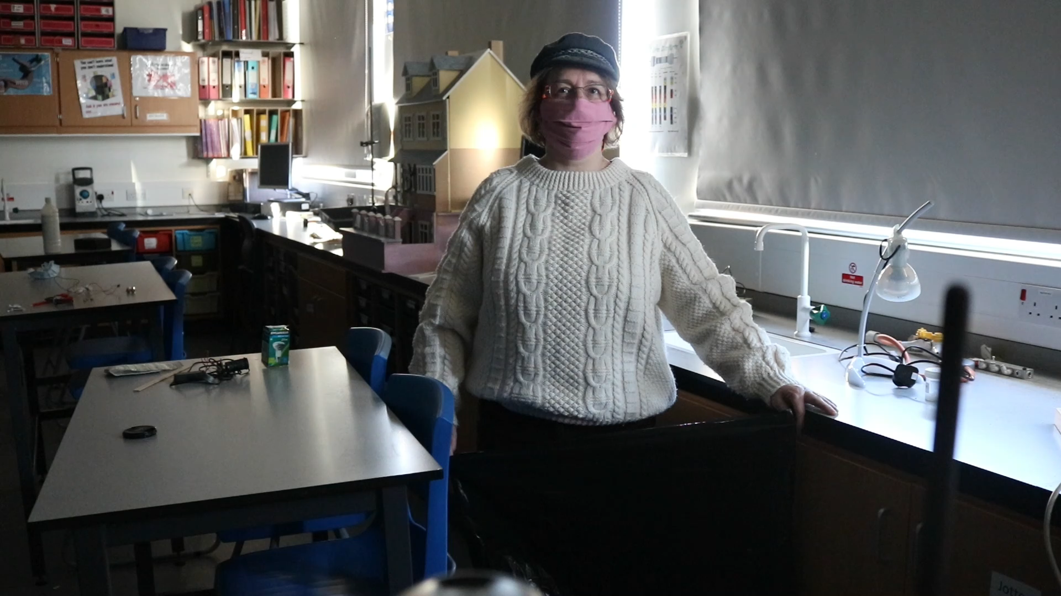
Infra red detectors

Slide 8
RADIAtion
heat travelling as waves
the way heat reaches us from the sun
does not require a medium (particles)
black surfaces good emitters and absorbers of radiation.
shiny surfaces good reflectors of radiation
also called infra red (IR) or thermal radiation

Slide 9
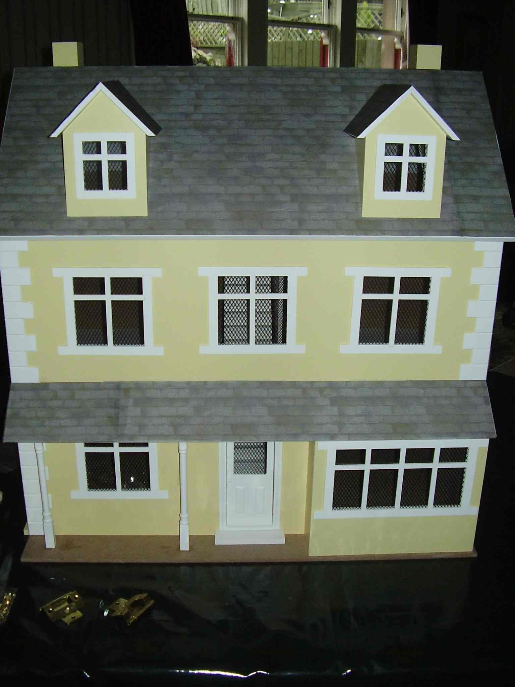

Heat Loss from HOUSES
How is heat lost from houses?
How can we test this in the lab?
How would it depend on ambient (air) temperature?
Can we do a fair test to find out?

Slide 10
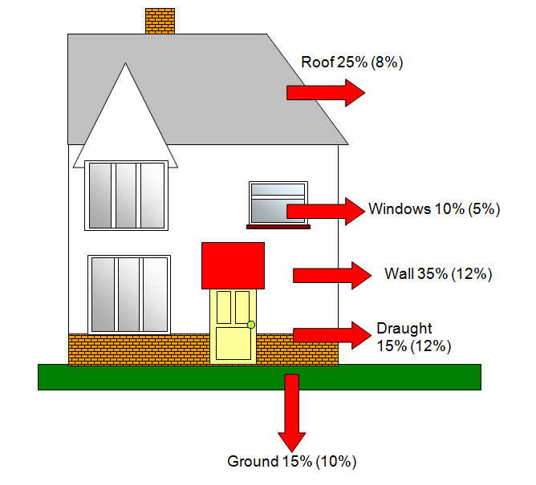
HEAT LOSS FROM HOUSES
Keith, G., 2021. schoolphysics ::Welcome::. [online] Schoolphysics.co.uk. Available at: <https://www.schoolphysics.co.uk/age11-14/Heat%20energy/Transfer%20of%20heat%20energy/text/Heat_loss_from_a_house/index.html>.

Slide 11
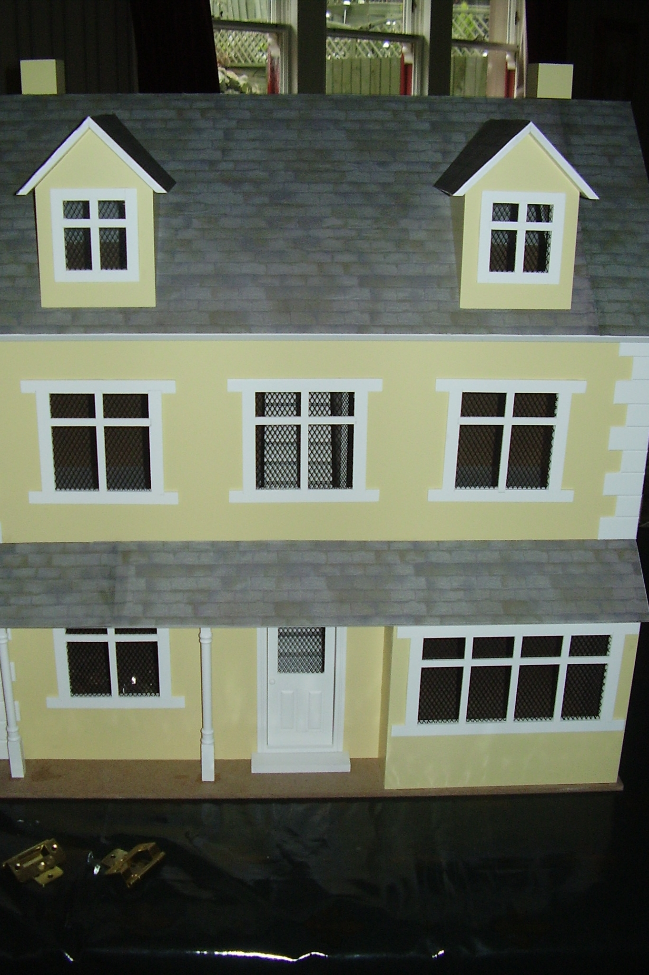
Research
Find out ways in which you can stop heat loss from houses.

Slide 12
Experimental Sheet
AIM
To find out _________________________________________________________________________________
HYPOTHESIS
I think _____________________
__________________________
METHOD
We cannot use a real house as it would not be practical so can you think of a way this could be done in the lab without using the doll’s house? We can use
DESIGN AN EXPERIMENT
Design an experiment that will show which ________________
uPVC/wooden/metal beaker or box

Slide 13
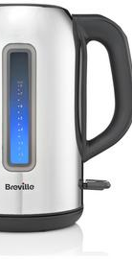
THINK ABOUT THE FOLLOWING
    What could you use as a source of heat?
    How could you log (measure) the temperature?
    How long will your experiment last?
    What materials could you use to represent what you’re trying to do?
    How will you set up your experiment?
    What results would you look for?
    How will you present your information?
    What will be your control?
    How will you make your experiment fair?

Slide 14
AFTER THE EXPERIMENT
RESULTS
CONCLUSION & EVALUATION
Draw a table of your results. You need to show the starting temperature and final temperature of your heat source with ______________________. How will you get all this information into the table?
Can you plot a graph of your results?
What do your results show? How can you tell? Look back at your aim, are you able to answer that question?
Do you think that this experiment truly represents what might happen in a real house

Slide 15
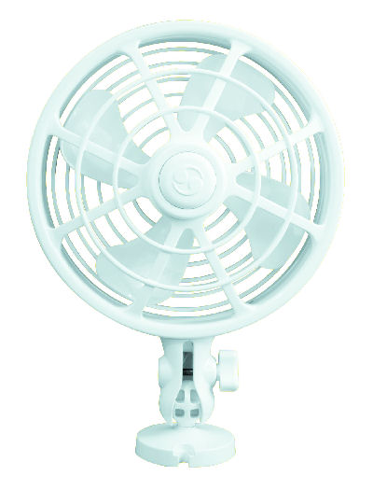


DRAUGHTS

Slide 16
GLAZING

