Slide 1


Particles and Waves
Higher Physics

Slide 2

Higher Waves Revision Form
https://forms.office.com/r/UgSC4N4Q8s

Slide 3
Phase and Coherence
Phase
Two points on a wave that are vibrating in exactly the same way, at the same time, are said to be in phase, e.g. two crests, or two troughs.
IN PHASE ⇒ two sources with the same frequency and wavelength that have their maximum displacement at the same moment.
Coherence
Two sources that are oscillating with a constant phase relationship are said to be coherent. This means the two sources also have the same frequency. Interesting interference effects can be observed when waves with a similar amplitude and come from coherent sources meet.
COHERENT ⇒ coherent sources have:
the same frequency
constant phase relationship
similar amplitude.

Slide 4
Two points that are vibrating in exactly the opposite way, at the same time, are said to be exactly out of phase, or 180º out of phase, e.g. a crest and a trough. Out of phase ⇒ two sources with the same frequency and wavelength. One has a crest at a point where the other source has a trough (completely out of phase).
v
G
B
F
H
A
C
E
Points ___ & ___ or ___ & ___ are in phase.
Points ___ & ___ or ___ & ___ or ___ & ___ are exactly out of phase.
Points ___ & ___ or ___ & ___ or ___ & ___ are 90° out of phase.
Points ___ and ___ are at present stationary.
Points ___, ___ and ___ are at present rising.
Points ___, ___ and ___ are at present dropping.
D

Slide 5
Points A & E, B & H are in phase
Points A& C, D & G, C&E are exactly out of phase
Points A& G, C & D, D & E, E & G are 90° out of phase
Points D & G are at present stationary
Points A, E and F are at present rising
Points B, C, & H are at present dropping
v
G
B
F
H
A
C
E
D

Slide 6
REVISION OF ATOMS
An atom consists of a positive nucleus and outer electrons
The nucleus contains protons, which have a positive charge and neutrons, which are neutral
Electrons in outer shells, permanently moving
Electrons = electrons, negative, distinct energy levels.
Electron has negative charge
Proton has positive charge
NOT TO SCALE
Remember -
Neutron has zero charge

Slide 7

Atoms
Nucleus = protons and neutrons. Massive, neutrons no charge protons positive charge and hence positive nucleus. Protons and neutrons are made of quarks. Protons = uud, neutrons =ddu
Most of the atom is empty space.
In an atom the number of protons equals the number of electrons
Most of the mass is concentrated in the nucleus (1 proton ≈ mass of 1 neutron ≈ mass of approximately 1850 electrons.
Electrons stay in their orbits as they are bound by the positive nucleus (cf. us and the Earth).
Energy must be added to remove an electron from the atom.
We say that zero energy is taken as being when the electron is outside the “field” of the atom. Therefore, electrons in the atom have negative energy because they are bound.

Slide 8
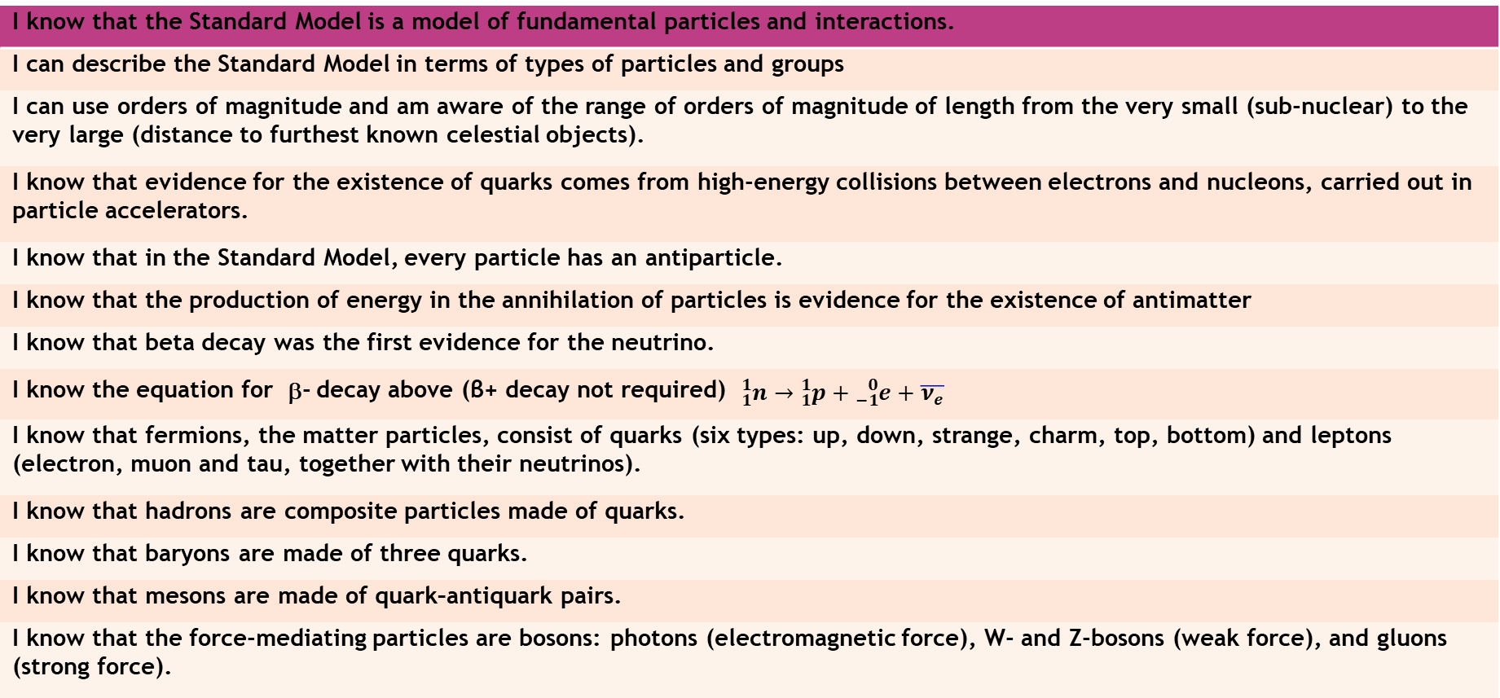
THE STANDARD MODEL
I know that the Standard Model is a model of fundamental particles and interactions.
I can describe the Standard Model in terms of types of particles and groups
I can use orders of magnitude and am aware of the range of orders of magnitude of length from the very small (sub-nuclear) to the very large (distance to furthest known celestial objects).
I know that evidence for the existence of quarks comes from high-energy collisions between electrons and nucleons, carried out in particle accelerators.
I know that in the Standard Model, every particle has an antiparticle.
I know that the production of energy in the annihilation of particles is evidence for the existence of antimatter
I know that beta decay was the first evidence for the neutrino.
I know the equation for β- decay above (β+ decay not required) ${}_{1}^{1}n→{}_{1}^{1}p+{}_{−1}^{0}{e+\overline{ν_{e}}}$
I know that fermions, the matter particles, consist of quarks (six types: up, down, strange, charm, top, bottom) and leptons (electron, muon and tau, together with their neutrinos).
I know that hadrons are composite particles made of quarks.
I know that baryons are made of three quarks.
I know that mesons are made of quark–antiquark pairs.
I know that the force-mediating particles are bosons: photons (electromagnetic force), W- and Z-bosons (weak force), and gluons (strong force).
Beware lots of new words coming up

Slide 9
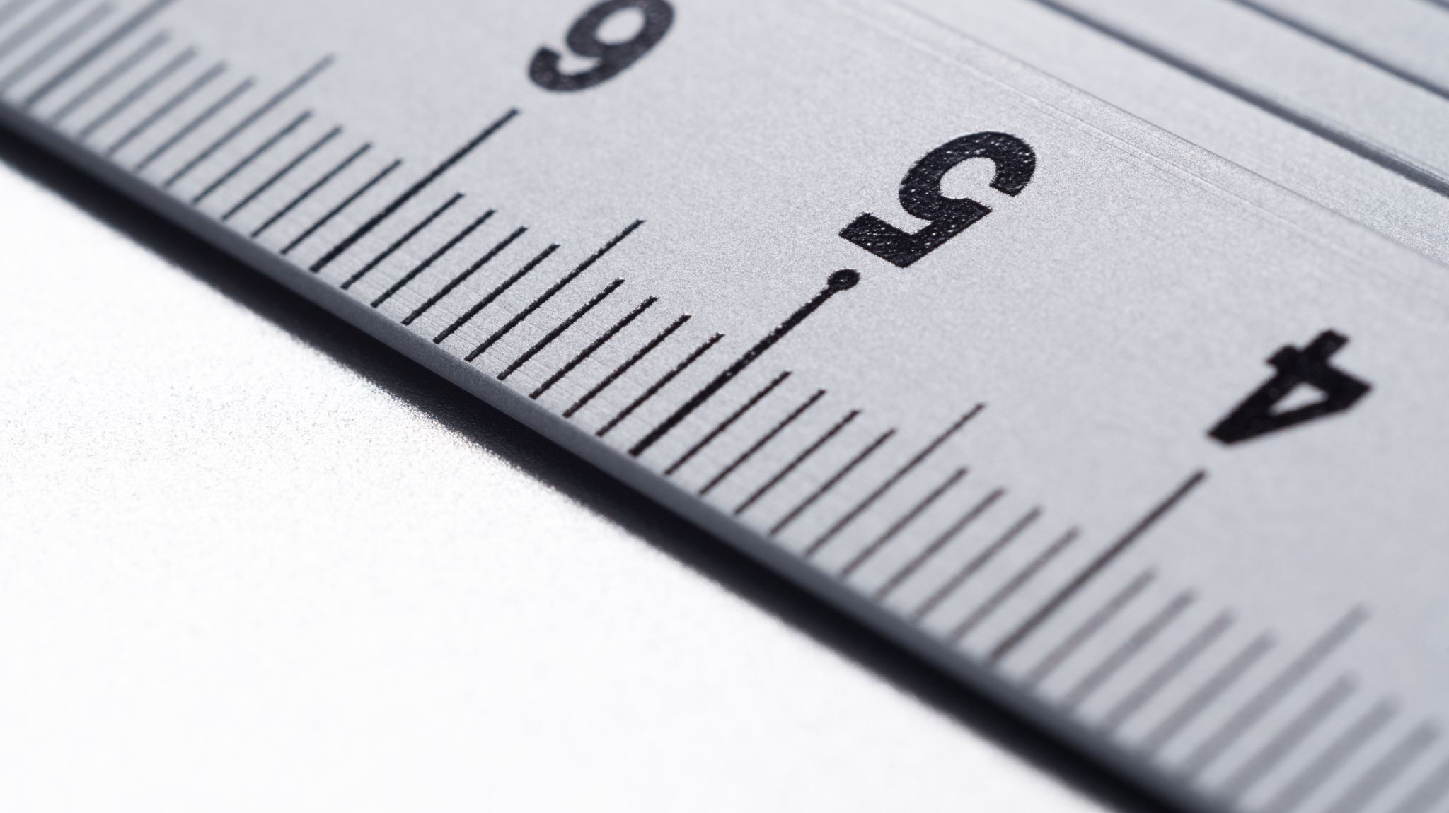
Orders of Magnitude
Size | Powers of 10
 | 10^{–18} m
1 fm (femto) | 10^{–15} m
 | 10^{–14} m
1 pm (pico) | 10^{–12} m
1Å (Angstrom) | 10^{–10} m
1 nm (nano) | 10^{–9} m
 | 10^{–8} m
 | 10^{–7} m
1 μm (micro) | 10^{–6} m
 | 10^{–5} m
 | 10^{–4} m
1 mm (milli) | 10^{–3} m
1 cm (centi) | 10^{–2} m
 | 10^{–1} m
1 m | 10⁰ m
 | 10¹ m
In your groups try to fill in the table A3 version

Slide 10
ORDERS OF MAGNITUDE
The very famous 1977 video!
https://www.youtube.com/watch?v=0fKBhvDjuy0
The latest version
https://www.youtube.com/watch?v=FglEbPXxka4
But this is better
https://www.youtube.com/watch?v=bhofN1xX6u0
And this has commentary by Morgan Freeman and is most like the original https://www.youtube.com/watch?v=44cv416bKP4
Or finally https://www.youtube.com/watch?v=50tpm2fAf-Y

Slide 11

….. And before we start someone needs to apologise.

Slide 12
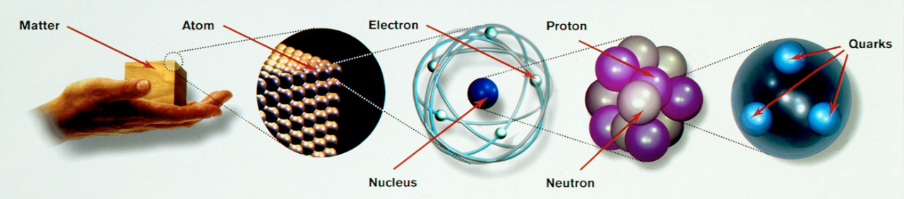
Particle Cosmology
Courtesy CERN CERN-DI-9501005
Thomson (1897): Discovers electron
Rutherford (1909): Nuclear Atom (proton)
Chadwick (1932): Discovers neutron
SLAC (1968): Quarks in neutrons and protons
Notes:
Cosmology is the study of the origin of the universe. Particle cosmologists understand the development of the very early universe using knowledge gained from the collisions observed at particle accelerators. From an event recorded by a bubble chamber in 1970 to a finding the Higgs boson in the ATLAS detector in 2012, more discoveries are continuously being made.

Slide 13
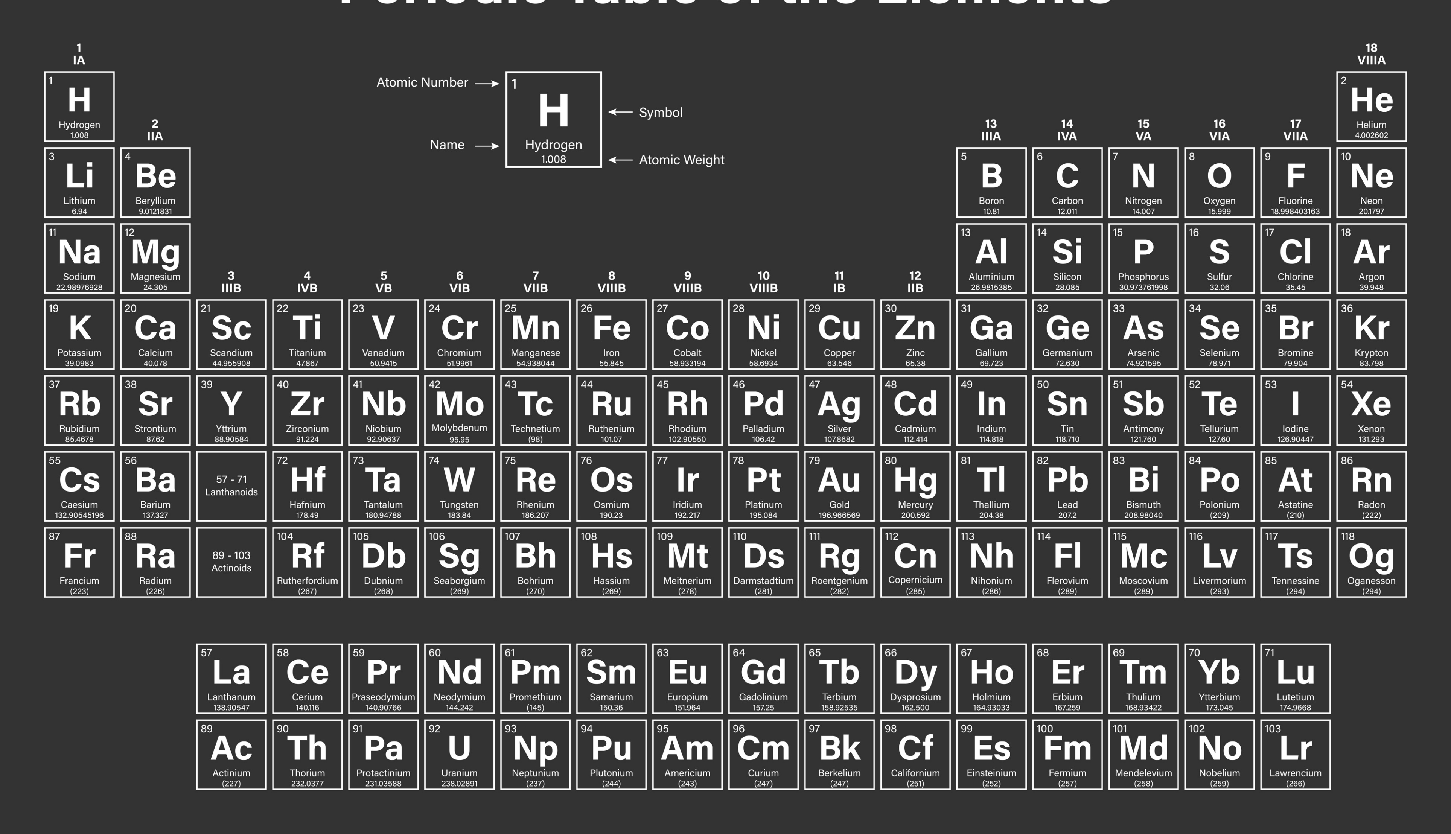
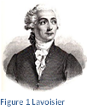
THE STANDARD MODEL OF PARTICLE PHYSICS
The ancient Greeks believed the world was made of 4 elements (fire, air, earth and water). Democritus used the term ‘atom’, which means “indivisible” (cannot be divided) to describe the basic building blocks of life, so he got that wrong then! Other cultures including the Chinese and the Indians had similar concepts.
In 1789 the French chemist Lavoisier discovered through very precise measurement that the total mass in a chemical reaction stays the same. He defined an element as a material that could not be broken down further by chemical means, and classified many new elements and compounds. His work was so admired that at the age of 50 he was guillotined during the French Revolution for his aristocratic background.

Slide 14
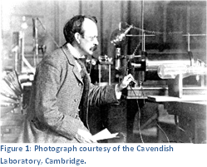
THE PERIODIC TABLE – ORDER OUT OF CHAOS
In 1803 Dalton measured very precisely the proportion of elements in various materials and reactions. He discovered that they always occurred in small integer multiples. This is considered the start of modern atomic theory.
In 1869 Mendeleev noticed that certain properties of chemical elements repeat themselves periodically and he organised them into the first periodic table.

Slide 15
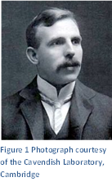
THE DISCOVERY OF THE ELECTRON
In 1897 J.J. Thomson discovered the electron and the concept of the atom as a single unit ended. This marked the birth of particle physics.
Although we cannot see atoms using light which has too large a wavelength, we can use an electron microscope. This fires a beam of electrons at the target and measures how they interact. By measuring the reflections and shadows, an image of individual atoms can be formed. We cannot actually see an atom using light, but we can create an image of one. The image shows a false-colour scanning tunnelling image of silicon.

Slide 16
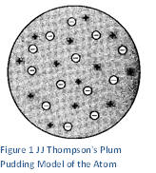
The Structure of Atoms
At the start of modern physics at the beginning of the 20th century, atoms were treated as semi-solid spheres with charge spread throughout them. J.J. Thompson’s model of the atom (1904) suggested that the positive charge was distributed evenly throughout the atom and the negative charges were fixed throughout; like fruit through a Christmas pudding, hence the model was known as the Plum Pudding Model.
This model fitted in well with experiments that had been done by then, but a new experiment by Ernest Rutherford in 1909 would soon change this. This was the first scattering experiment – an experiment to probe the structure of objects smaller than we can actually see by firing something at them and seeing how they deflect or reflect. According to the Plum Pudding Model, if charged particles were fired at the atoms you would only expect the charges to deflect slightly

Slide 17
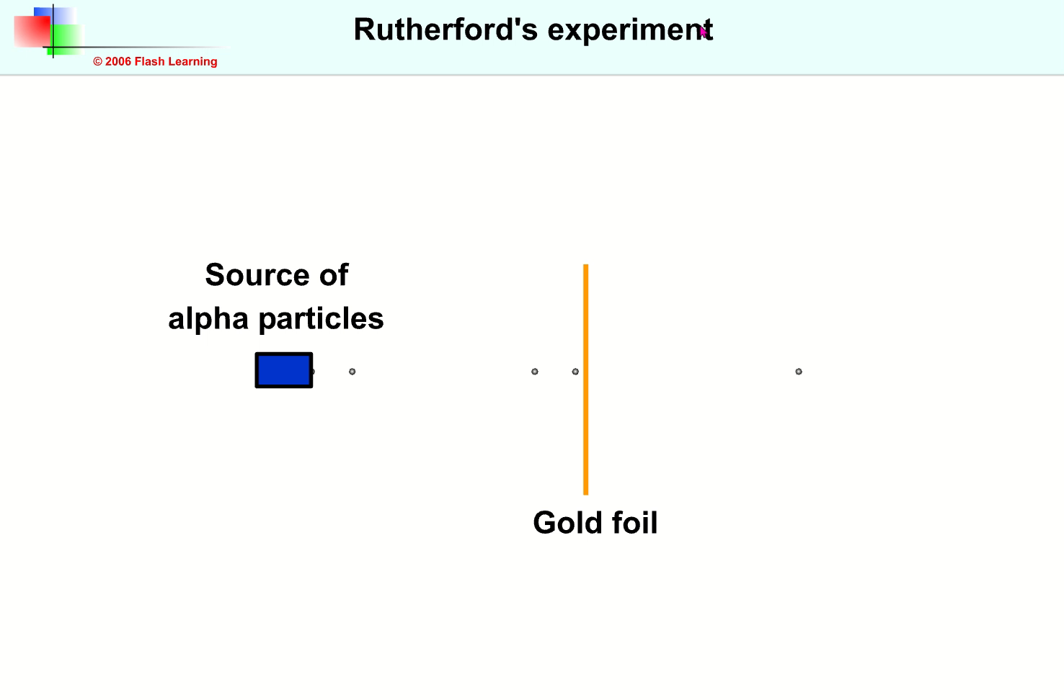
Watch carefully
You might miss it!
Record what happens to the particles!

Slide 18
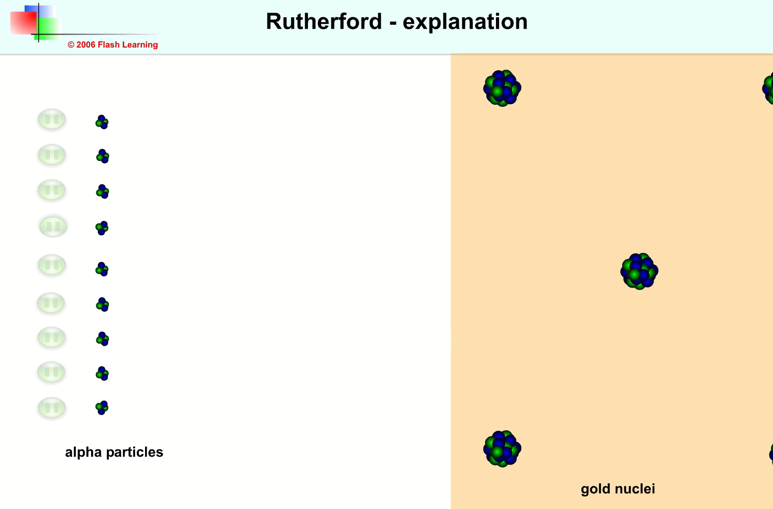
Explanation of the famous experiment
Most alpha particles pass straight through
Some are deflected
Very few rebound
Explain these findings

Slide 19
Conclusion
Results | Conclusion
most alpha particles went straight through the foil with little or no deflection detected between positions A and B. a small fraction of the particles were scattered through very large angles e.g. to position C, and a very small number were even deflected backwards, e.g. to position D. | The atoms contain more open space than explained by the plum-pudding model and was mainly open space. The foil, which was at least 100 atoms thick, suggesting the atom must be mostly empty space! Strong forces are needed to achieve this (alpha particles were travelling at about 10 ⁶ m s ⁻¹). This suggested a concentration of atomic charge. The alpha particles must be encountering something of very large mass and a positive charge.
1 : 8000 Relative sizes: a nucleus the size of a pea would result in the atom being the size of a football pitch (if drawn to the same scale).
A small deflection
alpha particles
no deflection
B small deflection
D
deflected back
C large deflection

Slide 20
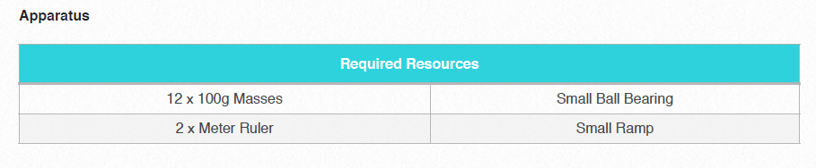
Do your own scattering experiment
Aim
The Scattering Experiment
To recreate Rutherford’s experiment to develop a deeper understanding of the Rutherford model of the atom.

Slide 21
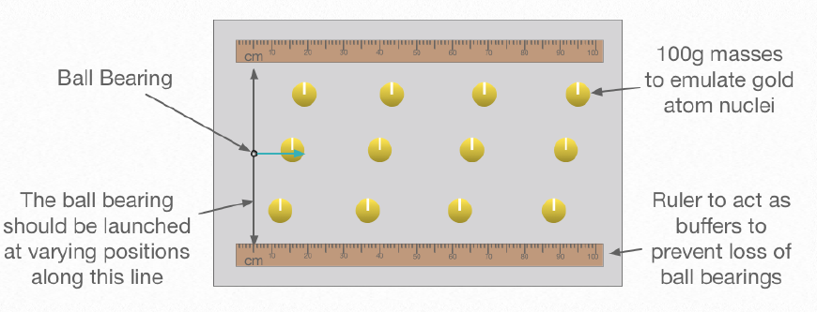

Slide 22
Method
1. Set up the apparatus shown. This apparatus models the gold foil used in Rutherford’s scattering experiment. The
100g masses emulate the gold atom nuclei and it is only a few atoms thick.
2. The small ball bearing acts as the alpha particles being fired at the “gold foil”.
3. Roll the ball bearing towards the “gold foil”
4. Record, using a tally mark in the table below, the direction the ball bearing travelled.
5. Repeat this and launch the ball from different positions between the two meter rulers.
6. Take at least 100 readings to ensure a large enough sample size.

Slide 23
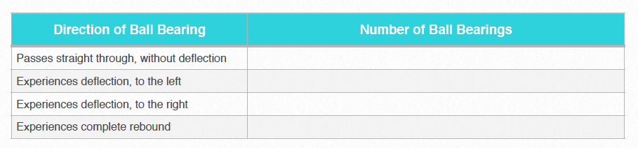
Data

Slide 24
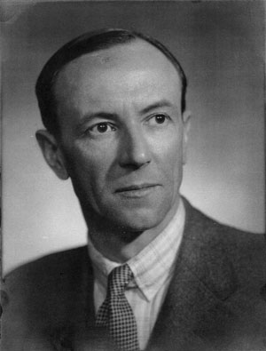
The discovery of the Neutron
Physicists realised that there must be another particle in the nucleus to stop the positive protons exploding apart, and to account for the additional mass scientists had determined was in atoms. This is the neutron which was discovered by Chadwick in 1932. This explained isotopes – elements with the same number of protons but different numbers of neutrons.

Slide 25
A bit of Chemistry
Each element, and hence the way it behaves, has a set number of protons, e.g. Hydrogen always has just 1 proton, and Carbon has 6 protons. In all atoms the number of protons in the nucleus is equal to the number of electrons surrounding the nucleus, (if not then the particle is an ion and not an atom).
The number of neutrons in the nucleus of any element can vary. We call these isotopes, e.g. carbon usually has 6 neutrons but can have 8. Larger atoms usually have many more isotopes.
We can represent each type of atom in the following way
where
A = mass number (no. of protons +neutrons) ie nucleons
Z = atomic number (no.of protons)
X = symbol to represent the atom, either 1 capital letter or one capital followed by 1 lower case letter.

Slide 26
Symbol | Name | Protons | Neutrons | Electrons | Is there an isotope of the element in this table?
 |  | 1 | 0 | 1
 |  | 6 | 8 | 6
 |  | 6 | 6 | 6
 |  | 79 | 118 | 79
 |  | 92 | 143 | 92
 |  | 92 | 146 | 92
 |  | 88 | 132 | 88
 |  | 86 | 136 | 86

Slide 27
Matter and Antimatter

Slide 28
