Slide 1
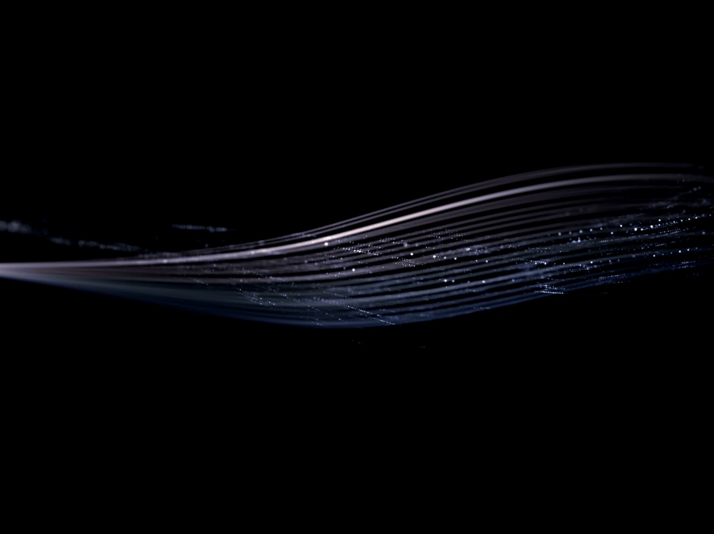
Particles ACCELERATORS
Higher Physics

Slide 2
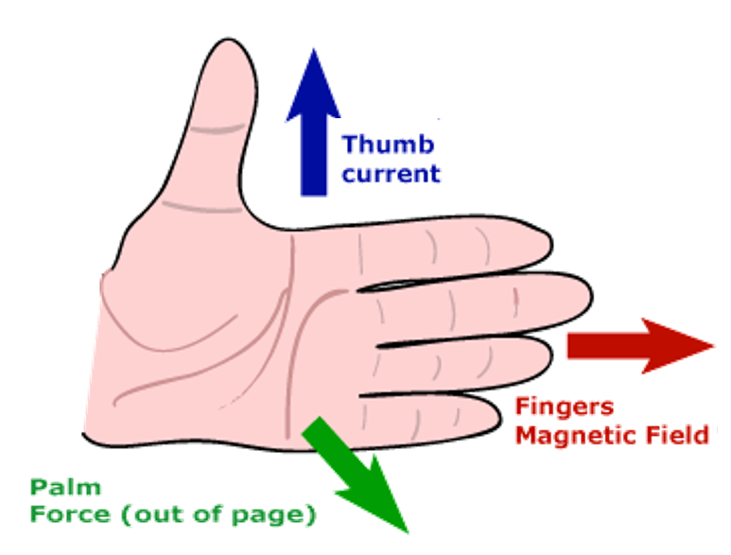
LEFT HAND SLAP Method.
The Left-hand Slap Rule where the four fingers of the left point in the direction of the magnetic field B and the thumb points in the direction of the electron current I, the direction of slapping would be the direction of force F on the conductor.

Slide 3
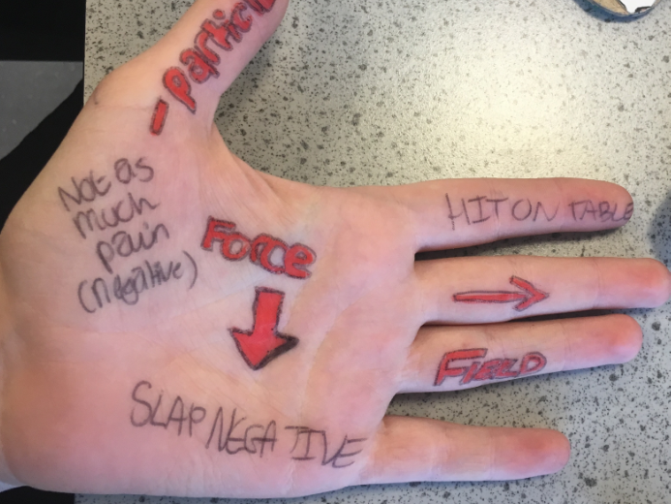

Slide 4
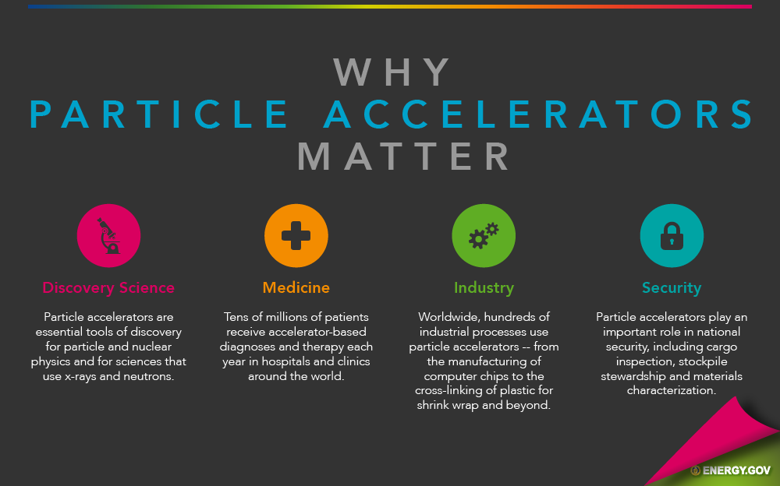
Scientists use particle accelerators to study the origins of the universe, investigate the subatomic structure of the world around us and advance research in medicine, environmental clean-up and more.

Slide 5
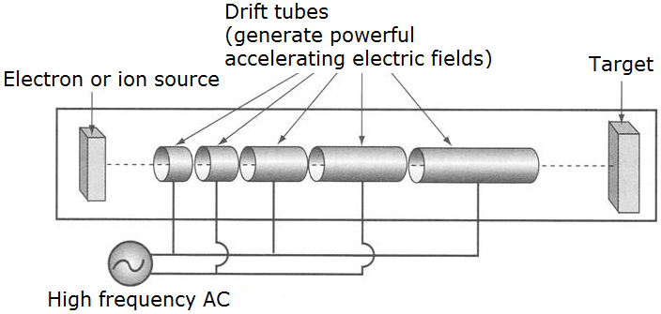
The particles pass through a line of hollow metal tubes enclosed in a long-evacuated cylinder.
The frequency of the alternating voltage is set so that the particle is pushed forward each time it goes through a gap between two of the metal drift tubes.
The largest linac in the world, at Stanford University in the USA, is 3.2km long.
Linear accelerator

Slide 6
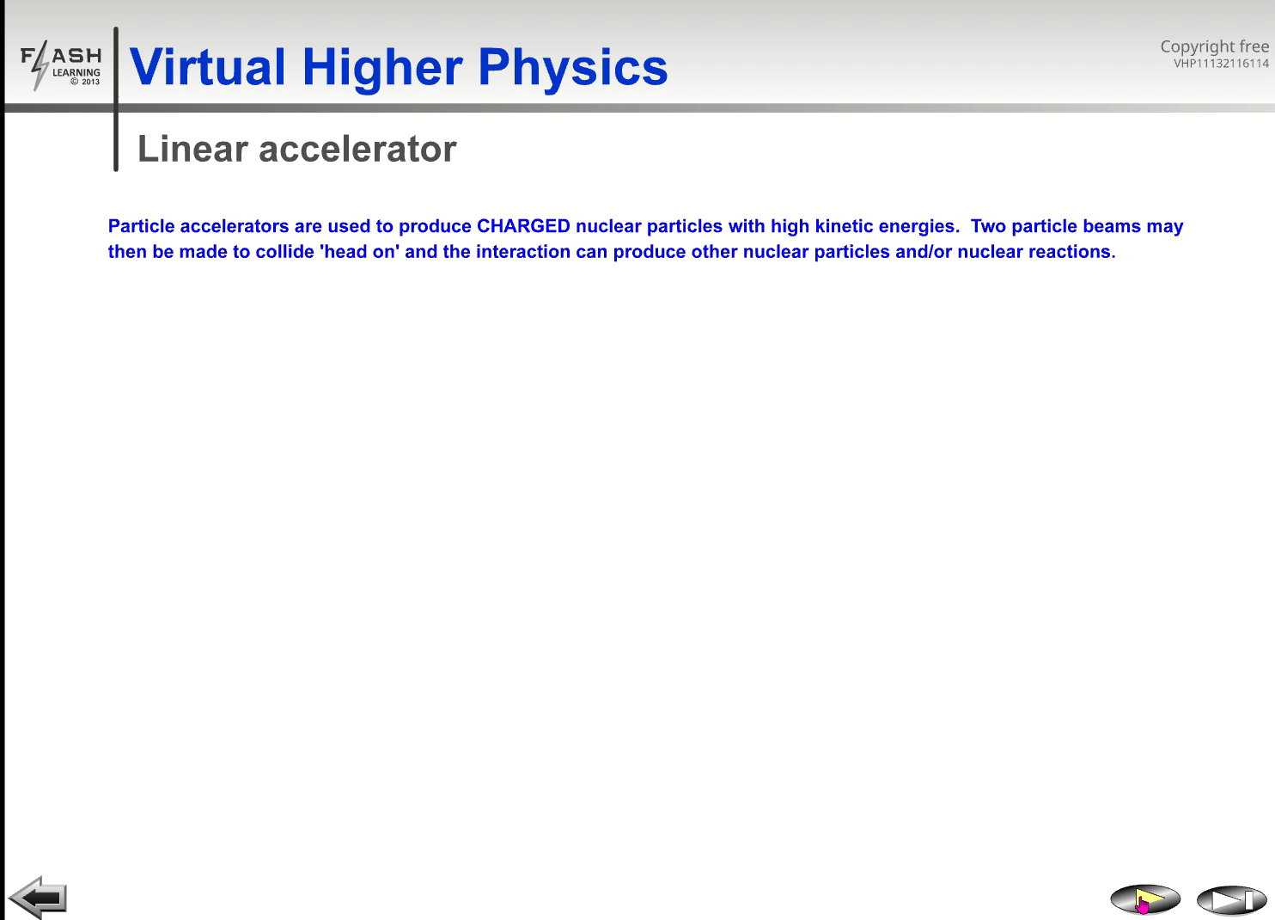

Slide 7
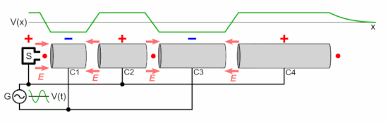
AC is constant frequency
https://upload.wikimedia.org/wikipedia/commons/thumb/0/08/Linear_accelerator_animation_16frames_1.6sec.gif/550px-Linear_accelerator_animation_16frames_1.6sec.gif

Slide 8
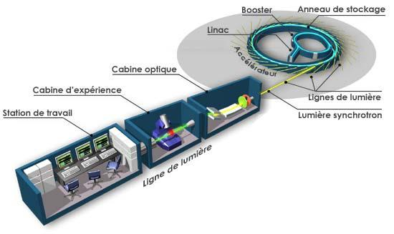
Linear accelerator
http://www.synchrotron-soleil.fr/images/Image/RessourcesPedagogiques/Soleil3Questions/image013.jpg

Slide 9
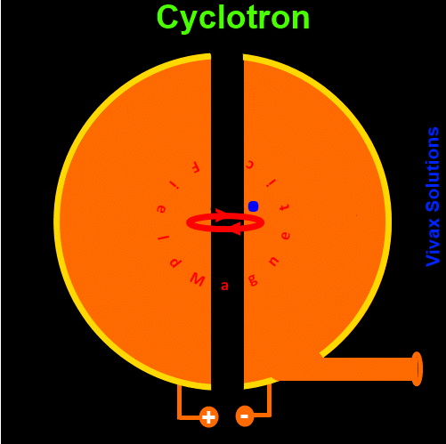

Slide 10
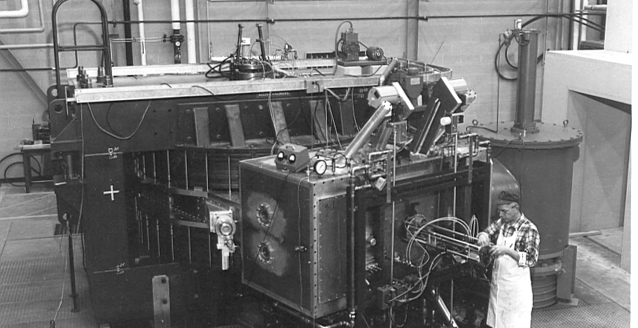
1969 at Michigan state National Superconducting Cyclotron Laboratory

Slide 11
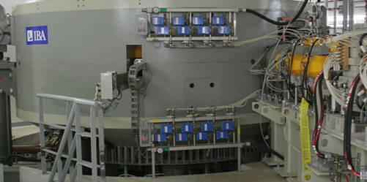
From outside
http://www.pennmedicine.org/perelman/images/proton/cyclotron.jpg

Slide 12
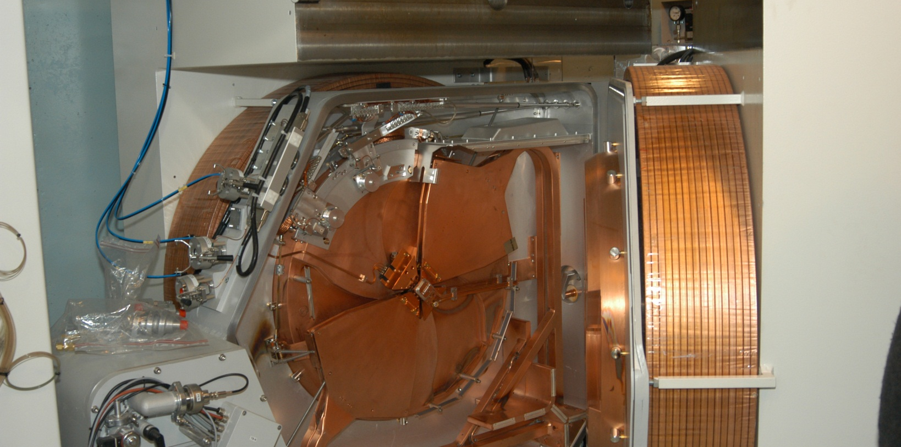
Inside

Slide 13
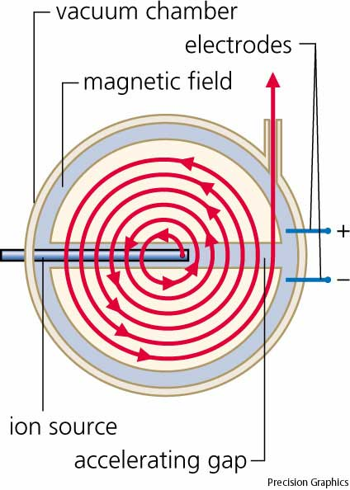
Inside
http://content.answcdn.com/main/content/img/ahd4/A4cyctrn.jpg

Slide 14
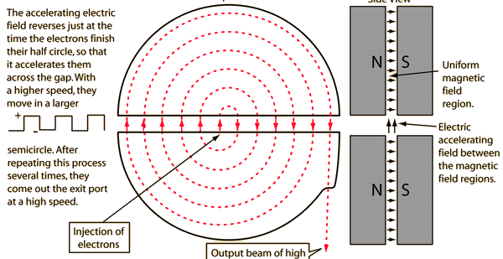
Cyclotron
Hence the “double D”

Slide 15
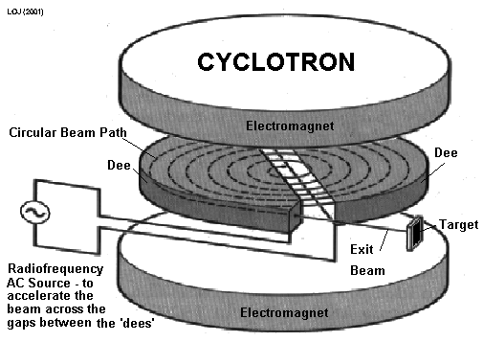
Exploded Schematic
http://www.cyberphysics.co.uk/topics/atomic/Accelerators/Cyclotron/cycfig.gif

Slide 16
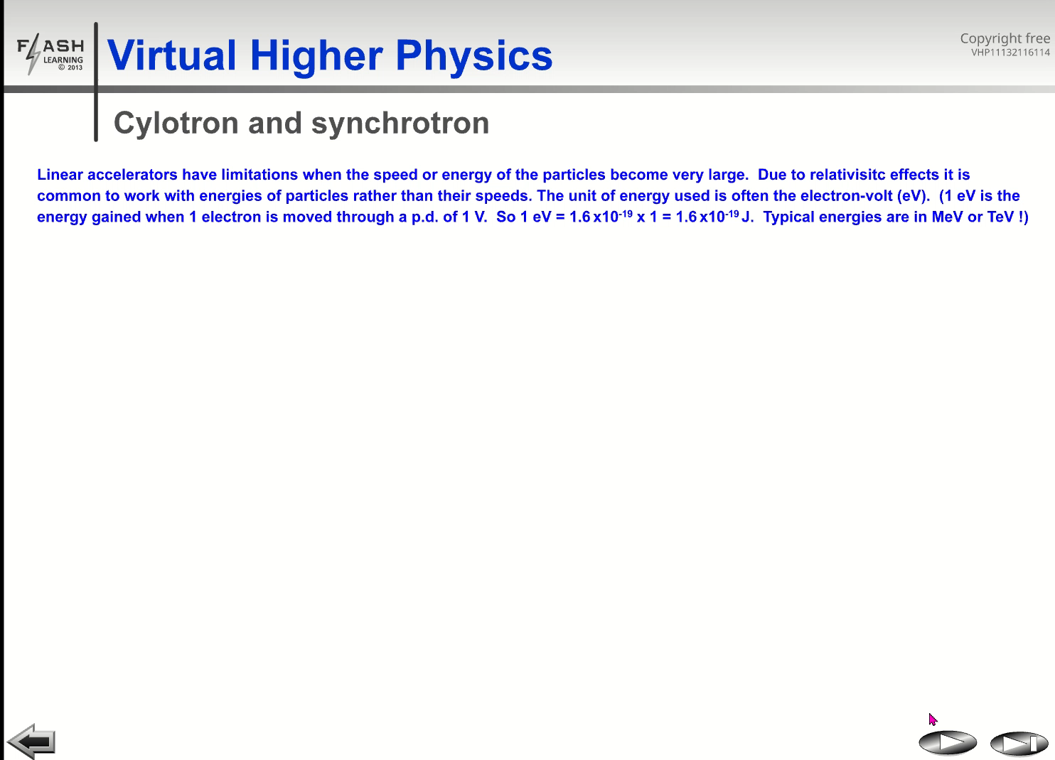

Slide 17
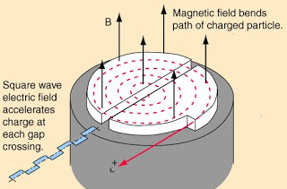
AC applied across gap
http://1.bp.blogspot.com/_eAzT4VdyVNk/SQa1b44JZxI/AAAAAAAAAIA/3Kbxun2e1DQ/s320/cyclotron.JPG

Slide 18
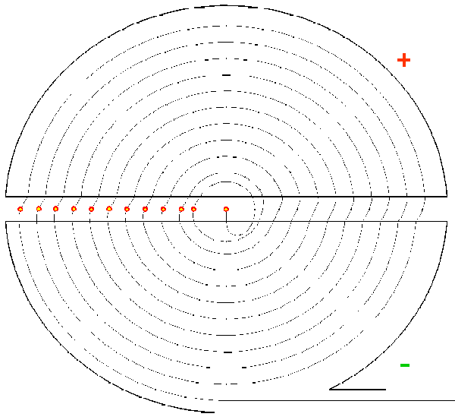
http://jol.liljenzin.se/CYCLOTR/CYCLOANI.HTM

Slide 19
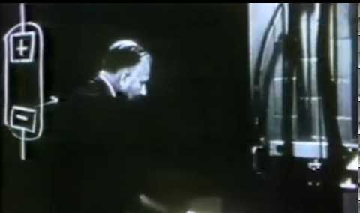
Cyclotron model

Slide 20
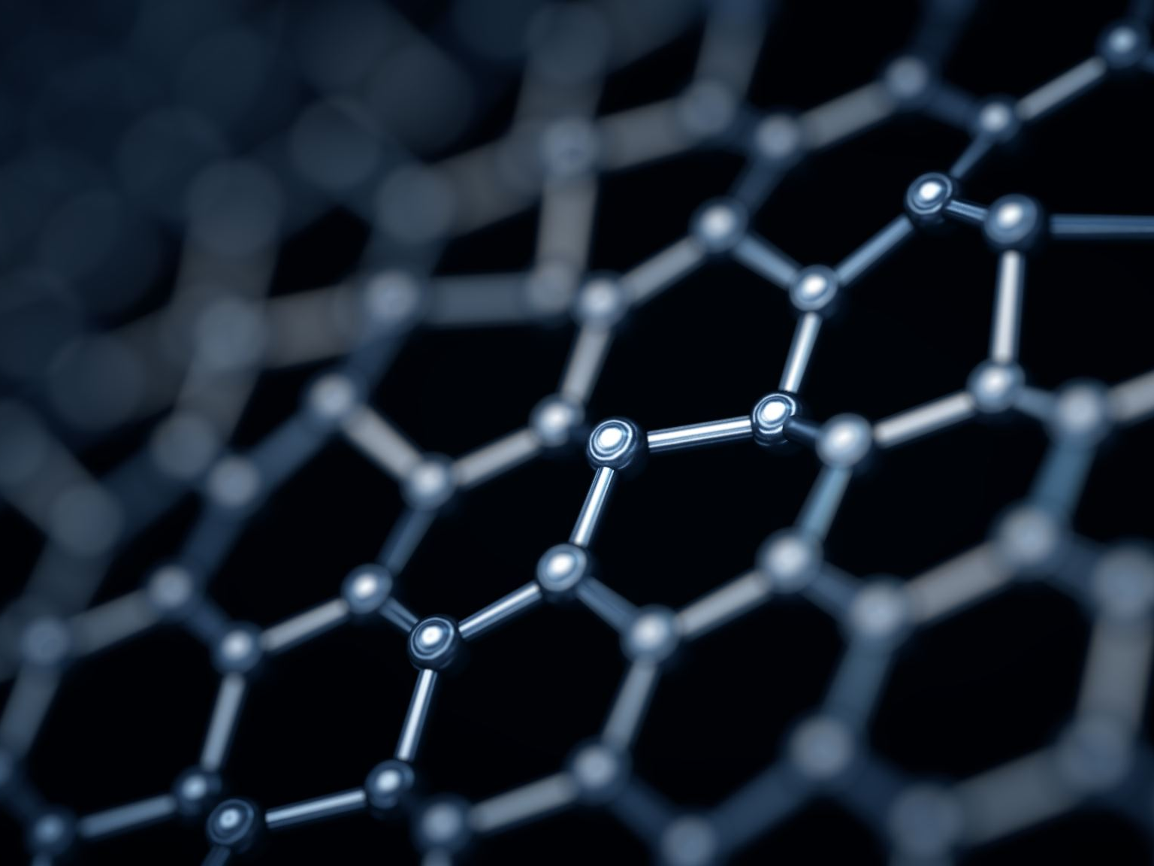
Cyclotron - Key points
Electric field accelerates proton across gap
Need AC as protons cross from side to side
Magnetic field keeps protons in circular motion to recycle
Time for each semicircle is constant.
Once radius is large enough proton escapes to target.

Slide 21
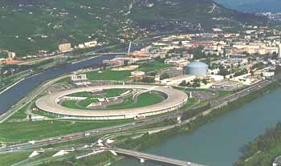
Grenoble

Slide 22
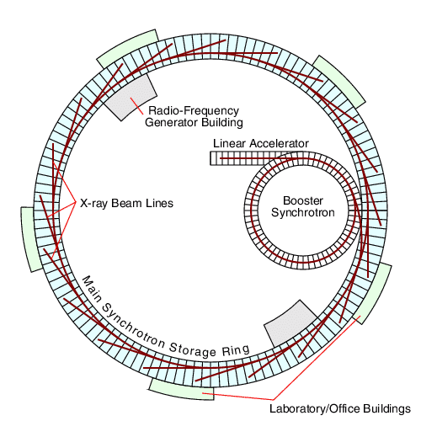
Synchrotron layout
http://pd.chem.ucl.ac.uk/pdnn/inst2/plan.gif

Slide 23
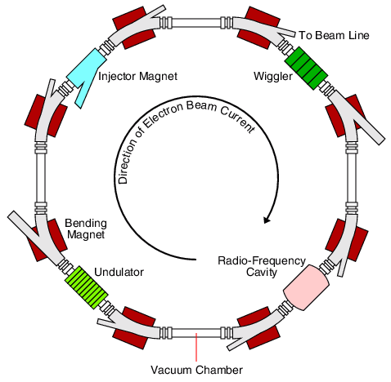
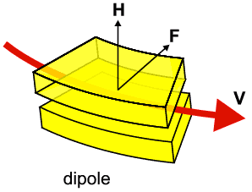
Synchrotron components
Dipole
http://pd.chem.ucl.ac.uk/pdnn/inst2/work.htm

Slide 24
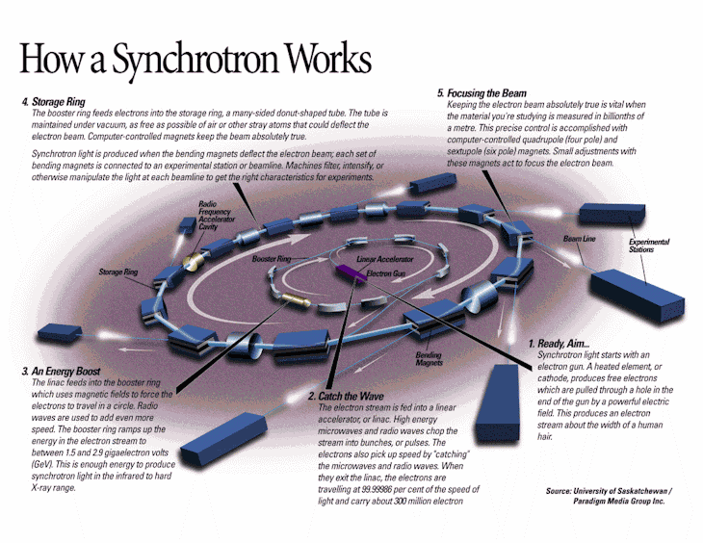
http://geographyfieldwork.com/Synchrotron9.gif

Slide 25
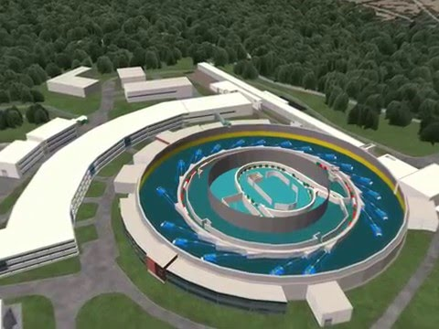
Elettra Synchrotron, Trieste
https://www.youtube.com/watch?v=l4NSF-gkKCU (4 mins)

Slide 26
synchrotron - Key points
Electric fields accelerate particles at different parts in the loop.
Need multiple accelerators
Magnetic field keeps particles in circle
Both fields need to be changed as speed increases.
Particles can be diverted at different points.

Slide 27
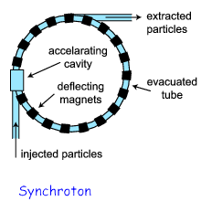
The synchrotron is more powerful and more advanced.
The largest and most powerful synchrotron in the world is at CERN near Geneva in Switzerland
A synchrotron consists of a tube in the shape of a large ring through which the particles travel.

Slide 28
Strong magnets keep the particles moving through the centre of the tube.
The particles enter the tube after already having been accelerated (usually by a linac).
The particles enter acceleration cavities (electric fields) driven by a high frequency oscillator as they travel around the accelerator.
The strengths of the magnets surrounding the ring is increased as the particles gain energy, taking account of the relativistic increase in the mass of the particles (hence the name synchrotron).
The particles can be steered out of their orbit using magnets and directed towards a target.
At CERN, a synchrotron allows for collisions between particles travelling in opposite directions around its ring. The energy associated with colliding beams is much greater than that involving a stationary target.

Slide 29
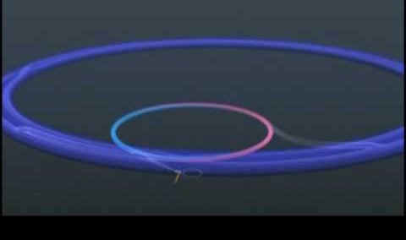
CERN LHC

Slide 30
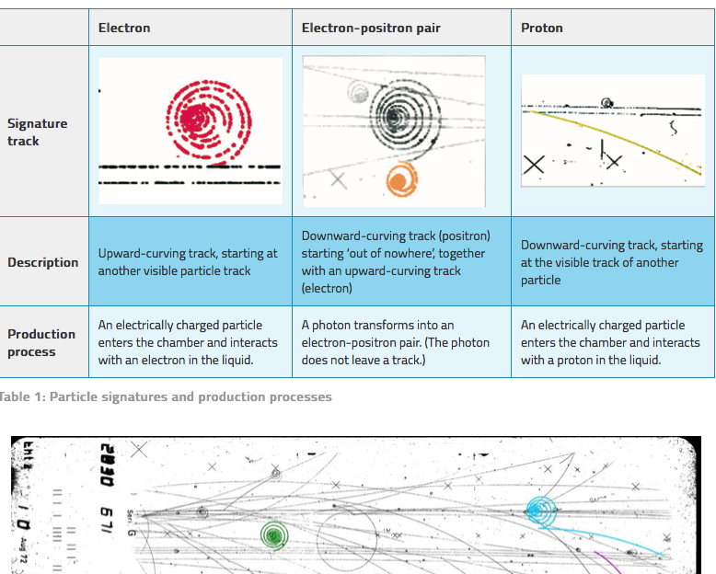
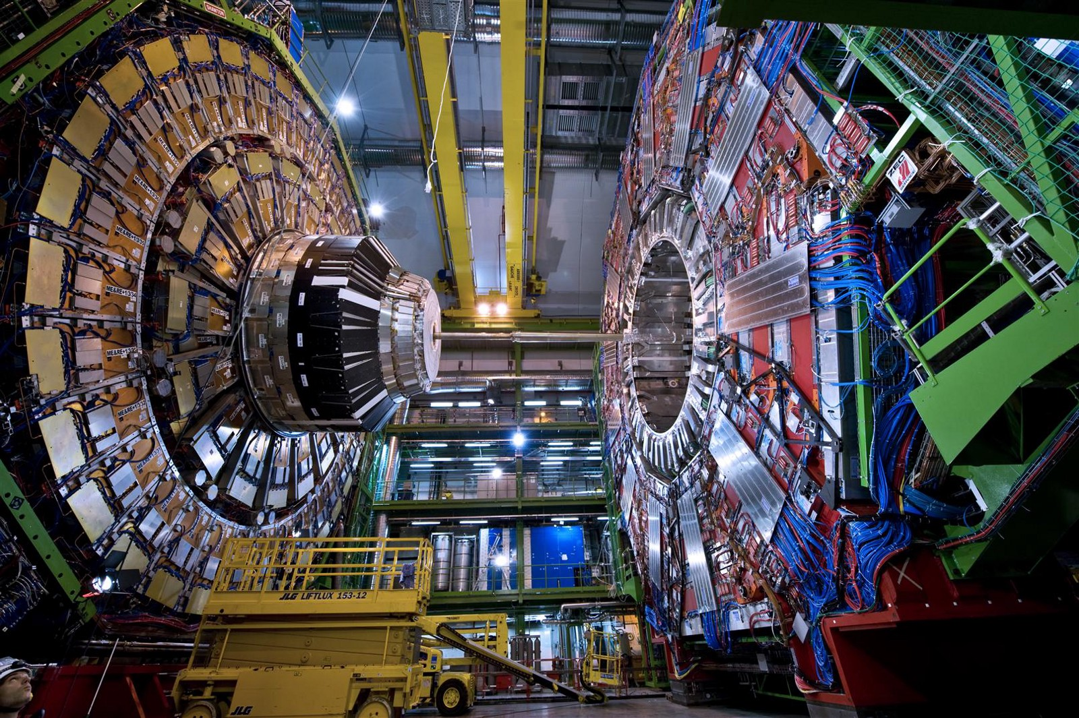
Tracks and the ATLAS detector
What does it detect?
How does it work?
How big is it?
What has it discovered?
https://www.scienceinschool.org/content/track-inspection-how-spot-subatomic-particles

Slide 31
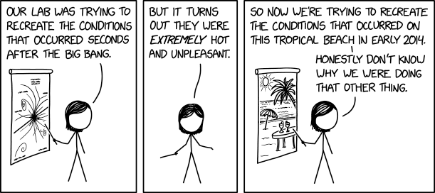
https://imgs.xkcd.com/comics/recreate_the_conditions.png

Slide 32
Particle Accelerators
Higher SQA content
Knowledge that a moving charge produces a magnetic field.
Determination of the direction of the force on a charged particle moving in a magnetic field for negative and positive charges.
Knowledge of the basic operation of particle accelerators in terms of
acceleration by electric fields,
deflection by magnetic fields and
high-energy collisions of charged particles to produce other particles.

Slide 33
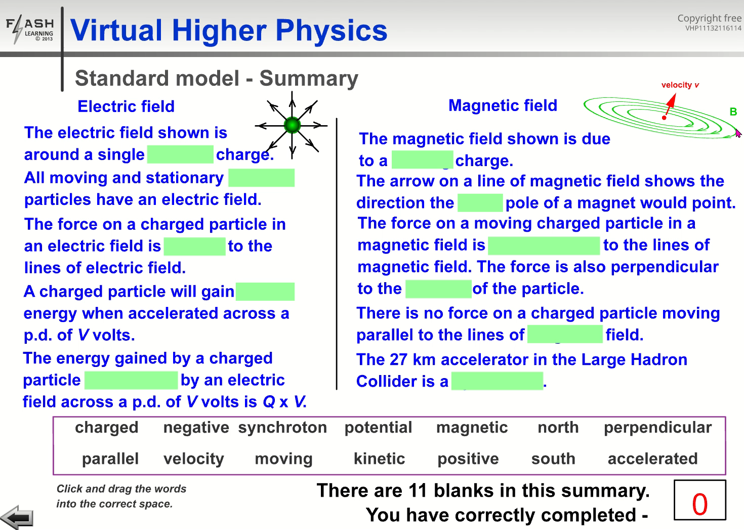

Slide 34
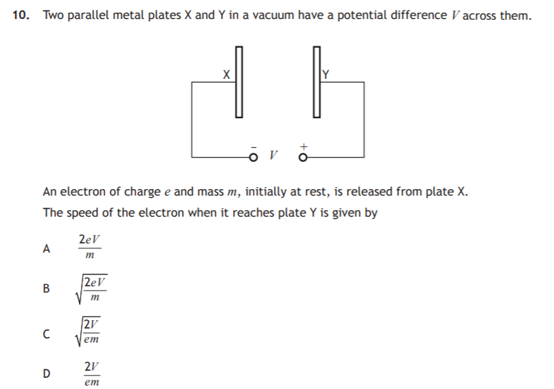
B

Slide 35
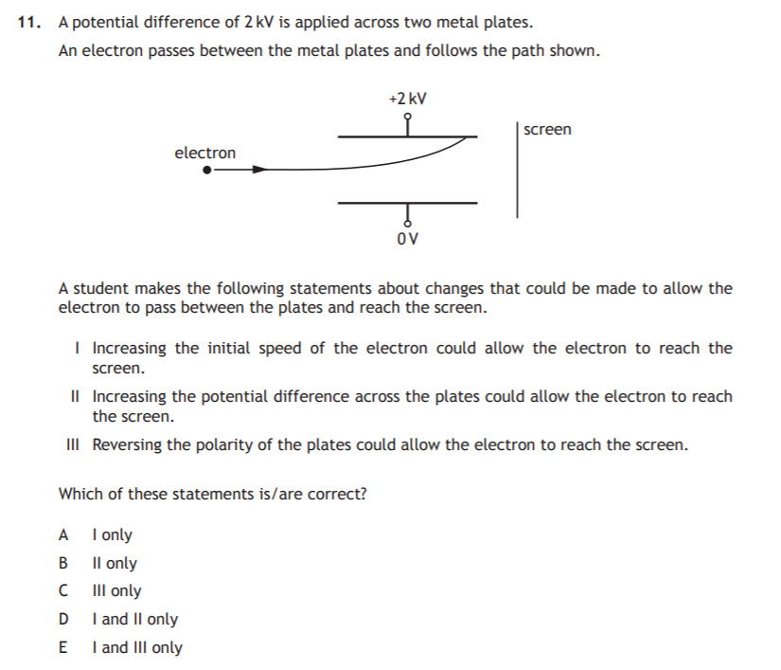
A

Slide 36
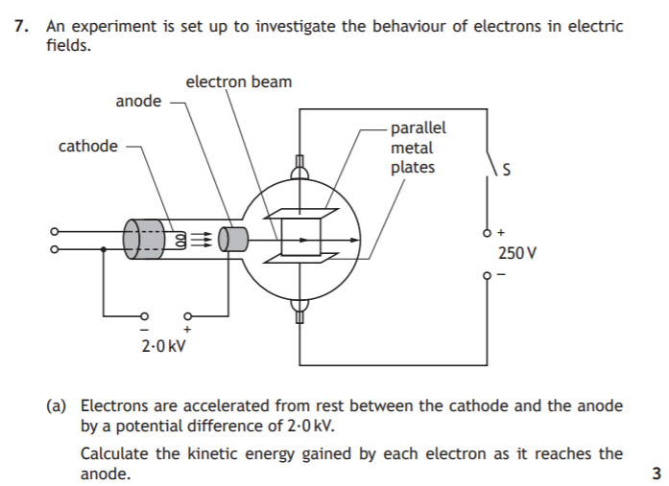
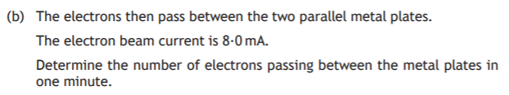

Slide 37
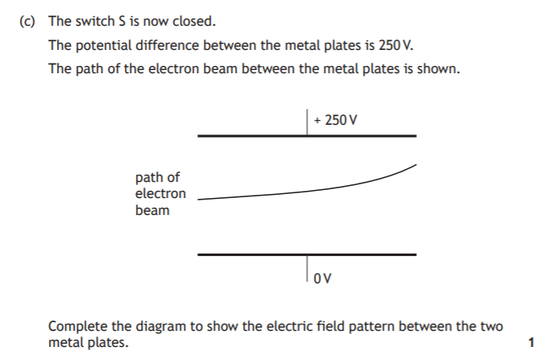

Slide 38
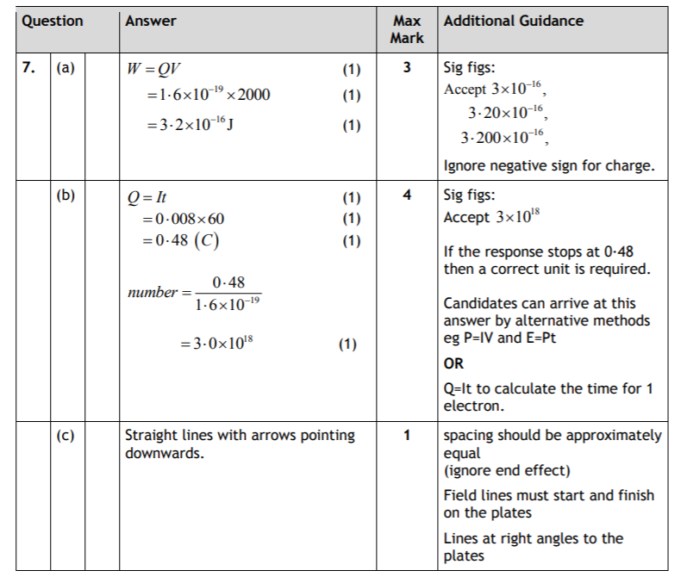

Slide 39
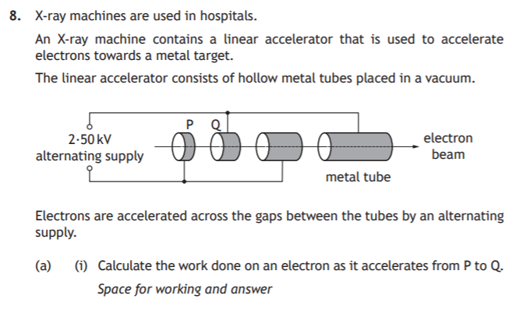

Slide 40
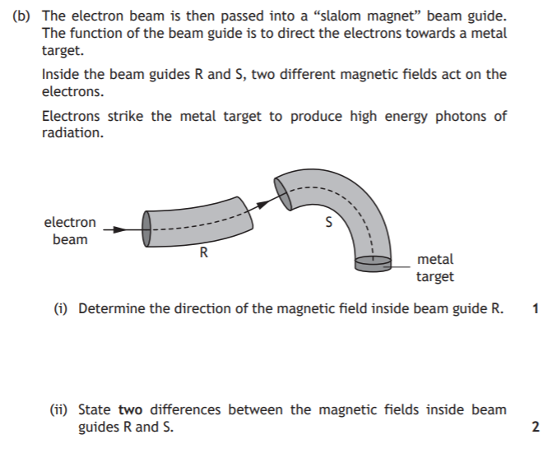

Slide 41
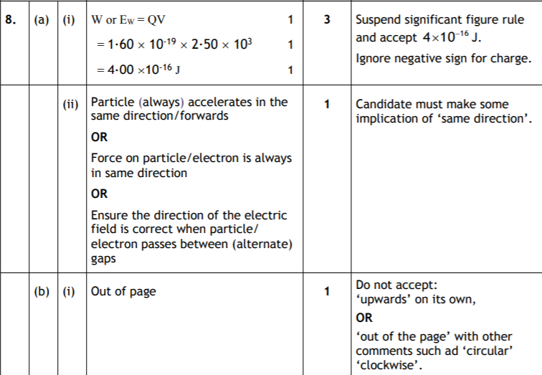

Slide 42
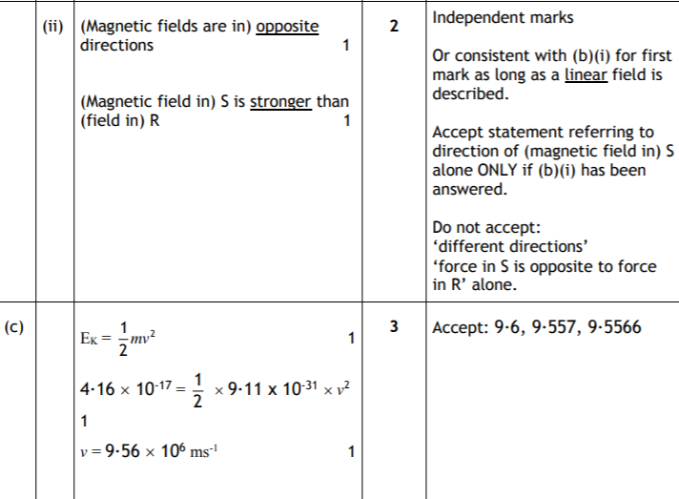

Slide 43
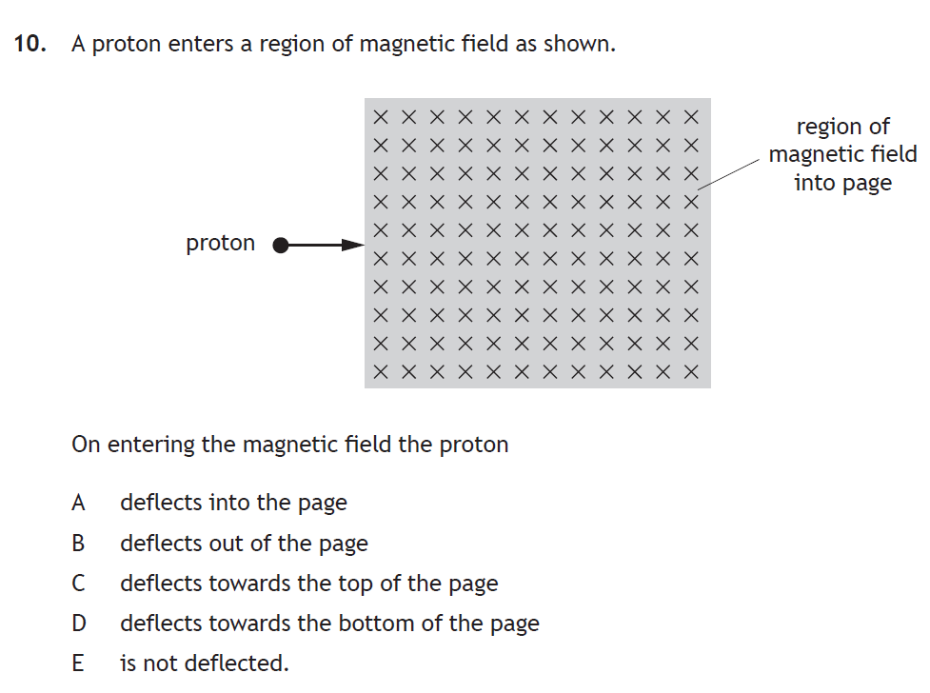
C

Slide 44
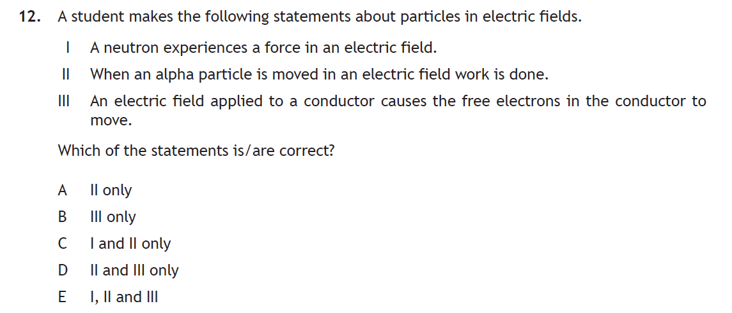
D

Slide 45
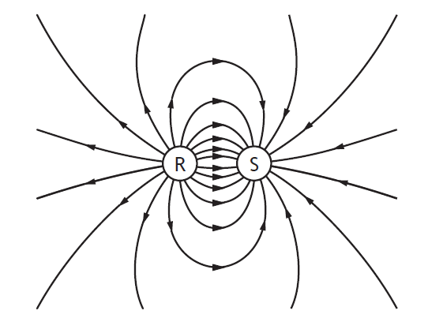
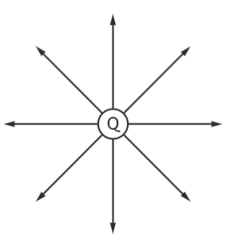
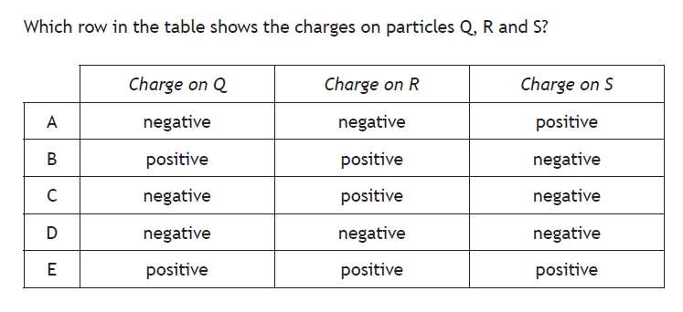
B

Slide 46
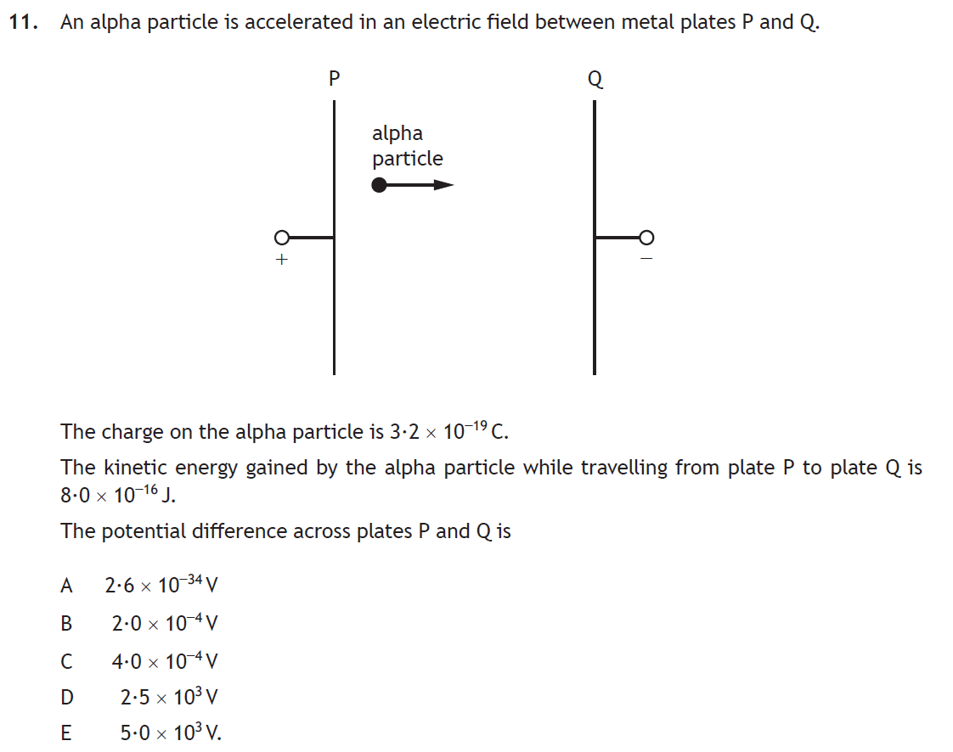
D

Slide 47
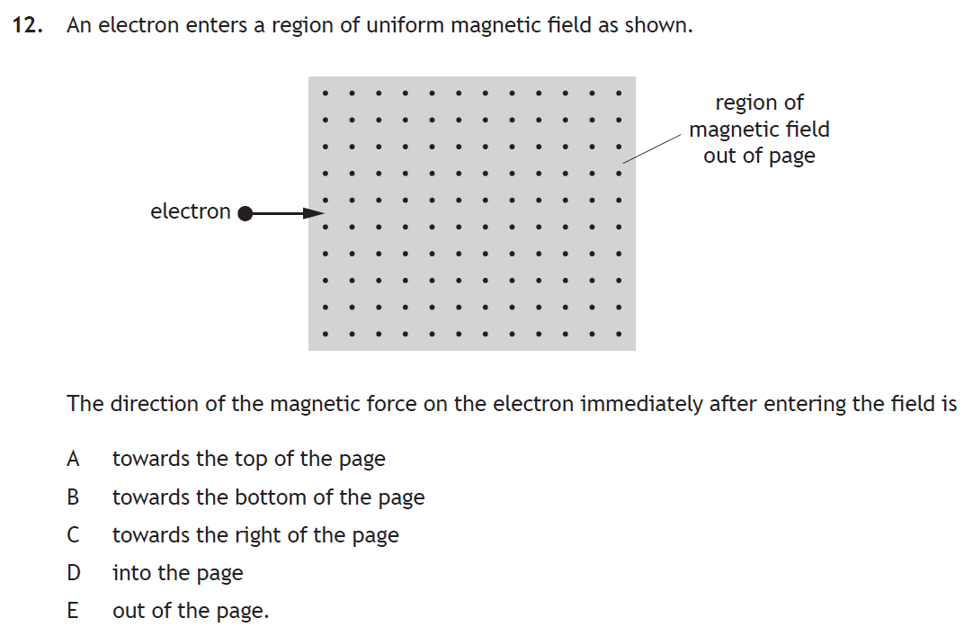
A

