Slide 1


Higher
Learn me statements
Please credit the author if you use this powerpoint. Thank you, Mrs Physics

Slide 2
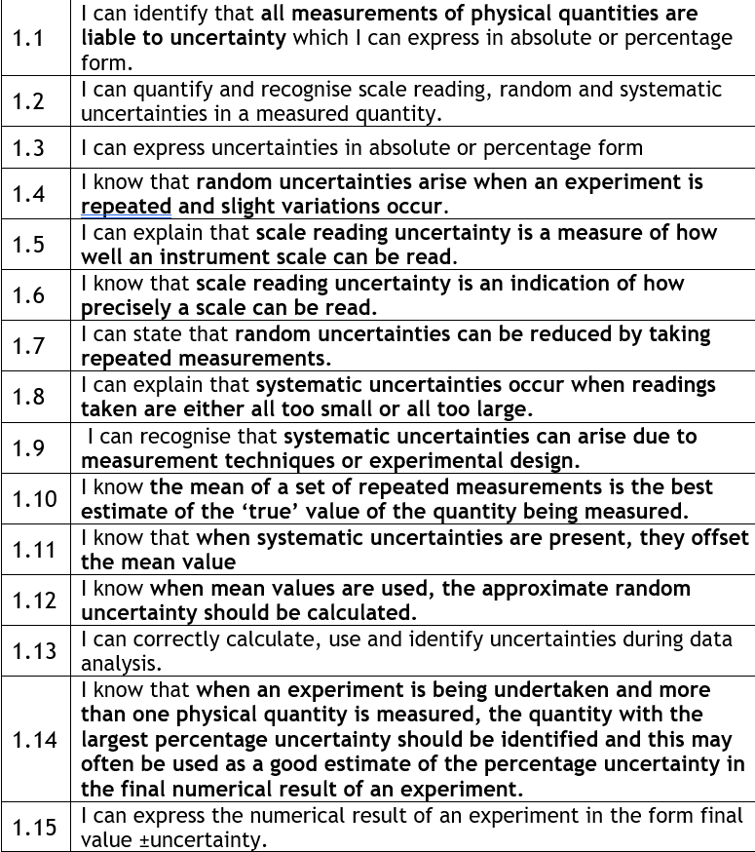
UNCERTAINTIES

Slide 3
State how random uncertainties arise.
random uncertainties arise when an experiment is repeated and slight variations occur.

Slide 4
State how random uncertainties are reduced.
random uncertainties can be reduced by taking repeated measurements

Slide 5
Explain how systematic uncertainties occur.
systematic uncertainties occur when readings taken are either all too small or all too large
systematic uncertainties can arise due to measurement techniques or experimental design.
Arising from bad experimental design or bad use of equipment or unreliable equipment

Slide 6
State the best estimate of the true value being measured.
the mean of a set of repeated measurements is the best estimate of the ‘true’ value of the quantity being measured.

Slide 7
State the effect of systematic uncertainties.
systematic uncertainties make all measurements too small or all too large

Slide 8
State how to determine the percentage uncertainty in the final result from a number of readings.
when an experiment is being undertaken and more than one physical quantity is measured, the quantity with the largest percentage uncertainty should be identified and this may often be used as a good estimate of the percentage uncertainty in the final numerical result of an experiment.

Slide 9
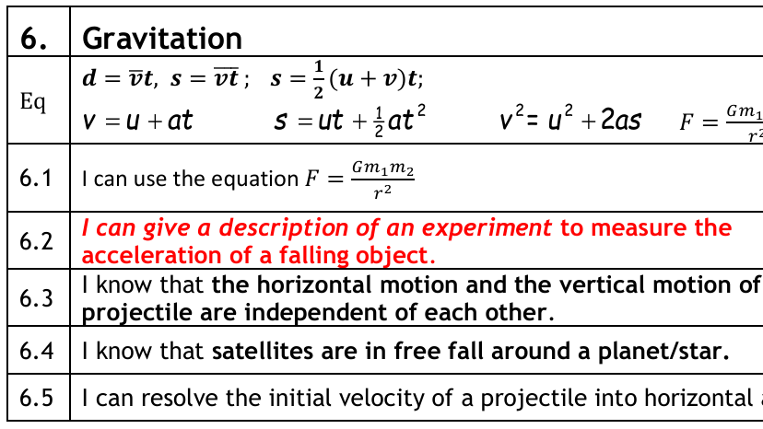
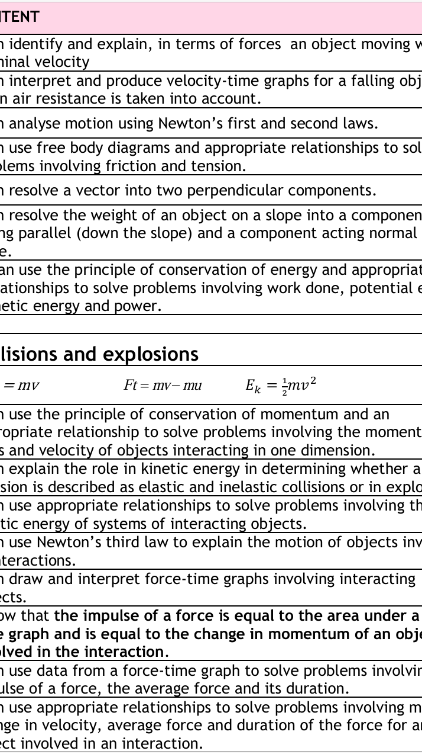
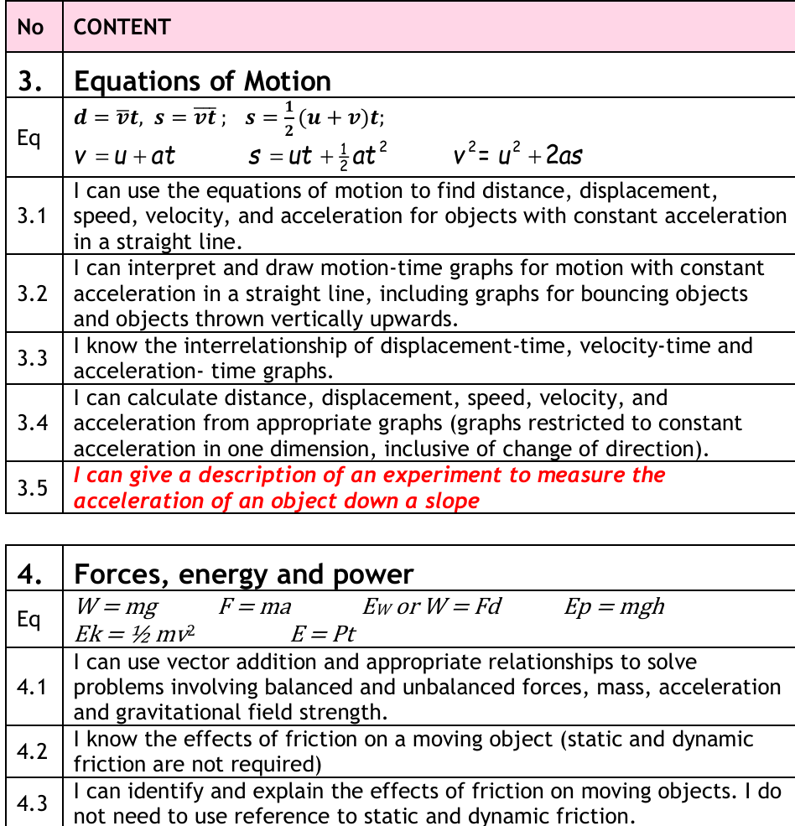
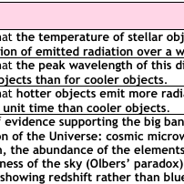
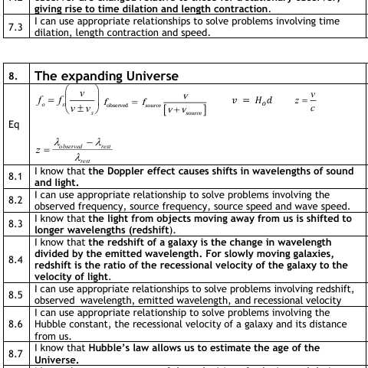
Our Dynamic Universe

Slide 10
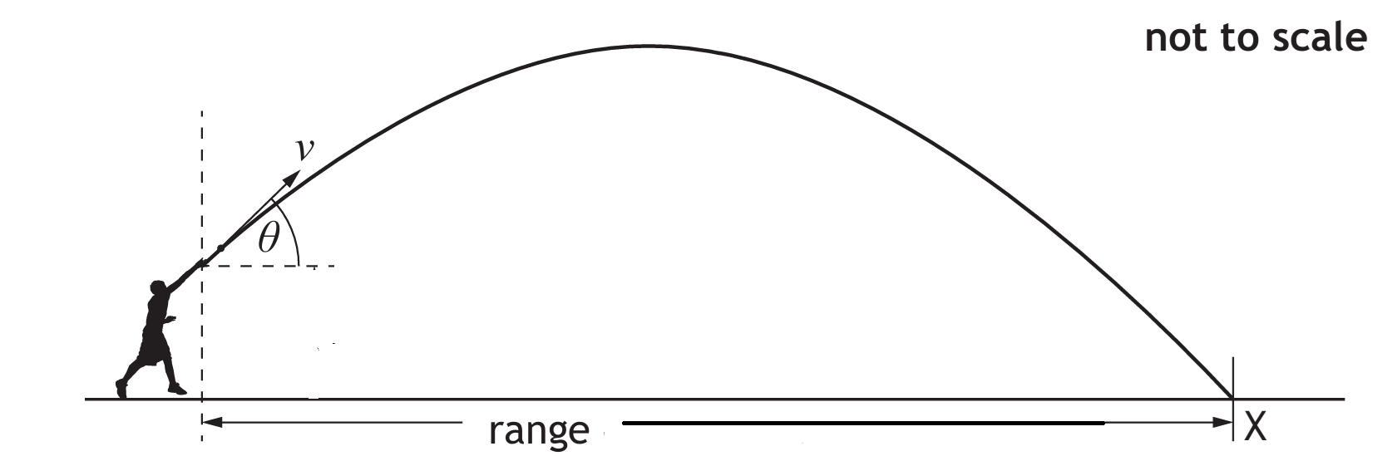
State the vertical and horizontal components for an object thrown at an angle
Horizontal component = v cos θ
Vertical component = v sin θ

Slide 11
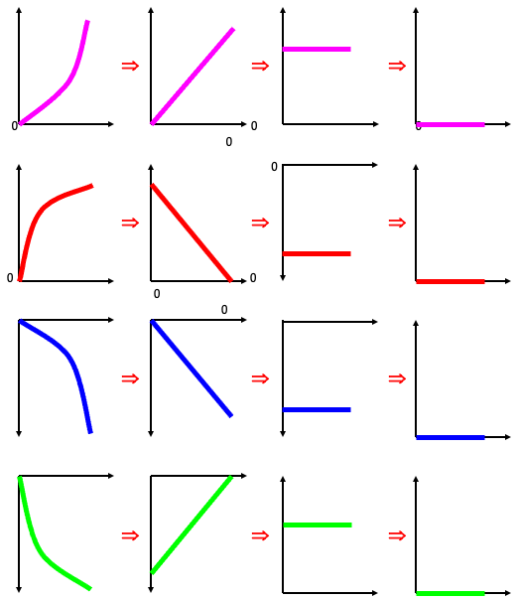
The graph to the right is the gradient of the previous one
So if you find have an s-t graph the next one right is the v-t graph and the next one right is the a-t graph.
Likewise the graph to the left is the area under the previous graph, so if you have an a-t graph to the left is the v-t graph and to the left of that the s-t graph.

Slide 12
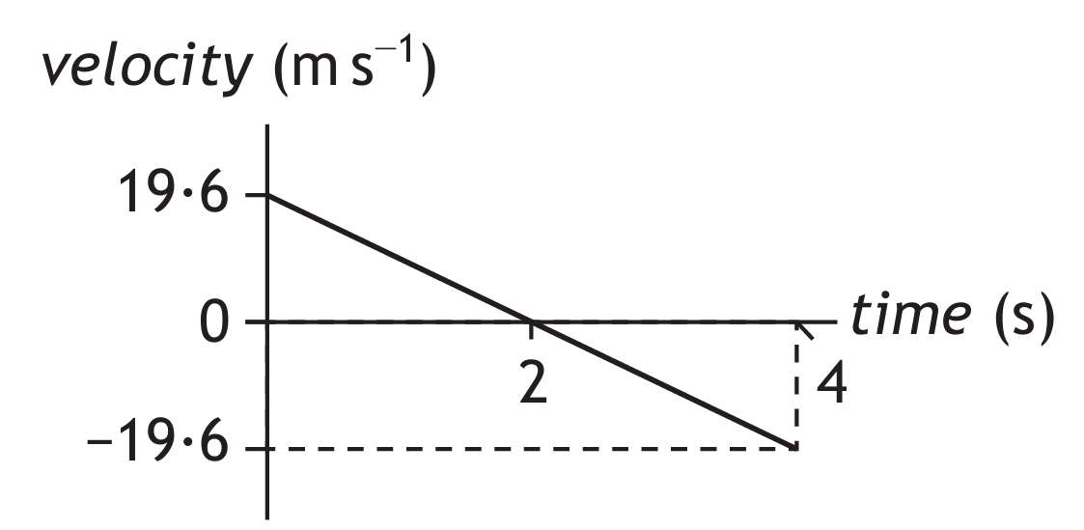
Sketch a v-t graph for an object thrown up in the air and caught on its return
For earth the gradient should be 9.8 ms⁻²
the initial velocity and time can vary
The initial and final vertical velocities should be constant if the ball is caught at the same height
The area under the graph should equal zero, as the bottom half is the negative displacement (return journey)
The area under the top half of the graph represents the max height reached
The gradient= acceleration =g = negative

Slide 13
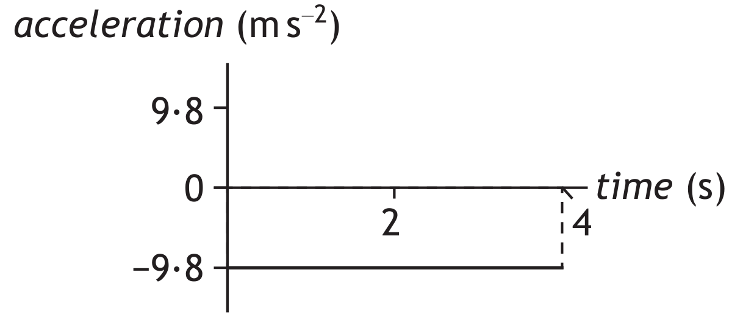
Sketch a a-t graph for an object thrown up in the air and caught on its return
For earth the gradient should be zero
For Earth the value of a = - 9.8 ms⁻²
The area under the graph should equal the change in velocity,
The time depends on how long the object remains in the air

Slide 14
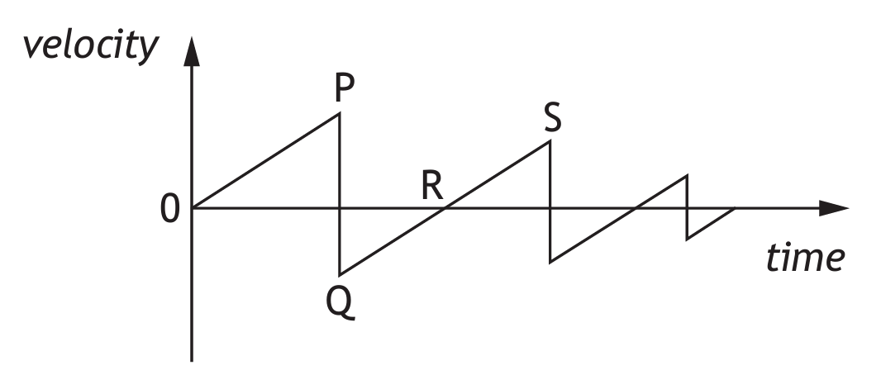
Sketch a v-t graph for an object dropped and allowed to bounce several times
For Earth the gradient,0P/QS should be equal and equal 9.8 ms⁻²
the initial velocity is zero as dropped from rest
The gradient PQ/ST >> 0P/QS as this is the acceleration during the bounce and the rate of change of velocity is great.
The velocity at P>S so after the bounce the ball must have lost Ek, the collision is inelastic

Slide 15
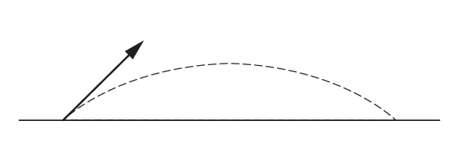
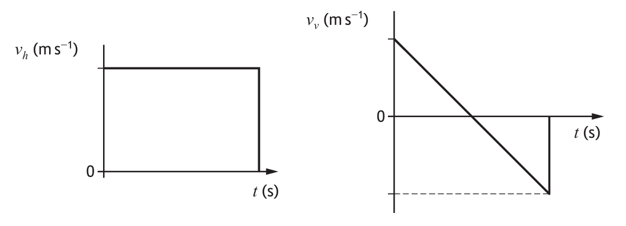
Sketch v-t graphs of the horizontal and vertical motions for an object thrown at an angle
The gradient until it hits the ground = g

Slide 16
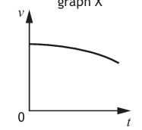
Sketch v-t graphs of the horizontal motion for an object thrown from a cliff when air resistance is accounted for

Slide 17
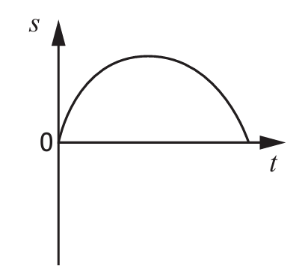
Sketch a displacement-time graph for a ball thrown vertically upwards and returing to its original position

Slide 18
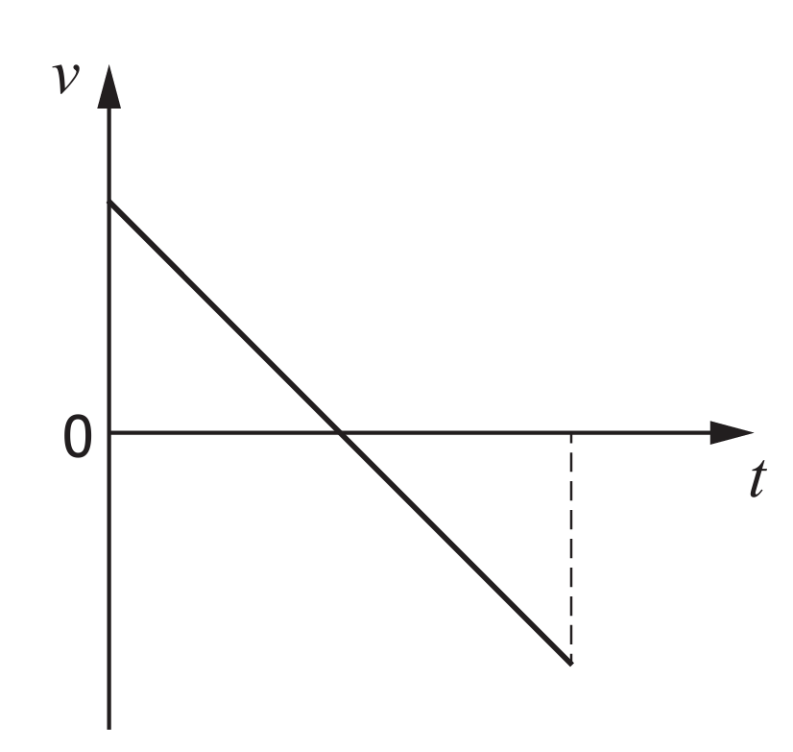
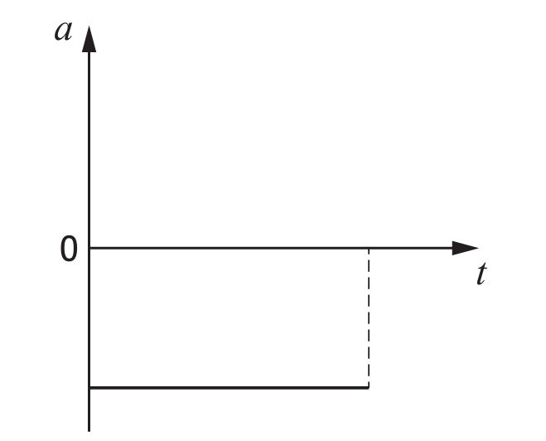
A ball is thrown vertically up and it falls back. The a-t graph is shown. Sketch the corresponding v-t graph

Slide 19
State the effect of friction on an object
Friction opposes motion, so will slow an object or cause an object with a force on it to move at constant velocity.
The force of friction increases with speed.

Slide 20
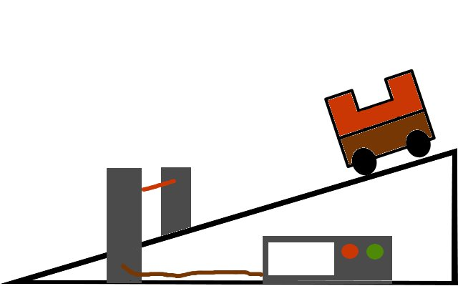
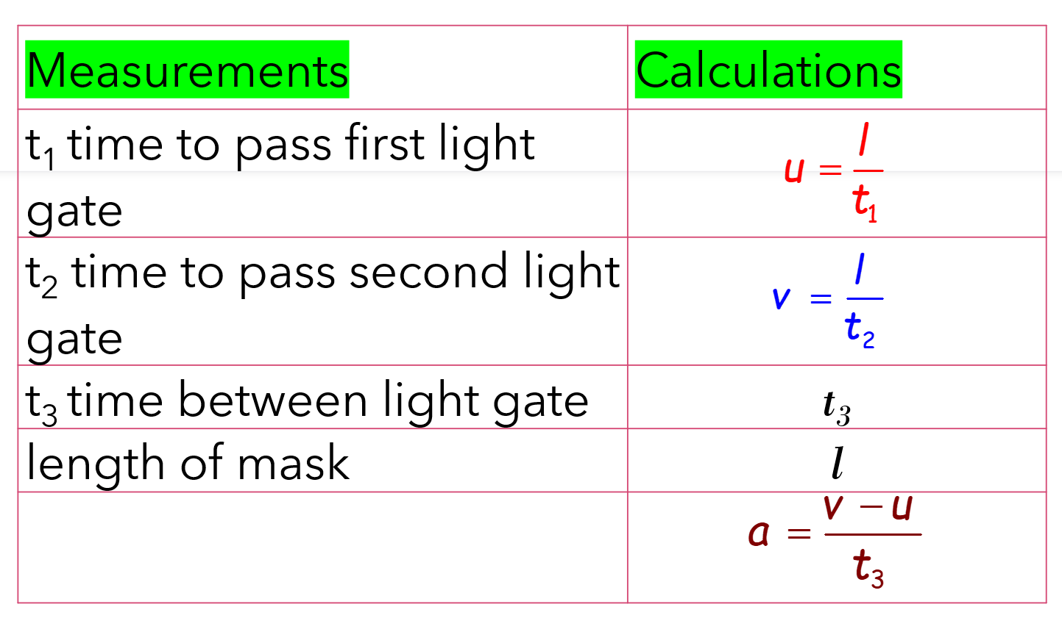
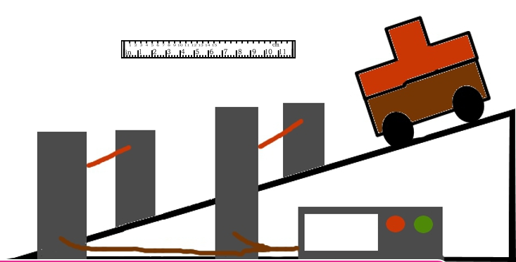
Give a description of an experiment to measure the acceleration of an object down a slope

Slide 21
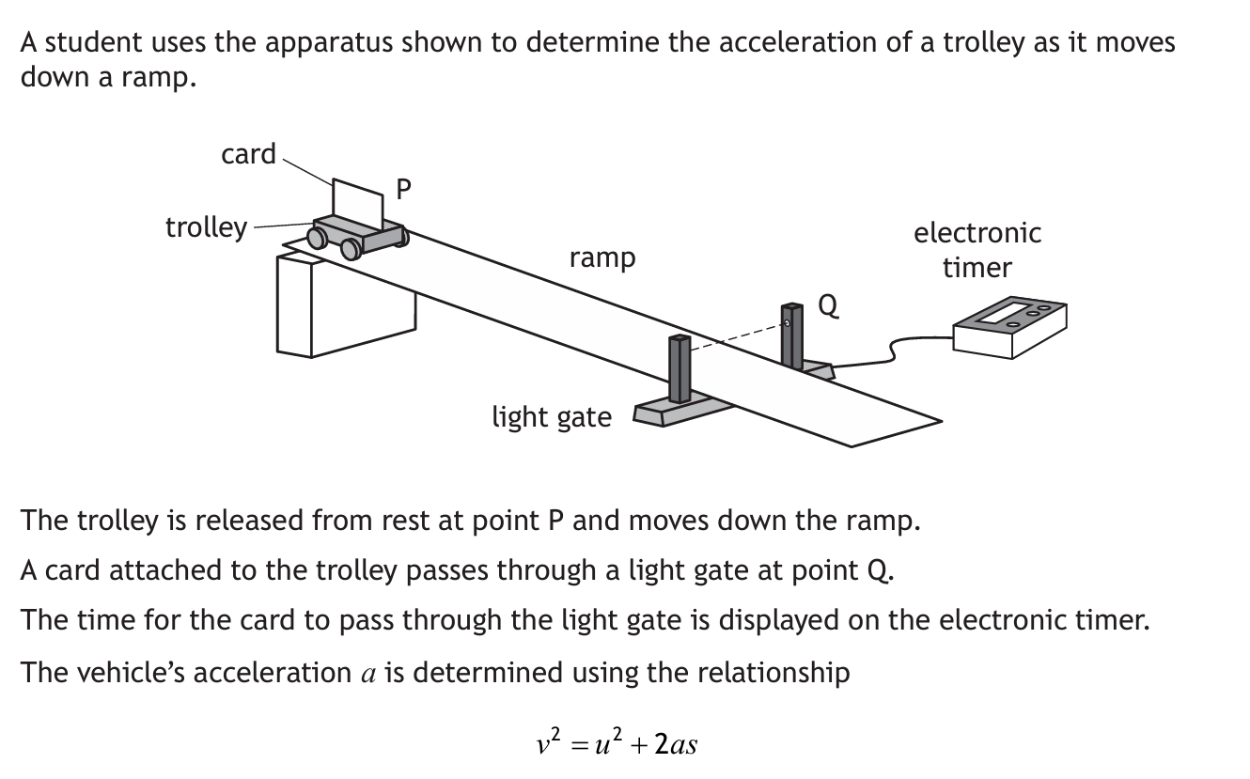
Give a description of an experiment to measure the acceleration of an object down a slope

Slide 22
Explain in terms of forces why an object reaches terminal velocity
Forces are balanced (mustn’t just say equal, must have equal and opposite)
Frictional forces increase with speed
Terminal speed achieved when forward forces balance the frictional forces

Slide 23
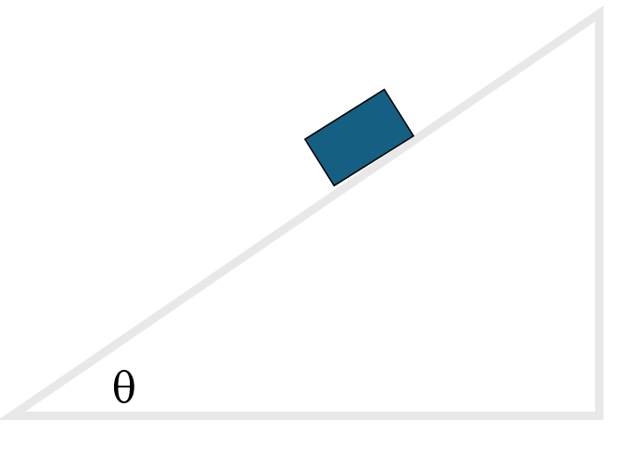
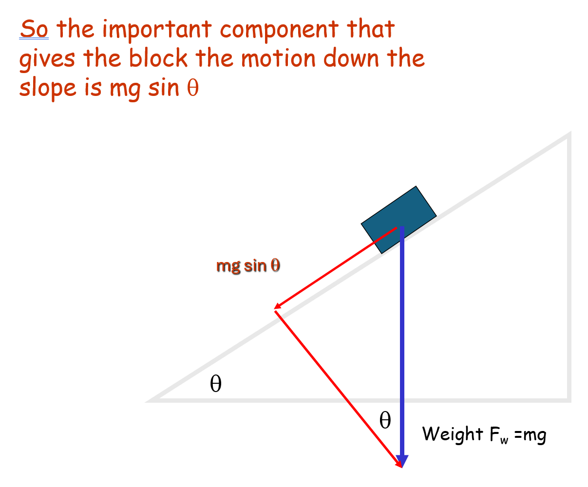

State the force/component of force acting down the slope
$$mg\sin{θor Wsin{θ}}$$

Slide 24
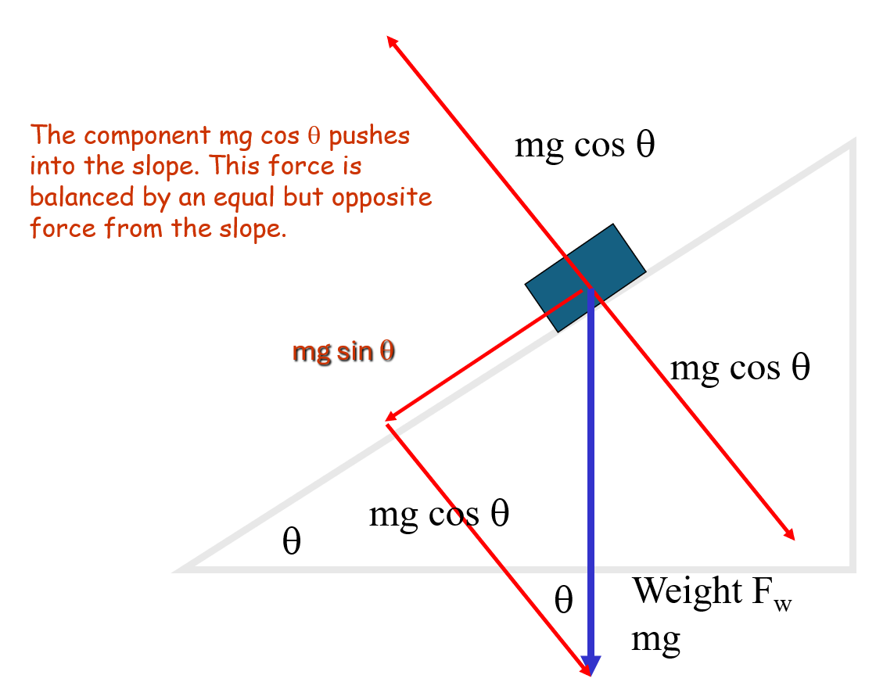
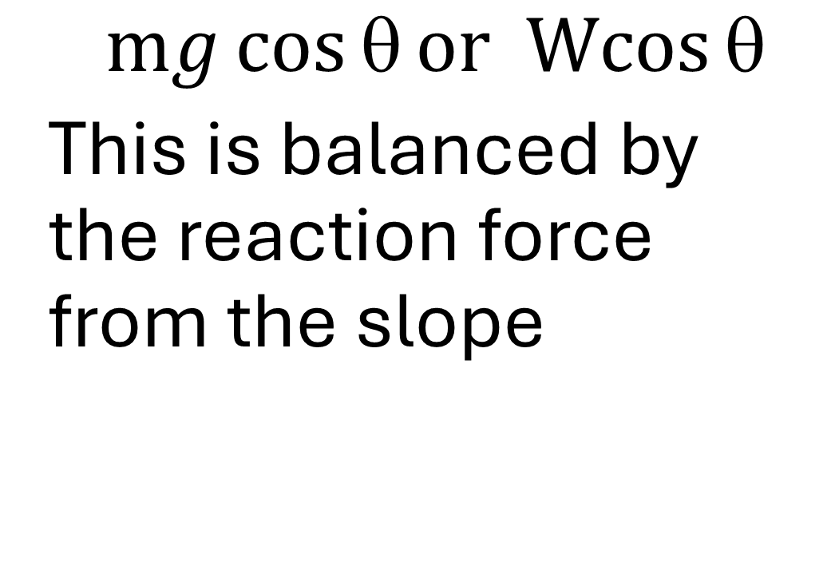
State the force/component of force normal to the slope.
$$mg\cos{θor Wcos{θ}}$$
This is balanced by the reaction force from the slope

Slide 25
State what is meant by the conservation of momentum
In the absence of external forces, total momentum before is equal to the total momentum after

Slide 26
State what is conserved and lost during an elastic collision
Total energy is conserved
Total Momentum is conserved
Total Kinetic energy is conserved

Slide 27
State what is conserved and lost during an inelastic collision
Total energy is conserved
Total Momentum is conserved
Total Kinetic energy is lost (to other forms)

Slide 28
Force time graphs

Slide 29
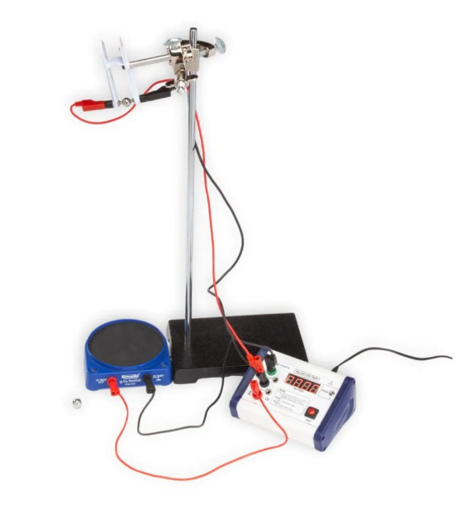
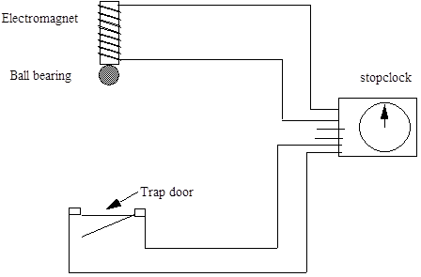
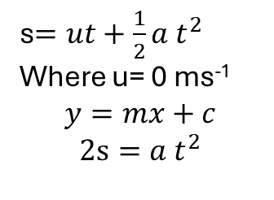
Describe an experiment to measure the acceleration of a falling object.
Measure and record the height between bottom of ball and trap door
Close the switch to release the ball and start timer
Record the time to fall
Repeat for other heights
Plot a graph of 2s against t²
The gradient is g the acceleration due to gravity
s$=ut+\frac{1}{2}a t^{2}$
Where u= 0 ms⁻¹
$$y=mx+c$$
$$2s=a t^{2}$$

Slide 30
Describe the horizontal and vertical motions of a projectile
Motions are independent
Horizontally (ignoring air resistance) horizontal motion is constant
Vertically (ignoring air resistance) motion is constant acceleration and is equal to g
The gradient until it hits the ground = g

Slide 31
Describe the motion of a satellite around a star or planet
satellites are in free fall around a planet/star
Satellites have a constant horizontal velocity and a constant downwards acceleration

Slide 32
State the speed of light for two observers in different frames of reference
the speed of light in a vacuum is the same for all observers.

Slide 33
measurements of space, time and distance for a moving observer are changed relative to those for a stationary observer, giving rise to time dilation and length contraction

Slide 34
State Einsteins two postulates
All the laws of physics are the same in all inertial frames of reference.
The speed of light (in a vacuum) is the same in all inertial frames of reference.

Slide 35
State the effect of the Doppler effect
Doppler effect causes shifts in wavelengths of sound and light.

Slide 36
State how distant galaxies are moving relative to us
Distant galaxies are moving away from us
The further the galaxy, the greater its recessional velocity.

Slide 37
State evidence supporting the big bang
cosmic microwave background radiation,
the abundance of the elements hydrogen and helium,
the darkness of the sky (Olbers’ paradox) and
the large number of galaxies showing redshift rather than blueshift.

Slide 38
State what the big bang suggests about our universe.
The expansion of the Universe.

Slide 39
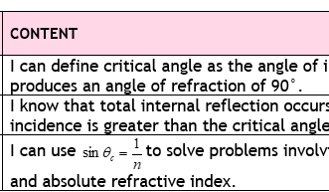
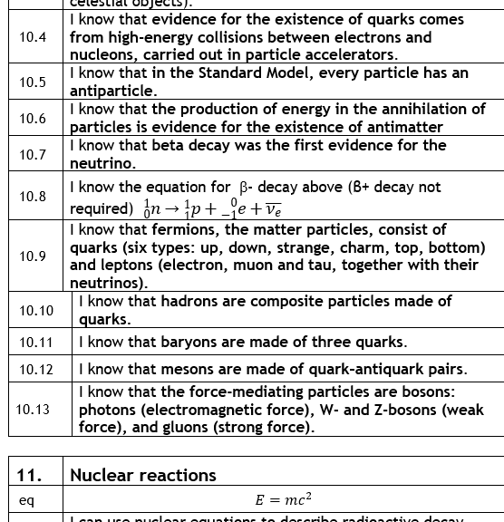
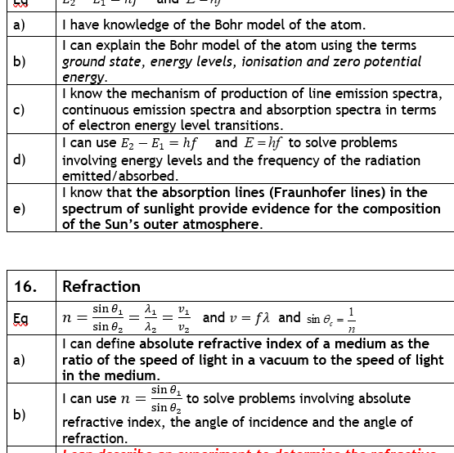
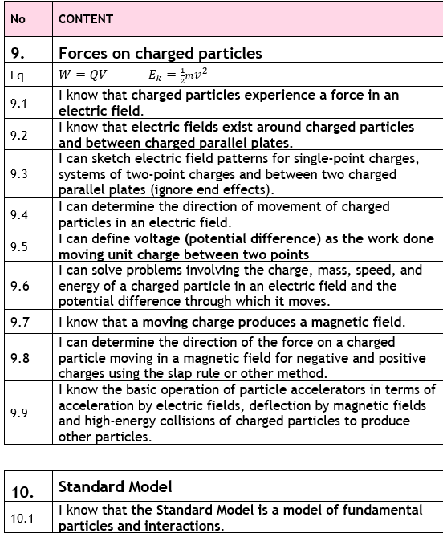
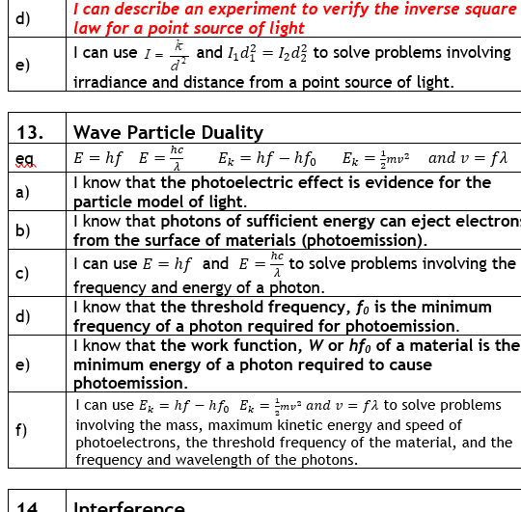
Particles and Waves

Slide 40
State what is meant by the Standard Model
the Standard Model is a model of fundamental particles and interactions

Slide 41
State what is meant by a fundamental particle
Fundamental particles cannot be broken down any further, so leptons and quarks are considered fundamental
Protons and neutrons are made of more than one particle so are not fundamental

Slide 42
Define the terms a) hadron, b) baryon, c) meson
Hadrons are made up of quarks (which cannot exist alone)
Baryons (3 syllables) are hadrons made up of 3 quarks
Mesons (2 syllables) are hadrons made up of a quark and anti-quark pair

Slide 43
Define the terms a) lepton, b) exchange particle
a) Leptons are fundamental particles that exist on their own
They have a whole charge
b) Exchange particles carry the force between two particles

Slide 44
Name the quarks
6 Quarks –
up,
down,
charm,
strange,
top,
bottom

Slide 45
Name the leptons
6 Leptons
electron,
electron neutrino,
muon,
muon neutrino,
tau,
tau neutrino

Slide 46
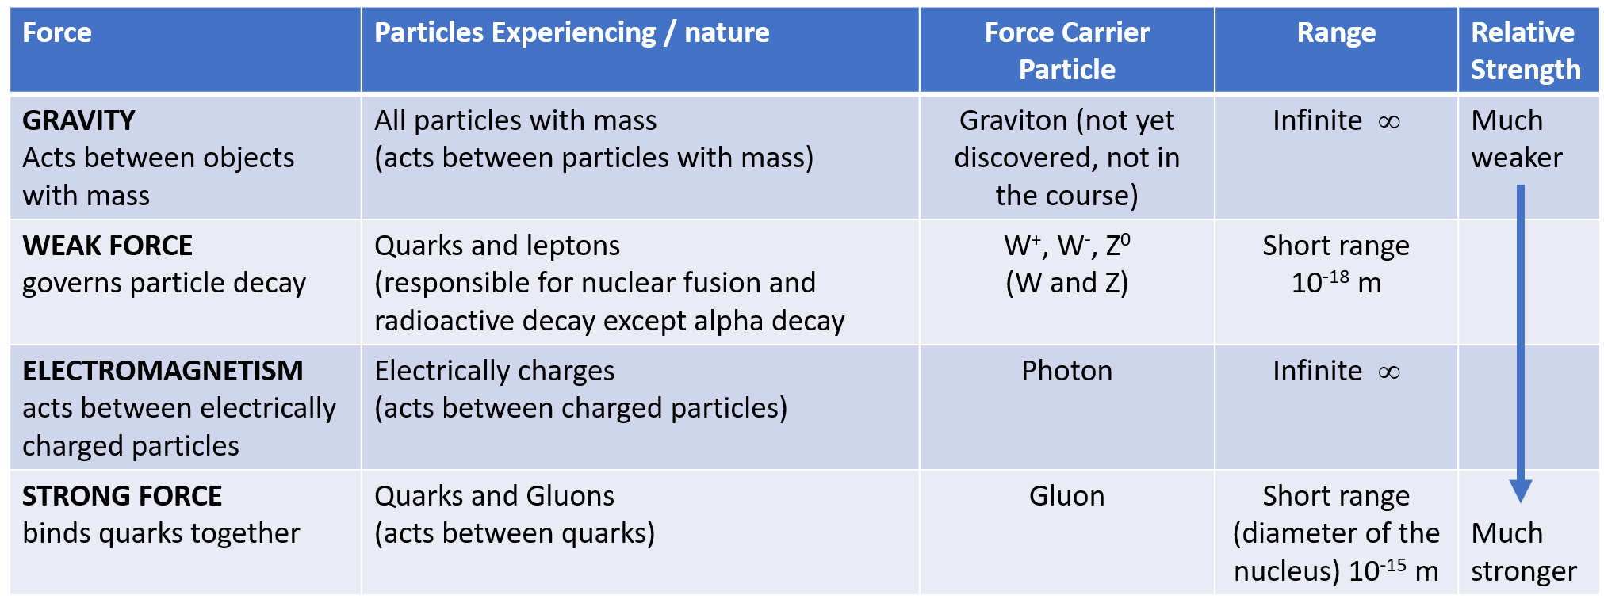
State the a) 4 fundamental forces, b) the particles that experience it, c) force carrying particle d) the range, and e) relative strength (NB gravity not required though)

Slide 47
Name the bosons and associated force
4 Gauge Bosons (force carriers) but graviton not on the course
photon (electromagnetic force)
Z and W± bosons (weak nuclear force)
gluon (strong nuclear force).

Slide 48
Define the term fermion
Fermions are matter particles, so all quarks and leptons

Slide 49
State what causes beta decay
State what evidence is provided by beta decay
Beta decay is caused by the weak force and
is evidence of the neutrino

Slide 50
Descibe antiparticles
Every type of particle of "ordinary" matter (as opposed to antimatter) is associated with an antiparticle with the same mass but with opposite physical charges (such as electric charge).
For example, the antiparticle of the electron is the positron (antielectron). The electron has a negative electric charge, the positron has a positive electric charge.
Particles and their antiparticles can annihilate each other producing energy

Slide 51
State the evidence for the existence of antimatter
the production of energy in the annihilation of particles

Slide 52
State what is meant by the strong force
Strong force holds quarks together and
so holds protons and neutrons together in the nucleus.
It acts over a very small range (the diameter of the nucleus) but it is very strong compared to the other forces of nature

Slide 53
State what is meant by a fermion
Fermions are matter particles they consist of the 6 quarks and the 6 leptons

Slide 54
State whether something can be a hadron, lepton, fermion, baryon and meson at the same time
Fermions- leptons, baryons, meson, hadrons
Leptons- fermions
Hadrons- either baryon or meson (not both), fermion
Baryons- hadrons, fermions
Mesons- hadrons, fermions

Slide 55

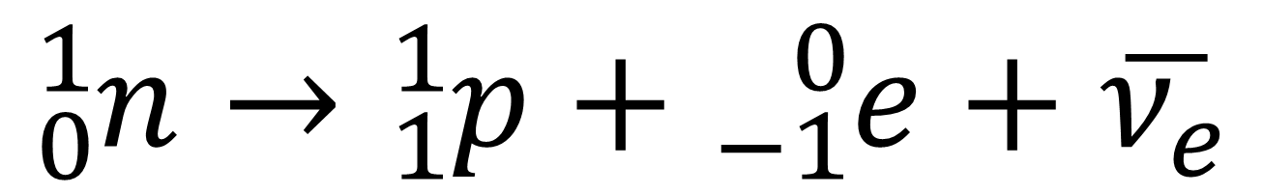
State what beta decay is evidence for.
State the equation for beta decay
$${}_{0}^{1}n→{}_{1}^{1}p+{}_{−1}^{0}{e+\overline{ν_{e}}}$$
$ν_{e}$ the neutrino

Slide 56
State what make up the group called fermions
fermions, the matter particles,
consist of quarks (six types: up, down, strange, charm, top, bottom)
and leptons (electron, muon and tau, together with their neutrinos).

Slide 57
State what is meant by composite particles
hadrons are composite particles made of quarks.
i.e they cannot exist alone

Slide 58
State what the force mediating particles are
the force-mediating particles are bosons:
photons (electromagnetic force),
W- and Z-bosons (weak force),
and gluons (strong force).

Slide 59
State what charged particles experience in an electric field
charged particles experience a force in an electric field.

Slide 60
State what exist around charged particles and between charged parallel plates.
electric fields

Slide 61
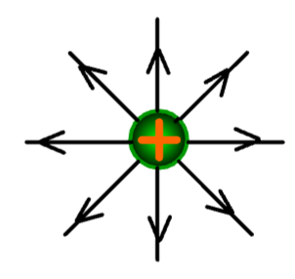
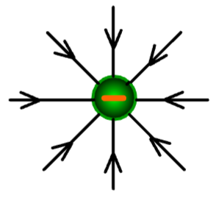
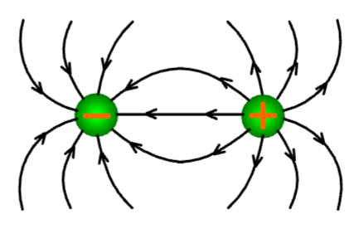
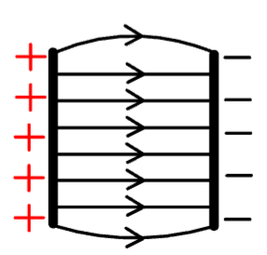
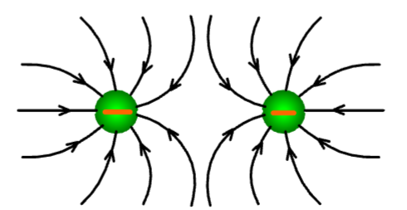
Sketch the electric field lines around a) a positive charge particle b) a negative charge particle c) a positive and negative charged particle d) between two negative particles and e) between charged parallel plates.
Note: The arrows on field lines between two positive charges would be reversed

Slide 62
define voltage
(potential difference) as the work done moving unit charge (1 coulomb) between two points

Slide 63
State what is produced by a moving charge
A magnetic field

Slide 64
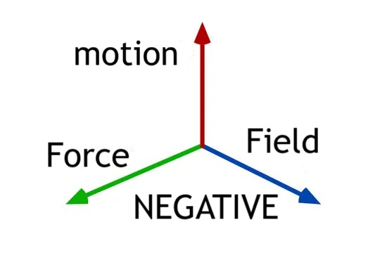
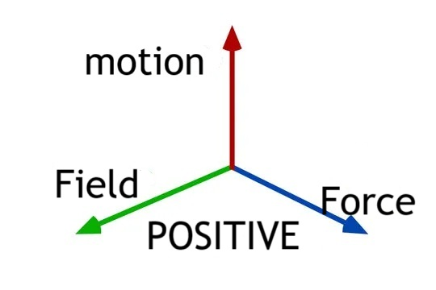
determine the direction of the force on a charged particle moving in a magnetic field
Negative particles have a force field and positive particles field the force
If the motion is up!
If you get these results your method works!

Slide 65
Explain how particle accelerators work.
In a particle accelerator an electric field is used to change the particle’s speed (SQA: accelerate) while it is most common to use a magnetic field to change the particle’s direction (SQA: deflect)

Slide 66
In particle accelerator state the function of a) electric fields, b) magnetic fields c) high-energy collisions
electric fields accelerate particles,
magnetic fields deflect particles
and high-energy collisions of charged particles produce other particles

Slide 67
Describe nuclear fission
Nuclear Fission (must spell it correctly) – big nucleus splitting into smaller parts
Induced/Stimulated Fission: usually caused by neutron bombardment
Spontaneous Fission: random event, no external trigger.
The products of a nuclear reaction have less mass than the particles did before. The difference in mass is converted into energy according to E = m c².

Slide 68
Describe nuclear fusion
Nuclear Fusion (must spell it correctly) –
Small nuclei combine to make a more massive nucleus.
The products of a nuclear reaction have less mass than the particles did before.
The difference in mass is converted into energy according to
E = m c².

Slide 69
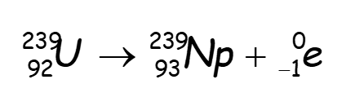
State what is meant by a spontaneous nuclear reaction
When a large nucleus decays into smaller nuclei and energy without the need for a neutron to start the reaction, mass is not conserved during the reaction but is converted to energy according to E=mc²

Slide 70
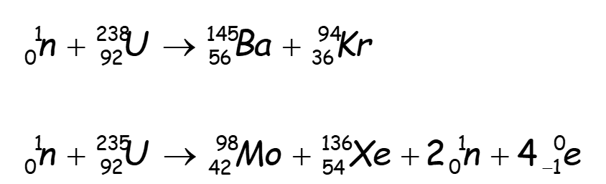
State what is meant by a induced nuclear reaction
When a neutron collides with a large nucleus which decays into smaller nuclei creating energy, mass is not conserved during the reaction but is converted to energy according to E=mc²

Slide 71

Summarise the effects of α,β+, β-, γ, neutron emission on the mass and atomic numbers
Particle | Symbol | Changes to Mass No, A. | Changes to Atomic No. Z
α |  | -4 | -2
/ β- |  | 0 | +1
β+ |  | 0 | -1
γ | γ | 0 | 0
 |  | -1 | 0
$${}_{Z}^{A}X$$

Slide 72
State what is required for fusion reactors
require charged particles
at a very high temperature (plasma)
this plasma has to be contained by magnetic fields.

Slide 73
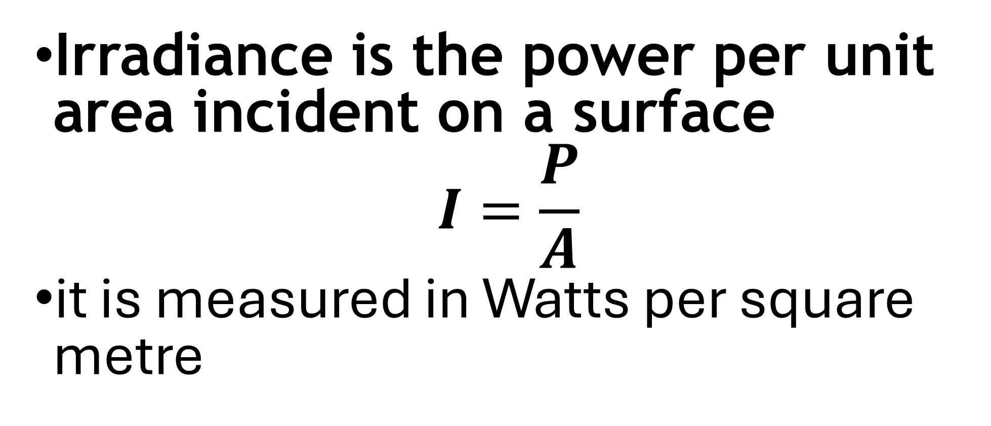
State the meaning of the term irradiance
Irradiance is the power per unit area incident on a surface
$$I=\frac{P}{A}$$
it is measured in Watts per square metre

Slide 74
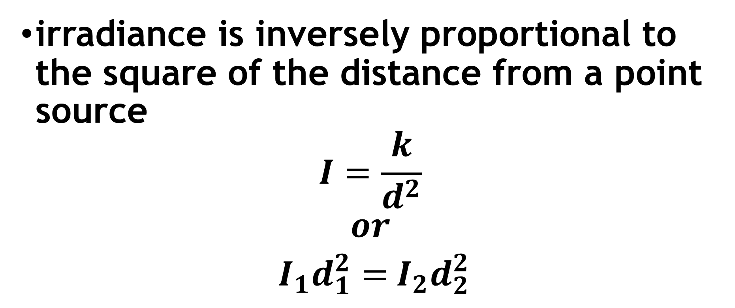
State the relationship between I and r
irradiance is inversely proportional to the square of the distance from a point source
$$I=\frac{k}{d^{2}}$$
$$or$$
$I_{1}d_{1}^{2}=$ $I_{2}d_{2}^{2}$

Slide 75
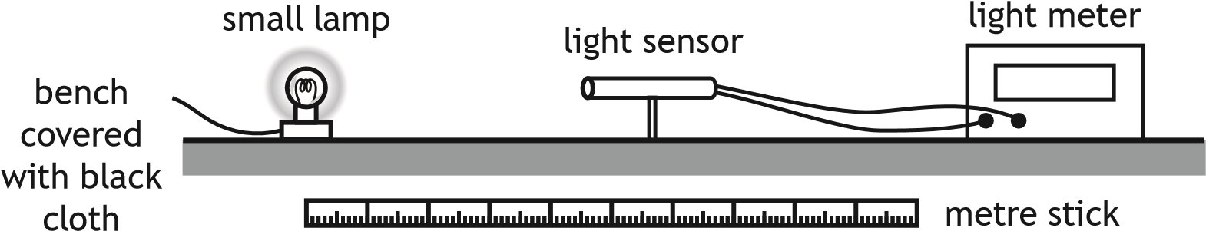
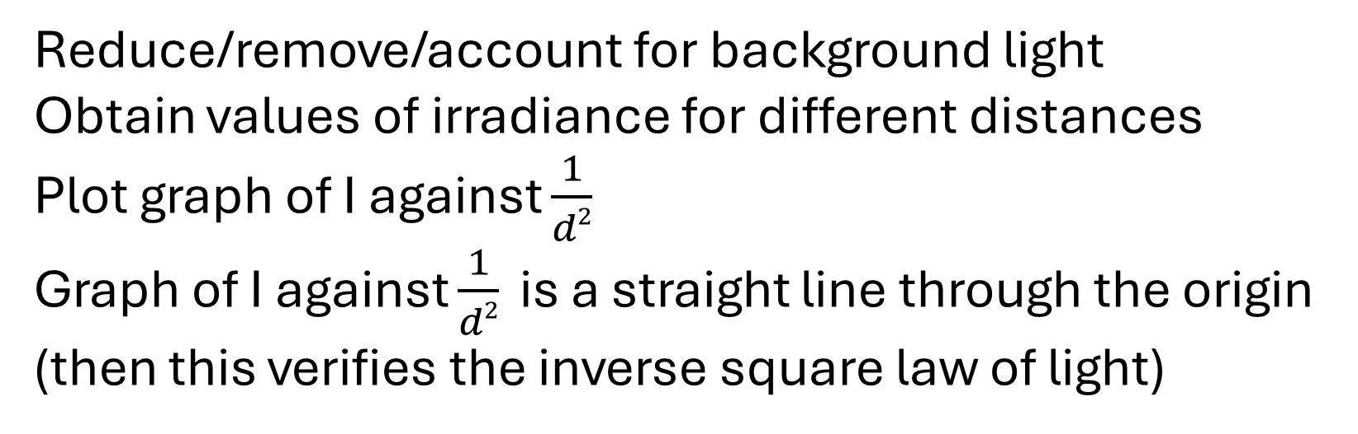
Describe an experiment to verify the inverse square law for a point source of light
Reduce/remove/account for background light
Obtain values of irradiance for different distances
Plot graph of I against $\frac{1}{d2}$
Graph of I against $\frac{1}{d2}$ is a straight line through the origin (then this verifies the inverse square law of light)

Slide 76
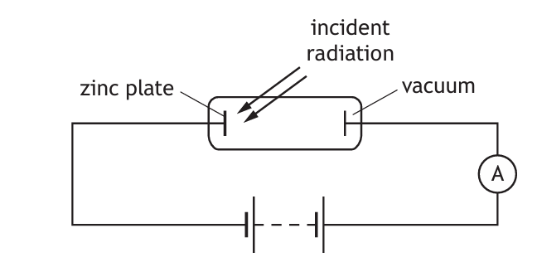
State evidence for the particle model of light.
the photoelectric effect

Slide 77
State the meaning of photoemission.
When electrons are ejected from the surface of materials when photons of sufficient energy are incident on the metal

Slide 78
State what can occur when photons of sufficient energy are inident on the surface of a metal.
electrons can be ejected from the surface of materials

Slide 79
State the meaning of threshold frequency
f₀ is the minimum frequency of an incident photon required for(to cause) photoemission

Slide 80
State the meaning of work function
the work function, W or hf₀ of a material is the minimum energy of a photon required to cause photoemission

Slide 81
State evidence for the wave model of light.
interference

Slide 82
State the meaning of the term coherent waves
Coherent waves have a constant phase relationship
Waves from coherent sources
  have the same velocity.
  have the same wavelength.
  have a constant phase relationship

Slide 83

describe of the conditions for constructive and destructive interference
maxima are produced when the path difference between waves is a whole number of wavelengths
minima are produced when the path difference between waves is an odd number of half-wavelengths

Slide 84
Describe the Bohr model of the atom.
Nucleus: A small, positively charged central region containing protons and neutrons.
Electrons: Negatively charged particles that orbit the nucleus at specific, fixed distances (called shells or energy levels).
Orbits: Electrons occupy specific, circular orbits around the nucleus, similar to planets orbiting a sun. Each orbit has a unique energy level associated with it.
Quantization: Electrons can only occupy specific, discrete energy levels (orbits) and cannot be found between them. This means that an electron can jump from one orbit to another by emitting or absorbing energy in the form of photons.
Stationary states: Each energy level (orbit) is a stationary state, meaning that an electron remains in that state until it gains or loses energy to transition to another orbit.
Ground state: The lowest energy level (orbit) is called the ground state, where the electron is closest to the nucleus.
Excited states: When an electron gains energy, it moves to a higher energy level (excited state), and when it loses energy, it returns to a lower energy level.
Electrons do not orbit in continuous paths, but rather jump between discrete energy levels.
The energy of an electron is quantized, meaning it can only have specific values.
The model explains the emission and absorption spectra of atoms, as electrons transition between energy levels by emitting or absorbing photons of specific energies.

Slide 85


Sketch a labelled diagram of the Bohr model of the atom.

Slide 86
Explain the Bohr model of the atom using the terms ground state, energy levels, ionisation and zero potential energy.
Ground State: In the Bohr model, the ground state refers to the lowest energy level of an atom, where an electron occupies the closest orbit around the nucleus. This state has the most negative energy value.
Energy Levels: The Bohr model proposes that electrons occupy specific, quantized energy levels or orbits around the nucleus. Each energy level has a unique energy value, with higher energy levels corresponding to greater distances from the nucleus.
Ionisation: According to the Bohr model, ionisation occurs when an electron gains sufficient energy to transition from a lower energy level to a higher one, effectively “jumping” to a more distant orbit. This process requires an external energy source, such as a photon, and results in the electron being removed from its original energy level.
Zero Potential Energy: In the Bohr model, the energy of an electron at infinite distance from the nucleus (i.e., completely separated from the nucleus) is considered to be zero potential energy. This serves as a reference point for calculating the energy of electrons in other orbits. The energy of an electron in a fixed orbit around the nucleus is always negative, relative to this zero potential energy.
In summary, the Bohr model describes the atom as having:
  A ground state with the lowest energy level, where the electron is closest to the nucleus.
  Quantized energy levels or orbits, with each level having a unique energy value.
  Ionisation occurring when an electron gains energy and transitions to a higher energy level.
  Zero potential energy serving as a reference point for calculating electron energies.

Slide 87
State evidence for the composition of the Sun’s outer atmosphere
the absorption lines (Fraunhofer lines) in the spectrum of sunlight

Slide 88

Explain Fraunhofer Lines
The Fraunhofer lines are a set of dark absorption lines observed in the optical spectrum of the Sun.
These lines are formed when light from the Sun’s central core (photosphere) passes through the cooler outer atmosphere (chromosphere).
The atoms and molecules in the chromosphere absorb specific wavelengths of light, resulting in the characteristic dark lines.

Slide 89

define absolute refractive index
absolute refractive index of a medium is the ratio of the speed of light in a vacuum to the speed of light in the medium.
$$n=\frac{v_{1}}{v_{2}}$$

Slide 90
Describe an experiment to determine the refractive index of a medium.
Shine monochromatic light into block along line of known angle
Mark the angle of refraction
Repeat for other angles of incidence
Measure angles with a protractor
Plot a graph of sinθ_{air} against sinθ_{material}.
Gradient is the refractive index
pre-marked angles
360° protractor
semi-circular glass block
ray box

Slide 91
State how the refractive index of a medium changes with incident radiation
the refractive index of a medium increases as the
frequency of incident radiation increases

Slide 92
define critical angle
the angle of incidence which produces an angle of refraction of 90°

Slide 93
State the conditions for total internal reflection to occur
total internal reflection occurs when the angle of incidence is greater than the critical angle

Slide 94




Electricity
Unit 3

Slide 95
Explain the term A.C
a current which changes direction and instantaneous value with time

Slide 96
State how to determine the peak voltage from an oscilloscope trace
Count the number of boxes on y-gain, from the centre of wave to the peak
Multiple by the y-gain (watch for mV etc)
This is the peak voltage

Slide 97
State how to determine the frequency from an oscilloscope trace
Count the number of boxes on time axis, for one wave.
Multiple by the time base setting, giving the period.
Frequency = 1/period

Slide 98
Explain the term electromotive force.
EMF (electromotive force) is the number of joules of energy supplied to each coulomb of charge as it passes through the source.
E.g a supply of emf 12 V supplies 12 joules of energy to each coulomb of charge passing through the source.

Slide 99
Explain the term resistance.
the opposition to the flow of charge.

Slide 100
Explain the term internal resistance.
The opposition to the flow of charge as it passes through the source

Slide 101
Explain the term lost volts.
Energy given up by each coulomb of charge as it passes through the source.

Slide 102
Explain the term open circuit.
An incomplete circuit
In an open circuit the resistance is infinitely high.
A voltmeter across an open circuit will give a reading equal to the EMF.

Slide 103
Explain the term short circuit.
In a short circuit the load resistance is zero or almost zero
There is a large current
Lost volts is a maximum

Slide 104
Explain the term terminal potential difference (tpd).
The terminal potential difference (p.d.) is the energy supplied per unit charge (voltage) available to the external circuit
  If there was no internal resistance, the terminal p.d. would be equal to the e.m.f.
  If a cell has internal resistance, the terminal p.d. is always lower than the e.m.f.
  If you have a load resistor R across the cell's terminals, then the terminal p.d. is also the potential difference across the load resistor

Slide 105
State why the EMF voltage is not available to the external circuit
As a result of the lost volts, the voltage available from the supply is always less than or equal to the maximum available voltage when no current flows (the e.m.f.).
The potential difference measured across the terminals of the supply is called the terminal potential difference (the t.p.d.). Effectively, this is the voltage which is available for the external circuit.

Slide 106

describe of an experiment to measure the EMF and internal resistance of a cell.
Measure voltage from Voltmeter and current from ammeter.
Adjust the resistance of the variable resistor
Repeat steps
Plot a graph of V against I,
y-intercept = EMF,
Gradient = -r

Slide 107

State what is meant by a capacitance of 1 Farad
a capacitor of 1 farad will store 1 coulomb of charge when the potential difference across it is 1 volt.
$C=\frac{Q}{V}$

Slide 108
State how you can determine the energy stored on a capacitor from graph
Energy is the area under a Q-V graph

Slide 109
State how you can determine the capacitance from a graph
For a QV graph, capacitance is the gradient of a Q (y axis), V (x-axis)
If plotted the other way up capacitance = 1/gradient

Slide 110
Sketch a graph of voltage against time for charging a capacitor
0

Slide 111
Sketch a graph of voltage against time for discharging a capacitor
0

Slide 112
Sketch a graph of current with time for charging a capacitor
0

Slide 113
Sketch a graph of current with time for discharging a capacitor
0

Slide 114

Describe an experiment to investigate the variation of current in a capacitor and voltage across a capacitor with time, for the charging and discharging of capacitors
Connect up the circuit.
Ensure the capacitor is fully discharged
Start clock and tmove switch to position A
Take regular values of V and I at set time intervals.
Rest clock and move switch to position B as clock restarted
Take regular values of V and I at set time intervals.
Plot graphs of V against t and I against t.
A B
V

Slide 115
Describe an experiment to investigate the variation of current in a capacitor with time, for the charging and discharging of capacitors
Connect up the circuit.
Ensure the capacitor is fully discharged
Start clock as switch moved to position A
Take regular values of I at set time intervals.
Rest clock and move switch to position B as clock restarted
Take regular values of I at set time intervals.
Plot graphs of I against t.
(Take readings of current from the ammeter at regular time intervals)
A B

Slide 116
State and explain the terms conduction band and valence band
Conduction Band: The conduction band is the energy band that contains the electrons that are free to move and conduct electricity. It is the higher energy band and is typically empty or partially filled with electrons.
Valence Band: The valence band is the energy band that contains the valence electrons, which are the electrons in the outermost shell of an atom. It is the lower energy band and is typically filled with electrons.

Slide 117
State how solids are categorised
solids can be categorised into conductors, semiconductors or insulators by their band structure and their ability to conduct electricity.
Every solid has its own characteristic energy band structure.
For a solid to be conductive, both free electrons and accessible empty states must be available

Slide 118
Sketch a graph of the energy bands in conductors, insulators and semiconductors
insulator
semiconductor
conductor
conduction
band
conduction
band
conduction
band
band gap
valence
band
valence
band
valence
band

Slide 119



Slide 120


Slide 121
State where electrons are contained in atoms
Electrons in atoms are contained in energy levels.
When the atoms come together to form solids, the electrons then become contained in energy bands separated by gaps

Slide 122
State how the energy bands are filled in metals
One or more bands are partially filled
Some metals have free electrons and partially filled valence bands, therefore they are highly conductive

Slide 123
Explain the distribution of electrons in insulators
The highest occupied band (called the valence band) is full.
The first unfilled band above the valence band is the conduction band.
For an insulator, the gap between the valence band and the conduction band is large and at room temperature there is not enough energy available to move electrons from the valence band into the conduction band where they would be able to contribute to conduction.
There is no electrical conduction in an insulator.

Slide 124
Explain the distribution of electrons in semiconductors
The gap between the valence band and conduction band is smaller than in an insulator
At room temperature there is sufficient energy available to move some electrons from the valence band into the conduction band
This allows some conduction to take place.

Slide 125
State the effect of temperature on semiconductors
An increase in temperature increases the conductivity of a semiconductor.

Slide 126
State when doping occurs in semiconductors
during manufacture, semiconductors may be doped with specific impurities
State how this affect conductivity
Conductivity increases, resulting in two types of semiconductor: p-type and n-type (all are overall neutrally charged but have either excess or deficiency in charge carriers)

Slide 127
State how a p-n junction arises and state the effect
a semiconductor contains the two types of doping (p-type and n- type) in adjacent layers,
There is an electric field in the p-n junction.

Slide 128
State devices that use one or more p-n junction. If possible state the bias
LED - Forward Bias photoconductive
Photodiodes Reverse bias
Solar Cells No bias set up in photovoltaic mode
Transistor (2 junctions eg pnp or npn) including MOSFET

Slide 129
State how to bias a p-n junction
an external voltage is applied across the junction

Slide 130


Sketch a diagram of forward bias
In forward bias the diode is connected with the p-type connected to the positive supply terminal and the n-type connected to the negative.
The electric field across the depletion layer decreases.
The resistance to electron flow is reduced.

Slide 131



Sketch a diagram of reverse bias
In reverse bias the diode is connected with the p-type connected to the negative supply terminal and the n-type connected to the positive.
The electric field across the depletion layer increases.
This acts as a barrier that stops electron flow.
The valence band energy level in the p-type material is raised above the free electrons of the conduction band of the n-type. This is due to the combination of doping and electric field across the junction.

Slide 132
State how forward biasing affects the electric field
Forward bias reduces the electric field in the p-n junction.
State how reverse biasing affects the electric field
reverse bias increases the electric field in the p-n junction.

Slide 133
Explain how an LED works
LEDs are forward biased p-n junction diodes that emit photons.
The forward bias potential difference across the junction causes electrons to move from the conduction band of the n-type semiconductor towards the conduction band of the p- type semiconductor.
Photons are emitted when electrons ‘fall’ from the conduction band into the valence band either side of the junction

Slide 134
Describe in detail the solar cell
solar cells are p-n junctions that produce a potential difference is when photons are absorbed.
Solar cells have no bias - this is known as the photovoltaic effect.
The absorption of photons provides energy to ‘raise’ electrons from the valence band to the conduction band.
The p-n junction causes the electrons in the conduction band to move towards the n-type semiconductor
and a potential difference is produced across the solar cell.

Slide 135

Hope you found this helpful
Please pass on any feedback before you go back to the beginning and try again, and see if you can get any more correct answers.
Little and often is the name of the game

