Slide 1

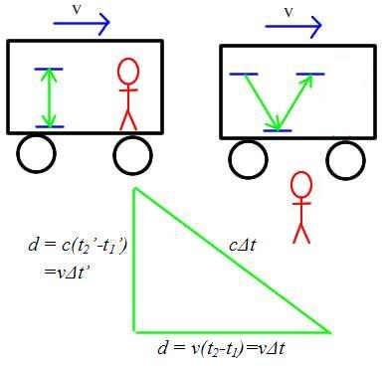

Special Relativity
Higher Physics

Slide 2
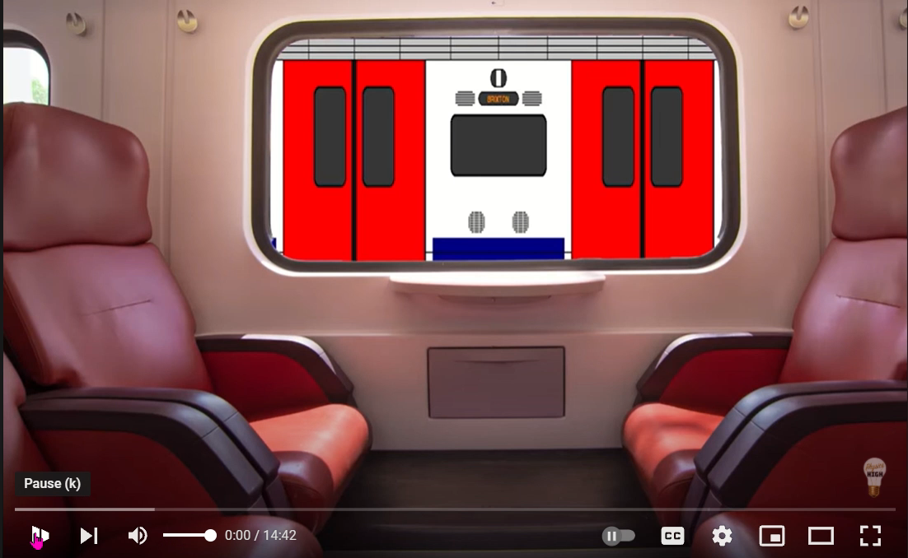
Relative motion
https://www.youtube.com/watch?v=pygnrS75HLs

Slide 3
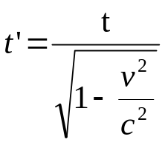
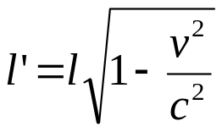
outcomes
6 |  | Special relativity
 | eq
 | a) | I know that the speed of light in a vacuum is the same for all observers.
 | b) | I know that measurements of space, time and distance for a moving observer are changed relative to those for a stationary observer, giving rise to time dilation and length contraction.
 | c) | I can use appropriate relationships to solve problems involving time dilation, length contraction and speed.
Notes:
There are only 3 outcomes for this session.

Slide 4
Useful Definitions and ideas
Term | Meaning
inertial reference frames | Simply two objects that are moving at constant speed relative to one another.
absolute reference frame | A unique, universal frame of reference from which everything could be defined or measured against. Einstein’s theories prove no such reference frame exists.
the ether (aether) | Early theories suggested that electromagnetic waves (light) required a medium: (a space-filling substance or field) to travel through. This ether was believed to be an absolute reference frame. Modern theories have no requirement for this idea, and the Michelson–Morley experiment performed in 1887 provided no evidence for such a field.
Time dilation | A difference in a time interval as measured by a stationary observer and a moving observer.
Length contraction | A difference in a length along the moving axis as measured by a stationary observer and a moving observer.

Slide 5
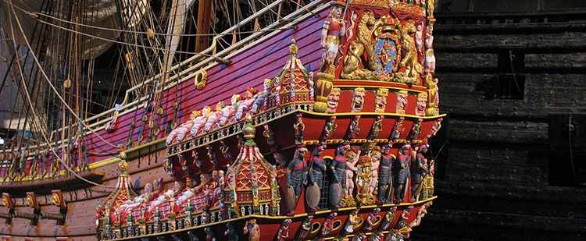




Galileo Invariance
Notes:
https://bambinidisatana.com/wp-content/uploads/2013/10/Galileo-Galilei-z3.jpg?6746a2
Galilean Invariance
Galileo was one of the first scientists to consider the idea of relativity.
He stated that the laws of Physics should be the same in all inertial frames of reference.
He first described this principle in 1632 using the example of a ship, travelling at constant velocity, without rocking, on a smooth sea; any observer doing experiments below the deck would not be able to tell whether the ship was moving or stationary.
In other words, the laws of Physics are the same whether moving at constant speed or at rest.

Slide 6

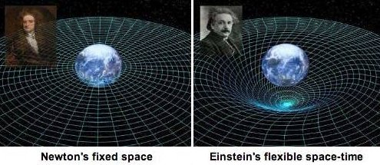
Newtonian Relativity
Notes:
Newtonian Relativity
Newton followed this up by expanding on Galileo’s ideas.
He introduced the idea of absolute or universal space time.
He believed that it was the same time at all points in the universe as it was on Earth, not an unreasonable assumption.
According to Newton, absolute time exists independently of any perceiver and progresses at a consistent pace throughout the universe. Absolute space, in its own nature, without regard to anything external, remains always similar and immovable.

Slide 7
Terminology
t time interval measured in the same frame of reference as the event (e.g. the pulse of light, throwing up a ball, running a race) or proper time (as measured at rest)
t’ time interval measured in a frame of reference moving relative to the one containing the event(e.g. on a train)
l length measured in the same frame of reference as the object (e.g. rod) or proper length (as measured at rest)
l’ length measured in a frame of reference moving relative to the one containing the object (e.g. rod)
v relative velocity of the two frames of reference
(Note: Recall that no one frame of reference is any more ‘stationary’ or ‘moving’ than any other. There is no ‘absolute rest’.)

Slide 8



Frames of Reference
1. Car moves relative to the road
2. Person in car moves relative to the car
3. Car moves relative to the house
4. Person in the house moves relative to the house
Notes:
How we see things in the world is determined by our position or viewing point. We call this our frame of reference. Relativity is all about observing events and measuring physical quantities, such as distance and time, from different reference frames. Frames of reference refer to any laboratory, vehicle, platform, spaceship, planet etc. and often have a relative velocity to another ‘frame of reference’. When the movement is in a straight line with a constant velocity we call these inertial frames of reference.
If you ask most people to explain what the term "motion" means, they will probably say something about movement, transport, travel, and other similar words that convey the idea of movement from one point to another. However, most people would omit to mention that all motion is relative. That is, motion can only be judged by comparing the position of the moving object with some other reference point or object.
In the language of physics, the reference against which the motion of an object is measured is called a "frame of reference". Thus, in the figure above, for example, the road is a frame of reference against which the motion of the car can be measured. Alternatively, the house could be a frame of reference against which the motion of the car is measured.
Thus;.
1. Car moves relative to the road
2. Person in car moves relative to the car
3. Car moves relative to the house
4. Person in the house moves relative to the house

Slide 9
Definition
An inertial frame of reference is one in which Newton's first law of motion holds, i.e you are travelling at constant velocity or are at rest (relative to the motion).
Notes:
Example. Imagine sitting in your stationary car on a flat road, with the gears in neutral. The car remains stationary, as there are no unbalanced forces acting on the car. Now put the car in gear and floor the accelerator. Forces from the engine act on the car and it picks up speed. Now if you were holding a cup of coffee at this point you are likely to spill this down your top. You will experience Newton’s Laws of Motion.
Remember this as a memory aid. If you’d spill your coffee you are not in an inertial reference frame. As the car continues to pick up speed, wind resistance increases on the car, and eventually the car will reach its maximum speed. At this point, the force from the engine is exactly balanced by the frictional and wind resistance forces, and hence the net force on the car is zero. The speed remains constant, at terminal velocity, in accordance with Newton's first law.
In this example, the road (or surface of the earth), against which the motion of the car is measured, is an inertial frame of reference. Frames of reference need not be stationary. It can be shown that if a stationary frame of reference is inertial, then it is also inertial if it moves at constant speed. Thus, in the figure above, the car is an inertial frame of reference whether it is stationary or moving relative to the road.
Here is another example, you probably feel that you are currently stationary, but remember that the Earth rotates on its axis once a day so at the equator a person would be moving at 1670 kmh⁻¹. The Earth is also moving with respect to the Sun, orbiting the Sun once a year requires the Earth to be moving at approximately 100 000 kmh⁻¹, with respect to the Sun. We are in the outer spiral of the Milky Way galaxy, so from an inertial reference frame in another galaxy we would observe someone on the Earth as travelling 800 000 kmh^{-1.} Which speed is correct? They are all correct- it depends on your frame of reference
However, any accelerating frame of reference is not inertial. Thus, the car in the figure above, if it is accelerating, is not an inertial frame of reference. Remember that if you spill your coffee you are not in an inertial frame of reference.
Note that without a frame of reference, it would not be possible to judge the state of motion of an object moving at constant speed. Newton believed that there was one overall, preferred, reference frame, called the "absolute" frame of reference, but Einstein disagreed.

Slide 10
Event 1: You are reading your Kindle on the train. The train is travelling at 60 mph.
Observer | Location | Observation
1 | Passenger sitting next to you | You are stationary
2 | Person standing on the platform | You are travelling towards them at 60 mph
3 | Passenger on train travelling at 60 mph in opposite direction | You are travelling towards them at 120 mph.

Slide 11
Event 2:
Observer | Location | Observation
1 | Passenger sitting next to you | You are stationary
2 | Person standing on the platform | You are travelling towards them at 2 × 10⁸ m s⁻¹
3 | Passenger on train travelling at 2 × 10⁸ m s⁻¹ in opposite direction | You are travelling towards them at 4 × 10⁸ m s⁻¹ ✗
You are reading your Kindle on an interstellar train. The train is travelling at 2 × 10⁸ m s⁻¹.
The observation made by observer three is impossible as an object cannot travel faster than the speed of light from any reference frame and it would certainly be impossible to watch something travel faster than light.

Slide 12
The Two postulates
Postulate 1:
All the laws of physics are the same in all inertial frames of reference.
Postulate 2:
The speed of light (in a vacuum) is the same in all inertial frames of reference.
Notes:
Postulate 1:
All the laws of physics are the same in all inertial frames of reference.
We can give a simple example of this principle in action. Consider a person standing at the road side and a person sitting in a car moving at constant speed. This postulate states that both people must observe the same laws of physics for all phenomena. If the car is accelerating, then it does not constitute an inertial frame of reference, and the person on the ground and in the car need not observe the same laws of physics.
The second postulate is, in a sense, a corollary (consequence) of the first postulate:
Postulate 2:
The speed of light (in a vacuum) is the same in all inertial frames of reference.
This postulate leads to a surprising difficulty when we consider what we expect to happen in everyday life. Suppose we are driving along at 50 mph, approaching a stationary person on the pavement. At the instant we pass the person, he throws a ball at 50 mph, relative to him and in the direction we and the car are travelling. In the frame of reference of the car, therefore, the ball is stationary.
The second postulate says that light does not behave in this way. Suppose that, instead of throwing a ball, the person on the pavement switches on a torch. The second postulate says that both we and him have to measure the same speed of light from the torch - no matter how fast we are travelling in the car.

Slide 13
Time dilation
Time dilation is the increase in an observed time interval for an object moving relative to an observer, compared to that measured when they are in the stationary frame of reference.

Slide 14
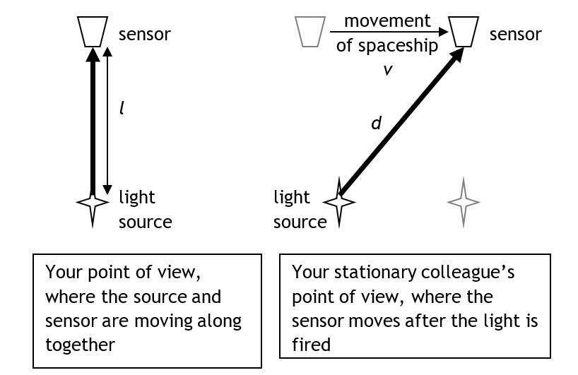
Notes:
Imagine you are on a spaceship travelling at constant speed (v) relative to a colleague on a space station. You are investigating a timing device based on the fact that the speed of light is constant. You fire a beam of light at a sensor and time how long it takes to arrive. From your point of view the light has less distance (l) to travel than from the point of view of your colleague on the space station (d). If you both observe the speed of light as the same then you cannot agree on when it arrives, i.e. both of you experience time in a different way.
Time is different for observers in different reference frames because the path they observe for a moving object is different.
light source
sensor
l
Your point of view, where the source and sensor are moving along together
Your stationary colleague’s point of view, where the sensor moves after the light is fired
light source
sensor
d
movement of spaceship
v

Slide 15
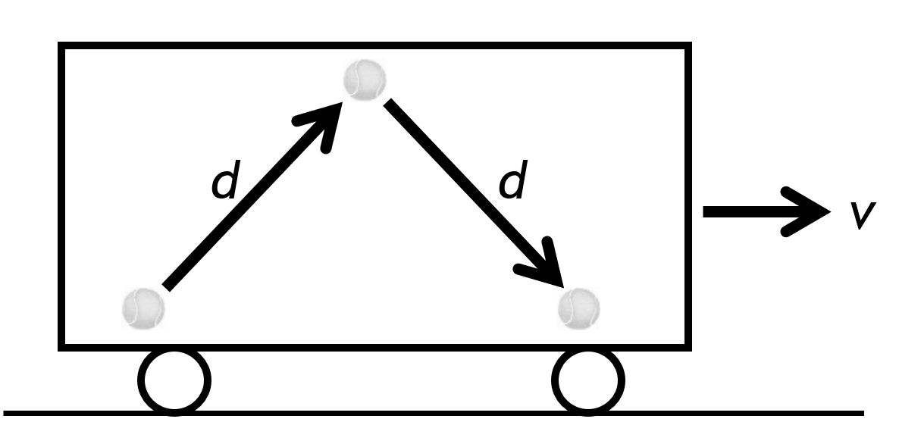
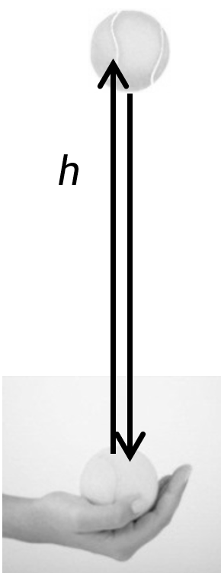
Depends on your reference frame
Notes:
h
Example 1: How distance can be different for different observers Event: Inside a moving train carriage, a tennis ball is thrown straight up and
caught in the same hand.
Observer 1: In Observer 1’s reference frame they are stationary and the ball has gone straight up and down.
Observer 1 sees the ball travel a total distance of 2h.
The ball is travelling at a speed s.
The period of time for the ball to return to the observers hand is:
$$t=\frac{2h}{v_{1}}$$
Observer 2, standing on the platform watches the train go past at a speed, v₂, and sees the passenger throw the ball. However, to them, the passenger is also travelling horizontally, at speed v. This means that, to Observer 2, the tennis ball has travelled a horizontal distance, as well as a vertical one.
v
d
d
Observer 2 sees the ball travel a total distance of 2d. The period of time for the ball to return to the observers hand is:$t^{′}=\frac{2d}{v_{1}}$
For observer 2, the ball has travelled a greater distance, in the same time.
Example 2: How time can be different for different observers
Event: Observer 1 is in a spaceship travelling to the left at speed s. Inside the spaceship cabin, a pulsed laser beam is pointed vertically up at the ceiling and is reflected back down. The laser emits another pulse when the reflected pulse is detected by a photodiode.

Slide 16
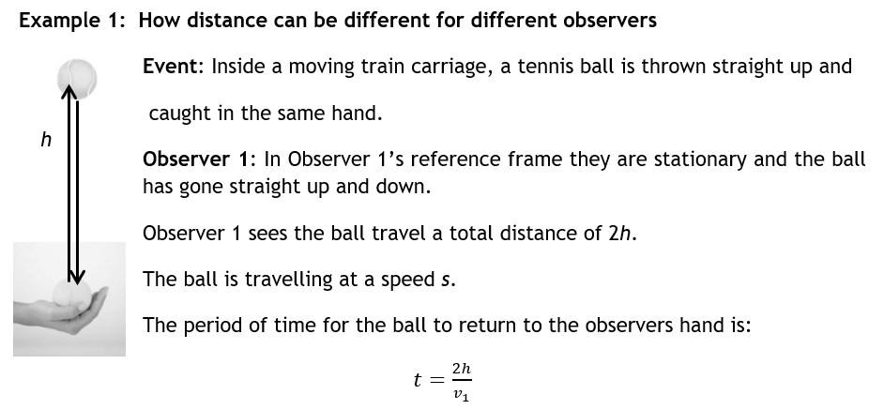

Slide 17
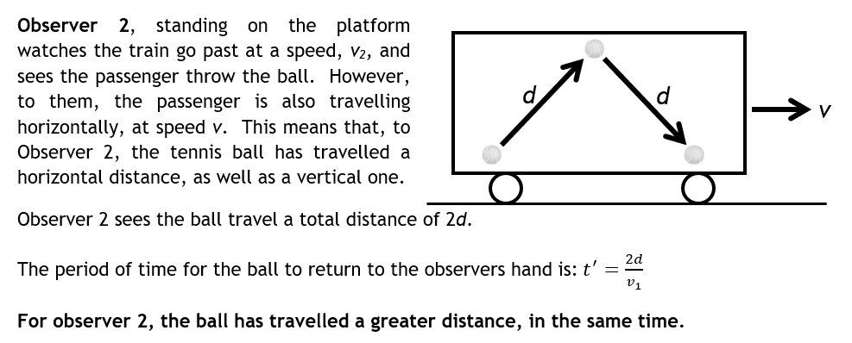

Slide 18
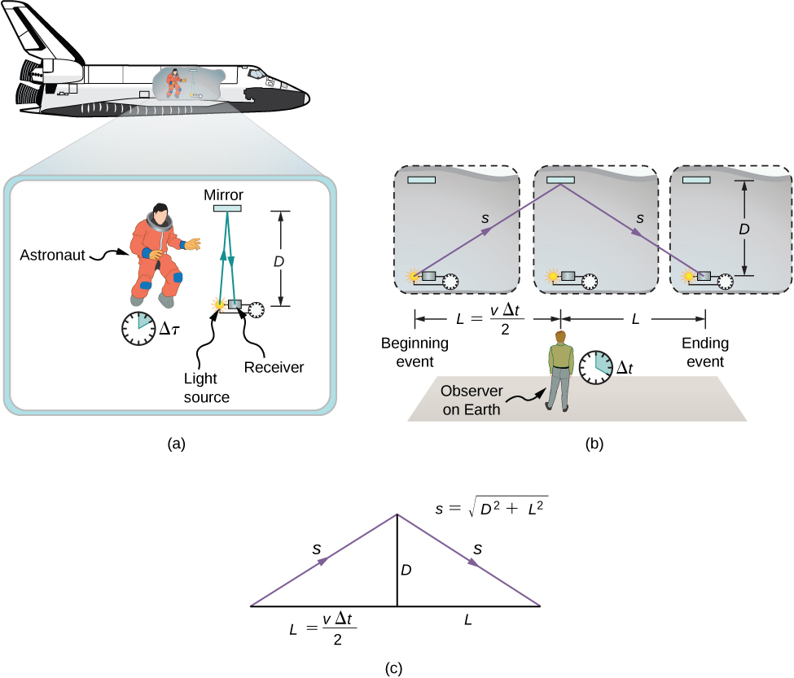
Example 2: How time can be different for different observers
Event: Observer 1 is in a spaceship travelling to the left at speed s. Inside the spaceship cabin, a pulsed laser beam is pointed vertically up at the ceiling and is reflected back down. The laser emits another pulse when the reflected pulse is detected by a photodiode.

Slide 19
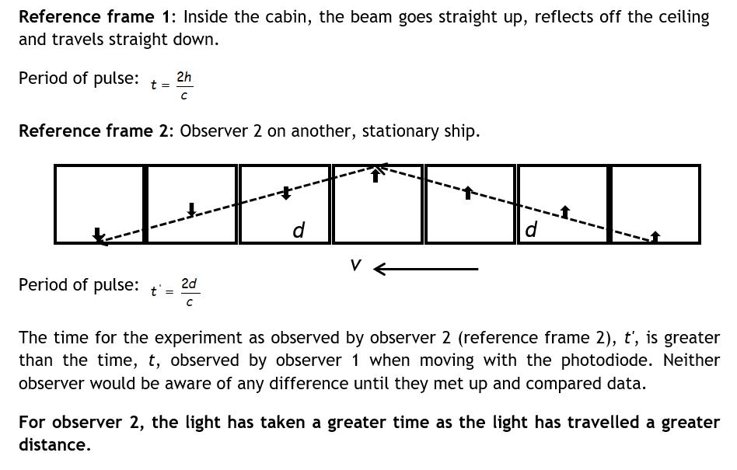

Slide 20
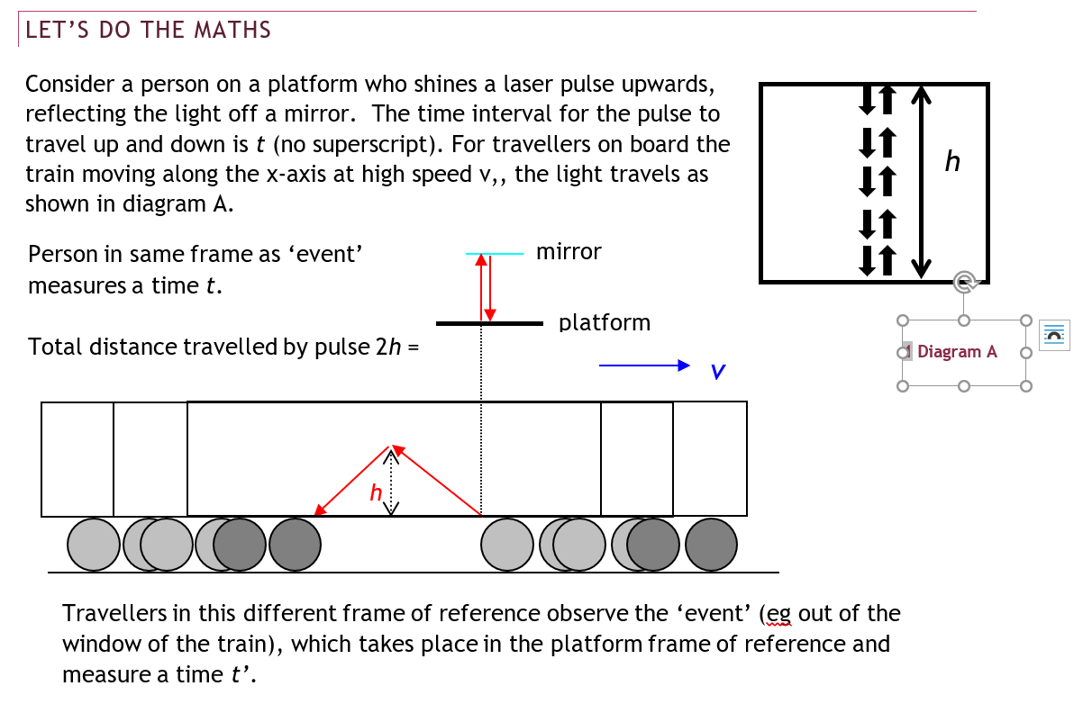

Slide 21
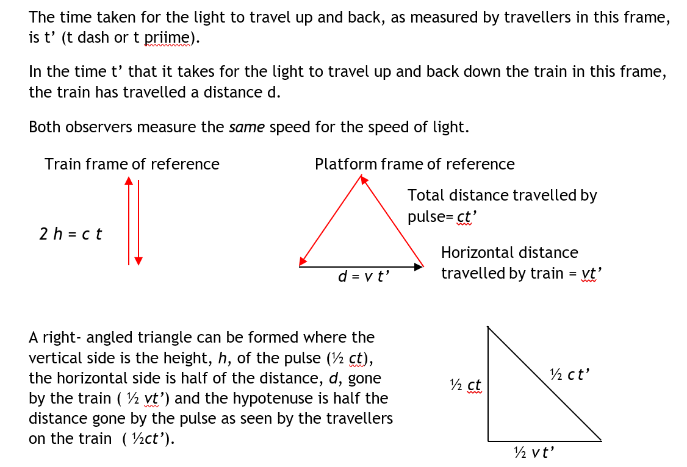

Slide 22
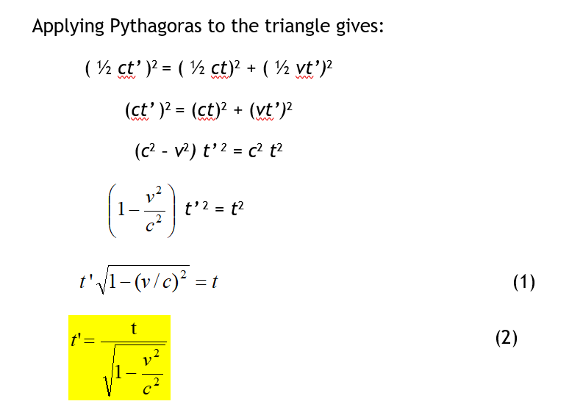
Where
t time interval measured in the same frame of reference as the event (e.g. the pulse of light, throwing up a ball, running a race).
t’ time interval measured in a frame of reference moving relative to the one containing the event(e.g. on a train).
v relative velocity of the two frames of reference.

Slide 23
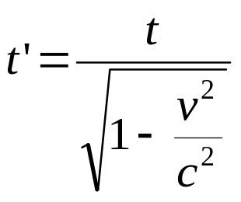

TIME DILATION FORMULA AND THE LORENTZ TRANSFORMATION
The formula linking these can be shown to be:
Note this is often written as: $t′=tγ$
where γ is known as the Lorentz Factor. It is often used in the study of special relativity and is given by:
$$γ=\frac{1}{\sqrt{1−\frac{v^{2}}{c^{2}}}}$$

Slide 24
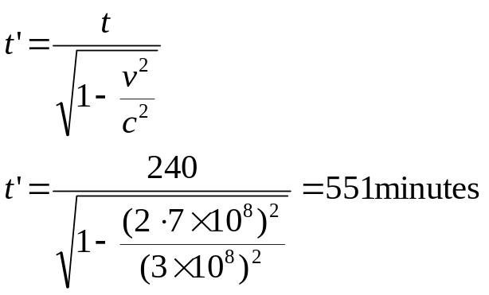
Example:
A rocket is travelling at a constant 2.7 × 10⁸ m s^{–1} compared to an observer on Earth. The pilot measures the journey as taking 240 minutes. (Note this is an impossible scenario with current technology)
How long did the journey take when measured from Earth?
Solution: | Note as time dilation is about relative times etc there is no requirement to change the units of time to seconds. Whatever unit you use will be the same unit for your unknown time.
 | t = 240 minutes (about 4 hours) v = 2.7 × 10⁸ m s^{–1} c = 3 × 10⁸ m s^{–1} t' = ?

Slide 25
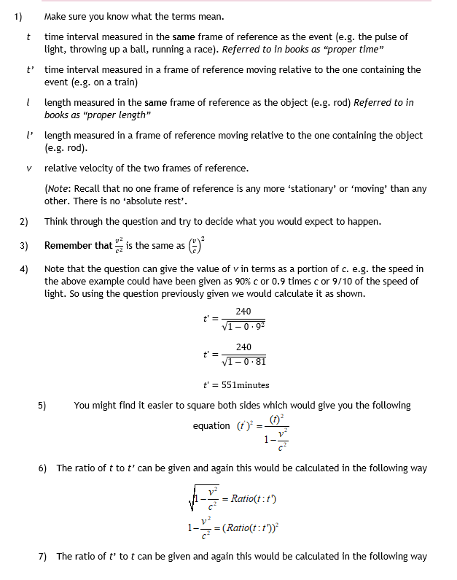
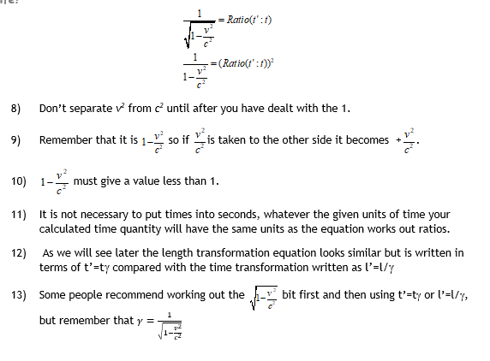

Slide 26
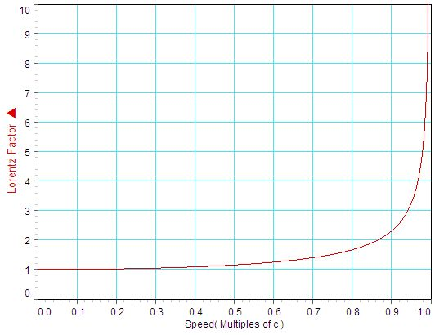
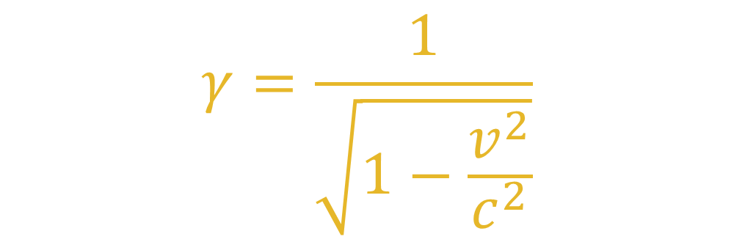
When do you notice these effects?
Make a table and plot the graph from your own results
$$γ=\frac{1}{\sqrt{1−\frac{v^{2}}{c^{2}}}}$$

Slide 27
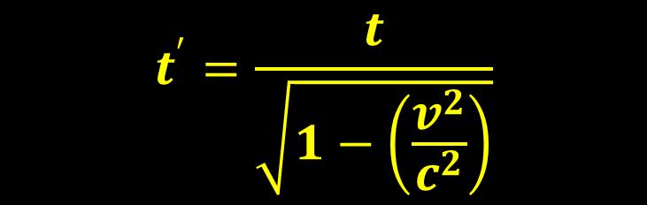
Time dilation
https://www.youtube.com/watch?v=iIEeSiT3SI4
NOTE THAT THIS IS AN EXAMPLE OF THE DIFFERENT NAMING OF THE TIME. This video used to when we call it t, they use t when we would use t’
$$t^{′}=\frac{t}{\sqrt{1−\left(\frac{v^{2}}{c^{2}}\right)}}$$

Slide 28
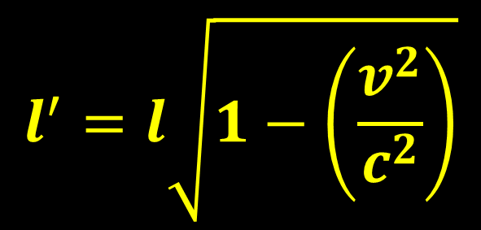
Length Contraction
https://www.youtube.com/watch?v=FPzGAksFCbs
NOTE THAT THIS IS AN EXAMPLE OF THE DIFFERENT NAMING OF THE LENGTH. This video used Lo when we call it l, they use L when we would use l’
$$l^{′}=l\sqrt{1−\left(\frac{v^{2}}{c^{2}}\right)}$$

Slide 29
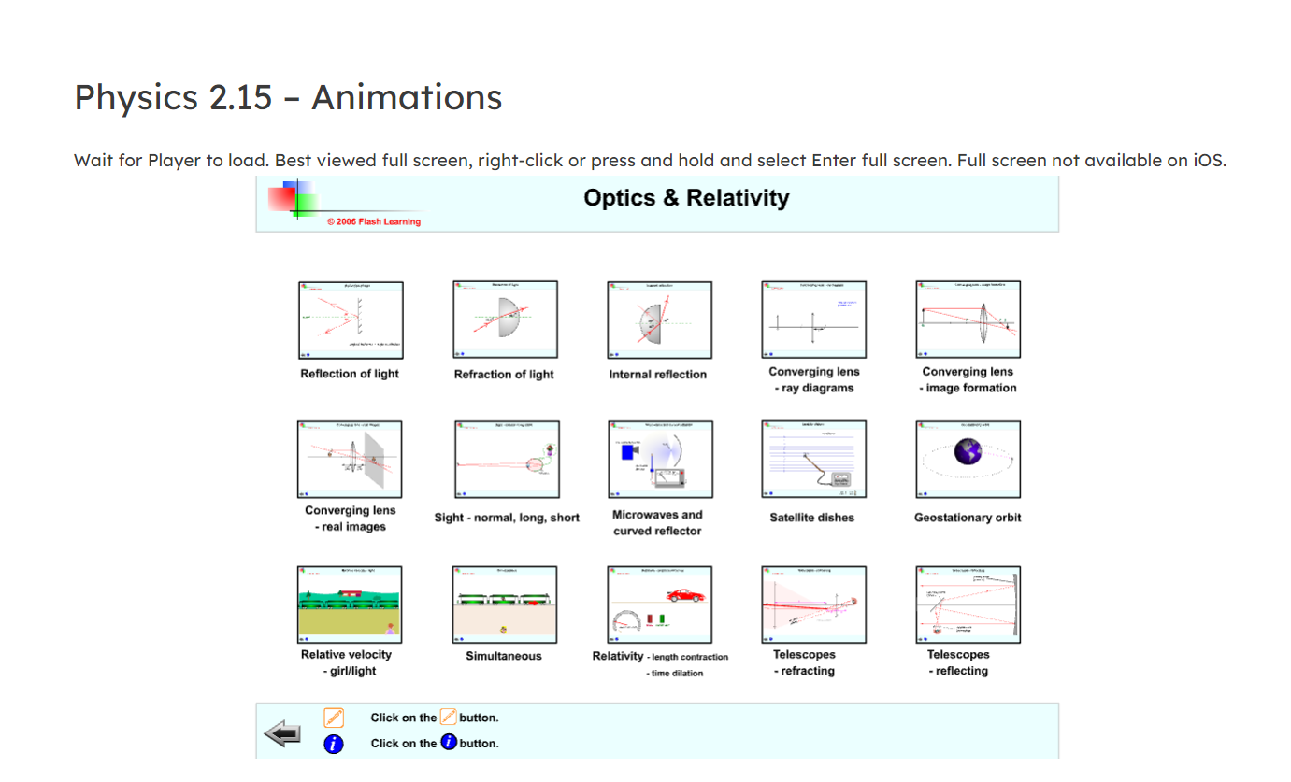
Web address: physicsflashrepo.cyou
YY^LU3!9X$cadc6h

Slide 30
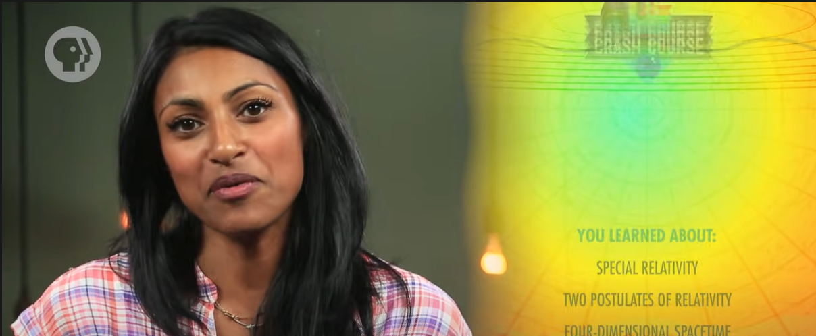
https://www.youtube.com/watch?v=AInCqm5nCzw
Notes:
If I’ve not made sense try this!

