Slide 1
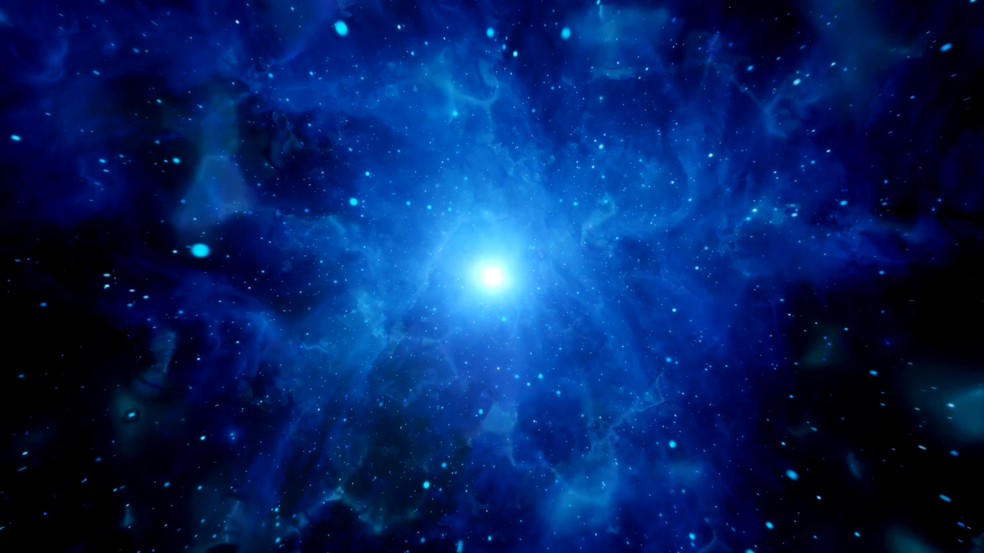

The Expanding Universe Part 2
Higher Physics

Slide 2
Learning Outcomes
8. The expanding Universe
I know that measurements of the velocities of galaxies and their distance from us lead to the theory of the expanding Universe.
I know that the mass of a galaxy can be estimated by the orbital speed of stars within it.
I know that evidence supporting the existence of dark matter comes from estimations of the mass of galaxies.
I know that evidence supporting the existence of dark energy comes from the accelerating rate of expansion of the Universe.
I know that the temperature of stellar objects is related to the distribution of emitted radiation over a wide range of wavelengths.
I know that the peak wavelength of this distribution is shorter for hotter objects than for cooler objects.
I know that hotter objects emit more radiation per unit surface area per unit time than cooler objects.
I know of evidence supporting the big bang theory and subsequent expansion of the Universe: cosmic microwave background radiation, the abundance of the elements hydrogen and helium, the darkness of the sky (Olbers’ paradox) and the large number of galaxies showing redshift rather than blueshift.

Slide 3
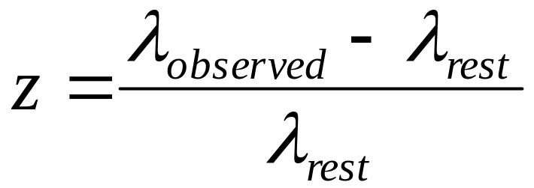
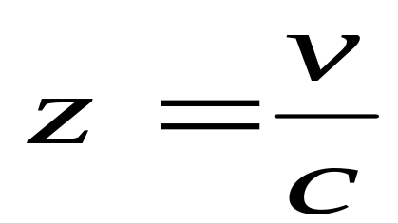
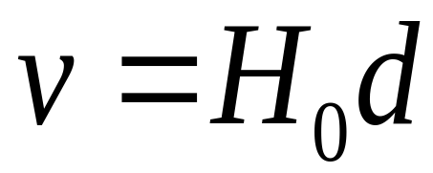
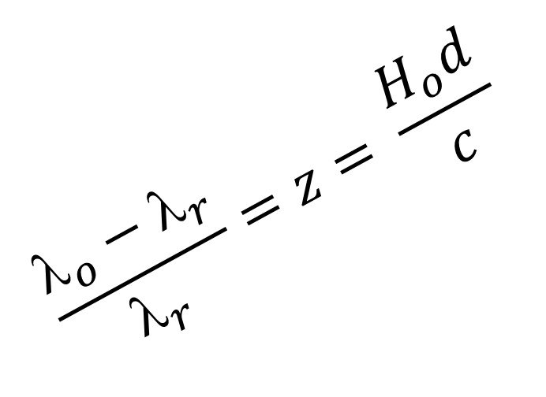
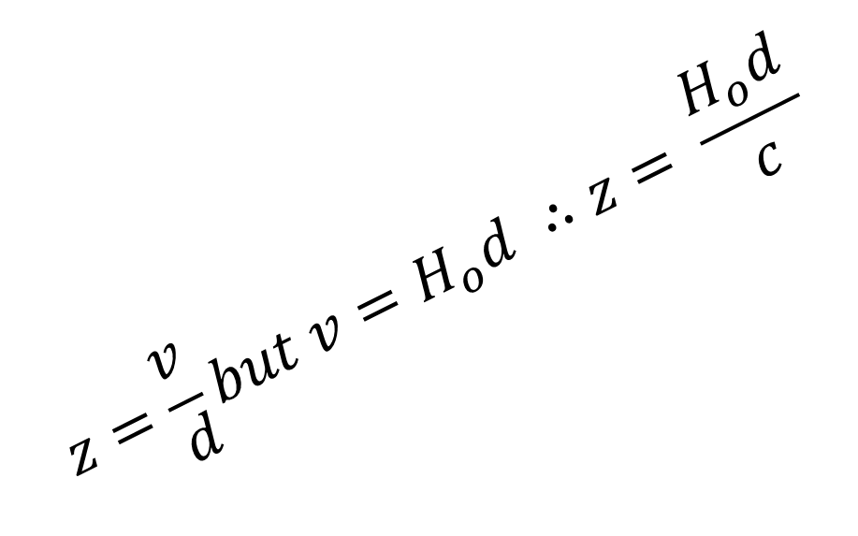

Reminder of your formula
$$z=\frac{v}{d}but v=H_{o}d ∴z= \frac{H_{o}d}{c}$$
$$\frac{λ_{o}−λ_{r}}{λ_{r}}=z= \frac{H_{o}d}{c}$$
$z=\frac{v}{c } but v=H_{o}d$

Slide 4
Evidence for ……
Scientists have gathered a lot of evidence and information about the universe. They have used their observations to develop a theory called the Big Bang. The theory states that originally all the matter in the universe was concentrated into a single incredibly tiny point, called a singularity. This began to enlarge rapidly in a hot expansion, and it is still expanding today. This expansion is called the Big Bang, and happened about 13.77 billion years ago (that's 13,800,000,000 years using the scientific definition of 1 billion = 1,000 million).
Notes:
The universe started with a sudden appearance of energy which consequently became matter and is now everything around us. There were two theories regarding the universe:
The Steady State Universe: where the universe had always been and would always continue to be in existence.
The Created Universe: where at some time in the past the universe was created.
Ironically the term ‘Big Bang’ was coined by Fred Hoyle a British astronomer who was the leading supporter of the Steady State theory and who was vehemently opposed to the idea of the Big Bang and expanding universe..
Scientists have also discovered that the Universe expanding at an increasing rate, i.e. the acceleration is increasing. This was the conclusion of astronomers in 1998 when observing distant supernovae. Their discovery was a great shock to the scientific community and was awarded the Nobel Prize in Physics in 2011.
Redshift (see previous notes) / Evidence from the Expanding Universe
From the expanding universe idea we can extrapolate our figures back (we consider running time backwards) and come to the conclusion that all matter in the Universe was all collected at a single point called the initial singularity.
Cosmic microwave background radiation
Cosmic Microwave Background Radiation (CMBR) observations support the hot Big Bang theory that the universe is expanding out from a single point, as Hubble postulated.

Slide 5
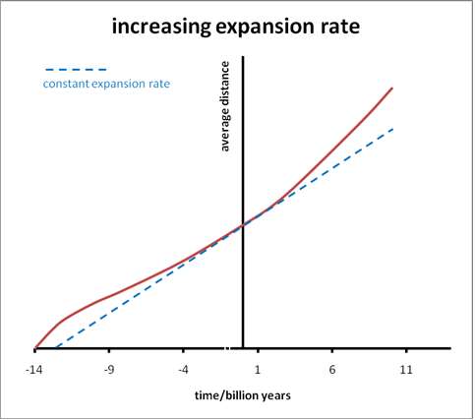
The Expanding Expanding Universe!
Notes:
From Hubble’s graph of speed versus distance, we can obtain an estimate of how long it took for a galaxy to reach its current position. Assuming they have been moving away from us at a constant speed, the time taken for a particular galaxy to reach its current position can be found by dividing the distance by the speed.
Since Hubble’s time, there have been other major breakthroughs in astronomy. All of these support the findings of Hubble, and allow the age of the universe to be calculated even more accurately.
The force of gravity acts between all matter in the universe. Matter clumps together due to the force of gravity, such as the contraction of hydrogen gas to create new stars, the grouping of stars to create galaxies and the grouping of galaxies to create local groups and superclusters.
Hubble’s Law and subsequent observations, show that the rate of expansion of the universe is increasing. There must be a force acting against the force of gravity, pushing matter apart. This force is causing a significant acceleration and so it is much greater in magnitude than the force of gravity. As yet, astronomers and cosmologists have not been able to determine a source of energy capable of producing this force. For lack of a better term it is, for now, simply referred to as dark energy.

Slide 6
Dark energy

Slide 7
Dark
matter

Slide 8
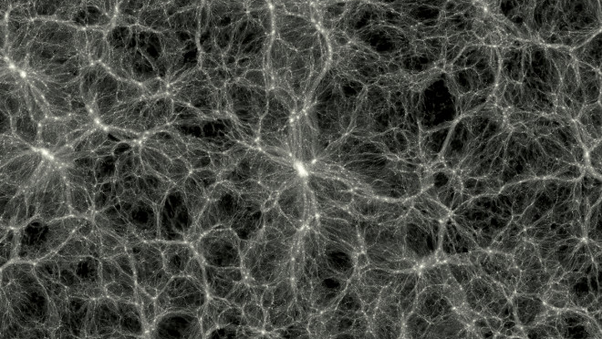
Dark Matter
https://www.youtube.com/watch?v=sI23cwbbNqs
Notes:
https://www.symmetrymagazine.org/article/december-2013/four-things-you-might-not-know-about-dark-matter
Dark matter is five times more prevalent than ordinary matter. It seems to exist in clumps around the universe, forming a kind of scaffolding on which visible matter coalesces into galaxies. The nature of dark matter is unknown, but physicists have suggested that it, like visible matter, is made up of particles.
Here are four facts to get you up to speed on one of the most exciting topics in particle physics:
1. We have already discovered dark matter
Illustration by Sandbox Studio, Chicago with Ana Kova
At this moment, several experiments are on the hunt for dark matter. But scientists actually discovered its existence decades ago.
In the 1930s, astrophysicist Fritz Zwicky was observing the rotations of the galaxies that form the Coma cluster, a group of more than 1000 galaxies located more than 300 million light years from Earth. He estimated the mass of these galaxies, based on the light they emitted. He was surprised to find that, if this estimate were correct, at the speed at which the galaxies were moving, they should have flown apart. In fact, the cluster needed at least 400 times the mass he had calculated to hold itself together. Something mysterious seemed to have its finger on the scale; an unseen “dark” matter seemed to be adding to the mass of the galaxies.
The idea of dark matter was largely ignored until the 1970s, when astronomer Vera Rubin saw something that gave her the same thought. She was studying the velocity of stars moving around the center of the neighboring Andromeda galaxy. She anticipated that the stars at the edge of the galaxy would move more slowly than those at its axis because the stars closest to the bright—and therefore massive—cluster of stars in the center would feel the most gravitational pull. However, she found that stars on the margins of the galaxy moved just as quickly as those in the middle. This would make sense, she thought, if the disc of visible stars were surrounded by an even larger halo made of something she couldn’t see: something like dark matter.
Other astronomical observations have since confirmed that something strange is going on with the way galaxies and light move through space. It’s possible that our confusion stems from a flaw in our understanding of gravity—Rubin herself said she favors this idea. However, if it’s true that dark matter exists, we’ve already seen its effects.
2. We have possibly already observed dark matter
Illustration by Sandbox Studio, Chicago with Ana Kova
Several experiments are searching for dark matter, and some of them may have even already found it. The problem is that no experiment has been able to make that claim with enough confidence to convince the wider scientific community—either due to statistics or an inability to rule out alternative possible explanations. And no two claims have lined up quite convincingly enough for scientists to declare any result confirmed.
In 1998 scientists on the DAMA experiment, a dark matter detector buried in Italy’s Gran Sasso mountain, saw a promising pattern in their data. The rate at which the experiment detected hits from possible dark matter particles changed over the course of the year—climbing to its peak in June and dipping to its nadir in December.
This was exactly what DAMA scientists were looking for. If our galaxy is surrounded by a dark matter halo, the Earth is constantly moving through that halo as it orbits the sun—and the sun is constantly moving through the dark matter as it orbits the center of the Milky Way. During half of the year, the Earth is moving in the same direction as the sun. During the other half, it is moving in the opposite direction. When the Earth and the sun are moving in tandem, their combined velocity through the dark matter halo is faster than the Earth’s velocity when it and the sun are at odds. DAMA’s results seemed to reveal that the Earth really was moving through a dark matter halo.
However, some loopholes exist; the particles the DAMA detector has been seeing could be something other than dark matter, something else the Earth and sun are constantly moving through. Or something else could be changing in the nearby environment. The DAMA experiment, now called DAMA/LIBRA, has continued to see this annual modulation, but the results are not conclusive enough for most scientists to consider it a dark-matter discovery.
It’s going to be difficult for any one experiment to convince scientists that they’ve found dark matter. It might be that people will come around only when several experiments start to see the same thing. But that will depend on what they find, says theorist Neal Weiner, director of the Center for Cosmology and Particle Physics at New York University. Dark matter could turn out to be something stranger or more complicated than we expect.
“If dark matter turns out to be something totally garden-variety, then maybe it will only take one experiment for people to be excited about it—and two for people to be borderline convinced,” he says. “But if something unexpected shows up, it might take more than that to persuade people.”
In 2008 the space-based PAMELA experiment detected an excess of positrons—a possible result of dark matter particles colliding and annihilating one another. In 2013 the AMS-02 experiment, attached to the International Space Station, found the same result with even more certainty. But scientists remain unconvinced, arguing that the positrons could also come from pulsars.
Underground experiments—including CoGeNT, XENON, CRESST, CDMS and LUX—have gone back and forth supporting and disclaiming possible dark matter sightings. It seems we will need to wait until the upcoming generation of dark matter experiments is complete to get a clearer picture.
3. We don’t know what dark matter is like; there could be several kinds making up a whole “dark sector”
Illustration by Sandbox Studio, Chicago with Ana Kova
Scientists have come up with several models for what dark matter might be like. The current leading candidate is called a WIMP, a Weakly Interacting Massive Particle. Other possibilities include particles conveniently already predicted in models of supersymmetry, a theory that adds a new fundamental particle to correspond with each one we already know. Groups of scientists are also searching for dark-matter particles called axions.
But there’s no reason there should be only one type of dark matter particle. Visible matter, the quarks and gluons and electrons that make up all of us and everything we can see, along with an entire zoo of fundamental particles and forces including photons, neutrinos and Higgs bosons, makes up just 5 percent of the universe. The rest is dark matter—which makes up about 23 percent—and dark energy, a whole other story—which claims the remaining 72 percent.
As Weiner puts it: Imagine a scientist in the dark-matter world trying to understand visible matter. Visible matter composes such a tiny fraction of what's out there; what dark-matter scientist would guess at its variety? The world we know is so diverse; why would dark matter be so simple? Scientists have wondered whether dark particles could combine into dark atoms that would interact through dark electromagnetism. Could dark chemistry be next? Scientists have begun to look for light dark-matter particles predicted in models of the “dark sector.”
4. Chances are good that we’ll observe dark matter in the next 5 to 10 years—but we may never see it at all
Illustration by Sandbox Studio, Chicago with Ana Kova
These are heady times for a scientist searching for dark matter. With a number of different experimental ideas scheduled to come to fruition in the coming years, many predict that dark matter will be in our grasp within a decade.
“Really one of the exciting things is all of these techniques are coming to maturity at the same time,” says theorist Tim Tait of the University of California, Irvine. “It’s a great opportunity to play them against each other and see what’s going on.”
Scientists could find dark matter in a few different ways.
First, they could detect it directly. Direct detection involves waiting patiently with a big, sensitive experiment in a quiet, underground laboratory, as free as possible from potential interference from other particles. In the next few years, scientists will narrow down their current list of detector technologies to focus their resources on building the biggest, most sensitive generation of experiments yet.
The second way to find dark matter is to observe it indirectly—by seeking out the effects of dark matter with space-based experiments. Updates from current experiments on satellites and the International Space Station will give scientists more data to help them determine the meaning of the possible dark-matter effects they have been seeing.
The third way to find dark matter is to produce it in an accelerator such as the Large Hadron Collider. It is possible that, when two particle beams collide in the LHC, their energy will convert into mass in the form of dark matter. The LHC is currently shut down for maintenance and upgrades, but when it restarts in 2015, it will reach almost double its previous energy, opening the door for it to make particles it has never made before.
Once scientists find dark matter using one method, they’ll be able to focus their efforts, Tait says. Once we know more about its properties, “that’ll really energize all of this activity,” he says. “Right now we’re in a dark room, fumbling around. Once you know where the thing you’re looking for is, you can study it a lot more carefully.”
But it is also possible that dark matter is out of our reach, simply too elusive to detect or produce. If scientists don’t see dark matter in the next 10 years, they might need to find a new way to look for it. Or they might need to reconsider what they know about gravity.

Slide 9
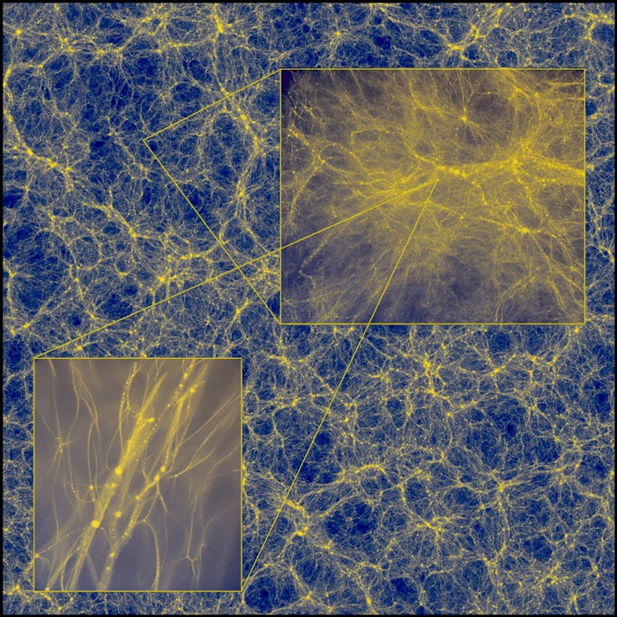
A zoomed in, computer-generated simulation of the distribution of dark matter in the universe. The top right inset shows dark-matter halos. The bottom left inset shows tiny blobs that depict dark-matter halos the size of Earth. J. Wang, S. Bose/CfA
the most commonly held theory about dark matter: that it consists of weakly interacting massive particles, or WIMPs, that are 100 times the mass of ordinary protons yet weakly charged.

Slide 10
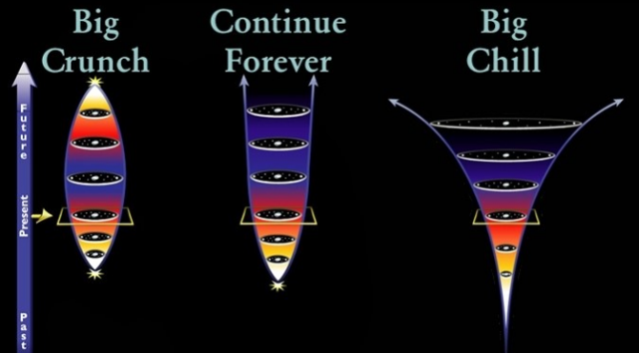
Fate of the Universe
OPTIONS
Expansion forever- cool to death
Collapse in on itself- “Big Crunch”
Oscillating theory of the Universe
Notes:
The Universe will expand forever: If the mean density is less than the critical density, then there is insufficient mass within the universe to stop the expansion - the universe will expand forever. Ultimately, the galaxies will move increasingly further apart. Star formation within the galaxies will eventually cease as the star forming material is exhausted. The universe will slowly cool to absolute zero: a heat death will occur. Life will be unable to exist.
The Universe will collapse in on itself: If the mean density exceeds the critical density, then the expansion of the universe will eventually cease, and the universe will begin to contract. Eventually, a fireball like that which initiated the universe's expansion will result. This is referred to as the "Big Crunch". If this were to happen, it is estimated that it is some 50 thousand million years in the future (at least ten times the remaining life of the Sun). It may be that the universe expands and contracts in a cyclic way and may, indeed, have been doing so in the past - this is the so-called "Oscillating Theory of the Universe".
Whatever the ultimate fate of the universe, it is clear that the universe does not allow for the possibility of eternal life.

Slide 11
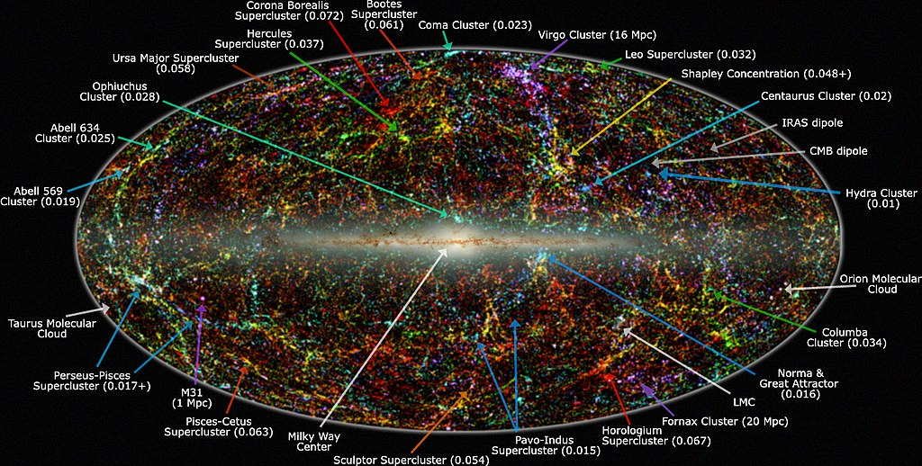
Evidence for the Big Bang
Panoramic view of the entire near-infrared sky reveals the distribution of galaxies beyond the Milky Way. Galaxies are color-coded by redshift.IPAC/Caltech, by Thomas Jarrett - "Large Scale Structure in the Local Universe: The 2MASS Galaxy Catalog", Jarrett, T.H. 2004, PASA, 21, 396

Slide 12
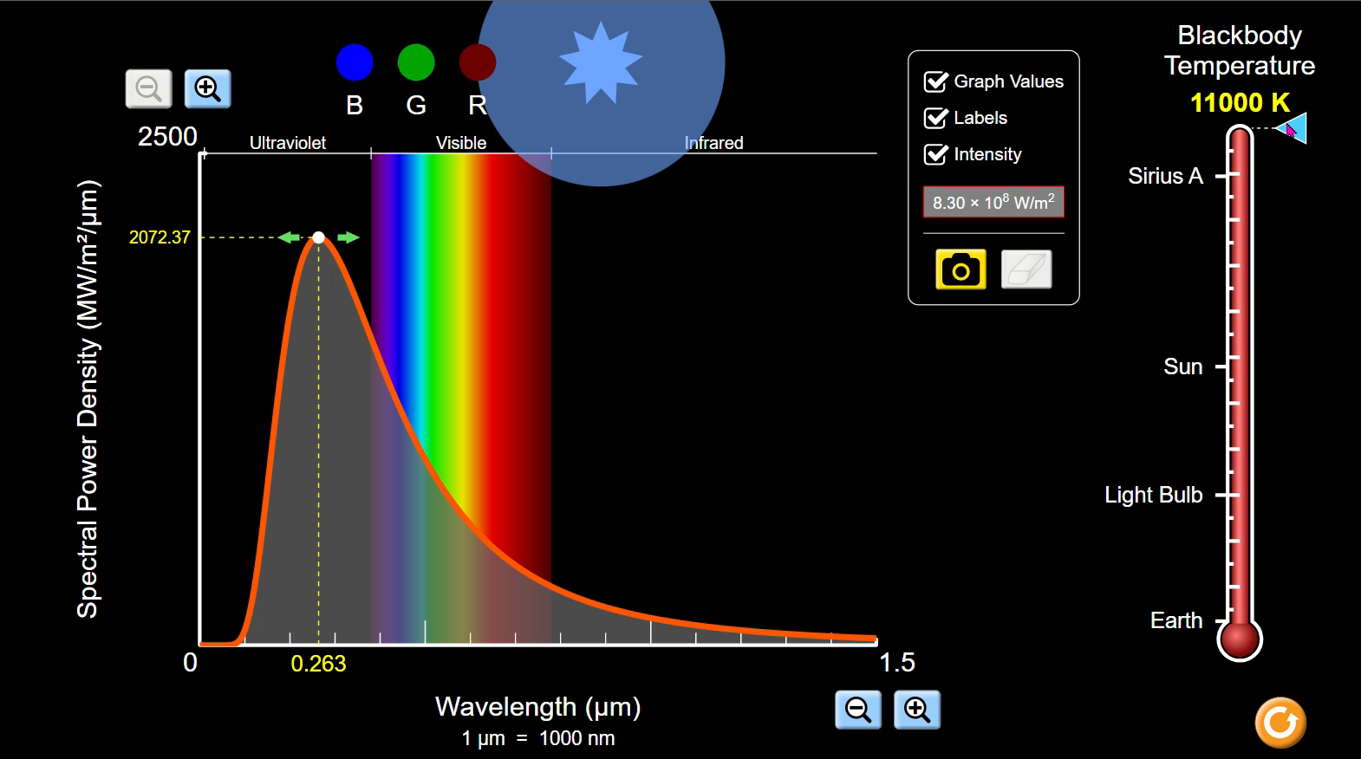
Temperature of stars
Notes:
Black Body Radiation
Stars are black bodies in that they absorb all the radiation. The existence of black-body (thermal) radiation, at a temperature of about 3000 K, filling the universe at the time of recombination (when electrons combined with nuclei to form atoms), is consistent with a universe which has expanded and cooled from a much hotter and denser original state at much earlier times – as the Big Bang theory predicts.

Slide 13
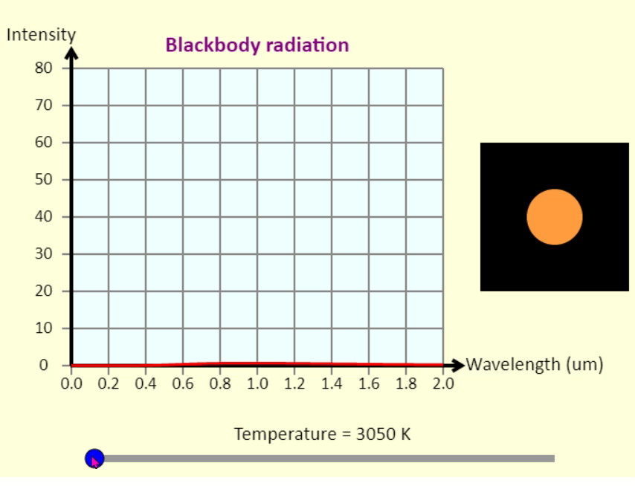
Blackbody Radiation
This simulation shows the spectrum of light emitted by a blackbody as a function of wavelength.
To the right of the graph, is a circle showing the approximate colour of a blackbody at that temperature. Such a blackbody could be an object here on Earth that is so hot it is glowing, or even a star in the sky. You can tell what the surface temperature of a star is just by looking at its colour.
Simulation written by Andrew Duffy,
Notes:
Black Body Radiation
Stars are black bodies in that they absorb all the radiation. The existence of black-body (thermal) radiation, at a temperature of about 3000 K, filling the universe at the time of recombination (when electrons combined with nuclei to form atoms), is consistent with a universe which has expanded and cooled from a much hotter and denser original state at much earlier times – as the Big Bang theory predicts.

Slide 14
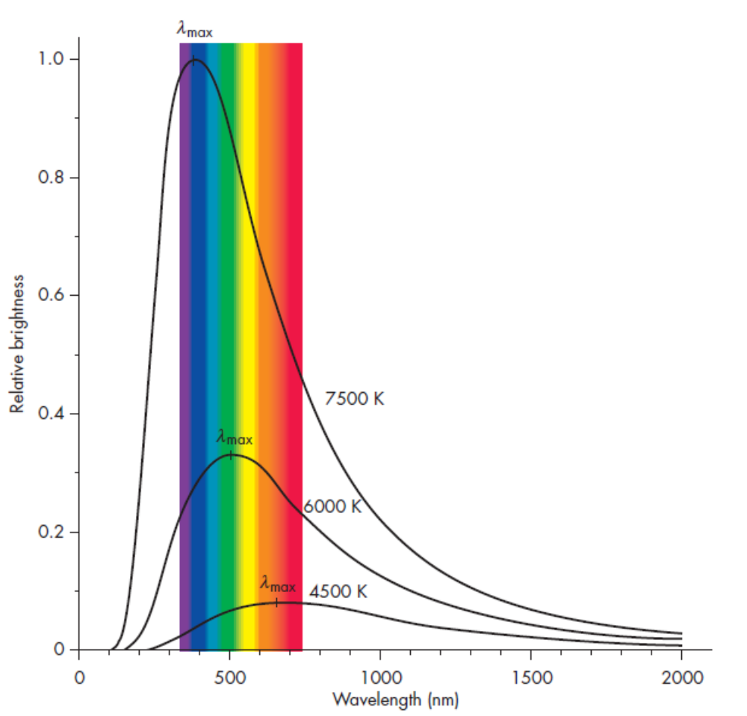
Temperature of stars -
A simple background to Black Body Radiation can give an understanding of stars
P = σT⁴
Where σ is Stefan’s (also referred to as the Stefan- Boltzmann) constant and
σ = 5.67 x 10⁻⁸ Wm⁻²K⁻⁴.
What this means is that by examining the spectrum of a distant star, its temperature can effectively be determined.
Figure 2 Courtesy of John D Fix Astronomy Journey to the Cosmic Frontier 5th Ed.
Notes:
From everyday experience we know that substances glow (incandesce) when heated to very high temperatures. The colour of light emitted depends only on temperature.
Figure 2 Courtesy of John D Fix Astronomy Journey to the Cosmic Frontier 5th Ed.
When an object is heated it does not initially glow, but radiates large amounts of energy as infrared radiation. We can feel this if we place our hand near, but not touching, a hot object. As an object becomes hotter it starts to glow a dull red, followed by bright red, then orange, yellow and finally white (white hot). At extremely high temperatures it becomes a bright blue-white colour.
The observant amongst you may realize that these are the colours in the visible spectrum.
The temperature of an object determines the frequency of light it emits. This idea has been with us for a long time; Jožef Stefan proposed in 1879 that the power irradiated from an object was proportional to its temperature in Kelvin to the fourth power.
P = σT⁴
Where σ is Stefan’s (also referred to as the Stefan- Boltzmann) constant and
σ = 5.67 x 10⁻⁸ Wm⁻²K⁻⁴.
What this means is that by examining the spectrum of a distant star, its temperature can effectively be determined.
A "black-body" is an ideal object whose temperature is the same at every point and constant in time. It is useful for study because such an object produces a spectrum which is dependent only on the temperature. The spectrum of black-body radiation is continuous from zero energy at zero wavelength, rising to a maximum at some wavelength determined by Wien's law (AH Physics), and then falling off to zero at infinite wavelength. The hotter the black body, the more energy is produced at EVERY wavelength. Black-bodies are useful models because many stars radiate approximately as black-body.

Slide 15
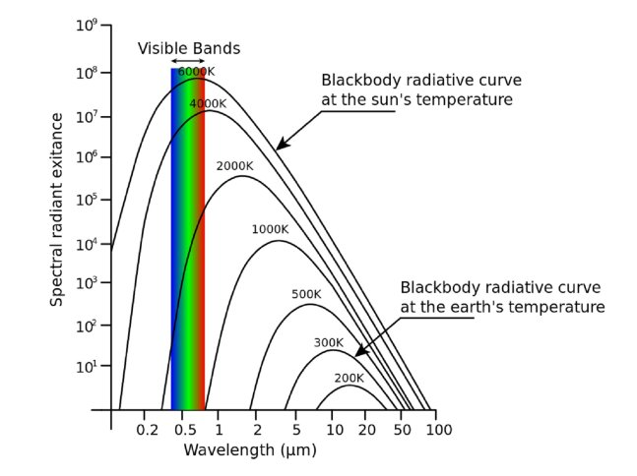
The black-body spectrum has three main features:
1. The basic shape is more or less the same (apart from a scaling factor) at all temperatures; it is like a skewed bell curve, falling off gently on the long wavelength side of the peak, and much more sharply on the shorter wavelength side.
2. As the temperature of the object is increased, the peak of the intensity spectrum shifts towards the shorter wavelengths.
3. As the temperature of the object is increased, the intensity increases for all wavelengths.
Notes:
The properties of the spectrum are characterised by a single parameter, temperature, hence it is sometimes referred to as a thermal radiation spectrum.
When the temperature is raised the peak moves towards the short wavelength end (blue), which gives the visible effect of changing from red to orange to yellow to white to blue-white, in that order.
A "black-body" is an ideal object whose temperature is the same at every point and constant in time. It is useful for study because such an object produces a spectrum which is dependent only on the temperature. The spectrum of black-body radiation is continuous from zero energy at zero wavelength, rising to a maximum at some wavelength determined by Wien's law, and then falling off to zero at infinite wavelength. The hotter the black body, the more energy is produced at EVERY wavelength. Black-bodies are useful models because many stars radiate approximately as black-body.

Slide 16
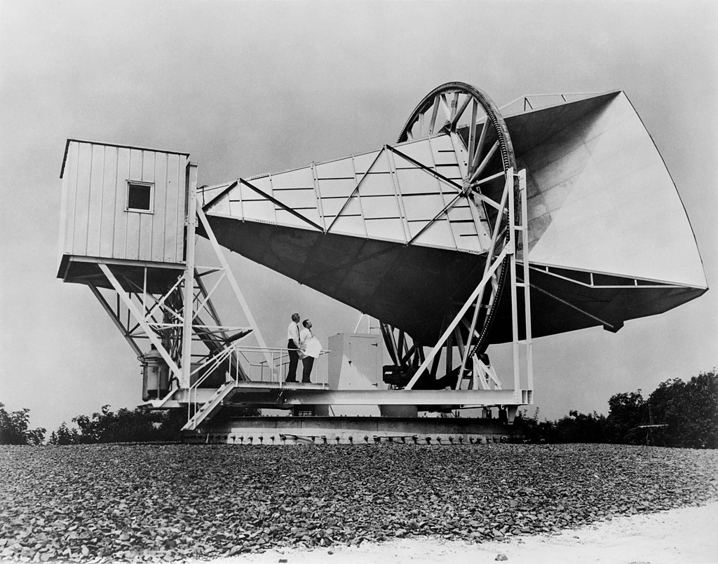

Cosmic Microwave Background Radiation
Arnold Penzias and Robert Wilson As one of their colleagues commented,
"Thus, they looked for “dung” but found gold, which is just opposite of the experience of most of us."
Notes:
Cosmic Microwave Background Radiation (CMBR) observations support the hot Big Bang theory that the universe is expanding out from a single point, as Hubble postulated.
During the very early stages of the universe, say when it was one millionth its present size, the temperature would have been around 3,000,000 K. If an electron became bound with a nucleus, high energy radiation would immediately strip it off. The universe was in a plasma state.
The universe expanded and cooled. As space expanded, the wavelength of photons became longer, so each photon had less energy.
Three physicists, had produced a paper in 1948 that if the Big Bang had actually taken place then there would be a residual background EM radiation, in the microwave region, in every direction in the sky representing a temperature of around 2.7 K. This value for this equivalent temperature was arrived at by considering how the light produced at the Big Bang would have changed as the universe expanded.
The discovery of this background radiation was another example of scientists finding something they weren’t looking for.
Arnold Penzias and Robert Wilson were working with a special radio telescope [shown in the picture] experimenting with satellite communication. They were getting a residual signal that seemed to come from outside the galaxy. At first they though it was actually due to pigeon droppings from the pigeons that roosted in the horn. Finally they realised that they had found the echo of the Big Bang.
As one of their colleagues commented,
"Thus, they looked for dung but found gold, which is just opposite of the experience of most of us."
He may not have actually said the word dung but I’m not going to write in the actual word as I find it too rude!
In 1989 a satellite was launched to study the background radiation, it was called the Cosmic Background Explorer [COBE].

Slide 17
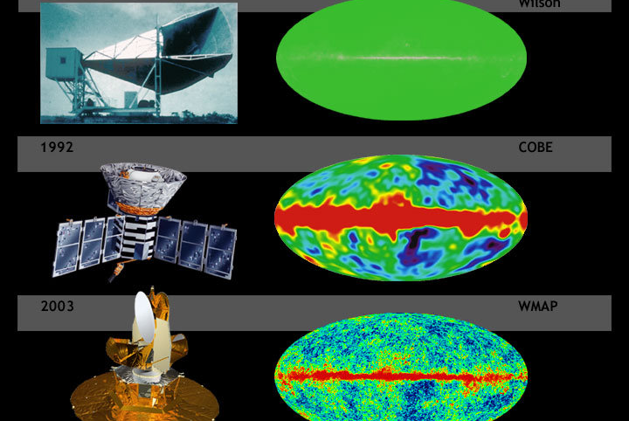
Cosmic Microwave Background Radiation
Notes:
A comparison of the sensitivity and resolution of WMAP with COBE and Penzias and Wilson's telescope, simulated data^{[1]}
NASA - map.gsfc.nasa.gov/m ig/030644/030644.html
Diagram of the history of the Cosmic Microwave Background Radiation (CMBR), showing the improvement of CMBR resolution over the years. The CMBR, a faint microwave radiation permeating all space that can be detected by radio telescopes, is remnant radiation left from the Big Bang, and one of the few sources of information on conditions in the early universe. (top left) Penzias and Wilson microwave horn antenna at Bell Labs, Murray Hill, NJ - 1965 Penzias and Wilson discovered the CMBR from the Big Bang and were awarded the 1978 Nobel Prize in physics for their work. (top right) Simulation of the sky viewed by Penzias and Wilson's microwave receiver - 1965 (middle left) COBE spacecraft (painting) - The Cosmic Background Explorer (COBE), launched in 1989, first discovered patterns in the CMBR, and Mather and Smoot were awarded the 2006 Nobel Prize for that work. (middle right) COBE's map of early universe- 1992 (bottom left) WMAP spacecraft (computer rendering) - The Wilkinson Microwave Anisotropy Probe (WMAP), launched in 2001 and active until 2010, mapped the patterns with much higher resolution to unveil new information about the history and fate of the universe. Bennet, Page, and Spergel won the 2010 Shaw Prize for their WMAP work. (bottom right) Simulated WMAP view of early universe

Slide 18
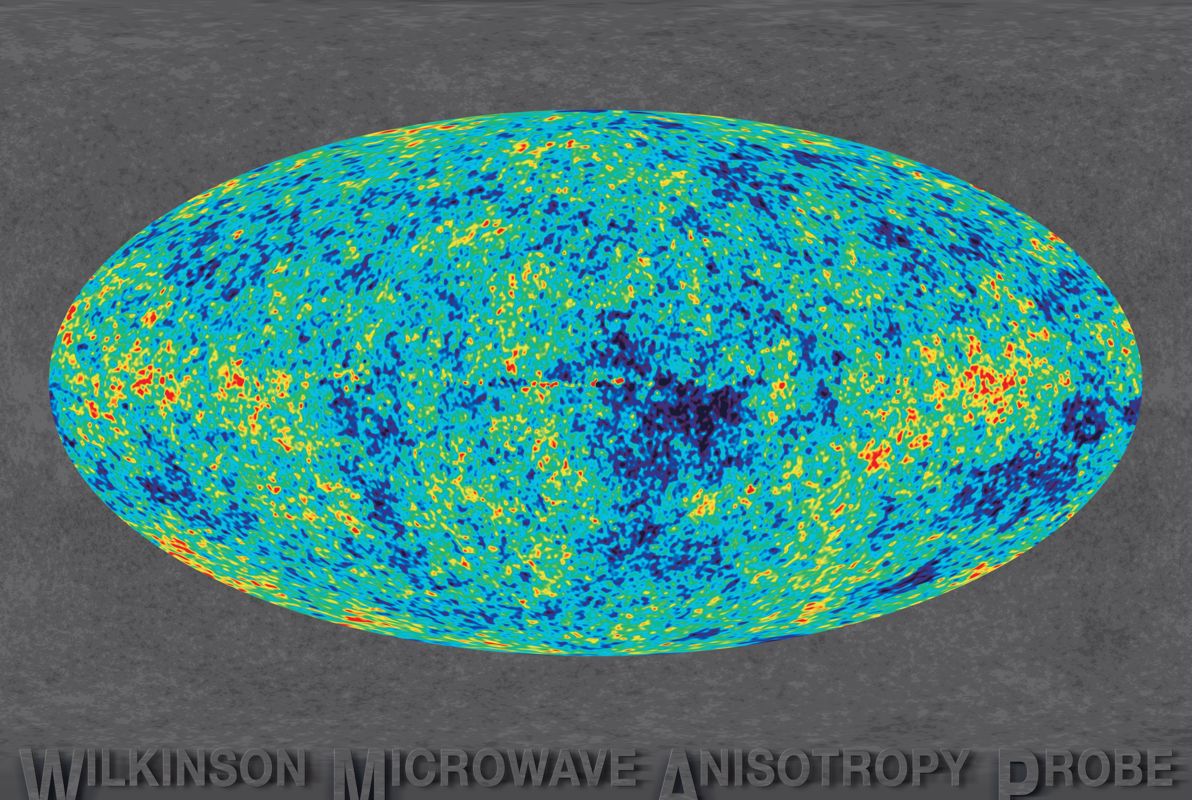
Cosmic background radiation is electromagnetic radiation from the Big Bang.
Its discovery and detailed observations of its properties are considered one of the major confirmations of the Big Bang. The discovery (by chance in 1965) of the cosmic background radiation suggests that the early universe was dominated by a radiation field, a field of extremely high temperature and pressure

Slide 19
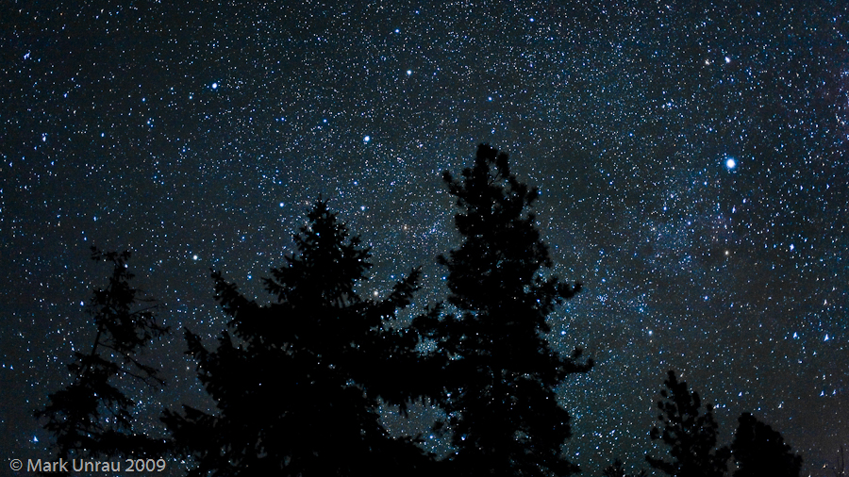
Olber’s Paradox
https://www.youtube.com/watch?v=KMAVpeaIJpw
Notes:
This question can be traced back to around 1576 and Thomas Digges, but it was first stated formally by the Prussian astronomer Heinrich Olbers in 1823, hence the name. It was commonly assumed, prior to the expansion of the universe being demonstrated by Hubble in 1929 that the universe was:
1. infinite
2. eternal
3. static.
If this was true, no matter which direction you looked, your line of sight would eventually intersect with a star. The entire sky would be virtually as bright as the Sun!
Olbers’ own explanation – that invisible interstellar dust absorbed the light – would make the intensity of starlight decrease exponentially with distance.
It can be shown that the amount of dust needed to do this would be so great as to block out the Sun! Also the radiation would heat up the dust so much that it would start to glow, becoming visible in the infrared region.
One solution to the paradox comes from considering the finite time light takes to reach us. Consider a galaxy very distant from our own. We only become aware of its existence when light from it reaches us. So if the universe is not infinitely old, galaxies must exist that are so distant that their light has not reached us yet. If the universe is not infinitely old, that implies that it was created some time in the past, which is consistent with the Big Bang theory.
Olber’s paradox asks the question, “why is the sky dark at night?”
This is not as obvious as you first might imagine.
The sun has set at night
Tam says:
What about all the stars? They’re suns as well
Wullie replies:
The Big Bang theory gives a finite age to the universe, and only stars within the observable universe can be seen. So the main reason why the night sky is dark is due to the finite age of the galaxies, not the expansion of the universe. This is consistent with the hot Big Bang model, but not with a steady-state universe.

Slide 20

Proportions of H and He
Element | relative abundance
Hydrogen | 10 000
Helium | 1 000
Oxygen | 6
Carbon | 1
All others | 1
Notes:
The Helium Problem
Other evidence to support the Big Bang theory includes the relative abundances of hydrogen and helium in the universe. Scientists predicted that there should be a significantly greater proportion of hydrogen in the universe. The next most abundant should be helium. The most abundant elements in the universe are hydrogen (70–75%) and helium (25–30%). However, the abundance of helium in the universe cannot be explained by the formation inside stars as most of it remains locked up in their cores. However, it can be accounted for by being formed during the dense phase of the early universe, i.e. shortly after the Big Bang.
The elements present in the universe can be determined by spectroscopy, which you will study later in Particles and Waves.
The latest proportions are given in the table shown. These observations conform to the predicted proportions.
Element
relative abundance
Hydrogen=10 000
Helium=1 000
Oxygen=6
Carbon=1
All others=1

Slide 21
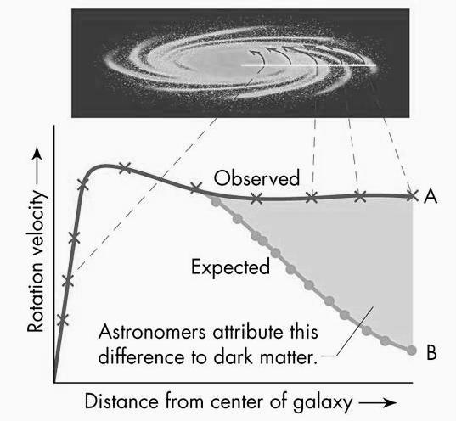
The stars are travelling too fast.
Notes:
The stars are travelling too fast.
As you can see from the graph above, the velocity of stars does not drop off as expected, at greater orbital radii. At these high velocities the observed mass of the galaxy should not be enough to hold on to many of its stars and we should see them fly off into intergalactic space.
The only logical conclusion that astronomers have to explain this consistent observation is that there must be a significant amount of mass that we cannot see. Hence the name: dark matter.

Slide 22
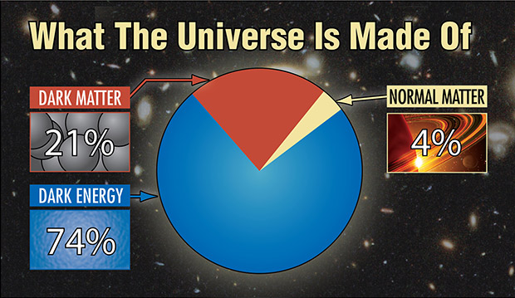
Dark Matter v Dark Energy
Remember Dark Energy REpels , Dark MAtter Attracts
Notes:
Our universe may contain 100 billion galaxies, each with billions of stars, great clouds of gas and dust, planets and moons. The stars produce an abundance of energy, from radio waves to X-rays, which streak across the universe at the speed of light.
Yet everything that we can see only accounts for only about 4 % of the total mass and energy in the universe.
About one-quarter of the universe consists of dark matter, which releases no detectable energy, but which exerts a gravitational pull on all the visible matter in the universe.
What dark matter consists of is uncertain at present, though it is believed not to be the type of matter with which we are familiar – electrons, neutrons, and protons.
While dark energy repels, dark matter attracts. And dark matter’s influence shows up even in individual galaxies, while dark energy acts only on the scale of the entire universe.
Remember Dark Energy REpels , Dark MAtter Attracts
Are dark matter and dark energy related? No one knows. The leading theory says that dark matter consists of a type of subatomic particle that has not yet been detected, although upcoming experiments with the world’s most powerful particle accelerator may reveal its presence. Dark energy may have its own particle, although there is little evidence of one.
Instead, dark matter and dark energy appear to be competing forces in our universe. The only things they seem to have in common is that both were forged in the Big Bang, and both remain mysterious. While dark matter pulls matter inward, dark energy pushes it outward. Also, dark energy shows itself only on the largest cosmic scale, dark matter exerts its influence on individual galaxies as well as the universe at large.

Slide 23
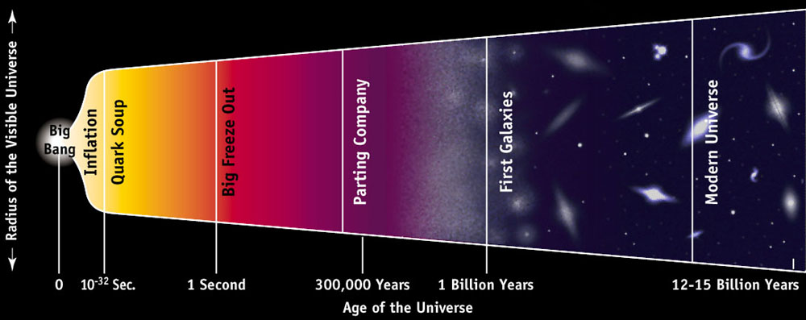
The Big Bang
http://archive.ncsa.illinois.edu/Cyberia/Cosmos/Images/CosmicTimeline_gr.jpg

Slide 24
A summary of some of the evidence
Evidence for big bang | Interpretation
The light from other galaxies is red-shifted. | The other galaxies are moving away from us.
The further away the galaxy, the more its light is red-shifted. | The most likely explanation is that the whole universe is expanding. This supports the theory that the start of the universe could have been from a single explosion.
Cosmic Microwave Background | The relatively uniform background radiation is the remains of energy created just after the Big Bang.
Proportions of H and He | The abundance of light elements is what we would expect from calculations about the formation of matter, called “Big Bang nucleosynthesis”

Slide 25
BANG!
The Big Bang was not like a conventional explosion in which matter is thrown apart from a single point into a pre-existing empty space.
Most cosmologists think space, time and matter originated at the Big Bang and before that there was no space, time or matter in the sense we think of them today.
Rather than thinking of galaxies as flying away from each other through space, it is much better to think of them as being essentially at rest in an expanding space.

Slide 26
Explosion |  | Expansion
Different bits fly off at different speeds |  | Expansion explains the large-scale symmetry we see in the distribution of galaxies
Fast parts overtake slow parts |  | Expanding space explains the redshifts and the Hubble law
Difficult to imagine a suitable mechanism to produce the range of velocities from 100 kms^{–1} to almost the speed of light |  | Expansion also explains redshifts and the Hubble law even if we are not at the centre of the universe
Seems likely velocity would be related to some physical property, eg if given the same energy, less massive galaxies would be moving faster |  | Balloon analogy – every galaxy moves away from every other as the space expands
If this was the case a definite correlation between mass and velocity would be expected – this is not observed |  | No galaxy is located at the centre
Hubble’s Law works well even if we only plot data for galaxies of similar mass |  | Not only are we not at the centre of the universe, it doesn’t even need to have a centre
Faster galaxies would leave slower ones behind, resulting in those near the centre (start) being more closely packed than those on the periphery (finish), like runners in a marathon, but this is not observed

