Slide 1


Instantaneous Speed
S2, S3, N5 Physics

Slide 2
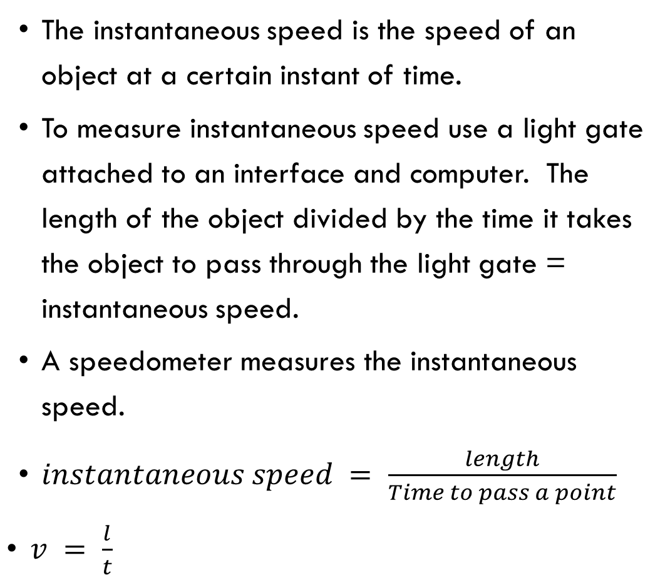
INSTANTANEOUS Speed
Learning Intentions
The instantaneous speed is the speed of an object at a certain instant of time.
To measure instantaneous speed use a light gate attached to an interface and computer. The length of the object divided by the time it takes the object to pass through the light gate = instantaneous speed.
A speedometer measures the instantaneous speed.
$instantaneous speed = \frac{length}{Time to pass a point}$
$v = \frac{l}{t}$

Slide 3
State the formula for average speed.
State two things you need to measure to find an object’s average speed.
How do you get the menu on your calculator?
Revision

Slide 4

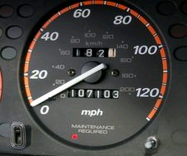
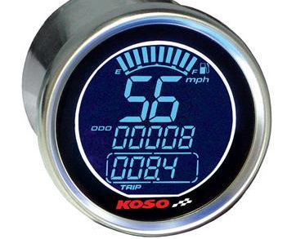
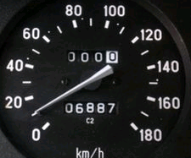
The instantaneous speed is the speed of an object at a certain instant of time.
A speedometer is a gauge that measures and displays the instantaneous speed of a land vehicle.
Notes:
Instantaneous speed is the speed at which you are travelling over a very short distance. It is measured in metres per second or miles per hour.

Slide 5
Instantaneous Speed
Answer this question:
Why is instantaneous speed difficult to measure?
Lets try that out!

Slide 6
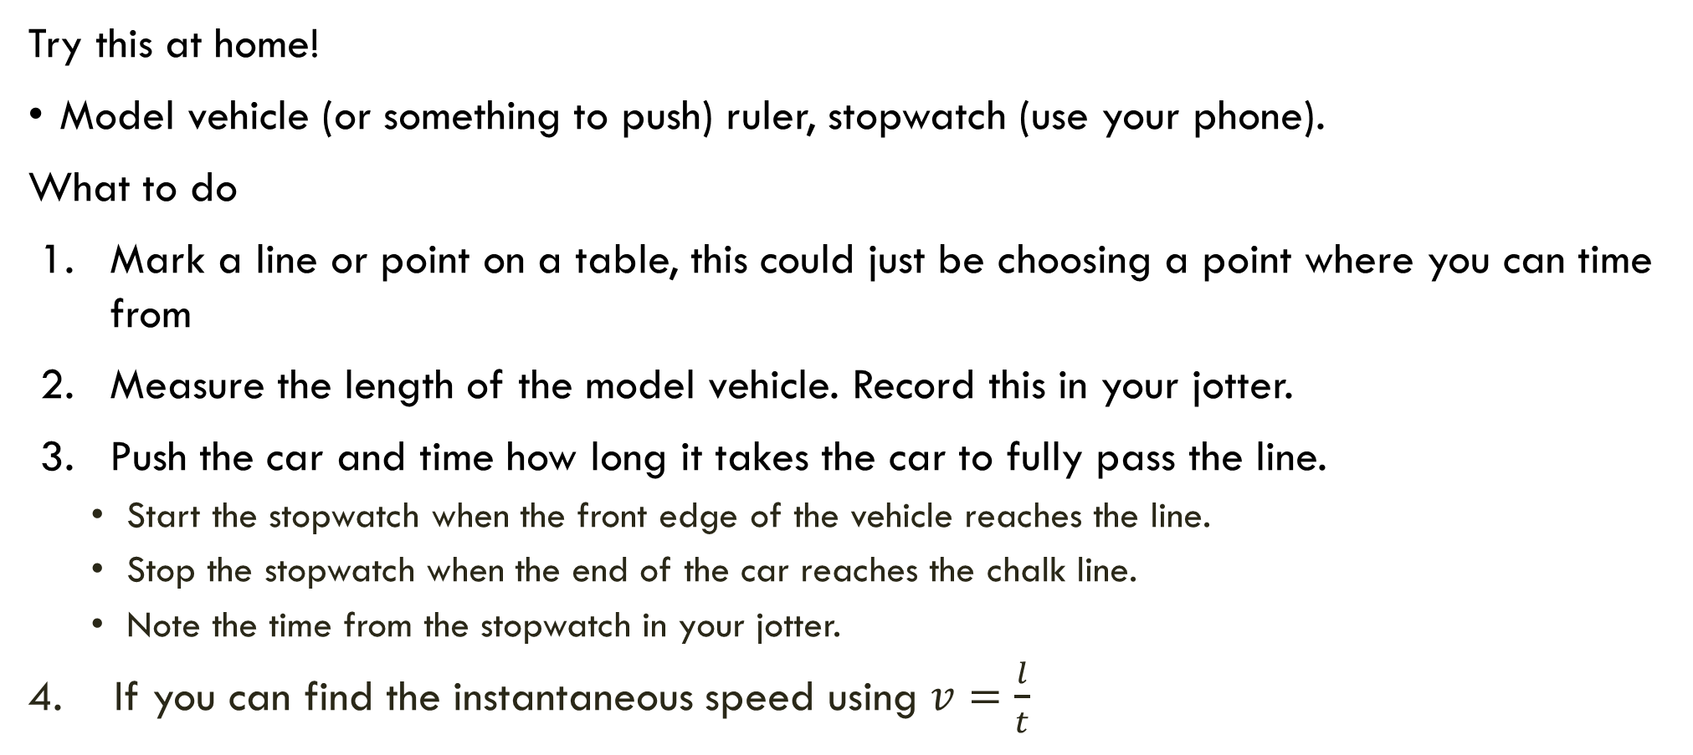
Measuring Instantaneous Speed Using A Stopwatch
Try this at home!
Model vehicle (or something to push) ruler, stopwatch (use your phone).
What to do
Mark a line or point on a table, this could just be choosing a point where you can time from
Measure the length of the model vehicle. Record this in your jotter.
Push the car and time how long it takes the car to fully pass the line.
  Start the stopwatch when the front edge of the vehicle reaches the line.
  Stop the stopwatch when the end of the car reaches the chalk line.
  Note the time from the stopwatch in your jotter.
  If you can find the instantaneous speed using $v=\frac{l}{t}$

Slide 7
Instantaneous Speed Using Light Gates
Another way to measure instantaneous speed is to use a light gate. The length of the object divided by the time it takes to pass through the light gate gives instantaneous speed.
$$instantaneous speed=\frac{length of object}{ time to pass a point}$$
Length of object
Light gate measures time to pass
Ramp

Slide 8
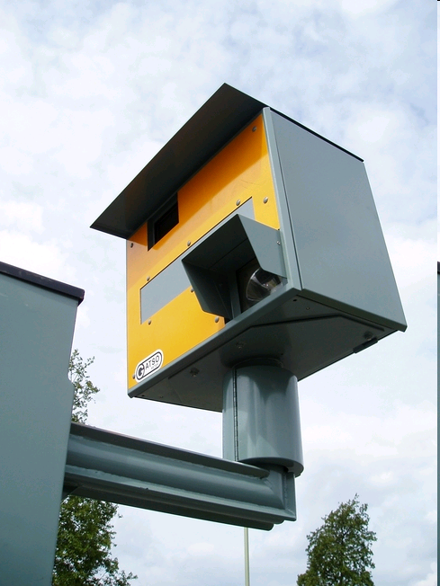

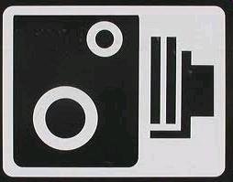
INSTANTANEOUS SPEED- Road Safety
Speed Cameras in D&G

Slide 9
Complete one of the Activities on the next two slides

