Slide 1

Kinetic Theory of Gases
N5 Physics

Slide 2

Get the notes here

Slide 3
On ¼ of the paper.
Draw a diagram of a gas (S1 Science)
What can you tell me about the particles in a gas?
What happens to the particles when I increase the temperature of the gas?
How much space do the particles take up?
In which direction are the particles moving? Explain your reasoning
How do the gas particles exert a pressure?

Slide 4
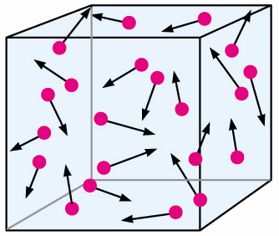
On ¼ of the paper.
Gas particles are spaced out, travelling, in all directions, fast moving, range of speeds
When I increase the temperature of the gas the particles move fasted so their mean average E_{k} increases
In an ideal gas the particles take up NO space
Particles moving in all directions. Explain your reasoning
Pressure is caused when the particles collide with the walls of the container- applying a FORCE

Slide 5
What causes pressure?
Pressure is caused by the force from the particles when they hit the walls of the container, ie F/A

Slide 6
KINETIC THEORY
All particles are moving.
Pressure is caused when the particles collide with the container walls
The hotter the particles the faster they move.
The faster they move the more often and more violent the collisions with the walls, greater impulse therefore greater force.
If the volume is less they will collide more often as there is a shorter distance between the container walls.

Slide 7
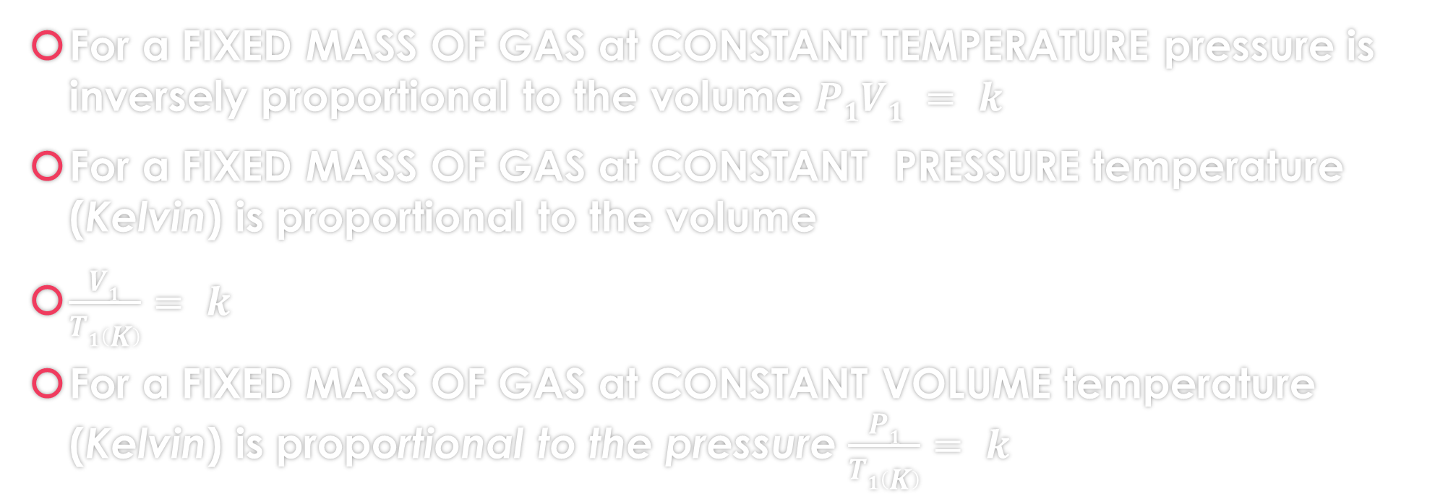
A few common explanations LEARN THESE
For a FIXED MASS OF GAS at CONSTANT TEMPERATURE pressure is inversely proportional to the volume $P1V1 = k$
For a FIXED MASS OF GAS at CONSTANT PRESSURE temperature (Kelvin) is proportional to the volume
$\frac{V1}{T1\left(K\right)}= k$
For a FIXED MASS OF GAS at CONSTANT VOLUME temperature (Kelvin) is proportional to the pressure $\frac{P1}{T1\left(K\right)}= k$

Slide 8
GAS LAWS/ TUTORIAL 1
A bicycle pump has a barrel filled with air at atmospheric pressure, 1 x 10⁵ Pa. As he inflates the tyre, this is compressed by the cyclist to a volume of 33.8 cm³ at a pressure of 6.5 × 10⁵ Pa. If we assume that the air in the pump keeps at a constant temperature, what is the volume of the pump before the handle is pressed down?
A bottle containing air at atmospheric pressure and a temperature of 293 K, falls into a bonfire where its temperature rises to 879 K. What is the new pressure of the air in the bottle?
The fuel-air mixture in a cylinder is at a pressure of 8 × 10⁵ Pa and a temperature of 293 K before the spark ignites it. What is the new pressure inside the cylinder if the burning mixture reaches a temperature of 1172 K before the piston has a chance to move?

Slide 9
More Questions
A girl fills a 20 ml syringe with air at 1 × 10⁵ Pa and puts her finger over the end as she presses the plunger down. What volume does she squash the air down to when she causes a pressure of 5.25 × 10⁵ Pa inside the syringe?
If the piston in a cylinder containing 300cm³ of gas at a pressure of 10⁵ Pa is moved outwards so that the pressure of the gas falls to 8·0 × 10 ⁵ Pa, find the new volume of the gas.
A weather balloon contains 80 m³ of helium at normal atmospheric pressure of 1×10⁵ Pa. What will be the volume of the balloon at an altitude where the pressure is 8 x 10⁴ Pa
A swimmer underwater uses a cylinder of compressed air which holds 15 litres of air at a pressure of 12,000 kPa.
Calculate the volume this air would occupy at a depth where the pressure is 200 kPa.
If the swimmer breathes 25 litres of air each minute at this pressure, calculate how long the swimmer could remain at this depth (assume all the air from the cylinder is available)

Slide 10
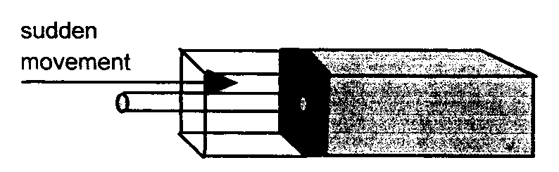
Gas Law 2
1. A fixed mass of gas is enclosed in an insulated container whose volume is suddenly reduced:
Explain what happens to
a. The number of collisions per second that the molecules make with the container walls.
b. The average spacing between the molecules.
c. The kinetic energy of the molecules.
A fixed mass of gas is enclosed in an insulated container whose volume is suddenly reduced:
Explain what happens to
  The number of collisions per second that the molecules make with the container walls.

Slide 11
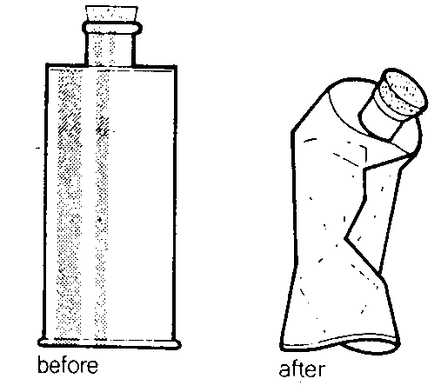
When air is pumped out of a metal can it collapses as indicated in the diagram.
Explain this effect in terms of air pressure.

Slide 12
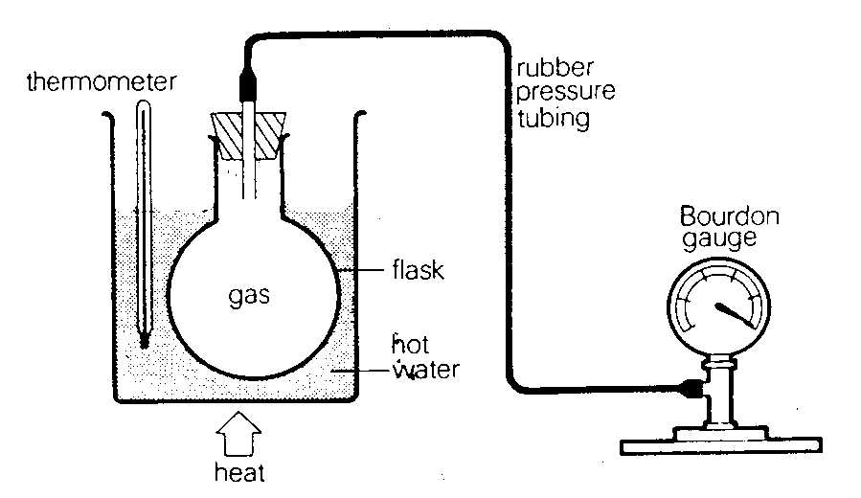
A boy used the following apparatus to test a hypothesis that “the pressure of a gas is directly proportional to its temperature”.
He obtained the
following results:
  Comment on the volume of the enclosed air during the experiment.
  Draw a graph of the results and show how a relationship between pressure and temperature of gas may be deduced.
  Rewrite the hypothesis in a more correct
  form.
  How could the errors be reduced
  in this experiment?
Temperature (ºC) | 0 | 20 | 40 | 60 | 80 | 100
Pressure (kN m^{–2}) | 90 | 96 | 103 | 110 | 117 | 123

