Slide 1
Ready Respectful Safe
Ready | Respectful | Safe
Enter the room quietly, calmly and on time; | Raise your hand, and wait for permission before speaking. | Follow the teacher’s instructions.
Come prepared for the work with jotters and pen or pencil etc. | Allow people to get on with their work. | Follow the laboratory rules
Complete all homework and hand it in on time | No Put Downs | Do not touch equipment that is not part of your work
Pay attention | Not deface jotters, desks folders, etc.
 | Pay attention
 | At the end of a lesson, when told to do so, pack away quietly, place stools under the desk and leave in an orderly manner.

Slide 2

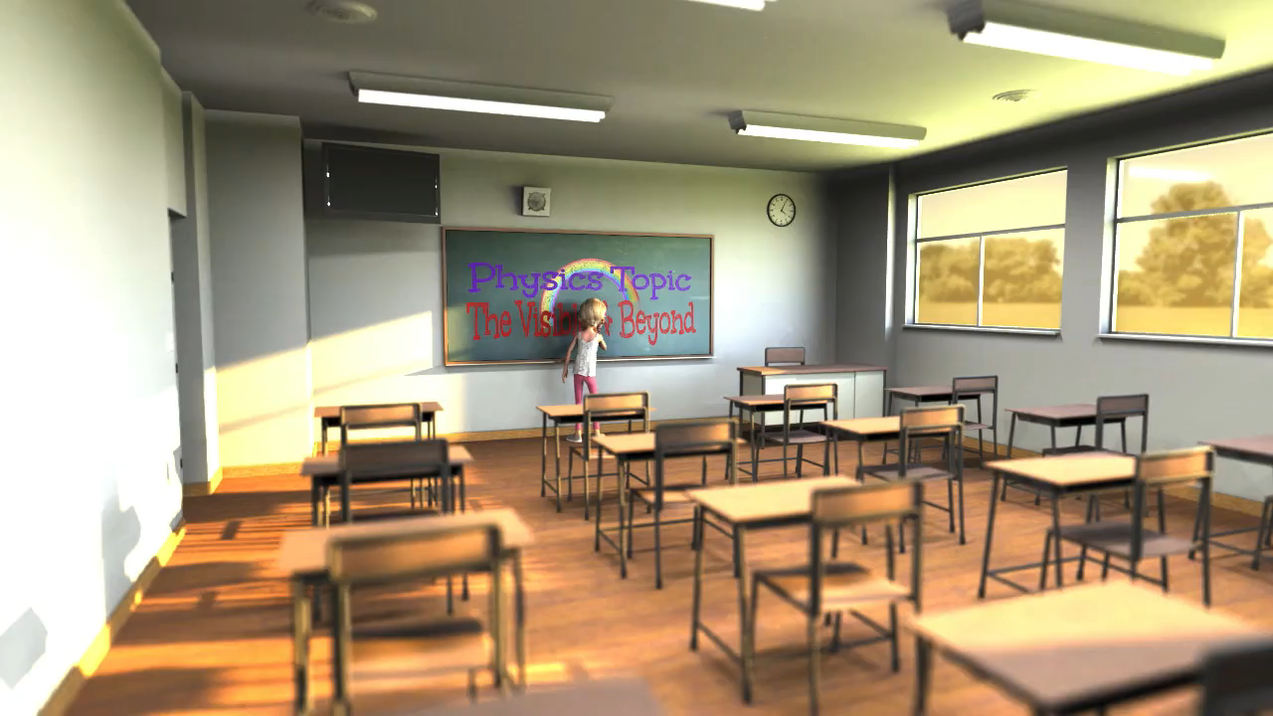
https://www.youtube.com/watch?v=OYK7G6r0Pec
A Physics topic on the Electromagnetic Spectrum

Slide 3
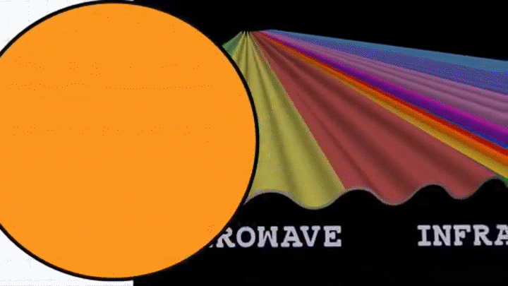
The Visible and Beyond!
A Physics topic on the Electromagnetic Spectrum
But we need some background first

Slide 4
Learning Intentions: Describing Waves
Lesson 1
REVISE:Amplitude is the midpoint to the crest of a wave
REVISE: Wavelength is the distance between the same point on successive waves
Frequency is the number of waves per second and is measured in Hertz, Hz,
Period is the time taken for one wave to pass a point, measured in seconds
Waves carry energy, the amplitude is a measure of the energy of a wave.
$wavelength = \frac{distance}{no. of waves}$,
$=\frac{d}{N}$
𝑤𝑎𝑣𝑒𝑙𝑒𝑛𝑔𝑡ℎ = 𝑑𝑖𝑠𝑡𝑎𝑛𝑐𝑒/(𝑛𝑜. 𝑜𝑓 𝑤𝑎𝑣𝑒𝑠),
λ=𝑑/𝑁
$Frequency =\frac{no. of waves}{time}$,
$f=\frac{N}{t}$
$period =\frac{time}{no. of waves}$. $T=\frac{1}{f}$
𝐹𝑟𝑒𝑞𝑢𝑒𝑛𝑐𝑦 =(𝑛𝑜. 𝑜𝑓 𝑤𝑎𝑣𝑒𝑠)/𝑡𝑖𝑚𝑒,
𝑓=𝑁/𝑡
𝑝𝑒𝑟𝑖𝑜𝑑 =𝑡𝑖𝑚𝑒/(𝑛𝑜. 𝑜𝑓 𝑤𝑎𝑣𝑒𝑠). 𝑇=1/𝑓
Understand and correctly use the formulae v=d/t
Properties of waves, reflection, refraction, (diffraction- not covered),
REVISE: Describe the two types of waves, longitudinal and transverse.
REVISE:Sound and seismic p- waves are examples of longitudinal waves and the EM waves are transverse waves.

Slide 5
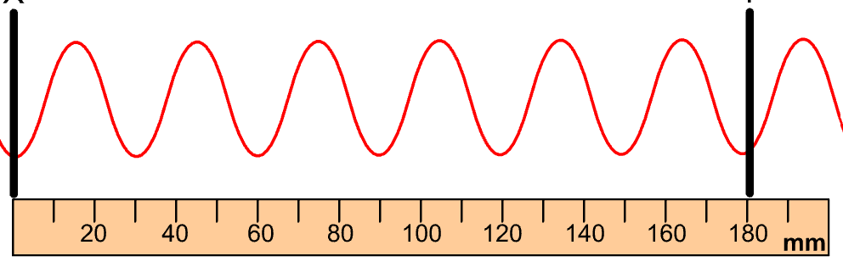
Describing Waves: Revision from Physics 1
A
C
D
E
B
Mean/ rest
Position or
midpoint
amplitude
crest
wavelength
trough

Slide 6
Describing a wave
Amplitude, A is the midpoint to the crest or trough of a wave.
Wavelength λ is the distance between the same point on waves next to each other.
Frequency, f is the number of waves per second and is measured in Hertz, Hz,
λ
crest
A
trough
λ

Slide 7
Wave term | Symbol | Definition | Unit | Unit symbol
Crest |  | highest point of a wave
Trough |  | lowest point of a wave
Wavelength | λ | horizontal distance between successive crests or troughs | metre | m
Amplitude | A | The distance between the midpoint to the crest or trough | metre | m
Wave Speed | v | distance travelled per unit time | metres per second | ms⁻¹
Period | T | the time it takes one wave to pass a point | seconds | s
Frequency | f | number of waves produced in one second | hertz | Hz

Slide 8
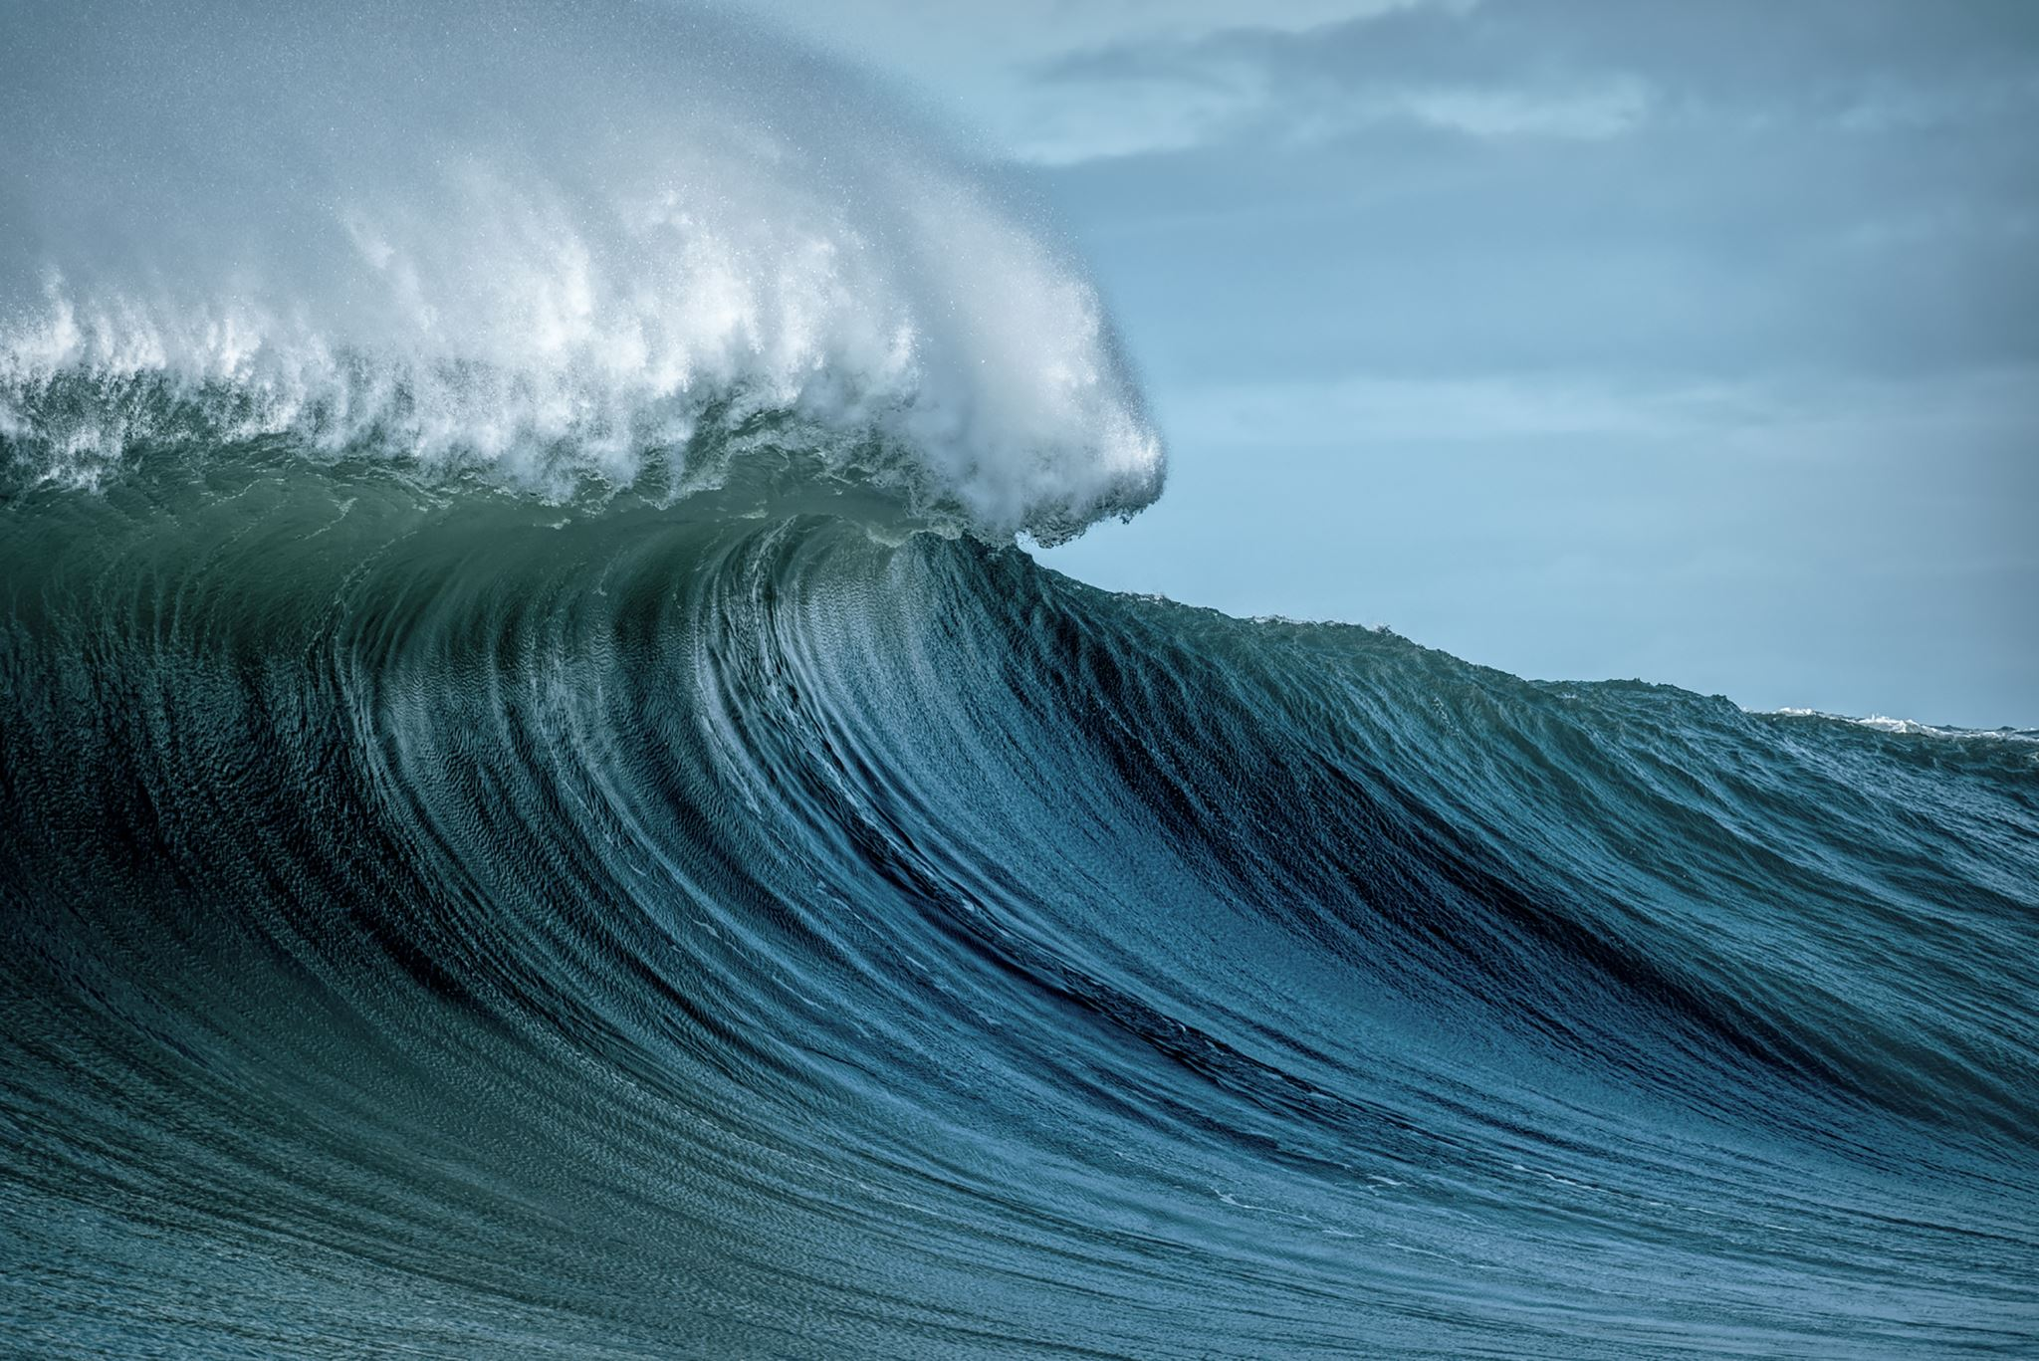
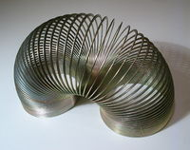
Describing Waves
Longitude and transverse wave animations
https://physicsflashrepo.cyou/flash/physics-2-15/physics-2-15.html
https://physicsflashrepo.cyou/flash/int2/int2-wavesandoptics.html
Using the slinky, lets go and make some waves:
You should
Draw and explain transverse waves
Draw and explain longitudinal waves
See waves reflecting from an end

Slide 9
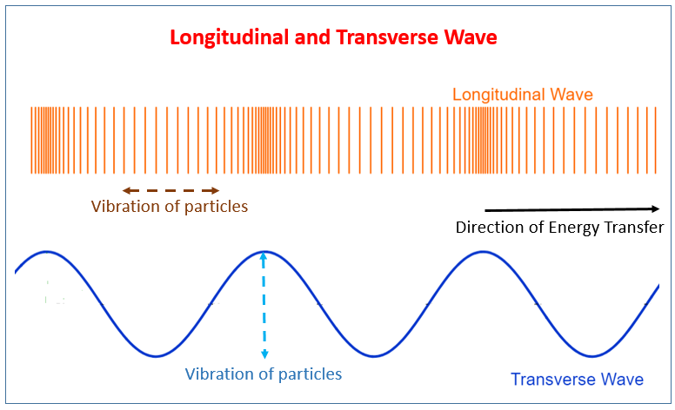
Types of Waves
Using the slinky, lets go and make some waves:
You should
Draw and explain transverse waves
Draw and explain longitudinal waves
See waves reflecting from an end
Longitude and transverse wave animations
https://physicsflashrepo.cyou/flash/physics-2-15/physics-2-15.html
https://physicsflashrepo.cyou/flash/int2/int2-wavesandoptics.html
No text
with text

Slide 10
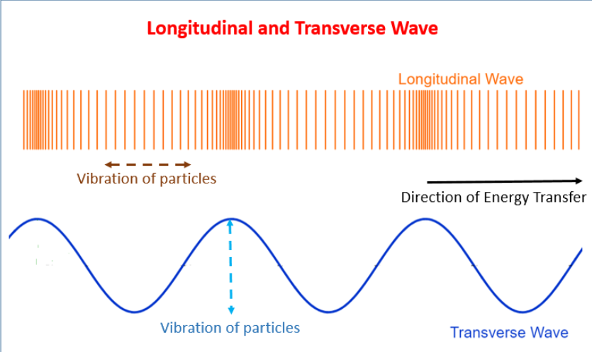
Draw me!

Slide 11
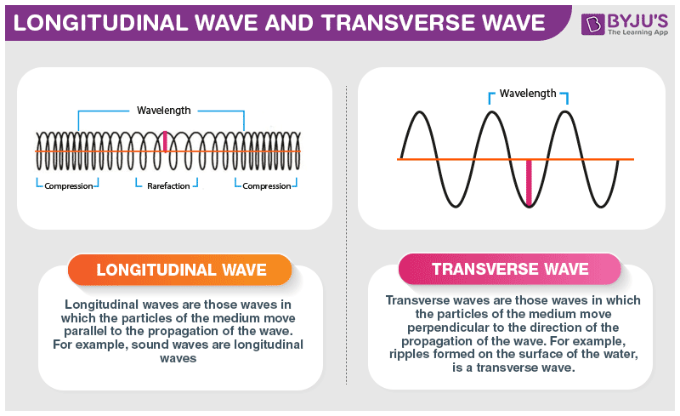
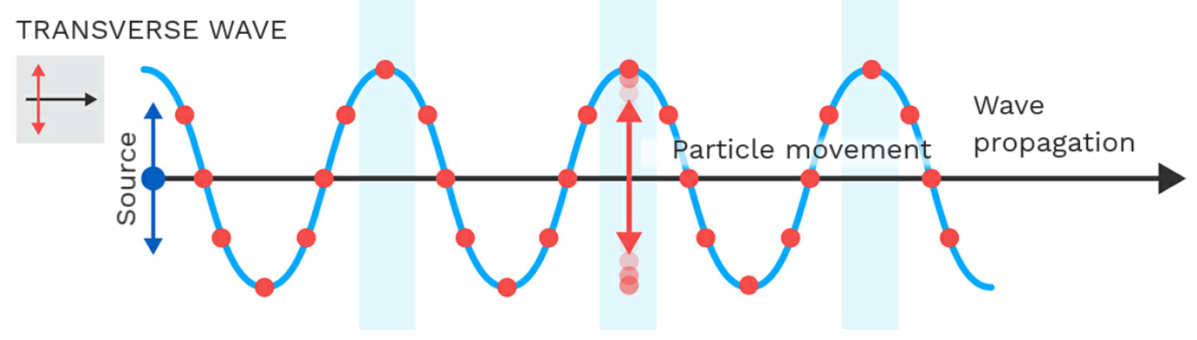
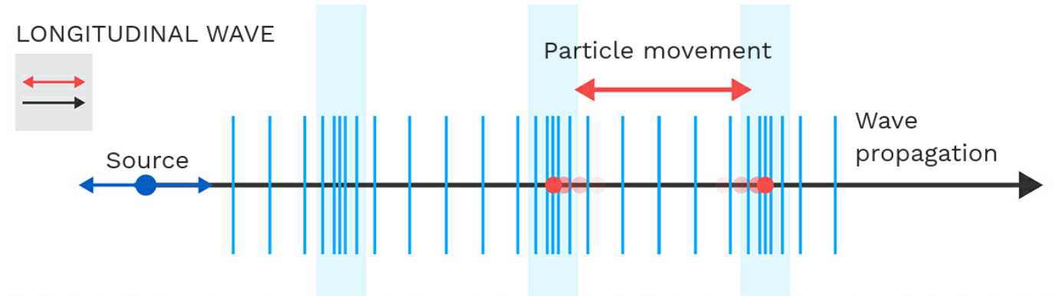

Slide 12
Frequency and period
frequency is the number of waves produced or passing a point per second. It is measured in Hertz, Hz
Period is the time for one wave to pass a point, it is measured in seconds, s

Slide 13
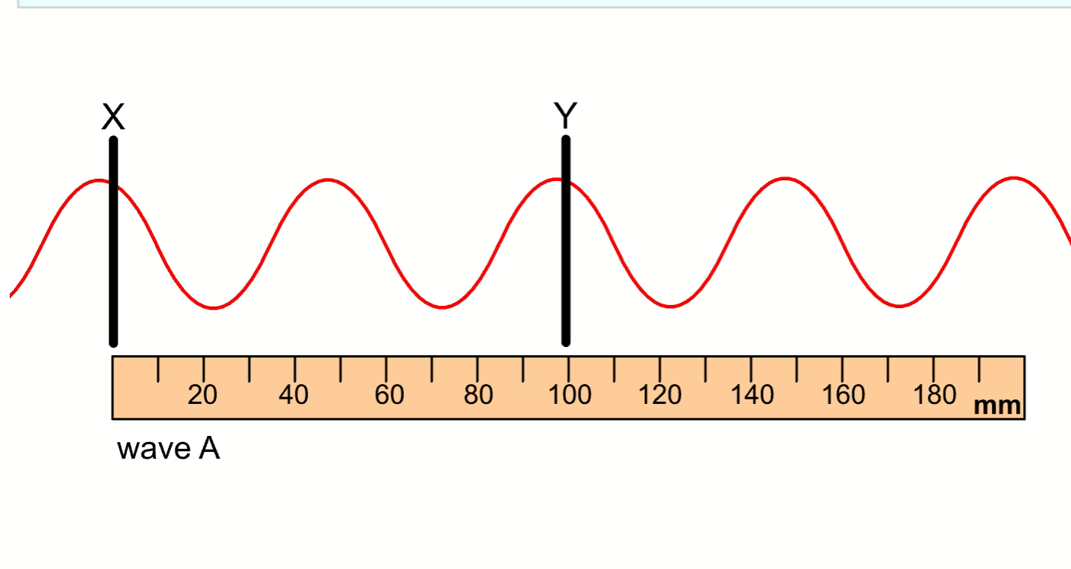
Can you find the number of waves passing a point per second (frequency)?
So how else can you find the frequency?
The best way is to TIME for 10 waves to pass point Y but don’t forget the first crest is zero, not 1!

Slide 14
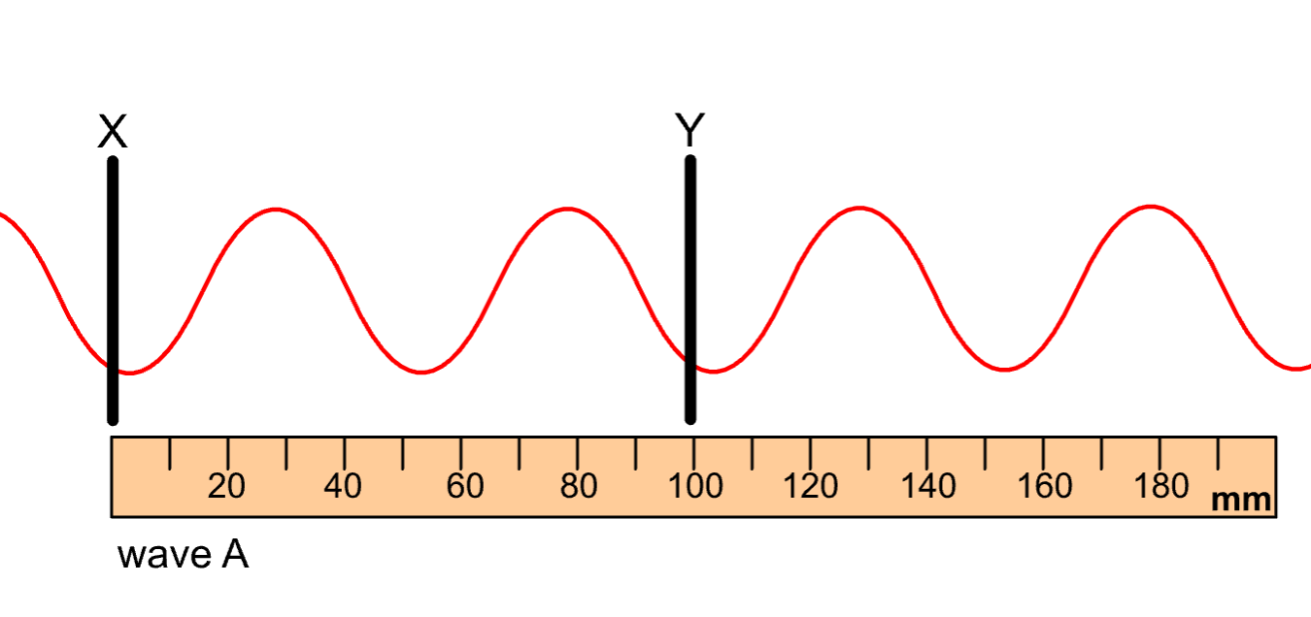
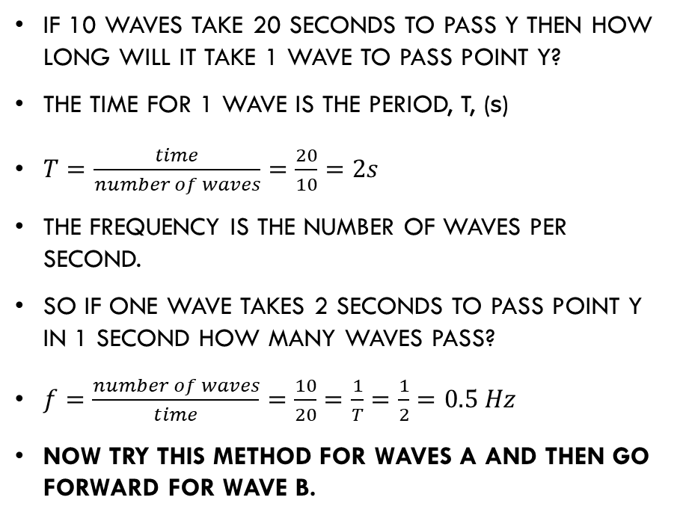
Now a little bit of maths
If 10 waves take 20 seconds to pass Y then how long will it take 1 wave to pass point Y?
The time for 1 wave is the period, T, (s)
$T=\frac{time}{number of waves}=\frac{20}{10}=2s$
The frequency is the number of waves per second.
So if one wave takes 2 seconds to pass point Y in 1 second how many waves pass?
$f=\frac{number of waves}{time}=\frac{10}{20}=\frac{1}{T}=\frac{1}{2}=0.5 Hz$
Now try this method for waves A and then go forward for wave B.

Slide 15
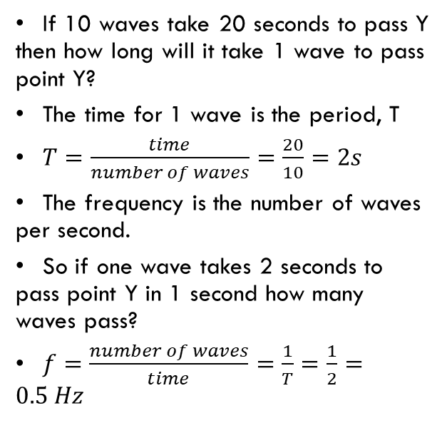
Replace the numbers in our example with those for wave A
If 10 waves take 20 seconds to pass Y then how long will it take 1 wave to pass point Y?
The time for 1 wave is the period, T
$T=\frac{time}{number of waves}=\frac{20}{10}=2s$
The frequency is the number of waves per second.
So if one wave takes 2 seconds to pass point Y in 1 second how many waves pass?
$f=\frac{number of waves}{time}=\frac{1}{T}=\frac{1}{2}=0.5 Hz$

Slide 16
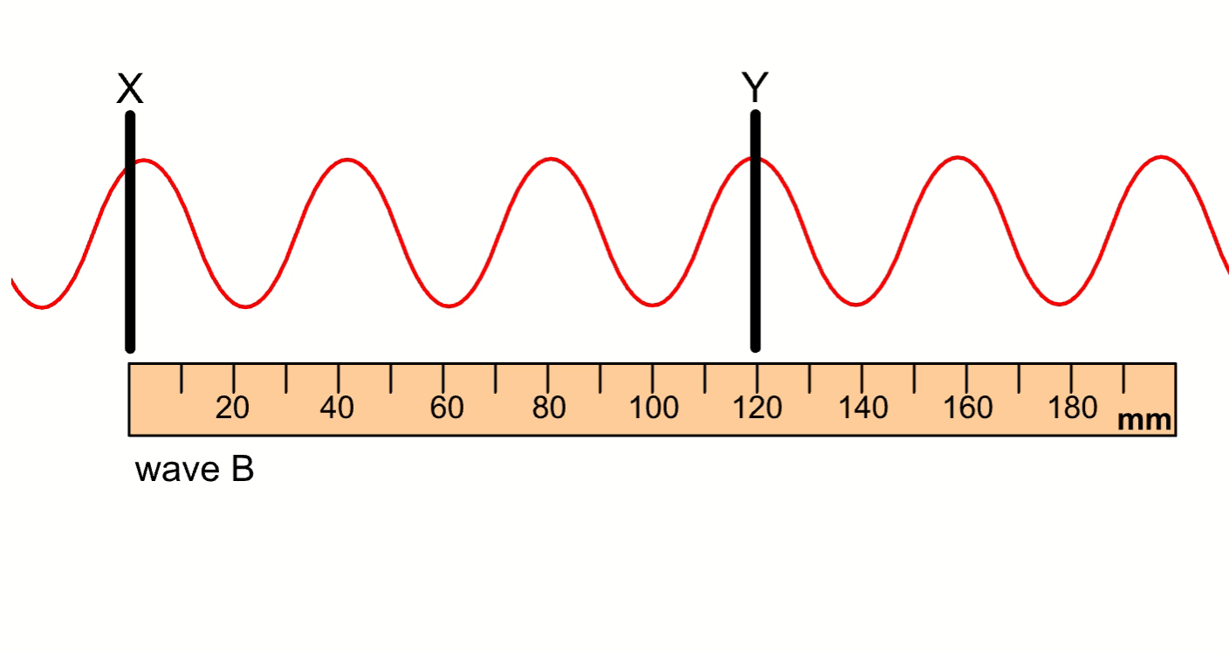
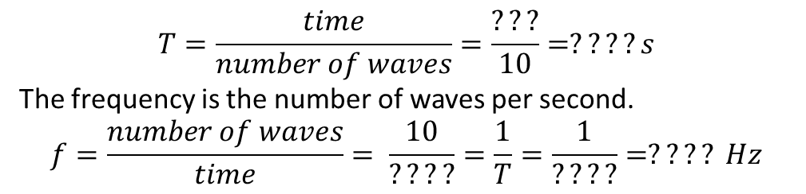
Find the frequency and period for Wave B
$$T=\frac{time}{number of waves}=\frac{???}{10}=????s$$
The frequency is the number of waves per second.
$$f=\frac{number of waves}{time}= \frac{10}{????}=\frac{1}{T}=\frac{1}{????}=???? Hz$$

Slide 17
Questions on frequency and period.
  State the frequency of the waves if 10 waves are produced in one second.
  Determine the frequency if 500 waves are produced in one second.
  If 10 waves are produced in 2.0 seconds, then 5 waves must be produced in 1.0 second. Calculate the frequency of the wave in this case.
  If 20 waves are produced in 2.0 seconds, determine the period of the waves.
  If 20 waves are produced in 2.0 seconds, calculate the frequency of the waves.
  6000 waves are produced in 10 seconds. State the frequency of the source.
  It takes 0.2s for a source to produce one wave. State the period of the wave and calculate the frequency of the source.
  120 waves pass a point in one minute, calculate the frequency and period of the waves.
10 Hz
500 Hz
5 Hz
0.1 s
10 Hz
600 Hz
0.2s 5 Hz
2 Hz, 0.5s

Slide 18
Transverse/Longitudinal waves
Transverse/Longitudinal waves
Transverse waves are those in which the vibrations are at right angles to the direction of travel
Longitudinal waves are those in which the vibrations are in the same direction as the direction of travel
Sound waves and seismic waves are longitudinal waves
All electromagnetic waves are transverse waves

Slide 19
Transverse & Longitudinal
Describing waves
Wave term | Symbol | Definition | Unit | Unit symbol
Crest |  | highest point of a wave
Trough |  | lowest point of a wave
Wavelength | λ | horizontal distance between successive crests or troughs | metre | m
Amplitude | A | The distance between the midpoint to the crest or trough | metre | m
Wave Speed | v | distance travelled per unit time | metres per second | ms⁻¹
Period | T | the time it takes one wave to pass a point | seconds | s
Frequency | f | number of waves produced in one second | hertz | Hz

Slide 20

Transverse & Longitudinal
Transverse & Longitudinal
The period is the time for one wave to pass a point
$$T=\frac{time}{number of waves}$$
The frequency is the number of waves per second.
$$f=\frac{number of waves}{time}$$
$$or$$
$$f=\frac{1}{T}$$

Slide 21


Exit Ticket:
If you’ve time listen to the song
https://www.youtube.com/watch?v=-H8HjxGtoXw
Exit Ticket
Record 5 words from today’s lesson

Slide 22

Starter Questions
Lesson 2
Copy and label the diagram using the terms, crest, trough, wavelength and amplitude.
List the group of waves to which light belongs.
In which waves are the vibrations at right angles to the direction of travel.
State one example of a longitudinal wave.
State one example of a transverse wave.

Slide 23
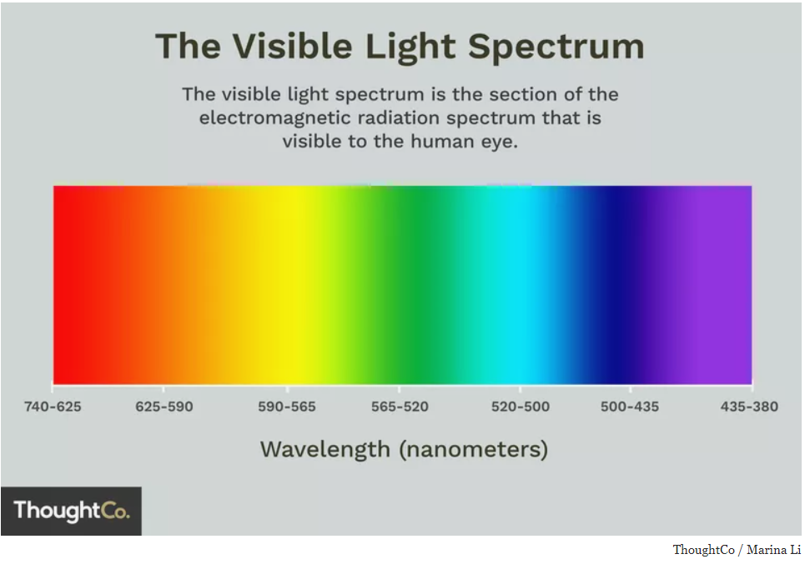
Visible Light
Learning Intentions
Lesson 2
There is a collection of waves that all travel at the speed of light and these form the electromagnetic spectrum.
Colours are mixed to give us all the colours of the spectrum (a rainbow)
The speed of light in air is 300 million metres per second,
Written as 300 000 000 m/s

Slide 24
Light is an electromagnetic wave
Electromagnetic waves travel VERY FAST –
300, 000, 000 m/s or 300,000 kilometres per second (the speed of light).
At this speed the waves can travel the equivalent of 7.5 times around the world in one second. (but light travels in straight lines)

Slide 25

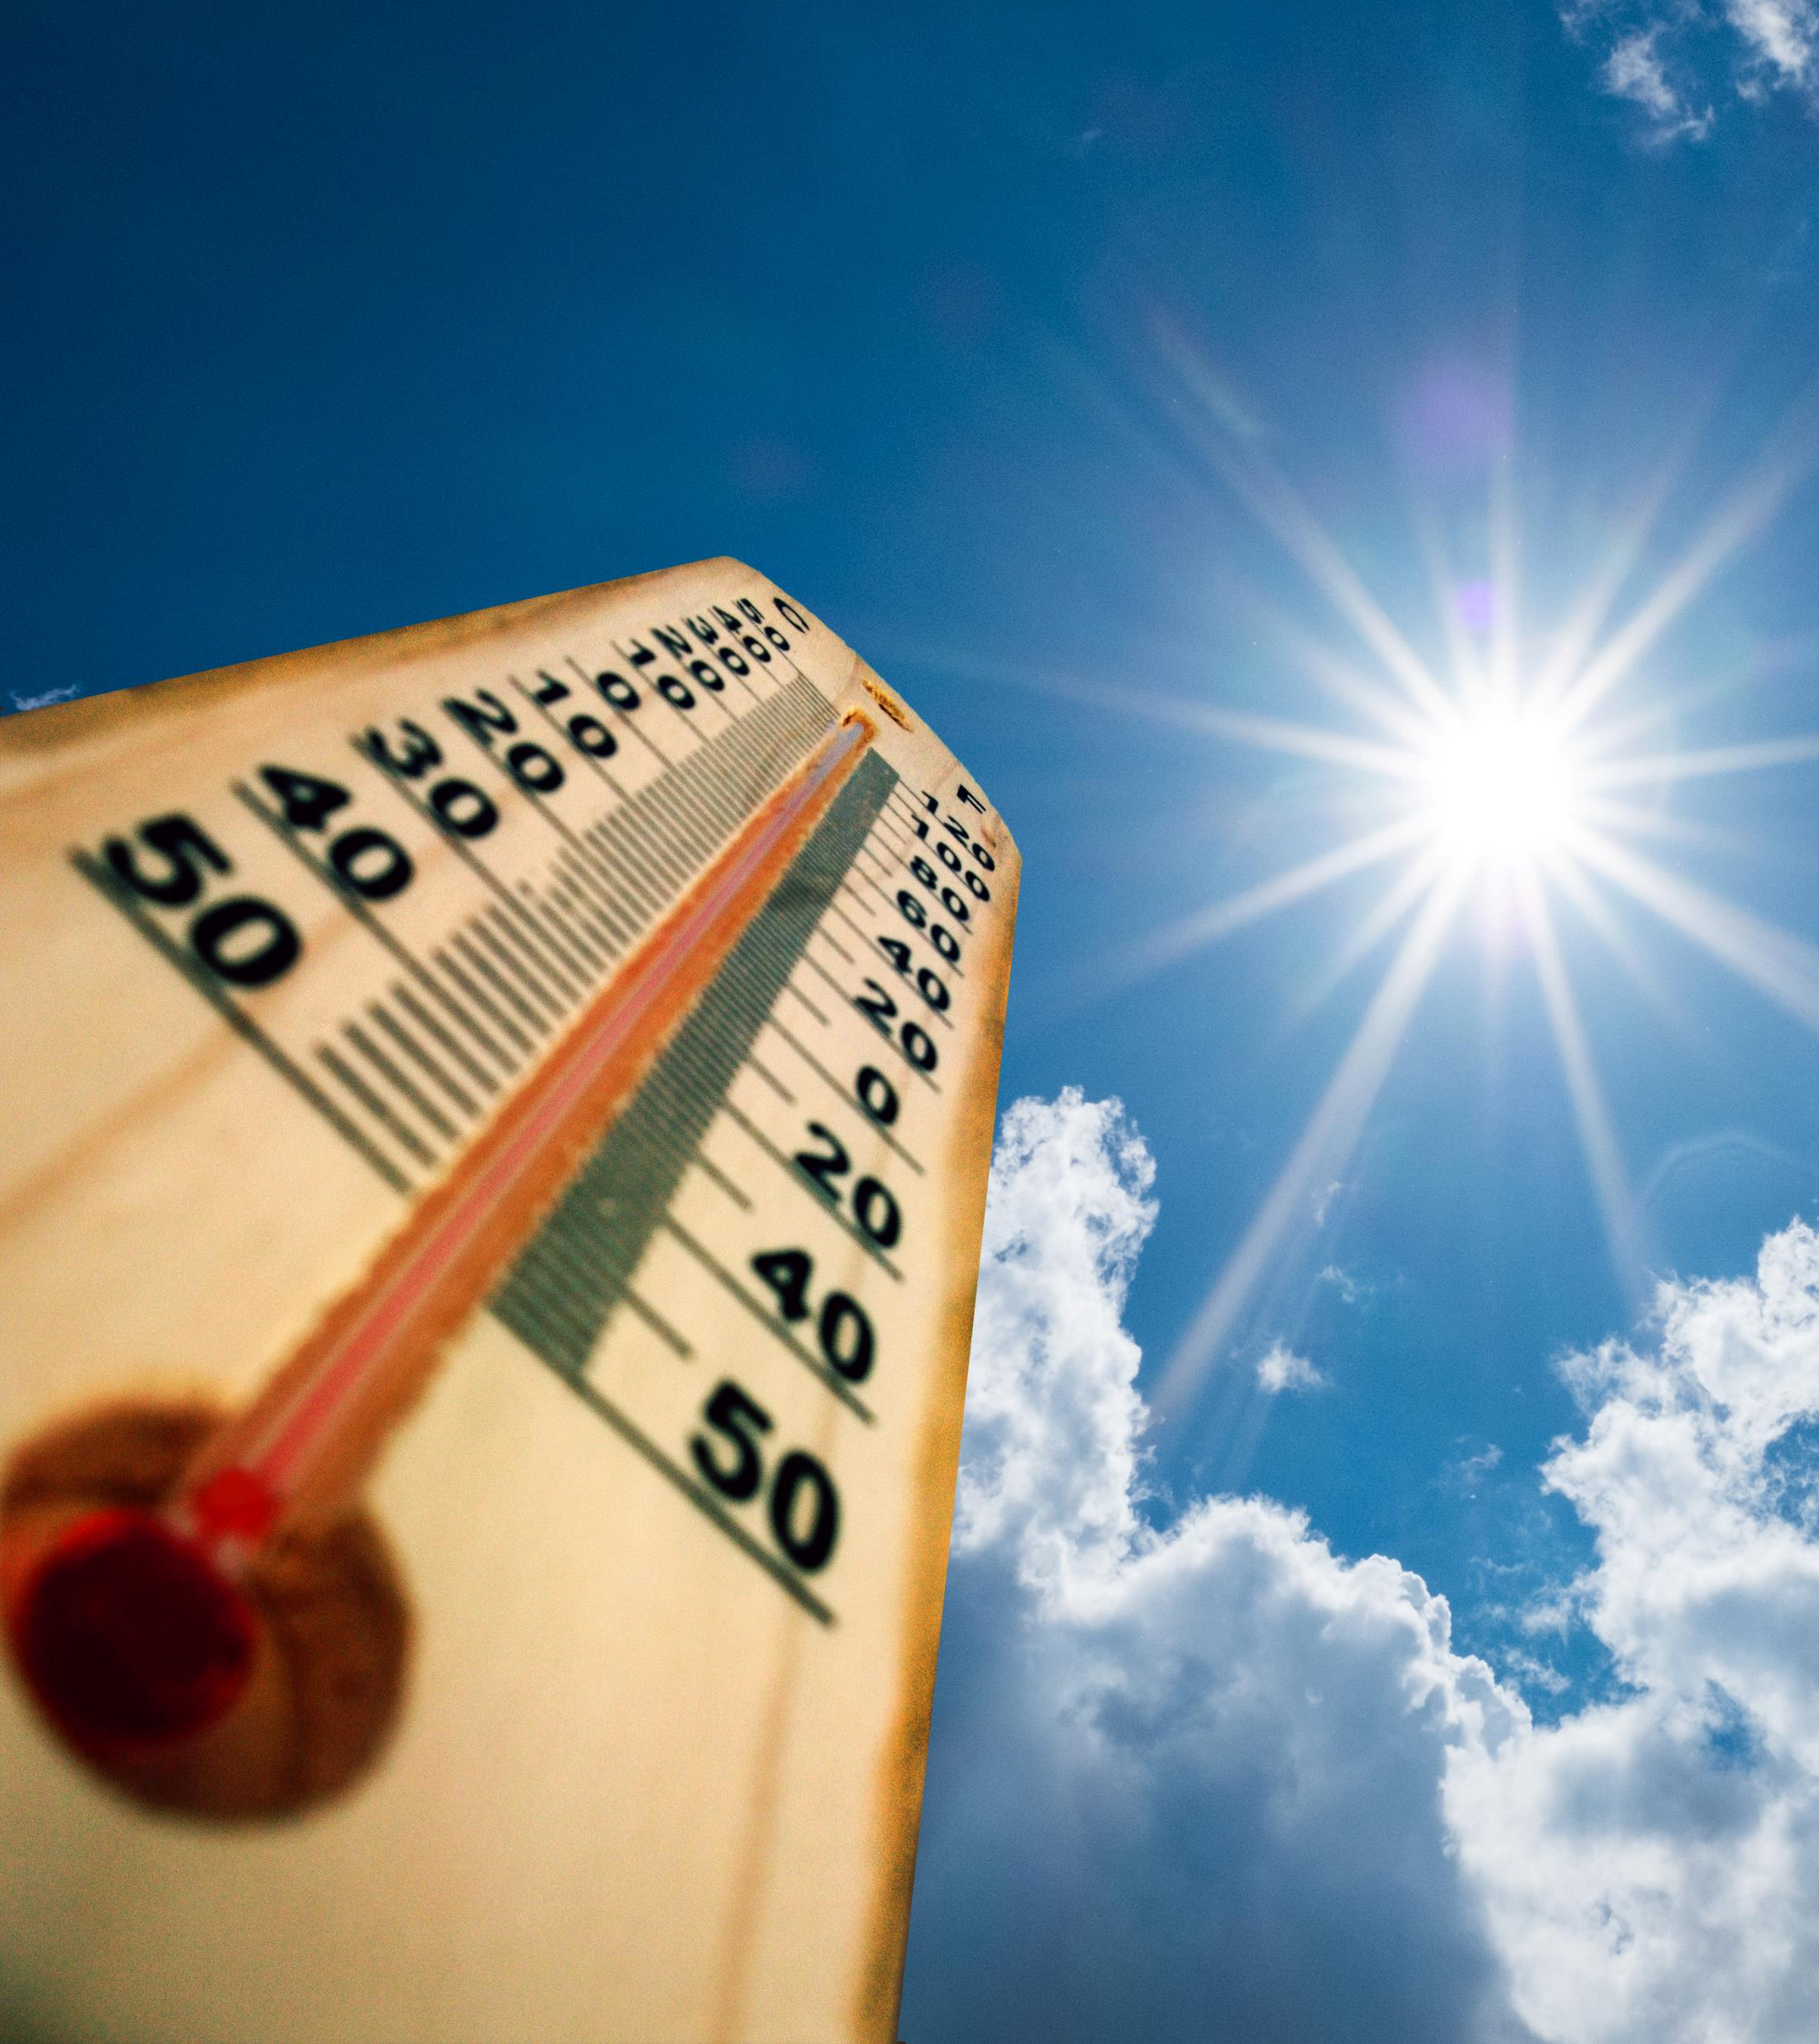
Extension
Here is a simple question with a difficult answer!
How is light made?

Slide 26
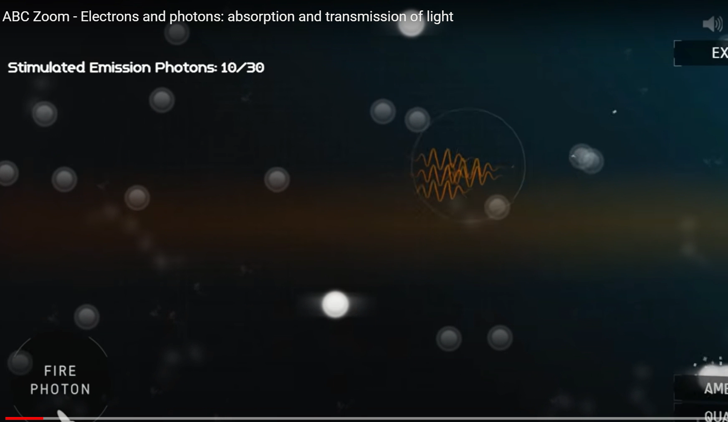
Only for the most curious!
https://www.youtube.com/watch?v=N9nWdNadklE

Slide 27
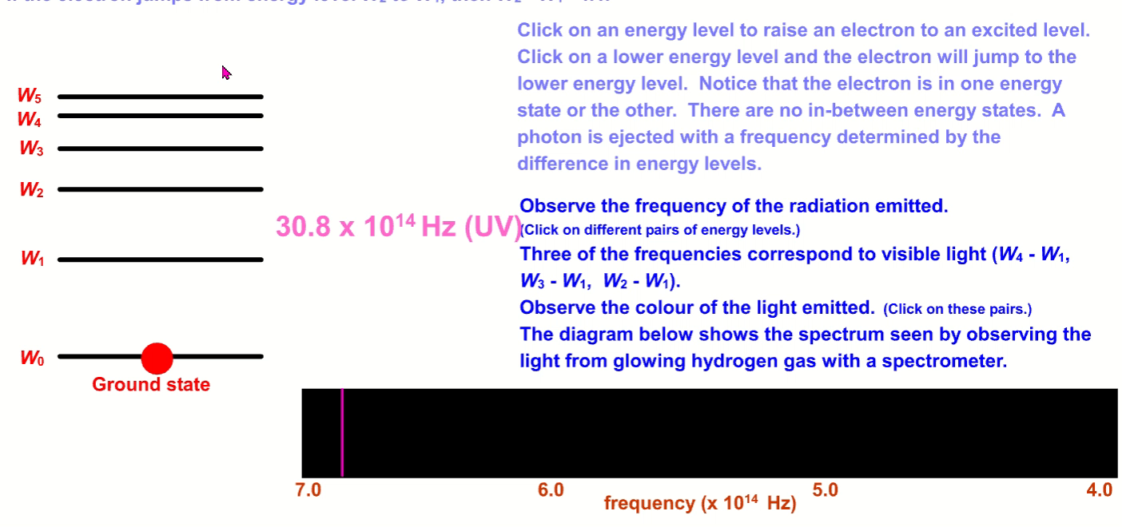
Yes things that burn or get hot give off light
Extension
only
But how?
When electrons drop from different energy levels in atoms they give off energy as packets of light

Slide 28
Colour Mixing
When people talk about PRIMARY COLOURS what do they mean?

Slide 29

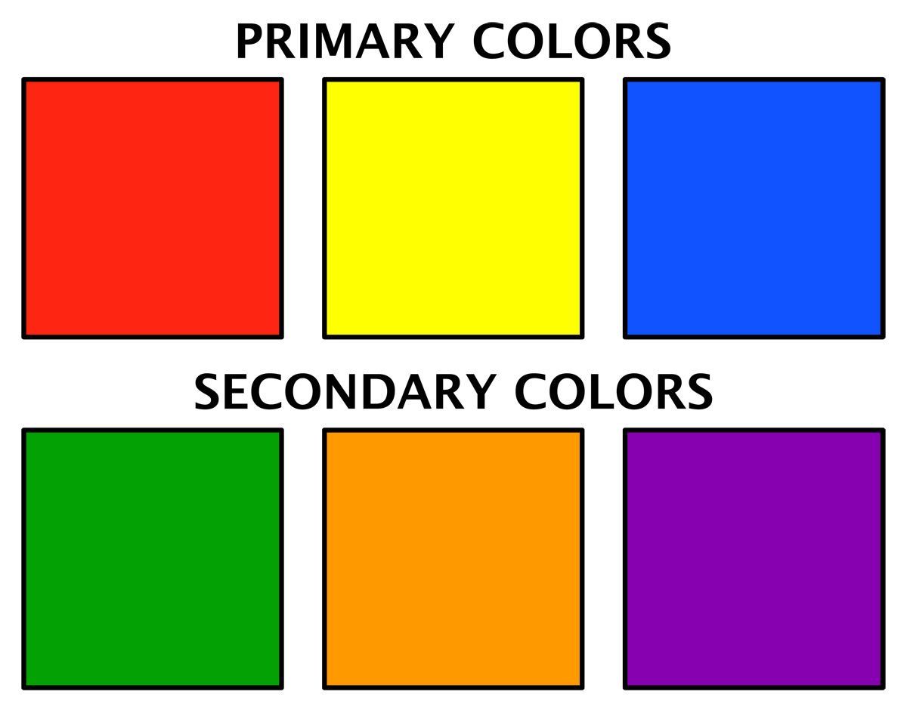
Who’s right?
….both
In Art you might have been taught that the primary colours are
RED, BLUE, and YELLOW
In Science it is different
the primary light colours are RED, BLUE, and …….

Slide 30


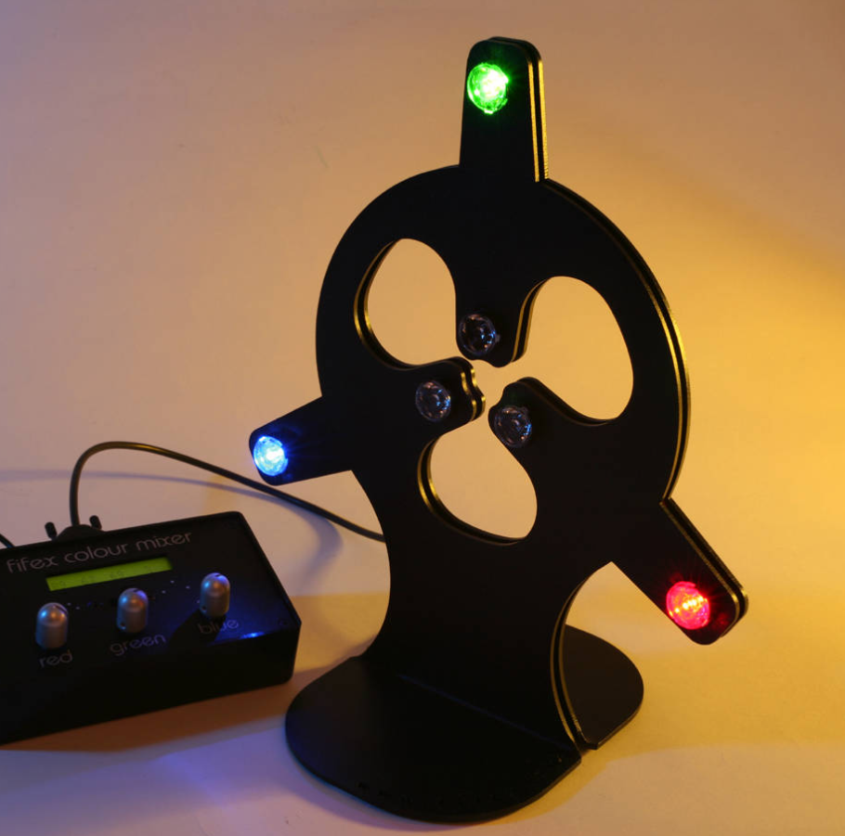
Your teacher has Set up the colour mixer

Slide 31
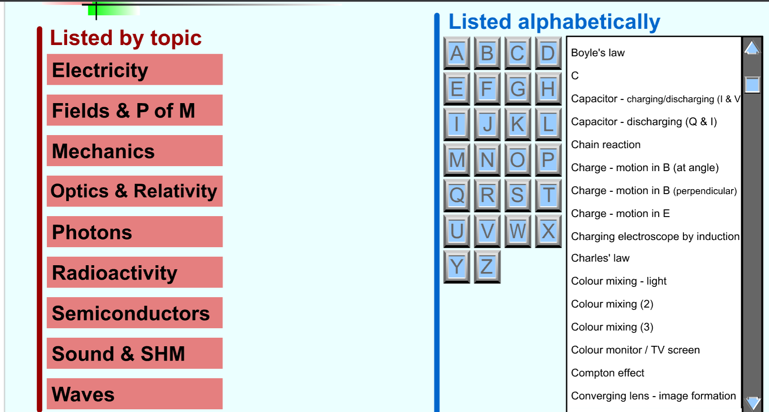
https://physicsflashrepo.cyou/flash/physics-2-15/physics-2-15.html

Slide 32

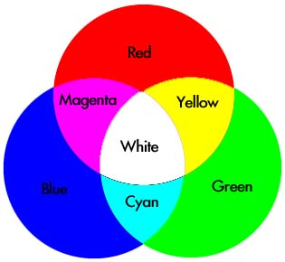
The Primary LIGHT Colours are
Red , Green, Blue
The secondary colours are
Magenta (mix Red & Blue)
Cyan (mix Blue & Green )
Yellow (mix Red & Green)
All the colours mixed make
WHITE LIGHT

Slide 33
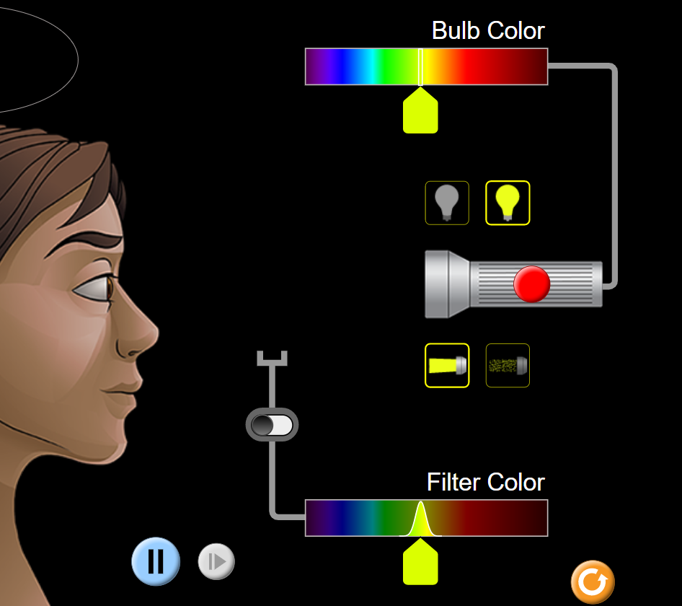
Colour Vision Simulator
https://phet.colorado.edu/sims/html/color-vision/latest/color-vision_en.html
Can you make the colour orange?
Can you make the colour tan?
Try to make the colour indigo

Slide 34
Colour Mixing
Extension
https://www.cyberphysics.co.uk/topics/light/colorAddition.html
Going further, colour subtraction
Why are the cartridges in a colour printer magenta, yellow and cyan?

Slide 35

Exit Pass
Exit Ticket
Record at least 2 primary light colours and at least 1 secondary light colour.
https://www.youtube.com/watch?v=-H8HjxGtoXw

Slide 36
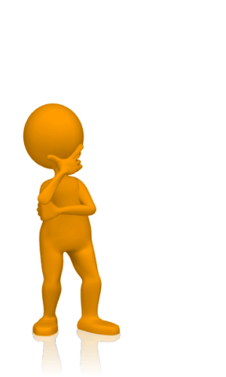
Lesson 3
Starter Questions
If 6 waves pass a point in 2s, CALCULATE the frequency of the waves?
If 6 waves pass a point in 2s, CALCULATE the period of the waves?
State the primary light colours
State what colours of light are needed to make the colour yellow
How do we make orange with light?

Slide 37

Lesson 3
By the end of this lesson I will
Complete a practical to find the link between the angle of incidence and the angle of reflection
State the principle of reversibility of a ray of light
Learn the terms, normal, incident ray, reflected ray, angle of incidence, angle of reflection
Know some properties of waves
Notes:
Where have you heard of the term reflection before

Slide 38
Reflection of Light
Mirror
Incident Ray
i
r
Reflected Ray
Normal
When light reflects off a mirror, we can study what happens to it. However, we need to understand some terms first of all.

Slide 39
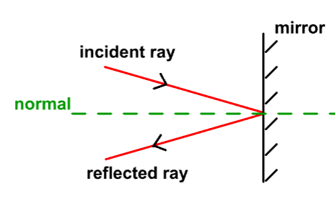
Wordbank
Normal: an imaginary line at right angles from a surface at the point where the incident ray strikes the mirror. All angles are measured from the normal
Incident ray: the incident ray is the beam of light that is being shone on to a mirror.
Reflected ray: is the beam of light that has bounced off a mirror.

Slide 40
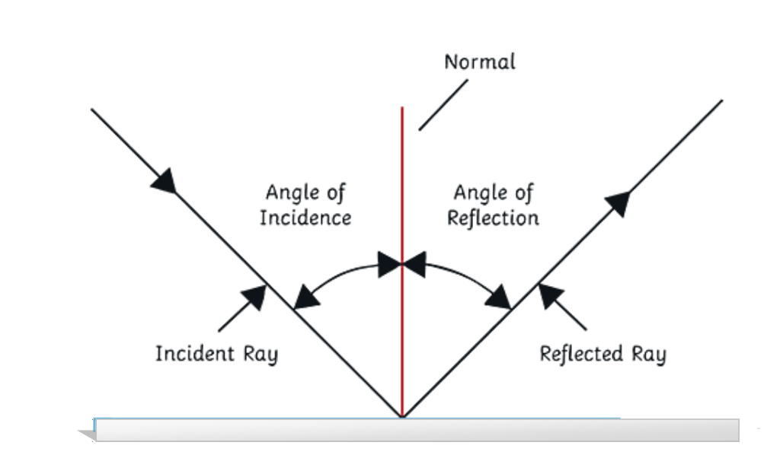
Wordbank (continued)
Angle of incidence: the angle measured from the normal to the incident ray
Reflected ray: the angle measured from the normal to the reflected ray.
All angles are measured from the normal

Slide 41
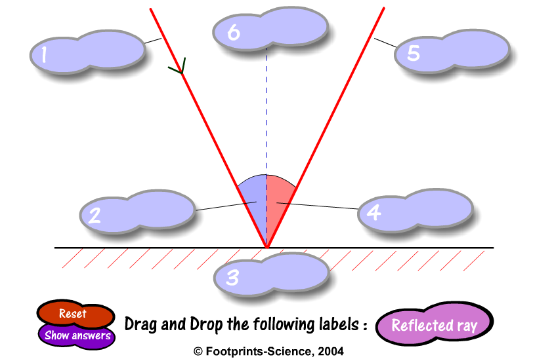
Reflection
Reflection

Slide 42
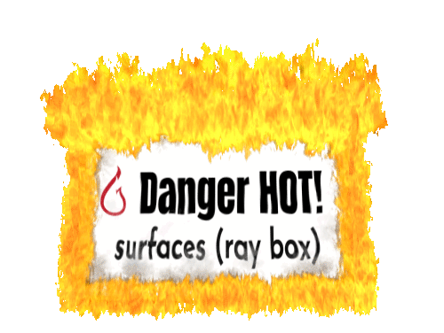
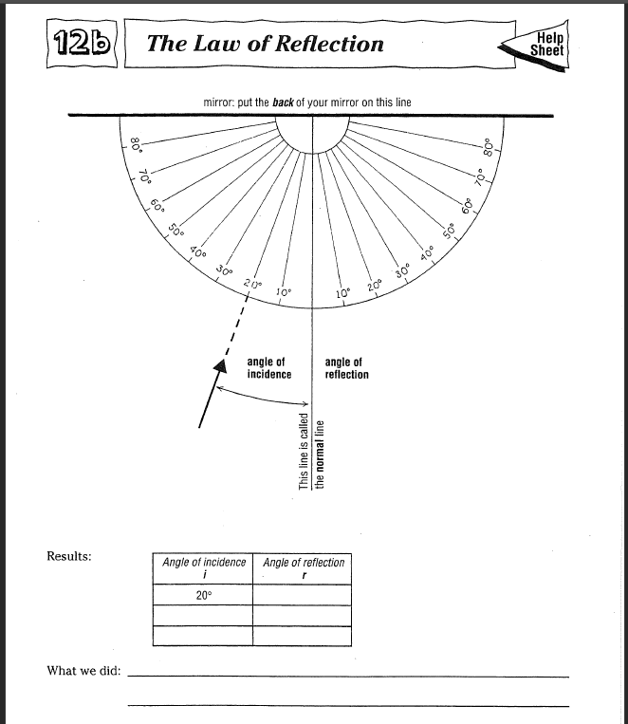
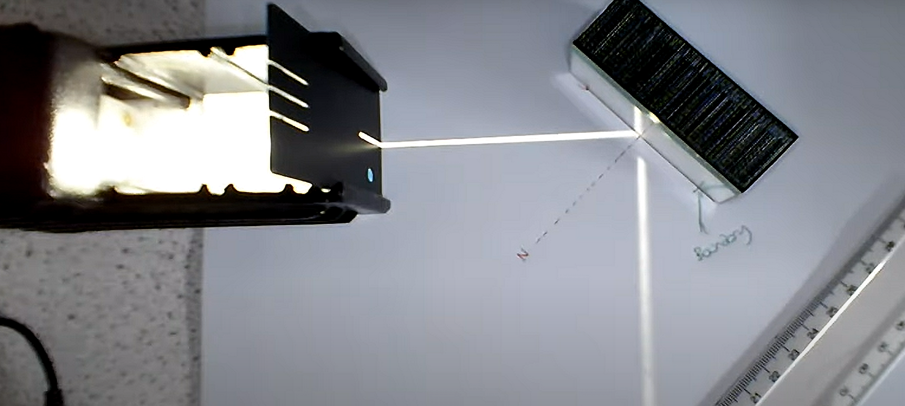
Reflection of Light
Collect a sheet (one each)
Set up the equipment as shown
Carefully hold the mirror along the line marked. You’ll need a friend to help you.
Shine a thin beam of light 10° from the normal,
Mark where it comes out (the reflected ray)
Move the box to the 20° line and mark where it comes out
Repeat for all angles
Repeat by shining the ray along the 10° angle of reflection line. What do you notice?
how the angle of incidence relates to the angle of reflection

Slide 43
Reflection of Light
Experiment
Write out a brief scientific report in your jotter. This guide should help you:
Aim: What are you trying to find out?
Method: How are you going to carry out the experiment? A labelled diagram is needed.
Hypothesis: What do you think will happen?
At this point, you are ready to start the experiment.
Results: A table of results and a graph is often required.
Conclusion: What did you find out? Was your hypothesis correct?

Slide 44
Conclusion
The angle of incidence ______________ the angle of reflection.
https://simpop.org/reflection/reflection.htm

Slide 45
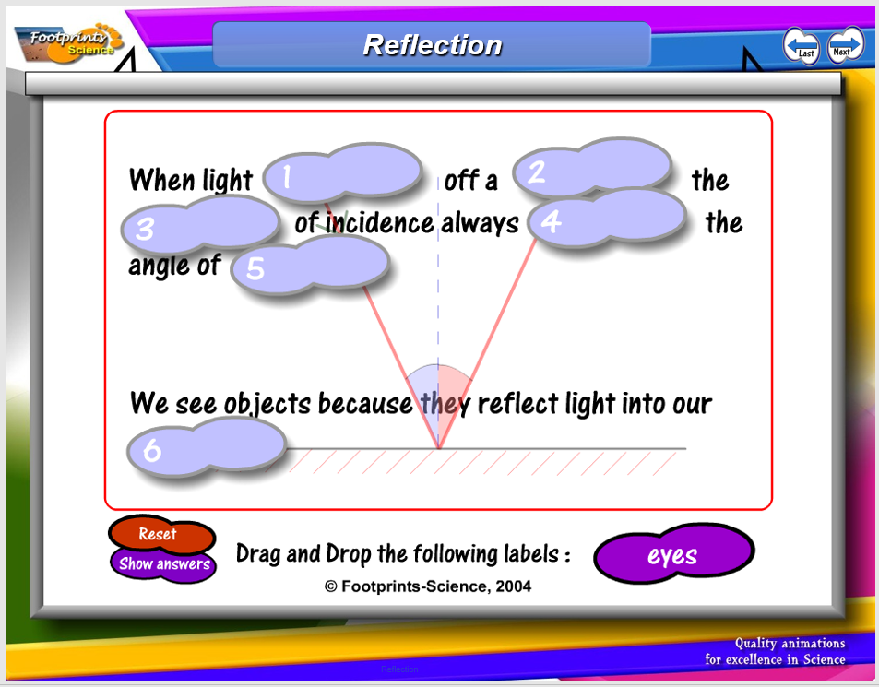
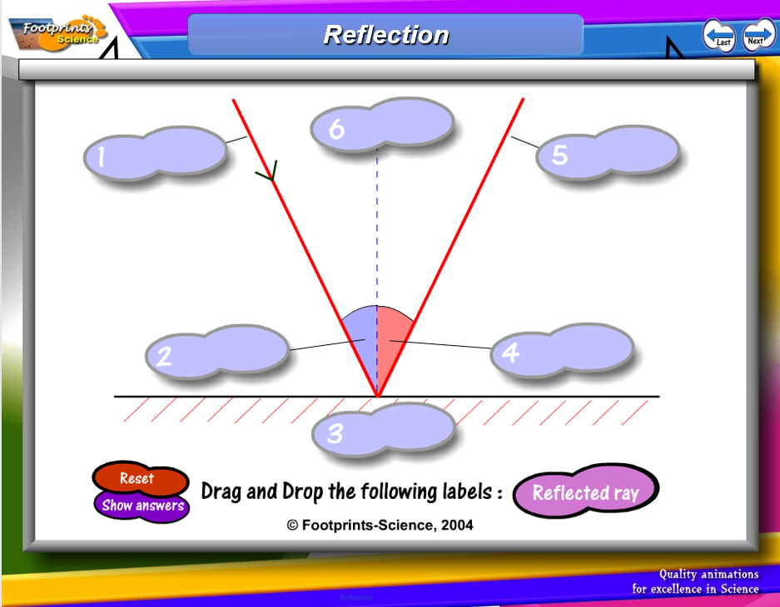
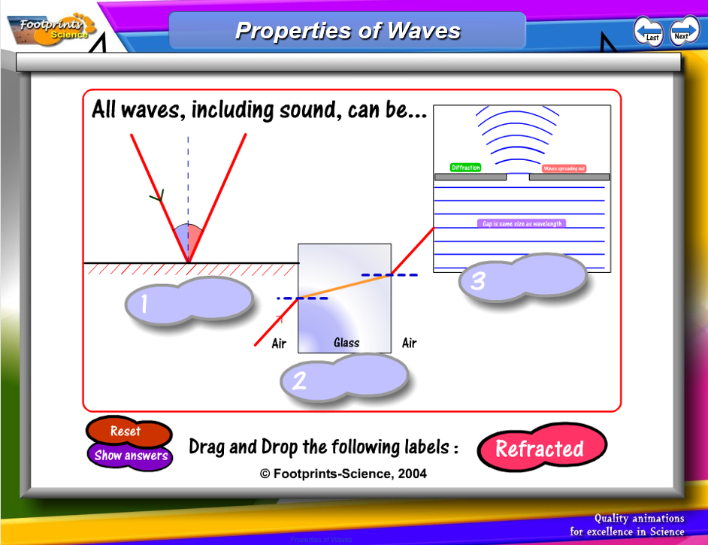
Footprint SCIENCE
There are some great examples of reflection in the footprint science students could try these
https://glowscotland.sharepoint.com/:p:/r/sites/LCKAS2Science/Shared%20Documents/General/CLASS%20RESOURCES/Footprints%20Science/Physical%20processes/Properties%20of%20Waves.pptm?d=w5901974f42a64d94ac93081a1104bcdd&csf=1&web=1&e=I1dSRA

Slide 46
Reflection of Light- homework
Experiment
Write out a brief scientific report in your jotter. This guide should help you:
Aim: What are you trying to find out?
Method: How are you going to carry out the experiment? A labelled diagram is needed.
Hypothesis: What do you think will happen?
At this point, you are ready to start the experiment.
Results: A table of results and a graph is often required.
Conclusion: What did you find out? Was your hypothesis correct?

Slide 47
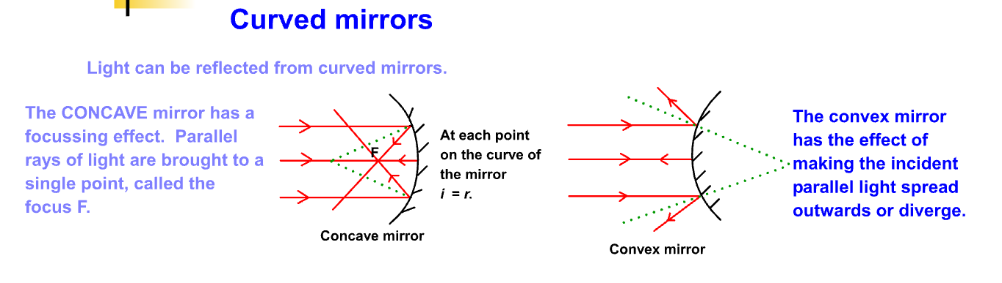
https://physicsflashrepo.cyou/flash/int2/int2-wavesandoptics.html
Repeat the reflection experiment using a concave and convex mirror, it is best if you use the three slits on the ray box slit, but you can use one and move the ray

Slide 48
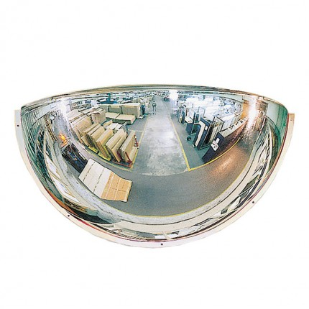
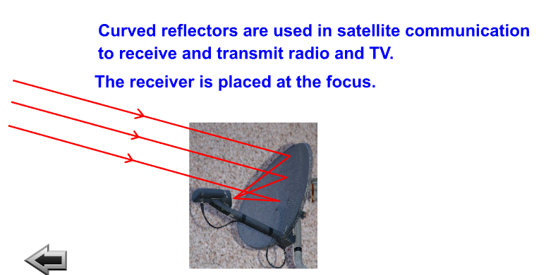
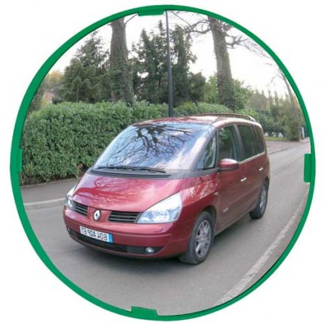

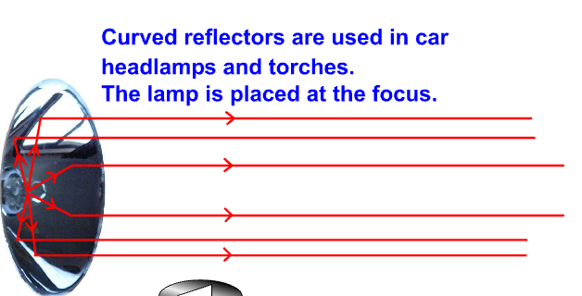
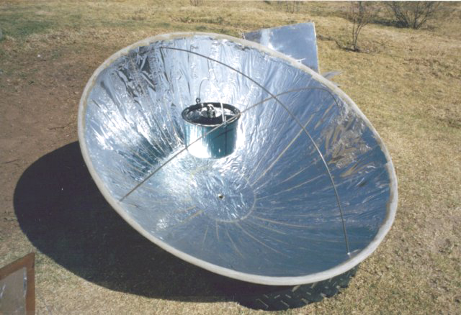
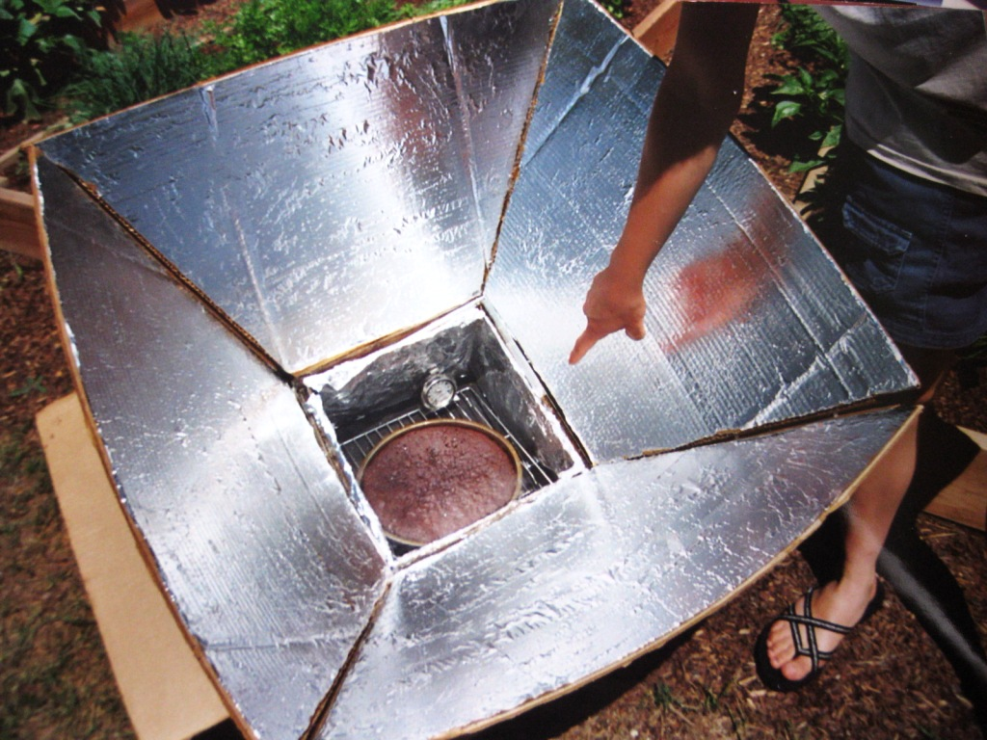
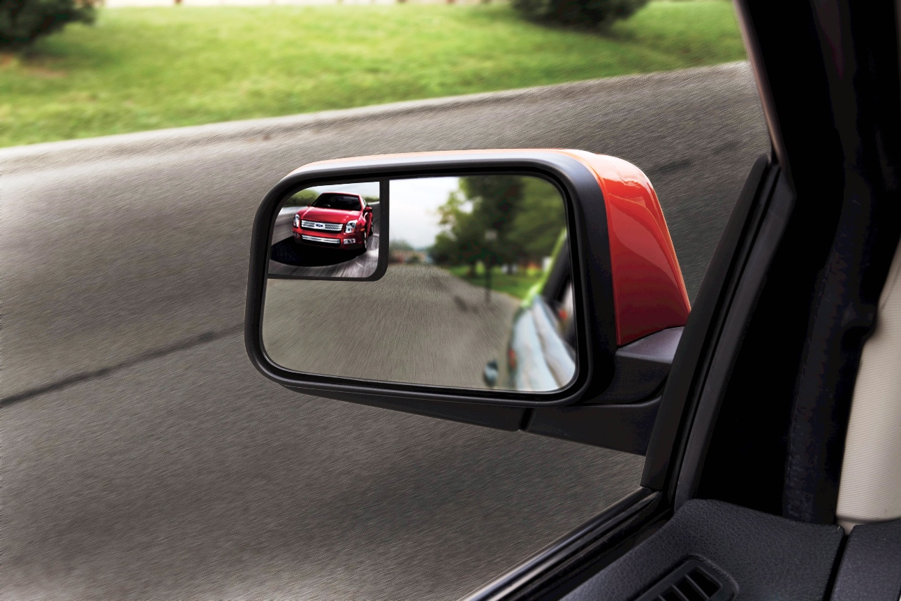
Uses of curved mirrors
Notes:
Security mirrors, to increase field of view, parking mirrors to see up and down a street, satellite dishes, torches and car headlights, additional wing mirrors to decrease the blind spot, inspection mirrors solar overs and solar cookers (we have a mini version, but the focus is not where the pot is) I have seen someone set a paper towel on fire using our solar cooker.

Slide 49

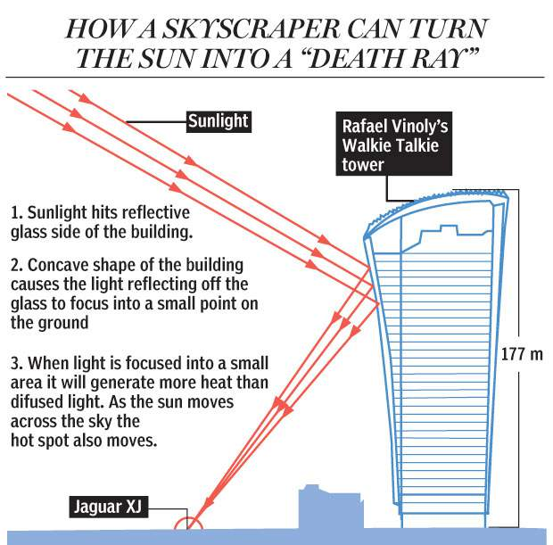
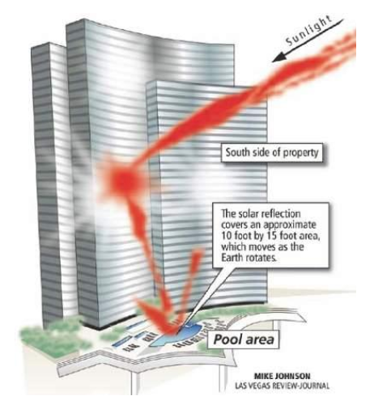
Extension
If you’ve time look up the walkie talkie building in London and find out what the architects ought to have thought about in the design.
Look up the Vdara hotel las vegas what should the architects have known?

Slide 50

Exit Pass
State the law of reflection
State from where all angles are measured.
State the meaning of the term angle of incidence
State the meaning of the term angle of reflection.
Why doesn’t light reflect off a black surface?
Or join in the song below!
https://www.youtube.com/watch?v=-H8HjxGtoXw

Slide 51
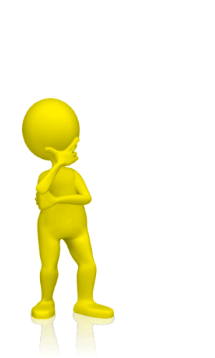
Starter Questions
Lesson 4
List the group of waves to which light belongs.
In which waves are the vibrations at right angles to the direction of travel.
State the meaning of the term “normal” with light
State the law of reflection.
State how angles are measured when using light.

Slide 52

Lesson 4
By the end of this lesson I will
Know the meaning of the term refraction.
Complete a practical to find how the angle of incidence and the angle of refraction change when entering a block
Know what happens to a ray of light as it enters and leaves a glass/ Perspex book.

Slide 53
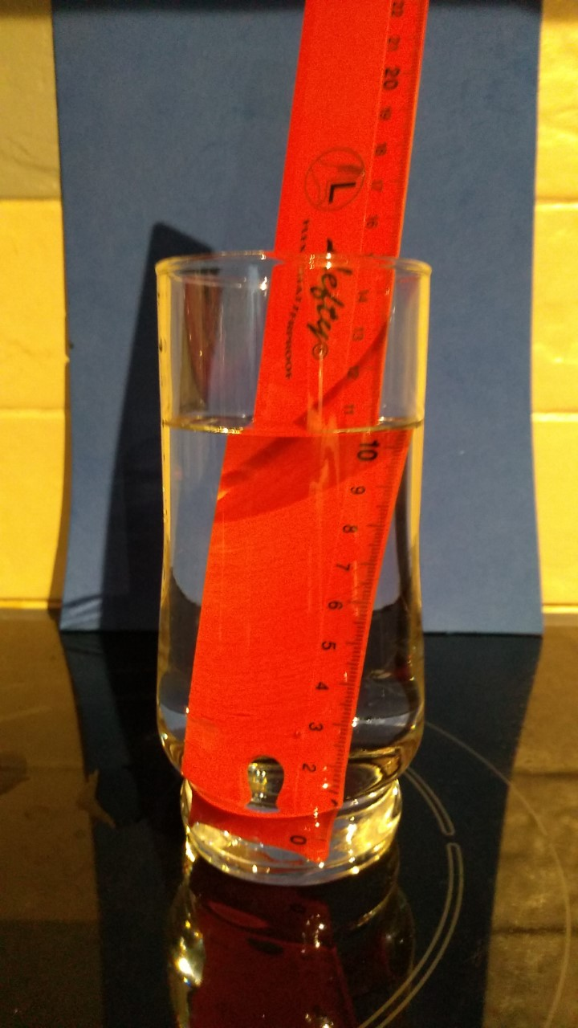
Why?
Notes:
Ask the students why the pencil/ ruler appears shifted. Do not use the term bends

Slide 54
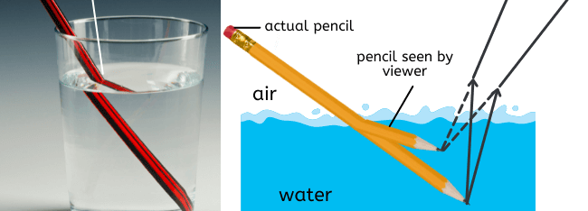
Refraction
Notes:
NB when you do a drawing the perceived image is DIRECTLY ABOVE THE ACTUAL OBJECT. MANY DIAGRAMS DO NOT SHOW THIS.

Slide 55
Refraction Definition
Refraction is a change in the speed and wavelength of a wave as it moves into a material of different optical densities and it can lead to a change in direction of the wave.

Slide 56
Refraction- definition
Never say the word BEND with REFRACTION, it is a change of direction
Refraction is the reduction in speed and wavelength as a wave moves into a more optically dense material. This often involves a change of direction. (frequency stays the same)
OR
Refraction is the increase in speed and wavelength as a wave moves into a less optically dense material. This often involves a change of direction. (frequency stays the same)

Slide 57
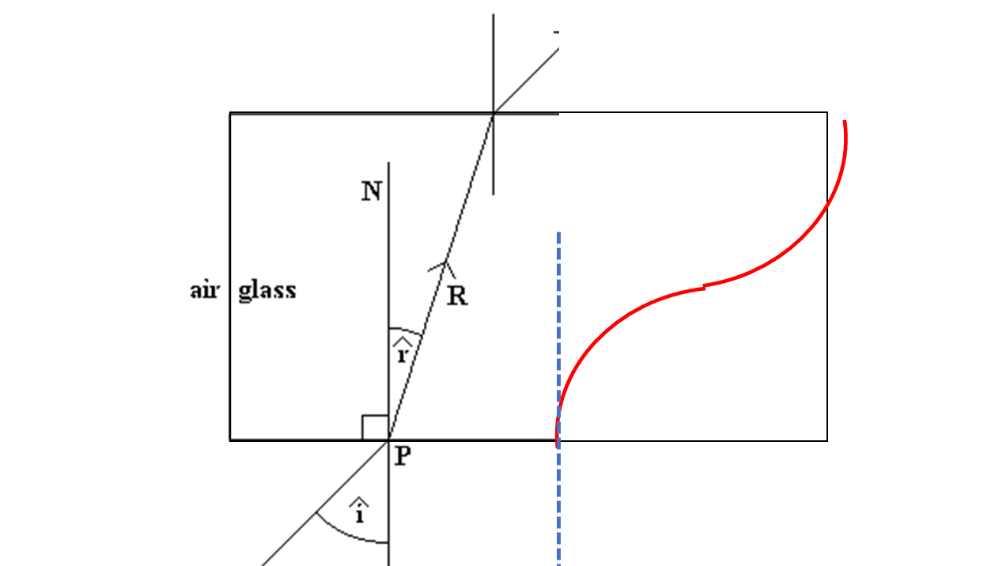
You’ll even see refraction and bending in text books!
Never say
Refraction is the bending  
This is bending
It refers to curving

Slide 58
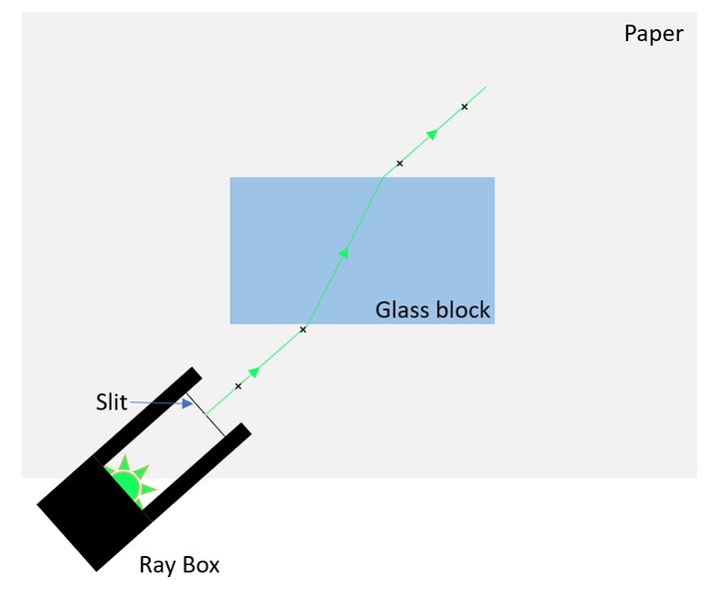
Experiment
Draw around a rectangular perspex block, using a pencil only.
Remove the block and draw on the normal 1/3 up from the bottom of the block, using a protractor.
Replace the block exactly on the line.
Shine a single ray into the block at the spot between the normal and surface.
Mark where the ray enters and exits.
Remove the block and join up the lines with a ruler. What do you notice?
normal

Slide 59

Lenses (NB singular is lens!!)
We will use thick and thin double convex and double concave lenses

Slide 60



Lenses
tip your jotter sideways, and draw around each lens, in pencil, on the left of side of each page. (not like in the picture!)
Draw around each of the 4 lenses,. The 4 lenses are fat and thin convex and fat and thin concave
Shine 3 rays from your raybox (the rays should come out parallel from the raybox)
Mark the rays going into the lens and coming out
The middle ray ought to go straight through without diverting

Slide 61








Uses of concave and convex lenses

Slide 62


A model to explain refraction
https://www.youtube.com/watch?v=gAtEiRIDyXg
Lockerbie academy video for the s1 the visible and beyond course.
https://www.youtube.com/watch?v=zarxpu43-ls but please point out it is not correct to say that the light is bent.

Slide 63

Extension
Find the focal length of a double convex lens, NB you must focus on a distant object and not the window.
Use a white screen rather than a wall to capture the image

Slide 64



Footprint SCIENCE
There are some great examples of reflection in the footprint science students could try these
https://glowscotland.sharepoint.com/:p:/r/sites/LCKAS2Science/Shared%20Documents/General/CLASS%20RESOURCES/Footprints%20Science/Physical%20processes/Properties%20of%20Waves.pptm?d=w5901974f42a64d94ac93081a1104bcdd&csf=1&web=1&e=I1dSRA

Slide 65

Exit PASS
Exit Ticket
Record the definition of refraction

Slide 66

Starter bingo
Lessons 5 & 6
Make a grid as shown, choose 9 words to put in the grid. Your teacher will give you some definitions, cross off the ones that the teacher describes and put your hand up when you get a row.
Longitudinal
transverse
Amplitude
Crest
Trough
Wavelength
Frequency
Period
Reflection
Convex
concave
Lens
Refraction
Angle of incidence
Angle of reflection
Angle of refraction
Normal
Incident ray
Reflected ray
Refracted ray
Primary light colours
Cyan
Magenta
Yellow
white

Slide 67
The EYE
Lesson 5
Learning intentions
Know how the eye changes in bright light
State the function of parts of the eye
Understand how we see
Label a diagram of the eye

Slide 68

BRAINPOP THE EYE
https://screencast-o-matic.com/watch/crVTbI976x

Slide 69


Slide 70

tear
Aqueous humour
Aqueous humour

Slide 71

Look at the model eye
Can you name the parts that you’ve marked on your diagram?

Slide 72

https://www.youtube.com/watch?v=2DVTgEvZBrA
https://www.youtube.com/watch?v=7lBtlGvS1Gc
(advanced explanation, for the very few)
https://www.youtube.com/watch?v=9OS-9pG1lT0
Nice simple explanation
https://www.youtube.com/watch?v=KoUyMuMVJQY
Seeing colour
https://www.youtube.com/watch?v=JDVVr6vEvbs
The best one but still talks about bending the light URGH!
https://www.youtube.com/watch?v=evQsOFQju08
Mind bending on colour perception
https://www.youtube.com/watch?v=af78RPi6ayE
Go and really learn with this Royal Institution Lecture

Slide 73


Slide 74
PARTS of the Eye and their function
What makes up an eye
FUNCTION |  | PART
a light sensitive layer that lines the interior of the eye. It is composed of light sensitive cells known as rods and cones. |  | cone cells
the circular opening in the centre of the iris through which light passes into the lens of the eye. |  | cornea
a small indentation at the centre of the macula and is the area with the greatest concentration of cone cells. |  | fovea
a transparent structure situated behind your pupil. It is enclosed in a thin transparent capsule and helps to refract incoming light and focus it onto the retina. |  | iris
a yellow spot on the retina at the back of the eye which surrounds the fovea. |  | lens
one of the two types of light-sensitive cells in the retina of the eye and used in dim light |  | macula
regulates the amount of light that enters your eye. |  | optic nerve
the second type of light sensitive cells in the retina of the eye. It is thought that there are three types of cones, each sensitive to the wavelength of a different primary colour – red, green or blue. |  | pupil
the transparent circular part of the front of the eyeball. It refracts the light entering the eye onto the lens |  | retina
the white part of the eye, a tough covering with which the cornea forms the external protective coat of the eye. |  | rod cells
where the signals leaves the eye transfers all the visual information to the brain. |  | sclera
Match up the function and PART

Slide 75
What makes up an eye
a light sensitive layer that lines the interior of the eye. It is composed of light sensitive cells known as rods and cones. | retina
the circular opening in the centre of the iris through which light passes into the lens of the eye. | pupil
a small indentation at the centre of the macula and is the area with the greatest concentration of cone cells. | fovea
a transparent structure situated behind your pupil. It is enclosed in a thin transparent capsule and helps to refract incoming light and focus it onto the retina. | lens
a yellow spot on the retina at the back of the eye which surrounds the fovea. | macula
a type of light-sensitive cells in the retina of the eye and used in dim light | rod cells
regulates the amount of light that enters your eye. | iris
A type of light sensitive cells in the retina of the eye. It is thought that there are three types of cones, each sensitive to the wavelength of a different primary colour – red, green or blue. | cone cells
the transparent circular part of the front of the eyeball. It refracts the light entering the eye onto the lens | cornea
the white part of the eye, a tough covering with which the cornea forms the external protective coat of the eye. | sclera
where the signals leave the eye transferring the visual information to the brain. | optic nerve

Slide 76


Eye dissection
Cut away the fat around the eye. Can you see the optic nerve at the back?
Cut around the middle of the eye (the sclera) until you have two halves, liquid vitreous humour will seep out. Remove this and look at the consistency.
Take out the lens and see what this is like on a piece of writing (use laminated sheets). It ought to magnify the writing.
Carefully remove the iris and notice the shape and size of the iris and pupil
Cut the cornea (the transparent covering at the front of the eye) and some liquid, called the aqueous humour, will come out.
Check out the retina, can you see the layers? Can you spot the fovea?
Notes:
15 minute timer.

Slide 77


Constricted

Slide 78
Dilated

Slide 79

Checking your blind spot
To do and notice
Hold the card at eye level about an arm’s length away. Make sure that the cross is on the right.
Close your right eye and look directly at the cross with your left eye. Notice that you can also see the dot.
Focus on the cross, but be aware of the dot as you slowly bring the card toward your face. The dot will disappear, and then reappear, as you bring the card toward your face. Try moving the card closer and farther to pinpoint exactly where this happens.
Now close your left eye and look directly at the dot with your right eye. This time the cross will disappear and reappear as you bring the card slowly toward your face.
Try the activity again, this time rotating the card so that the dot and cross are not directly across from each other. Are the results the same?

Slide 80

Sama is walking along an unlit street at night. A car comes round the corner, 200 m away, with its headlights on.
Explain, in detail, how Sama’s eyes will react as the car drives directly towards her.
Notes:
6 minutes (mark a minute).

Slide 81
EYE bingo
Lesson 6
Make a grid as shown, choose 9 words to put in the grid. Your teacher will give you some definitions, cross off the ones that the teacher describes and put your hand up when you get a row.
Retina
Sclera
Fovea
Cornea
Iris
Pupil
Lens
Optic nerve
Tear duct
Aqueous humour
Vitreous humour
Eyelid
Eye brow
Ciliary muscle
brain

Slide 82

Colour perception/ persistence and the eye
For each of the next few slides
Record the colour of the dot, they will appear in the order RED, BLUE, GREEN
Stare and focus on the dot for the full 30 seconds
When the blank slide pops up, record what you appear to see on the screen (note the colour)
This is why it is important not to stare at screens on the sun for long periods
This is occurring as you have “overloaded” your sense cells and the signals are still being sent to the brain, even though the image is no longer there.

Slide 91

If you follow the pink dot moving, the dots will remain pink, but if you stare at the plus sign in the centre, the rotating dot will turn green. That's cool, but now try this... focus on the plus sign in the centre for a short period and all the pink dots will disappear and all you will see is the green dot going around! cool huh?

Slide 92

Why do we have 2 eyes?
In pairs
Place a plastic beaker on the desk
Student one move to the far side of the classroom and cover one eye
The other student extend their arm with an eraser or coin
Get student one to direct the person until their arm is directly over the beaker. (Their arm should be at least 60 cm above the cup or it wont work)
When student one thinks student 2’s arm is directly above the cup they can say drop.
Does the eraser fall into the cup?
Repeat covering the other eye, and then
repeat with both eyes open
Why do we have 2 eyes?
Notes:
It is important that the student with arms extended raise their arms well above the cup or the student can pop the coin into the cup every time. What you ought to find it that the line is correct but the depth is often a little off.

Slide 93

Peripheral Vision
Extend your arms and raise your index finger
Move your arms around in front of your body and notice where you can see your index finger pointing up.
Where is your field of vision?
Repeat this with one eye closed
Repeat with the other eye closed?
Are you surprised how your field of vision changes with one eye closed?

Slide 94


Put your finger in front of your nose and focus on your finger. The focus on a distant object out of the window. Why does your vision blur for a second or so?
Accommodation
When objects are near, the lens needs to be thicker
The ciliary muscles contract which loosens the suspensory ligaments
The more rounded lens enables light to focus correctly on the retina
When objects are far, the lens needs to be thinner
The ciliary muscles relax which tightens the suspensory ligaments
The less rounded lens enables light to focus correctly on the retina

Slide 95
For anyone not wishing to do the dissection:
Watch the video https://www.youtube.com/watch?v=YcedXDN6a88
Or complete the following worksheet

Slide 96
Sense organs
Sense Organs
The brain can only understand electrical impulses
Receptors in the eyes change light into electrical impulses
Receptors in the ears change sound into electrical impulses
The iris can change the size of the pupil depending on light intensity

Slide 97




FOOTPRINT SCIENCE
There are some great examples of reflection in the footprint science students could try these
https://glowscotland.sharepoint.com/:p:/r/sites/LCKAS2Science/Shared%20Documents/General/CLASS%20RESOURCES/Footprints%20Science/Life%20Processes%20and%20Living%20Things/Sense%20Organs.ppt?d=w3b711d4f3f734cc4a006817c0b127fa5&csf=1&web=1&e=0s1QuM

Slide 98
Homework research task
Further work
Find out and write about one or two the following:
(a) animals and insects eyes
(b) playing sport with only one eye
(c) eye make up
(d) eye protection in work
(e) perspective in art
(f) Braille and problems for the blind
(g) communicating with our eyes

Slide 99

Exit Pass
Exit Ticket
State 2 parts of the eye and give their function

Slide 100
EYE bingo
Lesson 7
Make a grid as shown, choose 9 words to put in the grid. Your teacher will give you some definitions, cross off the ones that the teacher describes and put your hand up when you get a row.
Retina
Sclera
Fovea
Cornea
Iris
Pupil
Lens
Optic nerve
Tear duct
Aqueous humour
Vitreous humour
Eyelid
Eye brow
Ciliary muscle
brain

Slide 101

Eye defects
Lesson 7
Find out about some eye defects, long and short sight (hyperopia and myopia)
Find out about colour deficiency (colour blindness)
Correct long and short sight
Test your sight for colour-blindness

Slide 102

refract
refraction

Slide 103

Short-sightedness/ myopia
https://www.nhs.uk/conditions/short-sightedness/
https://www.youtube.com/watch?v=2DVTgEvZBrA Tim & Moby
is a common vision condition in which you can see objects near to you clearly, but objects farther away are blurry. it occurs when the shape of your eye causes light rays to refract incorrectly, focusing images in front of your retina instead of on your retina

Slide 104

long-sightedness/ hyperopia
https://www.youtube.com/watch?v=2DVTgEvZBrA
Long-sighted (hyperopia) is a common vision condition in which you can see distant objects clearly, but objects nearby may be blurry.
https://www.mayoclinic.org/diseases-conditions/farsightedness/symptoms-causes/syc-20372495

Slide 105


Colour deficiency
Use the Ishihara plates to see if you are colour deficient
https://www.hopkinsallchildrens.org/Patients-Families/Health-Library/HealthDocNew/What-It-s-Like-to-Be-Color-Blind
https://www.verywellhealth.com/what-do-color-blind-people-see-5092522

Slide 106

Reference https://www.colourblindawareness.org/colour-blindness/
Over a double page spread research and find out about colour blindness/deficiency
Types of colour-blindness | Causes of colour-blindness
Living with colour-blindness | Misconceptions

Slide 107
Extension Challenge
Use your knowledge of lenses and the eye to complete the eye ray diagrams worksheet.
15 minutes
Stretch: As we get older the lens of our eye stiffens and the ciliary muscles can become weaker. Explain the effect this would have and suggest a way to solve it.
Notes:
Stretch and support versions of the worksheet (9 red and orange to complete support, 8 green to complete stretch).

Slide 108

Exit Pass
Exit Ticket
State 2 of the 3 types of eye defect and how they can be corrected

Slide 109

Let’s start with a song to set the scene!
https://www.youtube.com/watch?v=bjOGNVH3D4Y
Before we do work on the EM Spectrum we need to find out more about WAVES

Slide 110

Starter thinkers
Draw a diagram of a transverse wave and label as much as you can
State the function of the iris in the eye
State one form of eye defect
List the colours in a rainbow!

Slide 111
THE REST OF THE BLOCK IS IN THE NEXT POWER POINT ELECTOMAGNETIC SPECTRUM
The electromagnetic spectrum!

Slide 112

Exit Pass
Exit Ticket
Write down 10 words from this topic and give 1 meaning

