Slide 1


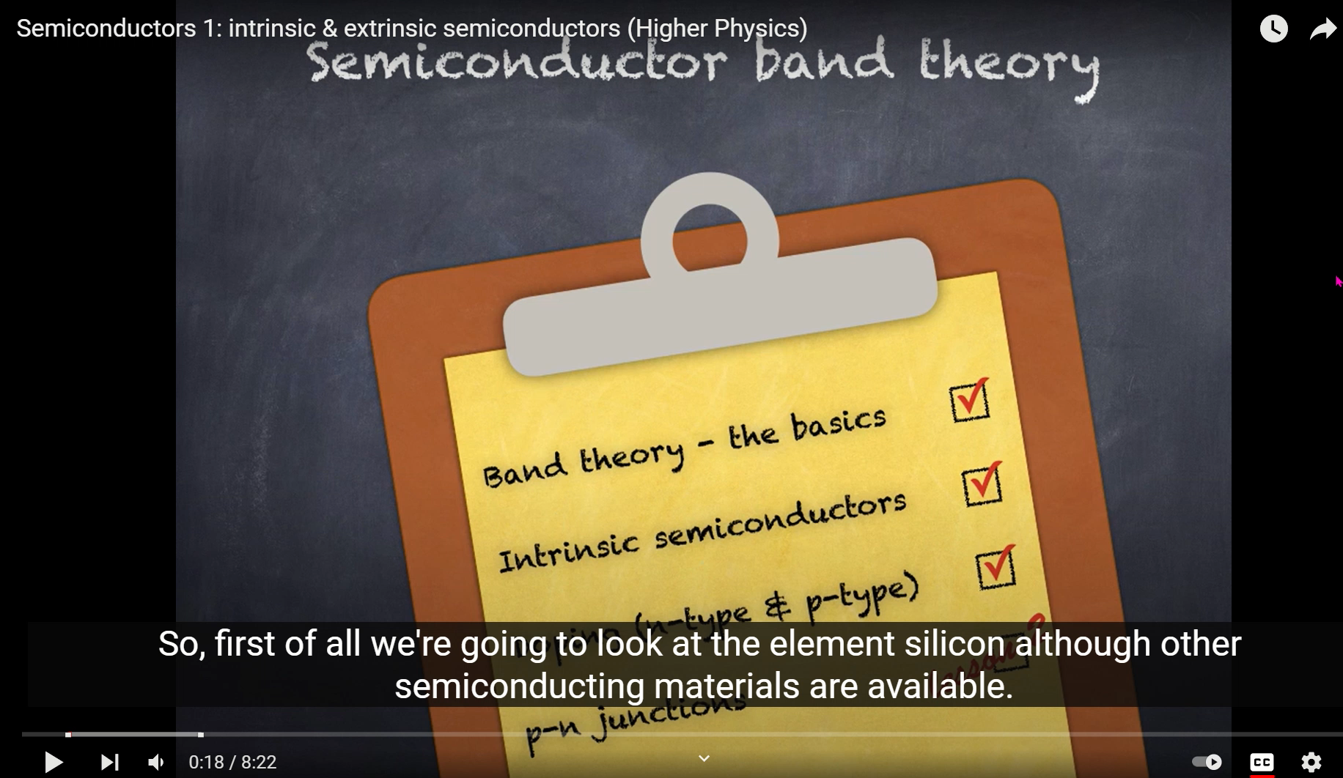




Slide 2

Outline
Conductors, insulators, and semiconductors: a basic introduction.
Energy bands: what are they, and where do they come from?

Slide 3
Photoelectric effect: reminder
incident
light
Shine light of frequency f onto the surface of a metal.
For f < f_{thresh}, nothing happens.
For f > f_{thresh}, electrons are emitted.
ejected
electron

Slide 4
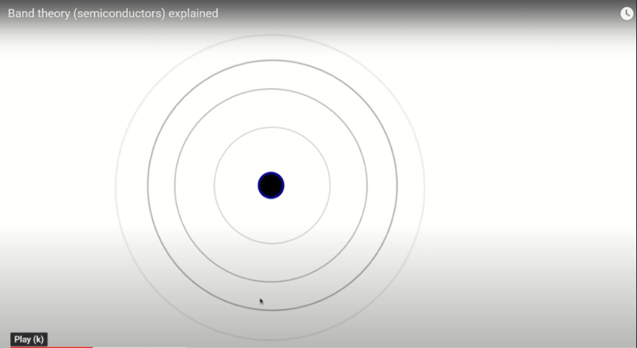
https://youtu.be/zdmEaXnB-5Q
A little over-simplified, but more understandable

Slide 5
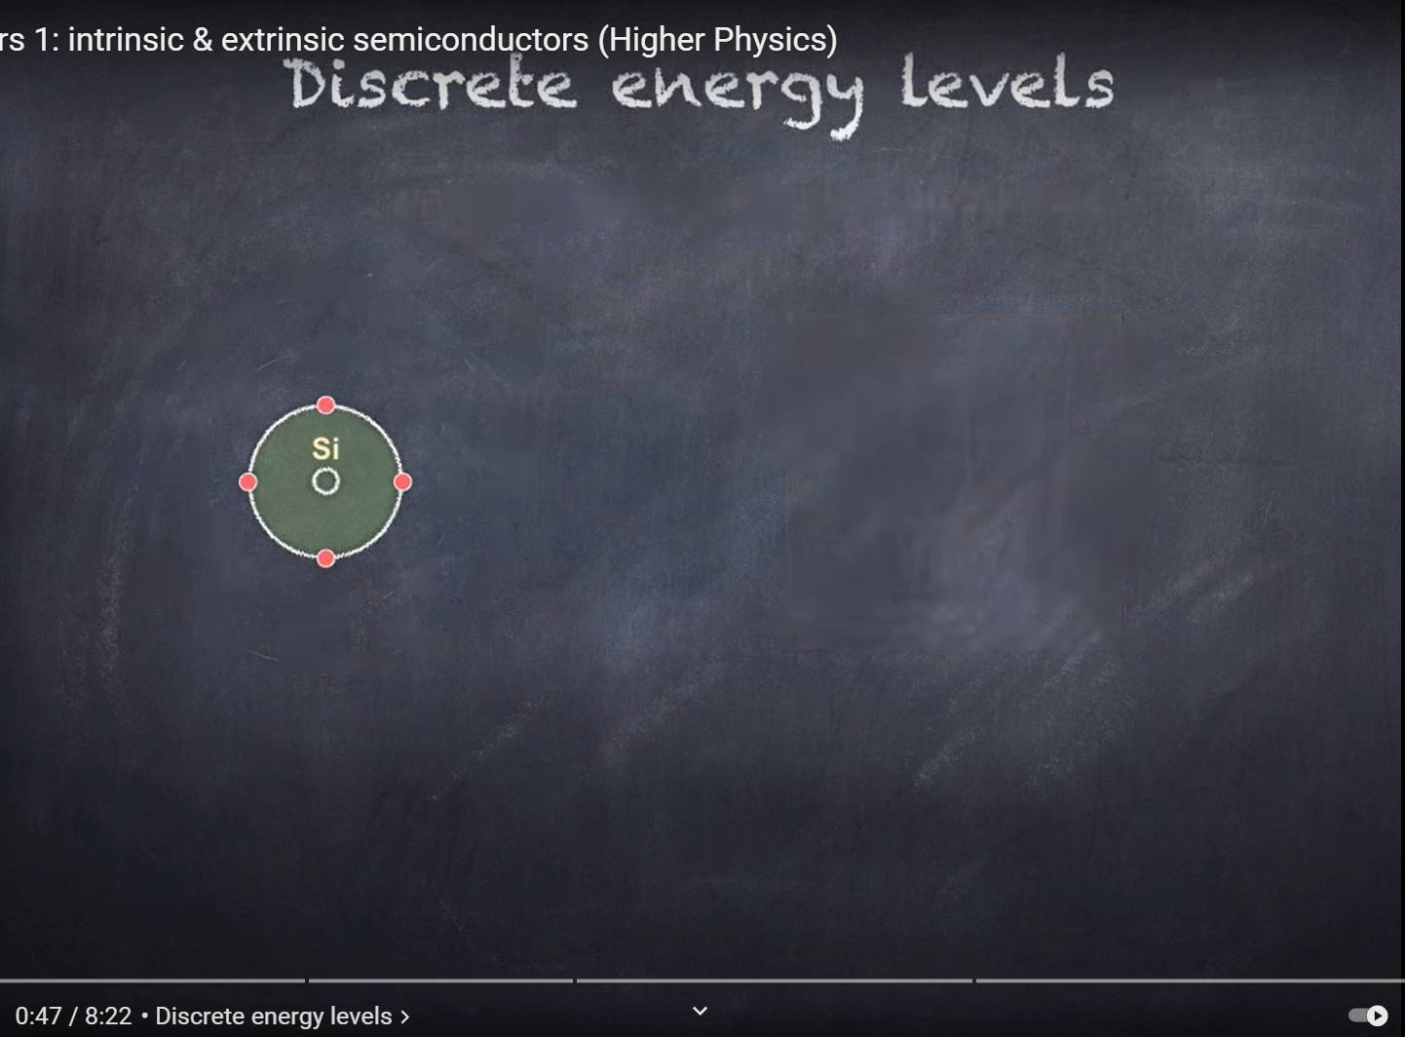
This is the simplified level required for Higher.

Slide 6
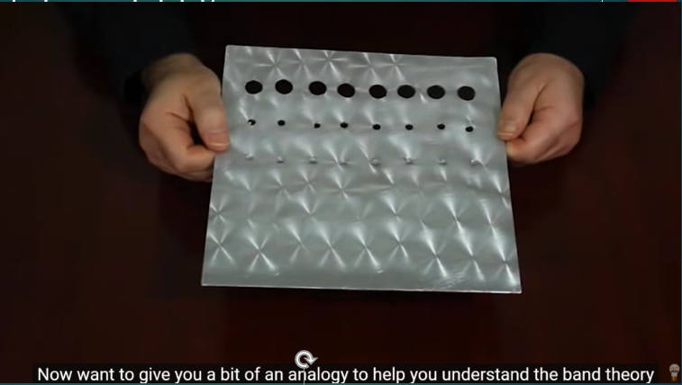
https://youtu.be/zdmEaXnB-5Q?t=427

Slide 7
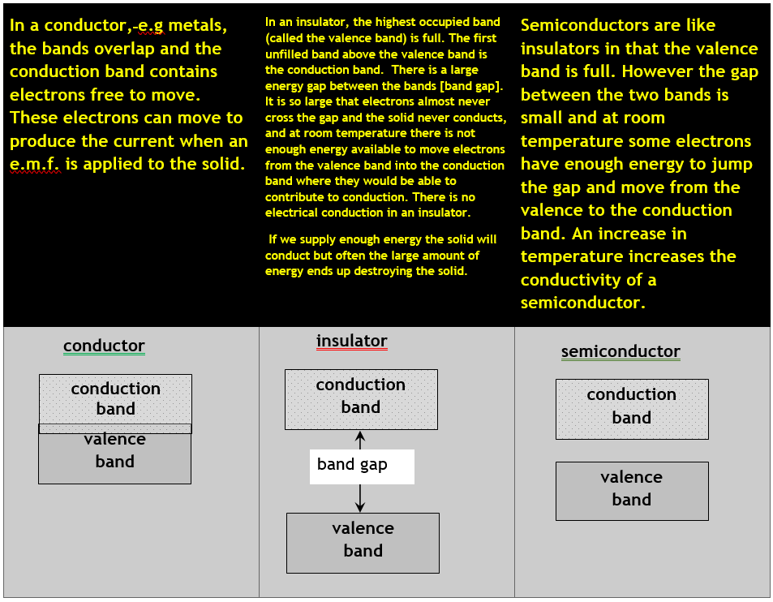
Summary

