Slide 1
Teacher Instructions:
As a whole class or in groups, split into two teams – red and blue
Red team has to claim hexagons to get across the board from top to bottom
Blue team has to claim hexagons to get across the board from left to right
All teams work on an answer as if the playing team gets it wrong, the other team can steal
Teams can choose hexagons to block opposing team
To play:
Teams take turns to select a hexagon by letter
Clicking on this takes you to the corresponding question
Clicking on the answer once displays the answer
Click again and you are returned to the game board where you can select the winning team colour
Continue with next team selecting a hexagon until one team has crossed the board.
Clicking on the winning team’s coloured star will light up the board.

Slide 2
B
L
O
C
K
E
U
I
G
F
L
S
T
J
C
W
Y
D
E
M
R
T
O
R
S

Slide 3
H
A
Q
S
F
E
L
I
G
N
U
P
B
Z
C
W
Y
D
V
M
R
T
O
X
K

Slide 4
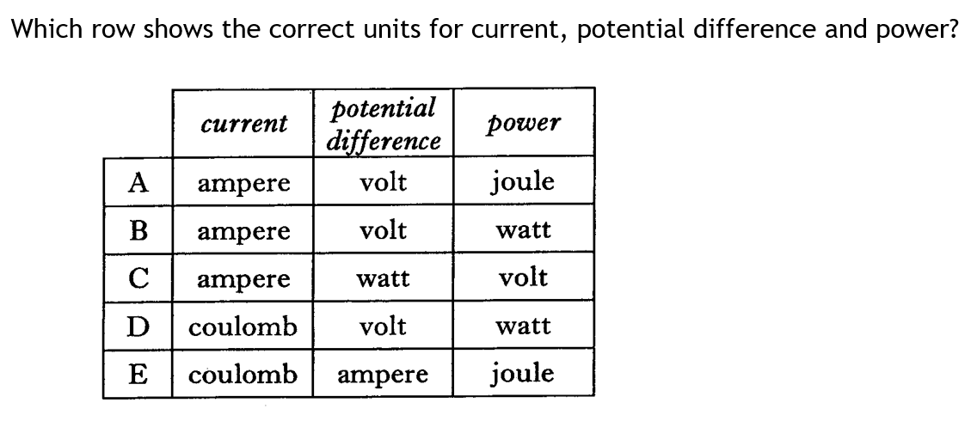


Answer
B

Slide 5
A block is moving along a surface from left to right. Two forces are acting on the block as shown.
There is a frictional force on the block of 6N.
The magnitude of the resultant force on the block is
A 10 N
B 14 N
C 16 N
D 20 N
E 24 N.
4 N
20 N
Answer
A

Slide 6
Which is the correct order for celestial bodies, from the smallest to the largest?
A star, solar system, galaxy
B galaxy, solar system, moon
C solar system, star, galaxy
D moon, star, exoplanet
E universe, galaxy, solar system
Answer
A

Slide 7
A student makes the following comments about satellites.
I A geostationary satellite has a period of 1440 minutes.
II A geostationary satellite orbits above the poles.
III A geostationary satellites orbits 36 000 m above the Earth’s surface.
A I only
B II only
C III only
D I and III only
E II and III only
Answer
A

Slide 8
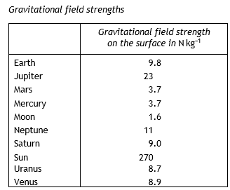
A Mars Rover has a weight of 3330 N on Mars.
The weight of the Rover on Earth is
A 33.3 kg
B 33.3 N
C 900 N
D 3330 N
E 8820 N.
Answer
E

Slide 9
A charge of 15 C passes through a resistor in 12 s. The potential difference across the resistor is 6 V.
The power developed by the resistor is
  4.8 W
  7.5 W
  9.4 W
  30 W
  1080 W
SQA 2009 Int2 9
Answer
B

Slide 10
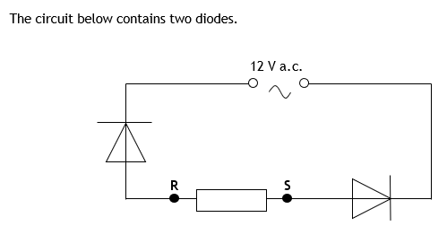
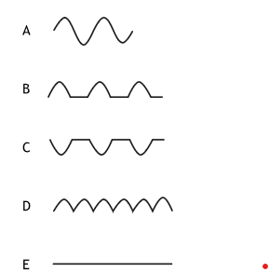
Which of the following correctly shows the waveform displayed on an oscilloscope connected across points R and S?
Answer
E

Slide 11
A syringe containing air is sealed at one end as shown.
The piston is pushed in slowly, there is no change in temperature of the air inside the syringe.
Which of the following statements describes and explains the change in pressure of the air in the syringe?
A The pressure decreases because the air particles have less kinetic energy.
B The pressure decreases because the air particles hit the sides of the syringe with less force.
C The pressure increases because the air particles hit the sides of the syringe less frequently.
D The pressure increases because the air particles hit the sides of the syringe more frequently.
E The pressure increases because the air particles have more kinetic energy.
syringe
piston
seal
air
Answer
D

Slide 12
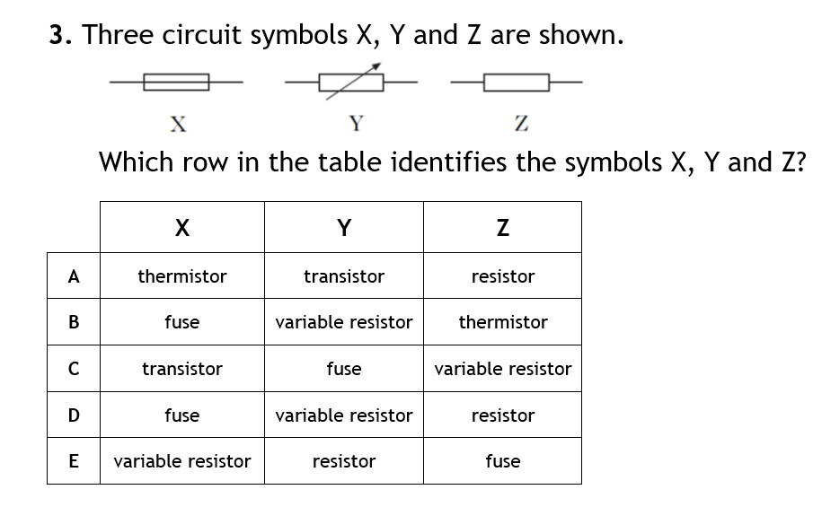
Answer
D

Slide 13
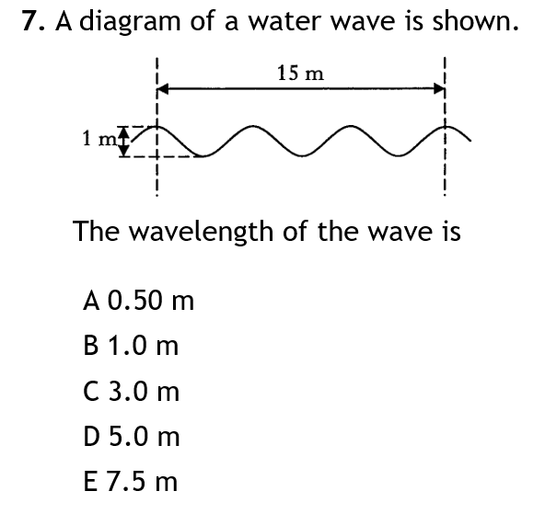
Answer
D

Slide 14
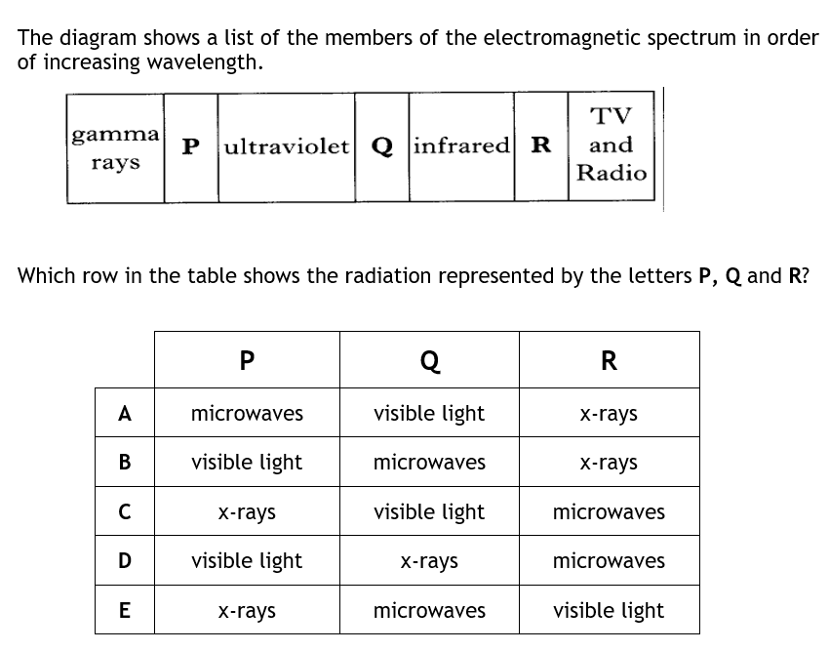
Answer
C

Slide 15
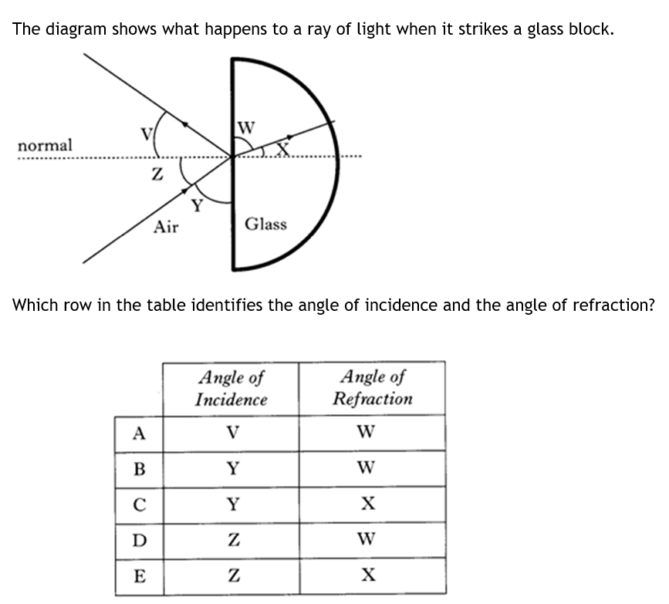
Answer
E

Slide 16
Which of the following best describes an alpha particle?
  A fast-moving electron
  A fast-moving proton
  A helium nucleus
  High frequency electromagnetic radiation
  Low frequency electromagnetic radiation
  P&N 2008-9 Int 2 Q19
Answer
C

Slide 17
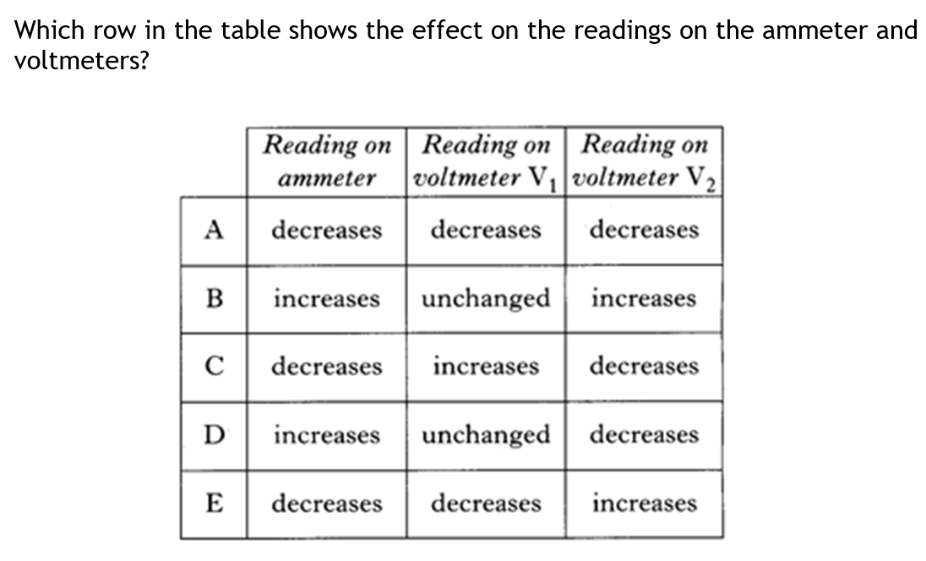
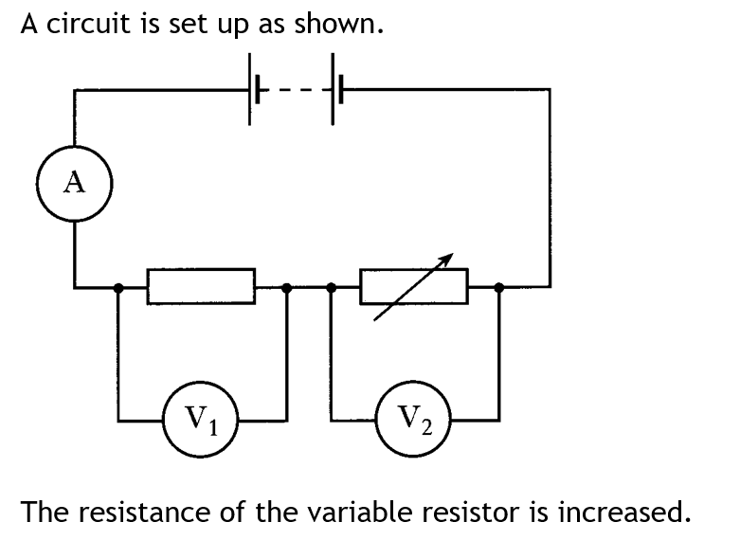
Answer
E

Slide 18
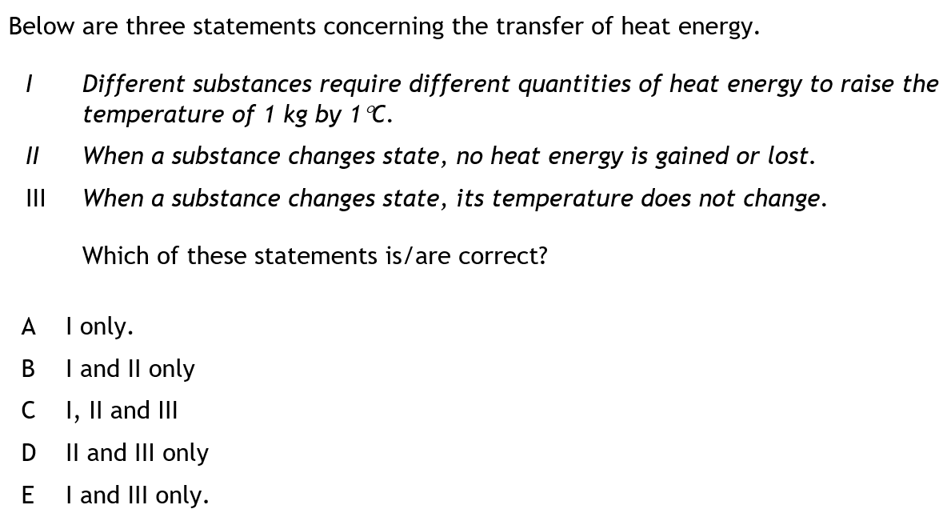
Answer
E

Slide 19
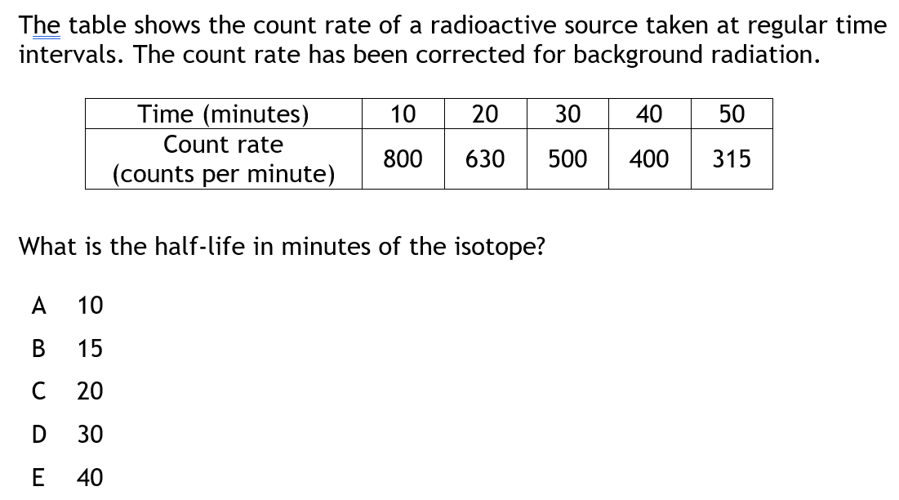
Answer
D

Slide 20
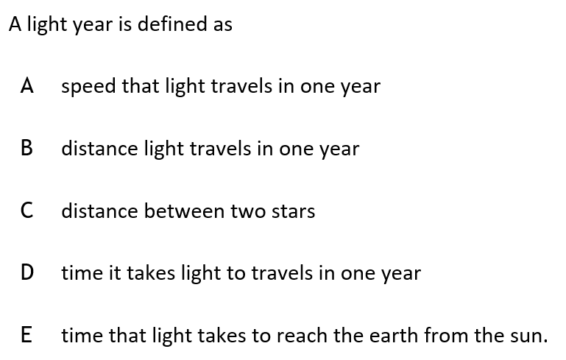
Answer
B

Slide 21
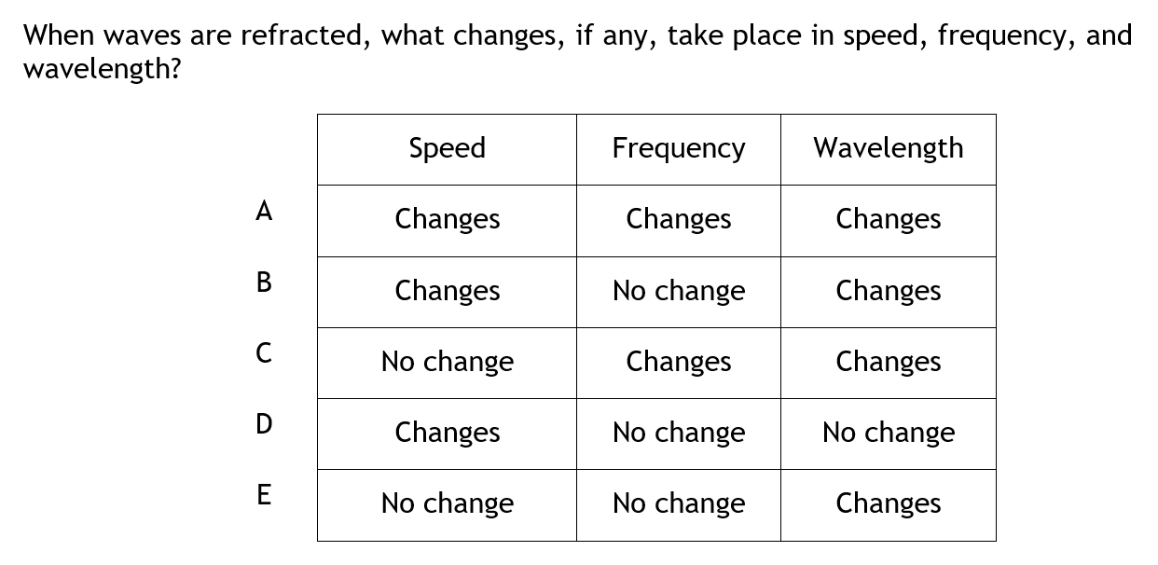
Answer
B

Slide 22
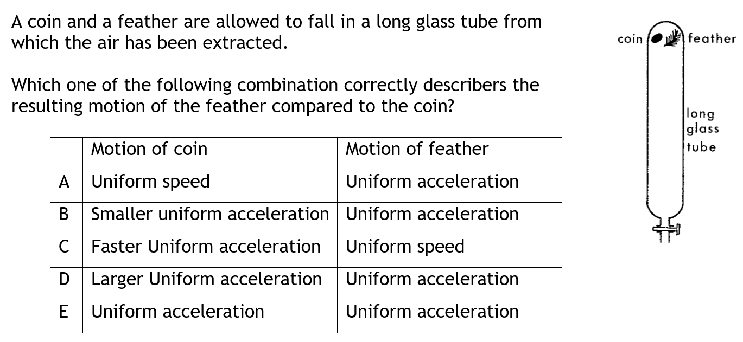
Answer
E

Slide 23
Which of these physical quantities are equivalent?
A mass and weight
B mass and acceleration due to gravity
C weight and acceleration due to gravity
D weight and gravitational field strength
E acceleration due to gravity and gravitational field strength
Answer
E

Slide 24
A student makes the following statements about the Universe.
I The Universe is approximately 14 billion years old.
II The Big Bang Theory is about the origin of the Universe.
III The Universe is no longer expanding.
Which of these statements is/are correct?
A I only
B II only
C I and II only
D II and III only
E I, II and III
Answer
C

Slide 25
A student makes the following statements about the space travel.
I The closer the spacecraft is to the Sun the greater the area of solar cells required to power the craft.
II Astronauts are exposed to a higher level of radiation than is likely on Earth.
III Astronauts float in space as there is no gravity.
Which of these statements is/are correct?
A I only
B II only
C I and II only
D II and III only
E I, II and III
Answer
B

Slide 26
A source has an activity of 120 k Bq.
The number of radioactive decays that take place in the source in a time of one minute is
A 120
B 2 000
C 14 400
D 120 000
E 7 200 000.
Answer
E

Slide 27
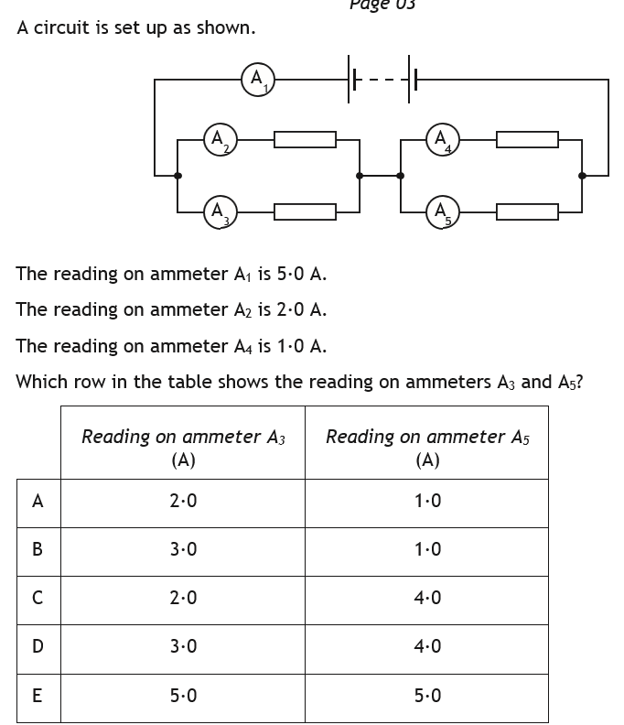
Answer
D

Slide 28
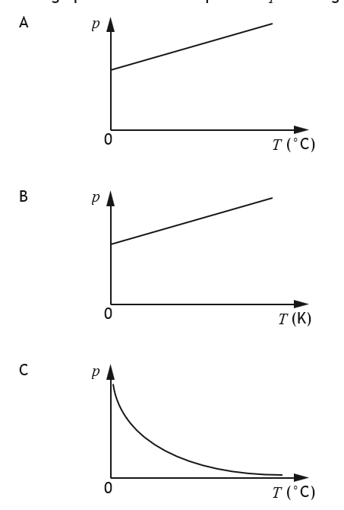
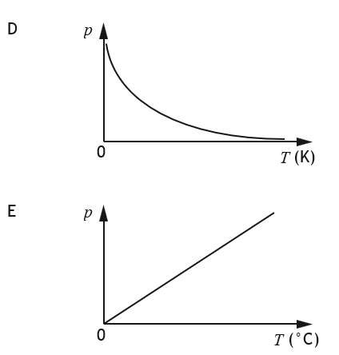
A sample of an ideal gas is enclosed in a sealed container.
Which graph shows how the pressure p of the gas varies
with the temperature T of the gas?
Answer
A

