Slide 1
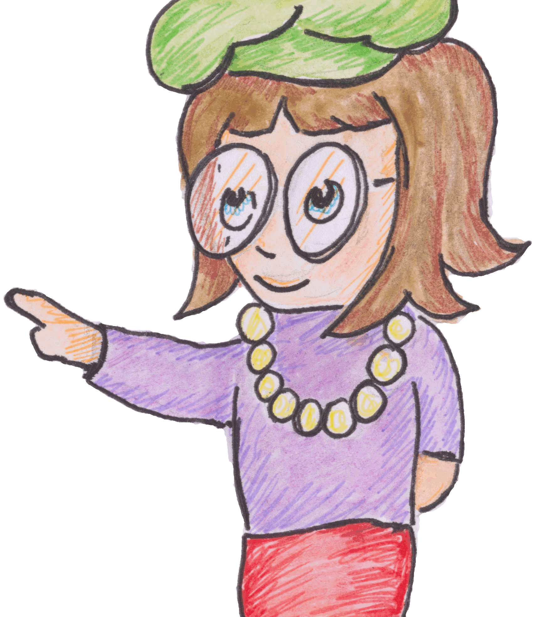
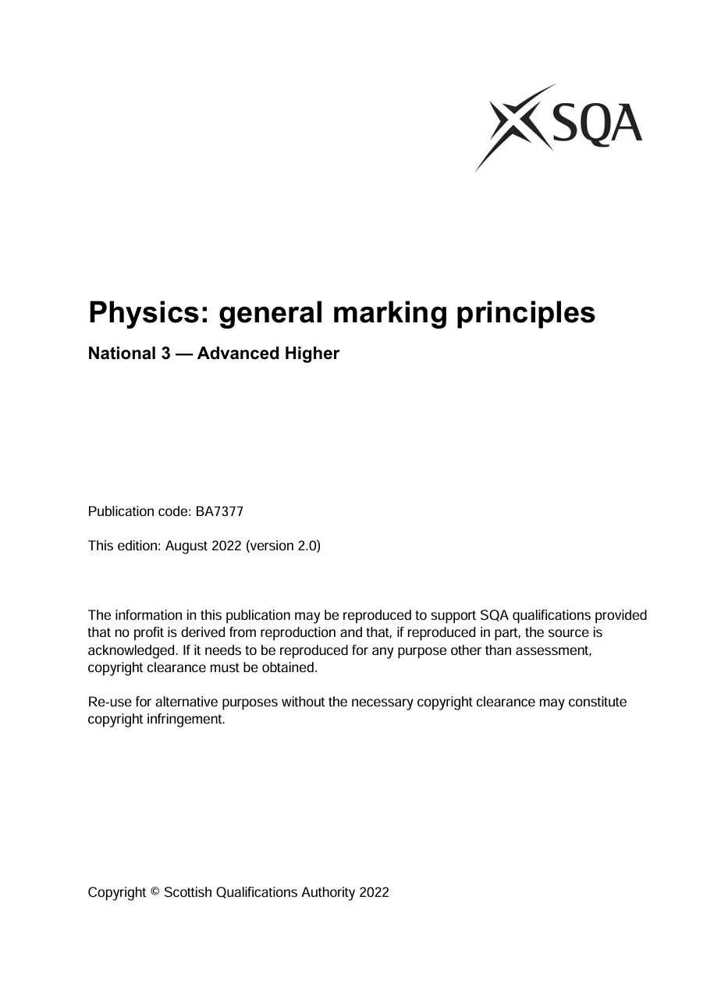
General Marking Principles
From 2022

Slide 2
Make the most of this powerpoint
This powerpoint has been produced by cutting and pasting the General Marking Principles 2022 (GMP). https://www.sqa.org.uk/sqa/files_ccc/general-marking-principles-physics.pdf
This document is used by all SQA markers and is the basis on which your exam script will be marked
Play the powerpoint through, one click at a time! After each response comes up award marks according to what you think the responses is worth.
Check your answers against the GMP, by clicking to forward the presentation, if you disagree ask your teacher/ tutor why this mark was awarded.
So grab yourself a paper and pen and see how well you know the marking instructions!

Slide 3
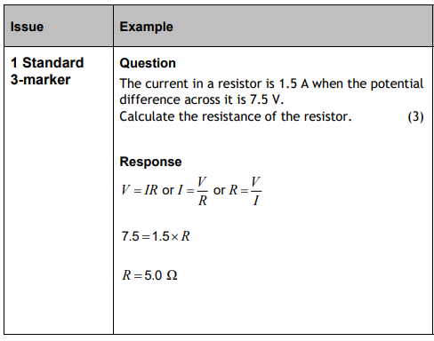
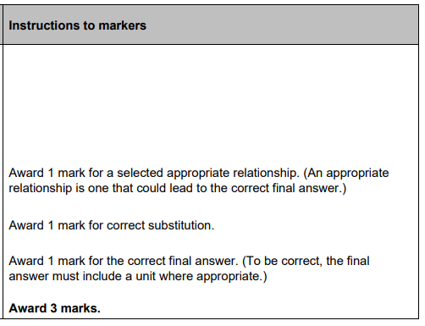
1. Standard 3 Marker
3

Slide 4
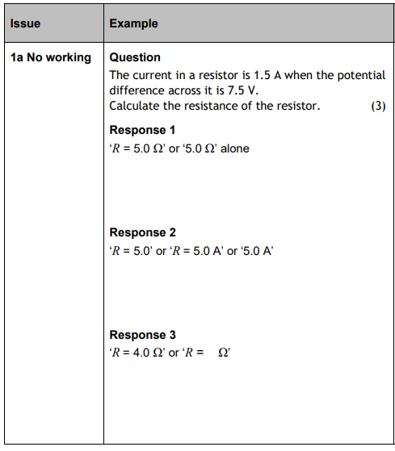
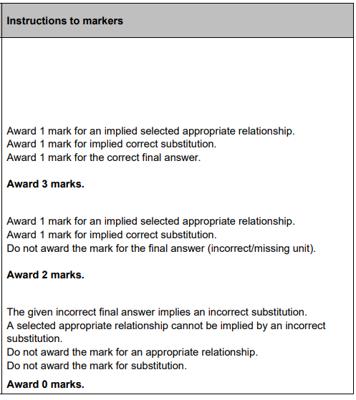
1a. No working
3
2
0

Slide 5
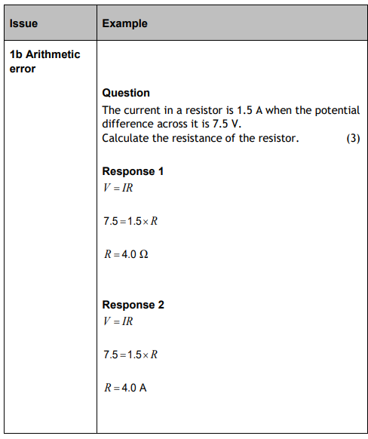
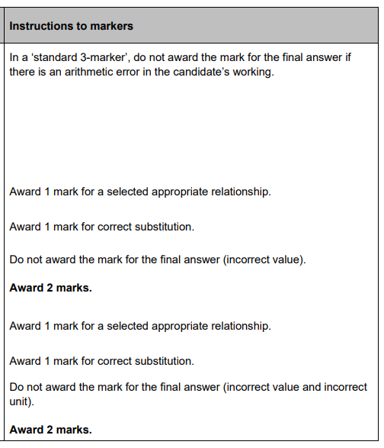
1b. Arithmetic Error
2
2

Slide 6
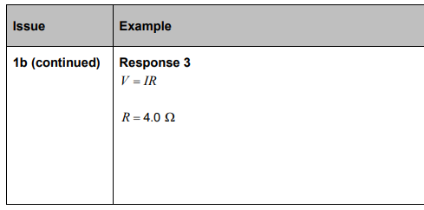
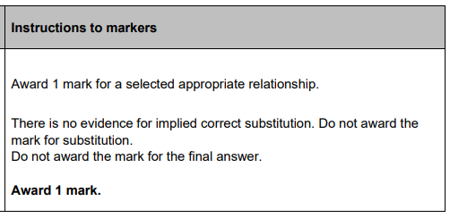

1b. Arithmetic Error
1

Slide 7
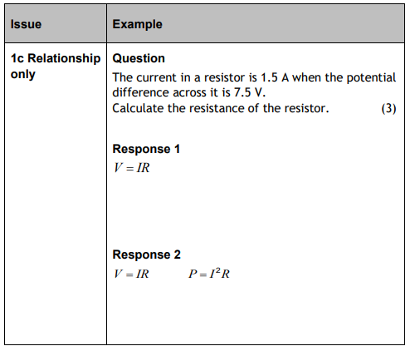
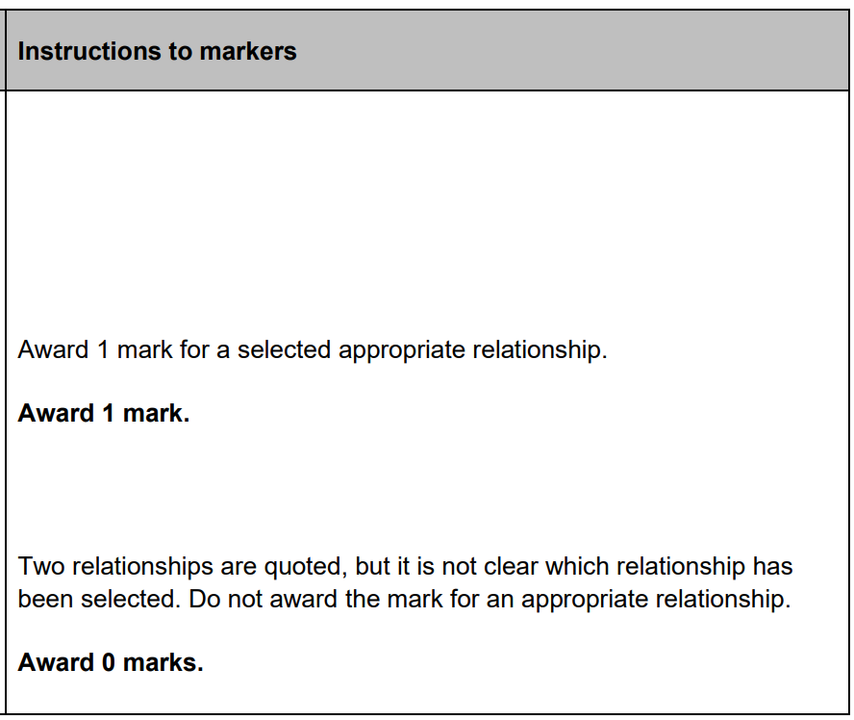
1c. Relationship Only
1
0

Slide 8
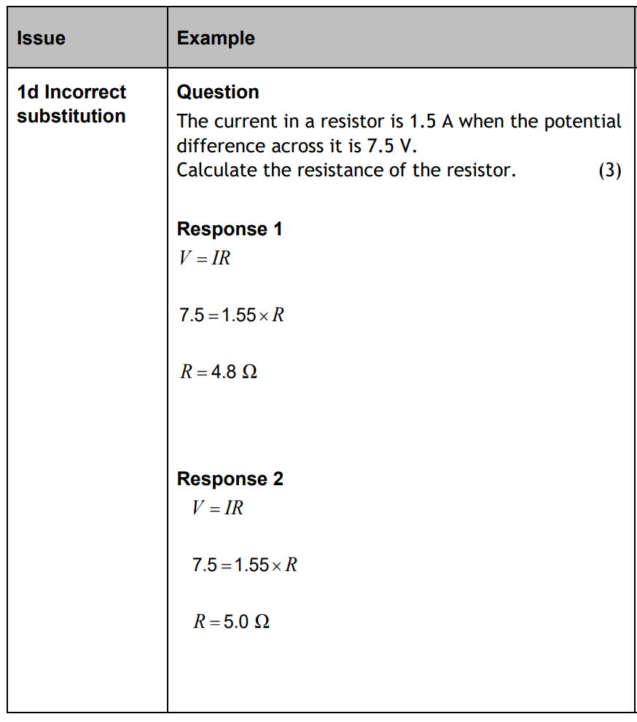
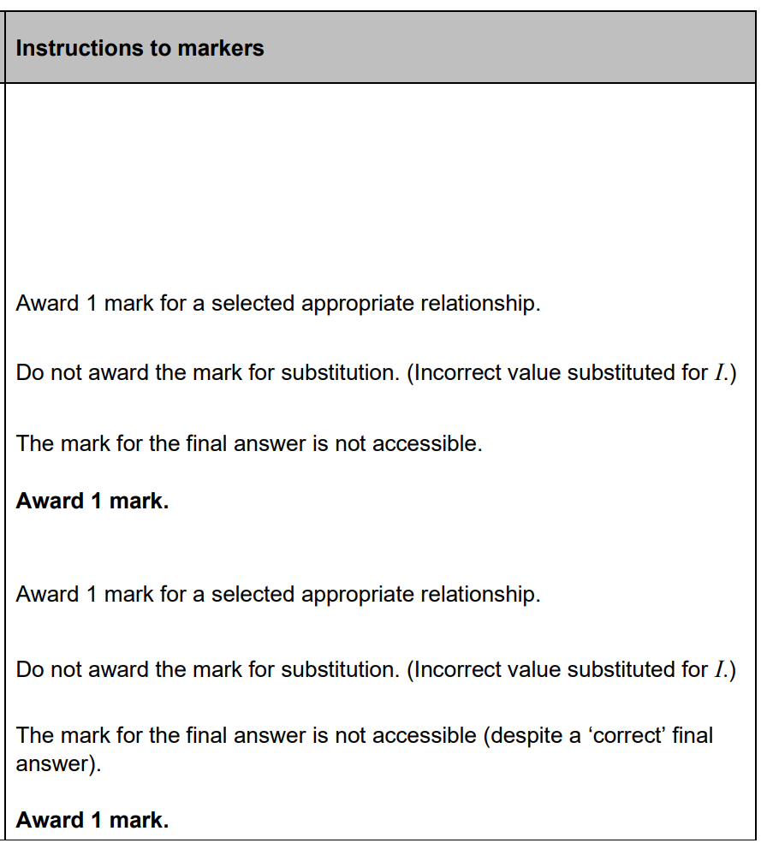
1d. Incorrect substitution
1
1

Slide 9
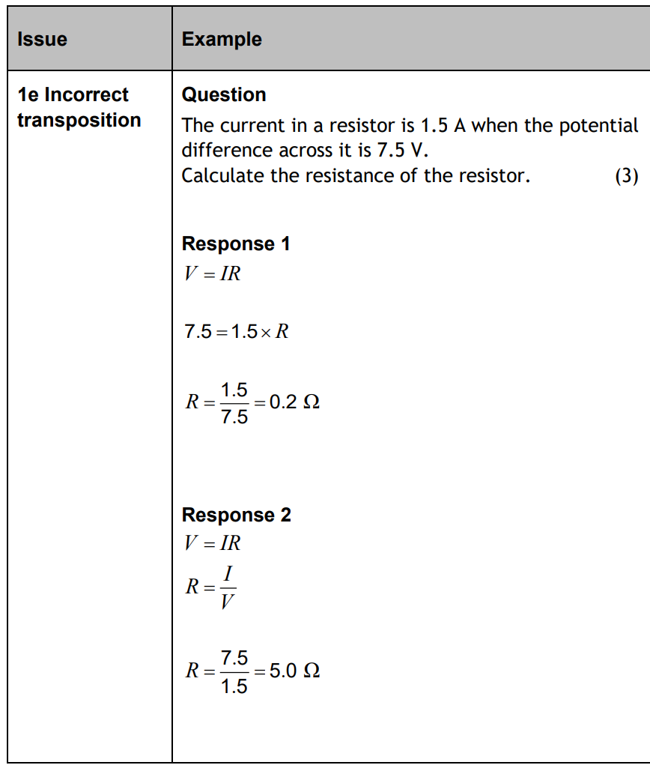
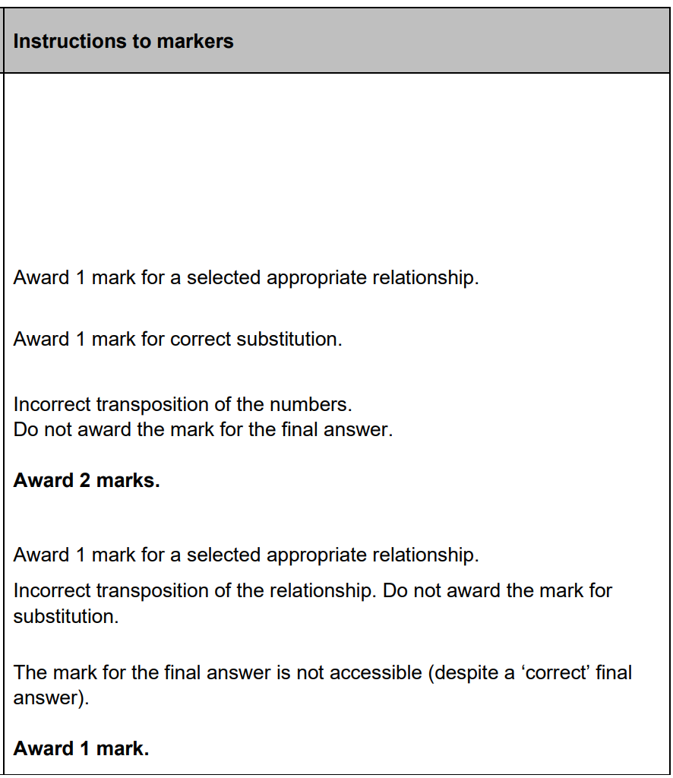
1e. Incorrect Transposition
2
1

Slide 10
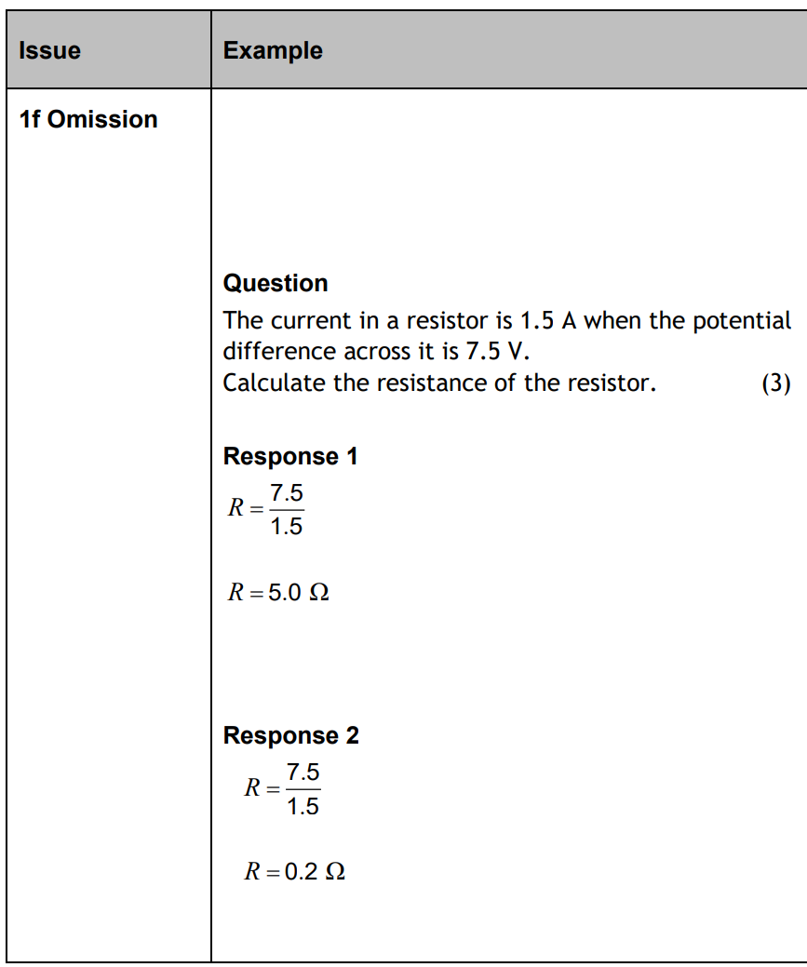
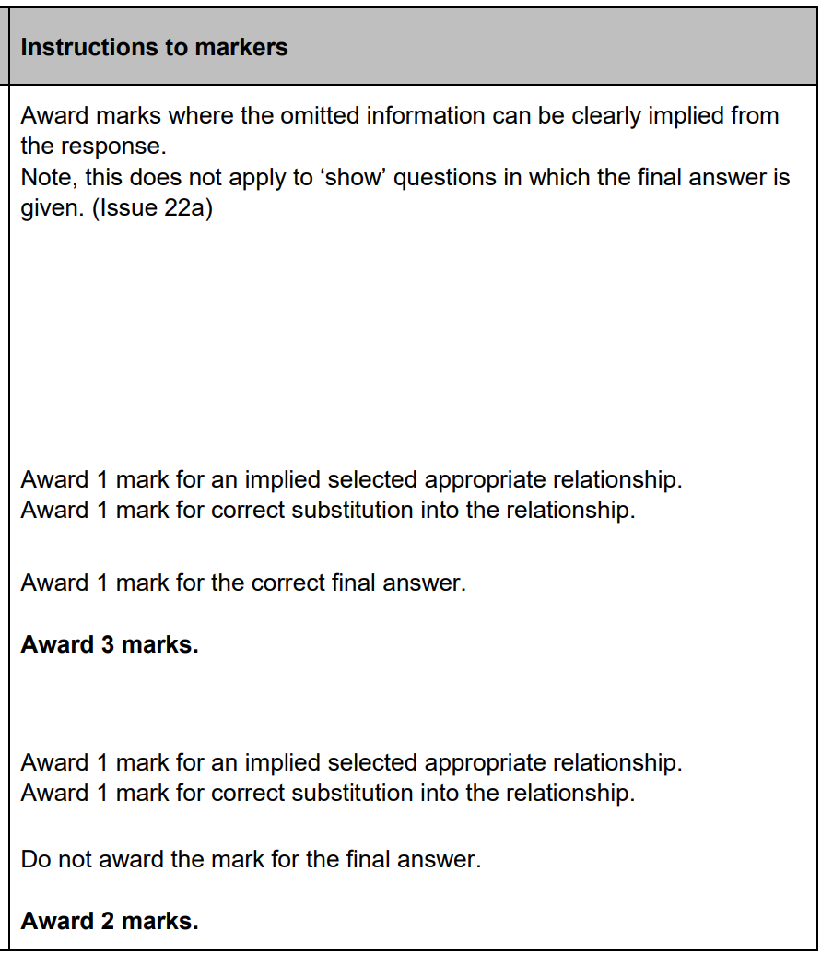
1f. Omission
3
2

Slide 11
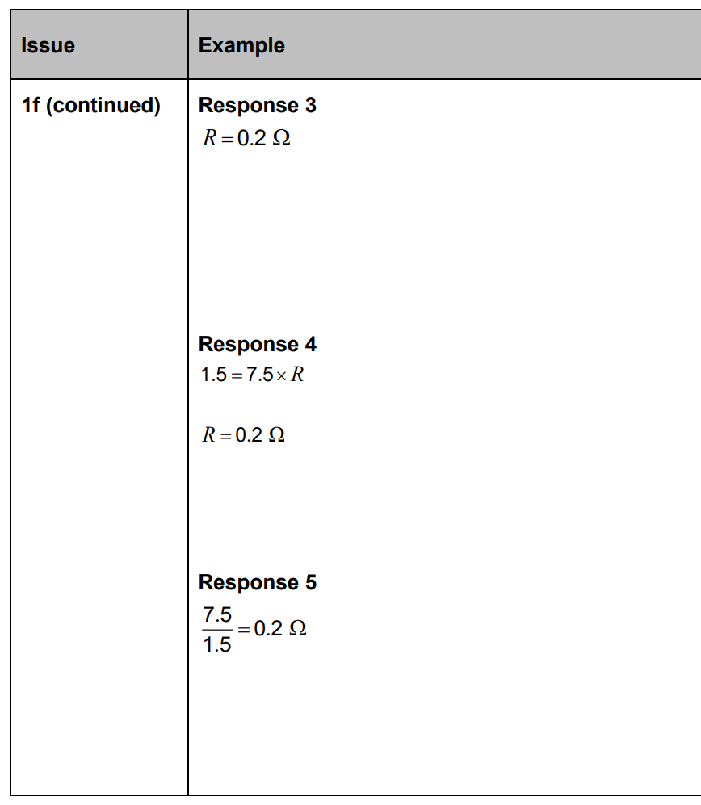
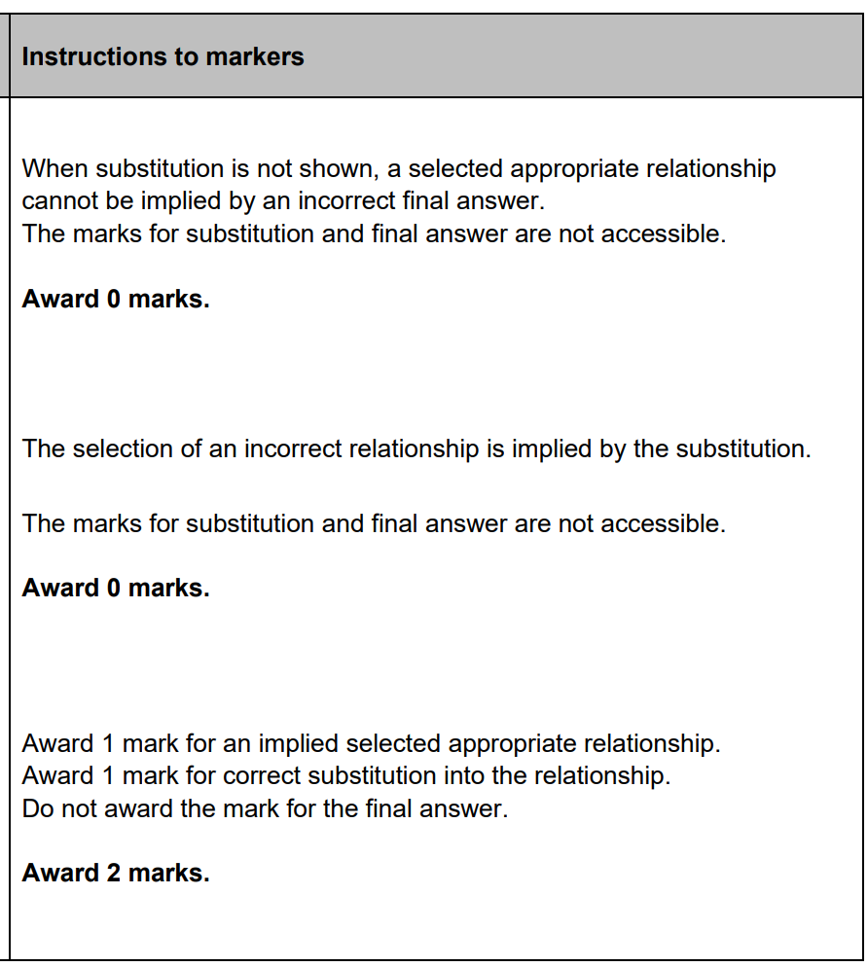
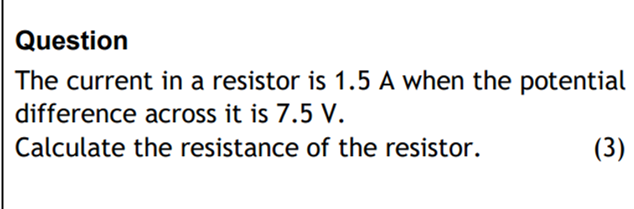
1f. (cont) Omission
0
0
2

Slide 12
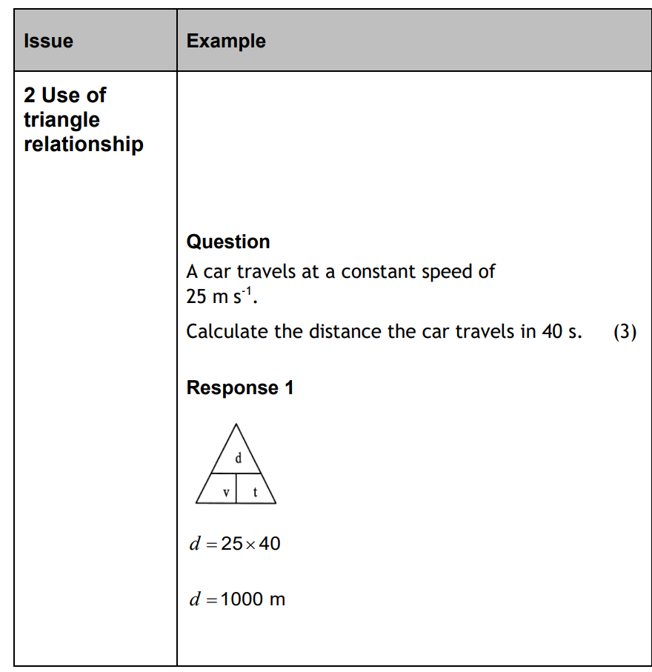
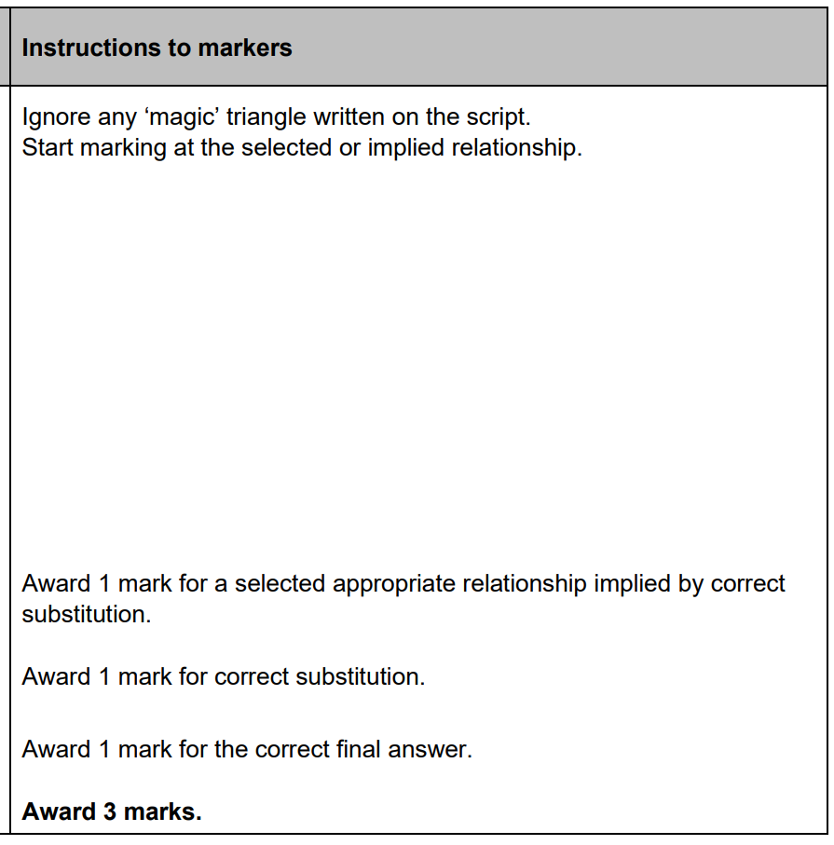
2. Use of ‘magic’ triangle
3

Slide 13
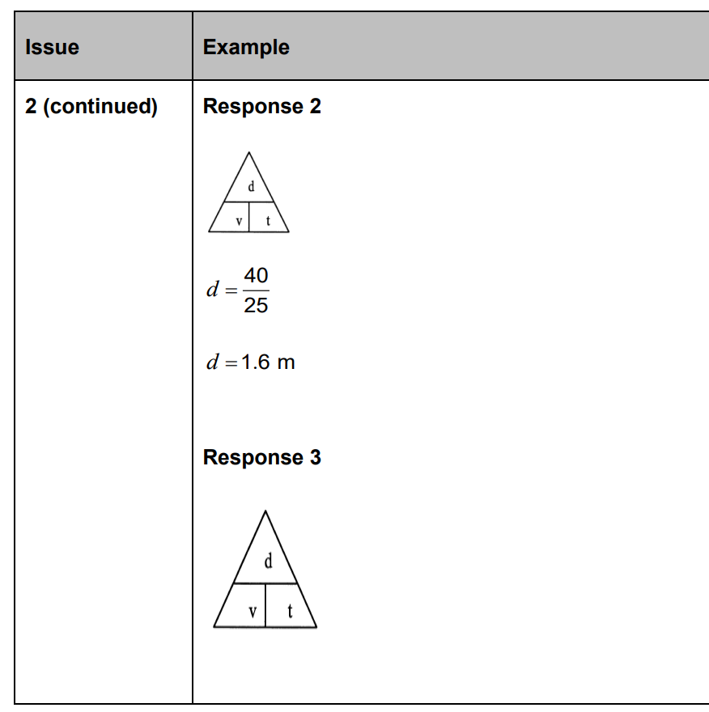
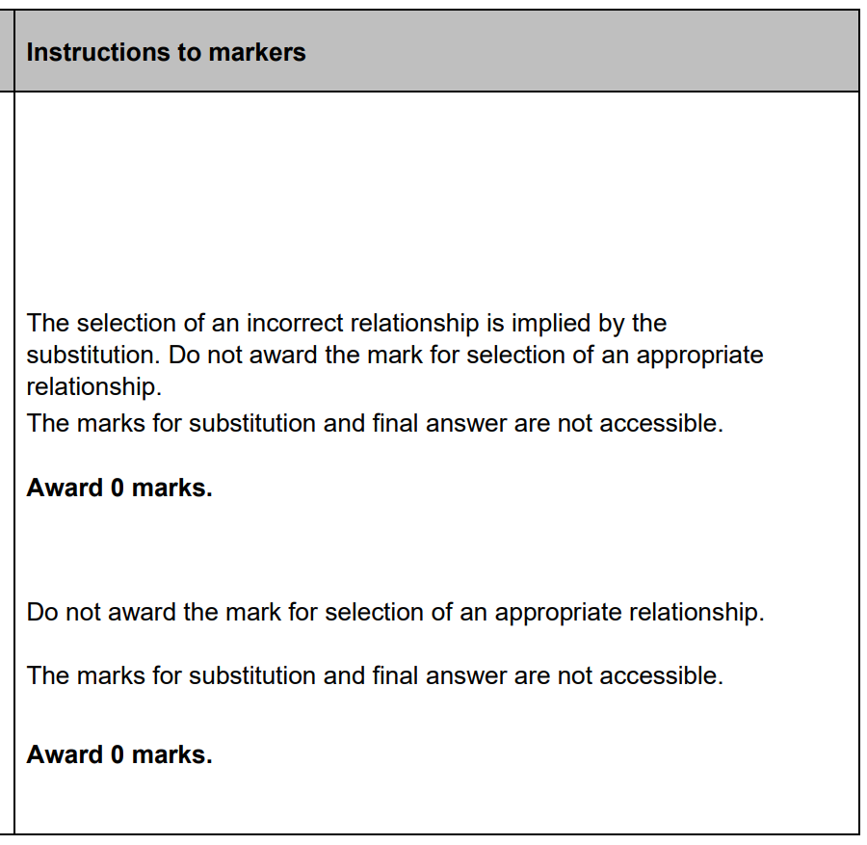
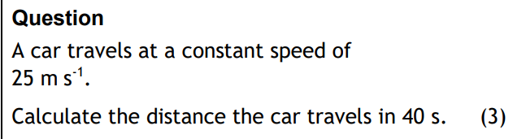
2. (cont) Use of ‘magic’ triangle
0
0

Slide 14
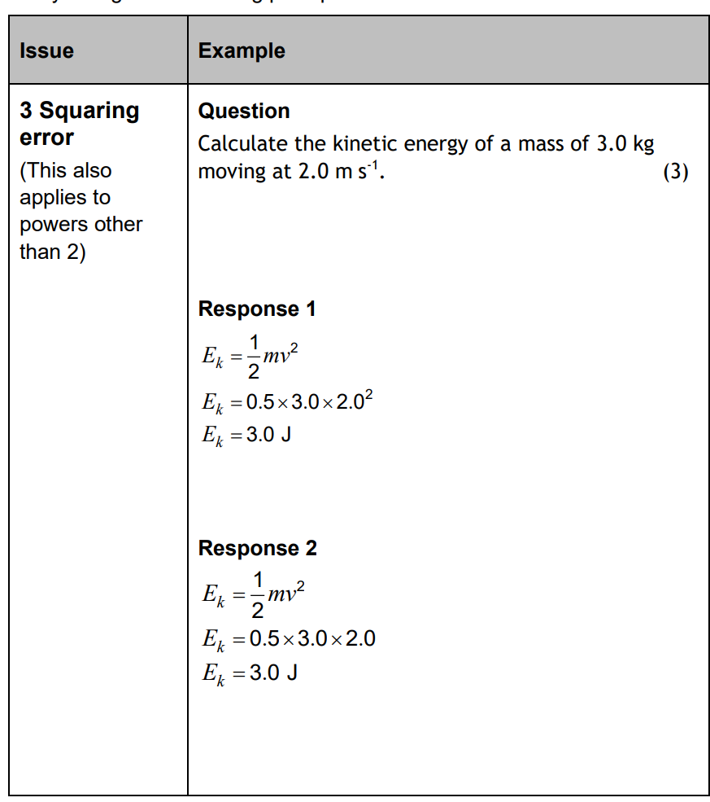
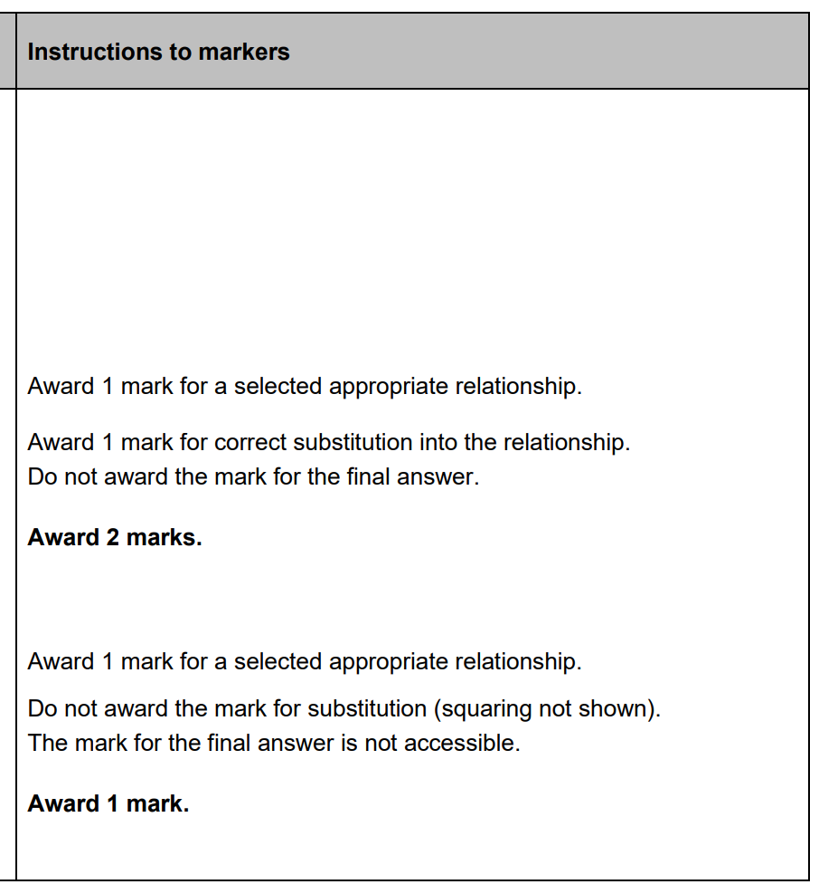
3. Squaring or powers
2
1

Slide 15
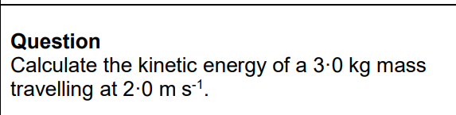
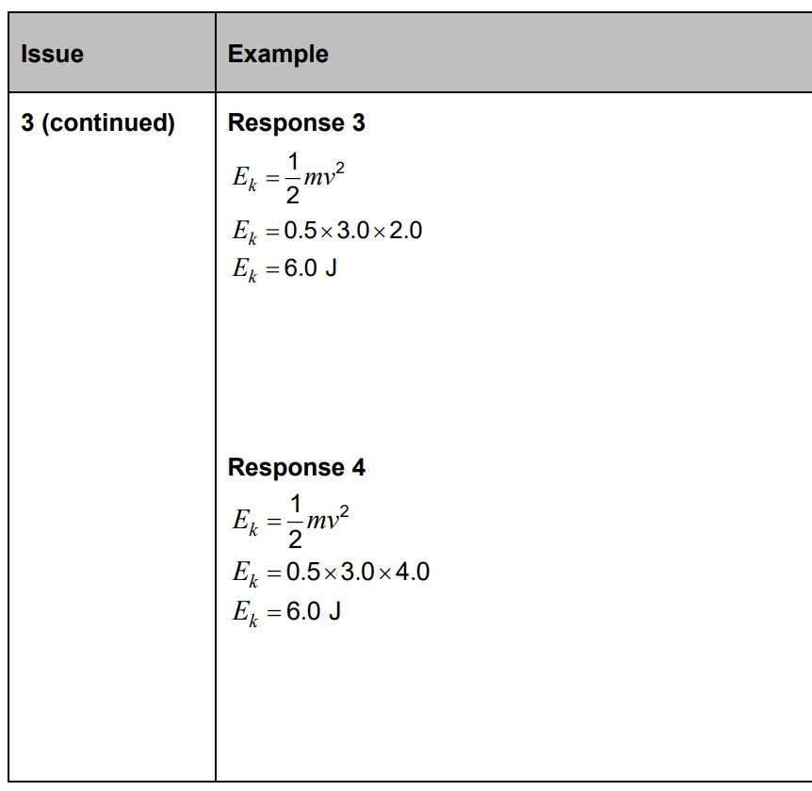
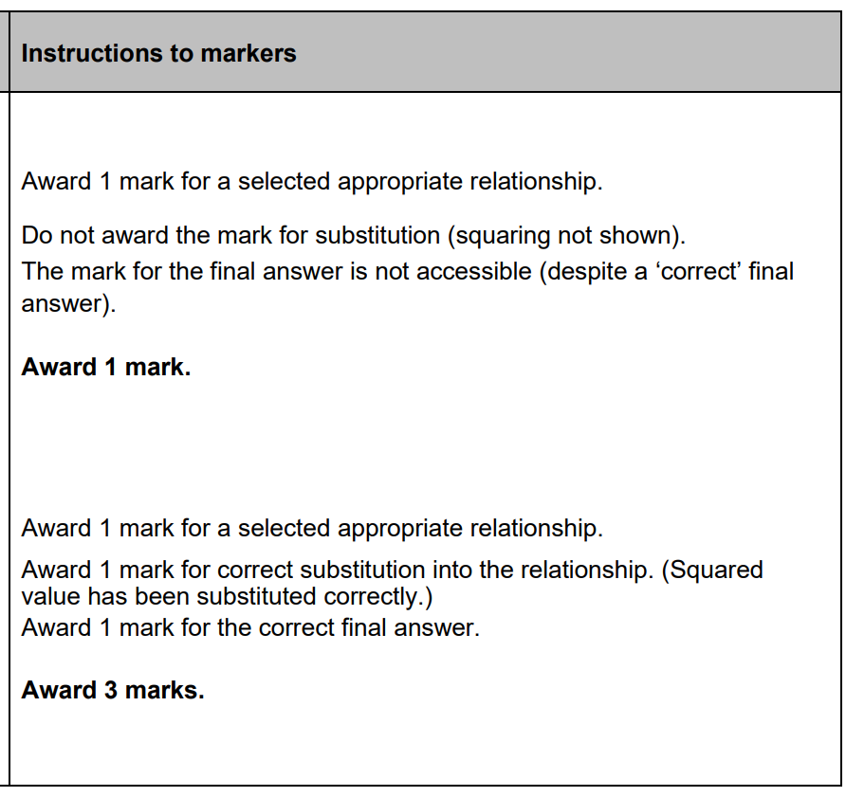
3. (cont) Squaring or powers
1
3

Slide 16
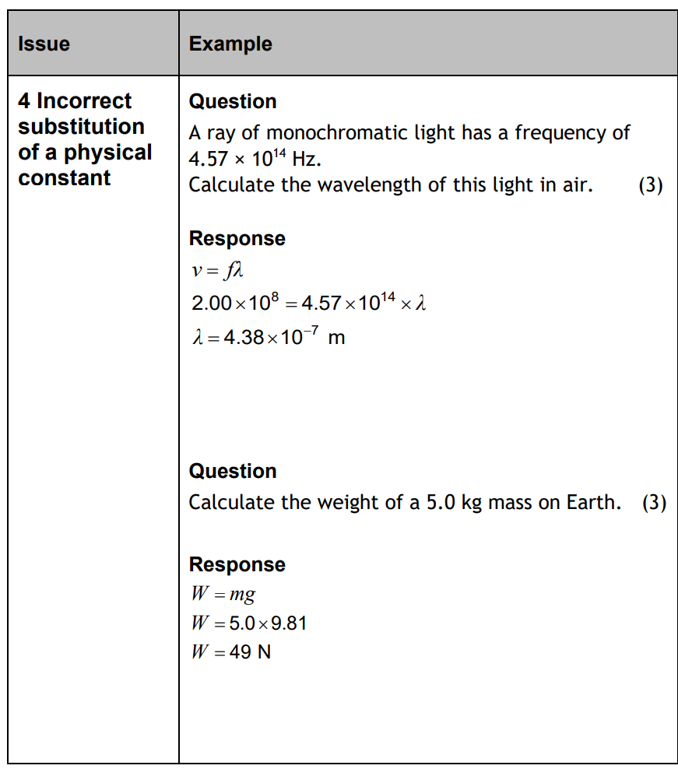
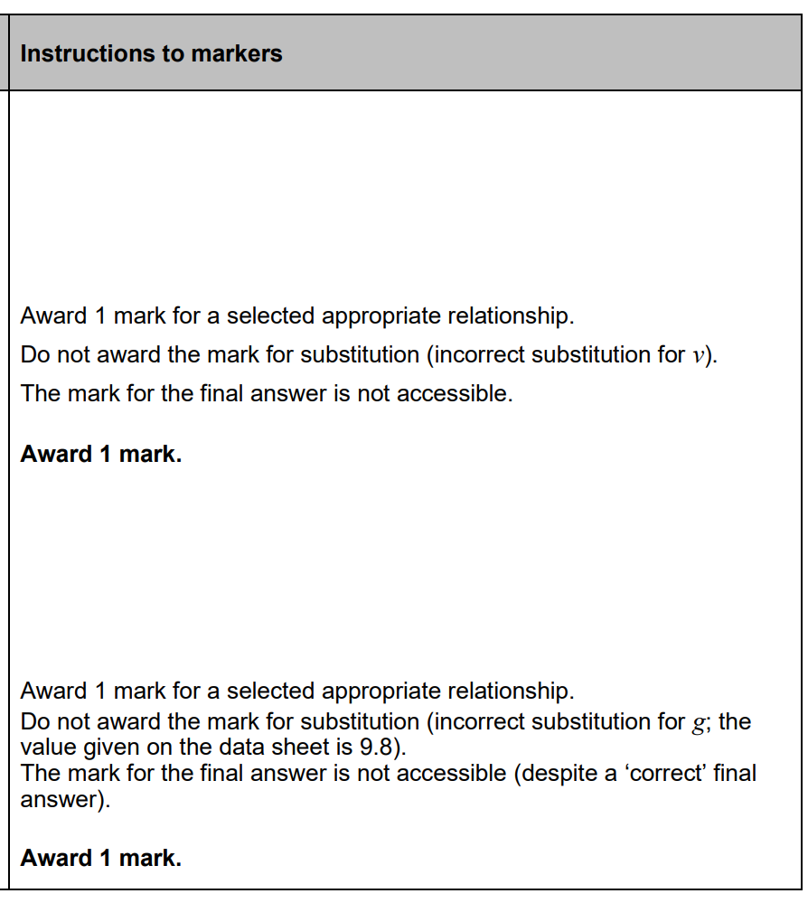
4. Incorrect sub of a physical quantity
1
1

Slide 17
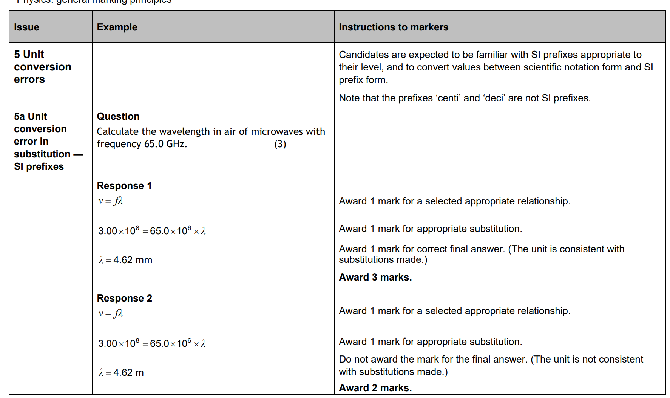
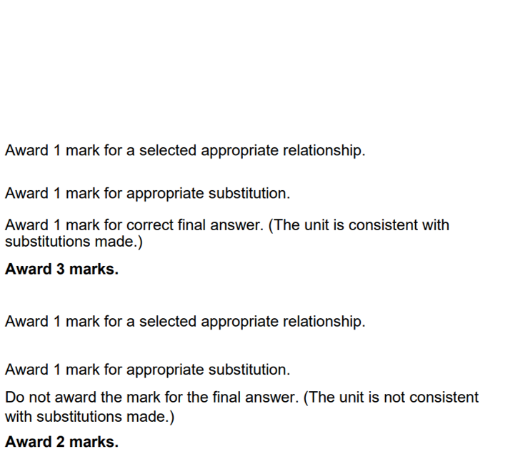
5a. Unit conversion
3
2

Slide 18
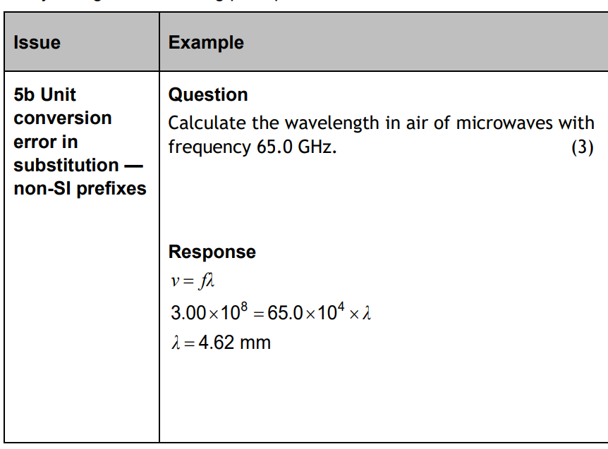
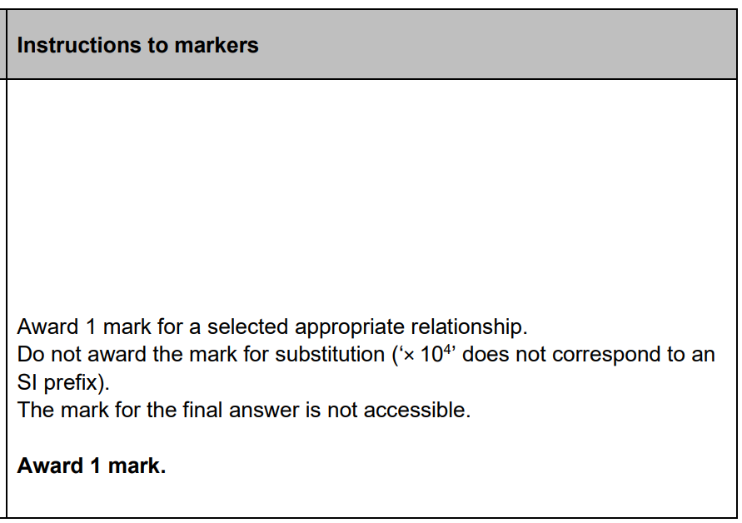
5b. Unit conversion
1

Slide 19
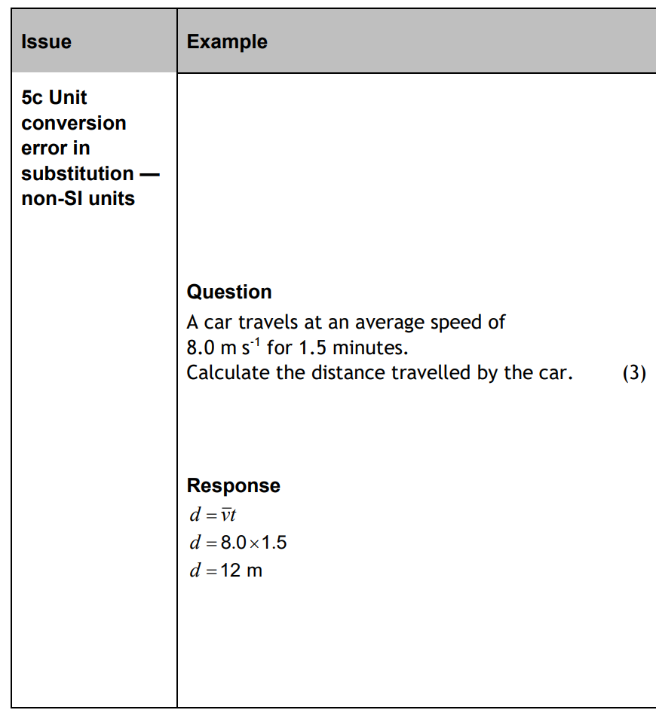
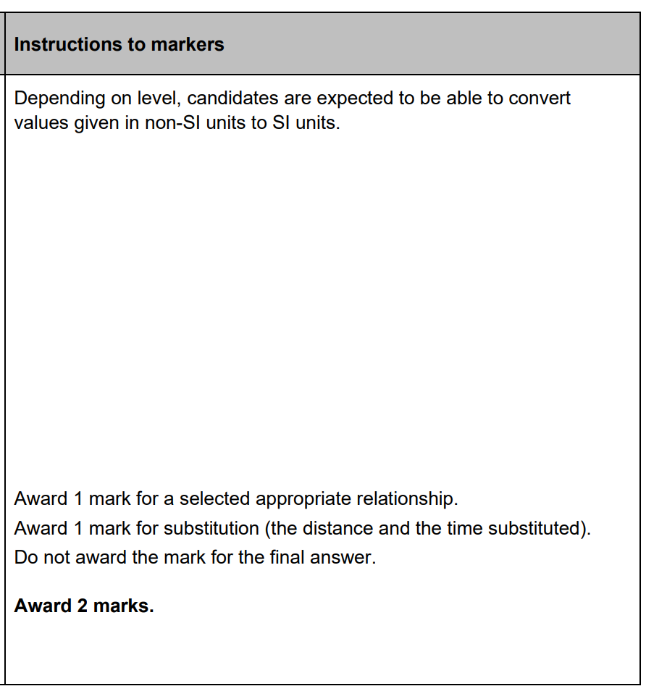
5c. Unit conversion
2

Slide 20
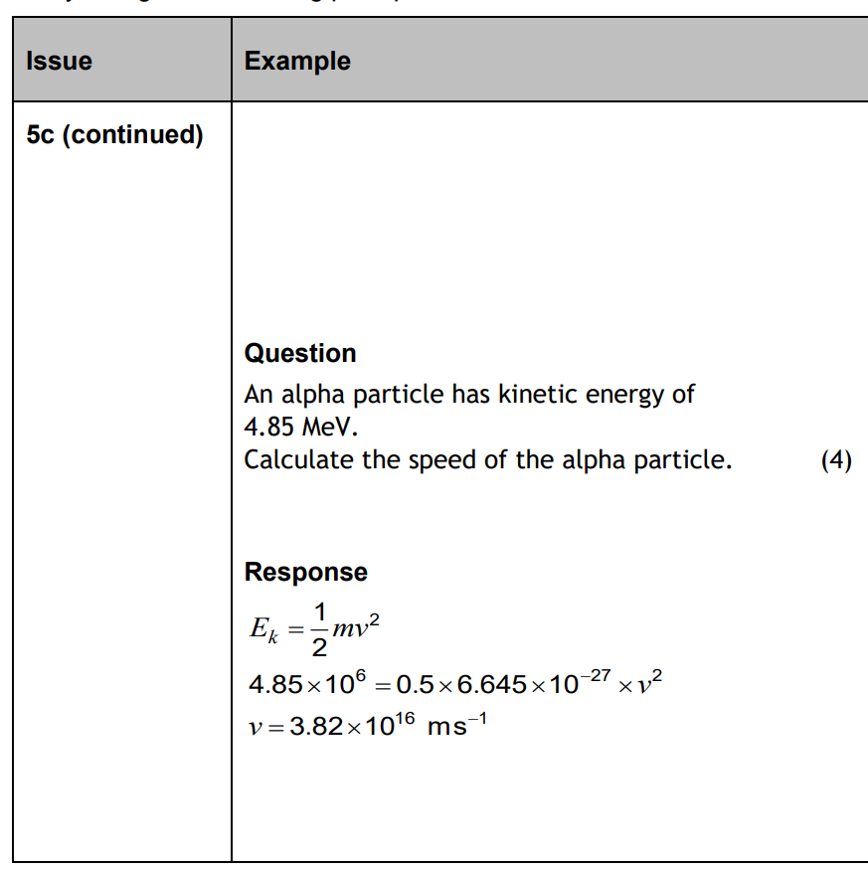
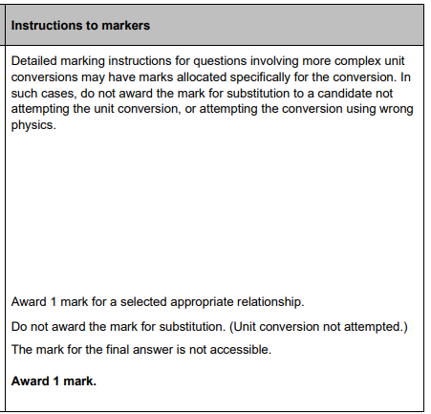
5c. (cont’d) Unit conversion
1

Slide 21
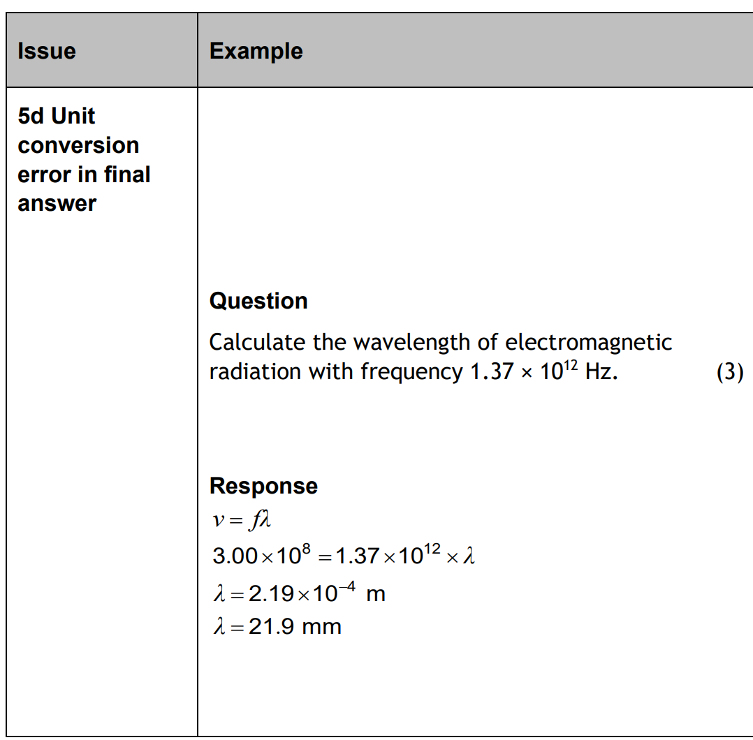
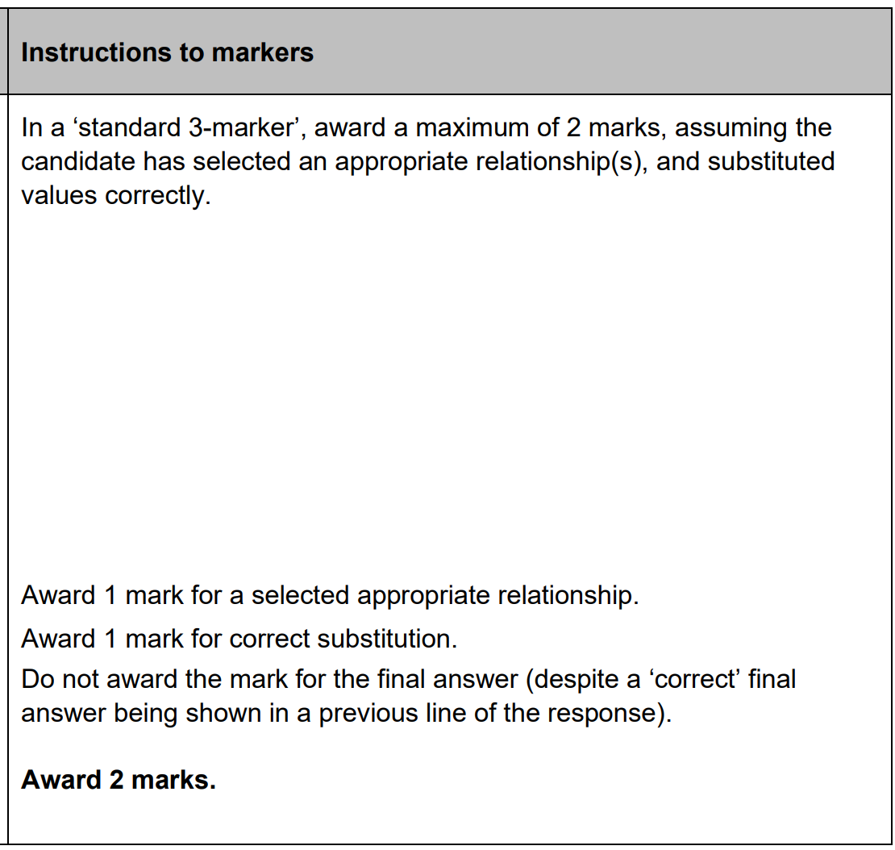
5d. Unit conversion
2

Slide 22
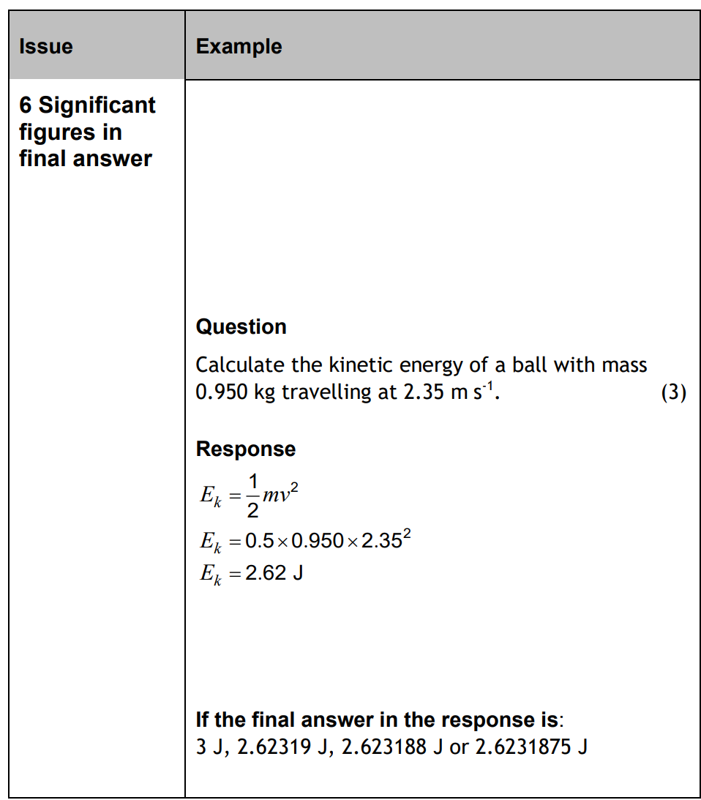
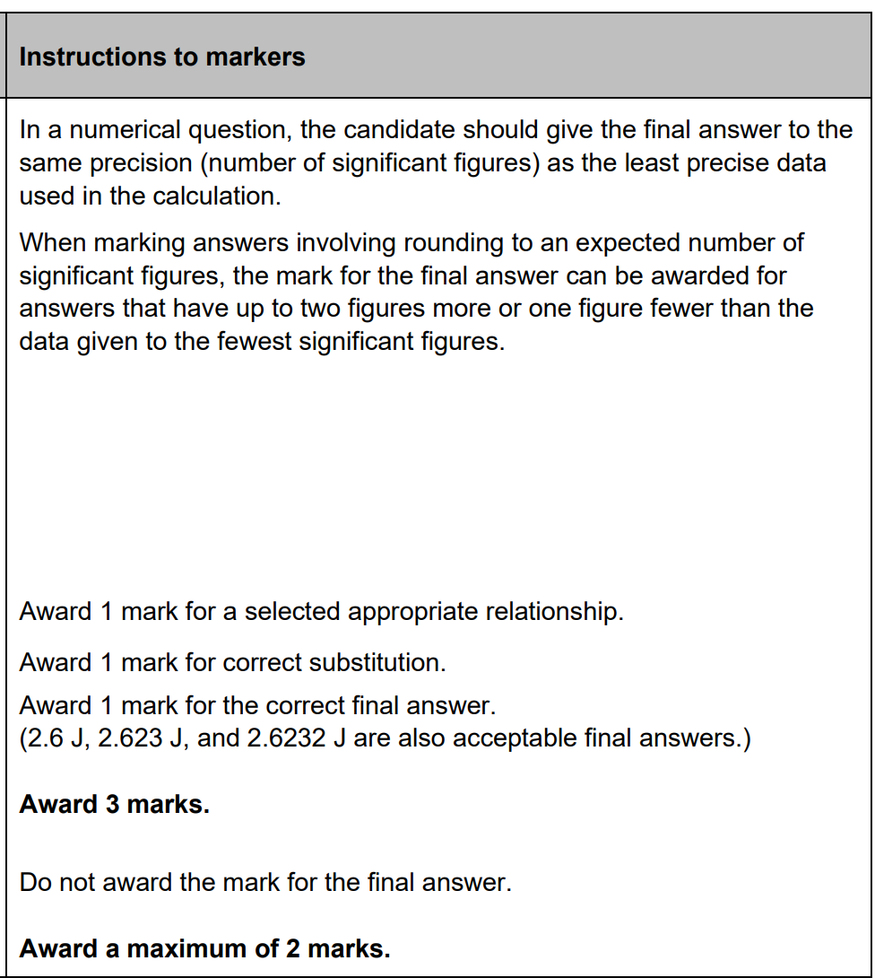
6. Sig fig in final answer
3
2

Slide 23
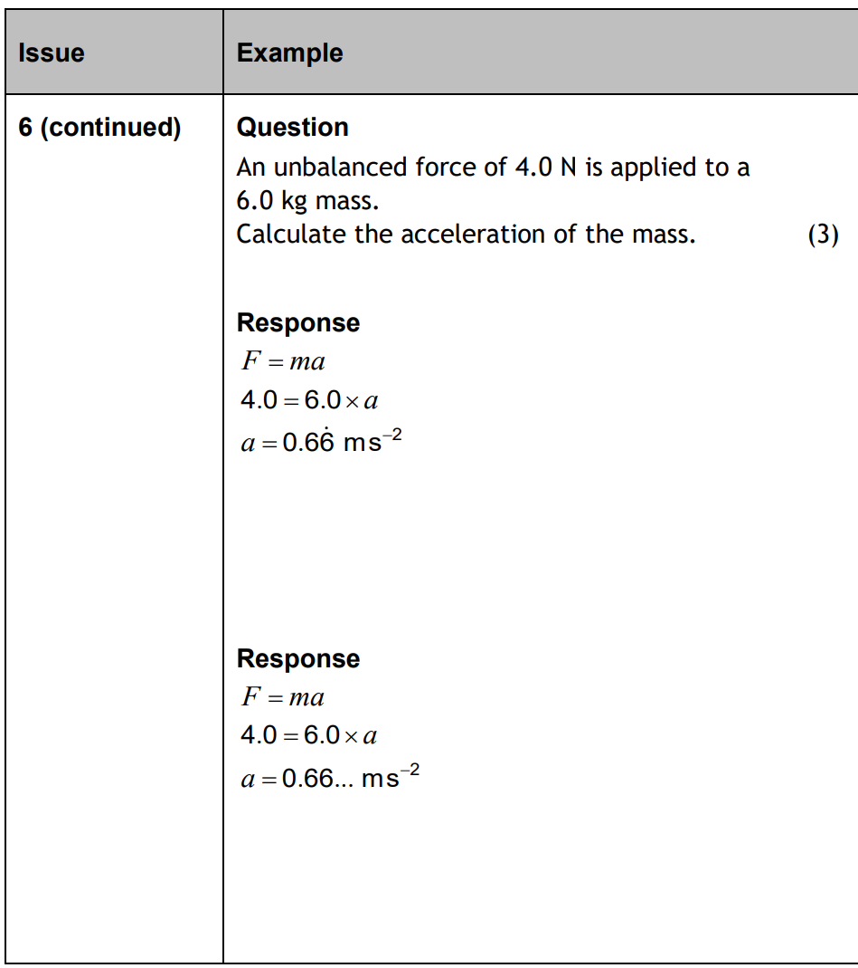
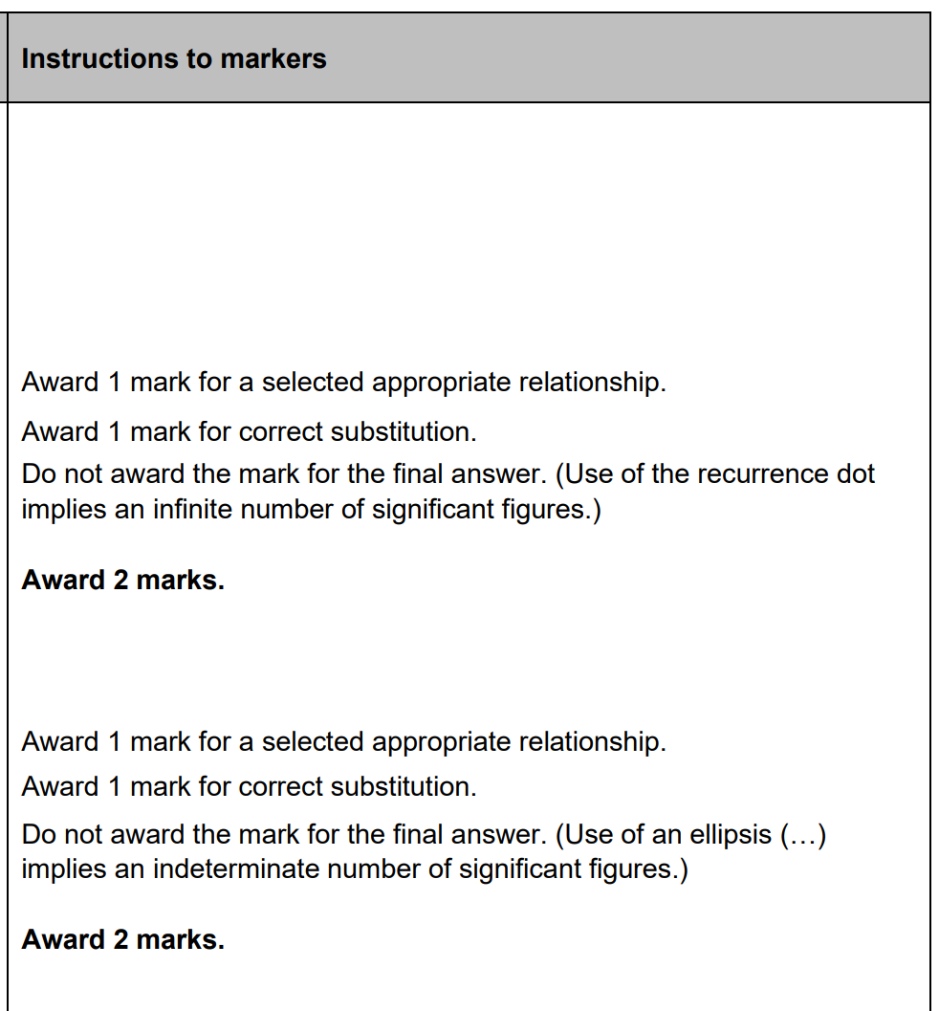
6. (cont) Sig fig in final answer
2
2

Slide 24
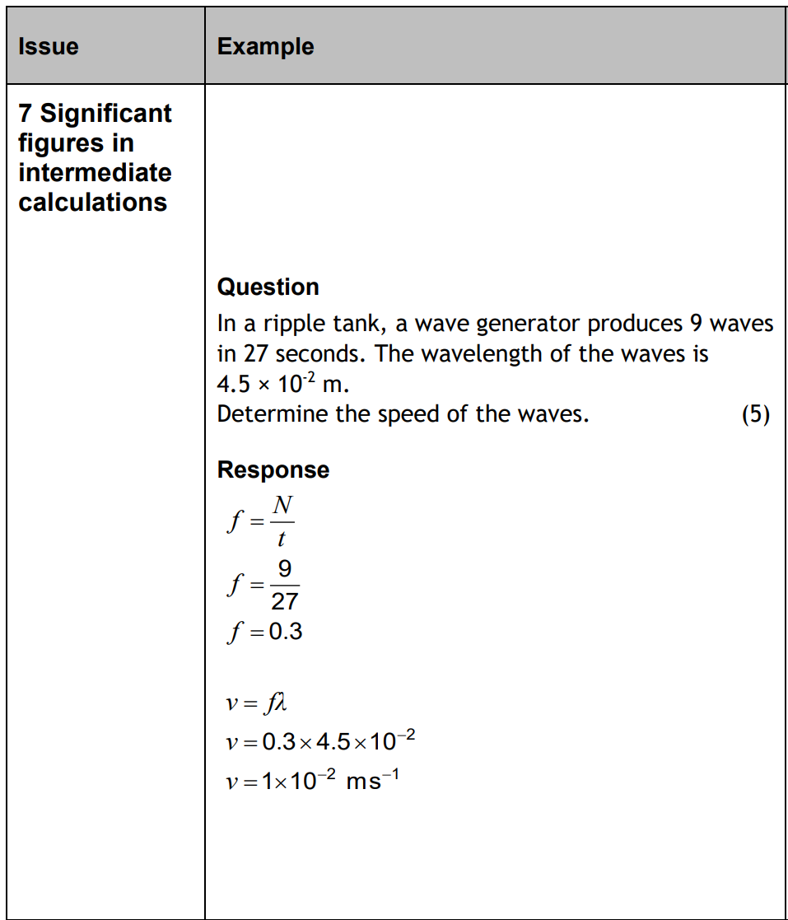
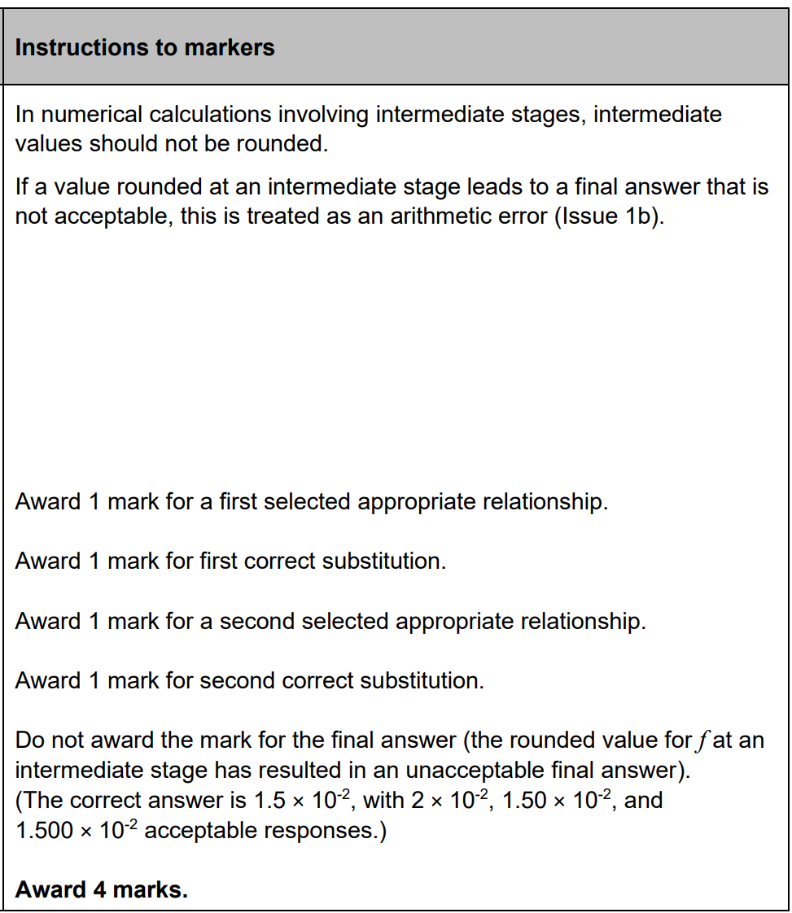
7. Sig fig intermediate calculations
4

Slide 25
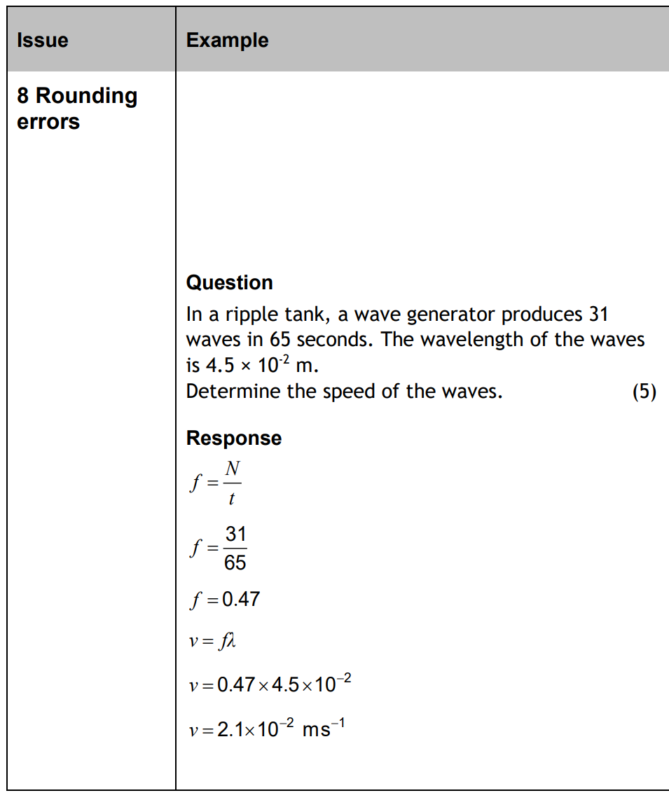

8. Rounding Errors
4

Slide 26


9. Vulgar Fractions
2

Slide 27


10. Incorrect index notation
2

Slide 28


11. Subscript and superscript
1

Slide 29


11. (cont) Subscript and superscript
0

Slide 30

12. Multiple errors in final answer
No final mark

Slide 31


13. Additional Calculations beyond answer
2

Slide 32


14. Application of wrong physics
0

Slide 33


14. Application of wrong physics
0

Slide 34

15. Carry forward

Slide 35



15. (cont) carry forward
1

Slide 36


15. Carry forward
2

Slide 37





16. Carry forward
1
3

Slide 38

17. Carry forward incorrect intermediate

Slide 39



17. (cont) Carry forward - intermediate
1
1

Slide 40


18. Wrong experiment
0

Slide 41


19. Solution by diagram
1

Slide 42


20. Non-standard symbols
3

Slide 43


20. (cont’d) Non-standard symbols
0
3

Slide 44


20. (cont’d) Non-standard symbols
0

Slide 45


21. Surplus answers
0
1

Slide 46


22. Incorrect spelling
1
0
Fusion, fission, reflection, refraction, diffraction

Slide 47

23. Show questions

Slide 48


23. (cont’d) Show questions
2
0

Slide 49


23. (cont’d) Show questions
1
1

Slide 50


23. (cont’d) Show questions
1

Slide 51


24. Explain questions
2

Slide 52



24. Explain questions
1
0

Slide 53

25. Justify / Must justify

Slide 54


25a. Justify
2
1
1

Slide 55



25a. Justify
1
0

Slide 56

25b. Must justify

Slide 57




25b. (cont’d)Must justify
2
1
0
0
0

Slide 58


26. State what is meant by questions
1

Slide 59


26. State what is meant by questions
0
0

Slide 60


26. (cont’d) State what is meant by questions
0
0
1

Slide 61

27. Open Ended Questions

Slide 62

28. Graph plotting questions

Slide 63
Some comments about MI
In the MI
Bold or underlined– this word must be in your answer
Brackets- part of an ideal answer but not required for the marks
Notice recently to avoid intermediate rounding, the MI are substituting the previous equation, or part of an answer, without working this out. If your rearranging is good, I’d recommend this.
The GMP are summarized at the beginning of the MI- do you just skip this?
If you’re a teacher the best way to get to learn about how things are done is to do some marking! Your students will appreciate it no end
All the best in your tests and exams
Mrs Physics

