Slide 1
Teacher Instructions:
As a whole class or in groups, split into two teams – red and blue
Red team has to claim hexagons to get across the board from top to bottom
Blue team has to claim hexagons to get across the board from left to right
All teams work on an answer as if the playing team gets it wrong, the other team can steal
Teams can choose hexagons to block opposing team
To play:
Teams take turns to select a hexagon by letter
Clicking on this takes you to the corresponding question
Clicking on the answer once displays the answer
Click again and you are returned to the game board where you can select the winning team colour
Continue with next team selecting a hexagon until one team has crossed the board.
Clicking on the winning team’s coloured star will light up the board.

Slide 2
B
L
O
C
K
E
U
I
G
F
L
S
T
J
C
W
Y
D
E
M
R
T
O
R
S

Slide 3
H
A
Q
S
F
E
L
I
G
N
U
P
B
Z
C
W
Y
D
V
M
R
T
O
X
K

Slide 4


State the value of the mains voltage in the UK.
Answer
230 V

Slide 5
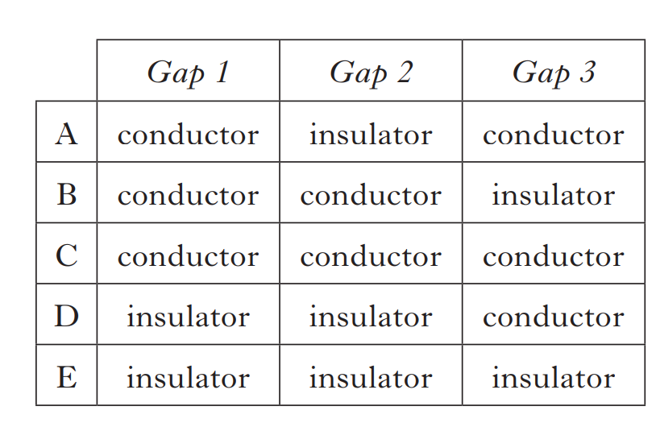
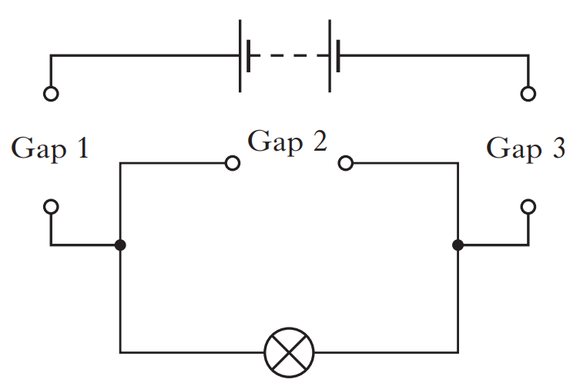
A circuit with three gaps is shown below.
Which row in the table shows the combination of conductors and insulators that should be placed in the gaps to allow the lamp to light?
Answer
A

Slide 6
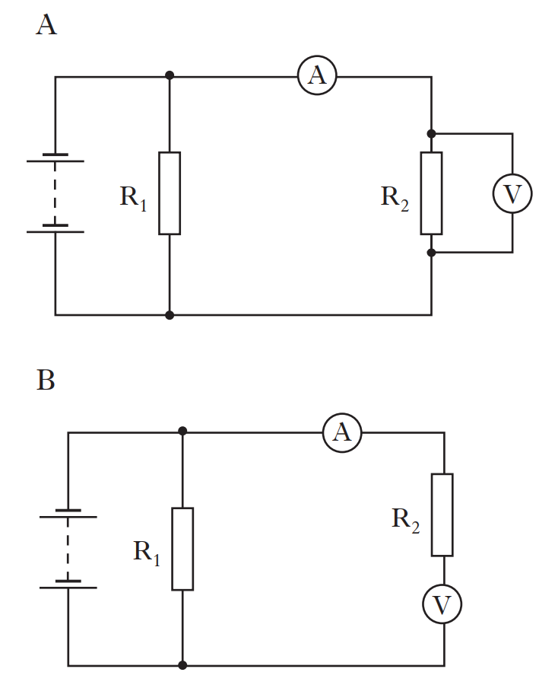
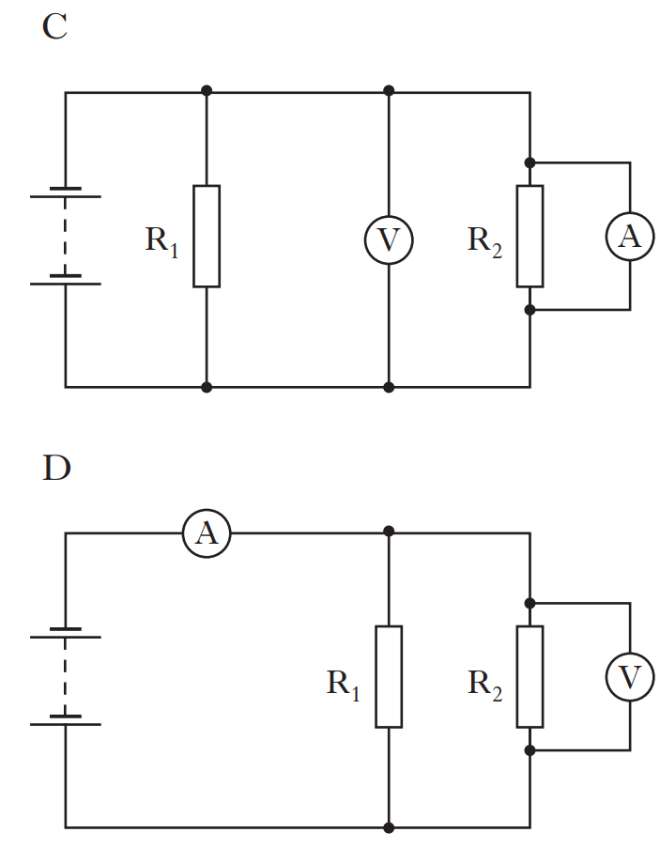
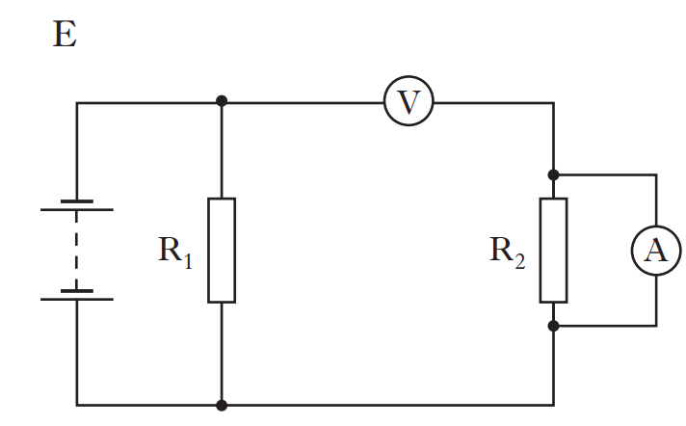
In which circuit below would the meter readings allow the resistance of R₂ to be calculated?
Answer
A

Slide 7
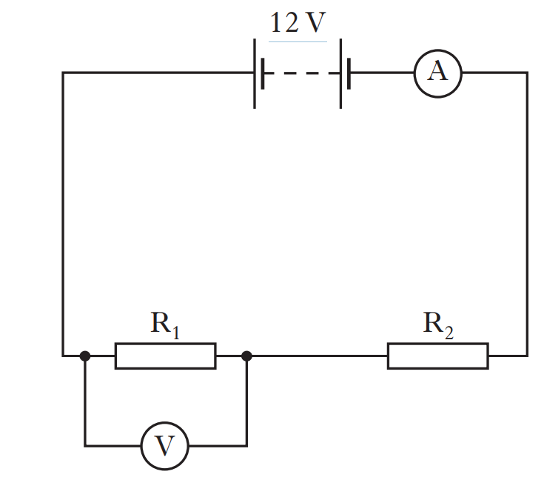
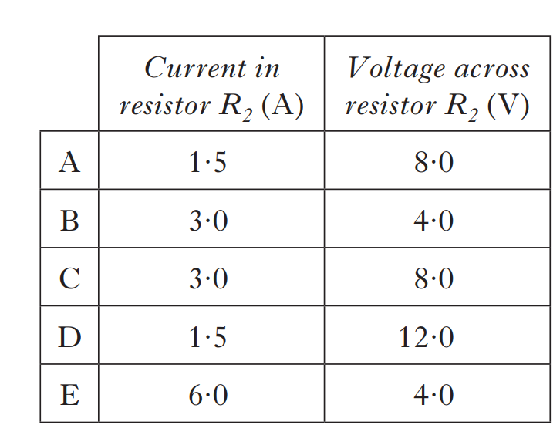
A circuit is set up as shown.
The reading on the ammeter is 3·0 A.
The reading on the voltmeter is 4·0 V.
Which row in the table shows the current in resistor R₂ and the voltage across resistor R₂?
Answer
C

Slide 8
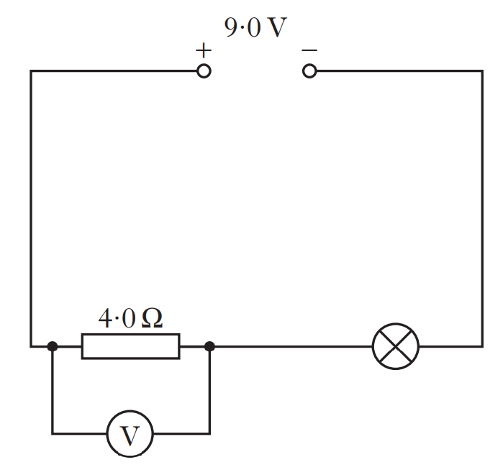
The current in the lamp is 1·5 A.
The reading on the voltmeter is 6·0 V.
The power developed in the lamp is
A 3·0W
B 4·5W
C 6·0W
D 9·0W
E 13·5W.
Answer
B

Slide 9
State what is meant by the term voltage.
Answer
(The voltage of a supply is a measure of) the energy given to the charges in a circuit.

Slide 10
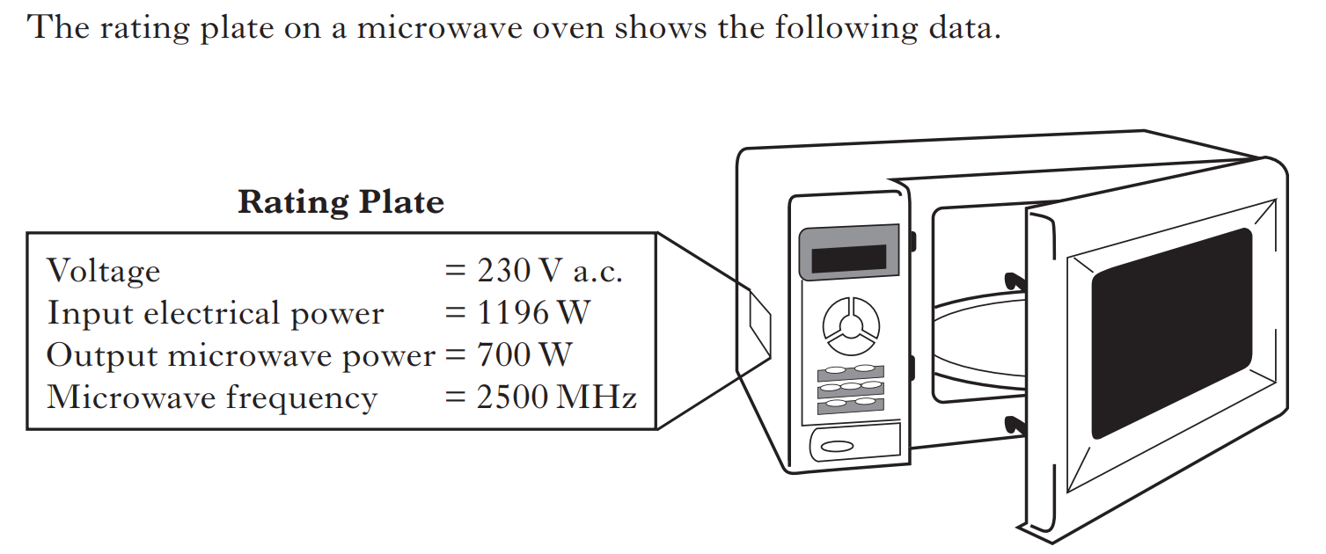
Calculate the input current.
Answer
5.2 A

Slide 11
A microwave flex has a current of 5.4 A during the 1 minute 30 seconds it is used to heat a cup of milk for.
Calculate how much electrical charge passes through the flex in this time.
Answer
486 C / 490 C

Slide 12
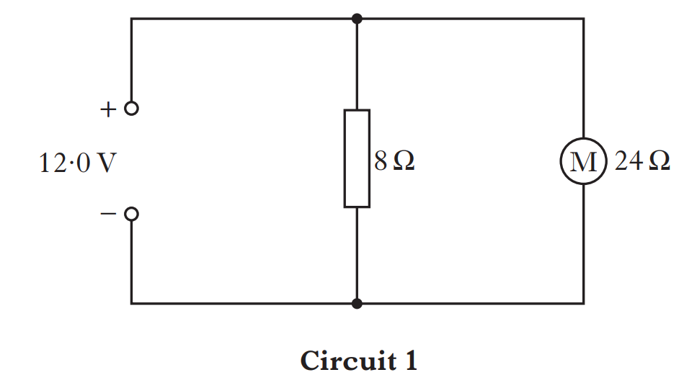
A technician builds a test circuit containing a resistor and a motor, as shown in Circuit 1.
State the voltage across the motor.
Answer
12 V

Slide 13
A technician builds a test circuit containing a resistor and a motor, as shown in Circuit 1.
Calculate the combined resistance of the resistor and the motor.
Answer
6 Ω

Slide 14
State the frequency of the UK mains supply
Answer
50 Hz

Slide 15
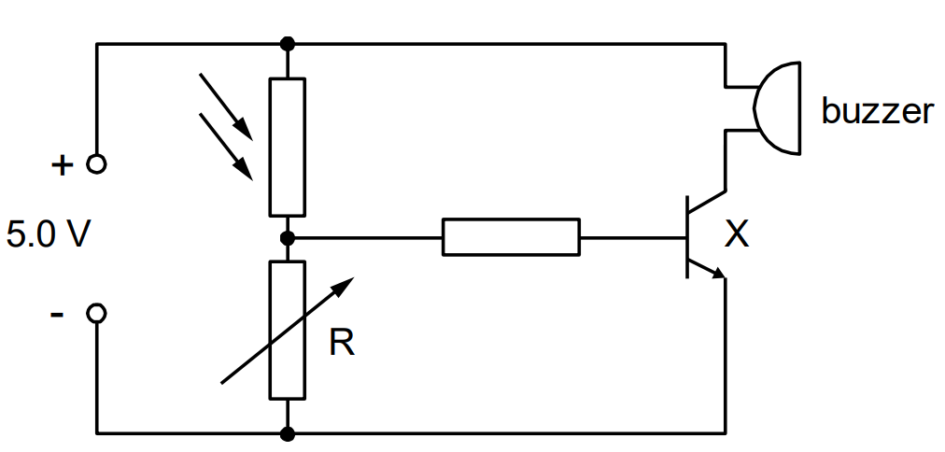
Name component X
Answer
(npn) transistor

Slide 16
State the purpose of component X
Answer
To act as a switch

Slide 17
State the purpose of the variable resistor in this circuit.
Answer
to set the light level at which the transistor will switch on

Slide 18
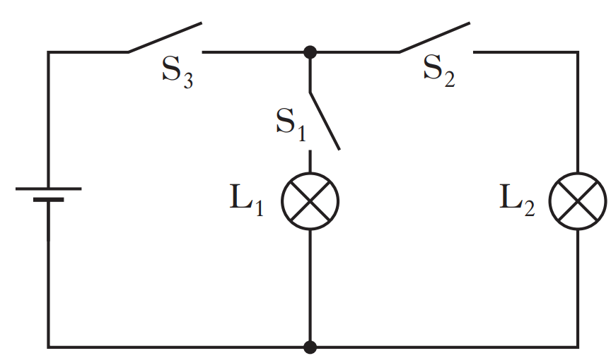
A circuit is set up as shown.
Which switch or switches must be closed to light lamp L₁ only?
A S₁ only
B S₂ only
C S₁ and S₂ only
D S₁ and S₃ only
E S₂ and S₃ only
Answer
D

Slide 19
Which of the following statements is/are correct?
The voltage of a battery is the number of joules of energy it gives to each coulomb of charge.
A battery only has a voltage when it is connected in a complete circuit.
Electrons are free to move within an insulator.
A I only
B II only
C III only
D II and III only
E I, II and III
Answer
A

Slide 20
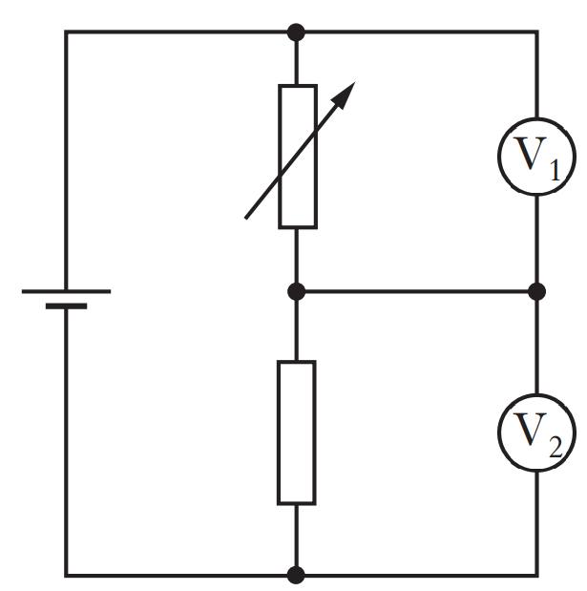
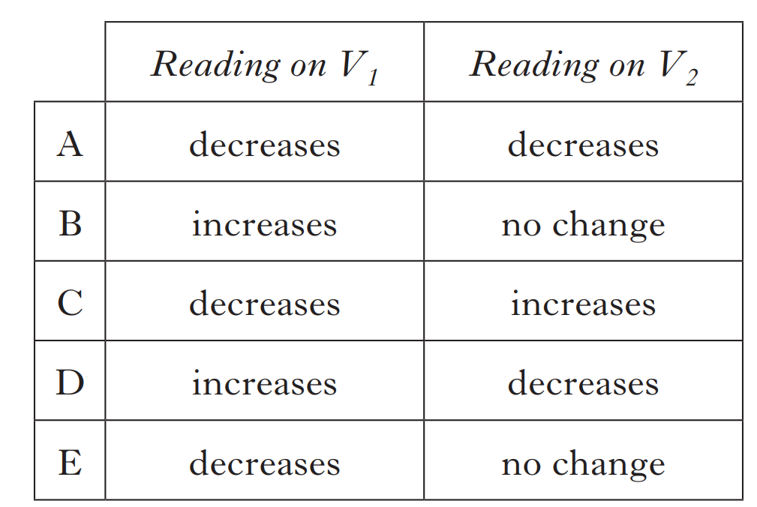
In the potential divider circuit shown, the resistance of the variable resistor is increased.
Which row in the table shows the effect of this on the voltmeter readings?
Answer
D

Slide 21
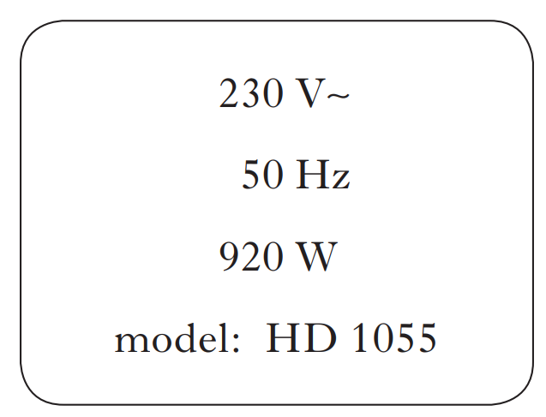
The rating plate on an electrical appliance is shown.
The resistance of this appliance is
A 0·017 Ω
B 0·25 Ω
C 4·0 Ω
D 18·4 Ω
E 57·5 Ω .
Answer
E

Slide 22
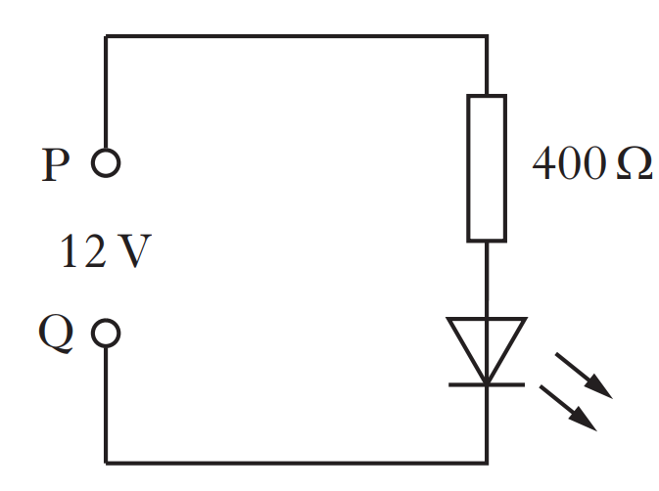
The circuit for the laser LED is shown below.
Which terminal of the supply, P or Q, should be positive to enable the LED to light?
Answer
P

Slide 23
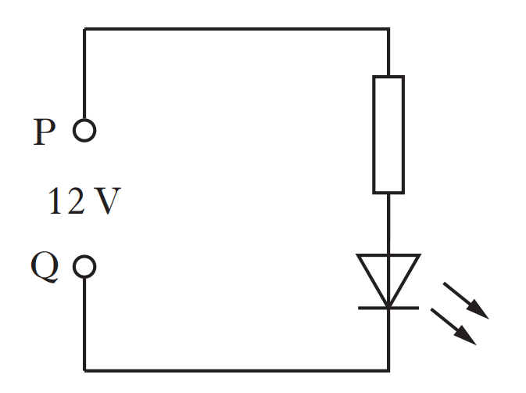
Determine the resistance of the resistor that allows the LED to light properly. The maximum voltage across the LED is 2.4 V and the maximum current is 1.5 mA
Answer
6400 Ω

Slide 24
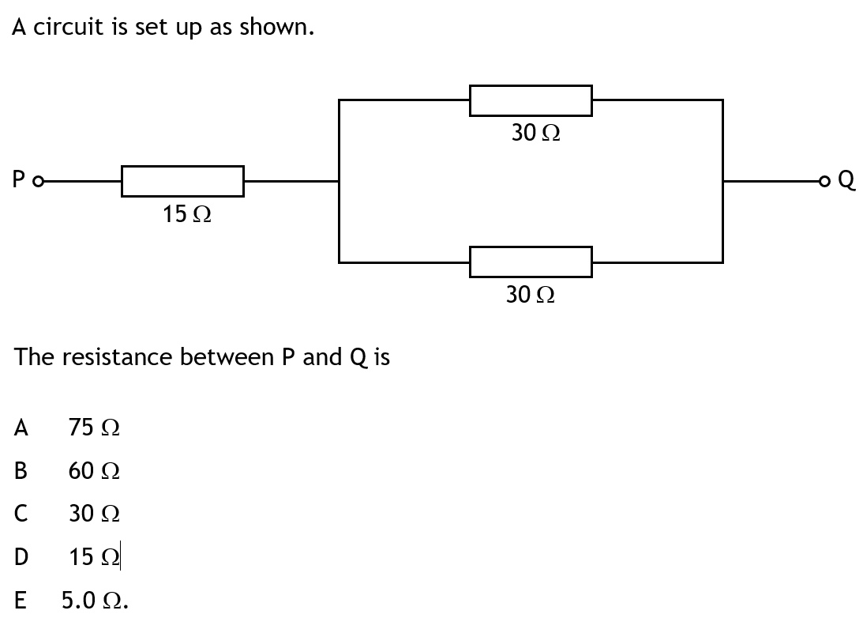
Answer
C

Slide 25
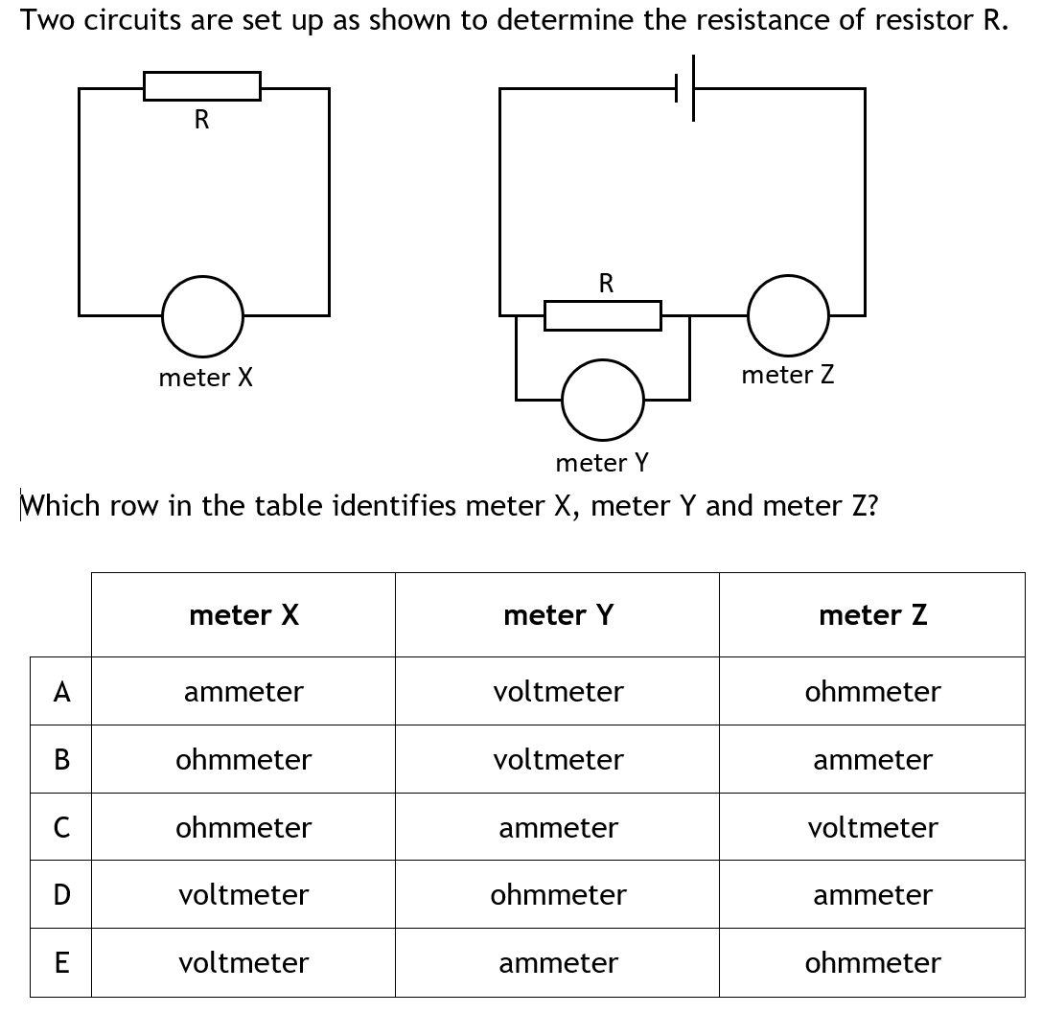
Answer
B

Slide 26
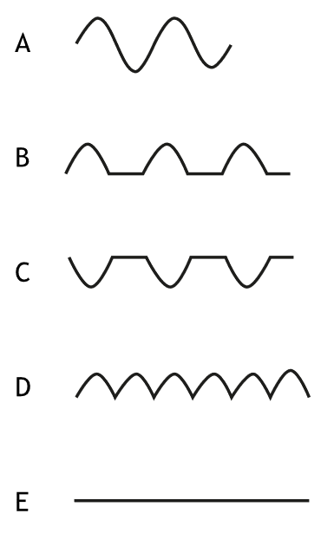
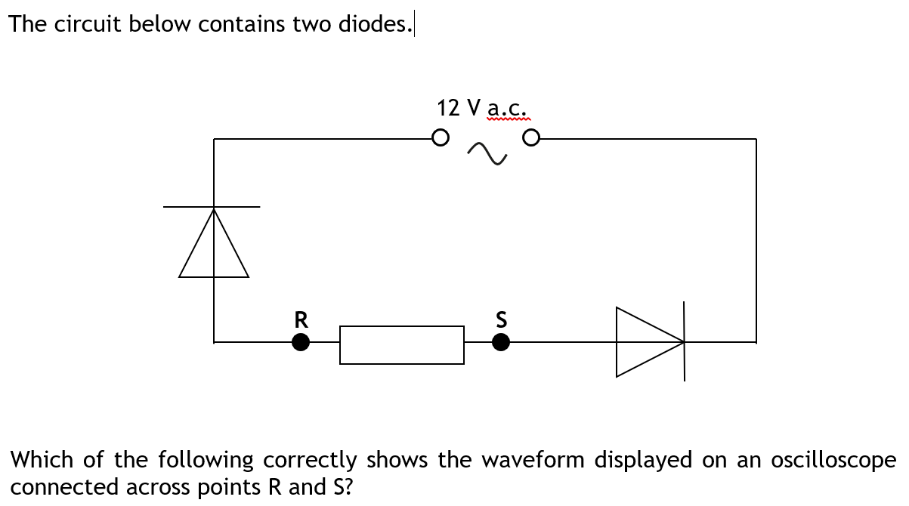
The circuit below contains two diodes
Which of the following correctly shows the waveform
Displayed on an oscilloscope connected
across points R and S?
Answer
E

Slide 27
A resistor is connected in series with an LED to prevent the LED being damaged.
A 6.0 V d.c. power supply is used.
When lit the current in the LED is 15 mA
and the voltage across it is 1.2 V.
The value of the series resistor is
A 400 Ω
B 320 Ω
C 80 Ω
D 72 Ω
E 0.018 Ω.
+
6.0 V
–
Answer
B

Slide 28
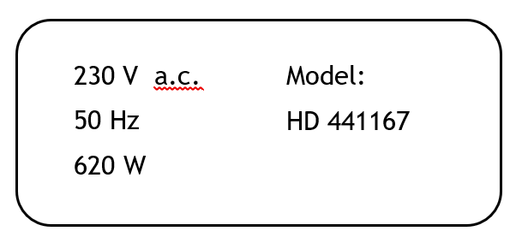
The rating plate on an electrical appliance is shown.
The correct fuse for this appliance is
A 1.0 A
B 2.0 A
C 3.0 A
D 5.0 A
E 13.0 A.
Answer
C

