Slide 1
Teacher Instructions:
As a whole class or in groups, split into two teams – red and blue
Red team has to claim hexagons to get across the board from top to bottom
Blue team has to claim hexagons to get across the board from left to right
All teams work on an answer as if the playing team gets it wrong, the other team can steal
Teams can choose hexagons to block opposing team
To play:
Teams take turns to select a hexagon by letter
Clicking on this takes you to the corresponding question
Clicking on the answer once displays the answer
Click again and you are returned to the game board where you can select the winning team colour
Continue with next team selecting a hexagon until one team has crossed the board.
Clicking on the winning team’s coloured star will light up the board.

Slide 2
B
L
O
C
K
E
U
I
G
F
L
S
T
J
C
W
Y
D
E
M
R
T
O
R
S

Slide 3
H
A
Q
S
F
E
L
I
G
N
U
P
B
Z
C
W
Y
D
V
M
R
T
O
X
K

Slide 4


Alpha radiation ionises an atom. Which statement describes what happens to the atom? A The atom splits in half. B The atom releases a neutron. C The atom becomes positively charged. D The atom gives out gamma radiation. E The atom releases heat.
Answer
C

Slide 5
A helium atom consists of electrons, neutrons and protons.
The nucleus contains
A electrons only
B neutrons and electrons
C protons and electrons
D protons and neutrons
E protons, neutrons and electrons.
Answer
D

Slide 6
A sample of tissue is irradiated using a radioactive source.
A student makes the following statements.
The equivalent dose received by the tissue is
I reduced by shielding the tissue with a lead screen.
II increased as the distance from the source to the tissue is increased.
III increased by increasing the time of exposure of the tissue to the radiation.
Which of the statements is/are correct?
A I only
B II only
C I and II only
D II and III only
E I and III only
Answer
E

Slide 7
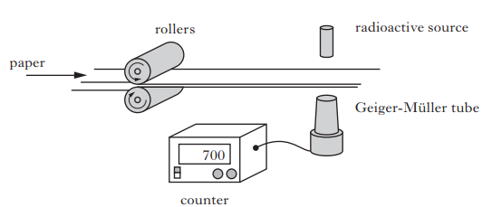
A paper mill uses a radioactive source in a system to monitor the thickness of paper.
Radiation passing through the paper is detected by the Geiger-Müller tube. The count rate is displayed on the counter as shown. The radioactive source has a half-life that allows the system to run continuously.
Does the count rate increase/decrease/ or stay the same if the thickness of the paper decreases?
Answer
increase

Slide 8
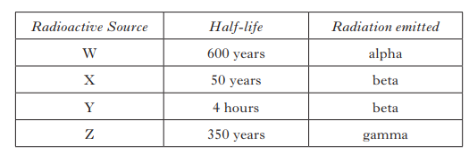
A paper mill uses a radioactive source in a system to monitor the thickness of paper.
Which source should be used?
Answer
Source X:
beta is required with a long half-life

Slide 9
State what is meant by the term half-life
Answer
Time taken for the activity to reduce by half

Slide 10
State what is meant by a gamma ray.
Answer
(high-frequency)
electromagnetic wave

Slide 11
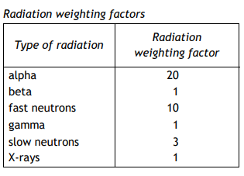
A scientist receives an absorbed dose of 20 mGy from gamma radiation. Calculate the equivalent dose received by the scientist.
Answer
20 mSv

Slide 12
A sample of the gamma source has an activity of 3MBq .
Calculate the number of decays in one minute.
Answer
180 million/ 1.8 x10⁸

Slide 13
Which row in the table describes alpha (α), beta (ß) and gamma (γ) radiations?
 | α | ß | γ
A | helium nucleus | electromagnetic radiation | electron from the nucleus
B | helium nucleus | electron from the nucleus | electromagnetic radiation
C | electron from the nucleus | helium nucleus | electromagnetic radiation
D | electromagnetic radiation | helium nucleus | electron from the nucleus
E | electromagnetic radiation | electron from the nucleus | helium nucleus
Answer
B

Slide 14
An airport worker passes suitcases through an X-ray machine.
The worker has a mass of 80 kg and on a particular day absorbs 7·2 mJ of energy from the X-ray machine.
Calculate the absorbed dose received by the worker.
Answer
9 x 10⁻⁵ Gy / 90 µGy

Slide 15
An airport worker passes suitcases through an X-ray machine.
The worker has a mass of 90 kg and on a particular day absorbs 8.4 mJ of energy from the X-ray machine. The worker receives an absorbed dose of 93 µGy
Calculate the equivalent dose received by the worker.
Answer
93 µSv

Slide 16
Explain what is meant by ionisation.
Answer
The gaining or losing of electrons from atoms

Slide 17
Calculate how many nuclei would decay during a 5 minute period when the sample has an activity of 4 × 10¹²Bq.
Answer
1.2 × 10¹⁵

Slide 18
A nuclear reactor produces
2·4 × 10⁹ J of energy every minute.
Calculate the power produced by the reactor.
Answer
40 MW or 4 ×10⁷W

Slide 19
A student makes the following statements.
I The nucleus of an atom contains protons and electrons.
II Gamma radiation produces the greatest ionisation density.
III Beta particles are fast moving electrons.
Which of the statements is/are correct?
A I only
B II only
C III only
D I and III only
E II and III only
Answer
C

Slide 20
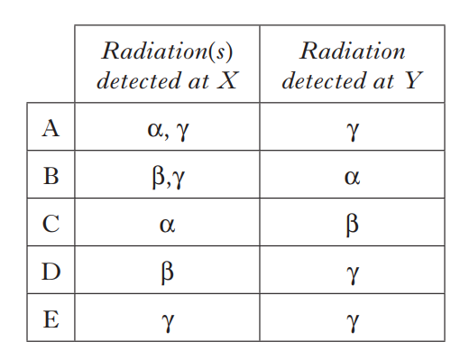
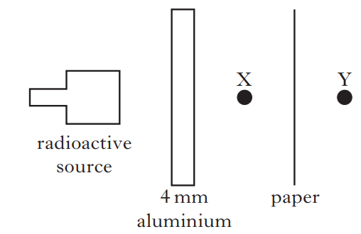
A radioactive source emits α, β and γ radiation. Sheets of aluminium and paper are placed close to the source as shown.
Which row in the table shows the radiation(s) from the source detected at points X and Y?
Answer
E

Slide 21
A student makes the following statements about radiation.
I The half life of a radioactive source is half of the time it takes for its activity to reduce to zero.
II The activity of a radioactive source is the number of decays per minute.
III The risk of biological harm from radiation depends on the type of tissue exposed.
Which of the statements is/are correct?
A I only
B II only
C III only
D II and III only
E I, II and III
Answer
C

Slide 22
Which of the following describes the term ionisation?
A An atom losing an orbiting electron.
B An atom losing a proton.
C A nucleus emitting an alpha particle.
D A nucleus emitting a neutron.
E A nucleus emitting a gamma ray
Answer
A

Slide 23
State what is meant by a radiation weighting factor.
A measure of the biological effect of a radiation
Answer

Slide 24
In a medical procedure, a radioactive chemical is injected into a patient.
The chemical is prepared by the technician from a source which has an activity
of 320MBq.
The source has a half-life of 6 hours.
Calculate the activity of the source 18 hours later.
Answer
40 MBq (3 t_{½} )

Slide 25
During a scan of the patient’s brain, the absorbed dose is measured as 1·5 mGy.
The mass of the brain is 1·4 kg.
Calculate the energy absorbed by the brain during the scan.
Answer
2.1 mJ or 2.1 ×10³ J

Slide 26
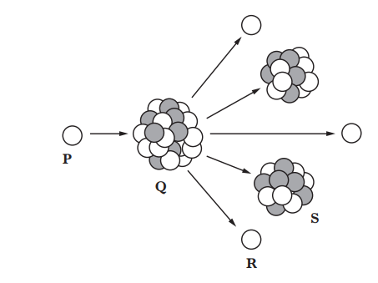
What type of nuclear reaction is shown in the diagram?
Answer
Fission

Slide 27
State the name of particle P.
Answer
(slow) neutron

Slide 28
State the average annual effective dose limit for a member of the public in the UK.
Answer
1mSv

