Slide 1
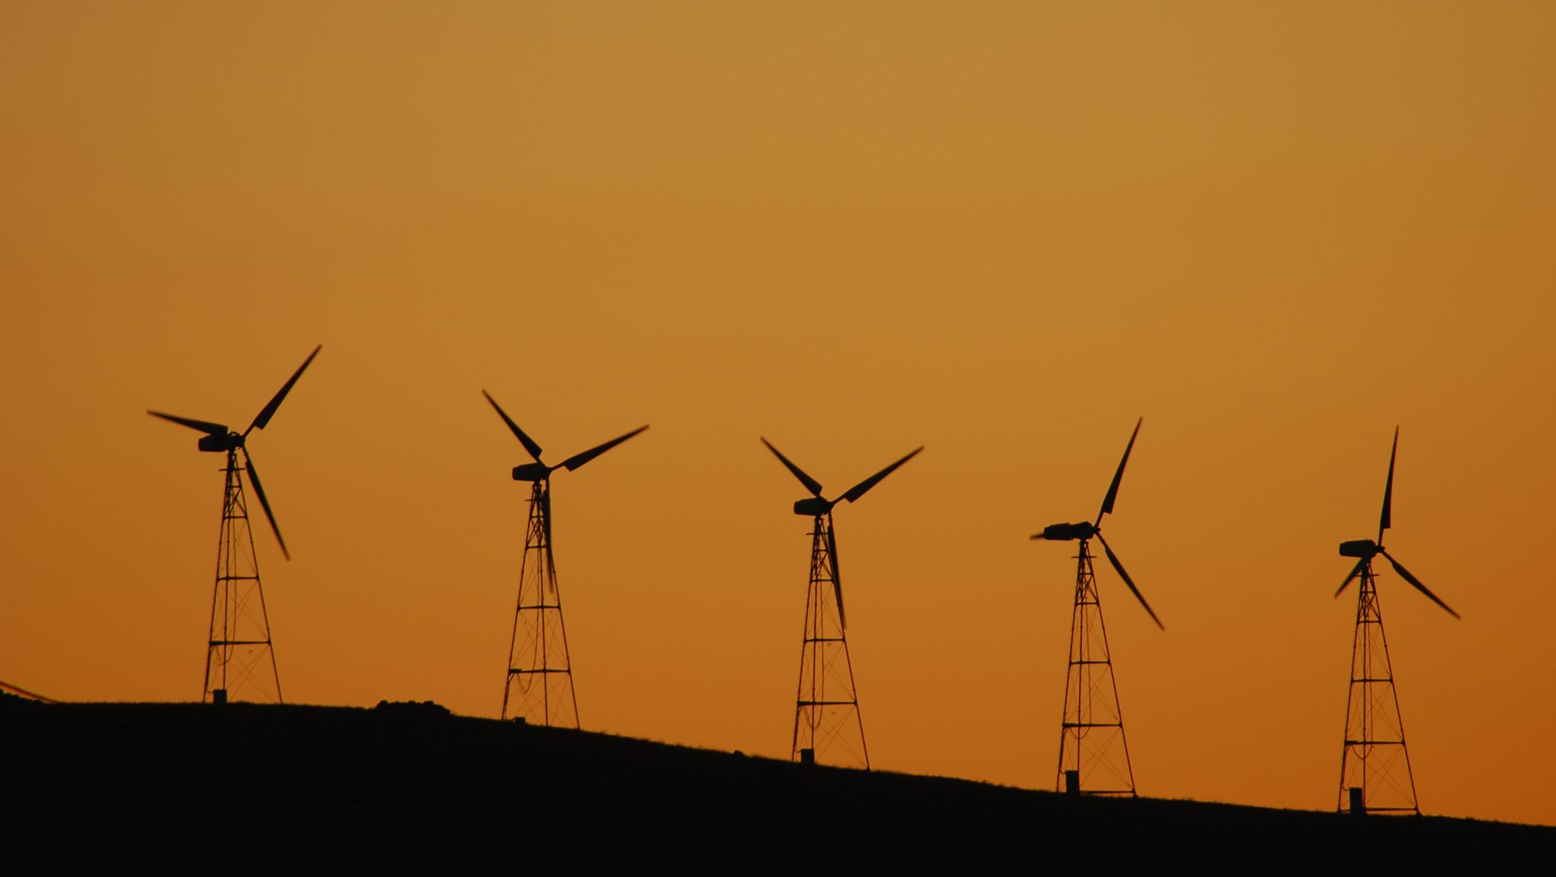
Energy Revision
S1

Slide 2
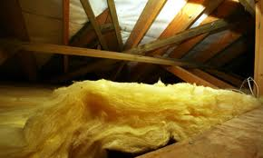
Concepts covered
Forms of energy- Thermal/Heat energy
Heat transfer- Solids by Conduction
- Fluids by convections
- Radiation
Insulating Houses to reduce energy bills
Renewables advantages and Disadvantages

Slide 3
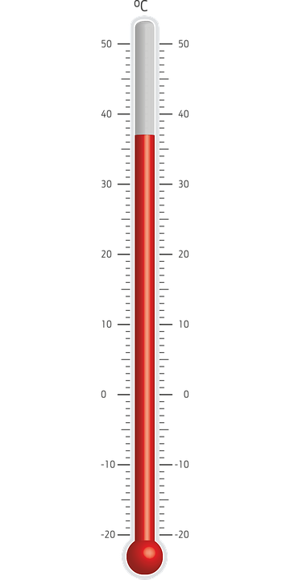
Heat versus Temperature
There is a difference between heat and temperature.
Heat is a form of energy.
Temperature is a measure of how hot or cold something is.
There unit of measurement is different.
Heat energy is in Joules
Temperature is in Degrees Celsius.

Slide 4
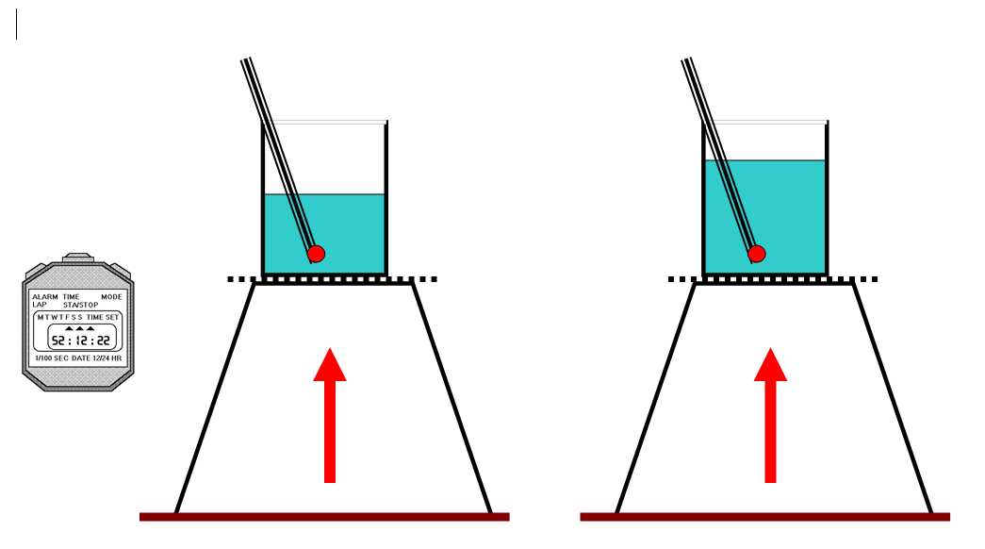
Which beaker will heat up first?
Why?
What type of heat transfer is occurring ?

Slide 5
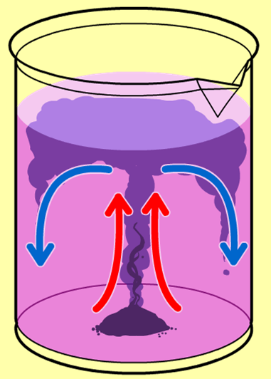
Convection currents
In the middle of a beaker a purple crystal is added to the beaker using a straw.
The heated fluid rises taking the purple dye with it, the colder fluid sinks down to take its place and the purple dye falls. This sets up a convection current. Eventually the water will reach its maximum temperature of 100 Degrees Celsius.

Slide 6
Radiation Brain dump

Slide 7
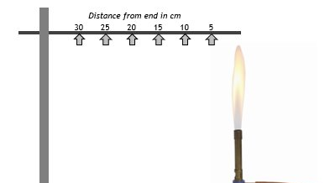
What is the method of heat transfer along the metal rod?

Slide 8
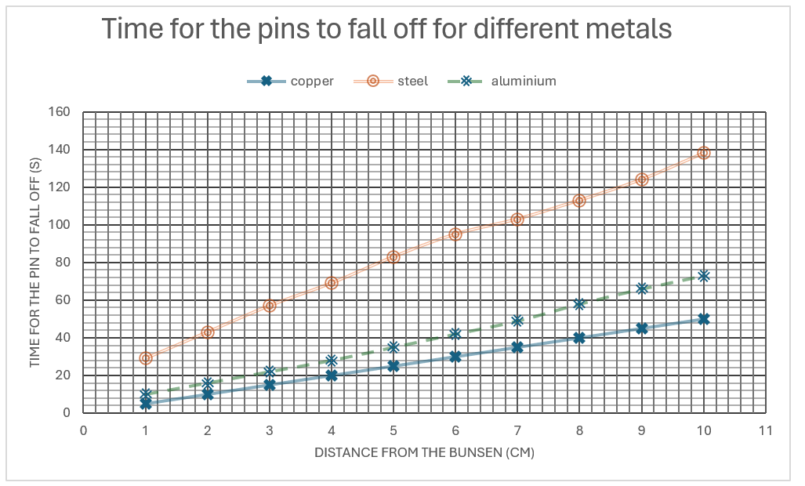
Which rod is the best conductor of heat and which is the worst?

Slide 9
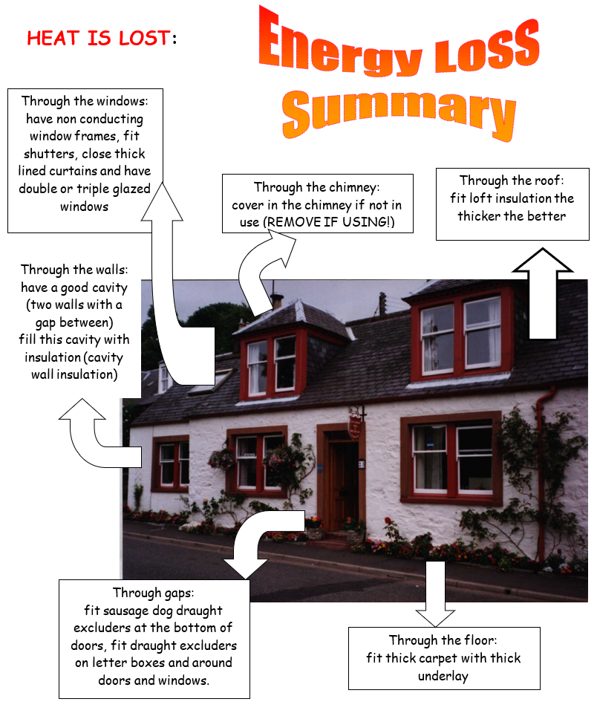
Insulating houses brain dump

Slide 10
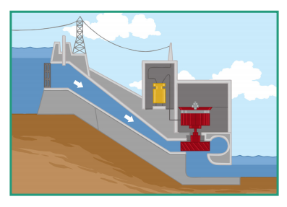
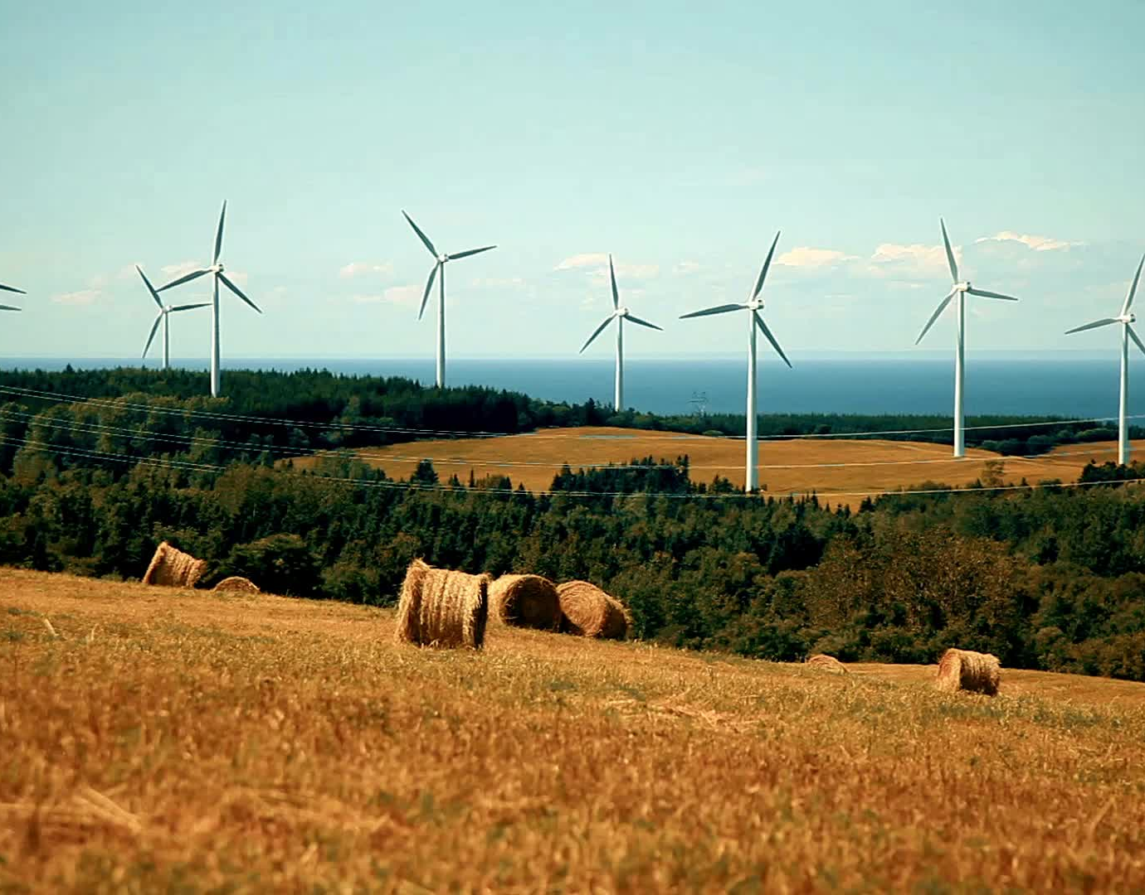
Renewables
Name the 2 renewable sources of energy in the pictures.
Name the natural resource
State one advantage
State on disadvantage

Slide 11
Everyday heat transfer name as many as you can in 3 minutes
Conduction | Convection | Radiation

