Slide 1
Dynamics and Space Revision
March 2017
Name: ____________________________________________

Slide 2
Describe the difference between a scalar and vector.

Slide 3
List 4 vector quantities and 5 scalar quantities
Scalar | Vector

Slide 4
In the relationship v = u + at, state what each symbol represents and the units of each

Slide 5
Sketch a velocity–time graph to show how the velocity of the car varies during the test run.
During a test run, a car starts from rest on a straight, flat track.
For the first 2 s of its motion it has a constant acceleration. It then travels at a constant velocity for a further 3 s.
Numerical values are only required on the time axis.

Slide 7
A fork –lift truck us used to load a crate of mass 200kg onto a lorry.
It has to drive 12m to the lorry and then lift the crate up 1.5 m on to the lorry. The driving force is 500N and the energy available for the operation is 8000J. Will the fork lift truck be able to load the crate onto the lorry?

Slide 9
State Newton’s Three Laws of Motion

Slide 10
Label the forces

Slide 11
Weight
Are these examples of balanced forces or Newton Pairs?

Slide 12
What can you infer about the size of the forces in the example below?

Slide 13
State the forces on the car and the corresponding Newton Pair.

Slide 14
What is the name given to this type of diagram?
Label the forces on the diagram.

Slide 15
Calculate the accelerations and the distance travelled in the first 5s and the total distance travelled
C
A
B
D
O

Slide 17
A car drives 60 km north, then 80 km east, as shown in the diagram. The journey takes 2 hours. Calculate the
a) distance travelled
b) displacement
c) average speed
d) average velocity.

Slide 18
The brakes of a car exert a force of 500N to stop the car. If the braking distance is 67m how much work is done by the brakes to stop the car.
What happens to the kinetic energy of the car?

Slide 19
Explain how to measure the acceleration of a trolley as it rolls down a slope

Slide 20
Sketch a graph of the velocity against time for a parachutist from the moment they jump out of the plane to when they land
Describe each part of the journey, making references to the forces involved

Slide 22
Explain the term terminal velocity and explain how this arises.

Slide 23

A rocket, of mass 300kg, on a launch pad produces a thrust of 2500 N. Describe what happens to the rocket.

Slide 24
A ball is kicked horizontally off a bench. a) Sketch the path taken by the ball. b) describe, in detail, the motion of the ball.

Slide 26
Space Exploration
Give two risks and two benefits of space exploration

Slide 27
Explain the difference in motion between an object dropped from 2m on the Earth and one dropped from the same height on the Moon.

Slide 28
Describe what is special about the orbit of a geostationary/ geosynchronous satellite

Slide 29
State what you can infer about satellite periods from the table below
Height of orbit (km) | Period (h)
200 | 1.5
700 | 1.6
1 000 | 1.8
1 414 | 1.9
10 000 | 5.8
20 000 | 11.9
35 786 | 24.0

Slide 30
A 5kg object is taken to the moon
State the value of the mass at the three points in its journey.
Position | Mass (kg)
On Earth
In space ship during the journey
On the moon

Slide 31
Show by calculation that a light year is 9.47 × 10¹⁵ m

Slide 32
Give one example of how space exploration has impacted on everyday life.

Slide 33
Why does re-entry to a planet’s atmosphere pose a challenge to spacecraft designers and engineers?

Slide 34



Name the different spectra

Slide 35





Identify the elements in this star spectrum
H
He
C
N
O

Slide 36
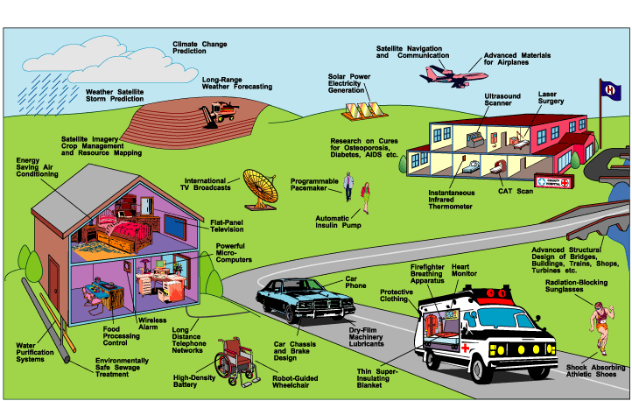
How many of these NASA spinoffs have you used recently?

Slide 37
Define the following terms
Term | Definition
Planet
Moon
Star
Sun
Galaxy
Solar System
Universe
Comet

Slide 38
Put the following in order of size from the largest to the smallest.
Term
Planet
Moon
Star
Sun
Galaxy
Solar System
Universe
Comet

Slide 39
Calculate the amount of heat energy required to melt 0.3 kg of ice at 0 °C.
(Specific latent heat of fusion of ice = 3.34 x 10⁵ J/kg)

Slide 40
The graph below shows how the temperature of a 2 kg lump of solid wax varies with time when heated.
A) Explain what is happening to the wax in the regions AB, BC and CD.
B) If a 200 W heater was used to heat the wax, calculate the specific latent heat of fusion of the solid wax.

