Slide 1
N5 Physics Revision
Past paper selector
Questions on required experiments (descriptions and improvements)
Questions that require explanations
Suggestions for
Open Ended Questions
Questions that require drawing graphs
Questions on unfamiliar
Physics
Questions that require drawing sketches

Slide 2
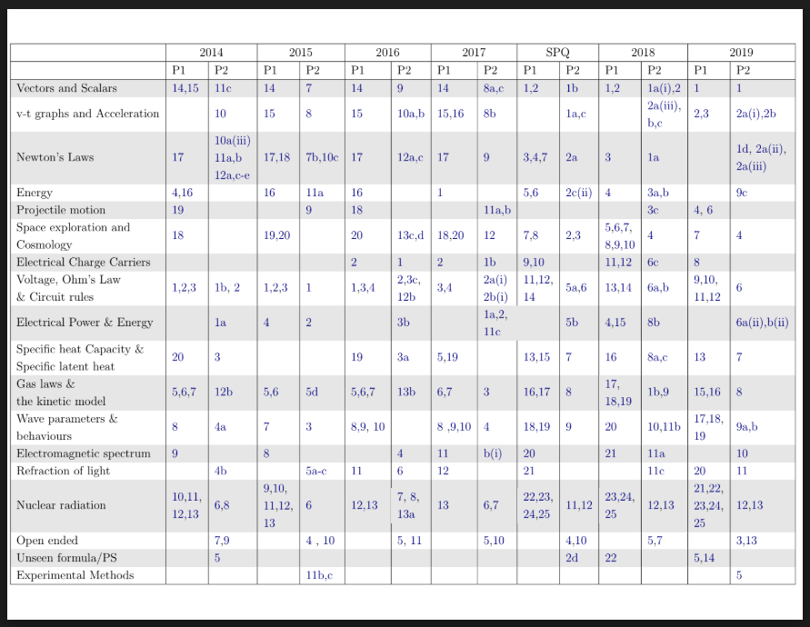
Descriptions of Experiments
←
Read experiment summary document (opens in external tab)
Complete past paper questions as follows.
Average and instantaneous speed | 2024 MC Q2, 2023 MC Q2, 2018 Q2ai
Acceleration | 2020 2a, 2015 Q8ai
Half-life | 2024 MC Q25, 2023 Q14ai, 2020 Q12biii, 2019 Q12a, 2018 Q13ai, 2014 Q6bi
Ohm’s Law | 2024 Q8aiii, 2016 Q2b
Gas laws | 2022 Q9a, 2018 Q9ai, SPQ Q8a,8d
Specific heat capacity | 2014 Q3, 2017 MC Q5, 2018 Q8a, 2023 MC Q16, 2024 MC Q15
Specific latent heat | 2018 Q8c
Improvement to experiments | 2014 3c, 2015 11b, 2016 6c, 2017 4aii, 2018 8aii, 2018 9b, 2018 13ci, 2019 5aiv, 2019 12b, 2020 11ciii, 2022 2aiii, 2022 9c, 2023 7b, 2024 11bii

Slide 3
N5 Physics Revision
Past paper selector
Questions on required experiments (descriptions and improvements)
Questions that require explanations
Suggestions for
Open Ended Questions
Questions that require drawing graphs
Questions on unfamiliar
Physics
Questions that require drawing sketches

Slide 4
Explanation Questions topic selection
←
🏎️ Dynamics 🏎️
🌡️ Properties of matter 🌡️
⚡ Electricity ⚡
🪐 Space 🪐
☢️ Radioactivity ☢️
〰️ Waves 〰️

Slide 5
Common Explanation Questions
←
🏎️ Dynamics 🏎️
Vectors and scalars | 2016 9bii, 2023 1bii
Free body diagrams and Newton’s Laws | 2014 10e, 2014 12c, 12e, 2015 7b, 2016 10c, 2017 9a, SPQ 1cii, SPQ 2ci, 2019 1d, 2023 2ci
Energy conservation | 2018 3bii, 2019 9cii, 2020 3bii, 2023 1ciii
Projectile motion | 2017 Q11bi, Sketch questions: 2015 Q9a, 2018 Q3c, 2023 Q2a, 2024 Q3b

Slide 6
Common Explanation Questions
←
⚡ Electricity ⚡
AC/DC | 2017 1b, 2024 7a
Switches | 2014 1bii, 2015 1c, 2020 6b, 2023 6bii
Resistors | 2019 5b, 2020 6ai, 2022 6cii,
NPN and MOSFET (transistors) | 2014 2bi, 2014 2bii, 2016 3c, SPQ 6a, 2020 7bi, 2022 7c, 2024 7c
Power | 2017 2bii, SPQ 5b, 2019 6bii,

Slide 7
Common Explanation Questions
←
☢️ Radioactivity ☢️
Nature of radiation, ionisation and activity | 2016 Q7c, SPQ 12c, 2019 12d, 2022 13a,bii, 2023 13a, 2023 13b
Dosimetry equations
Half life | SPQ 11b, 2018 12b
Fission and fusion | 2016 13a, 2017 Q7b, 2020 13a, 2022 14bii, 2024 15b,c,d

Slide 8
Common Explanation Questions
←
🌡️ Properties of matter 🌡️
Specific heat capacity and specific latent heat | 2016 3bii, SPQ Q7cii, 2018 Q8aii, 2019 Q7biii, 2020 Q8c. 2022 8bii, 2023 8aii,8b, 2024 9bii
Gas laws and the kinetic model | 2017 Q3b, SPQ Q8aii,8c, 2018 1b, 2018 9aii, 2019 8cii, 2020 9bii, 2022 9d, 2023 9aiii, 2024 10aii

Slide 9
Common Explanation Questions
←
🪐 Space 🪐
Space and Cosmology | 2016 Q12b, 2016 Q13d, SPQ Q2b,c, SPQ Q2d, 2018 Q4b, 2019 Q4b,c 2020 4c,dii, 2022 3b, 2022 Q5b, 2022 Q5c, 2023 Q3a, 2024 Q4b, 2024 Q4c, 2024 Q15a

Slide 10
Common Explanation Questions
←
〰️ Waves 〰️
Wave parameters & behaviours | 2015 3d, 2019 9b, 2023 10bii, 2024 12c
Diffraction | 2017 4d, 2023 11b,
Refraction | 2018 11cii, 2019 11b, 2024 12bi,

Slide 11
N5 Physics Revision
Past paper selector
Questions on required experiments (descriptions and improvements)
Questions that require explanations
Suggestions for
Open Ended Questions
Questions that require drawing graphs
Questions on unfamiliar
Physics
Questions that require drawing sketches

Slide 12
Open Ended Questions
←
Vaguely categorised!
Dynamics | 2016 Q11
Electricity | 2018 Q7, 2020 Q10
Radioactivity | 2017 Q5, 2019 Q13, 2024 Q13
Properties of matter | 2015 Q4, 2017 Q10, 2022 Q12b
Space | 2014 Q9, 2015 Q10, SQP Q4, 2018 Q5, 2019 Q3, 2020 Q5, 2022 Q4, 2023 Q4, 2024 Q5
Waves | 2014 Q7, 2016 Q5, 2023 Q12

Slide 13
N5 Physics Revision
Past paper selector
Questions on required experiments (descriptions and improvements)
Questions that require explanations
Suggestions for
Open Ended Questions
Questions that require drawing graphs
Questions on unfamiliar
Physics
Questions that require drawing sketches

Slide 14
Graph drawing
←
Dynamics | SQP Q8a, 2015 Q11b, 2022 Q2a
Electricity | 2019 Q5a, 2023 Q7a, 2024 Q8a
Radioactivity | 2018 Q13b
Properties of matter
Space
Waves | 2020 Q11c

Slide 15
N5 Physics Revision
Past paper selector
Questions on required experiments (descriptions and improvements)
Questions that require explanations
Suggestions for
Open Ended Questions
Questions that require drawing graphs
Questions on unfamiliar
Physics
Questions that require drawing sketches

Slide 16
Unfamiliar Physics
←
Dynamics | SQP Q2d, 2018 Q22, 2020 Q4, 2024 Q18
Electricity
Radioactivity
Properties of matter | 2019 Q14, 2021 Q18
Space | 2023 Q6
Waves | 2014 Q5

Slide 17
N5 Physics Revision
Past paper selector
Questions on required experiments (descriptions and improvements)
Questions that require explanations
Suggestions for
Open Ended Questions
Questions that require drawing graphs
Questions on unfamiliar
Physics
Questions that require drawing sketches

Slide 18
Drawing questions
←
Dynamics | Velocity time graphs 2018 Q2c 2023 Q2bii | Free body diagrams 2015 Q7b 2016 Q10c 2019 Q8a 2022 Q3(ii) | Projectiles 2015 Q9a 2018 Q3c 2023 Q2a 2024 Q3b
Electricity | Circuit diagram 2015 Q1a 2016 2a | Transistor circuit 2022 Q7c(i) | Voltage current graph 2024 Q8b (V-I graph)
Properties of matter | 2017 Q3c (pV graph) | 2022 Q12a(ii) (Leslie’s cube)
Waves | Refraction 2014 Q4b (water) 2019 Q11ai ( prism) 2022 Q11a (semicircular) | Normal and angles 2015 Q5a (i and r) 2016 6a (normal, i,r) 2018 11c (normal, i,r) | Diffraction & waves 2017 Q4c (gap) 2020 Q11a (wave) 2022 Q10b (obstacle) 2024 Q11d (obstacle)

Slide 19
N5 Physics Revision
Past paper selector
Questions on required experiments (descriptions and improvements)
Questions that require explanations
Suggestions for
Open Ended Questions
Questions that require drawing graphs
Questions on unfamiliar
Physics
Questions that require drawing sketches

Slide 20
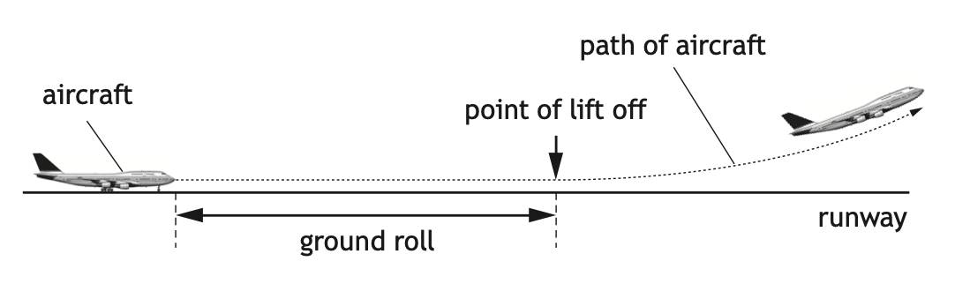
Dynamics
←
Open ended questions
2016 Q11
The length of runway required for aircraft to lift off the ground into the air is known as the ground roll.
This is quite a hard Open Ended Question!
Good answers relate to what affects the ground roll. Lift (the upward force) is provided by the wings - this lift must be greater than the weight (so a free body diagram might be good to include) for the plane to take off. The lift force is dependent on the speed of the air flow over the wings…so what would affect the speed of the aircraft?
Speed is dependent on the acceleration, which is given by a = F/m. The thrust of the engines provides the forward force, so a bigger more powerful engine would provide more thrust. However bigger engines and bigger planes have more mass, so the acceleration may consequently be reduced. If there is a wind acting against or in the same direction the plane is moving this would also affect the unbalanced force. And air resistance will increase as the plane gets faster, so acceleration may reduce as it speeds up.
Ultimately the rate of acceleration determines how long the ground roll needs to be.
The ground roll of an aircraft varies for each take-off.
Use your knowledge of physics to comment on why the ground roll of an aircraft varies for each take-off.
Notes:
a = 0.19 ms-2

Slide 21
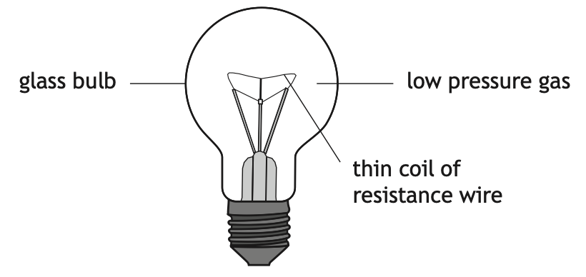
Electricity
←
Open ended questions
2018 Q7
A filament lamp consists of a thin coil of resistance wire surrounded by a low pressure gas, enclosed in a glass bulb.
Two main things to consider here.
The thin coil of resistance wire. This gives you the opportunity to show off your understanding of resistance, voltage and current. What happens to the electrons as they flow through this thin wire…what causes it to glow? Why is a thin wire used and not a thick wire? Is it important that it is in a coil? Discussions about ohmic vs non-ohmic resistors would be appropriate here too.
The low pressure gas - why is a low pressure gas used? Are there considerations to Gay-Lussac’s law? Could you describe what happens to a gas and its pressure when the gas is heated, as will inevitably happen when the bulb is lit? Does this give a reason why a low pressure gas is used? Also why is a gas in there at all…why not have no gas in the bulb?
Using your knowledge of physics, comment on the suitability of this design as a light source.
Notes:
a = 0.19 ms-2

Slide 22
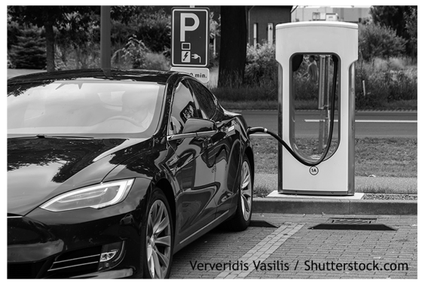
Electricity
←
Open ended questions
2020 Q10
Physics points to consider:
E_{w} = Fd. The energy stored in the battery causes a force to be applied over a certain distance. Moving an electric car requires a large amount of force, as they are heavy, so for them to accelerate, since a = F/m, a larger force is required for a larger mass to provide the same rate of acceleration.
Knowing the force the engine exerts on the car would allow you to determine the distance the car can travel, assuming we know the energy the battery stores.
However, some energy is always lost as heat. This relates to the efficiency of the engine. If more energy is lost as heat, less is available to drive the wheels, which will reduce the distance the car can travel.
Range can also be affected by air resistance - the faster you travel, the greater the air resistance and the greater effect this will have on how far you can travel.
Temperature also affects the efficiency of batteries, so range is lower in the colder months.
Electric vehicles are being promoted as an environmentally friendly method of transport.
Currently one of the limitations of electric vehicles is their range. The range is the maximum distance that an electric vehicle can travel before its batteries need to be recharged.
Using your knowledge of physics comment on possible factors affecting the range of an electric vehicle.
Notes:
a = 0.19 ms-2

Slide 23
Radioactivity
←
Open ended questions
2017 Q5
This is an opportunity to state just what the question is looking for….properties of alpha, beta and gamma….
range of travel
penetration ability and what materials absorb them
ionising ability and radiation weighting factor
composition (what are they made of)
uses/applications of each kind of radiation
This is a fairly easy OEQ to get good marks.
Alpha, beta and gamma are types of nuclear radiation, which have a range of properties and effects.
Using your knowledge of physics, comment on the similarities and/or differences between these types of nuclear radiation.
Notes:
a = 0.19 ms-2

Slide 24
Radioactivity
←
Open ended questions
2019 Q13
Key things to communicate:
Nuclear fission is splitting the nucleus of the large unstable atom
Nuclear fusion is joining small nuclei together to form larger nuclei.
Both processes result in the release of energy.
Nuclear fission has products which have long half-lives and therefore remain radioactive for a long time. This is known as nuclear waste and creates a storage problem for generations to come.
Nuclear fission however is well understood and currently is sustainable using controlled chain reactions in nuclear reactors - it is a viable method for generating electricity that does not result in emission of CO₂ in the generation process.
Fusion however is not currently viable. Discussions about the challenges of fusion, namely the large amount of heat energy required to produce plasma, and then the requirement to contain this plasma using magnetic fields so that the nuclei can fuse together, should be included.
A physics teacher makes the following statement.
‘Instead of nuclear fission, perhaps one day nuclear fusion will become a practical source of generating energy.’
Using your knowledge of physics, comment on the similarities and/or differences between using nuclear fission and nuclear fusion to generate energy.
Notes:
a = 0.19 ms-2

Slide 25
Radioactivity
←
Open ended questions
2024 Q13
Physics to consider:
This question primarily relates to the difference between ionising and non-ionising radiation. Nuclear radiation, i.e., radiation emitted from the nucleus of the atom, is ionising (alpha, beta and gamma). These types of radiation can ionise the atoms in our body, changing the chemical structure and potentially causing cells to mutate.
Non-ionising radiation, for example radio waves, microwaves and infrared have different sources, and are considered safer. However microwaves emitted from a microwave oven high intensity, and can heat molecules of water.
Since our body is made of water exposing ourselves to the amount of power generated by a microwave oven would be dangerous, however low intensity microwaves from mobile phones and wifi routers are not dangerous.
Same can be said for infrared. It is not dangerous, but from high power sources the amount of IR could burn our skin.
Two students are discussing radiation.
The first student states: ‘All radiation is dangerous, so we should never allow ourselves to be exposed to it.’
The second student states: ‘No, it’s only nuclear radiation that we need to worry about.’
Using your knowledge of physics, comment on the students’ statements.
Notes:
a = 0.19 ms-2

Slide 26
Properties of matter
←
Open ended questions
2015 Q4
A science technician removes two metal blocks from an oven. Immediately after the blocks are removed from the oven the technician measures the temperature of each block, using an infrared thermometer. The temperature of each block is 230 ºC.
After several minutes the temperature of each block is measured again. One block is now at a temperature of 123 ºC and the other block is at a temperature of 187 ºC.
The main focus of this question relates to specific heat capacity, but answers can include other reasons why one block cools much faster than the other.
Since, ΔT = E_{h}/mc, the temperature drop is dependent on the rate of heat loss, the mass of the block and the specific heat capacity of the block.
Firstly, specific heat capacity. You could define this, and explain that the block that cools down quicker may have a lower specific heat capacity. This means it needs to lose less energy for the temperature to drop by 1 degree.
Other factors that would affect the temperature drop include the mass of the blocks (the smaller mass would fall in temperature faster (see equation E_{h} = mcΔT)), but also the rate of energy transfer due to the colour of block, what surface the block is placed on and the surrounding temperature would affect how quickly the block loses heat energy and therefore changes temperature.
Using your knowledge of physics, comment on possible explanations for this difference in temperature.
Notes:
a = 0.19 ms-2

Slide 27
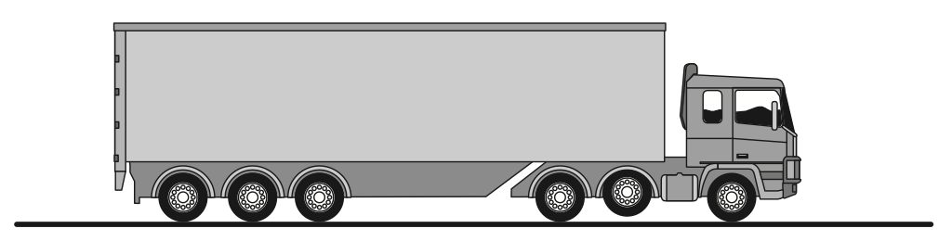
Properties of matter
←
Open ended questions
2017 Q10
Key areas to consider:
Why would lorry need to lower its wheels…?
To add more friction when it is slippy. You could discuss causes of reduced friction on road…gravel, moisture, ice etc. and explain what friction is.
When the lorry carries more load so there is more weight (explain how weight relates to mass) - this leads to ideas about pressure…
Pressure is force per unit area. If the weight is greater, the downward force is greater therefore the pressure would increase (as pressure = force/area).
To reduce this pressure, wheels would be lowered to increase surface area. This is important when the lorry is travelling over soft ground, were the large pressure could cause the lorry to get stuck.
An articulated lorry has six pairs of wheels.
One pair of wheels can be raised off the ground.
Using your knowledge of physics, comment on situations in which the wheels may be raised or lowered.
Notes:
a = 0.19 ms-2

Slide 28
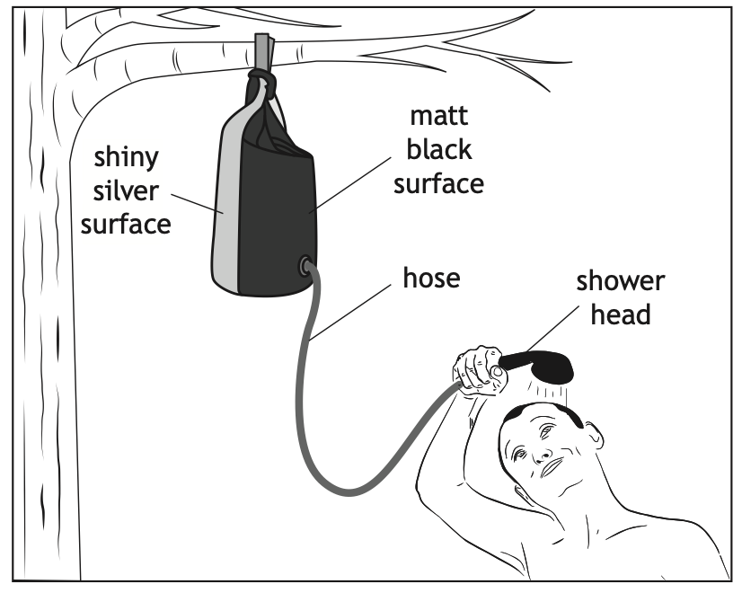
Properties of matter
←
Open ended questions
2022 Q12b
A solar shower consists of a heavy-duty plastic bag, with a matt black surface and a shiny silver surface, connected to a hose and shower head. The bag uses infrared radiation from the Sun to heat water for a shower, when camping.
Using your knowledge of physics, comment on how the solar shower works.
Physics to focus on:
Black colours absorb heat, whereas shiny surfaces reflect heat - and how this is utilised to make the shower bag.
Pressure changes of water in bag as liquid gets heated by sun.
Gravitational potential energy stored in the water converted to kinetic energy as it falls through the shower head.
Notes:
a = 0.19 ms-2

Slide 29
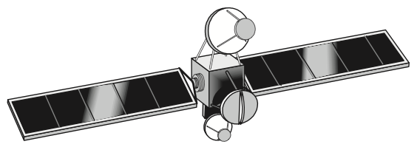
Space
←
Open ended questions
2014 Q9
A communications satellite is used to transmit live television broadcasts from the UK to Canada.
The premise of this question relates to a misunderstanding of the term geostationary satellite.
Define what a geostationary satellite is and state that for communication between UK and Canada via satellites the satellite needs to stay at the same location above the earth’s surface. A drawing would help with this.
Ground based transmitters (also likely to be satellite transmitters - you could explain how curved reflectors work) can send microwave signals to the fixed location in the sky where the satellite is, and this signal can then be amplified and relayed to the ground receiver in the other country.
However it is important to state clearly that a geostationary satellite is moving - it acts like a projectile with a horizontal velocity and a vertical acceleration, as it orbits the earth. It’s just that the earth spins on its own axis with the same period.
Could also discuss speed of signal and give examples of speed, distance and time calculations.
A student states that, to allow the live television broadcasts to be received in Canada, it is important that the satellite does not move.
Use your knowledge of physics to comment on this statement.
Notes:
a = 0.19 ms-2

Slide 30
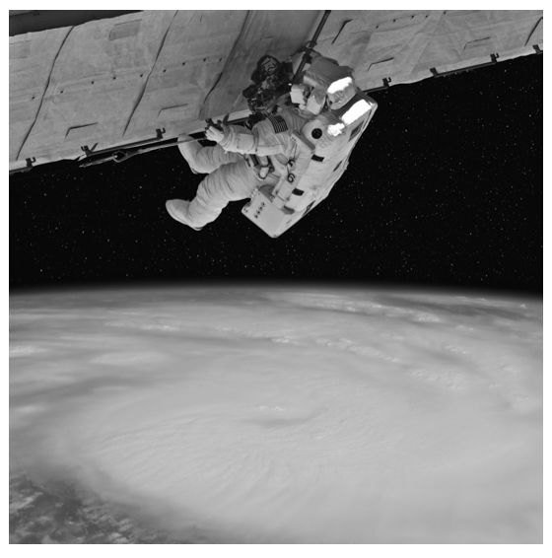
Space
←
Open ended questions
2015 Q10
This question links directly to learning intentions in the course spec document:
Awareness of the challenges of space travel:
travelling large distances with the possible solution of attaining high velocity by using ion drive (producing a small unbalanced force over an extended period of time)
travelling large distances using a ‘catapult’ from a fast moving asteroid, moon or planet
manoeuvring a spacecraft in a zero friction environment, possibly to dock with the ISS
maintaining sufficient energy to operate life support systems in a spacecraft, with the possible solution of using solar cells with area that varies with distance from the Sun
Awareness of the risks associated with manned space exploration: fuel load on take-off
potential exposure to radiation
pressure differential
re-entry through an atmosphere
Space exploration involves placing astronauts in difficult environments.
Despite this, many people believe the benefits of space exploration outweigh the risks.
Using your knowledge of physics, comment on the benefits and/or risks of space exploration.
Notes:
a = 0.19 ms-2

Slide 31
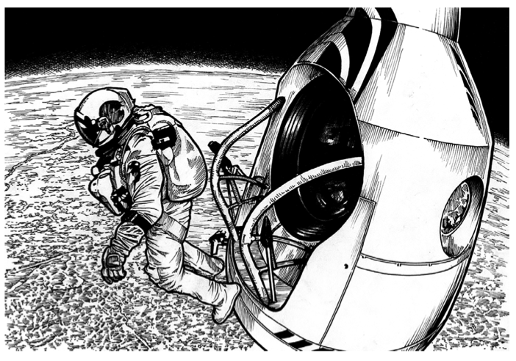
Space
←
Open ended questions
SQP Q4
In October 2012, a skydiver jumped from a balloon at a height of 39 km above the surface of the Earth.
He became the first person to jump from this height.
He also became the first human to fall at speeds higher than the speed of sound in air.
Points to consider relating to challenges:
Low air pressure in upper atmosphere causing breathing difficulties.
(not really significant but increased exposure to cosmic rays at these heights increases risk due to biological effects of nuclear radiation).
Extreme cold, as air traps heat from the sun, so low air pressure means very cold conditions.
Rate of acceleration is very high (equivalent to g due to lack of air resistance, resulting in rapid speed increase, as skydiver starts to travel through thicker atmosphere, greater air resistance produces heat (like shuttle re-entering atmosphere, risk of heat causing material to catch fire, or harm diver). This heat is caused by friction - can you explain how friction generates heat?
Challenges of deceleration - knowing when to deploy parachute so that diver comes to a suitable landing speed in time (as more time is required to decelerate from this high speed).
Using your knowledge of physics, comment on the challenges faced by the skydiver when making this jump.
Notes:
a = 0.19 ms-2

Slide 32
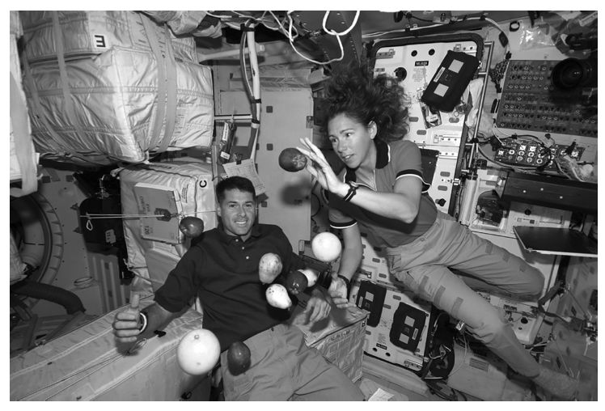
Space
←
Open ended questions
2018 Q5
A group of students are watching a video clip of astronauts on board the International Space Station (ISS) as it orbits the Earth.
Using your knowledge of physics, comment on the statement made by the student.
The key idea here is that the astronauts only appear to be weightless. The gravitational field strength where the ISS orbits is not that much less than on the surface of the Earth. To say that there is no gravity in space is a big error of understanding.
The ISS orbits because it is pulled to the earth due to gravity. Therefore everything and everyone inside it are also orbiting and being pulled to the Earth.
The difference is it also has a horizontal velocity (like a projectile) so it is falling toward Earth but never hit it. The Newton’s cannon ‘thought experiment’ could be describe here. Compare the motion of the ISS to a projectile.
One student states, ‘I would love to be weightless and float like the astronauts do on the ISS.’
Notes:
a = 0.19 ms-2

Slide 33
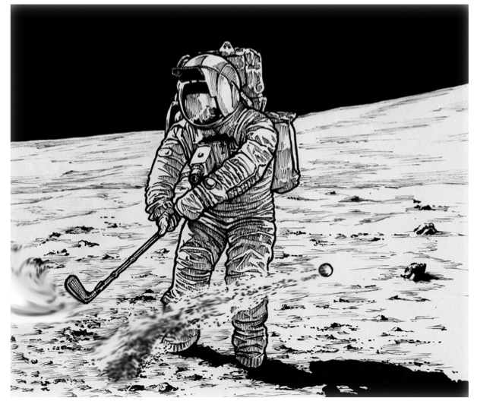
Space
←
Open ended questions
2019 Q3
In 1971, the astronaut Alan Shepard hit a golf ball on the surface of the Moon.
Points to consider:
Gravitational field strength on the moon is lower. This means that when the projectile is launched (hit by the club) it will travel higher as the rate of deceleration is lower (remember, gravitational field strength is equivalent to acceleration due to gravity). This also means it will travel farther horizontally as it will take longer to fall to the ground from a higher height.
Air resistance. There is no atmosphere on the moon, so there is no air resistance. With projectile motion on the earth, we assume the horizontal velocity is constant as there are no forces acting horizontally. In reality air resistance slows down the horizontal velocity. On the moon this would not happen and the horizontal velocity would actually be truly constant.
Also, the vertical acceleration of a golf ball on the Earth would be constantly changing, as when it travels upward and slows down, the air resistance would get less. However on the moon the vertical acceleration is not changing.
Using your knowledge of physics, comment on the similarities and/or differences between this event and hitting an identical ball on the surface of the Earth.
Notes:
a = 0.19 ms-2

Slide 34
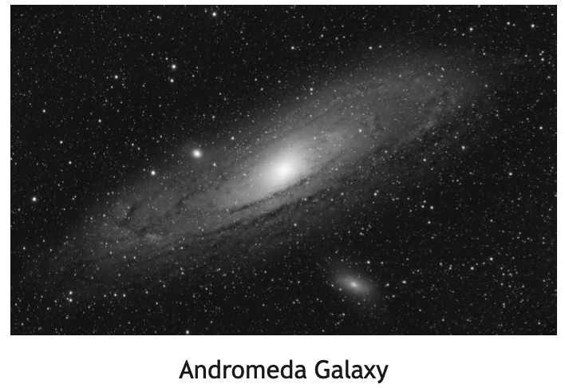
Space
←
Open ended questions
2020 Q5
The Andromeda Galaxy is more than 2 million light-years from Earth and is visible with the naked eye. However, there are many astronomical objects that are not visible with the naked eye.
Some ideas to consider:
Physical exploration - sending robots and people to different astronomical objects - could discuss the risks and benefits of manned space exploration.
Observation using telescopes
The light from stars and galaxies contains information about the chemical composition of stars. Could explain how line spectral information from starlight is used to determine the chemical makeup of the atmosphere of stars (and also exoplanets).
Information from different parts of the EM spectrum - each part of the EM spectrum tells information about the makeup of stellar objects - see this NASA link (opens in new tab) for more information.
Doppler effect - the redshift of light from galaxies tells us that the universe is expanding.
Using your knowledge of physics, comment on how astronomers obtain information about astronomical objects.
Notes:
a = 0.19 ms-2

Slide 35
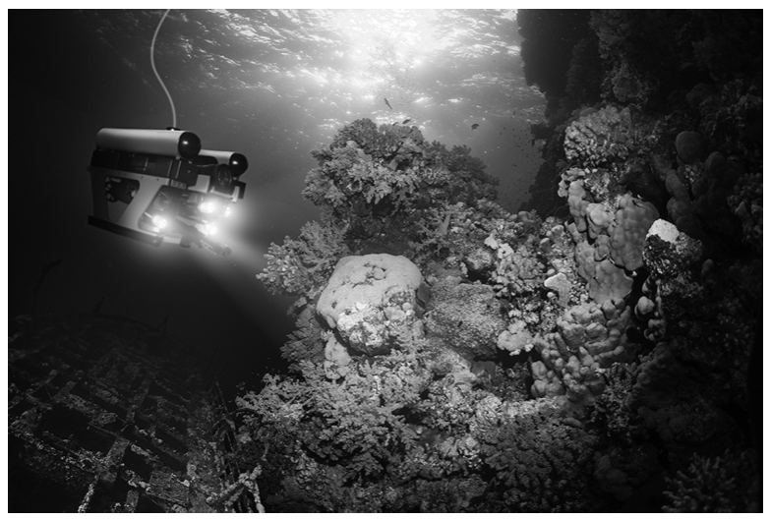
Space
←
Open ended questions
2022 Q4
Space exploration is often in the news, yet we have only explored about 5% of the oceans on Earth.
Difficult question
Focus on the risks of space exploration content (see 2015 Q10) and compare that with issues with water pressure at depth, and how increased water pressure has an effect of reducing the volume of air - this can cause risks for divers.
Light penetration through water is also a problem compared to the vacuum of space. However sound, in principle, can travel in water, whereas it cannot travel in a vacuum, unlike light.
Newton’s 3rd law - in space there is nothing to push off to move forward, and slowing down has challenges due to lack of friction and air resistance. Not so much of an issue under water. Indeed, there is a large amounts of drag due to water resistance.
Oxygen supplies are needed both in space and under water, but not much physics to say about that!
Using your knowledge of physics, comment on the similarities and/or differences between space exploration and underwater exploration.
Notes:
a = 0.19 ms-2

Slide 36
Space
←
Open ended questions
2023 Q4
Think about the risks and benefits of using the Moon as a base:
Risks - pressure differential - there is no atmosphere on the moon, so pressurised suits are needed all the time. An impact by a micro meteor could cause a leak which would put astronauts lives at risk.
Potential exposure to radiation - the moon does not have an atmosphere. This risks greater exposure to ionising cosmic rays from the Sun (explain ionisation). Also, the lack of atmosphere means meteors are not going to burn up like they would in Earth’s atmosphere due to friction turning the kinetic energy of the rocks into heat.
Maintaining life support - with no obvious fuel source solar panels would need to convert the Sun’s light energy into electrical energy.
Benefits - the Moon’s lower gravitational field would mean that less fuel and upward thrust would be required to accelerate off the surface, or with the same thrust greater accelerations would be possible as the unbalanced force would be greater (Since W = mg, lower weight due to lower g).
No atmosphere, so no air resistance on take off also means greater acceleration.
The lack of atmosphere would allow ground based telescopes on the moon to have a better view of space, as there would be no atmospheric distortion.
A space scientist makes the following statement.
‘Before we can have human space exploration of the solar system and beyond, we need to build a base on the Moon.’
Using your knowledge of physics, comment on the benefits and/or challenges of using a base on the Moon from which humans could explore the solar system and beyond.
Notes:
a = 0.19 ms-2

Slide 37
Space
←
Open ended questions
2024 Q5
Physics points to consider:
The Sun is not motionless. It rotates on its own axis, and it also orbits the galaxy. The galaxy, like other galaxies, is moving with the expansion of space.
The sun appears motionless relative to the earth. It is correct that the earth orbits the sun. However the Sun is not at the centre of the universe, rather it is at the centre of our solar system - an explanation of what the solar system is and how there are other star systems with exoplanets orbiting them could be part of your answer.
The stars in the night sky are also not fixed. They all rotate on their own axis, some orbit a fixed point with other stars (binary stars) and all stars also orbit the galaxy, which is believed to have a black hole at its centre.
You could comment how on a typical clear night the stars (and the moon) appear to move across the sky, but that is because the Earth is spinning on its own axis.
At different times of year we see different stars in the sky (and planets at different positions), because of Earth's relative position in its orbit around the Sun.
Around 500 years ago Nicolaus Copernicus, a Polish astronomer, proposed a model of the Universe with the Sun motionless at its centre and the stars fixed in position in the night sky.
Using your knowledge of physics, comment on this model.
Notes:
a = 0.19 ms-2

Slide 38
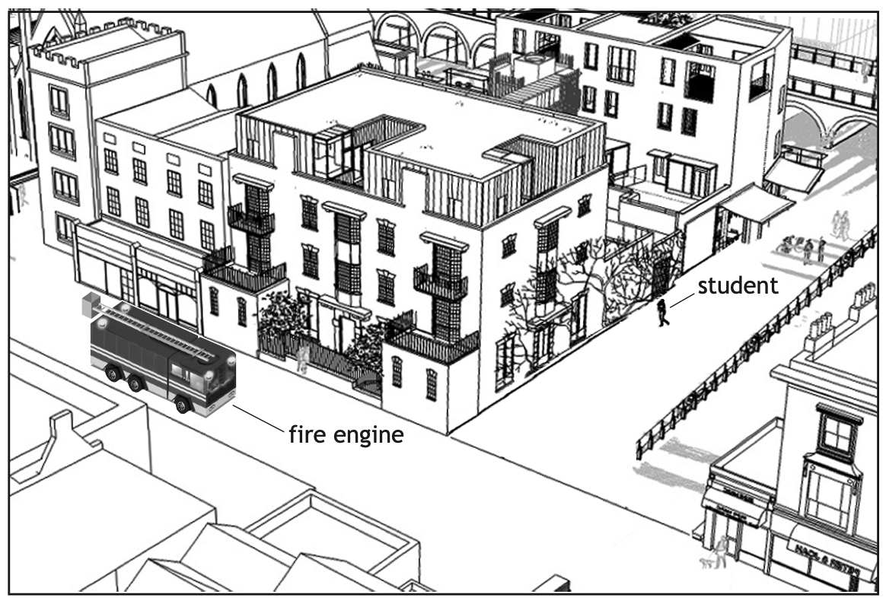
Waves
←
Open ended questions
2014 Q7
A fire engine on its way to an emergency is travelling along a main street.
The siren on the fire engine is sounding.
A student standing in a nearby street cannot see the fire engine but can hear the siren.
Key Physics - light waves travel in straight lines but sound waves can diffract around corners.
This is because light waves have very small wavelength and so can only diffract through very small gaps, whereas sound waves have much longer wavelengths and so can diffract around much larger objects and gaps, hence travelling around the corner.
Sound waves are also more able to reflect off buildings, whereas light waves would need mirrors to reflect off buildings.
A convex mirror would allow light waves to reflect providing a large field of view.
This is a fairly hard question to get good marks.
Use your knowledge of physics to comment on why the student can hear the siren even though the fire engine is not in view.
Notes:
a = 0.19 ms-2

Slide 39
Waves
←
Open ended questions
2016 Q5
A Physics textbook contains the following statement.
“Electromagnetic waves can be sent out like ripples on a pond.”
Key areas of physics are EM waves and water waves.
Ripples on a pond are transverse waves…opportunity to define transverse waves and explain the properties of a transverse wave (amplitude, wavelength etc.) and also that waves need a medium to travel through.
EM waves are also transverse, but they do not require a medium to travel through - instead they permeate through space (which is a vacuum) as electric and magnetic fields oscillating like a transverse wave.
You could explain that EM waves also travel out in all directions from a source, just like throwing a stone into a pond to produce water waves. Also that EM waves behave like water waves in that they can reflect off objects and diffract as they travel through gaps, just like water waves do.
You could also describe the different types of EM waves, that the wavelength and frequency can vary just like water waves can dependent on the source producing the rippling in a pond.
Using your knowledge of physics, comment on the similarities and/or differences between electromagnetic waves and the ripples on a pond.
Notes:
a = 0.19 ms-2

Slide 40
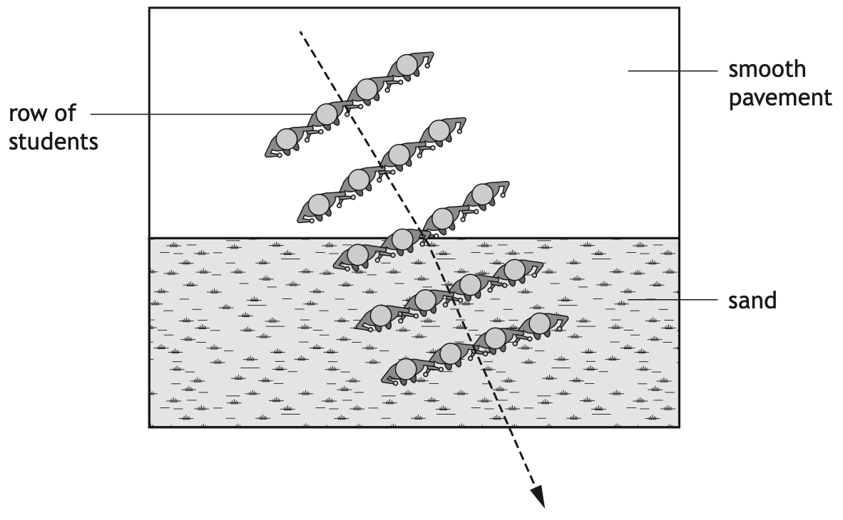
Waves
←
Open ended questions
2023 Q12
The use of analogies from everyday life can help improve the understanding of physics concepts.
Rows of students with arms linked together moving from a smooth pavement to sand can be used as an analogy for the refraction of light.
Using your knowledge of physics, comment on this analogy.
Physics to consider:
Define refraction - change of speed of light and wavelength of light (and direction if incident at a non-zero angle relative to the normal line) when light travels from one medium to another.
In the example we can clearly see a reduction of wavelength of the ‘wavefronts’ as the students move in the sand. This is because they have slowed down. Furthermore, the student on the left enter the sand first, so the ‘wavefront’ changes direction as those on the left slow before those on the right, causing them to travel less distance than those on the right.
You could explain what would happen if the students all approached at 90° to the sand - wavelength and speed would reduce but they would not change direction - just like light in a glass block.
Notes:
a = 0.19 ms-2

Slide 41
N5 Physics Revision
Past paper selector
Questions on required experiments (descriptions and improvements)
Questions that require explanations
Suggestions for
Open Ended Questions
Questions that require drawing graphs
Questions on unfamiliar
Physics
Questions that require drawing sketches

Slide 42
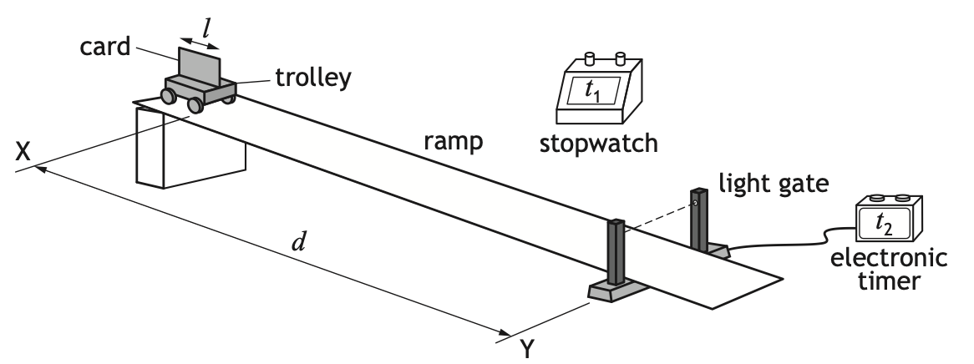
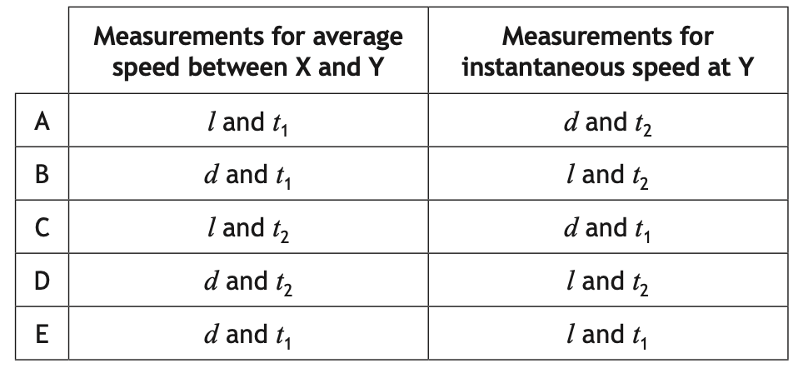
Description of experiments
←
Average and instantaneous speed
2024 MC Q2
A student uses the apparatus shown to determine the average speed and instantaneous speed of a trolley as it travels down a slope.
The trolley is released at X and travels down the slope. The distance between X and the light gate at Y is d.
The time taken for the trolley to reach the light gate is t₁.
The length of the card on the trolley is l.
The time taken for the card to pass through the light gate is t₂.
Which row in the table shows the measurements required to determine the average speed of the trolley between X and Y, and the instantaneous speed of the trolley at Y?
Notes:
a = 0.19 ms-2

Slide 43
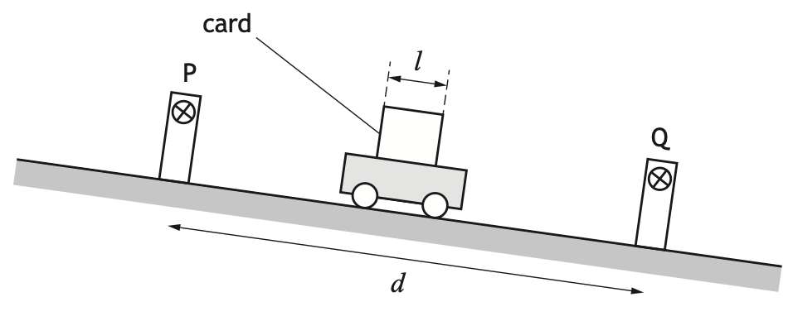
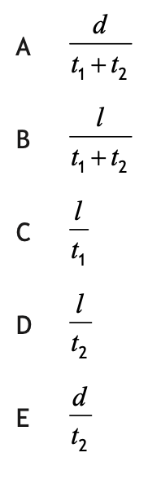
Description of experiments
←
Average and instantaneous speed
2023 MC Q2
A trolley is released from the top of a slope and passes between two light gates P and Q.
The distance between the light gates is d.
The time taken for the card to pass through light gate P is t₁.
The time taken for the card to pass through light gate Q is t₂.
The length of the card on the trolley is l.
The instantaneous speed of the trolley at light gate Q is given by
Notes:
a = 0.19 ms-2

Slide 44
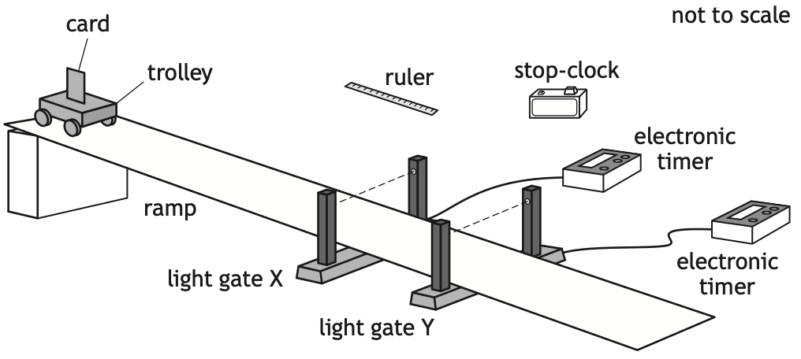
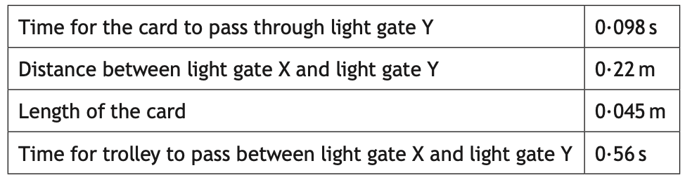
Description of experiments
←
Average and instantaneous speed
Relationship sheet
2018 Q2ai
Two students are investigating a trolley travelling down a ramp. Some of the measurements made by the student are shown.
Time for card to cut/pass through light gate X
The student determines the instantaneous speed of the trolley at light gate X to be 0·32 ms⁻ ¹.
Calculations:
Instantaneous speed at Y
Acceleration of the trolley on the slope
0.46 ms⁻¹
State the additional measurement made by the student determine the instantaneous speed of the trolley at light gate X.
0.25 ms⁻²
Notes:
a = 0.19 ms-2

Slide 45
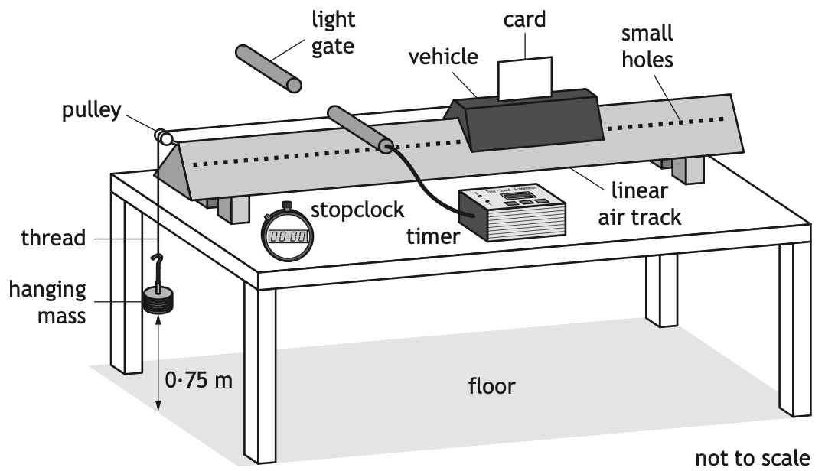
Description of experiments
←
Acceleration
Relationship sheet
2020 Q2a
A student sets up an experiment using a linear air track.
A vehicle is mounted on the track.
Air is blown into the track and out through small holes in the sides of the track, causing the vehicle to be lifted slightly above the track.
The vehicle is released from rest and the card mounted on it passes through the light gate.
Explain the purpose of using air to lift the vehicle slightly above the track. (1)
State the measurements the student must make in this experiment to determine the acceleration of the vehicle. (3)
To reduce friction (1)
length/width of card (1)
time for card to pass through the (light) gate (1)
time taken for card to reach (light) gate (1)
Notes:
a = 0.19 ms-2

Slide 46
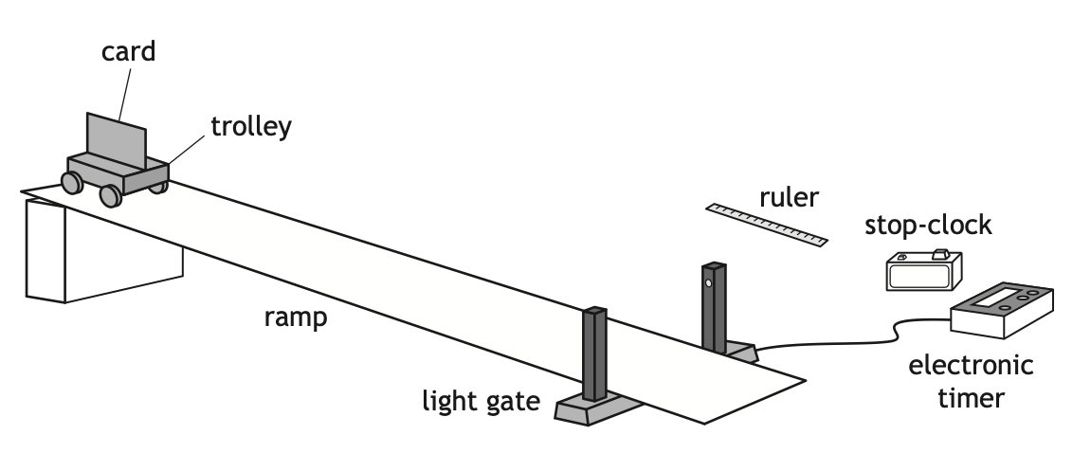
Description of experiments
←
Acceleration
2015 Q8ai
The student uses the apparatus shown to carry out an experiment to determine the acceleration of a trolley as it rolls down a ramp.
The trolley is released from rest at the top of the ramp.
State the measurements the student must make to calculate the acceleration of the trolley. (3)
length/width of card (1)
time taken for card to pass (through) the light gate (1)
time taken for trolley to travel from starting position) to light gate (1)
Notes:
a = 0.19 ms-2

Slide 47
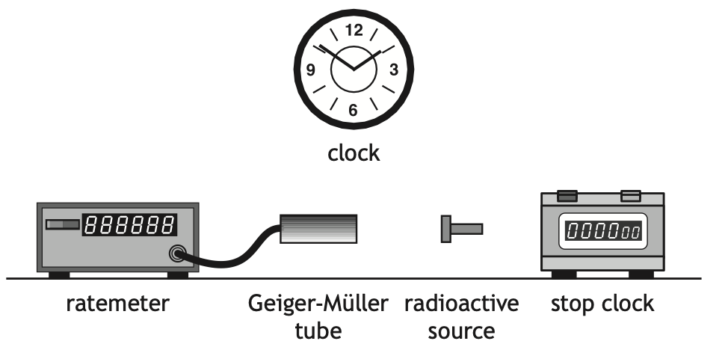
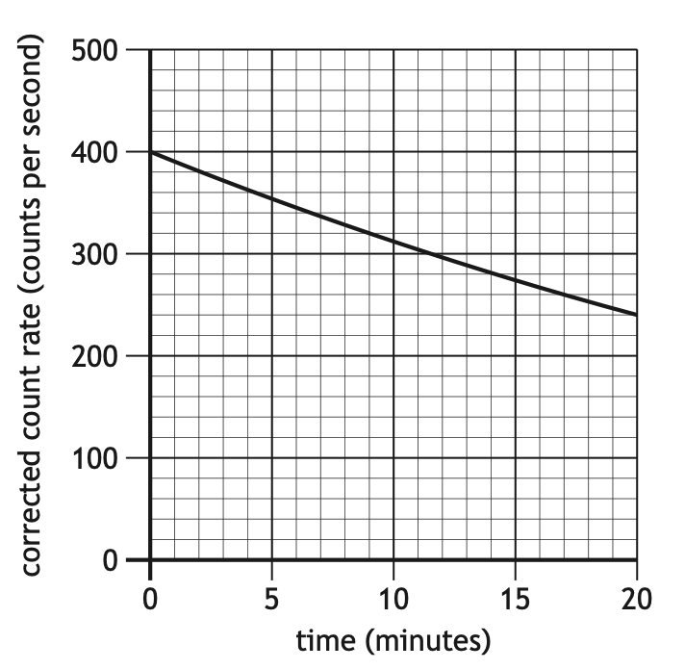
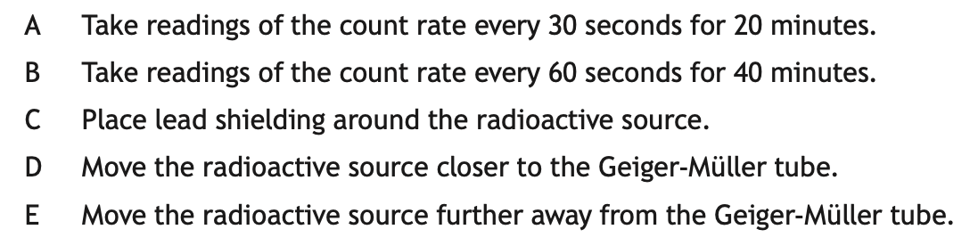
Description of experiments
←
Half-life
2024 MC Q25
A technician carries out an experiment, using the apparatus shown, to determine the half-life of a radioactive source.
Before carrying out the experiment the technician measures the background count rate.
The technician takes readings of the count rate displayed on the ratemeter every 60 s for a period of 20 minutes.
Which of the following changes would allow the technician to more easily determine the half-life of the radioactive source?
Notes:
a = 0.19 ms-2

Slide 48
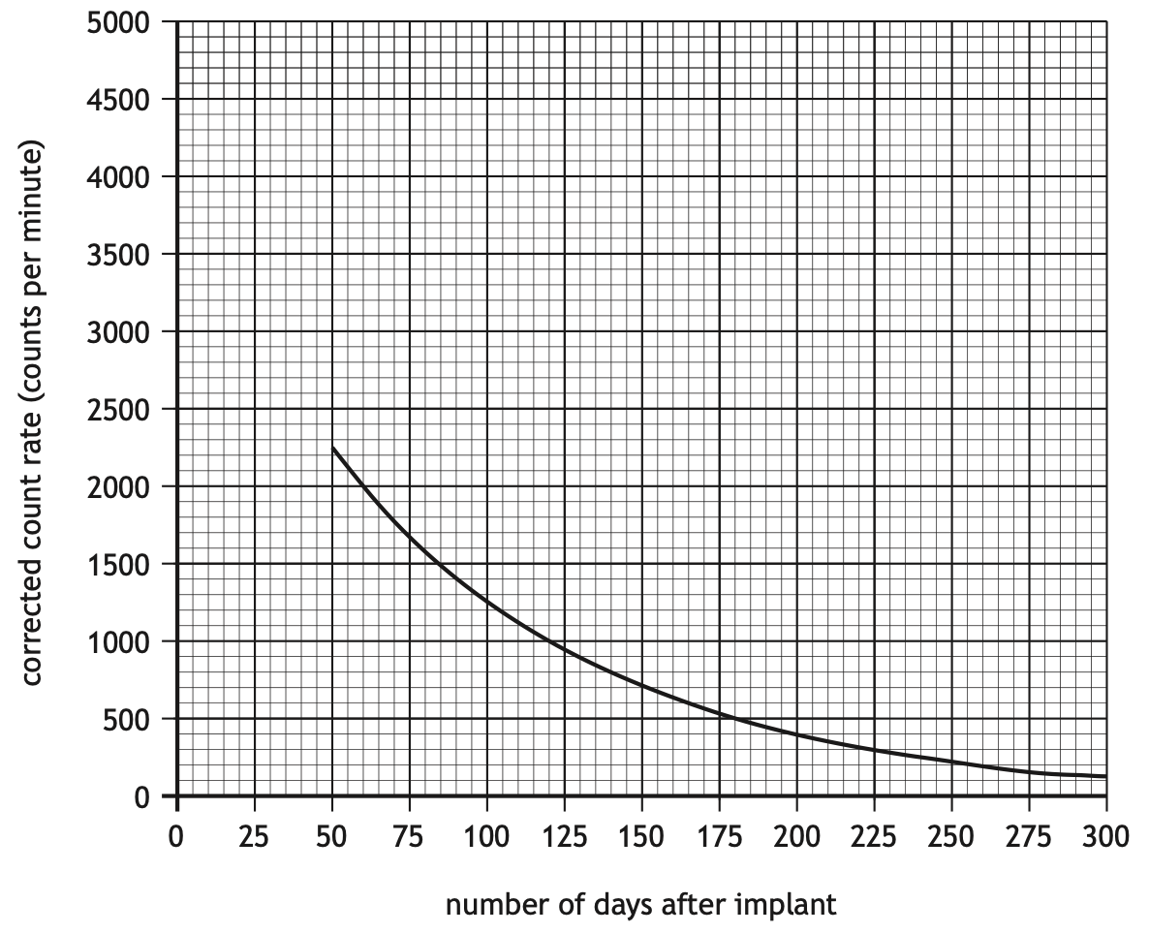
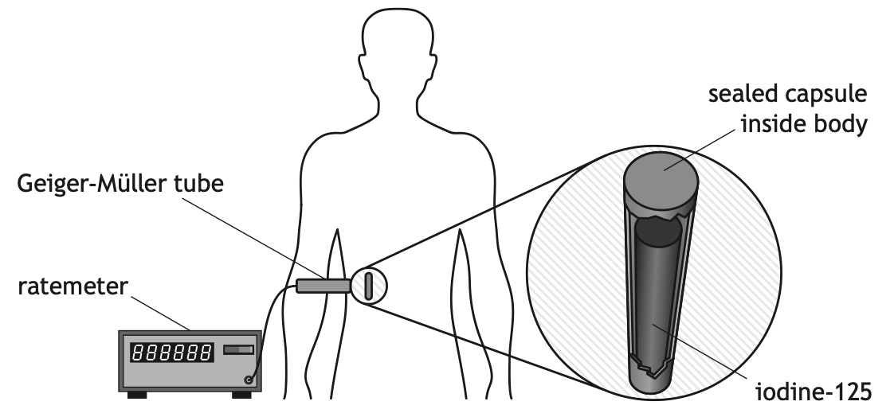
Description of experiments
←
Half-life
2023 Q14a
A sealed capsule containing iodine-125 is implanted inside a patient, next to the cancer cells.
Measurements of the count rate are taken at regular time intervals.
These measurements are used to produce a graph showing how the corrected count rate varies with the number of days after implant.
State the additional measurement that must have been made in order to determine the corrected count rate. (1)
Gamma rays emitted by the iodine-125 damage the cancer cells.
A Geiger-Müller tube and ratemeter are used to measure the count rate from the iodine-125.
background count (rate)
Notes:
a = 0.19 ms-2

Slide 49
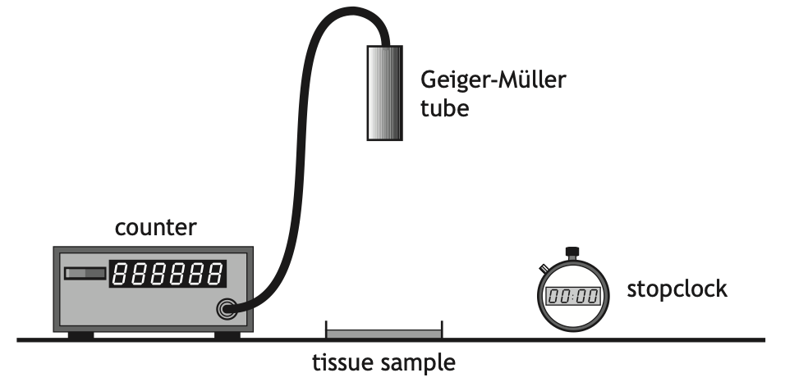
Description of experiments
←
Half-life
2020 Q12biii
The scientist uses the equipment shown to test a tissue sample to identify if a radioactive DNA probe is present in a tissue sample.
Suggest one change to the set up that would increase the number of decays per minute detected by the Geiger-Müller tube due to the sample. (1)
Move the Geiger-Müller tube closer (to the tissue sample).
Notes:
a = 0.19 ms-2

Slide 50
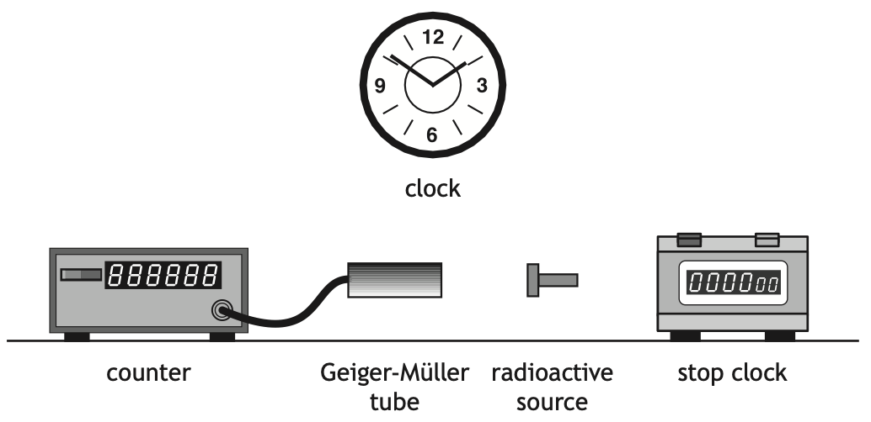
Description of experiments
←
Half-life
2019 Q12a
A technician carries out an experiment, using the apparatus shown, to determine the half-life of a radioactive source.
Describe how the apparatus can be used to determine the half-life of the radioactive source. (3)
Measure the count in a set time (1)
Repeat at (regular) intervals (1)
(Measure and) subtract background (count) (1)
Notes:
a = 0.19 ms-2

Slide 51
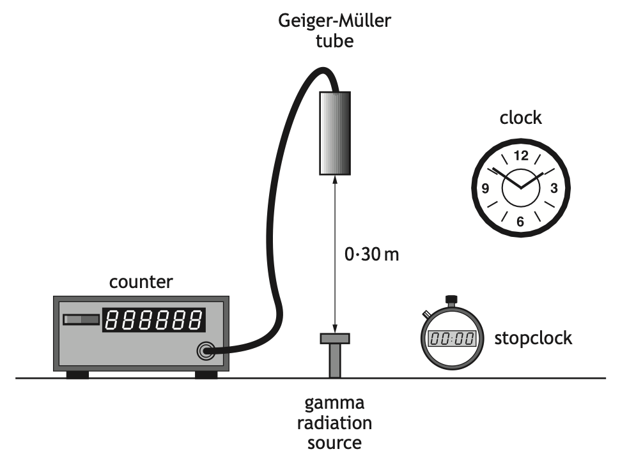
Description of experiments
←
Acceleration
2018 Q13ai
A technician carries out an experiment, using the apparatus shown, to determine the half-life of a gamma radiation source.
Before carrying out the experiment the technician measures the background count rate.
Explain why this measurement is made. (1)
The counter reading will include the source and background count. (1)
OR
Background will need to be subtracted.
OR
To measure/determine the count rate due to the source.
Notes:
a = 0.19 ms-2

Slide 52
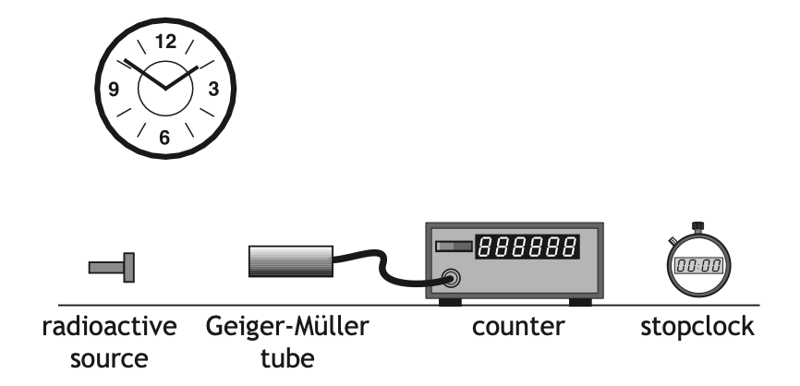
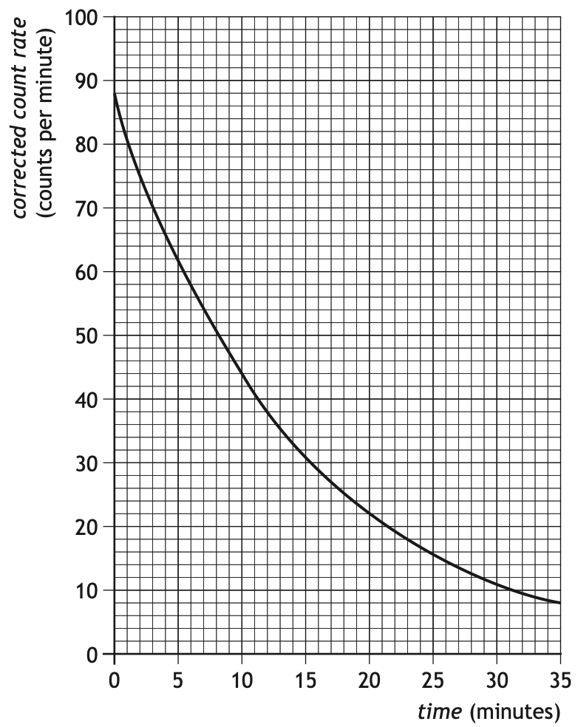
Description of experiments
←
Half-life
2014 Q6bi
A technician carries out an experiment, using the apparatus shown, to determine the half-life of a radioactive source.
Describe how the apparatus could be used to obtain the experimental data required to produce this graph. (3)
The technician displays the data obtained from the experiment in the graph on the left.
Measure the count in a set time interval (1)
Repeat at (regular) intervals (1)
Measure background (count) and subtract (1)
Notes:
a = 0.19 ms-2

Slide 53
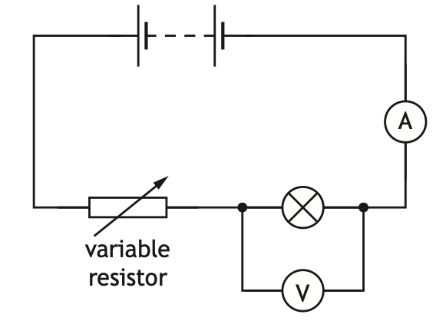
Description of experiments
←
Ohm’s Law
2024 Q8aiii
A student sets up the following circuit to investigate the relationship between the current in and the voltage across a lamp.
Describe how the student obtained a range of values of current and voltage using this circuit. (1)
(The student) varied the resistance of the variable resistor (1)
The student uses the circuit to obtain a range of measurements of current in the lamp and voltage across the lamp.
Notes:
a = 0.19 ms-2

Slide 54
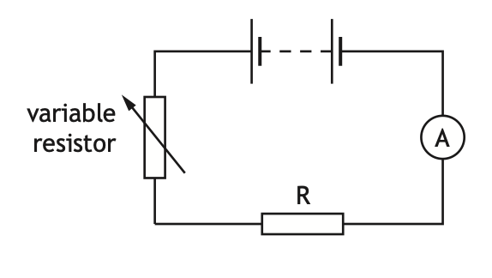
Description of experiments
←
Ohm’s Law
2016 Q2a&b
A student investigates the resistance of a resistor using the circuit shown.
Complete the circuit diagram to show where a voltmeter must be connected to measure the voltage across resistor R. (1)
Voltmeter across resistor R (1)
Describe how the student obtains a range of values of voltage and current. (1)
increase/decrease/vary/change the resistance of the variable resistor (1)
Notes:
a = 0.19 ms-2

Slide 55
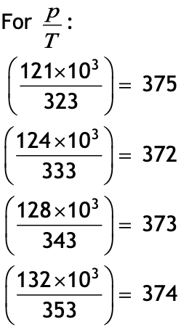
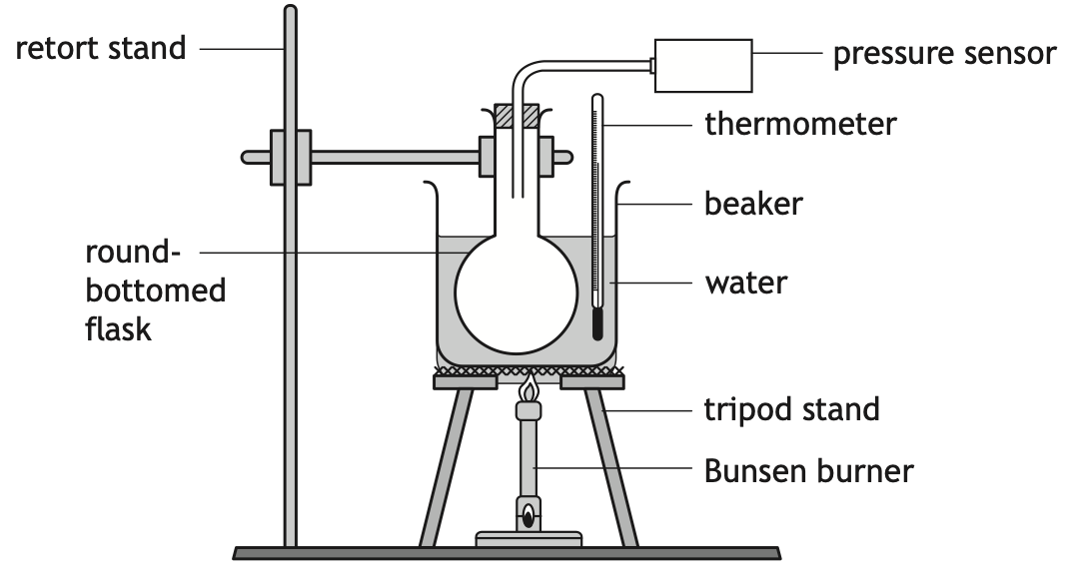
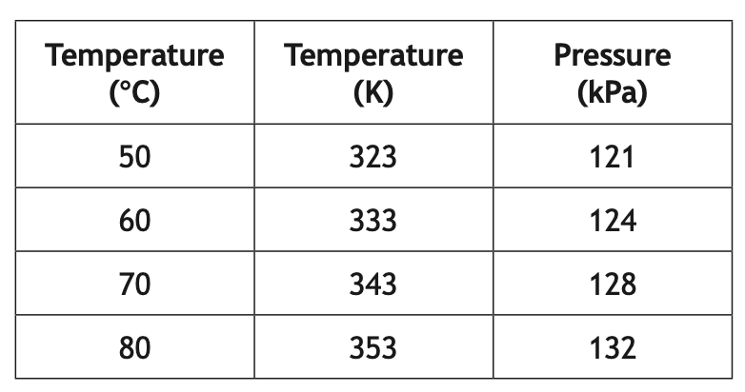
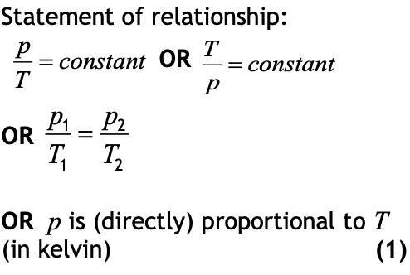
Description of experiments
←
Gas laws
Relationship sheet
2022 Q9a
A group of students are investigating how the pressure of a fixed mass of gas varies with its temperature. This is known as Gay-Lussac’s Law.
First two marks are awarded for the calculations:
• All four calculations correct (2)
• Three calculations correct (1)
• Fewer than three calculations correct (0)
The students set up an experiment as shown.
The students’ results are shown.
Use all the appropriate data to establish the relationship between the pressure and the temperature of the gas. (3)
Notes:
a = 0.19 ms-2

Slide 56

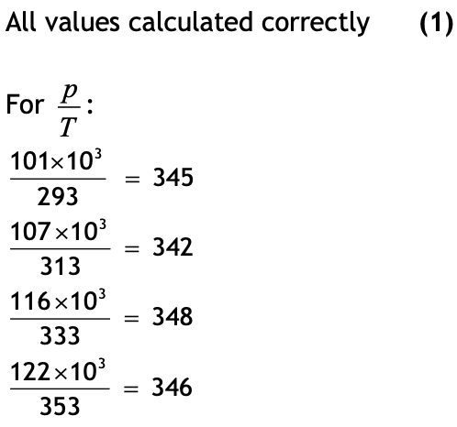
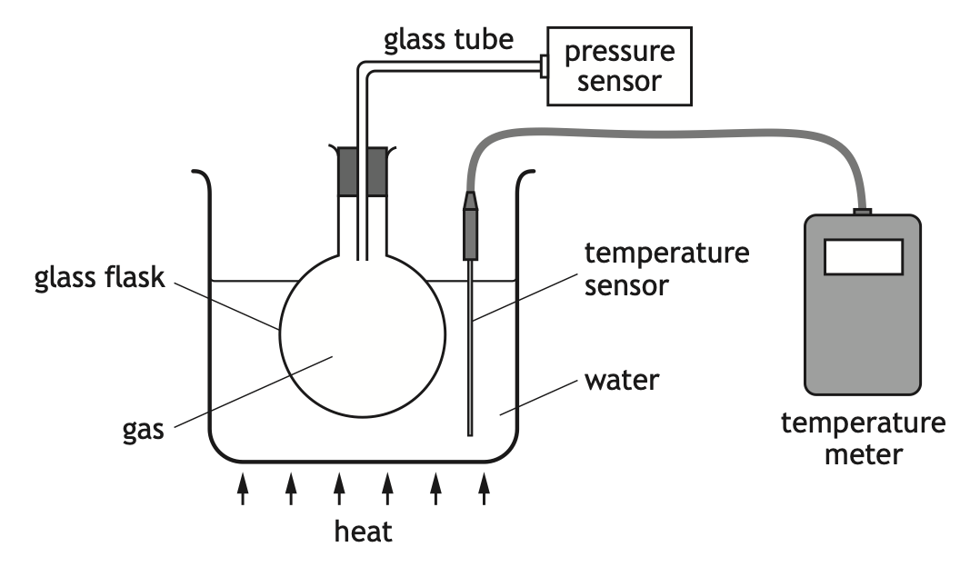
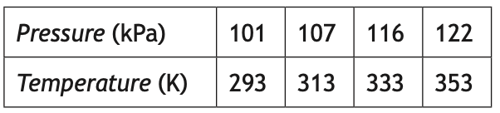
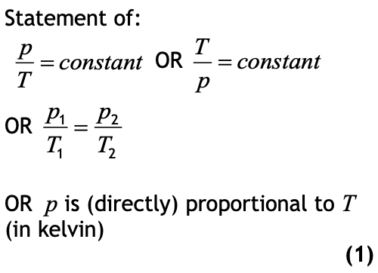
Description of experiments
←
Gas laws
Relationship sheet
2018 Q9ai
A student sets up an experiment to investigate the relationship between the pressure and temperature of a fixed mass of gas as shown.
The student heats the water and records the following readings of pressure and temperature.
Using all the data, establish the relationship between the pressure and the temperature of the gas. (3)
Notes:
a = 0.19 ms-2

Slide 57
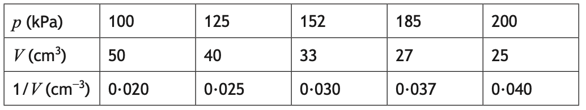
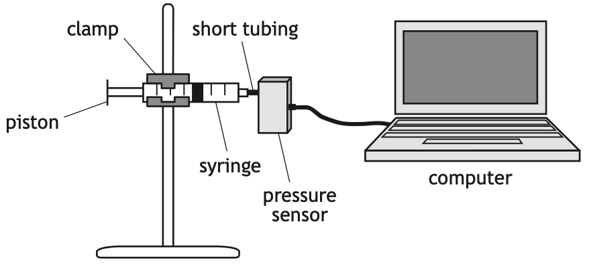
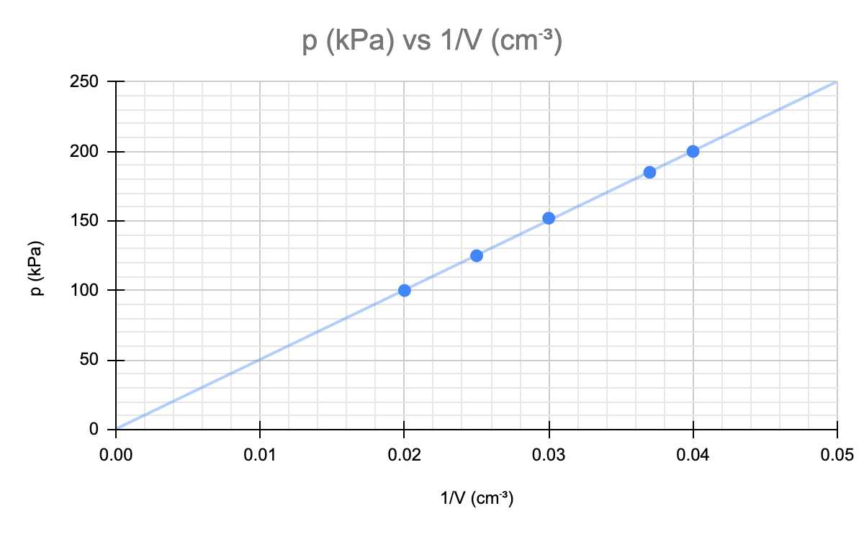
Description of experiments
←
Gas laws
SQP Q8a
A student carries out an experiment to investigate the relationship between the pressure and volume of a fixed mass of gas using the apparatus shown.
Draw a graph of p against 1/V (3)
Explain how the graph confirms that pressure is directly proportional to 1/volume. (1)
i) Axes labelled with units (1)
Axes scaled linearly (1)
Data points accurately plotted with line of best fit (1)
The pressure p of the gas is recorded using a pressure sensor connected to a computer. The volume V of the gas in the syringe is also recorded. The student pushes the piston to alter the volume and a series of readings is taken.
The temperature of the gas is constant during the experiment. The results are shown.
ii) The line of best fit is a straight line which passes through the origin (1)
Notes:
a = 0.19 ms-2

Slide 58
Description of experiments
←
Gas laws
SQP Q8d
A student carries out an experiment to investigate the relationship between the pressure and volume of a fixed mass of gas using the apparatus shown.
When carrying out the experiment, the student clamped the syringe rather than holding it in their hand.
Explain why this is better experimental practice. (2)
A second student suggests that replacing the short tubing between the syringe and the pressure sensor with one of longer length would improve the experiment.
Explain why this student’s suggestion is incorrect. (2)
i.Using a clamp will prevent heat from the student’s hand increasing the temperature of the gas in the syringe (1)
If the temperature of the gas in the syringe is not constant, the experiment would not be valid (1)
ii The suggestion is incorrect because the volume of air in the tubing is not being read from the scale on the syringe (1)
A longer length of tubing would increase the (systematic) uncertainty in the experiment (1)
Notes:
a = 0.19 ms-2

Slide 59
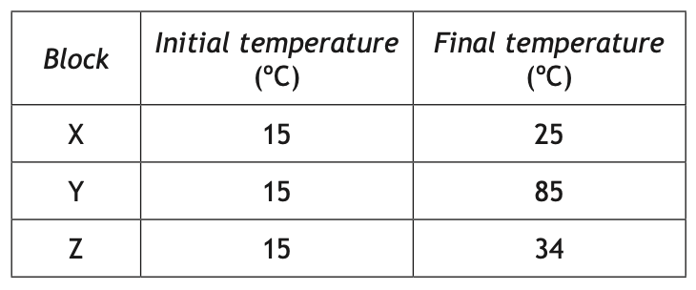
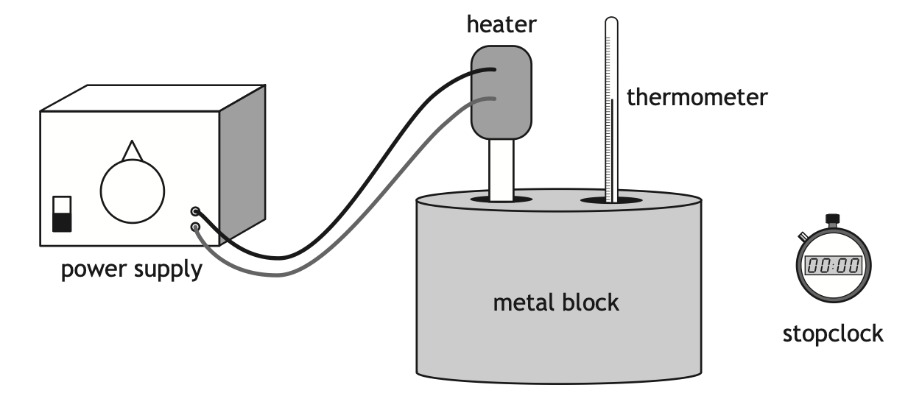
Description of experiments
←
Specific heat capacity
Relationship sheet
2014 Q3a
A student is investigating the specific heat capacity of three metal blocks X, Y and Z.
The student’s results are shown in the table.
The heater has a power rating of 15 W.
The initial temperature of the block is measured.
The heater is switched on for 10 minutes and the final temperature of the block is recorded.
This procedure is repeated for the other two blocks.
Calculations:
Find energy provided by heater.
Identify block with largest value of c.
Calculate specific heat capacity of block with largest value of c.
9000 J
X
900 Jkg⁻¹°C⁻¹
Notes:
a = 0.19 ms-2

Slide 60
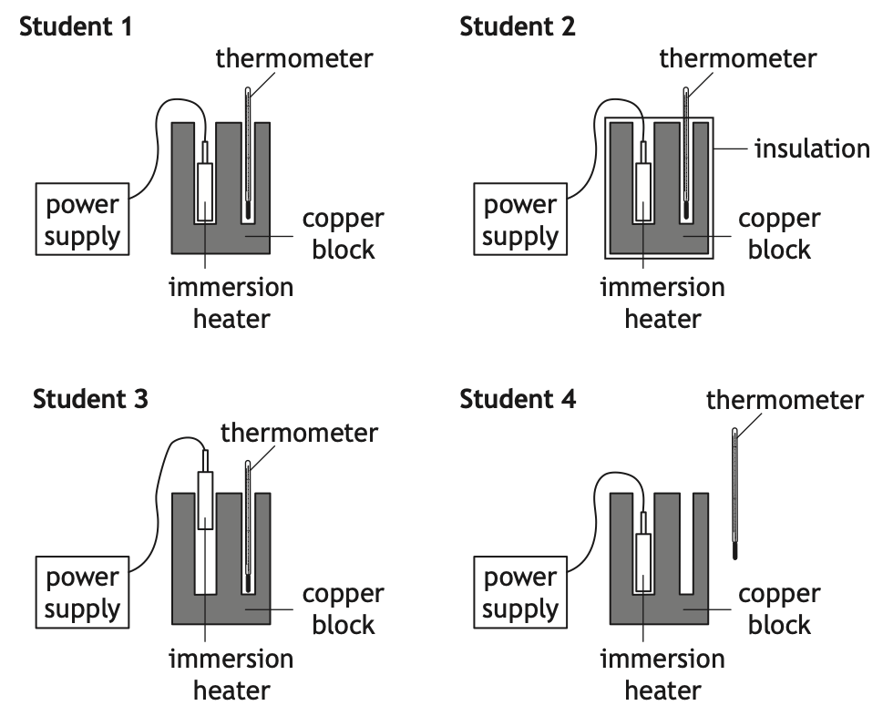
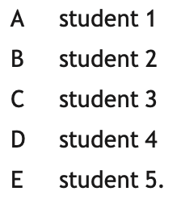

Description of experiments
←
Specific heat capacity
2017 MC Q5
Five students each carry out an experiment to determine the specific heat capacity of copper. The setup used by each student is shown.
The student with the setup that would allow the most accurate value for the specific heat capacity of copper to be determined is
Notes:
a = 0.19 ms-2

Slide 61


Description of experiments
←
Specific heat capacity
Relationship sheet
2018 Q8a
A student carries out an experiment, using the apparatus shown, to determine a value for the specific heat capacity of water.
The student records these measurements.
Calculations:
Calculate the specific heat capacity.
Why is the value different from the data sheet value?
For how long is the immersion heater on in this experiment?
5 400 Jkg⁻¹°C⁻¹
The student switches on the power supply and the immersion heater heats the water.
The joulemeter measures the energy supplied to the immersion heater.
Heat (energy) is lost to the surroundings/to air.
450 s
Notes:
a = 0.19 ms-2

Slide 62


Description of experiments
←
Specific heat capacity
2023 MC Q16
A student carries out an experiment to determine the specific heat capacity of copper using the apparatus shown.
The student switches on the power supply and the electrical heater heats the block of copper. The joulemeter measures the energy supplied to the electrical heater.
The student suggests the following measurements should also be made:
I The mass of the block of copper.
II The initial and final readings on the thermometer.
III The power rating of the electrical heater.
Which of these measurements must be made to determine the specific heat capacity of copper?
Notes:
a = 0.19 ms-2

Slide 63


Description of experiments
←
Specific heat capacity
2024 MC Q15
A student carries out an experiment to determine the specific heat capacity of copper. The setup used by the student is shown.
The student heats the copper block for 5 minutes.
The temperature of the block increases by 14 °C.
The value of the specific heat capacity of copper determined by the student using this method is found to be inaccurate.
Which of the following changes would improve the accuracy of this experiment?
Notes:
a = 0.19 ms-2

Slide 64

Description of experiments
←
Specific latent heat
2018 Q8c
The student then carries out a second experiment, using the apparatus shown, to determine a value for the specific latent heat of vaporisation of water.
Describe how this apparatus would be used to determine a value for the specific latent heat of vaporisation of water.
Your description must include:
• measurements made
• any necessary calculations (3)
(Measure the) mass of water evaporated. (1)
(Measure the) energy supplied. (1)
E_{h} = ml (1)
Notes:
a = 0.19 ms-2

Slide 65
Description of experiments
←
Improvement to experiments
2014 3c
A student is investigating the specific heat capacity of three metal blocks X, Y and Z.
Suggest a possible improvement that would reduce energy losses. (1)
Insulating the (metal) block
OR
Switch heater on for shorter time
Due to energy losses, the specific heat capacities calculated in this investigation are different from the accepted values.
The student decides to improve the set up in order to obtain a value closer to the accepted value for each block.

Slide 66


Description of experiments
←
Improvement to experiments
2015 11b
A student investigates how a crater is formed by dropping a marble into a tray of sand.
The student drops the marble from different heights and measures the diameter of each crater that is formed.
The table shows the student’s results.
Suggest two improvements that the student could make to this investigation. (2)
Any two from:
Repeat (and average)
Take (more) readings in the 0·15 (m) to 0·35 (m) drop height range
increase the height range
level sand between drops
or other suitable improvement

Slide 67

Description of experiments
←
Improvement to experiments
2016 6c
A student directs a ray of red light into a Perspex block to investigate refraction.
Any one of:
To obtain more reliable results
Eliminate rogue results/outliers
To allow an average/mean to be calculated
More accurate
Suggest why it would be good practice for the student to repeat the investigation a further three or four times. (1)

Slide 68

Description of experiments
←
Improvement to experiments
2017 4aii
A student observes water waves entering a harbour.
Suggest how the accuracy of the frequency determined by the student could be improved. (1)
measure the time for more waves to pass
OR
count the number of waves in a longer period of time
OR
repeat (the measurement) and average

Slide 69

Description of experiments
←
Improvement to experiments
2018 8aii
A student carries out an experiment, using the apparatus shown, to determine a value for the specific heat capacity of water.
Explain why the value determined from the experiment is different from the value quoted in the data sheet. (1)
Heat (energy) is lost to the surroundings/to air.
OR
some of the heat (energy) is used to heat up the heater/beaker.

Slide 70
Description of experiments
←
Improvement to experiments
2018 9b
A student sets up an experiment to investigate the relationship between the pressure and temperature of a fixed mass of gas as shown.
Have more of the flask under the water, so that the gas is at the same temperature /evenly heated
OR
Reduce the length/diameter/volume of the connecting tube so that the gas is at the same temperature /evenly heated
Accept:
Place the temperature sensor in the flask (1)
So that the temperature of the gas is being measured (1)
OR (so that all the gas is being heated’
Do not accept:
‘repeat measurements’ – it is an improvement to the set up that is required
State one way in which the set-up of the experiment could be improved to give more reliable results.
Justify your answer. (2)

Slide 71

Description of experiments
←
Improvement to experiments
2018 13ci
A technician carries out an experiment, using the apparatus shown, to determine the half-life of a gamma radiation source.
Suggest a change the technician must make to the experimental set-up to determine the half-life of the alpha radiation source.
Justify your answer. (2)
The technician repeats the experiment with an alpha radiation source.
Reduce the distance (between the detector and the source) (1)
Alpha is absorbed by a few cm of air/range in air is a few cm. (1)
OR
Alpha has a shorter range (than gamma).

Slide 72

Description of experiments
←
Improvement to experiments
2019 5aiv
A student is investigating how the length of a wire affects its resistance.
The student connects different lengths of wire to a power supply of fixed voltage and measures the current in each length of wire.
The measurements taken by the student are shown in the table.
Suggest one way in which the experimental procedure could be improved to give more reliable results. (1)
repeat (and average)
Accept:
increase the range of lengths
increase the number of different lengths
If candidates use the terms ‘accurate’ and/or ‘precise’ in their response, they must be used correctly otherwise (0).

Slide 73


Description of experiments
←
Improvement to experiments
2019 12b
A technician carries out an experiment, using the apparatus shown, to determine the half-life of a radioactive source.
The technician carries out the experiment over a period of 30 minutes, and displays the data obtained in a graph as shown.
Suggest an improvement that the technician could make to the procedure to more easily determine a value for the half-life of this source. (1)
Carry out experiment over a longer time period.

Slide 74


Description of experiments
←
Improvement to experiments
2020 11ciii
A student investigating sound cuts a drinking straw as shown.
The student carries out an experiment to investigate how the length of the straw affects the frequency of the sound produced. The results of this experiment are as shown.
Suggest one change that could be made to improve the reliability of this experiment. (1)
Repeat (measurements and average) (1)
Accept:
• Increase the range of lengths.
• Increase the number of different lengths.
If candidates use the term ‘accurate’ and/or ‘precise’ in their response, they must be used correctly, otherwise (0)

Slide 75

Description of experiments
←
Improvement to experiments
2022 2aiii
A student is investigating factors that affect the horizontal range of a marble, using the apparatus shown.
The student releases a marble from different heights on the ramp and measures the horizontal range.
Suggest an improvement to the experiment to determine more accurately where the marble hit the ground. (1)
In order to measure the horizontal range, the student watched to see where the marble hit the ground.
Place carbon paper under landing site (1)
OR
Place sand tray under landing site
OR
Use video analysis

Slide 76
Description of experiments
←
Improvement to experiments
2022 9c
A group of students are investigating how the pressure of a fixed mass of gas varies with its temperature. This is known as Gay-Lussac’s Law.
Repeat the experiment
OR Increase the range (of temperatures)
OR Take readings at more (different) temperatures within the range
OR Have more of the flask in the water
OR Add more water (in the beaker)
OR Reduce the length/diameter of the connecting tube
OR Stir the water
Accept:
Place thermometer inside the flask/in the gas.
The students set up an experiment as shown.
The students’ results are shown.
Suggest one way the students could improve the experiment. (1)

Slide 77


Description of experiments
←
Improvement to experiments
2023 7b
A capacitor consisting of two parallel metal plates, X and Y, is connected in a circuit as shown.
Suggest two ways in which the experimental procedure could be improved. (2)
The charge Q stored on the capacitor for a range of different distances d between plate X and plate Y is shown in the table.
Any two of the following for (1) mark each:
Repeat measurements and average
Repeat measurements to identify outliers/rogue points
Increase the range of distances
Increase the number of different distances
Do not accept:
‘repeat measurements’ alone
‘more readings’ alone

Slide 78

Description of experiments
←
Improvement to experiments
2024 11bii
A wave energy converter is a machine anchored to the seabed that changes the kinetic energy of water waves into electrical energy.
Suggest how the accuracy of the frequency of the waves determined by the engineer could be improved. (1)
measure (the time for) more waves to pass
OR
count the number of waves in a longer period of time
OR
repeat (the measurement) and average
An engineer uses a stopwatch to measure the time taken for one complete wave to pass the end of the converter.
The stopwatch is started when a crest passes the end of the converter and stopped when the next crest passes.

Slide 79
N5 Physics Revision
Past paper selector
Questions on required experiments (descriptions and improvements)
Questions that require explanations
Suggestions for
Open Ended Questions
Questions that require drawing graphs
Questions on unfamiliar
Physics
Questions that require drawing sketches

Slide 80













←
Back to Description of experiments questions
Relationships sheet

Slide 81
N5 Physics Revision
Past paper selector
Questions on required experiments (descriptions and improvements)
Questions that require explanations
Suggestions for
Open Ended Questions
Questions that require drawing graphs
Questions on unfamiliar
Physics
Questions that require drawing sketches

Slide 82

NPN and MOSFET (transistors)
←
Electricity (explanation questions)
2014 2bi
The circuit is now connected to a switching circuit to operate a heater
Explain how the circuit operates to switch on the heater when the temperature falls below a certain value. (3)
As Resistance of thermistor increases Voltage across thermistor increases (1)
When Voltage across thermistor = 2·0 V or V reaches switching voltage, MOSFET/transistor turns on (1)
Relay switches on (the heater). (1)
Calculations:
Lots of potential divider questions to test understanding. TRY IT!
Notes:
a = 0.19 ms-2

Slide 83
NPN and MOSFET (transistors)
←
Electricity (explanation questions)
2014 2bii
The resistance of the variable resistor R is now increased. What effect does this have on the temperature at which the heater is switched on?
You must justify your answer. (3)
Temperature decreases (1)
Resistance of thermistor must be greater / increase (1)
to switch on MOSFET / transistor (1)
Notes:
a = 0.19 ms-2

Slide 84

NPN and MOSFET (transistors)
←
Electricity (explanation questions)
2016 3c
The temperature of the water in the washing machine is monitored by a circuit containing a thermistor.
As the temperature of the water increases, the resistance of the thermistor decreases.
The heating element is switched off when the temperature of the water reaches 40 ºC.
Explain how the circuit operates to switch off the heating element. (3)
Voltage across thermistor decreases (1)
MOSFET/transistor switches off/deactivates (1)
Relay switches off/relay switch opens/relay deactivates (1)
Notes:
a = 0.19 ms-2

Slide 85

NPN and MOSFET (transistors)
←
Electricity (explanation questions)
SPQ 6a
An office has an automatic window blind that closes when the light level outside gets too high.
The electronic circuit that operates the motor to close the blind is shown.
(i) Explain how this circuit works to close the blind. (3)
(ii) What is the purpose of the variable resistor R? (1)
(i) Light level increases, LDR
resistance decreases 1
LDR resistance decreases, voltage
across R increases 1
Voltage across R increases,
MOSFET switches the motor on 1
The MOSFET switches on when the voltage across variable resistor R reaches 2·4 V.
(ii) The variable resistor controls the light level at which the motor operates the blind
Notes:
a = 0.19 ms-2

Slide 86

NPN and MOSFET (transistors)
←
Electricity (explanation questions)
Relationship sheet
2020 7bi
A security floodlight is used to automatically illuminate an area outside a building when it gets dark. The circuit for this system is shown.
The control circuit operates at 5 V, the floodlight at 230 V.
Accept: The two parts of the circuit operate at different voltages. OR
The floodlight requires a higher current than can be supplied in the transistor circuit.
Calculations:
Show that the transistor is switched on if the resistance of the LDR is 3.4 kΩ and the switch on voltage is 0.7 V.
If floodlight has power rating 575 W, determine current in floodlight.
The floodlight is connected in a part of the circuit controlled by a relay.
Explain why a relay is used in the circuit. (1)
transistor on, since V₂ = 0.85 V
2.5 A
Notes:
I = 2.5 A

Slide 87

NPN and MOSFET (transistors)
←
Electricity (explanation questions)
2022 7c
The dehumidifier switches on automatically when the moisture in the air increases above a certain level. This causes an LED to light and a fan to turn on.
(ii) The voltage across the moisture sensor decreases as the moisture in the air increases.
Explain how the circuit operates to turn on the LED when the moisture in the air increases above a certain level. (2)
(iii) Explain the purpose of the variable resistor in this circuit. (1)
(ii) Voltage across variable resistor increases (1)
Transistor switches on (1)
(iii) To adjust/control the moisture level at which the dehumidifier/transistor LED/fan switches on. (1)
Notes:
I = 2.5 A

Slide 88

NPN and MOSFET (transistors)
←
Electricity (explanation questions)
2024 7c
The charger contains a fan that switches on automatically when the temperature of the charger increases above a certain level.
Part of the circuit containing the fan is shown.
As the temperature of the charger increases, the resistance of the thermistor decreases.
Explain how the circuit operates to switch on the fan when the temperature of the charger increases above a certain level. (3)
(As the temperature increases) the voltage across the thermistor decreases (1)
Voltage across the resistor increases (1)
MOSFET turns on (1)
Notes:
I = 2.5 A

Slide 89
N5 Physics Revision
Past paper selector
Questions on required experiments (descriptions and improvements)
Questions that require explanations
Suggestions for
Open Ended Questions
Questions that require drawing graphs
Questions on unfamiliar
Physics
Questions that require drawing sketches

Slide 90
←
Back to Electricity (explanation) questions
Relationships sheet

Slide 91

Distance and displacement
←
Dynamics (explanation questions)
Relationship sheet
2016 9bii
A student walks around a building from point X to point Y.
The student takes 68s to walk from X to Y.
The student states that their average speed between point X and point Y is greater than the magnitude of their average velocity between point X and point Y.
Explain why the student is correct. (2)
distance is greater (than displacement) (1)
same time (1)
Calculations:
magnitude of displacement.
direction of displacement.
average velocity from X to Y
85m
062
1.3ms⁻¹ at 062
Notes:
a = 0.19 ms-2

Slide 92

Distance and displacement
←
Dynamics (explanation questions)
Relationship sheet
2023 1bii
A seagull flies above a school playground. The seagull remains at a constant height above the ground during its flight.
The seagull flies from point A to point E in 31s using the route shown.
A student states that the average speed of the seagull between point A and point E is greater than the magnitude of the average velocity of the seagull between point A and point E.
Explain why the student is correct. (2)
distance is greater (than displacement) (1)
same time (1)
Calculations:
magnitude of displacement.
direction of displacement.
average velocity from A to E
67 m
291
2.2 ms⁻¹ at 291
Notes:
a = 0.19 ms-2

Slide 93


Free body diagrams and Newton’s Laws
←
Dynamics (explanation questions)
Relationship sheet
2014 10e
In a rowing event a boat moves off in a straight line. A graph of the boat’s motion is shown.
For forward force there are other acceptable answers such as thrust, push(ing) (force), etc (1)
For friction also accept water resistance, drag. (1)
Calculations:
Acceleration in first 25 seconds.
Distance travelled after 510 s.
Average velocity of the boat
Draw a diagram showing the horizontal forces acting on the boat between 25 s and 450 s.
You must name these forces and show their directions. (2)
0.19ms⁻²
2244 m
4.4 ms⁻¹
Notes:
a = 0.19 ms-2

Slide 94

Free body diagrams and Newton’s Laws
←
Dynamics (explanation questions)
Relationship sheet
2014 12c
A student is investigating the motion of water rockets.
Use Newton’s Third Law to explain how the rocket launches. (1)
Rocket / bottle pushes down on water,
water pushes up on rocket / bottle
Calculations:
Weight if the mass of the rocket is 0.94kg
Total pressure if area of each fin is 2.0 x 10⁻⁴ m² (there are 3 fins)
Initial acceleration if initial upward thrust is 370 N.
9.2 N
1.5x10⁴ Pa
380 ms⁻²

Slide 95
Free body diagrams and Newton’s Laws
←
Dynamics (explanation questions)
Relationship sheet
2014 12e
A student is investigating the motion of water rockets.
Explain why the rocket fails to reach the same height. (2)
more water will increase weight/mass (1)
unbalanced force decreases (1)
acceleration is less (1) (Any two from three)
Calculations:
Weight if the mass of the rocket is 0.94kg
Total pressure if area of each fin is 2.0 x 10⁻⁴ m² (there are 3 fins)
Initial acceleration if initial upward thrust is 370 N.
9.2 N
The student launches the rocket a second time.
For this launch, the student adds a greater volume of water than before. The same initial upward thrust acts on the rocket but it fails to reach the same height.
1.5x10⁴ Pa
380 ms⁻²

Slide 96


Free body diagrams and Newton’s Laws
←
Dynamics (explanation questions)
2015 7b
Out in the open sea the ship comes to rest.
buoyancy force/upthrust/force of water on ship/flotation force (1)
weight/force of gravity (1)
(These) forces are balanced (1)
Explain, with the aid of a labelled diagram, why the ship floats. (3)

Slide 97


Free body diagrams and Newton’s Laws
←
Dynamics (explanation questions)
2016 10c
During part of the drop the forces on the climber are balanced.
Accept: ‘pull of rope’ ‘gravitational pull’ ‘pull of gravity’
Do not accept: ‘pull/force of air descender’ ‘gravity’ alone ‘upward force’ alone
Ignore horizontal forces
On the diagram above show all the forces acting vertically on the climber during this part of the drop.
You must name these forces and show their directions. (3)

Slide 98

Free body diagrams and Newton’s Laws
←
Dynamics (explanation questions)
Relationship sheet
2017 9a
A weightlifter applies an upwards force of 1176 N to a barbell to hold it in a stationary position as shown.
Describe how the upward force exerted by the weightlifter on the barbell compares to the weight of the barbell. (1)
(The forces are) equal (in size) and opposite (in direction).
Calculations:
mass of barbell.
initial acceleration if weightlifter increases upward force to 1344N
120 kg
1.4 ms⁻²
Notes:
m = 120 kg
a = 1.4 ms^-2

Slide 99


Free body diagrams and Newton’s Laws
←
Dynamics (explanation questions)
Relationship sheet
SPQ 1cii
The aircraft arrives at the destination airport. There are three runways, X, Y and Z, available for the aircraft to land on.
The length of each runway is given in the table.
Explain why larger aircraft require a longer runway to land safely. (2)
Aircraft has increased mass (1)
so has reduced deceleration (1)
OR
Aircraft has increased kinetic energy (1)
E_{w} = Fd (so if F is constant d is greater) (1)
Calculation:
Which runways could the aircraft safely land on, if the graph on the left shows the speed of the aircraft during landing, from the moment the wheels touchdown?
This airport has runways of different lengths to accommodate different sizes of aircraft.
s = 2350 m so all runways!
Notes:
m = 120 kg
a = 1.4 ms^-2

Slide 100

Free body diagrams and Newton’s Laws
←
Dynamics (explanation questions)
Relationship sheet
SPQ 2ci
The Soyuz Spacecraft is used to transport astronauts from the International Space Station (ISS) to Earth.
Explain, in terms of forces, how the parachutes reduce the speed of the Module. (2)
Upward force is increased (by parachutes) (1)
producing an unbalanced force upwards (1)
Calculations:
find the initial acceleration assuming the upward force of the propulsion module is 1430N
After the Descent Module has re-entered the atmosphere, its speed is dramatically reduced. Four parachutes are used to slow the Module’s rate of descent.
0.2 ms⁻²
Notes:
a = 0.2ms^-2

Slide 101

Free body diagrams and Newton’s Laws
←
Dynamics (explanation questions)
2019 1d
A quadcopter is a drone with four rotating blades.
Describe how the overall lift force provided by the four rotating blades compares to the weight of the quadcopter (1)
(The forces are) equal (in size) and opposite (in direction).
Calculations:
Lots!
Try the whole question relating to distance/displacement speed and velocity!
The quadcopter hovers at a constant height.
Notes:
a = 0.2ms^-2

Slide 102

Free body diagrams and Newton’s Laws
←
Dynamics (explanation questions)
Relationship sheet
2023 2ci
At another point in the race, the cyclist rides behind their team-mate along a straight, flat section of road.
Explain, in terms of the forces acting on the cyclist, the advantage of cycling behind a team-mate. (1)
reduces friction/air resistance
Accept: wind resistance
Do not accept: no friction/no air resistance ‘slipstreaming’ alone ‘resistance’ alone
Calculation:
If the cyclist (+ bike) have a combined mass of 74kg, the forward force is 54 N and the frictional force is 22 N, determine acceleration of cyclist.
0.43 ms⁻²
Notes:
a = 0.2ms^-2

Slide 103

Energy loses (energy conservation)
←
Dynamics (explanation questions)
Relationship sheet
2018 3bii
During a BMX competition, a cyclist freewheels down a slope and up a ‘kicker’ to complete a vertical jump.
Explain why the actual height of the jump above point X would be less than the calculated height (1)
Energy lost (as heat and sound) due to friction/air resistance
Calculations:
E_{k} at point X
Maximum jump height above X
2400 J
The cyclist and bike have a combined mass of 75 kg.
At point X the cyclist and bike have a speed of 8·0 m s⁻¹.
3·3 m
Notes:
a = 0.2ms^-2

Slide 104

Energy loses (energy conservation)
←
Dynamics (explanation questions)
Relationship sheet
2019 9cii
The lifeboat has a mass of 25 000 kg. When it is launched, it loses 4·5 × 10⁵ J of gravitational potential energy before it enters the water.
Explain why, in practice, the speed of the lifeboat as it enters the water is less than calculated (1)
energy is lost (as heat and sound) due to friction/air resistance
Calculations:
maximum speed of lifeboat as it enters the water
6·0 ms⁻¹
Notes:
a = 0.2ms^-2

Slide 105

Energy loses (energy conservation)
←
Dynamics (explanation questions)
Relationship sheet
2020 3bii
An athlete is training on a rowing machine.
Each movement back and forward on the machine is known as a stroke.
The display unit on the machine shows data about the training session.
Energy will also have been generated as heat/sound
Accept: Energy is lost to the surroundings
Heat energy produced due to friction or similar
Calculations:
frequency of stroke
energy transferred to machine by athlete in 1200 s
If athlete pulls handle back 1.3 m and transfers 208 J to machine, what is average force exerted
0·45 Hz
1.1 x 10⁵ J
Explain why, during this time, the athlete produces more energy than that calculated (1)
160 N
Notes:
a = 0.2ms^-2

Slide 106

Energy loses (energy conservation)
←
Dynamics (explanation questions)
Relationship sheet
2023 1ciii
A seagull flies above a school playground. The seagull flies at a height of 7.5 m above the ground, holding a chip in its beak.
The mass of the chip is 0.0025 kg.
energy lost (as heat) due to air resistance/friction
Do not accept:
energy lost alone
air resistance/friction alone
Calculations:
gravitational potential energy of chip at 7.5 m
maximum vertical speed of chip as it reaches the ground
0.18 J
Explain why, in practice, the vertical speed of the chip as it reaches the ground is less than calculated (1)
12 ms⁻¹
Notes:
a = 0.2ms^-2

Slide 107


Projectile motion
←
Dynamics (explanation questions)
Relationship sheet
2017 11bi
A tennis player serves a tennis ball horizontally at a velocity of 42 ms⁻¹.
equal (to) (1)
vertical/downward acceleration is the same (1)
Calculations:
Which graph shows the vertical velocity of ball
Moving a section of a retractable tennis court roof 25 m requires 5.5 kJ of energy. What is the average force acting on this section of roof?
Q
In a second serve the player hits the ball horizontally with a smaller velocity from the same height.
State whether the time taken for the ball to reach the ground is less than, equal to, or greater than the time taken in the first serve.
Justify your answer. (2)
220 N
Notes:
a = 0.2ms^-2

Slide 108

Projectile motion
←
Dynamics (explanation questions)
Relationship sheet
2015 Q9a
A child throws a stone horizontally from a bridge into a river.
suitable curved path (1)
Do not accept an indication of stone rising
Stone must hit the water
Calculate:
vertical velocity if stone takes 0.80 s to reach water
height above the water at which stone was released
7.8 ms⁻¹
On the above diagram sketch the path taken by the stone between leaving the child’s hand and hitting the water. (1)
3.1m
Notes:
a = 0.2ms^-2

Slide 109

Projectile motion
←
Dynamics (explanation questions)
Relationship sheet
2015 Q9a
During another part of the competition, the cyclist and bike travel horizontally at 6.0 ms⁻¹ off a ledge as shown.
curved path (1)
Do not accept an indication of competitor and bike rising.
Bike must reach the ground
Calculate:
the vertical velocity of the cyclist and bike as they reach the ground, if it takes 0.40 s to reach ground after leaving ledge
On the diagram above, sketch the path taken by the cyclist and bike between leaving the ledge and reaching the ground. (1)
3.9 ms⁻¹
Notes:
a = 0.2ms^-2

Slide 110


Projectile motion
←
Dynamics (explanation questions)
Relationship sheet
2023 Q2a
During a cycle race, a cyclist attempts to pass a water bottle to a team-mate. The cyclist is travelling in a straight line at 12.5 ms⁻¹ when they drop the bottle. The bottle hits the ground 0.53 s later.
A spectator at the side of the road observes the cyclist dropping the bottle.
curved path (1)
Do not accept indication of curve rising above horizontal. Bottle must reach the ground
Calculate:
the vertical velocity of the bottle as it hits the ground
sketch a velocity-time graph for the vertical velocity
determine the height from which the bottle was dropped
5.2 ms⁻¹
On the diagram above, sketch the path taken by the bottle from the point it is dropped, as observed by the spectator at the side of the road. (1)
1.4 m
Notes:
a = 0.2ms^-2

Slide 111

Projectile motion
←
Dynamics (explanation questions)
Relationship sheet
2024 Q3b
A boardslide is a common trick where a skateboarder uses the middle of the skateboard to slide along a horizontal rail. The skateboarder and board have a combined mass of 65 kg.
The skateboarder and board slide off the end of the rail.
curved path (1)
Do not accept indication of curve rising above horizontal. Curve must reach the ground.
Calculate:
the decrease in kinetic energy of the skateboarder sliding along the rail, before they slide off the end.
  at start of rail, speed = 7.0 ms⁻¹
  at end of rail, speed = 3.0 ms⁻¹
Average force of friction if rail is 2.0 m long.
1300 J
On the diagram, sketch the path of the skateboarder and board between leaving the rail and reaching the ground. (1)
650 N
Notes:
a = 0.2ms^-2

Slide 112
N5 Physics Revision
Past paper selector
Questions on required experiments (descriptions and improvements)
Questions that require explanations
Suggestions for
Open Ended Questions
Questions that require drawing graphs
Questions on unfamiliar
Physics
Questions that require drawing sketches

Slide 113
←
Back to Dynamics (explanation) questions
Relationships sheet

Slide 114

Switches
←
Electricity (explanation questions)
Relationship sheet
2014 1bii
Effect:
The other lamp stays on (1)
OR is the same brightness
Justification:
The current still has a path through the other lamp. (1)
OR
The current in the other lamp is the same (assuming the brightness is the same is the first mark response)(1)
OR
It has the same voltage / 12 V (across it) (1)
One of the lamps now develops a fault and stops working. State the effect this has on the other lamp.
You must justify your answer. (2)
Calculations:
Power in motor
Total resistance
1.44 W
20 Ω

Slide 115

Switches
←
Electricity (explanation questions)
Relationship sheet
2015 1c
Effect:
Lamp L is brighter (1)
Justification:
M is in parallel (1)
Greater current in/through lamp L (1)
Effect:
Lamp L brighter (1)
Justification:
M is in parallel (1)
Greater voltage across lamp L (1)
When the switch is closed, will lamp L be brighter, dimmer or the same brightness as lamp M?
You must justify your answer. (3)
Calculations:
Find the resistance of the lamp
(when V = 2.5V and I = 0.50A)
5 Ω

Slide 116

AC/DC
←
Electricity (explanation questions)
Relationship sheet
2017 1b
The rating plate on a food blender is shown.
Explain in terms of electron flow what is meant by alternating current. (1)
direction of electron (flow) is
(continually)
changing back and forth
OR
moving to and fro
The blender is connected to an alternating current (a.c.) supply.
Calculations:
Determine the rating of the fuse required.
3A fuse required, as I = 1.3 A

Slide 117

AC/DC
←
Electricity (explanation questions)
Relationship sheet
2024 7a
Explain in terms of electron flow what is meant by direct current. (1)
Electrons move in one direction (only).
Calculations:
Charge supplied when I = 2.5 A and
time =1.5 hours
The charger is connected to a direct current (d.c.) supply via a flex.
14000 C

Slide 118

Electrical power
←
Electricity (explanation questions)
Relationship sheet
2017 2bii
Power dissipated is greater (1)
when connected in parallel, total resistance is less (1)
current (in motor) is greater
OR
voltage across motor is greater (1)
Calculations:
Voltage across motor when S1 closed
Power dissipated in motor
Total resistance when S2 closed
Switch 1 is already closed.
7.50 V
State the effect that closing switch S2 has on the power dissipated in the motor.
Justify your answer. (3)
2.25 W
10.5 Ω

Slide 119


Electrical power
←
Electricity (explanation questions)
Relationship sheet
SPQ 5b
State how the power dissipated in the 15 Ω resistor when connected in the top circuit compares to when it is connected in the bottom circuit.
You must justify your answer. (3)
Power dissipated is greater (1)
The total resistance of the circuit is now less (1)
The current in the circuit is now greater (1)
Calculations:
Total resistance in the series circuit.
Current in the series circuit
Power dissipated in 15 Ω resistor when in the series circuit
75 Ω
0.20 A
0.60 W

Slide 120

Resistors
←
Electricity (explanation questions)
Relationship sheet
2019 5b
A length of the wire with a resistance of 5·2 Ω is folded into a rectangular shape and the ends are joined together.
An ohmmeter is connected across the wire between point X and point Y as shown.
State whether the reading on the ohmmeter would be less than, equal to or greater than 5·2 Ω.
You must justify your answer. (2)
Resistance will be less (than 5·2 Ω) (1)
(The wire now has) shorter length (between X and Y)
OR
(Two wires are) connected in parallel (1)

Slide 121


Electrical power
←
Electricity (explanation questions)
Relationship sheet
2019 6bii
State how the power dissipated in the 120 Ω resistor in circuit A compares to when it is connected in circuit B.
You must justify your answer. (2)
Circuit A
Power will be the same (1)
Current in the 120 Ω resistor will be the same (1)
OR
Voltage across the 120 Ω resistor will be the same.
Circuit B
Calculations:
Total resistance of the series circuit.
Current in the series circuit
Power dissipated in 120 Ω resistor when connected in series
480 Ω
0.025 A
0.075 W

Slide 122

Resistors
←
Electricity (explanation questions)
Relationship sheet
2020 6ai
To reduce/limit the current (in the LEDs)
Accept:
To reduce the voltage across the LEDs
OR
Protect/prevent damage to the LEDs.
Calculations:
Each red LED operates at a voltage of 1·8 V and a current of 0·020 A
Calculate the resistance of R₁
State the purpose of the resistor connected in series with the LEDs. (1)
330 Ω

Slide 123
Switches
←
Electricity (explanation questions)
2020 6b
State whether the red LEDs will be brighter, dimmer or the same brightness compared to when only S1 is closed.
You must justify your answer. (2)
same brightness (1)
same voltage across the red LEDs
OR
the three branches are connected in parallel, so voltage across them does not change (1)
All three switches are closed.

Slide 124


Resistors
←
Electricity (explanation questions)
Relationship sheet
2022 6cii
Resistor 1 (1)
Lower resistance (therefore greater current) (1)
Calculations:
Reading on voltmeter
State which of the two resistors will allow the greater current to pass.
You must justify your answer. (2)
1.2 V

Slide 125

Resistors
←
Electricity (explanation questions)
Relationship sheet
2022 6cii
State the effect this change has on the reading on the ammeter.
Justify your answer. (2)
Reading on ammeter increases (1)
Total resistance decreases (1)
Calculations:
Total resistance of the parallel circuit
Another ceramic power resistor is now connected in parallel with the two resistors shown in the circuit.
3.2 Ω

Slide 126

Switches
←
Electricity (explanation questions)
Relationship sheet
2023 6bii
State whether the reading on the ammeter will now be less than, equal to or greater than the value when just switch S1 is closed.
You must justify your answer. (2)
Ammeter reading will be greater (1)
Total circuit resistance will be less (1)
Switch S1 is closed.
Switch S2 is then closed.
Calculations:
Ammeter reading when S1 is closed.
Total resistance when S1 and S2 are closed.
0.20 A
42 Ω

Slide 127
N5 Physics Revision
Past paper selector
Questions on required experiments (descriptions and improvements)
Questions that require explanations
Suggestions for
Open Ended Questions
Questions that require drawing graphs
Questions on unfamiliar
Physics
Questions that require drawing sketches

Slide 128
←
Back to Radiation (explanation) questions
Relationships sheet

Slide 129

Nature of radiation…
←
Radiation (explanation questions)
Relationship sheet
2016 Q7c
A spacecraft uses a radioisotope thermoelectric generator (RTG) as a power source.
Any one of:
(Alpha is) more easily absorbed/stopped/blocked
(Alpha) is absorbed by thinner materials/less dense materials.
Gamma is absorbed by thicker materials/more dense materials.
(Alpha) is less penetrating (than gamma).
Gamma is more penetrating (than alpha)
The RTG transforms the heat released by plutonium–238 into electrical energy.
Calculate:
the activity, if 7.92x10¹⁸ nuclei decay in 15 minutes.
the power output if one decay produces heat that is transformed into 4.49 x 10⁻¹⁴ J of electrical energy.
Plutonium-238 emits alpha radiation.
Explain why a source that emits alpha radiation requires less shielding than a source that emits gamma radiation. (1)
8.8 x 10⁻¹⁵ Bq
400 W

Slide 130
Nature of radiation…
←
Radiation (explanation questions)
Relationship sheet
SPQ 12c
A worker in the radiation industry uses a radioactive source to investigate the effect of gamma rays on biological tissue.
High frequency (or short wavelength) electromagnetic radiation
Lead can absorb (some of) the gamma rays
State what is meant by the term gamma rays. (1)
The radioactive source must be stored in a lead-lined container.
Explain why a lead-lined container should be used. (1)
Calculate:
the energy absorbed by a tissue sample if..
  the mass of tissue is 0.10 kg
  the absorbed dose is 50 μGy.
5.0 x 10⁻⁶ J

Slide 131

Nature of radiation…
←
Radiation (explanation questions)
Relationship sheet
2019 12d
The technician wears a film badge to monitor exposure to radiation.
The film badge contains a piece of photographic film behind windows of different materials.
(Photographic) film blackened/ darkened/fogged (1)
(Film behind) different windows affected by different types of radiation (1)
Calculate:
the absorbed dose received by technician if
  the mass of technician is 80.0 kg
  the energy absorbed is 1.2 μJ.
the radiation weighting factor of source if
  the technician receives an equivalent dose of 4.5 x 10⁻⁸ Sv.
1.5 x 10⁻⁸ Gy
Explain how this badge is used to determine the type of radiation the technician has been exposed to. (2)
ω_{R} = 3

Slide 132


Nature of radiation…
←
Radiation (explanation questions)
2022 13a,bii
Smoke detectors are designed to automatically detect smoke and give a warning. It is recommended that smoke detectors are replaced every ten years.
In most smoke detectors the radioactive source used is americium-241, which emits alpha particles.
Give two reasons why an alpha radiation source is used rather than a beta or gamma source. (2)
Explain why these sources would not be suitable for use in a smoke detector. (2)
Inside the smoke detector a radioactive source causes ionisation of the air between two electrically charged plates. When smoke enters the detector, the ionisation of the air is reduced. The graphs show how the activity of three different alpha sources X, Y, and Z change with time.
(a) Alpha is (more easily) absorbed by air/smoke/detector
OR Alpha has a short(er) range in air (1)
Alpha is the most ionising (1)
(b) The half-life of the sources are too short (1)
The smoke detectors would only work for a short time/need to be replaced frequently/would not last 10 years. (1)

Slide 133


Nature of radiation…
←
Radiation (explanation questions)
2023 13a
An experiment is carried out, using the apparatus shown, to investigate the radiation emitted from different radioactive sources.
One of the sources emits beta radiation only, one emits gamma radiation only, and one emits both alpha and gamma radiation.
State which source, X, Y or Z, emits both alpha and gamma radiation. Justify your answer. (3)
Different absorbing materials are placed, in turn, between the radioactive source and the Geiger- Müller tube, and the count rate is determined. This procedure is repeated for each radioactive source.
Y (1)
Sheet of paper absorbs alpha radiation, (reducing the count rate). (1)
(8 mm of) lead absorbs (some of the) gamma radiation, (reducing the count rate further).
OR (Some) gamma radiation is able to penetrate (8 mm of) lead
OR The gamma radiation is able to penetrate the (3mm of) aluminium
OR (Source) Y is the only source with a (significant) reduction in count rate due to paper (1)

Slide 134


Nature of radiation…
←
Radiation (explanation questions)
2023 13bii
A second experiment is carried out to investigate the ionising effect of radiation.
A radioactive source is held close to a spark counter. The spark counter consists of a metal wire connected to a microammeter and a high voltage power supply as shown.
State what is meant by the term ionisation. (1)
When an (uncharged) atom gains or loses an electron(s).
OR When an (uncharged) atom gains an electron(s).
OR When an (uncharged) atom loses an electron(s).
The radioactive source used in this experiment emits alpha and gamma radiation.
A radioactive source is placed close to the metal grid.
Using information from the table, state which type of radiation emitted from the source is causing the air between the wire and metal grid to be ionised.
You must justify your answer. (2)
Radiation from the source ionises the air between the metal wire and the grid. Sparks are produced between the wire and the grid.
alpha (radiation) (1)
Alpha radiation only has a short range (in air)
OR Fewer alpha particles would reach the spark counter at increased distance. (1)

Slide 135

Half life
←
Radiation (explanation questions)
Relationship sheet
SPQ 11b
Trees continually absorb carbon-14 when they are alive. When a tree dies the carbon-14 contained in its wood is not replaced. Carbon-14 is radioactive and decays by beta emission.
Following the tree’s death, the activity of the carbon-14 within a 25 mg sample of its wood changes as shown.
First, calculate:
using the graph, the half-life of carbon-14.
the time taken for the activity of the sample to fall to 6.5 Bq
estimate the age of a 125 mg sample of the same wood, where the activity was 40 Bq.
5800 ± 100 years
t = 10 600 years
9700 ± 100 years
Now, explain why this method could not be used to estimate the age of a tree that died 100 years ago. (1)
The activity (of a sample from the tree) would not have reduced significantly/ measurably in 100 years

Slide 136

Half life
←
Radiation (explanation questions)
Relationship sheet
2018 12b
A tritium torch includes a sealed glass capsule containing radioactive tritium gas.
Fast/high-energy electron (1)
Activity of tritium source is less/ fewer beta particles emitted per second. (1)
Less light produced (1)
Beta particles emitted by the tritium gas are absorbed by a coating on the inside of the glass capsule.
The coating then emits visible light.
Also, calculate:
the energy absorbed by radiation worker if…
  their mass is 85 kg
  their absorbed dose is 0.40 mGy
the equivalent dose received by the worker
State what is meant by a beta particle. (1)
The half-life of tritium gas is 12·3 years.
The manufacturer states that the torch will work effectively for 15 years. Explain why the torch will be less effective after this time. (2)
0.034 J
4.0 x 10⁻⁴ Sv

Slide 137

Fission and fusion
←
Radiation (explanation questions)
Relationship sheet
2016 13a
Supernova explosion
The average temperature of the surface of the Sun is 5778 K. In the core of the Sun energy is produced by nuclear fusion. Once the Sun has used all its nuclear fuel it will collapse to form a white dwarf.
State what is meant by the term nuclear fusion. (1)
(Two) nuclei combine (to form a larger nucleus). (1)
A star with a mass much larger than that of the Sun will end its life in an enormous explosion called a supernova. The energy released in a supernova explosion is more than a hundred times the energy that the Sun will radiate over its entire 10 billion year lifetime.
In our galaxy, the star Betelgeuse is predicted to explode in a supernova. Betelgeuse has a mass of around 8 times the mass of the Sun. Even though Betelgeuse is 640 light-years from Earth, the supernova will be as bright as a full moon at night in our sky.
Also, calculate:
the average temperature of the Sun in °C
the distance from Earth to Betelgeuse in metres
5505 (°C)
6.1 x 10¹⁸ m

Slide 138

Fission and fusion
←
Radiation (explanation questions)
Relationship sheet
2017 Q7b
In a nuclear reaction a uranium-235 nucleus is split by a neutron to produce two smaller nuclei, three neutrons, and energy.
80 000 (nuclei) decay(s) per unit time (1)
neutrons can go on to cause further (fission) reactions/split more (uranium) nuclei (1)
causing a chain reaction/this process repeats (1)
any suitable use (eg treating cancer/tracers/ sterilisation/smoke detectors/ measuring thickness of paper) (1)
The fuel for the power station is in the form of pellets, containing uranium-235.
A fuel pellet has an activity of 80 kBq.
Also, calculate:
the power output of a reactor if
  one reaction releases 3.2 x 10⁻¹¹ J
  there are 3.0 x 10²¹ reactions each minute
State what is meant by an activity of 80 kBq. (1)
Explain how a single reaction can lead to the continuous generation of energy. (2)
The nuclear reactor produces waste that emits nuclear radiation.State a use of nuclear radiation. (1)
1.6 × 10⁹ W

Slide 139

Fission and fusion
←
Radiation (explanation questions)
Relationship sheet
2020 13a
In a nuclear power station, nuclear reactions are used to generate electrical energy.
(induced nuclear) fission (1)
The neutrons produced in first reaction can go on to cause further reactions/split more nuclei (1)
this process repeats/a chain reaction occurs. (1)
Also, calculate:
the time for activity of nuclear waste to drop to 1/32 of its original value if half-life is 32 years.
the equivalent dose of worker receives
  2·2 μGy of slow neutrons
  3·4 μGy of gamma radiation
number of shifts it would take for worker to receive 20 mSv.
In a nuclear reaction a uranium nucleus is split by a neutron to produce two smaller nuclei, two or three neutrons and energy.
96 years
State the name given to this type of nuclear reaction. (1)
Explain how a single reaction can lead to the continuous generation of energy. (2)
1·0 × 10⁻⁵ Sv
2000 shifts

Slide 140

Fission and fusion
←
Radiation (explanation questions)
Relationship sheet
2022 14bii
Nuclear fission is used in nuclear reactors to generate electricity.
Nuclear fusion happens naturally in stars such as the Sun.
(Nuclear fission is when a large) nucleus (of an atom) splits (into two or more smaller nuclei). (1)
(b) (ii) Any one of:
Requires high temperatures
Difficult to control/contain plasma
Requires strong magnetic fields
Electricity generated from nuclear fission reactions is used to power the engines of an icebreaker ship.
Also, calculate:
the minimum number of fission reactions every hour if…
  the power output of the reactor is 150 MW
  each nuclear fission reaction releases 2.9 x 10⁻¹¹ J of energy
State what is meant by the term nuclear fission. (1)
(ii) For many years, scientists have been attempting to develop nuclear fusion reactors. Current fusion reactors can only sustain reactions for a limited period of time.
Describe one difficulty in sustaining nuclear fusion reactions in a reactor. (1)
1.9 x 10²²

Slide 141

Fission and fusion
←
Radiation (explanation questions)
2024 15b,c,d
Read the passage and answer the questions that follow.
Explain why the decay of plutonium to uranium is described as a nuclear fission reaction.(1)
Describe the role of neutrons in a nuclear fission chain reaction. (2)
Voyager 2 has been travelling through space for nearly 50 years.
Explain why the power output of the RTGs on Voyager 2 have decreased over this time. (1)
Spacecraft travelling to distant parts of the Solar System need to have a source of power to operate their electrical systems.
Many spacecraft use solar cells to generate electricity, but this is not always suitable.
Some spacecraft, such as Voyager 2, are powered using energy generated by Radioisotope Thermoelectric Generators (RTGs). The RTGs in Voyager 2 use plutonium-238 as a fuel. The half-life of plutonium-238 is 88 years. The plutonium decays to uranium in a nuclear fission reaction. The heat generated by this radioactive decay is then converted into electrical energy.
In the future, NASA plans to equip spacecraft with miniature nuclear reactors, which use nuclear fission chain reactions to generate power.
(b) (plutonium/large) nucleus splits (into smaller nuclei) (1)
(c) The neutrons released from one reaction (1)
go on to split other nuclei/cause further fissions (1)
(d) The activity (of plutonium) decreases (with time) (1)

Slide 142
N5 Physics Revision
Past paper selector
Questions on required experiments (descriptions and improvements)
Questions that require explanations
Suggestions for
Open Ended Questions
Questions that require drawing graphs
Questions on unfamiliar
Physics
Questions that require drawing sketches

Slide 143
←
Back to Properties of matter (explanation) questions
Relationships sheet

Slide 144

Specific heat capacity and latent heat
←
Properties of matter (explanation questions)
Relationship sheet
2016 3bii
A washing machine fills with water at a temperature of 15·0 ºC.
The water is heated by a heating element.
Heat (energy) is lost (from the water) to the washing machine/drum /surroundings/clothing
OR
Some of the energy is used to heat up the washing machine/element/drum/clothing
Also, calculate:
the minimum energy to raise the temperature of the water from 15°C to 40°C
time time taken for the 1800 W heating element to heat the water
627 000 J
Explain why, in practice, it takes longer to heat the water from 15 ºC to 40 ºC than the theoretical calculated value (1)
350 s

Slide 145

Specific heat capacity and latent heat
←
Properties of matter (explanation questions)
Relationship sheet
SPQ Q7cii
A fridge/freezer has water and ice dispensers as shown.
Also, calculate:
the energy removed from 0·100 kg of water that flows into the freezer at 15·0°C and cools to 0°C.
the energy released from 0·100 kg of water at 0°C that changes to ice at 0°C
the minimum time taken to produced 0·100 kg of ice from 0·100 kg of water, initially at 15°C, if the freezer removes heat at a rate of 115 Js⁻¹.
6270 J
3⋅34 × 10⁴ J
Explain why the actual time taken to make the ice will be longer than the time calculated (2)
Heat will be taken in from the surroundings (1)
so the system will have additional heat to remove (1)
345 s

Slide 146

Specific heat capacity and latent heat
←
Properties of matter (explanation questions)
Relationship sheet
2018 Q8aii
A student carries out an experiment, using the apparatus shown, to determine a value for the specific heat capacity of water.
Heat (energy) is lost to the surroundings/to air.
OR
some of the heat (energy) is used to heat up the heater/beaker.
Also, calculate:
the specific heat capacity of water if
  energy supplied by heater = 21 600 J
  the mass of water = 0.50 kg
  water rises in temp from 16°C to 24°C
  voltmeter = 12V, ammeter = 4.0 A
the time for which the immersion heater is switched on in this experiment.
5 400 J kg⁻¹ °C⁻¹
Explain why the value determined from the experiment is different from the value quoted in the data sheet. (1)
450 s

Slide 147


Specific heat capacity and latent heat
←
Properties of matter (explanation questions)
Relationship sheet
2019 Q7biii
A hot water dispenser is used to heat enough water for one cup at a time.
Heat (energy) lost to the surroundings.
OR
Some of the heat (energy) is used to heat the dispenser.
Also, calculate:
the energy supplied to the hot water during the heating process
the minimum energy to heat 0·250 kg of water from 20·0°C to boiling point
the maximum mass of steam produced while the water for one cup is heated.
91 000 J
The hot water dispenser takes 26 s to heat enough water for one cup.
83 600 J
Explain why, in practice, the mass of steam produced is less than calculated. (1)
0·0033 kg

Slide 148


Specific heat capacity and latent heat
←
Properties of matter (explanation questions)
Relationship sheet
2020 Q8c
A storage heater heats a material overnight then allows the material to radiate this heat during the day.
greater time (1)
specific heat capacity (of oil) is greater (than clay brick) (1)
A manufacturer is testing heat storage materials with different specific heat capacities.
Also, calculate:
the energy required to heat the clay brick (specific heat capacity = 810 J kg⁻¹ °C⁻¹)
total resistance of
the heating elements
power developed in the circuit.
In each test the temperature of 2∙5 kg of material is raised from 22 °C to 250 °C.
4∙6 × 10⁵ J
The manufacturer conducts the test using both oil and a clay brick.
State whether the time taken to heat the oil is less than, equal to or greater than the time to heat the clay brick.
Justify your answer. (2)
58·0 Ω
910 W

Slide 149

Specific heat capacity and latent heat
←
Properties of matter (explanation questions)
Relationship sheet
2022 Q8bii
An electric iron operates at 230 V a.c.
The power rating of the iron is 1750 W.
Heat (energy) is lost to the surroundings/rest of iron/clothes (1)
Also, calculate:
the current in the iron when operating normally
the maximum temperature reached by the soleplate if it has a mass of 0·650 kg and is initially at a temperature of 22 °C
When the iron is switched on, it takes 72·0 s for the soleplate to reach the correct temperature.
During this time, 126 000 J of energy is transferred to the soleplate.
7·6 A
Explain why the maximum temperature reached by the soleplate will be less than that calculated. (1)
237 ºC

Slide 150

Specific heat capacity and latent heat
←
Properties of matter (explanation questions)
Relationship sheet
2023 Q8aii,8b
A set of hair straighteners contain a pair of titanium plates that are heated.
Suggest two reasons why the time taken to heat the ceramic plates is different to the time taken to heat the titanium plates. (2)
different (specific) heat capacity (1)
different mass (1)
Explain why the energy supplied to the titanium plate is greater than the heat energy gained by the plate. (1)
Also, calculate:
the minimum energy to raise the titanium plates from 25°C to 235°C if…
  the mass of the plates are 1.90 × 10⁻² kg.
  the plates have a specific heat capacity of 532 J kg⁻¹ °C⁻¹.
Heat (energy) lost to the surroundings. (1)
The titanium plates are now replaced with ceramic plates. The titanium plate is at an initial temperature of 25 °C.
The hair straighteners are switched on and the titanium plate reaches a temperature of 235 °C.
2120 J

Slide 151

Specific heat capacity and latent heat
←
Properties of matter (explanation questions)
Relationship sheet
2024 Q9bii
Bottles used for feeding babies require sterilising before use.
For one design of bottle, a microwave oven is used to heat water in the bottle. This produces steam, which sterilises the bottle.
Also, calculate:
the energy required to bring 0.020 kg of water to boiling point from 6.3 °C
During heating, 0.014kg of the water is change to steam
calculate the energy required to change 0.014 kg of water at boiling point to steam
the minimum energy required to produce 0.014 kg of steam from 0.020 kg of water at 6.3°C
the total energy used by the microwave
7 800 J
Power rating: 750 W
Time to sterilise bottle: 180s
32 000 J
Explain why the total energy used by the microwave oven during this time is different to the minimum energy required to produce the steam (1)
39 800 J
Heat loss to the surroundings. (1)
OR Not all the energy used by the microwave is transferred to the water.
140 000 J

Slide 152


Gas laws and the kinetic model
←
Properties of matter (explanation questions)
Relationship sheet
2017 Q3b
A bicycle pump with a sealed outlet contains 4·0×10⁻⁴ m³ of air.
The air inside the pump is at an initial pressure of 1·0×10⁵ Pa.
The piston of the pump is now pushed slowly inwards until the volume of air in the pump is 1·6×10⁻⁴ m³ as shown.
Also, calculate:
the final pressure of the air in the pump
sketch a graph to show how the pressure of the air in the pump varies with volume as the piston is released and moves outward toward its original position
2·5×10⁵ Pa
Using the kinetic model, explain what happens to the pressure of the air inside the pump as its volume decreases. (3)
(individual) particles collide with container/walls more frequently (than before) (1)
(overall) force (on walls) is greater (1)
pressure increases (1)
axes labelled p and V (1)
correct shape (curved) (1)

Slide 153


Gas laws and the kinetic model
←
Properties of matter (explanation questions)
Relationship sheet
SPQ Q8aii,8c
A student carries out an experiment to investigate the relationship between the pressure and volume of a fixed mass of gas using the apparatus shown.
Draw:
a graph of p against 1/V.
Explain how the graph confirms that pressure is directly proportional to 1/volume. (1)
The line of best fit is a straight line which passes through the origin (1)
The pressure p of the gas is recorded using a pressure sensor connected to a computer. The volume V of the gas in the syringe is also recorded. The student pushes the piston to alter the volume and a series of readings is taken.
Using the kinetic model, explain the increase in the pressure of the gas in the syringe as its volume decreases. (2)
As volume decreases, the particles of gas will strike the piston of the syringe more often (1)
Since P = F/A, this results in an increased pressure (1)

Slide 154

Gas laws and the kinetic model
←
Properties of matter (explanation questions)
Relationship sheet
2018 1b
A passenger aircraft is flying horizontally.
Mass/weight/(downward) force is less. (1)
pressure is force/weight per unit area. (1)
Calculate:
the magnitude and direction of the resultant force acting on the aircraft due to
  engine (184 kN due South)
  crosswind (138 kN due East)
The acceleration of the aircraft if its mass is 6.8 x 10⁴ kg.
During the flight the aircraft uses fuel.
230 kN at 143
Explain why the pressure exerted by the tyres of the aircraft on the runway after the flight is less than the pressure exerted by the tyres on the runway before the flight. (2)
3·4 m s⁻²

Slide 155


Gas laws and the kinetic model
←
Properties of matter (explanation questions)
Relationship sheet
2018 9aii
A student sets up an experiment to investigate the relationship between the pressure and temperature of a fixed mass of gas as shown.
Using the kinetic model, explain why the pressure of the gas increases as its temperature increases. (3)
(The increase in temperature) increases the kinetic energy of the gas particles/the particles move faster. (1)
The particles hit the container/walls more frequently. (1)
The particles hit the container/walls with greater force. (1)
Predict:
the pressure reading which would be obtained if the student was to cool the gas to 253 K
The student heats the water and records the following readings of pressure and temperature.
Any single value between 83 kPa and 89 kPa inclusive

Slide 156

Gas laws and the kinetic model
←
Properties of matter (explanation questions)
Relationship sheet
2019 8cii
A water rocket consists of a plastic bottle partly filled with water. Air is pumped in through the water. When the pressure is great enough, the tube detaches from the bottle. Water is forced out of the bottle, which causes the bottle to be launched upwards.
(individual) particles collide with container/walls less frequently (than before) (1)
(overall) force (on walls) is less (1)
pressure decreases (1)
Calculate:
the force exerted on the water at launch by the pressurised air if the area of contact is 4.50 x 10⁻³ m²
the pressure of the air in the bottle if the volume of the air in the bottle increases from
7.5 x 10⁻⁴ m³ to 1·2 × 10⁻⁴ m³.
783N
At launch, the air in the bottle is at a pressure of 1·74 × 10⁵ Pa.
Using the kinetic model, explain what happens to the pressure of the air inside the bottle as the volume of the air increases. (3)
1·5 × 10⁵ Pa

Slide 157

Gas laws and the kinetic model
←
Properties of matter (explanation questions)
Relationship sheet
2020 9bii
A scuba diver uses compressed air from a cylinder to breathe underwater.
Calculate:
the pressure in a full cylinder if…
  the volume of a cylinder is 12 litres
  the compressed air is equivalent to 960 litres of air at a pressure of 2·5 x 10⁵ Pa
A full cylinder of air at a pressure of 2.0 x 10⁷ Pa is stored at 21°C before the dive.
Calculate:
the temperature of the water that causes the pressure of the air in the cylinder to drop to 1.9 x 10⁷ Pa when submerged in the water.
Using the kinetic model, explain why the pressure of the gas inside the full cylinder decreases as the temperature decreases. (3)
2⋅0 × 10⁷ Pa
(The decrease in temperature) decreases the kinetic energy of the gas particles/the particles move slower. (1)
The particles hit the walls of the container less often/frequently. (1)
The particles hit the walls of the container with less force. (1)
(since p= F/A and A is constant, the pressure decreases)
280 K

Slide 158
Gas laws and the kinetic model
←
Properties of matter (explanation questions)
2022 9d
The tyre pressure in racing cars is carefully monitored throughout a race.
As the cars drive around the racing circuit, the temperature of the gas inside the tyres increases.
(The increase in temperature) increases the kinetic energy of the gas particles/the particles move faster. (1)
The particles hit the tyre walls more frequently
OR
The particles hit the tyre walls with greater force. (1)
Pressure (in the tyre) increases (1)
Explain, using the kinetic model, how this affects the pressure of the gas inside the tyres. (3)

Slide 159
Gas laws and the kinetic model
←
Properties of matter (explanation questions)
Relationship sheet
2023 9aiii
An aircraft is flying at high altitude.
During the flight the pressure of the air inside the aircraft is reduced.
During the flight a passenger notices that the volume of a crisp packet is greater than it was at take-off.
At take-off the pressure of the gas inside the crisp packet was 101 kPa and the volume of gas in the crisp packet was 2.3 × 10⁻³ m³ .
During the flight the pressure of the gas inside the crisp packet is 92 kPa.
The temperature of the gas inside the crisp packet remains constant.
Calculate:
the volume of the gas inside the crisp packet at a pressure of 92 kPa.
State what is meant by the term pressure. (1)
Force per unit area (1)
Describe how the kinetic model accounts for the pressure of the gas inside the crisp packet. (1)
The (gas) particles collide with the walls (of the crisp packet). (1)
2.5 × 10⁻³ m³

Slide 160

Gas laws and the kinetic model
←
Properties of matter (explanation questions)
Relationship sheet
2024 10aii
A cyclist inflates the tyres on their bike before going cycling.
Explain, using the kinetic model, how the decrease in temperature affects the pressure of the gas inside the tyre. (3)
(As the temperature decreases) the kinetic energy of the particles decreases/particles move slower (1)
Particles collide with the walls of the container less frequently/often OR Particles collide with the walls of the container with less force (1)
Pressure decreases (1)
The cyclist inflates a tyre to a pressure of 655 kPa.
The temperature of the gas inside the tyre is 21 °C.
At one point in the journey the temperature of the gas inside the tyre is 14 °C. The mass of gas and the volume of gas inside the tyre remain constant.
Calculations:
the pressure when the temperature of the gas is 14°C.
the mass of cyclist and bike if pressure on ground is 1.02x10⁶ Pa and area of contact is 7.5x10⁻⁴ m².
639 kPa
78 kg
Notes:
a = 0.19 ms-2

Slide 161
N5 Physics Revision
Past paper selector
Questions on required experiments (descriptions and improvements)
Questions that require explanations
Suggestions for
Open Ended Questions
Questions that require drawing graphs
Questions on unfamiliar
Physics
Questions that require drawing sketches

Slide 162
←
Back to Waves (explanation) questions
Relationships sheet

Slide 163


Wave parameters & behaviours
←
Waves (explanation questions)
2015 3d
State whether the speed of ultrasound in brass is less than, equal to or greater than the speed of ultrasound in steel.
You must justify your answer. (2)
The time between the ultrasound pulse being transmitted and received at position P is greater than the time recorded at position X in the steel sample.
(The brass sample has the same thickness as the steel sample)
Speed of ultrasound in brass is less than in steel. (1)
Takes greater time to travel (same) distance /thickness. (1)
Calculations:
Lots of challenging problem solving questions here, worth the time!

Slide 164


Diffraction
←
Waves (explanation questions)
Relationship sheet
2017 4d
As the waves pass into the harbour the student observes that the amplitude of the waves decreases.
Explain this observation. (1)
energy decreases/lost
Calculations:
the frequency if the time for one wave to pass a point of 2.5 s
the velocity if the wavelength of the waves is 8.0 m
Diagram:
draw wave crests inside the harbour
0.40 Hz
3.2 ms⁻¹

Slide 165


Refraction
←
Waves (explanation questions)
2018 11cii
Some of the infrared light is refracted when travelling from the glass windscreen into a raindrop.
Wavelength in water is greater than in glass (1)
Speed of light in water is greater than in glass. (1)
Other questions:
Suitable detector of infrared
Diagram:
Draw normal, angle i and r
State whether the wavelength of the infrared light in the raindrop is less than, equal to or greater than the wavelength of the infrared light in the glass.
You must justify your answer. (2)
Any one of: photodiode phototransistor, thermistor, LDR, thermocouple, thermopile, CCD.

Slide 166

Wave parameters & behaviours
←
Waves (explanation questions)
Relationship sheet
2019 9b
Explain why the second crew member does not observe the beeps and the flashes happening at the same time. (2)
When the pager receives a message it beeps loudly and a light on the pager flashes.
A crew member holding the pager observes the beeps and the flashes happening at the same time.
A second crew member, who is 100 m away from the pager, also observes the beeps and the flashes.
The speed of light is (much) greater than the speed of sound. (1)
The sound takes more time to travel (the 100 m). (1)
Calculation:
Find the wavelength of radio waves if the frequency is 153 MHz.
2.0 m

Slide 167



Refraction
←
Waves (explanation questions)
2019 11b
The student replaces the triangular glass block with a rectangular block made of the same material. The path of the ray of red light is as shown.
(wavelength is the) same (1)
the blocks are made of the same material. (1)
Diagram:
Draw the red light through and out of the prism.
Name the dashed line.
Identify the angle of incidence i
normal
State whether the wavelength of the red light in this block is less than, the same as, or greater than the wavelength of the red light in the triangular glass block.
Justify your answer. (2)
i →

Slide 168



Wave parameters and behaviours
←
Waves (explanation questions)
Relationship sheet
2023 10bii
During testing, a stationary car emits a sound wave with a frequency of 48 000 Hz. The time taken between the sound wave being emitted and detected by the car is 0.015 s.
Speed (of sound in air) is the same
OR The distance is the same
Calculations:
Determine distance between the car and the wall.
Show that the frequency of the
new sound wave (wave
displayed above) is 45 000 Hz
2.6 m
The system in the car is now adjusted to emit sound waves with a different frequency.
Explain why the time taken between this sound wave being emitted and detected is also 0.015 s. (1)

Slide 169

Diffraction
←
Waves (explanation questions)
2023 11b
The diagram shows the electromagnetic spectrum in order of increasing wavelength.
State which part of the electromagnetic spectrum experiences the greatest amount of diffraction.
Justify your answer. (2)
Radio (waves) (1)
Have the longest wavelength (1)

Slide 170

Refraction
←
Waves (explanation questions)
2024 12bi
The camera in the mobile phone uses a glass lens to focus rays of the red light onto a sensor as shown.
Explain why the ray of red light passing through the centre of the lens does not change direction. (1)
Ray of light is incident at 90°/right angles/perpendicular to the lens
OR
Ray of light is travelling along the normal
Other question:
How does the frequency of the red light inside the lens compare with the frequency in the air?
equal to (frequency does not change, only speed and wavelength change)

Slide 171

Wave parameters and behaviours
←
Waves (explanation questions)
2024 12c
At one point during the display the student moves to a position near a tall building and, as a result, now hears two bangs from each firework explosion.
State how the amplitude of the second bang from each explosion heard by the student compares to the amplitude of the first bang from each explosion heard by the student.
You must justify your answer. (2)
(The amplitude of the second bang is) less than (the amplitude of the first bang.) (1)
(The reflected sound has travelled further so) the second bang has less energy than the first bang (1)

Slide 172
N5 Physics Revision
Past paper selector
Questions on required experiments (descriptions and improvements)
Questions that require explanations
Suggestions for
Open Ended Questions
Questions that require drawing graphs
Questions on unfamiliar
Physics
Questions that require drawing sketches

Slide 173
←
Back to Space (explanation) questions
Relationships sheet

Slide 174


Space and Cosmology
←
Space (explanation questions)
Relationship sheet
2016 Q12b
On 12th November 2014, on a mission known as Rosetta, the European Space Agency successfully landed a probe on the surface of a comet.
i) light (energy) to electrical (energy) (1)
ii) Maximise the light received (from the Sun) (1)
Accept: So that they always face the Sun (or similar)
Calculations:
The weight of the spacecraft on Earth
Total energy output of solar arrays when operating at 5.25 AU for 2 hours
Total force produced by four thrusters
Acceleration due to thrusters if 1.00 x 10³ kg of propellant was used in this time
2.9 x 10⁴ N
The solar arrays contain photovoltaic cells.
2.8 x 10⁶ J
i) State the energy change in a photovoltaic cell. (1)
ii) Suggest why the solar arrays were designed so that they can rotate. (1)
40 N
0.02 ms⁻²

Slide 175

Space and Cosmology
←
Space (explanation questions)
Relationship sheet
2016 Q13d
Read the passage and answer the question.
Supernova explosion
The average temperature of the surface of the Sun is 5778 K. In the core of the Sun energy is produced by nuclear fusion.
The light/radiation from the explosion has not reached the Earth yet. (1)
OR
The light/radiation takes time/640 years to reach Earth /to get here.
Once the Sun has used all its nuclear fuel it will collapse to form a white dwarf. A star with a mass much larger than that of the Sun will end its life in an enormous explosion called a supernova. The energy released in a supernova explosion is more than a hundred times the energy that the Sun will radiate over its entire 10 billion year lifetime.
In our galaxy, the star Betelgeuse is predicted to explode in a supernova. Betelgeuse has a mass of around 8 times the mass of the Sun. Even though Betelgeuse is 640 light-years from Earth, the supernova will be as bright as a full moon at night in our sky.
Calculations:
Determine the average temperature of the surface of the Sun in degrees Celsius
Calculate the distance from the Earth to Betelgeuse in metres
5505 °C
Betelgeuse may have already exploded in a supernova. Explain this statement. (1)
6.1 x 10¹⁸ m

Slide 176
Space and Cosmology
←
Space (explanation questions)
Relationship sheet
SPQ Q2b,c
The Soyuz Spacecraft is used to transport astronauts from the International Space Station (ISS) to Earth.
During the flight, the Orbital Module and the Instrumentation/Propulsion Module are jettisoned. Instead of returning to Earth, they burn up in the atmosphere at a very high temperature.
After the Descent Module has re-entered the atmosphere, its speed is dramatically reduced. Four parachutes are used to slow the Module’s rate of descent.
b) Force of friction is created on the surface of the modules (1)
causes heat to be produced (1)
c) Upward force is increased (by parachutes) (1)
producing an unbalanced force upwards (1)
b) Explain why these Modules burn up on re-entry into the atmosphere. (2)
Calculations:
the acceleration of spacecraft as it leaves ISS if it’s mass is 7 150 kg and the propulsion force is 1 430 N.
The force produced by engines just before touchdown to Earth if the work done by the engines is 8.0 x 10⁴ J over a distance of 5.0 m.
0.2 ms⁻²
c) Explain, in terms of forces, how the parachutes reduce the speed of the Module. (2)
16 000 N

Slide 177
Space and Cosmology
←
Space (explanation questions)
SPQ Q2d
The ISS orbits with an altitude of between
3∙30 × 10⁵ m and 4∙35 × 10⁵ m above the surface of the Earth.
State whether the orbital period of the ISS in its highest orbit will be less than, the same as, or greater than the orbital period in its lowest orbit? (1)
Explain, in terms of its horizontal velocity and weight, how the ISS remains in orbit around the Earth. (2)
i) (Orbital period will be) greater (1)
ii) The horizontal velocity of the ISS is large enough to ensure that it does not get closer to the Earth’s surface (or equivalent statement) (1)
The weight of the ISS is large enough to ensure that it does not move further away from the Earth’s surface (or equivalent statement) (1)

Slide 178
Space and Cosmology
←
Space (explanation questions)
Relationship sheet
2018 Q4b
Within our solar system distances are often measured in astronomical units (AU).
1 AU = 1·50 × 10¹¹ m
Mars orbits the Sun at an average distance of 1·52 AU.
In the future it is hoped that humans will be able to travel to Mars. One challenge of space travel to Mars is maintaining sufficient energy to operate life support systems.
i) Solar cells (1)
ii) One of the following:
Manoeuvring in zero friction environment
Fuel load on take-off
Potential exposure to radiation
Pressure differential
Re-entry through an atmosphere
Calculations:
average distance in metres at which Mars orbits the Sun
average time for light from the Sun to reach Mars
Suggest one solution to this challenge. (1)
State another challenge of space travel to Mars. (1)
2.28 x 10¹¹ (m)
760 s

Slide 179
Space and Cosmology
←
Space (explanation questions)
Relationship sheet
2019 Q4b,c
Astronomers studying a distant star analyse the light from the star that reaches Earth. A star is 97 light-years from Earth.
Astronomers use satellite-based telescopes to collect information about objects in space.
bi) The distance light travels in one year.
ci) One of the following:
No atmosphere to absorb light
full range of EM waves can be observed
can be used in cloudy weather/ daytime
no light pollution
cii) GPS, weather forecasting, communications, scientific discovery
bi) State what is meant by the term light-year. (1)
ci) Suggest an advantage of using satellite-based telescopes such as the Hubble Space Telescope. (1)
cii) State one other use of satellites. (1)
Calculations:
the distance, in metres, from the star to Earth
9.2 x 10¹⁷ (m)

Slide 180

Space and Cosmology
←
Space (explanation questions)
2020 4b,c,dii
The table shows information about the moons of the dwarf planet Pluto.
On its journey to Pluto, the space probe New Horizons passed close by the planet Jupiter.
New Horizons maintained this speed as it travelled on towards Pluto.
Explain how passing close to Jupiter reduced the journey time to Pluto. (2)
It received a gravitational boost/ slingshot/catapult from Jupiter (1)
(causing) an increase in its speed/kinetic energy (1)
State which of these moons orbits at the greatest distance from Pluto.
Justify your answer. (2)
Explain, in terms of forces, why New Horizons did not have to use any fuel in order to maintain this speed. (2)
Hydra (1)
Longest orbital period (1)
There is no friction/air resistance/ opposing force (1)
Therefore there is no unbalanced force (1)

Slide 181

Space and Cosmology
←
Space (explanation questions)
Relationship sheet
2022 Q3b
A spaceship on Mars is being prepared for the return journey to Earth.
Acceleration increases (1)
Weight/mass decreases (as fuel is used)
OR
Gravitational field strength decreases (1)
The mass of the spaceship including fuel and crew is 1.3 × 10⁶ kg.
The rocket engines on the spaceship produce a constant upward thrust of 1.2 × 10⁷ N.
Calculations:
The weight of the spaceship on Mars
The acceleration of the spaceship at launch off the surface of Mars
State what happens to the acceleration of the spaceship as its altitude increases.
Justify your answer. (2)
4.8 x 10⁶ N
5.5 ms⁻²

Slide 182

Space and Cosmology
←
Space (explanation questions)
2022 Q5b
Read the passage and answer the questions that follow.
Making plans for Rigel
Betelgeuse might be regularly mentioned in the news but there are other supergiants in the night sky. One of these is Rigel, a blue supergiant star that makes up the ‘left foot’ of the constellation of Orion. It is approximately 8 million years old and is one of the brightest stars in our night sky.
Blue supergiants, such as Rigel, are short-lived and are destined to explode as a supernova. Even though Rigel is 860 light-years from Earth, the supernova will be clear to see. Astronomers believe that it will be as bright as a half-moon and will be visible in the sky during the day. However, the light show will only last a few months before it fades.
When it explodes, Rigel will throw debris into space at approximately 5% of the speed of light. Intense waves of radiation, including X-rays and gamma rays, will be radiated into space. The core of the star will collapse into an extremely dense ball of nuclear matter called a neutron star.
It is not possible to predict exactly when Rigel will explode and there is the possibility that it has already happened, it just hasn’t been detected yet! The best estimate scientists have is that it will take place within the next million years, or so.
Explain why the supernova explosion may already have happened but has not yet been detected. (1)
Light/EM radiation will take 860 years to reach Earth.
OR
The light/EM radiation from the supernova has not reached Earth yet.

Slide 183

Space and Cosmology
←
Space (explanation questions)
2022 Q5c
Astronomers can identify elements present in stars by studying the spectrum of the light they produce.
A spectrum from a star is shown.
(i) State the type of spectrum shown. (1)
(ii) Explain how the spectrum can be used to identify the elements present in the star. (1)
(i) line (spectrum) (Accept absorption spectrum)
(ii) (Lines in) this spectrum can be matched/compared with (lines in) the spectrum from the element.

Slide 184


Space and Cosmology
←
Space (explanation questions)
Relationship sheet
2023 Q3a
Television signals are transmitted from satellites that remain above the same point on Earth’s surface at all times.
Information about some satellites are shown in the table.
Astra 1KR (1)
it is a geostationary satellite
OR
it has an orbital period of 24 hours
OR
it is at an orbital altitude of 36 000 km (1)
Calculation:
The weight of UKube-1 at an orbital altitude of 825 km where the gravitational field strength is 7.7 Nkg⁻¹
Predict:
The orbital period of another satellite orbiting at an altitude of 1200 km.
27 N
State which of the satellites in the table is used to transmit these television signals.
You must justify your answer. (2)
any single value greater than 101 minutes and less than 676 minutes

Slide 185
Space and Cosmology
←
Space (explanation questions)
2024 Q4b
NASA is planning a crewed mission to the Moon.
Part of the mission includes placing a spacecraft in orbit at an altitude of 140 km above the surface of the Moon.
Once the spacecraft is in orbit, some of the astronauts will travel to the surface of the Moon in a transportation module.
These astronauts will remain on the surface of the Moon for approximately one week.
Describe one physics-related challenge these astronauts will face while on the surface of the Moon. (1)
exposure to radiation
OR pressure differential
OR lower gravitational field strength
OR extreme temperatures

Slide 186

Space and Cosmology
←
Space (explanation questions)
Relationship sheet
2024 Q4c
The graph shows the gravitational field strength at different altitudes above the surface of the Moon.
State what will happen to the acceleration of the transportation module during this part of the journey.
You must justify your answer.
After spending time on the Moon, the astronauts will return to the orbiting spacecraft using the transportation module.
Acceleration increases (1)
Justification:
mass decreases (as fuel is used)
OR gravitational field strength decreases (with altitude) (1)
weight decreases OR unbalanced force increases (1)
Calculation:
Calculate the weight of an astronaut with a mass of 67 kg when they are at an altitude of 140 km above the surface of the Moon.
During the first part of this return journey, the rockets on the transportation module will exert a constant upward force.
94 N

Slide 187

Space and Cosmology
←
Space (explanation questions)
2024 Q15a
Read the passage and answer the question that follows.
Explain why solar cells may not be a suitable source of power when exploring distant parts of the Solar System. (1)
Spacecraft travelling to distant parts of the Solar System need to have a source of power to operate their electrical systems.
Many spacecraft use solar cells to generate electricity, but this is not always suitable.
Some spacecraft, such as Voyager 2, are powered using energy generated by Radioisotope Thermoelectric Generators (RTGs). The RTGs in Voyager 2 use plutonium-238 as a fuel. The half-life of plutonium-238 is 88 years. The plutonium decays to uranium in a nuclear fission reaction. The heat generated by this radioactive decay is then converted into electrical energy.
In the future, NASA plans to equip spacecraft with miniature nuclear reactors, which use nuclear fission chain reactions to generate power.
less energy/power from the Sun (is available at greater distance from the Sun)
OR
less light from the Sun (is available at greater distance from the Sun)
OR
would need a (very) large area of cells (to generate the same amount of power)

Slide 188
N5 Physics Revision
Past paper selector
Questions on required experiments (descriptions and improvements)
Questions that require explanations
Suggestions for
Open Ended Questions
Questions that require drawing graphs
Questions on unfamiliar
Physics
Questions that require drawing sketches

Slide 189

Gas laws graphing
←
Drawing (graph questions)
SQP Q8a
The results are shown.
Draw a graph of p against 1/V (3)
Explain how the graph confirms that pressure is directly proportional to 1/volume. (1)

Slide 190

Gas laws graphing
←
Drawing (graph questions)
SQP Q8a
The results are shown.
ii) The line of best fit is a straight line which passes through the origin (1)
Draw a graph of p against 1/V (3)
Explain how the graph confirms that pressure is directly proportional to 1/volume. (1)
i) Axes labelled with units (1)
Axes scaled linearly (1)
Data points accurately plotted with line of best fit (1)

Slide 191

Half life graphing
←
Drawing (graph questions)
2018 Q13b
The technician’s results are shown in the table.
Using the graph paper, draw a graph of these results.
Use your graph to determine the half-life of the gamma radiation source.

Slide 192

Half life graphing
←
Drawing (graph questions)
2018 Q13b
The technician’s results are shown in the table.
Using the graph paper, draw a graph of these results.
Use your graph to determine the half-life of the gamma radiation source.
Suitable scales, labels and units (1)
All points plotted accurately to ±half a division (1)
Best fit curve (1)
Half-life is 30 minutes

Slide 193

Conservation of energy graphing
←
Drawing (graph questions)
2015 Q11b
The student drops the marble from different heights and measures the diameter of each crater that is formed. The table shows the student’s results.
(i) Using the graph paper, draw a graph of these results.
(ii) Use your graph to predict the diameter of the crater that is formed when the marble is dropped from a height of 0·25 m.

Slide 194

Conservation of energy graphing
←
Drawing (graph questions)
2015 Q11b
The student drops the marble from different heights and measures the diameter of each crater that is formed. The table shows the student’s results.
(i) Using the graph paper, draw a graph of these results.
(i) suitable scales, labels and units (1)
all points plotted accurately to ± half a division (1)
best fit curve (1)
(ii) Consistent with best fit curve from (b)(i).
(ii) Use your graph to predict the diameter of the crater that is formed when the marble is dropped from a height of 0·25 m.

Slide 195


Electricity graphing
←
Drawing (graph questions)
2019 Q5a
A student is investigating how the length of a wire affects its resistance.
The student connects different lengths of wire to a power supply of fixed voltage and measures the current in each length of wire.
Using the graph paper, draw a graph of these measurements. (3)
State whether the resistance of the wire increases, decreases or stays the same, as the length of wire increases. Justify your answer. (2)
Use your graph to predict the current in a 0·50 m length of wire, when connected to the power supply. (1)

Slide 196

Electricity graphing
←
Drawing (graph questions)
2019 Q5a
A student is investigating how the length of a wire affects its resistance.
The student connects different lengths of wire to a power supply of fixed voltage and measures the current in each length of wire.
(i) suitable scales, labels and units (1)
all points plotted accurately to ± half a division (1)
best fit curve (1)
(ii)(Resistance of wire) increases (as the length of wire increases) (1)
Current decreases (as the length of wire increases). (1)
(iii) 0·55 A (1)
Using the graph paper, draw a graph of these measurements. (3)
State whether the resistance of the wire increases, decreases or stays the same, as the length of wire increases. Justify your answer. (2)
Use your graph to predict the current in a 0·50 m length of wire, when connected to the power supply. (1)

Slide 197


Waves graphing
←
Drawing (graph questions)
2020 Q11c
The student carries out an experiment to investigate how the length of the straw affects the frequency of the sound produced.
The results of this experiment are as shown.
Using the graph paper below, draw a graph of these results.
Use your graph to predict the frequency of sound produced by a straw that is 30 mm in length.

Slide 198

Waves graphing
←
Drawing (graph questions)
2020 Q11c
The student carries out an experiment to investigate how the length of the straw affects the frequency of the sound produced.
The results of this experiment are as shown.
Using the graph paper below, draw a graph of these results.
Use your graph to predict the frequency of sound produced by a straw that is 30 mm in length.
i) Suitable scales, labels and units (1)
All points plotted accurately to ± half a division (1)
Best fit curve (1)
ii) (Resistance of wire) increases (as the length of wire increases) (1)
Current decreases (as the length of wire increases). (1)

Slide 199


Projectile motion graphing
←
Drawing (graph questions)
2022 Q2a
A student is investigating factors that affect the horizontal range of a marble, using the apparatus shown.
The student releases a marble from different heights on the ramp and measures the horizontal range.
The student’s results are shown in the table.
Using the graph paper, draw a graph of these results.
Use your graph to predict the horizontal range of a marble released from a height of 0.22 m.

Slide 200

Projectile motion graphing
←
Drawing (graph questions)
2022 Q2a
A student is investigating factors that affect the horizontal range of a marble, using the apparatus shown.
The student releases a marble from different heights on the ramp and measures the horizontal range.
The student’s results are shown in the table.
i) Suitable scales, labels, and units (1)
All points plotted accurately to ±half a division (1)
Best fit straight line (1)
ii) 0.57 m (1)
Using the graph paper, draw a graph of these results.
Use your graph to predict the horizontal range of a marble released from a height of 0.22 m.

Slide 201
Electricity graphing
←
Drawing (graph questions)
2023 Q7a
A capacitor consisting of two parallel metal plates, X and Y, is connected in a circuit as shown.
The charge Q stored on the capacitor for a range of different distances d between plate X and plate Y is shown in the table.
Using the graph paper, draw a graph of these results.
Use your graph to determine the charge stored on the capacitor when the distance between plate X and plate Y is 25 mm.

Slide 202

Electricity graphing
←
Drawing (graph questions)
2023 Q7a
A capacitor consisting of two parallel metal plates, X and Y, is connected in a circuit as shown.
The charge Q stored on the capacitor for a range of different distances d between plate X and plate Y is shown in the table.
Using the graph paper, draw a graph of these results.
i) Suitable scales, labels, and units (1)
All points plotted accurately to ±half a division (1)
Best fit curve (1)
ii) 74 × 10⁻¹² C (1)
Use your graph to determine the charge stored on the capacitor when the distance between plate X and plate Y is 25 mm.

Slide 203


Electricity graphing
←
Drawing (graph questions)
2024 Q8a
A student sets up the following circuit to investigate the relationship between the current in and the voltage across a lamp.
The student uses the circuit to obtain a range of measurements of current in the lamp and voltage across the lamp.
The measurements taken by the student are shown in the table.
Using the graph paper, draw a graph of the student’s results.
Use your graph to determine the voltage across the lamp when the current in the lamp is 0.70 A.

Slide 204

Electricity graphing
←
Drawing (graph questions)
2024 Q8a
A student sets up the following circuit to investigate the relationship between the current in and the voltage across a lamp.
The student uses the circuit to obtain a range of measurements of current in the lamp and voltage across the lamp.
The measurements taken by the student are shown in the table.
Using the graph paper, draw a graph of the student’s results.
i) Suitable scales, labels, and units (1)
All points plotted accurately to ±half a division (1)
Best fit curve (1)
ii) 6.6 V (1)
Use your graph to determine the voltage across the lamp when the current in the lamp is 0.70 A.

Slide 205
N5 Physics Revision
Past paper selector
Questions on required experiments (descriptions and improvements)
Questions that require explanations
Suggestions for
Open Ended Questions
Questions that require drawing graphs
Questions on unfamiliar
Physics
Questions that require drawing sketches

Slide 206


Dynamics
←
Unfamiliar Physics
SQP Q2d
The orbital period T, in seconds, of the ISS can be calculated using the relationship
Calculation:
Calculate the orbital period of the ISS when it is orbiting at an altitude of 3∙30 × 10⁵ m.
where v is the orbital speed in metres per second and R is the orbital radius in metres.
The orbital radius R is the sum of the radius of the Earth and the altitude above the surface of the Earth.
The radius of the Earth is 6∙4 × 10⁶ m.
The orbital speed of the ISS can be taken to be 7∙7 × 10³ m s⁻¹.

Slide 207


Dynamics
←
Unfamiliar Physics
2018 Q22
The energy of a water wave can be calculated using
Calculation:
The energy of the wave is
where:
E is the energy of the wave in J
ρ is the density of the water in kg m⁻³
g is the gravitational field strength in N kg⁻¹
A is the amplitude of the wave in m.
A wave out at sea has an amplitude of 3·5 m.
The density of the sea water is 1·02 × 10³ kg m⁻³.

Slide 208


Dynamics
←
Unfamiliar Physics
2020 Q4
A student designs an experiment to investigate the relationship between the extension y of a spring and the magnitude of the force F applied to it.
Different masses are attached to the spring and the length of the spring is recorded for each mass.
The relationship between F and y is
F = ky
where k is the spring constant of the spring.
The length of the spring with no mass attached is 0∙080 m.
When a mass is attached to the spring, the length of the
spring increases to 0∙110 m.
The spring constant of the spring is 12 N m⁻¹.
Calculation:
The magnitude of the force applied to the spring is

Slide 209

Dynamics
←
Unfamiliar Physics
2024 Q18
The size of the buoyancy force F_{b} acting on an object immersed in a fluid is given by the relationship
Calculation:
The volume of an object that experiences a buoyancy force of 360 N when immersed in a fluid of density 1020 kg m⁻³ is
F_{b} = ρgV
where: ρ is the density of the fluid in kg m⁻³
g is the gravitational field strength in N kg⁻¹
V is the volume of the object in m³.

Slide 210

Properties of matter
←
Unfamiliar Physics
2019 Q14
The pressure p due to a liquid at a depth h is given by the relationship
p = ρgh
where ρ is the density of the liquid and g is the gravitational field strength.
A liquid has a density of 990 kg m⁻³.
Calculation:
When the pressure due to the liquid is 1470 Pa, the depth in the liquid is

Slide 211


Properties of matter
←
Unfamiliar Physics
2021 Q18
The average kinetic energy of a gas molecule can be determined using the following relationship.
where:
E_{k} is the average kinetic energy of a gas molecule in joules, J
k_{B} is Boltzmann’s constant = 1.38 × 10⁻²³ JK⁻¹
T is the temperature of a gas molecule in kelvin, K.
Calculation:
The average kinetic energy of a gas molecule at 100 °C is:

Slide 212


Space and Cosmology
←
Unfamiliar Physics
2023 Q6
The natural greenhouse effect is vital for sustaining life on Earth.
The ‘no greenhouse’ temperature is the average surface temperature of Earth if there were no natural greenhouse effect.
The ‘no greenhouse’ temperature T can be determined using the relationship
where: T is the ‘no greenhouse’ temperature in kelvin
α is the proportion of incoming solar radiation that Earth reflects
d is the mean distance from the Sun in astronomical units (AU).
Calculation:
The value of α for Earth is taken to be 0.290 and the mean distance from the Sun to Earth is 1.00 AU.
The ‘no greenhouse’ temperature of Earth is

Slide 213



Waves
←
Unfamiliar Physics
2014 Q5
The UV Index is an international standard measurement of the intensity of ultraviolet radiation from the Sun. Its purpose is to help people to effectively protect themselves from UV rays.
The UV index can be calculated using
The UV index is then rounded to the nearest whole number.
Calculation:
At a particular location the total effect of UV radiation is 280.
The elevation is 2 km above sea level with overcast skies.
Calculate the UV index value for this location.
The tables below give information for elevation above sea level and cloud cover.
UV index = (280 x 1·12 x 0·31) ÷ 25 (1)
= 3·89
= 4 (1)

Slide 214
N5 Physics Revision
Past paper selector
Questions on required experiments (descriptions and improvements)
Questions that require explanations
Suggestions for
Open Ended Questions
Questions that require drawing graphs
Questions on unfamiliar
Physics
Questions that require drawing sketches

Slide 215


Normals and angles
←
Drawing
2016 Q6a
A student directs a ray of red light into a Perspex block to investigate refraction.
Click/tap here for answer
On the diagram, draw and label:
the normal; (1)
the angle of incidence i and the angle of refraction r. (1)

Slide 216


Normals and angles
←
Drawing
2015 Q5a
Diamonds are popular and sought after gemstones.
Light is refracted as it enters and leaves a diamond. The diagram shows a ray of light entering a diamond.
On the diagram, label the angle of incidence i and the angle of refraction r. (1)

Slide 217


Refraction in prism
←
Drawing
2019 Q11ai
A student carries out an experiment to investigate the effect of different shaped glass blocks on the path of a ray of light.
The student directs a ray of red light at a triangular glass block as shown.
Click/tap here for answer
Complete the diagram above to show the path of the ray of red light through and out of the glass block. (2)

Slide 218


Refraction in semicircular glass block
←
Drawing
2022 Q11a
A laser produces a narrow beam of concentrated light of one particular wavelength. A ray of red light from a laser is directed into a semi-circular glass block.
Click/tap here for answer
Complete the diagram to show the path of the ray of red light through and out of the semi-circular glass block. (2)

Slide 219


Refraction in semicircular glass block
←
Drawing
2022 Q11a
When looking down into the calm water behind the pier the student sees a fish.
Click/tap here for answer
Complete the diagram to show the path of a ray of light from the fish to the student.
You should include the normal in your diagram. (3)

Slide 220


Normals and angles
←
Drawing
2018 11c
Some of the infrared light is refracted when travelling from the glass windscreen into a raindrop.
Click/tap here for answer
On the diagram, draw and label:
(A) a normal; (1)
(B) an angle of incidence i and an angle of refraction r. (1)

Slide 221

Diffraction
←
Drawing
2017 Q4c
Waves travel towards the entrance of the harbour as shown.
Click/tap here for answer
Complete the diagram to show the pattern of wave crests inside the harbour. (2)

Slide 222


Diffraction
←
Drawing
2020 Q11a
The student blows through the straw to produce a sound.
A microphone is connected to an oscilloscope. The oscilloscope displays a trace of the sound wave produced by the straw as shown.
Click/tap here for answer
On the trace, draw and label
(i) the amplitude (1)
(ii) the wavelength, λ. (1)

Slide 223


Diffraction
←
Drawing
2022 Q10b
The student now places a plastic block in the ripple tank.
Click/tap here for answer
Complete the diagram to show the pattern of the water waves beyond the plastic block. (2)

Slide 224


Diffraction
←
Drawing
2024 Q11d
The wave energy converter is now moved to a position behind a harbour wall, so it can be serviced.
Waves travel towards the harbour wall, as shown.
Click/tap here for answer
Complete the diagram to show the pattern of the wave crests beyond the harbour wall. (2)

Slide 225


Properties of matter (pV graph)
←
Drawing
2017 Q3c
Using the axes provided, sketch a graph to show how the pressure of the air in the pump varies as its volume increases.
Numerical values are not required on either axis.
Click/tap here for answer
axes labelled p and V (1)
correct shape (curved) (1)

Slide 226



Properties of matter (pV graph)
←
Drawing
2022 Q12a(ii)
A student uses a Leslie’s cube and thermopile to investigate the amount of infrared radiation emitted by different surfaces of the cube.
The student fills the cube with hot water and measures the amount of infrared radiation at different distances from the cube, using the thermopile.
On the graph, draw a line to show how the voltage produced by the thermopile varies with distance for the shiny silver side.
Click/tap here for answer
The student produces a graph of their results for the matt black side.The experiment is repeated using the shiny silver side.

Slide 227



Circuit diagrams
←
Drawing
2015 Q1a
A student sets up the following circuit using a battery, two lamps, a switch and a resistor.
Click/tap here for answer
2 marks for symbols:
All correct (2)
At least two different symbols correct (1)
1 mark for correct representation of external circuit wiring with no gaps
Draw a circuit diagram for this circuit using the correct symbols for the components. (3)

Slide 228


Circuit diagrams
←
Drawing
2016 2a
A student investigates the resistance of a resistor using the circuit shown.
Click/tap here for answer
Complete the circuit diagram to show where a voltmeter must be connected to measure the voltage across resistor R. (1)
Voltmeter across resistor R (1)

Slide 229



Transistor circuit with LED
←
Drawing
2022 Q7c(i)
The dehumidifier switches on automatically when the moisture in the air increases above a certain level. This causes an LED to light and a fan to turn on.
Part of the circuit diagram for the circuit is shown.
Complete the circuit diagram to show the LED connected correctly between X and Y. (1)
Click/tap here for answer
Also acceptable →

Slide 230



Voltage-current graph
←
Drawing
2024 Q8b
A student sets up the following circuit to investigate the relationship between the current in and the voltage across a lamp.
Part of the circuit diagram for circuit is shown.
Click/tap here for answer
The student then replaces the lamp in the circuit with a fixed resistor and repeats the investigation.
Ignore any numerical values.
Accept:
Any passably straight line that would extrapolate through the origin.
Using the axes, sketch a graph to show how the voltage V across the fixed resistor varies with the current I in the circuit. (1)

Slide 231



Velocity-time graph
←
Drawing
2018 Q2c
In a further experiment the second student places a piece of elastic across the bottom of the ramp as shown.
Click/tap here for answer
First mark can be awarded for vertical line crossing time axis.
Ignore any numerical values.
Line should not continue beyond the time when the trolley reaches its maximum height.
The student again releases the trolley. The trolley rolls down the ramp and rebounds from the elastic to move back up the ramp.
Using the axes provided, complete the velocity-time graph for the motion of the trolley from the moment it contacts the elastic, until it reaches its maximum height back up the ramp. (2)
Line with negative gradient to cross time axis to negative value of velocity (1)
Line with positive gradient to return to intercept time axis (1)

Slide 232




Velocity-time graph
←
Drawing
2023 Q2bii
During a cycle race, a cyclist attempts to pass a water bottle to a team-mate.
Click/tap here for answer
For numerical values must first calculate final vertical velocity
The cyclist is travelling in a straight line at 12.5 ms⁻ ¹ when they drop the bottle. The bottle hits the ground 0.53 s later.
A spectator at the side of the road observes the cyclist dropping the bottle.
Sketch a velocity-time graph showing the magnitude of the vertical velocity of the bottle from the time it is released until it reaches the ground.
Numerical values are required on both axes. (2)
correct shape - straight line with positive gradient starting at origin (1)
graph ends at (0.53, 5.2) (1)

Slide 233


Free body diagrams
←
Drawing
2015 Q7b
Out in the open sea the ship comes to rest.
Click/tap here for answer
buoyancy force/upthrust/force of water on ship/flotation force (1)
weight/force of gravity (1)
(These) forces are balanced (1)
Explain, with the aid of a labelled diagram, why the ship floats. (3)

Slide 234



Free body diagrams
←
Drawing
2016 Q10c
A climber, attached to an air descender by a rope, steps off the platform and drops towards the ground and lands safely.
During part of the drop the forces on the climber are balanced.
Click/tap here for answer
(air) friction or drag OR air resistance (1)
force of rope
OR
tension (1)
On the diagram show all the forces acting vertically on the climber during this part of the drop.
You must name these forces and show their directions. (3)
force of gravity
OR
weight (1)

Slide 235


Free body diagrams
←
Drawing
2019 Q8a
A water rocket consists of a plastic bottle partly filled with water. Air is pumped in through the water. When the pressure is great enough, the tube detaches from the bottle. Water is forced out of the bottle, which causes the bottle to be launched upwards.
Click/tap here for answer
Name and direction required for each mark.
thrust (1)
force of gravity
OR
weight (1)
On the diagram, show all the forces acting vertically on the bottle as it is launched.
You must name these forces and show their directions. (2)

Slide 236


Free body diagrams
←
Drawing
2022 Q3(ii)
A spaceship on Mars is being prepared for the return journey to Earth.
Click/tap here for answer
(1) for each force correctly labelled with corresponding direction.
Ignore friction/air resistance/drag
Ignore horizontal forces
(engine) thrust (1)
weight (1)
On the diagram, show all the forces acting vertically on the spaceship just after it leaves the surface.
You must name these forces and show their directions. (2)

Slide 237

Projectiles
←
Drawing
2015 Q9a
A child throws a stone horizontally from a bridge into a river.
Click/tap here for answer
Do not accept an indication of stone rising
suitable curved path (1)
On the diagram sketch the path taken by the stone between leaving the child’s hand and hitting the water. (1)

Slide 238

Projectiles
←
Drawing
2018 Q3c
During part of the competition, a cyclist and bike travel horizontally at 6 m s⁻¹ off a ledge as shown.
Click/tap here for answer
Curved path (1)
Do not accept an indication of competitor and bike rising.
On the diagram above, sketch the path taken by the cyclist and bike between leaving the ledge and reaching the ground. (1)

Slide 239
Projectiles
←
Drawing
2023 Q2a
During a cycle race, a cyclist attempts to pass a water bottle to a team-mate. The cyclist is travelling in a straight line at 12.5 ms⁻¹ when they drop the bottle. The bottle hits the ground 0.53 s later.
A spectator at the side of the road observes the cyclist dropping the bottle.
Click/tap here for answer
correct curved path shown (1)
Do not accept indication of curve rising above horizontal
On the diagram above, sketch the path taken by the bottle from the point it is dropped, as observed by the spectator at the side of the road. (1)

Slide 240
Projectiles
←
Drawing
2024 Q3b
A boardslide is a common trick where a skateboarder uses the middle of the skateboard to slide along a horizontal rail. The skateboarder and board have a combined mass of 65 kg.
The skateboarder and board slide off the end of the rail.
Click/tap here for answer
correct curved path shown (1)
Do not accept indication of curve rising above horizontal
On the diagram, sketch the path of the skateboarder and board between leaving the rail and reaching the ground. (1)

Slide 241
N5 Physics Revision
Past paper selector
Questions on required experiments (descriptions and improvements)
Questions that require explanations
Suggestions for
Open Ended Questions
Questions that require drawing graphs
Questions on unfamiliar
Physics
Questions that require drawing sketches

Slide 242
←
Back to past paper selector
Relationships sheet

Slide 243
N5 Physics Revision
Past paper selector
Questions on required experiments (descriptions and improvements)
Questions that require explanations
Suggestions for
Open Ended Questions
Questions that require drawing graphs
Questions on unfamiliar
Physics
Questions that require drawing sketches

