Slide 1
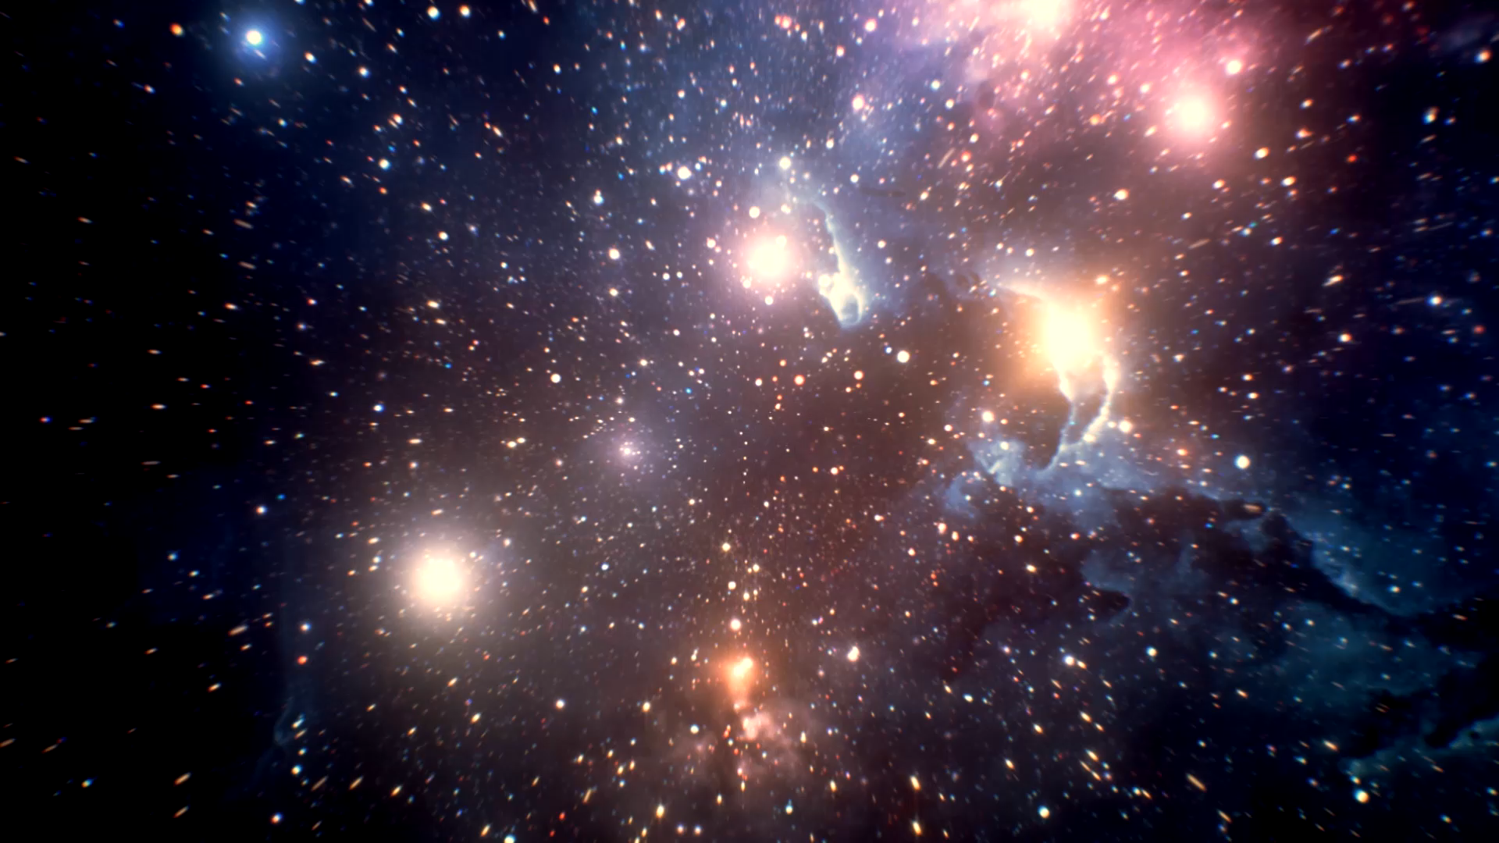
Space- Astronomy v Astrology!
S3 Space

Slide 2

State whether these comments refer to Astronomy or Astrology

Slide 3
the study of everything in the universe beyond Earth's atmosphere.

Slide 4

Is a Science

Slide 5

claims to divine information about human affairs and terrestrial events by studying the movements and relative positions of celestial objects

Slide 6

Is a fake/ pseuodoscience

Slide 7
researchers have successfully challenged it and experimentally shown it to have no scientific validity

Slide 8
Not considered academic or theoretical

Slide 9
it even includes questions about things we can't see at all, like dark matter and dark energy

Slide 10

helps us study how to prolong the survival of our species.

Slide 11
So…..
Can you define ASTRONOMY and ASTROLOGY and do you know the difference?

Slide 12
Astronomy v Astrology
Astronomy is a science that studies everything outside of the earth's atmosphere, such as planets, stars, asteroids, galaxies; and the properties and relationships of those celestial bodies.
... Astrology, is the belief that the positioning of the stars and planets affect the way events occur on earth.

