Slide 1

The Language of Physics
Does it really matter what we say?
Notes:
Does it matter what we say when teaching students? Do we need to be ‘precise’ in our language? I say YES!

Slide 2
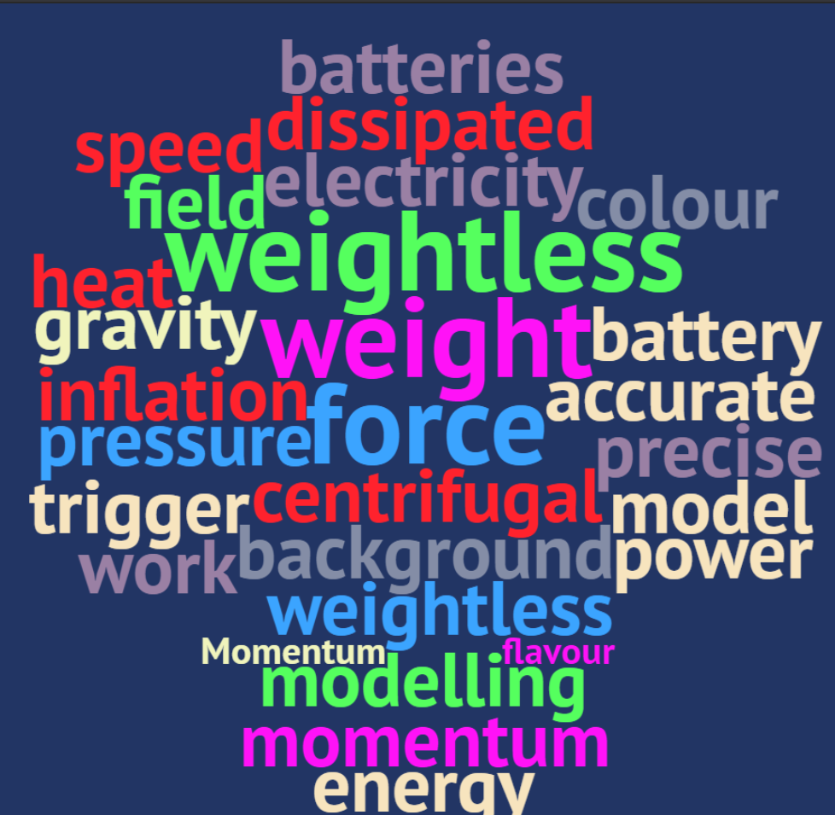
Sometimes the world uses Physics words!
Notes:
Some of the problem we have with the language is that some of words we have specific meanings for are used in everyday speech. Some of these are generally used correctly, (I’d say momentum, speed) but some cause confusion- weight, power, centrifugal etc. And maybe one that causes the most trouble- accuracy and precision, which I think is now pretty well understood with the following graphic.

Slide 3


Introducing scientific language
https://www.education.vic.gov.au/school/teachers/teachingresources/discipline/science/continuum/Pages/scilang.aspx

Slide 4
What we are now teaching, is what will become taught.
My first intellectual quote! MrsPhysics

Slide 5
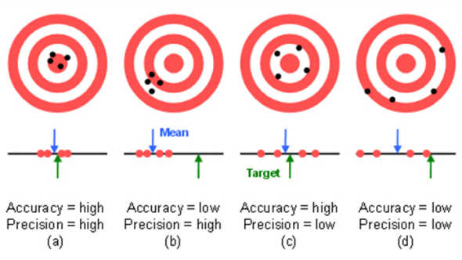
Accuracy v Precision
Accuracy is how close your answer is to the true value. Precision is how repeatable a measurement is.

Slide 6
What do these words mean?
ELECTRICITY
RADIOACTIVITY
GRAVITY
Notes:
There is too much ambiguity in these words. AVOID using them or letting the students use them wherever possible. Maybe ask the students what they mean by these words and show that there is a difference. Keep asking this same question at the start of each topic as the students get older and see if the answers diverge further.
Or say that these are just topic headings with no precise meaning. Avoid using them in exam questions.

Slide 7
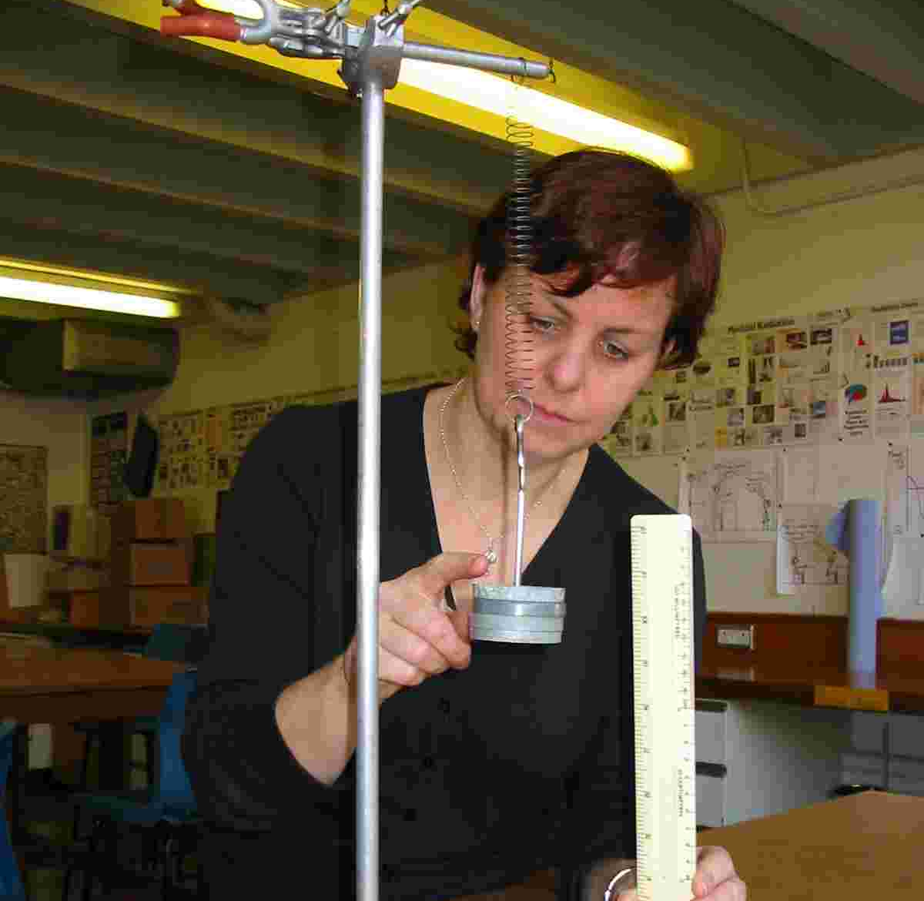
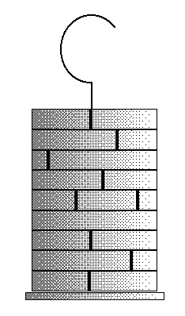
What is this?
What is put on the end of a spring to make it stretch?
Notes:
They are marked as masses, but we are using them because of their weight and they produce a force to stretch the spring. I like to call them a load and then there is little conflict in using the words and causing confusion. If we think about the words we use we are less likely to unwittingly make Physics “extra” hard!

Slide 8

What is this?
What does it do?
Why does it cause confusion?
Notes:
Students often think that some little magic works here and this is where there is a load of charge stored in here and that they set off when the circuit is complete. Does our language indicate that the charge is in the conductors and that the energy is what is provided by this?

Slide 9
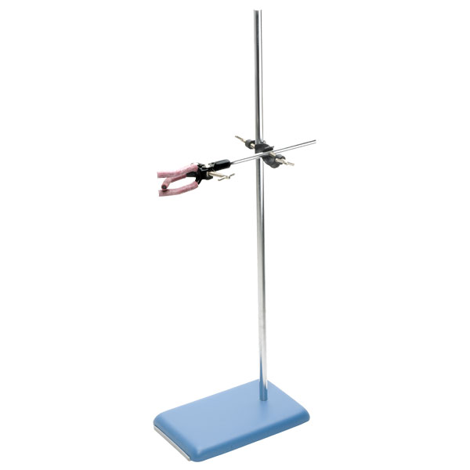
Label this
Retort stand
Bosshead
Clamp
Base
Notes:
I know of teachers and students who look blankly when told they need a bosshead for their stand. If we don’t tell them these words who will? Then who will then be able to teach the next generation of school children if we haven’t taught the current one some of whom will become teachers. If we don’t know the correct language, do we know where to go to look it up? Does it matter? Is it ok to call it a gripper (discuss later)

Slide 10

The area is 4.0 m²
How do you say this?
https://www.mrsphysics.co.uk/blog/difference-between-square-metres-and-metres-squared/
Notes:
This is one of my bug bears and something that I’ve only recently sorted for myself. It is the most viewed post on my website and indicates that most people don’t know the correct answer to this. Although it is written metres squared the area is 4.0 square metres. The square metre is the SI unit of area and can be any shape. I won’t go into further detail here, but we must make sure we are consistent and take time to explain this to the students. As one post on the website says, if a carpet seller can’t get this right I could end up with the wrong size and shaped carpet and whose fault would it be. A square of 4.0 metres squared would be a square of side 4.0 m and either side 1.0 m or 4.0 m. AREA in SQUARE METRES, and I know it is misunderstood as I’d copied someones sheet into my compendium and hadn’t checked it!

Slide 11
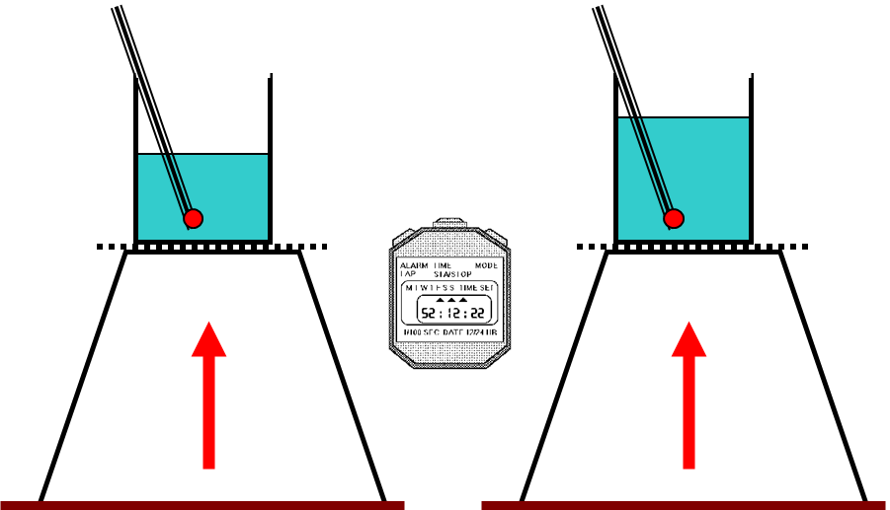
Explaining HEAT v TEMPERATURE
Notes:
The difference between heat and temperature for students is always difficult unless you go through this picture which instantly and clearly shows them the difference. Both beakers contain water at the same starting temperature. If we heat them with the same Bunsen for the same length of time they’ve had the same energy delivered- same heat energy. All students will know that providing the water isn’t boiling the one on the left will have the hotter/higher temperature of water. This is a clear visualisation for this difficulty.

Slide 12

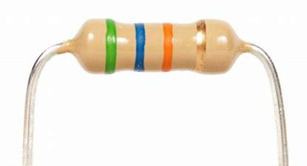
Big resistor v small resistor
Notes:
This is one which we’ll discuss in more detail, but it is certainly one for the SQA talk later. Sometimes we can say replace with a bigger resistor! This image should indicate what scientists are saying when they say bigger- we can have bigger area, more massive, but it doesn’t relate to the resistance, that would be a larger resistance. Where possible I try to teach students to use the term increase or decrease in a quantity and that covers just about everything.
Is this an optical illusion too? The Jennie on the left looks smaller then the Jennie on the right!

Slide 13
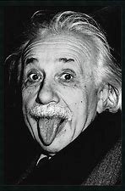


Quicker time
Notes:
Here is another common word that might get into students language quite wrongly. We don’t talk about time running quicker or slower until we introduce students to relativity at higher, so time doesn’t go quicker when the speed of an object changes, the time increases or decreases. A good way I’ve found to explain this is to clap at one second intervals, then clap “quicker” / “slower” and say each clap is still one second.

Slide 14
The best line of fit can be a curve!
Notes:
Do we always take time to explain what is meant by a best fit line? Maybe we should give students a graph, where the points clearly line up in a curve and ask them to draw the best fit line. I had some fantastic teachers who obviously knew their stuff and taught me all those little useless things that have proved so helpful., like do you know if you pick up a piece of graph paper and hold it sloping away from you at eye level it is easy to see what the best fit line is? Try it.

Slide 15
Notes:
If you’ve a mobile or a laptop you could try this. Tip the page

Slide 16
5 words to spell correctly
FUSION
FISSION
REFRACTION
DIFFRACTION
REFLECTION
Notes:
It would help if all words are spelt correctly but these ones might be worth a spelling test. I remember Fusion and Fission by thinking of a neutron hitting the word FISSION (with 2 s and splitting it in half- fis sion).
Quite often pupils write down the word "defraction". Do they mean refraction or diffraction or just hedging their bets?

Slide 17
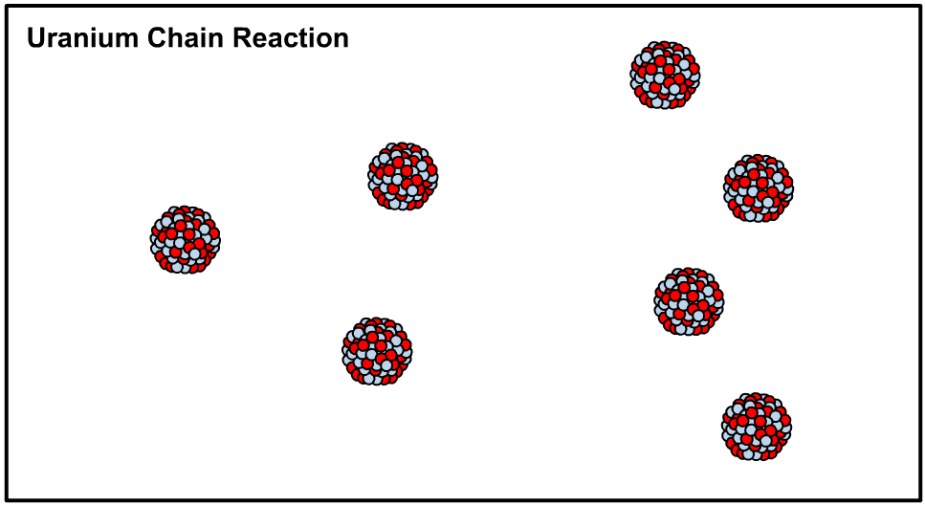
Fission v
ION
FUSION
FUS
FIS
FISSION
SION

Slide 18
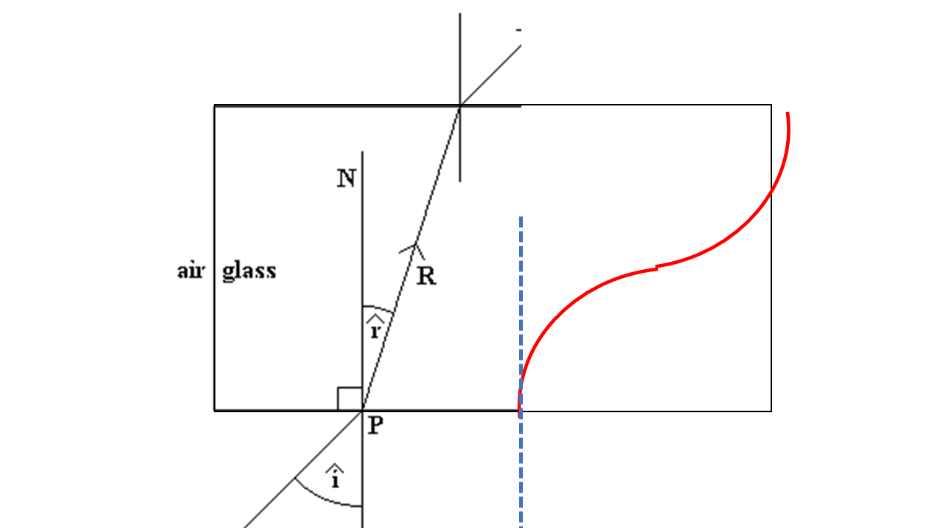
Never say
Refraction is the bending  
Notes:
Refraction is not

Slide 19
Big resistor v small resistor
For another time…..
SQA LANGUAGE
This can cost students lots of marks if we don’t teach it properly

Slide 20
SQA Command Words
describe, | you must provide a statement or structure of characteristics and/or features;
determine or calculate, | you must determine a number from given facts, figures or information; You should use numbers given and always show your working, as it may be possible for the examiner to award some marks for the method even if the final answer is wrong. Always give the units as the final mark is for the answer and unit.
estimate, | you must determine an approximate value for something;
explain, | you must relate cause and effect and/or make relationships between things clear. The answer should not be a simple list of reasons. This means that points in the answer must be linked coherently and logically. All of the stages/steps in an explanation must be included to gain full marks.
identify, name, give, or state, | Only a short answer is required. Often it can be answered with a single word, phrase or sentence. If the question asks you to state, give, or write down one (or two etc) examples, you should write down only the specified number of answers.
Notes:
It was a long time in to the new NQ before I realised there are no questions on the exam, not totally true as the m/c are generally questions but the long questions are not questions but commands! Students should be taught the difference, especially between justify and you must justify. Check the marking instructions for the difference.

Slide 21
justify, | you must give reasons to support their suggestions or conclusions, e.g. this might be by identifying an appropriate relationship and the effect of changing variables;
predict, | you must suggest what may happen based on available information;
show that, | you must use physics [and mathematics] to prove something e.g. a given value – All steps, including the stated answer, must be shown;
suggest, | you must apply your knowledge and understanding of physics to a new situation. A number of responses are acceptable.
use your knowledge of physics or aspect of physics to comment on, | you must apply your skills, knowledge and understanding to respond appropriately to the problem/situation presented (for example by making a statement of principle(s) involved and/or a relationship or equation, and applying these to respond to the problem/situation). you will be rewarded for the breadth and/or depth of their conceptual understanding.
Use the information in the passage/ diagram/ graph/ table to… | The answer must be based on the information given in the question. Unless the information given in the question is used, no marks can be given.
compare | This requires the student to describe the similarities and/or differences between things, not just write about one. If students are asked to ‘compare x with y’, they need to write down something about x compared to y, using comparative words such as ‘better, ‘more than’, ‘less than’, ‘quicker’, ‘more expensive’, ‘on the other hand.’

